Slide 1
Project X Superconducting Cavities Status Report
Mark Champion, Fermilab
Project X Collaboration Meeting
April 12-14, 2011

Slide 3
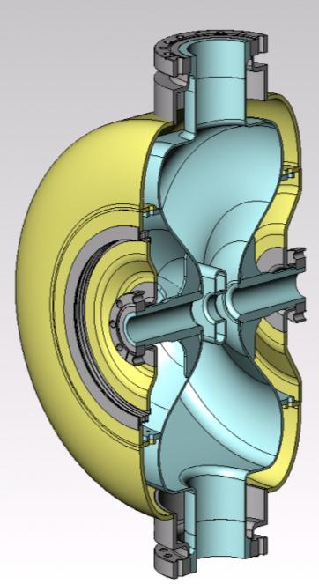
Electromagnetic Designs of 325 MHz Single-Spoke Resonators have been Completed
Three designs cover the beta range 0.11 – 0.42
SSR0 ( β = 0.11 )
  Design optimization complete
  Iterated between EM and mechanical designs to achieve:
    required EM parameters,
    minimum frequency sensitivity (dF/dP),
    tunability,
    minimum length,
    and manufacturability
  Plan to initiate procurement of 1-2 prototypes in Q3 FY11
cavity type | β_{G} | Freq MHz | U_{acc, max} MeV | E_{max} MV/m | B_{max} mT | R/Q, Ω | G, Ω | Q_{0,2K} ×10⁹ | P_{max,2K} W
SSR0 | β=0.114 | 325 | 0.6 | 32 | 39 | 108 | 50 | 6.5 | 0.5
SSR1 | β=0.215 | 325 | 1.47 | 28 | 43 | 242 | 84 | 11.0 | 0.8
SSR2 | β=0.42 | 325 | 3.34 | 32 | 60 | 292 | 109 | 13.0 | 2.9
EM Design of the Low-Beta SC Cavities for the Project X Front End
I. Gonin et al., TUP070
PAC’11

Slide 4
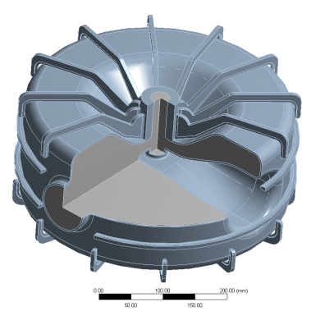
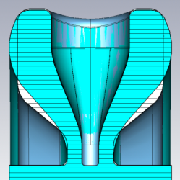
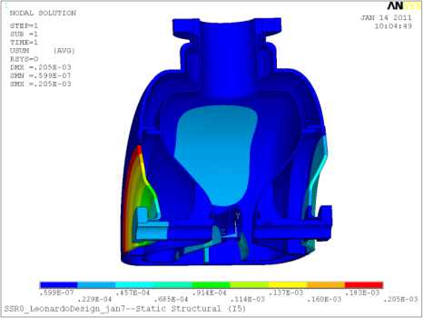
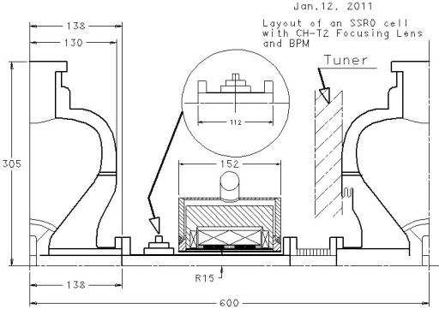
Recent Developments on the SSR0 Design
dF/dP~ +5 Hz/torr
SS helium vessel
SS/Nb braze joints
Initial Concept
Rounded end walls to reduce frequency sensitivity to pressure variations
Connection between helium vessel and cavity wall key to minimizing dF/dP
Bolted SS/Nb connection
Bellows
(one side only)
Lattice spacing requirement: <610 mm
Need BPM, solenoid, bellows and tuner between cavities
Appears feasible (but tight)
Design of Single Spoke Resonators for Project X
L. Ristori et al., TUP084
Mechanical Design

Slide 5
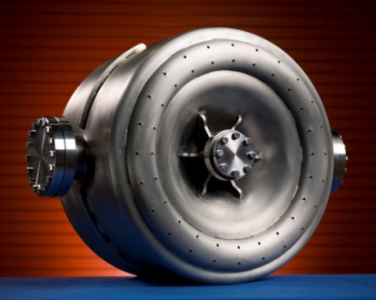
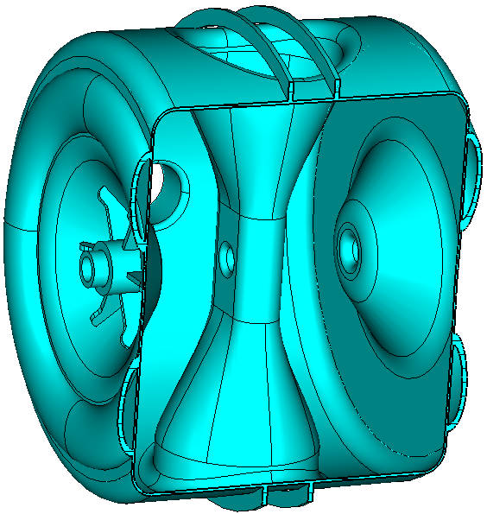
Status of Design Work on 325 MHz Single-Spoke Resonators SSR1 and SSR2
SSR1 ( β = 0.22 )
  EM and mechanical design complete
  Two prototypes have been fabricated by Zanon and Roark, processed in collaboration with ANL and JLab, and tested at Fermilab
  Two cavities in fabrication at IUAC/Delhi
    Expected to arrive at Fermilab in FY11
  Ten cavities in fabrication by Niowave/Roark
    Expected deliveries beginning in spring 2011; complete by end of CY11
  SSR1 development started under HINS program and is therefore more advanced
SSR2 ( β = 0.42 )
  EM design complete
  mechanical design on hold while we complete higher priority work on SSR0 and SSR1 cavities

Slide 6
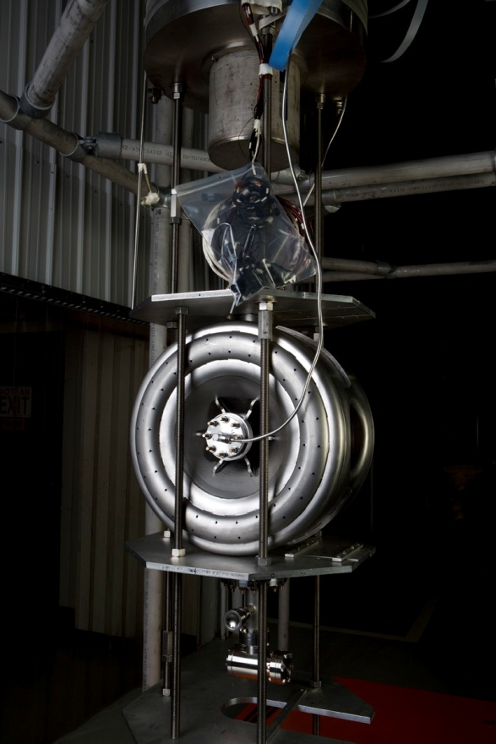
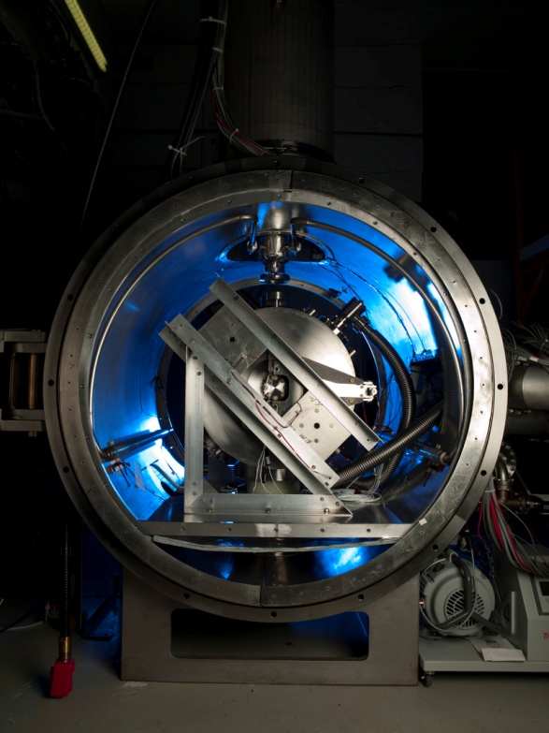
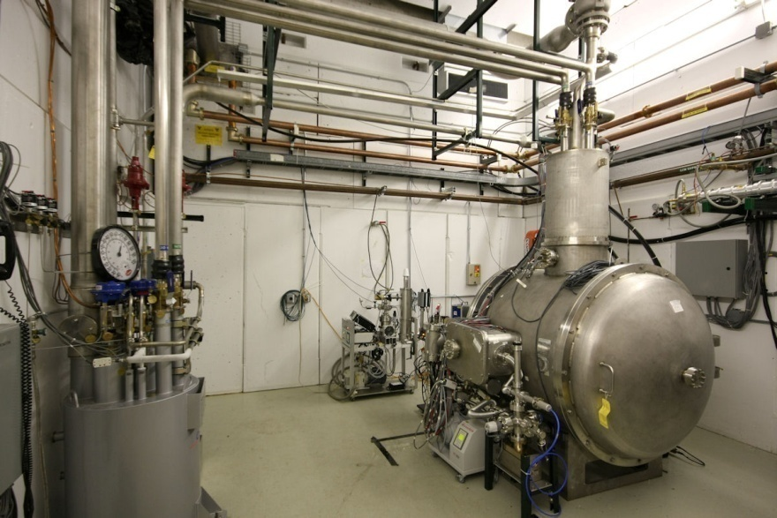
New 325 MHz Test Capabilities Developed
SSR1 prototype ready for vertical dewar testing.
The testing was carried out in the vertical dewar used for 1.3 GHz cavity testing with the addition of new electronics and tooling.
Spoke Cavity Test Cryostat completed and commissioned.
Includes cryostat, shielded enclosure, helium distribution, vacuum system, instrumentation, RF power, and safety interlocks.
Enables 4.2 K testing of “dressed” 325 MHz single-spoke resonators.
Will be upgraded for 2 K operation in FY12.
Dressed SSR1 prototype under preparation for testing.
All auxiliaries, including RF couplers, tuners, and magnetic shielding included.

Slide 7
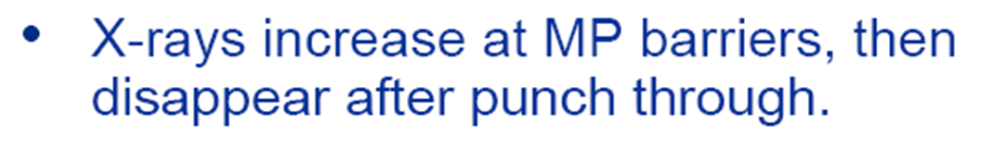
Prototype SSR1 Cavities Exceeded Performance Expectations in Vertical Dewar Testing
Design Specifications: Gradient = 10 MV/m, Qo = 5e8, 4.2K

Slide 8
Collaborated with Jefferson Lab and Argonne in Preparation for the First Test of a Spoke Cavity with its Helium Vessel
at FNAL.
at FNAL.
at ANL.

Slide 9
Helium Vessel and Tuner Installed in Preparation for Testing in the Spoke Cavity Test Cryostat
- 325 MHz SRF Spoke Cavity Tuner Tests
- Microphonics in the CW Project X Linac
Y. Pischalnikov, W. Schappert, et al., TUP080, TUP086

Slide 10
First Test Result in Spoke Cavity Test Cryostat
CW test with high-Q input coupler

Slide 11
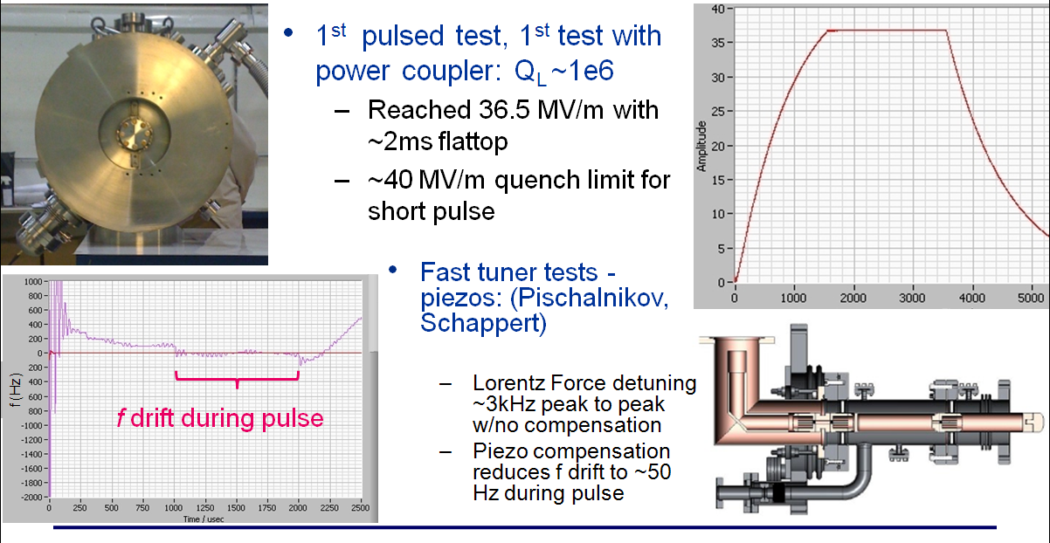
High-Power Pulsed Testing Results
Piezo Compensation ON
First High Power Pulsed Tests of a Dressed 325 MHz Superconducting Single Spoke Resonator at Fermilab
R. Madrak et al., TUP076

Slide 12
Basic Electromagnetic Design of 650 MHz β = 0.6 and β = 0.9 Five-Cell Cavities is Complete
- Concept EM Design of the 650 MHz Cavities for the Project X
- HOMs in the Project X Linac
V. Yakovlev et al., TUP089, TUP088

Slide 13
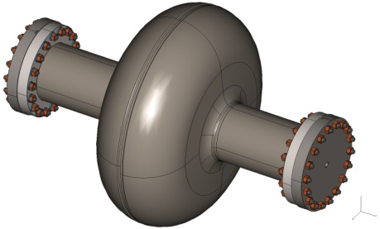
650 MHz Cavity Prototypes and Readiness for Processing & Testing
Single-cell designs complete for β = 0.6 and β = 0.9 cavities
  Two single-cell β = 0.6 cavities are being prototyped at Jefferson Lab
  Six single-cell β = 0.9 cavities on order from AES; expected in Q3 FY11
  Prototyping of single-cell β = 0.9 cavities in progress at RRCAT
Modifications in progress at Fermilab vertical test stand
Cavity cage design complete and a few prototypes are on hand
  Compatible with existing tooling for cavity handling, high pressure rinsing, and optical inspection
Electro-polishing tools under development at ANL and AES
BCP capability exists at ANL, JLab, and in US industry
Optical inspection system undergoing modifications for use with 650 MHz cavities (KEK/Kyoto system - designed for 1.3 GHz cavities)

Slide 14
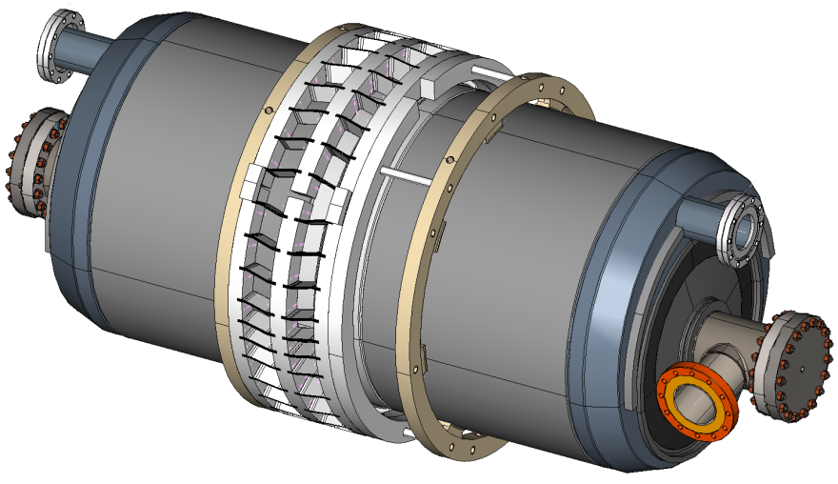
650 MHz Five-Cell beta=0.9 Cavity Design Status
Drawing package nearly complete
Fabrication specification in progress
Niobium material on-hand
Weld samples in progress to verify end cell to beam tube adaptor design
Plan to be ready to initiate prototype procurements in FY11
Cavity Model:
Niobium wall thickness is 4 mm
Nb/Ti flanges with Al hex seals
Stiffening rings located to minimize dF/dP while maintaining tunability
Concept for pass-through helium vessel utilizing blade tuner
Status of the Mechanical Design of the 650 MHz Cavities for Project X
S. Barbanotti et al., TUP069

Slide 15
325 MHz R&D Plans: SSR0 Cavities
Continue design work on the SSR0 cavity
  Be ready in Q3 FY11 to initiate procurement of 1-2 prototype cavities from industry
Receive prototype cavities within 9-12 months
Process and vertical dewar test the bare cavities
Upon achievement of performance requirements, proceed to dress these cavities (install helium vessel, tuner, and RF coupler) and test in the spoke cavity test cryostat
  First dressed-cavity test planned in FY13

Slide 16
325 MHz R&D Plans: SSR1 Cavities
Complete testing of the 1st prototype SSR1 cavity in the spoke cavity test cryostat – essentially complete
Dress and test the 2nd prototype SSR1 cavity in the spoke cavity test cryostat – probably not
Upgrade the spoke cavity test facility for 2K operation
Receive two SSR1 cavities from IUAC-Delhi
Receive ten SSR1 cavities from US industry
  Initiate processing and vertical dewar testing of these 12 cavities in FY11
  Proceed at steady rate until all cavities have been tested
  Achieve a good understanding of the performance limits of these cavities
Dress several of these cavities and test in the spoke cavity test cryostat
  Goal is to have 4 cavities qualified in FY13 for inclusion in a prototype SSR1 cryomodule

Slide 17
325 MHz R&D Plans: SSR2 Cavities
The SSR2 electromagnetic design is complete
Plan to proceed with mechanical design and acquisition of prototypes in the FY12-14 period
SSR0 and SSR1 work has higher priority at this time
Excellent opportunity for a collaborator

Slide 18
650 MHz R&D Plans: beta=0.6 cavity
The beta=0.6 cavity is being developed at Jefferson Lab
Production of two single-cell prototypes is in progress
  Processing and testing planned for late FY11, early FY12
Plan to be ready to initiate production of two five-cell prototypes by end of FY11
  Processing and testing planned for FY12-13

Slide 19
650 MHz R&D Plans: beta=0.9 cavity
Six prototype single-cell beta=0.9 cavities are under production at AES
  Delivery expected in Summer 2011
Continue the development of instrumentation and tooling to support processing and testing of these cavities
  BCP processing at ANL, JLab, or US industry
  EP at ANL or US industry
  High-pressure rinsing and test preparation at ANL
  Vertical dewar testing at Fermilab
  Optical inspection at Fermilab
Be ready to initiate procurement of two prototype five-cell cavities in FY11

Slide 20
Some Issues
Ongoing discussion about low-energy SSR0 section of Linac:
  Would it be better to use 162.5 MHz half-wave resonators? Unclear
  Shall we proceed with procurement of SSR0 prototypes? Yes
Nobody is working on SSR2 – volunteers?
HOM couplers on 650 MHz cavities
  Are they needed for the Linac? No, but…
  Shall we include them on 5-cell prototype cavities? No
Helium vessel design for 650 MHz cavities
  Flow through or separate two-phase pipe? Separate pipe if thermal characteristics acceptable
Tuner designs:
  Piezoelectric tuners mandatory? Yes
  Motors and gearboxes inside vacuum vessel? Only if field serviceable

Slide 21
Conclusion
Progress on the development of 4 of 5 cavity types needed for the 3 GeV Linac
Much work remains
Looking forward to tests of prototype single-cell 650 MHz cavities
Plan to initiate prototype procurements of SSR0 and five-cell 650 MHz cavities this year
Thanks to all colleagues for their efforts in cavity development for Project X

