Slide 1
Foil Injection for RDR and Long Pulse Operations
David Johnson
Project X Collaboration Meeting
April 13, 2011

Slide 2
Foil Issues
Foil Temperature
What is an acceptable maximum temperature?
SNS initial camera system designed to measure temps down to 1500-1600ºK but never got a good measurement. A new system is planned…. Best guess for 1.4MW is in the 1500-1600ºK range (M. Plum)
JPARC reported on initial tests of measurement system of phototransistor and photodiode. Large errors in photodiode output. Focusing on pulsed measurement. Estimate safe carbon or diamond foil temp around 1600ºK (A. Takagi)
Secondary Electrons
Shape and magnitude of magnetic field – trajectory of electrons – beam normal to B
Resistivity of injection foil ( build up of static charge – lesson learned SNS)
Minimizing secondary hits by circulating protons
Ring lattice functions ( symmetric insertion, a=0 at foil)
Foil size and orientation (matched to injection beam size)
Painting algorithm
Losses due to
H0 excited states (location of foil in rising field of HBC3 only n=1 not captured into circulating beam - 0.7% 2.2 kW will go to injection dump)
Nuclear collision in 500 mg/cm2 foil
-> probability 8.3E-6 -> Power=n hits*int/sec*NCP*E*C -> for 30 hits loss approaches 84 W
Large angle coulomb scattering -> previously estimated for 30 hits est. 81 W
H- missing the foil (utilize beam shaping to safely remove large amplitude)

Slide 3
Transverse Painting Schemes
Type | Advantage | Disadvantage
Correlated | Paint over halo Square profile | Singular density Coupling emittance growth
Anti-Correlated | Immune to coupling Circular Profile | Halo Growth due to space charge Extra 50% aperture
H-V Coupled | Paint over halo Diamond Profile | Extra Aperture
Paint (H)/ Steer(V) | Similar to anti-correlated Fewer Kicker | Foil Support Difficult Susceptible operation error
Paint V/ Steer H | Similar to Anti-correlated. Fewer Kicker e- collection on mid-plane | Vertical injection Susceptible to operation error
Oscil. Bump (sin/cos) | Paint over halo Circular profile | Fast PS Switch Extra 50% Aperture

Slide 4
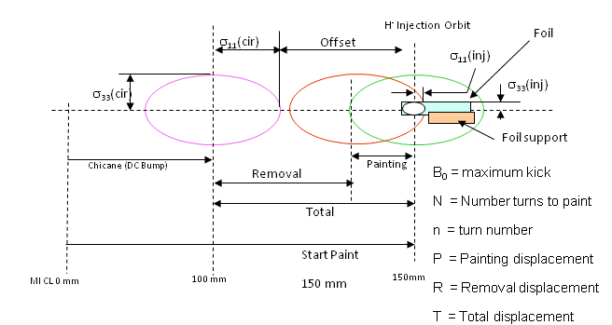
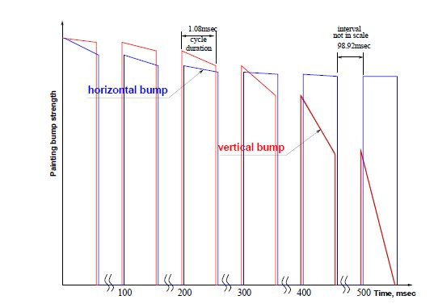
Recycler Injection
Stripping foil
H⁰
Thick foil H⁰->H⁺
HBC1
H⁻
HBC2
HBC3
HBC4
H⁺ to inj. absorber
75 to 100 mm
Circulating protons
8.941 m
0.606 m
1.068 m
+3.5669 kG
-0.4656 kG
-11 kG
11 kG
KEK (anti-correlated) H paint V steer
Foil orientation (corner foil used in present simulation)
Hor. Strip foil (matched to size of beam)
18mm
6-8mm
14mm
12mm

Slide 5
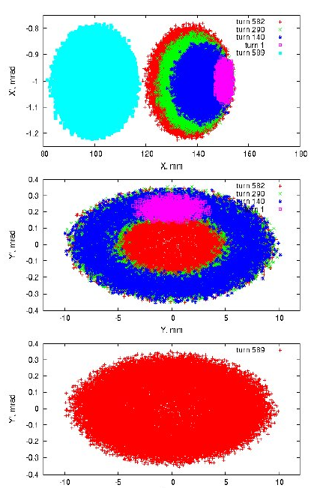
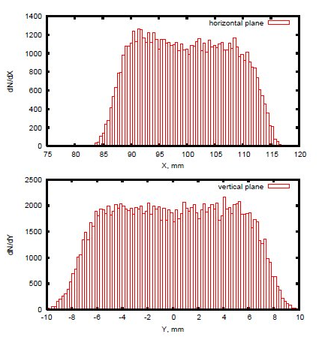
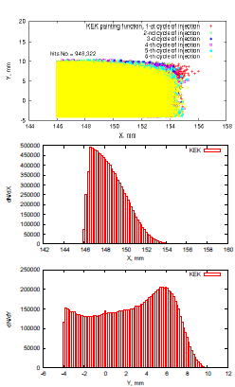
Distributions during painting
Uniform distribution in X and Y
Circulating beam hits on foil

Slide 6
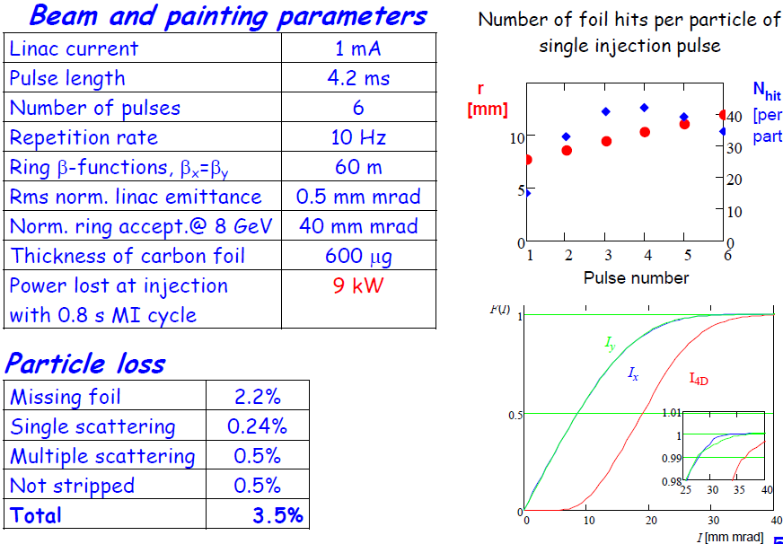
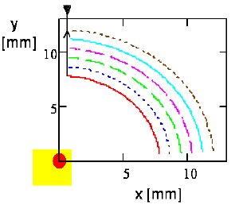
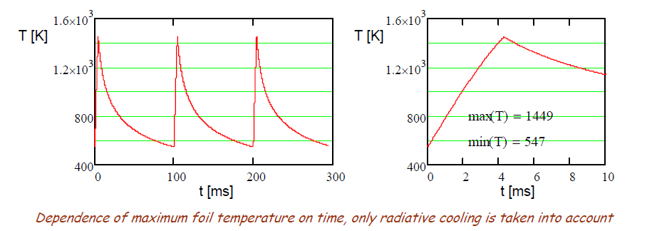
Transverse painting is designed to:
Minimize the number of secondary passages and foil heating
To make correlated x-y painting (K-V distribution) with radius increase for each next pulse
Injected beam does not move on foil
Closed orbit describes almost a quarter of circle (forward and back)

Slide 7
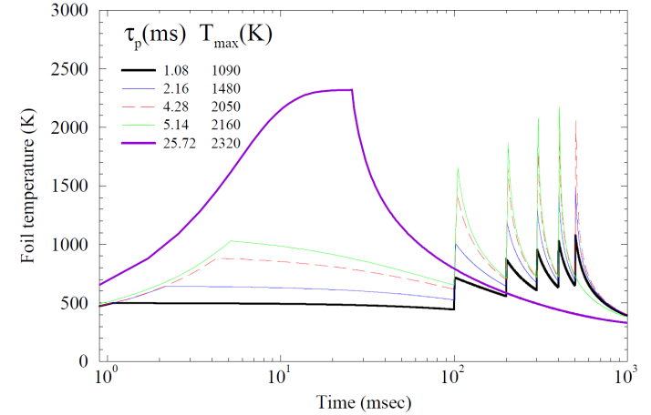
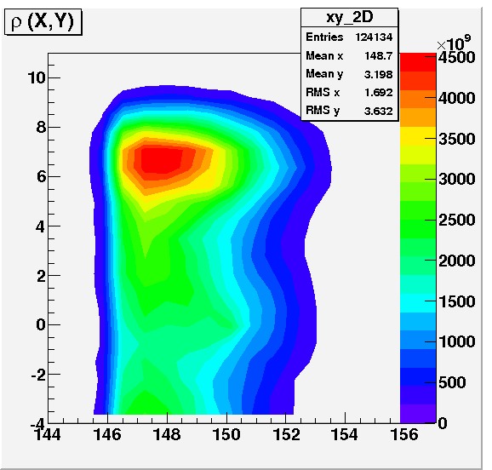
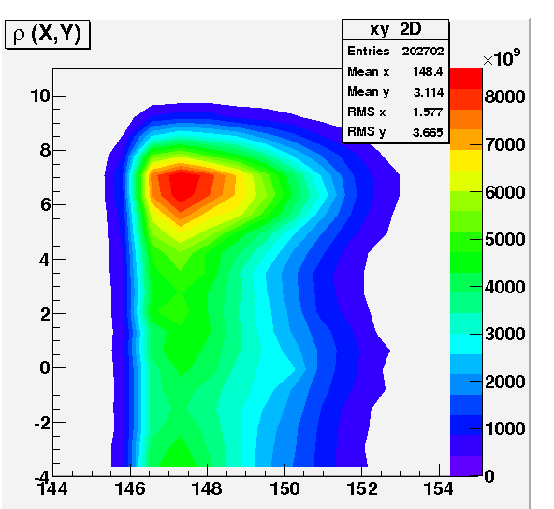
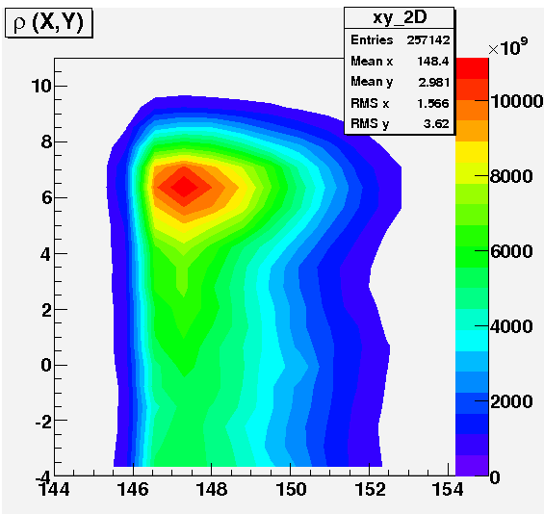
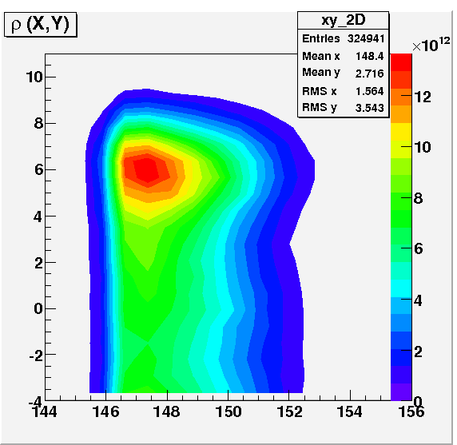
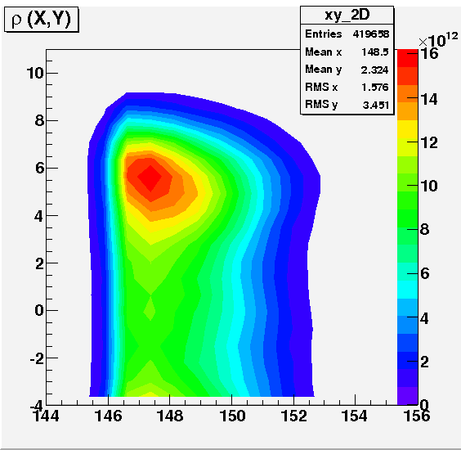
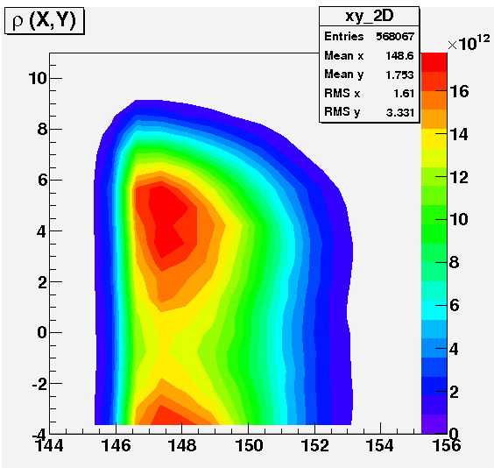
Foil Temperature
The hit densities, N, from the STRUCT simulation for each injection are used to calculate the peak temperature as a function of time with
Peak foil temperature for five linac current pulse length combinations utilizing the
H paint/V steer painting algorithm.
Hit Density for Corner Foil (1ms)

Slide 8
Summary of Painting
case | I | II | III | IV_{S} | VII | S/c
linac current[mA] | 4 | 2 | 1 | 2 | 1 | 1
pulse length[ms] | 1.08 | 2.16 | 4.28 | 2 | 25.72 | 4.3
#turns/inj | 97 | 194 | 385 | 194 | 2310 | 385
#turns total | 582 | 1164 | 2310 | 1164 | 2310 | 2310
h_{min} | 13.5 | 27.0 | 53.7 | 27.0 | 53.7 | 53.7
<#hits> _{sim} | 32.6 | 60 | 118 | 38.7 | 118 | 35
hit density_{max} [E12] | 34 | 68 | 134 | 64 | 515 | ?
Peak temp | 1090 | 1480 | 2050 | 1420 | 2320 | 1400
loss (inelastic) W | 93 | 171 | 336 | 110 | 336 | 100
loss (nuclear coll.) W | 65 | 119 | 234 | 77 | 234 | 69
An analytical expression has been developed [10] for the minimum number of foil traversals, h_{min}, by a circulating beam as

Slide 9
Foil for Long Pulse Injection
SBIR Proposal Submitted:
H- Stripping Innovations (Muon’s Inc.)
Concept for rotating foil
Spread beam heating
Doesn’t address loss due to parasitic hits
Simulation of moving foil to investigate interaction with circulating beam and hit density - STRUCT
Argonne Center for Nano Technology
UNCD Fabrication Facility

Slide 10
Rotating Diamond Foil Assembly
for H- Stripping
2 micron UNCD film
(surface structure may be required
Si substrate
ω
Copper
42 mm
34 mm
5 mm
5 mm
H- beam
τ = 30 ms
ω = 12,600 rpm (disk Drive speed)
The Si substrate and UNCD film are
sandwiched between two copper disks

Slide 11
Next Steps for Long Pulse
Simulate rotating foil in tracking to determine number of interactions with circulating beam to estimate power lost.
Initiate effort to develop a mechanical and thermal model for rotating foil (if SBIR awarded work with Muon’s Inc.).
If results of mechanical/thermal model are encouraging initiate collaboration with Argonne’s Center for Nano Technology to investigate the design of a prototype foil.
Investigate other foil configurations

