Slide 1
TiN Coatings at FermiLab
Dave Capista
Linda Valerio
Project X Collaboration Meeting
October 25-27, 2011

Slide 2
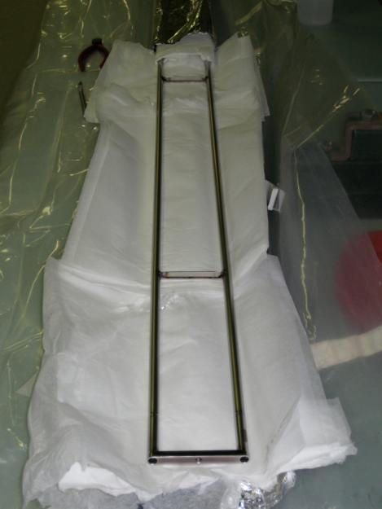
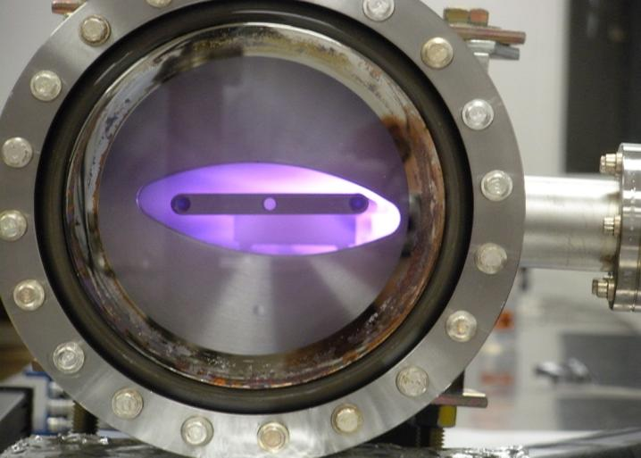
TiN Coatings at SLAC
SLAC coated an elliptical beam tune in late 2009
The cathode was shipped to FNAL in early 2010

Slide 3
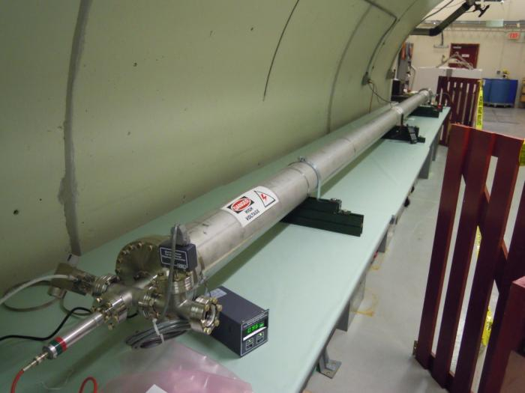
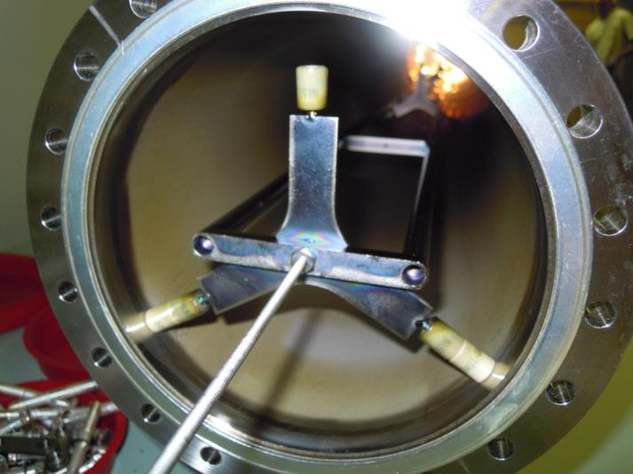
Set Up at FNAL E4R
Began in early 2011 setting up the E4R service building for TiN coatings of a round beam tube
Coatings started in summer 2011

Slide 4
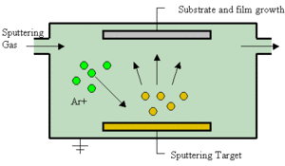
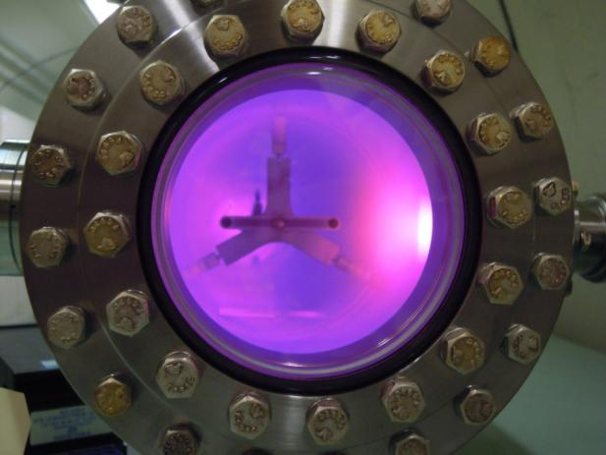
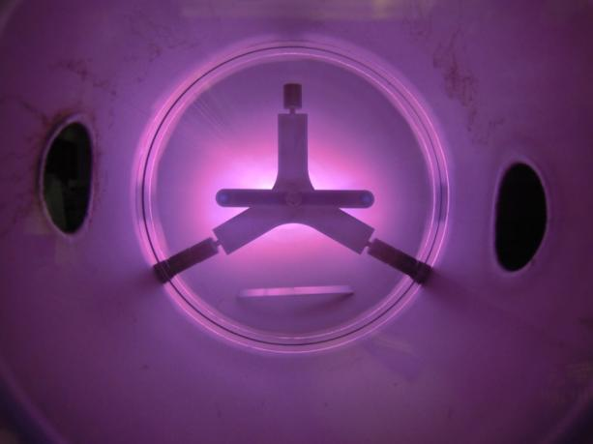
Coating Process
Used a gas mixture of 80% AR and 20% N2
The cathode needs to be connected to the negative side of the power supply
Wrong polarity, plasma on the wall
Correct polarity, plasma on cathode

Slide 5
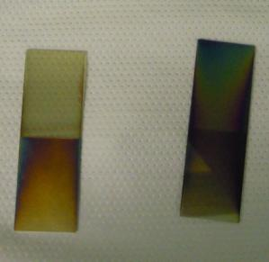
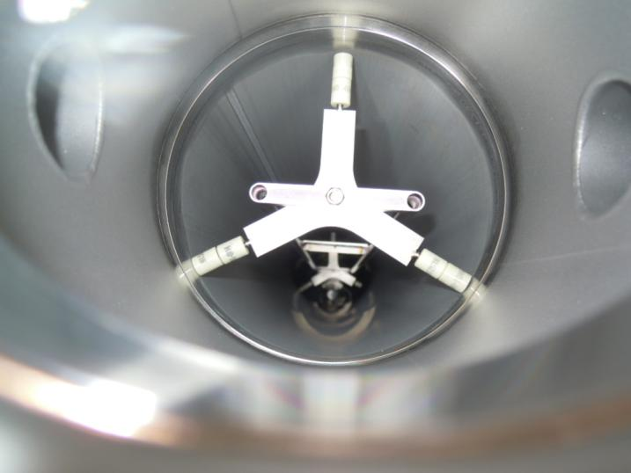
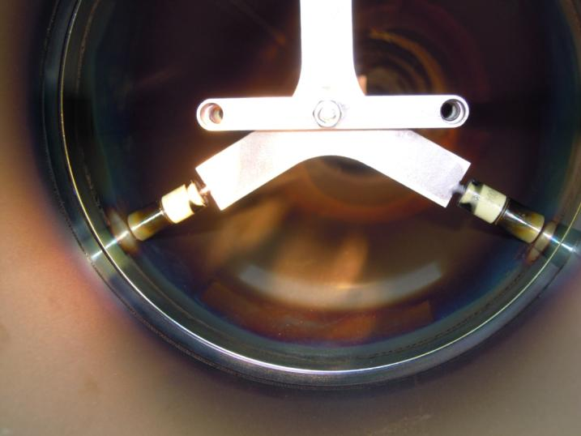
Coating
Beam tube before and after coating and coupons

Slide 6
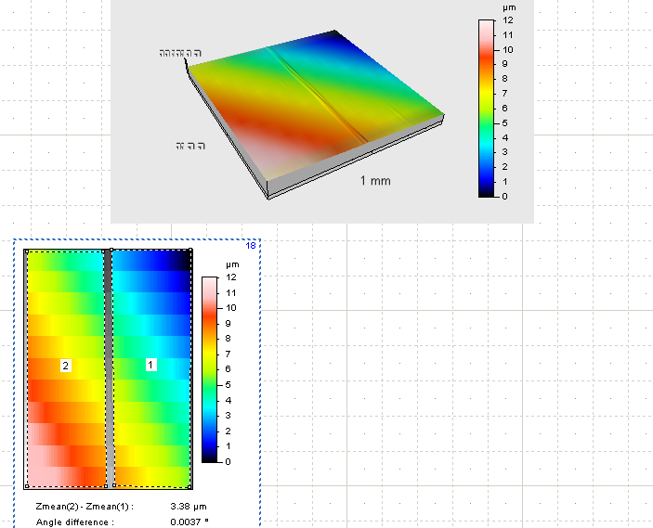
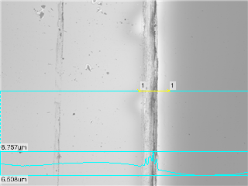
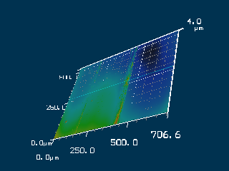
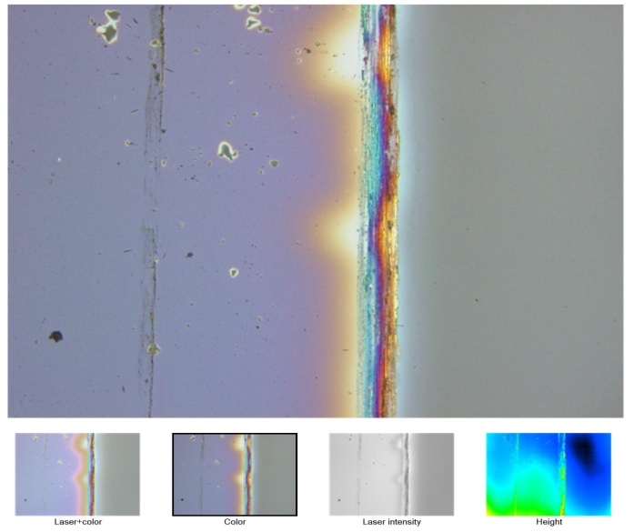
Coating Thickness Measurements
Measured with a stylus profilometer and laser profilometer

Slide 7
Coating Data and Results
The cathode current was regulated at 900mA and the voltage allowed to vary, between 500 and 575 volts
The pressure was controlled by a manual leak valve and was adjusted about every half hour
The coating process was run for 36 hours
Coupon location | Pressure | Coating thickness
Upstream (leak source) | 200 mTorr | 3560nm stylus 6665nm laser
Downstream | 300 mTorr | 3380nm stylus 4028nm laser
Measured thickness seems much higher than expected.
Further investigation is needed.

Slide 8
Future R&D Possibilities
Better understand thickness measurements
Understand the effect of gas pressure on the coating thickness for a specified run time, nm/hr
Estimate effort to in situ coat the Main Injector given the current understanding of this coating process
Coat test coupons for SEY measurements in MI
Understand the engineering involved to make a cathode that accommodates the bend angle of the MI dipoles
???

Slide 9
Thank you for your attention.

