Slide 1
Longitudinal dynamic analysis for the 3-8 GeV pulsed LINAC
G. Cancelo, B. Chase, et al.

Slide 2
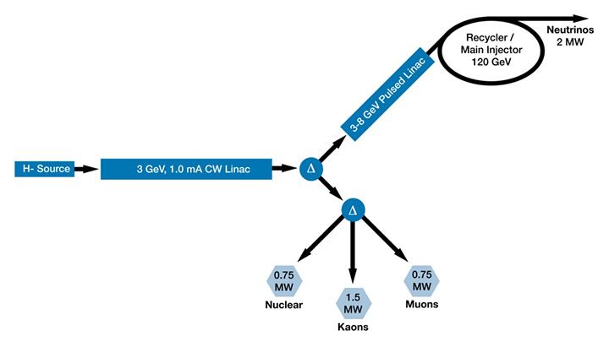
Project X layout
Project X, a high-power proton facility in support of world-leading programs in long-baseline neutrino physics and the physics of rare processes.
A 3 GeV continuous-wave superconducting H- LINAC.
A 3 to 8 GeV, pulsed LINAC.
Injection into Fermilab's existing Recycler/Main Injector complex.
Project X will provide 3 MW of total beam power to the 3 GeV program, simultaneously with 2 MW to a neutrino production target at 60-120 GeV.

Slide 3
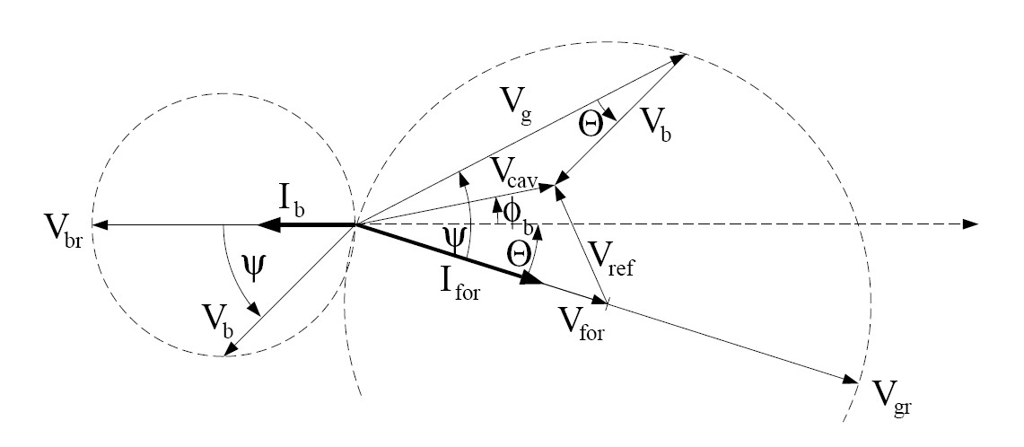
Longitudinal dynamics
An ion/proton LINAC is designed for the synchronous particle which should remain in synchronism with the accelerating fields.
At non relativistic velocities other particles in the bunch will experience phase oscillations around the sync phase.
At 3-8 GeV the β_{b} > 0.97 so oscillations are slow (more on a later slide).
Longitudinal focusing is provided by proper choice of the beam phase relative to the RF field.
E₀
Late particle
Convention: Ib phase =-180˚, RF phase =10˚
Sync particle φ_{s}
Early particle
t

Slide 4
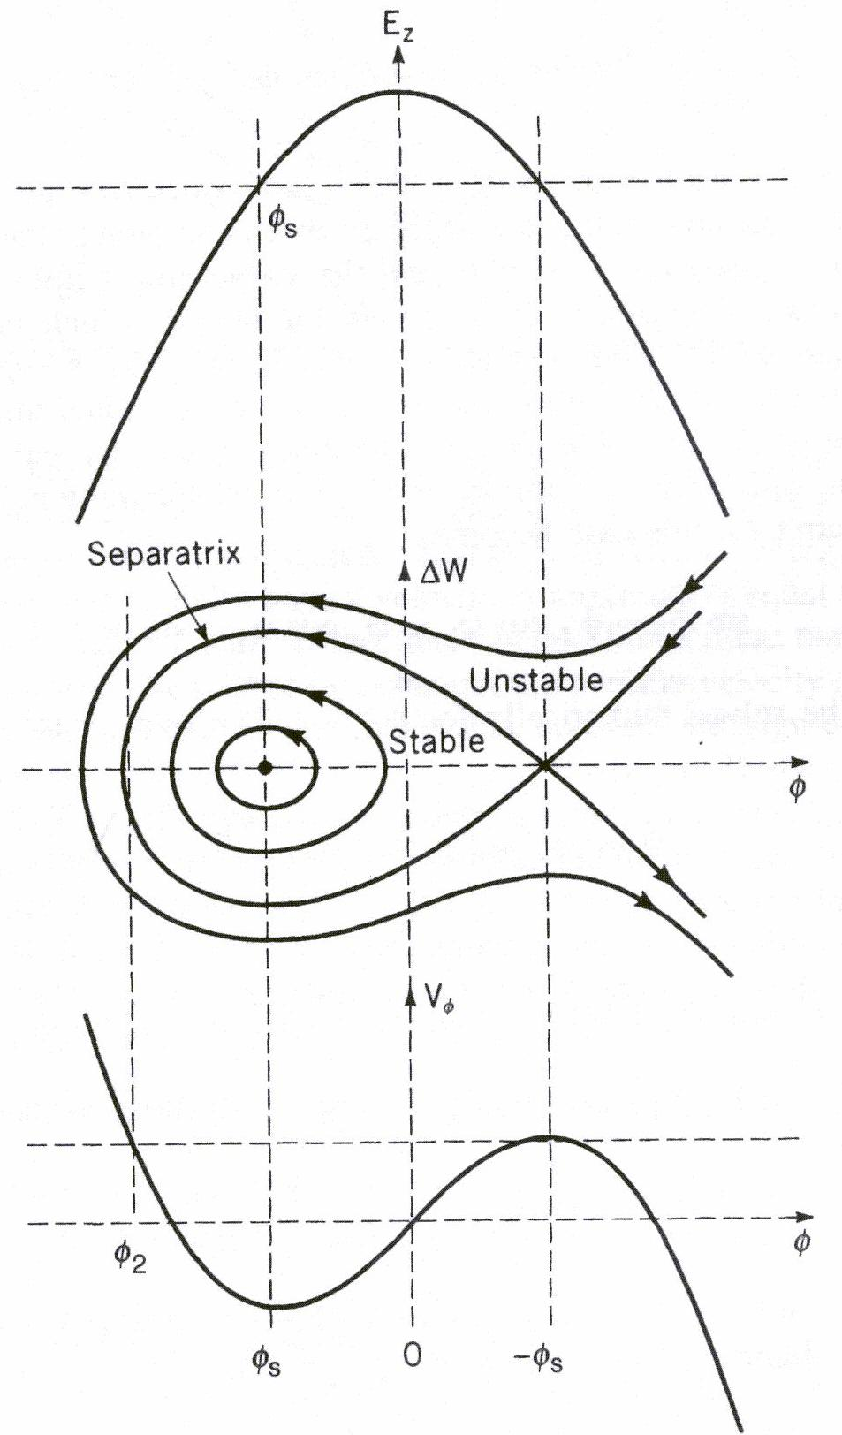
Hamiltonian system
The longitudinal dynamics can be described by a Hamiltonian system in terms of kinetic and potential energy:
Hamiltonian
System H_{φ}
Kinetic
Energy
Potential
Energy
A and B are constants for each particular cavity, but they change cavity to cavity because A is a function of β_{S} and γ_{S}. B is a function of E₀ and TTF.
The bucket has a stable region defined by -φ_{S} and φ₂. φ₂≈ 2φ_{S}.
The maximum ΔW is

Slide 5
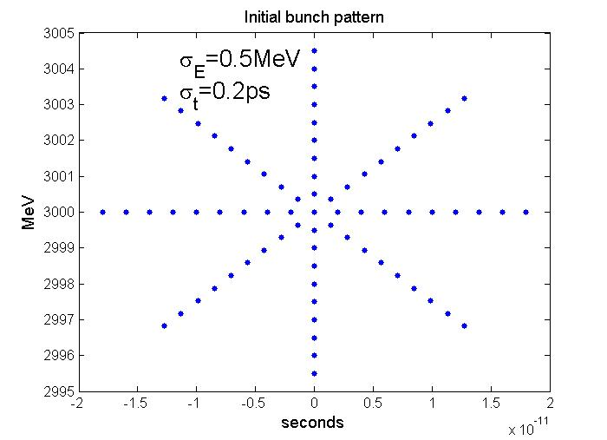
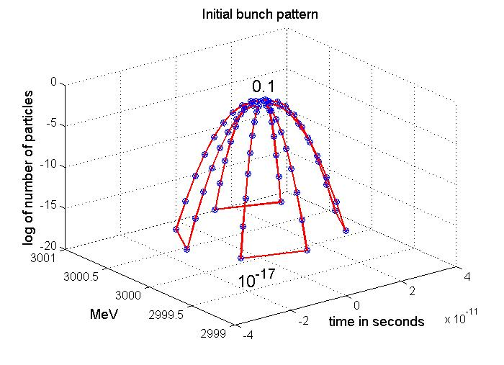
Initial bunch pattern
2ps
73 macroparticles
Total number of particles: 6.24 10¹² per mA of current

Slide 6
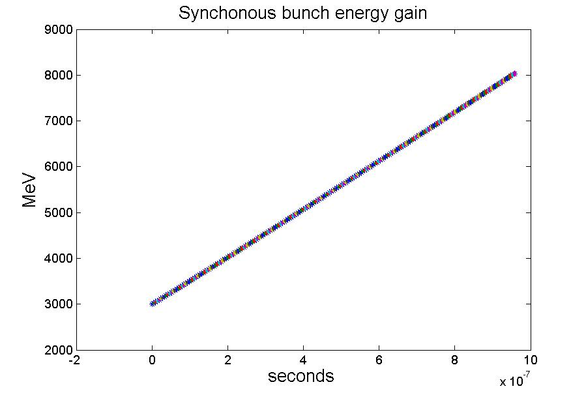
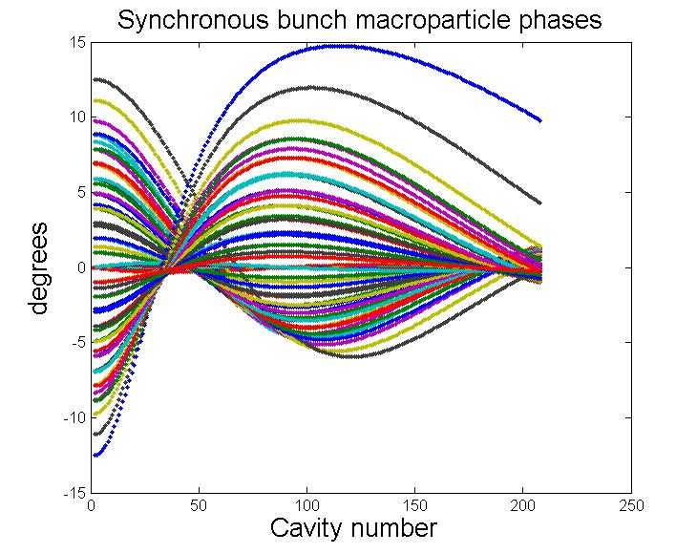
Synchronous bunch simulations
Synchronous bunch energy gain:
Synchronous particle the energy gain:
φ_{S}=-10 degrees
At 3 GeV the small amplitude oscillation frequency is 1.24 MHz (i.e. 0.8µs period). The oscillation frequency slows down as energy increases.
~1µs

Slide 7
3-8 GeV pulsed LINAC
Requirements:
Average gradient amplitude 25 MV/m.
13 RF Stations: 2 cryomodules and 16 cavities/RF ST.
Total Energy gain ~5 GeV.
Beam current: 1 mA (try also 2 mA).
Beam phase: -10 degrees.
RF pulse: 4.3 ms flattop. (try also 20 or 30 ms).
Fill Time: 2.4 and 4.2 ms.
Qload: max=1e7.
NOTE: The Ql for a matched cavity at 25MV, I_{b}=1mA and (R/Qo)=1036Ω is is 2.5e7 => BW_{1/2} =26Hz. Too small to deal with LFD and microphonics.
R/Q=1036 Ohm/cav.
16 cavities/kly and 32 cavities/kly.

Slide 8
3-8 GeV pulsed LINAC: Major concerns
Only VS is regulated (flat), individual cavity gradients tilt (A & φ)
Non constant beam energy gain along bunch train.
Potential emmitance grow and beam loss due to tilts in amplitudes and phases.
How do we fix cavity tilts?
LFD: peak to peak detuning, in particular for long pulses.
Impact of fill time in LFD.
Active compensation or stiffer mechanical systems?
Gradient spread.
Reduce gradient spread or minimize impact.
Find optimum QL for a given gradient spread.
Bringing up the LINAC
How much gradient overhead is needed to go from Ib=0 to Ib=max?

Slide 9
Other RF issues
DESY
FLASH
DESY-FLASH ACC6 & ACC& reach 25MV on average with 20% & 10% spread respectively.
Fix RF distribution.
And equal power distribution:
Operate all cavities below the lowest quenching limit of all cavities in the RF station. Loose 20% gradient.
Proportional power distribution:
Cavities operated at different gradients to achieve desired VS.
Flattop tilts. They get worse for longer flattops.
Fix couplers.
Can be optimized for a single beam loading condition.
Tilts for all other beam loading conditions.
Cavity tilts.
Cavity tilts and cryomodule misalignment generate orbit errors.
Beam OFF, beam ON.
Tilt slopes are a function of gradient distribution in the RF station
ACC6 (MV)
29.77
30.81
28.63
28.18
17.84
18.36
22.45
22.23 Avg=24.8
ACC7
26.56
26.56
27.47
27.47
32.05
32.05
23.81
23.81 Avg=27.5
State of the art for cavity spread around 25 MV is ~10 to 20%

Slide 10
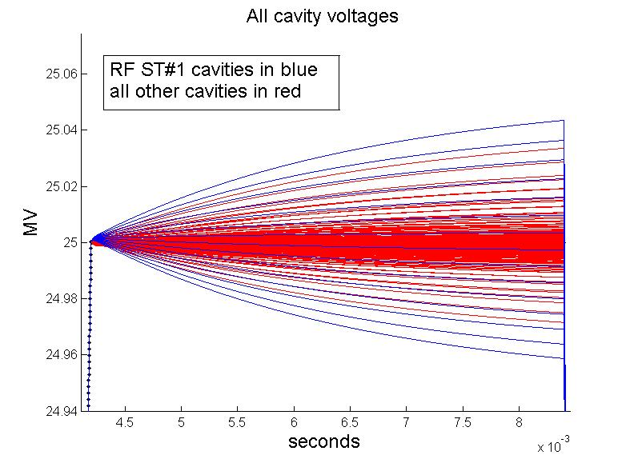
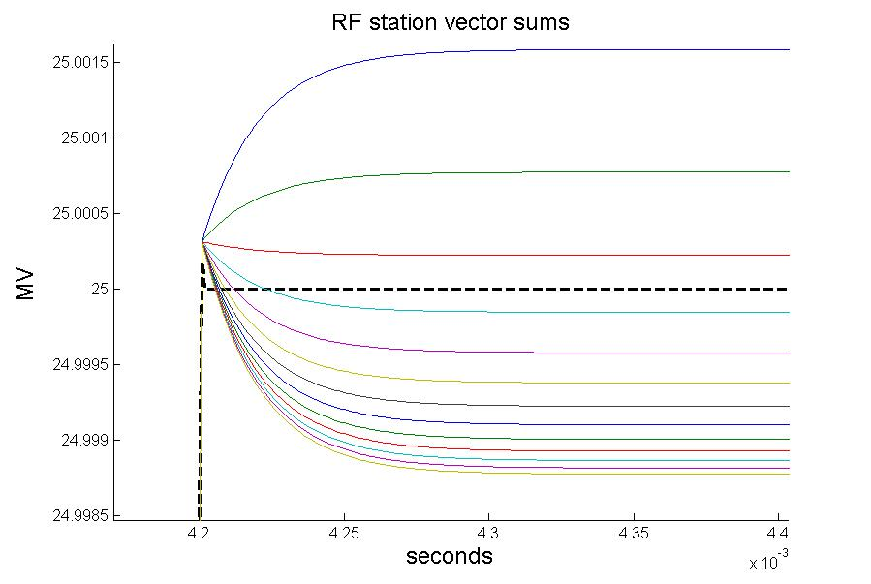
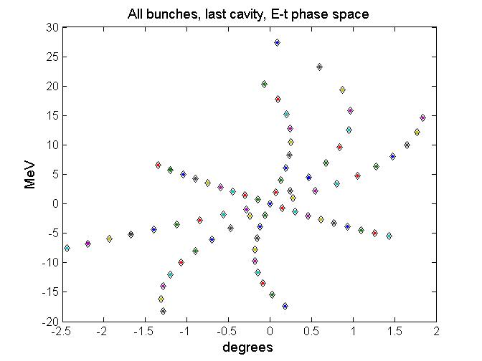
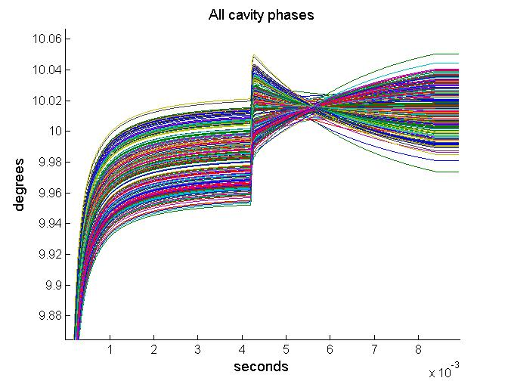
Closed loop cavity voltages (no detuning)
The RF loop redistributes cavity voltages around the vector sum
All vector sums are 1/(K_{P}+1) closer to the set point.
Total Vector sum is kept flat and close to 25MV
±1 KeV
±40KeV

Slide 11
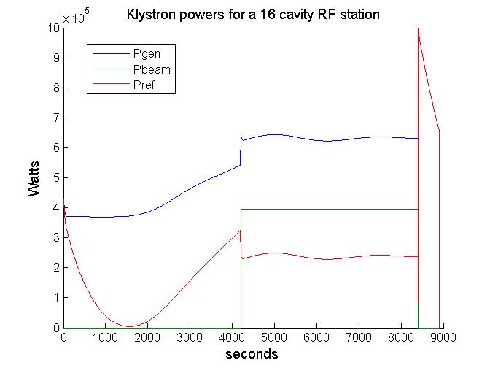
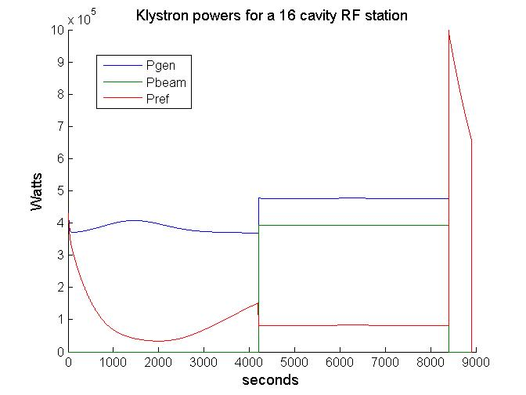
Detuning of ~60Hz at 25MV
Left plot: Largest LFD swing during filling, forward power increases but only 15% because V² is still low.
Right plot: no predetuning. Worst detuning is at the end of the filling. 50% more Forward power is required.
During the flattop 60% more power is required to compensate for detuning.

Slide 12
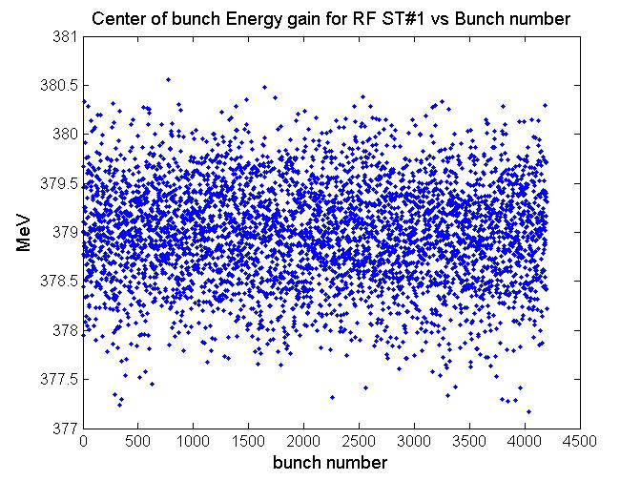
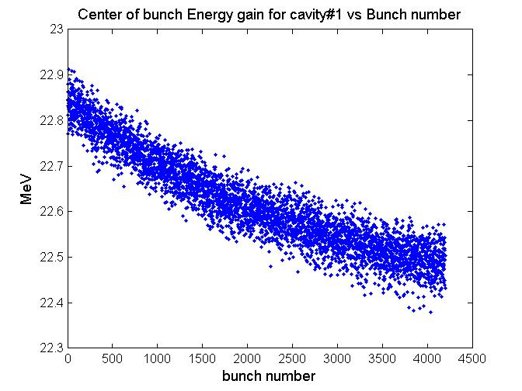
A little bit more realistic simulations
The LLRF controls the vector sum. The energy gain looks OK for a group of 16 cavities.
But each cavity has a large bunch train head to tail spread.

Slide 13
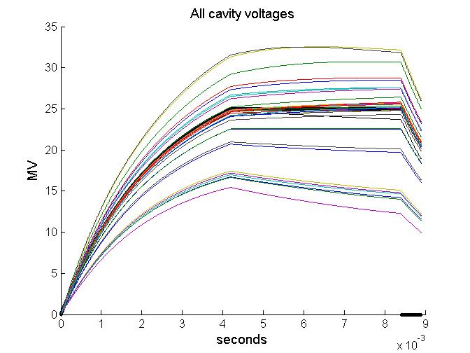
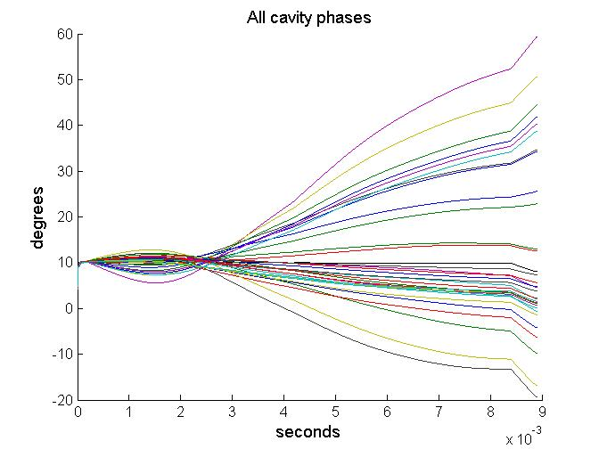
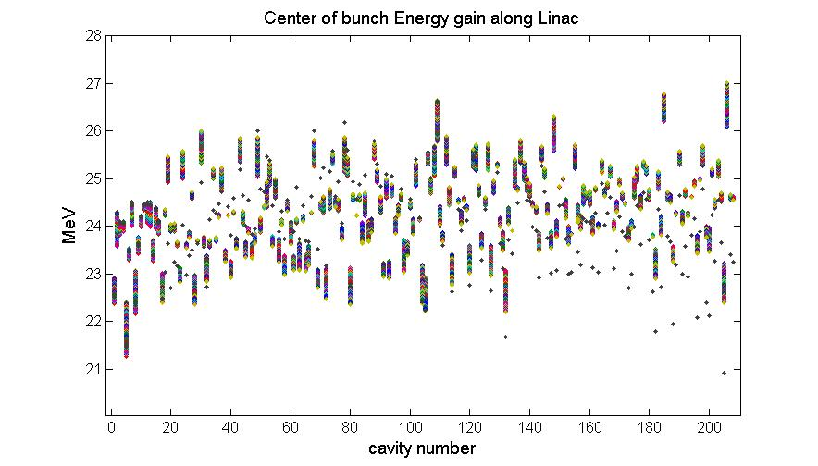
20% gradient spread, LFD, u-phonics, beam and coupler errors
1st RF station is DESY-FLASH ACC6-7
All other 12 RF stations have 2 low gradient cavities at 18MV and 14 cavities at 26MV.
Simulation assumptions:
LFD: ~ 60 Hz at 25 MV.
µ-phonics: ±5Hz uniformly distributed.
Beam errors:
Coupler error: 10% uniformly distributed.
Head of the bunch train
Tail of the bunch train

Slide 14
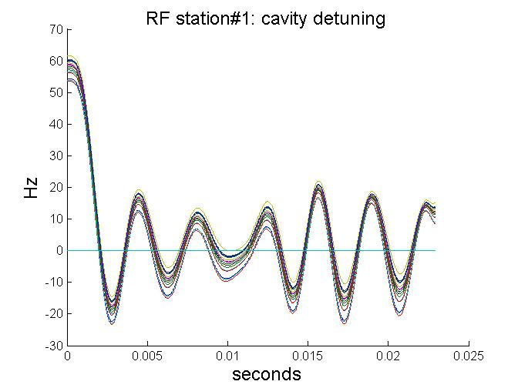
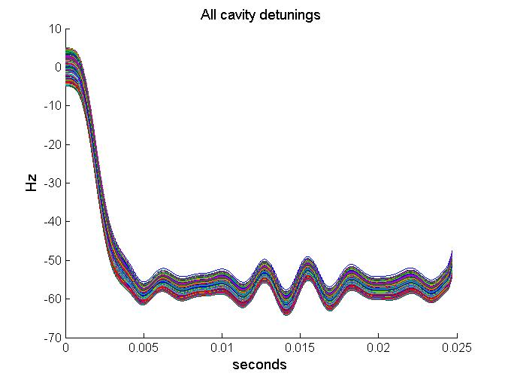
Detuning for 4.2ms vs. 2.4ms fill time
ILC type 9-cell niobium cavities detune about 600Hz at 25MV by effect of LFD. This number would prohibitive in terms of RF power required. We assume that LFD can be reduced to 50Hz peak to peak or better.
In this simulation we assume a cavity to cavity uniform random microphonic detuning of ±5Hz.
2.4 ms fill
4.2 ms fill
The LFD is a function of V².
Longer flattops do not imply worse LFD.
Predetuning the cavities can reduce the LFD during the flattop.
Uniform distributed ±5Hz microphonic added.
~50 Hz
peak to peak
~15 Hz peak to peak
The size of the Δω oscillation is proportional to electrical bandwidth ω₁₂. I.e. inversely proportional to the electrical Q_{L} and also to the fill time.

Slide 15
We can also control the slope of the ramp with t_{fill}.
To lower the amplitude of the oscillation, instead of a high Q_{L} we can try slowing down the filling of the cavity using a smooth input function, like a ramp or a sigmoid.
A function like these may lower the energy exiting the cavity mechanical resonances.
For instance a input power ramp will produce an approximate voltage response of:
$$\begin{matrix}V\left(t\right)=\frac{V_{0}}{t_{fill}ω_{12}}\left(ω_{12}t−1+e^{−ω_{12}t}\right) & for & 0<t<t_{fill}\end{matrix}$$
$$\begin{matrix}{V\left(t\right)}^{2}=\frac{{V_{0}}^{2}}{{\left(t_{fill}ω_{12}\right)}^{2}}{\left(ω_{12}t−1+e^{−ω_{12}t}\right)}^{2} & for & 0<t<t_{fill}\end{matrix}$$
$$\begin{matrix}∆ω=\frac{{V_{o}}^{2}}{{t_{fill}^{}}^{2}}\left[t^{2}−at+\frac{e^{−t/τ}}{\sqrt{4{Q_{m}}^{2}−1}}\left(1−\sin\left({\sqrt{4{Q_{m}}^{2}−1} ω}_{m}t+φ_{0}\right)\right)\right] & for & 0<t<t_{fill}\end{matrix}$$

Slide 16
Multiple Cavities Using a Single Source
From Tom Powers presentation (borrowed without permission)
It can present problems when:
The beam is sensitive to errors in gradients or phase.
Detuning becomes significant as compared to the FPC bandwidths.
Cavities are operated at different gradients.
Cavities have different loaded-Qs
Cavities are operated at different beam phases with respect to crest.
Induced phase shifts are comparable to that required for putting an energy chirp on the beam.
Note that the gradients have not yet achieved their steady state values as would be necessary in a CW machine.
If you fix the gradient what happens to the phase errors?

Slide 17
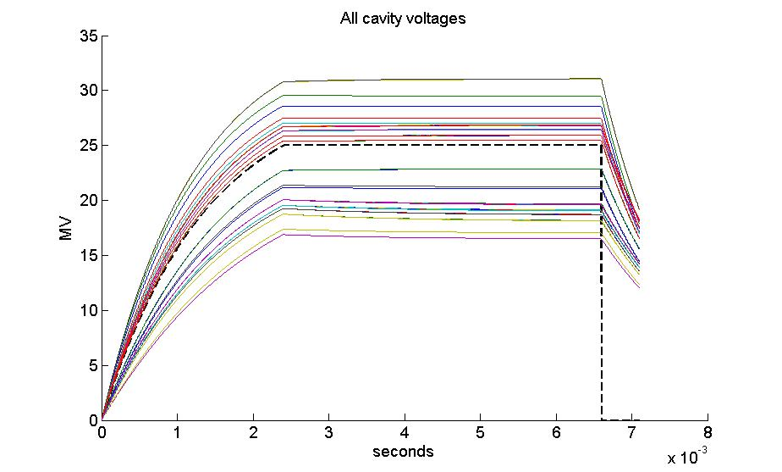
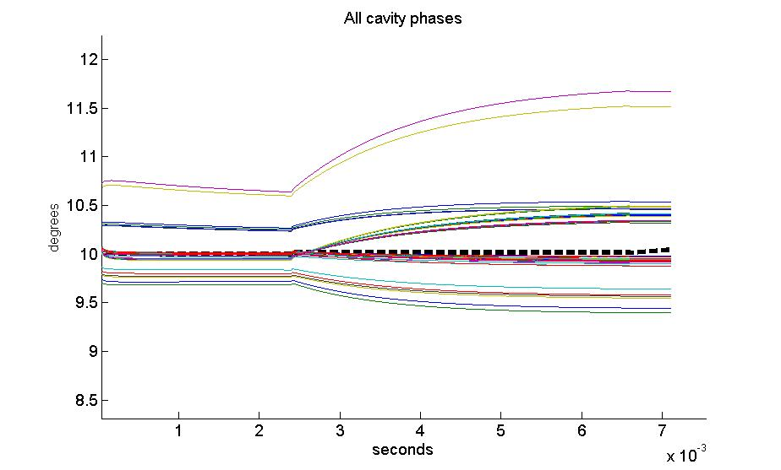
Optimum gradients using the cavity transient response
QL spread 45% (QLmin=4.5e6 QLmax=6.5e6)

Slide 18
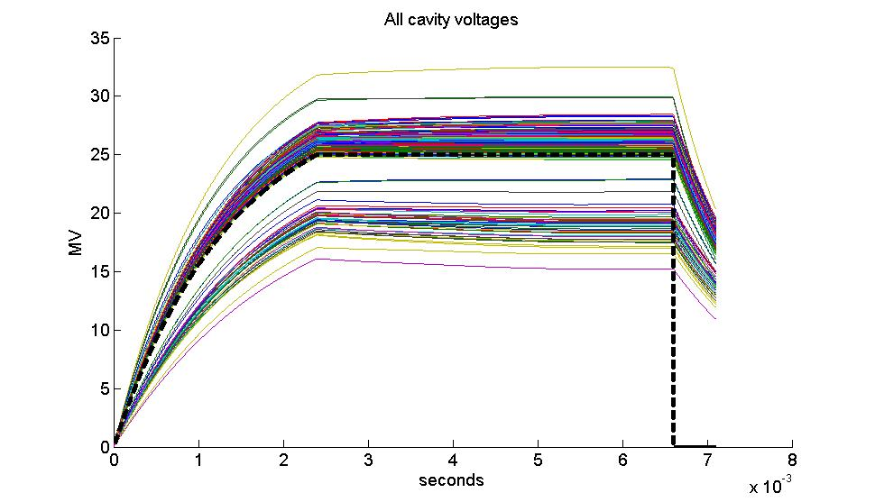
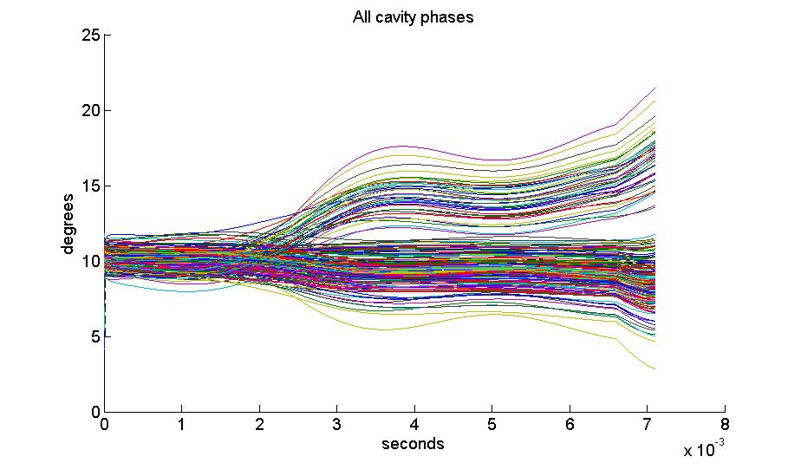
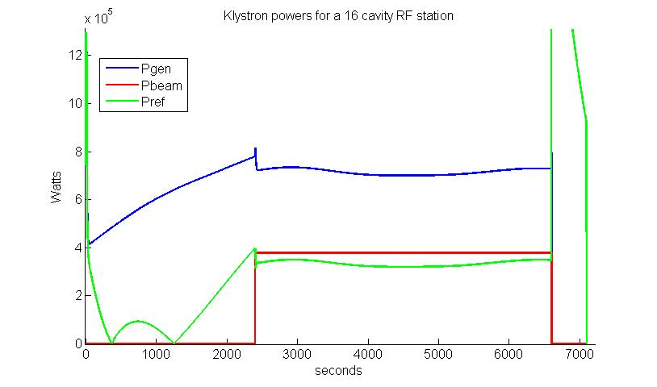
Optimum gradients using the cavity transient response
Adding LFD 50Hz and u-phonics 10 Hz peak to peak
Worst case LFD, 2.4us fill time.
20% gradient spread.

Slide 19
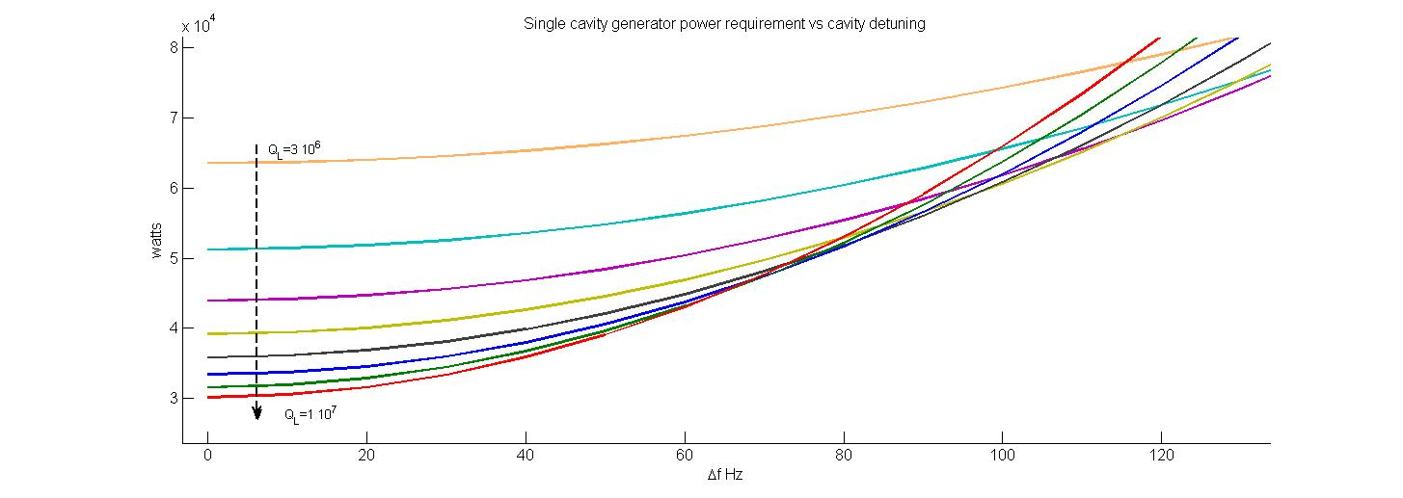
Power vs LFD analysis
For 65 Hz detuning the power requirements for Ql 6e6 to 1e7 are very similar

Slide 20
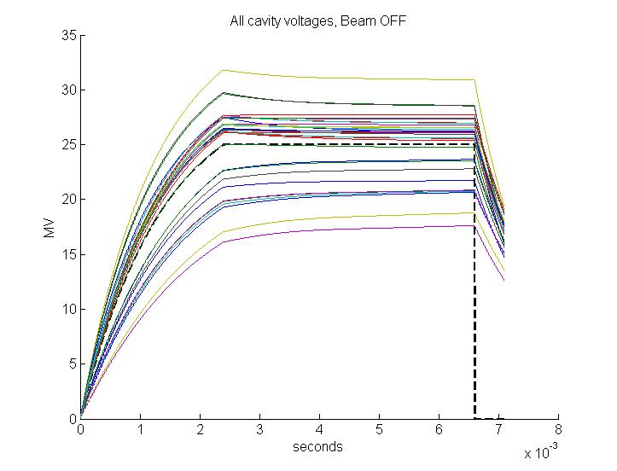
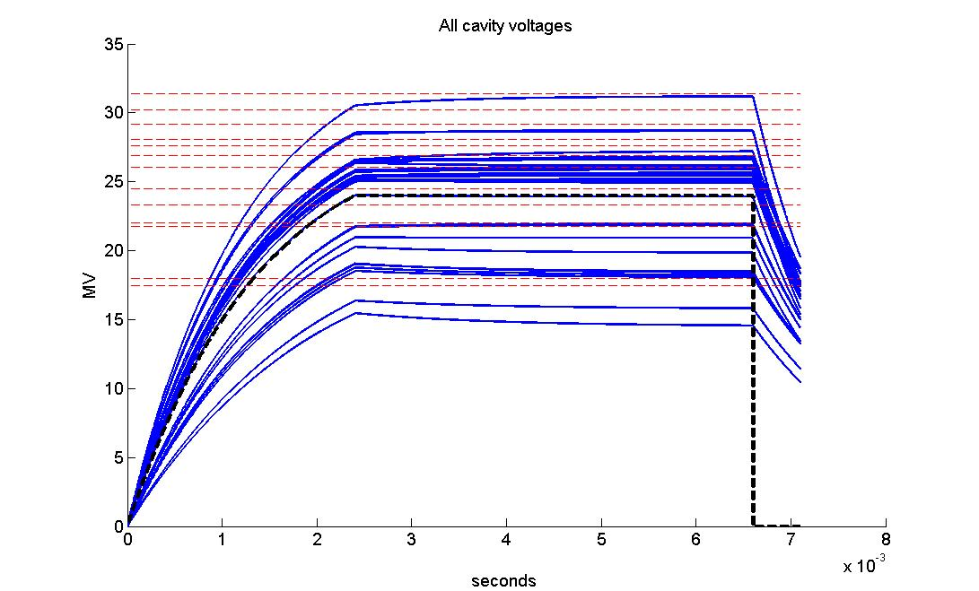
Bean OFF vs. beam ON
If parameters, such as Pk’s and QL’s are optimized for beam ON, cavities will tilt when the beam is OFF.
The slope of the tilt is proportional to the difference between the cavity voltage and the VS voltage.
The delta voltage is proportional to the slope times ~2.5 cavity tau’s.
To avoid quenches we need to drop the VS gradient.
1.7MV
4.2ms pulse

Slide 21
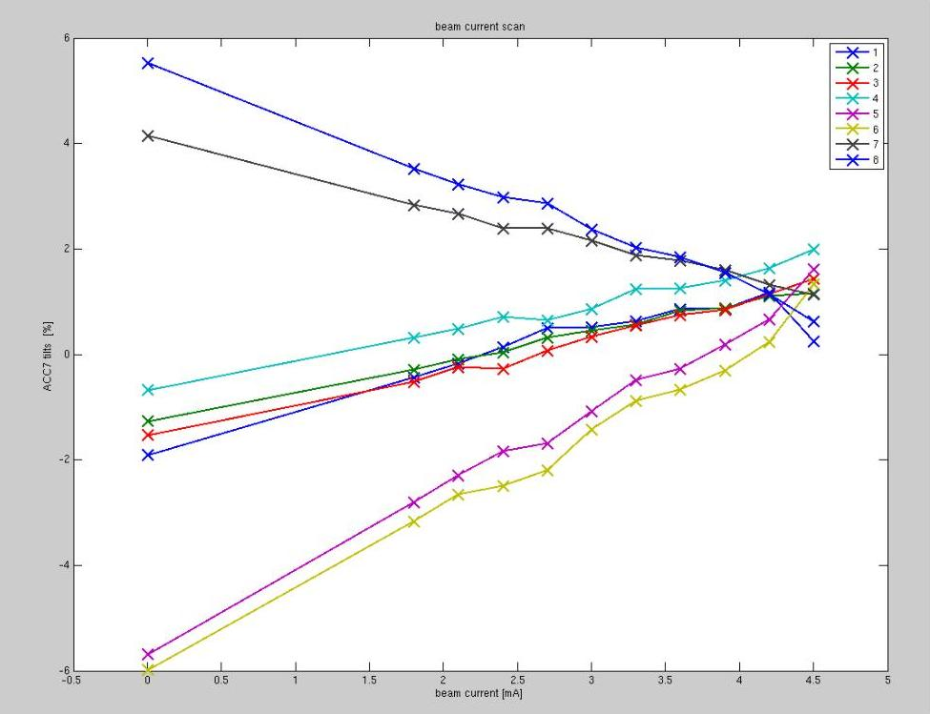
TILTS, P_{k,}and Q_{L} (studies at FLASH)
At FLASH cryomodules are set for equal Q_{L}’s of 3e6. and gradients to be flat when beam loading is 0.
Beam loading is compensated using feed forward plus adaptive feed forward plus beam feedback compensations.
Only the VS is compensated.
Cavities are operated very close to “on crest”
Beam based VS calibration.
Manual tuning of cavities to reduce LFD. (Piezos operated only occasionally for ILC tests).
ILC 9mA test approach:
Recalculate Q_{L}’s so cavity amplitude and phases are as flat as possible with desired beam loading.
I_{g} : total forward power
k : forward to flattop power ratio
t₀ : fill time
tilts
Can we make tilts = 0 ?
Tilts are linearly proportional to beam loading changes.
Size of tilts are proportional to the voltage spread in the RF station.
Beam loading

Slide 22
Summary
Project X LLRF simulations benefit from the ILC 9mA program at FLASH and soon from FNAL-NML and KEK S1-global.
Project X 3-8 GeV LINAC wants to push for high QL’s and long pulses.
Cavity gradient spread must be minimized (ideally made 0)
Excellent LFD and microphonic control is needed.
Strategies used in simulations show good results but multi cavity control does not provide a robust solution for individual cavities.

Slide 23
Spare slides

Slide 24
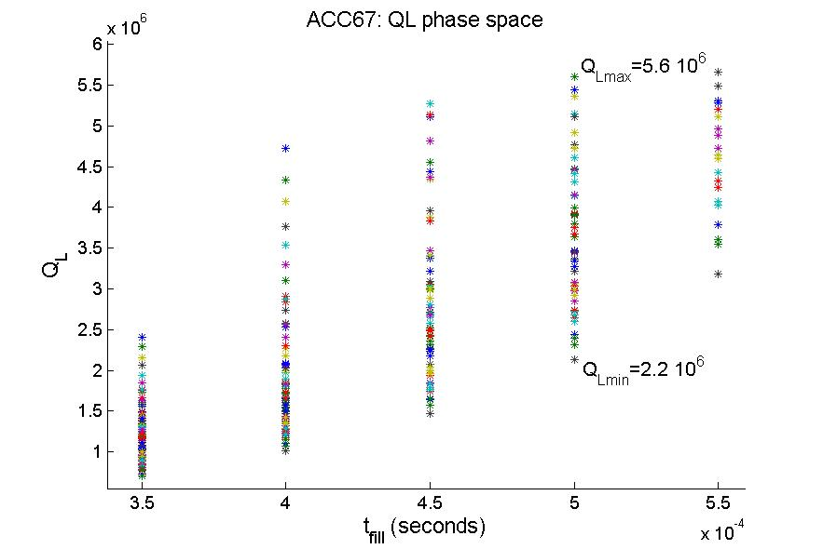
TILTS and cavity voltage spread: P_{k}-Q_{L} studies at FLASH
T_{CL}(S) is proportional to gradient spread.
Question: given tilts =0 (all cavities) for beam loading Ib1, can we make tilts =0 (all cavities) for beam loading I_{b2}≠I_{b1}?
Yes, but needed Ql’s can be outside the coupler ranges.
Only a 2D plot of a higher dimensional problem.
k
forward power ratio between filling power and flattop power.

Slide 25
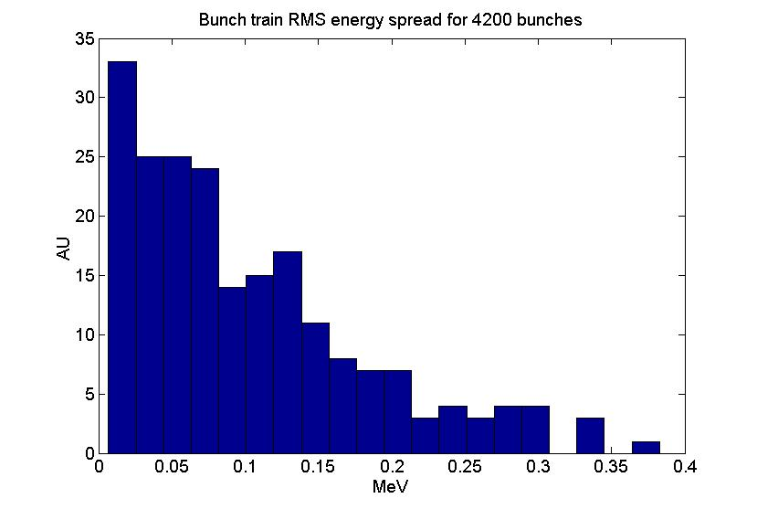
Optimum gradients using the cavity transient response
Adding LFD 50Hz and u-phonics 10 Hz peak to peak
RMS
X4 better

Slide 26
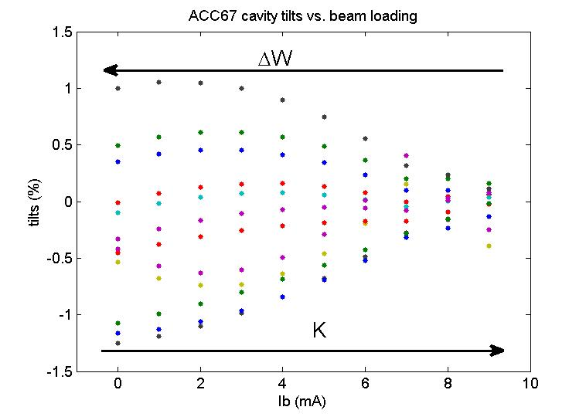
Bringing up the LINAC: Beam OFF/ON
Bringing up the LINAC:
Set Qls for nominal beam current.
Detune cavities for I_{b}=I_{min}.
Set beam compensation K for I_{min}.
Increase number of bunches to full bunch train.
Iterate 1 to 3 increasing I_{b}.
Only requires cavity resonant frequency tuning and LLRF parameters.
Ql’s and HLRF stay put.

