Slide 1
Fermilab 650 MHz Cavity and Cryomodule Status Report
Mark Champion, Fermilab
Project X Collaboration Meeting
October 25-27, 2011

Slide 2
650 MHz Cavity Prototypes and
Readiness for Processing & Testing
Orders placed for a mix of single-cell and five-cell cavities (next slide)
Vertical test stand ready for testing 650 MHz cavities
  Single-cell β=0.6 cavity to be tested soon
    Facility shakedown & comparison with measurements at JLab
Infrastructure ready for preparation of single-cell cavities
  Tooling design in progress for handling five-cell cavities
Electro-polishing tool at ANL nearly ready
Optical inspection system ready

Slide 3
Cavity Procurements
Beta | Type | Quantity | Provider | Due Date
0.9 | 1-cell | 6 | AES | First two by end of CY2011
0.9 | 5-cell | 2 (option +2) | AES | June 2012
0.6 | 1-cell (FNAL) | 3 | RI | June 2012
0.6 | 1-cell (JLab) | 3 | RI | June 2012
0.6 | 1-cell (JLab) | 2 | JLab | Complete

Slide 4
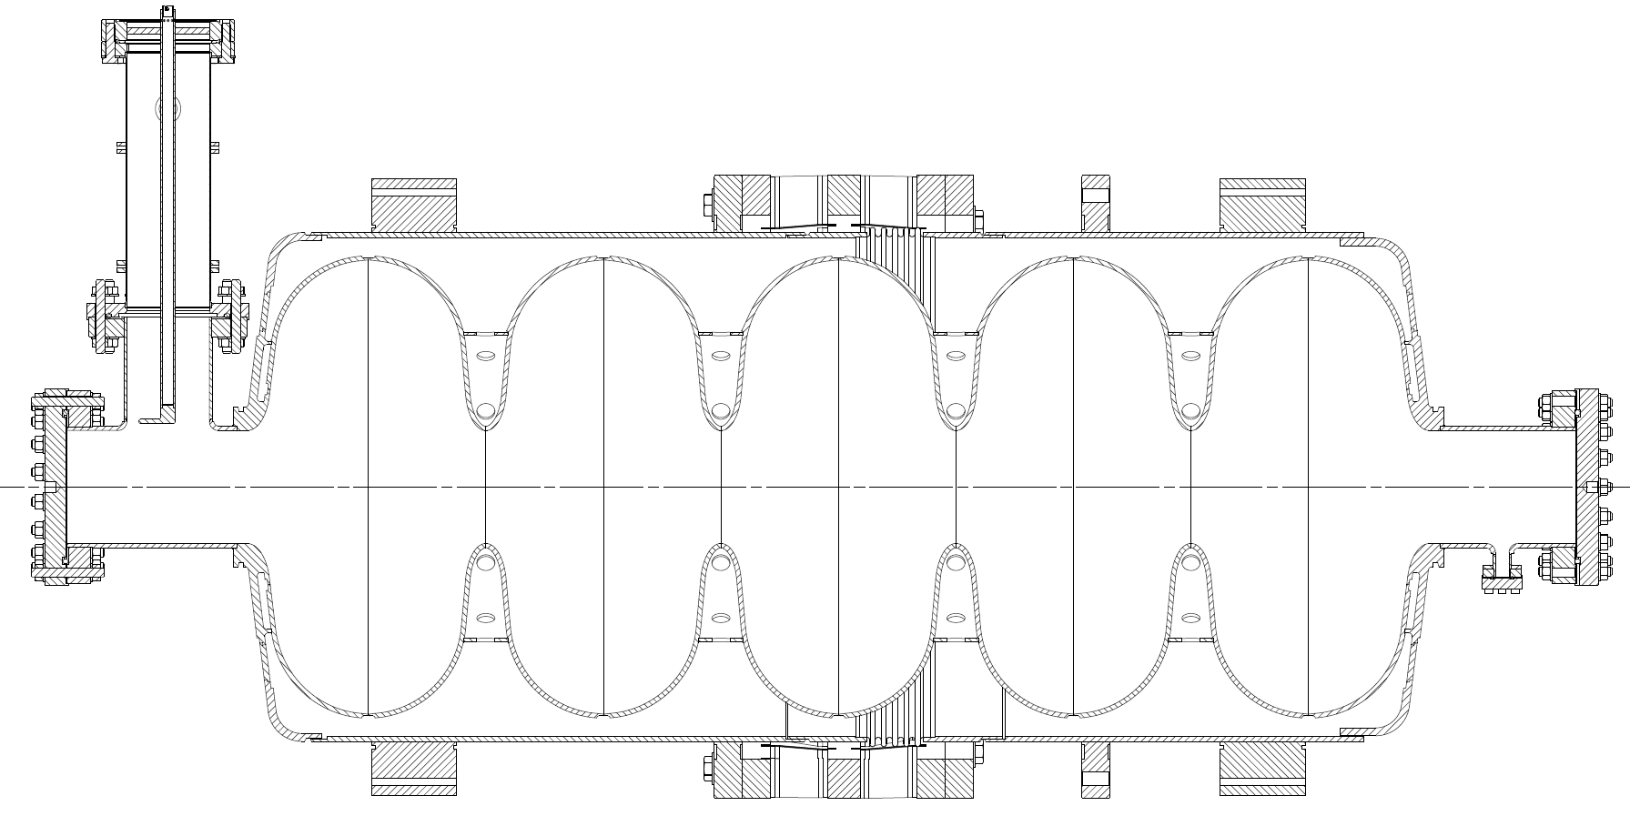
β=0.9 five-cell cavity prototype design
4 mm Nb wall thickness
Ti helium vessel
Nb-Ti transition
Nb-Ti flanges
No HOM couplers

Slide 5
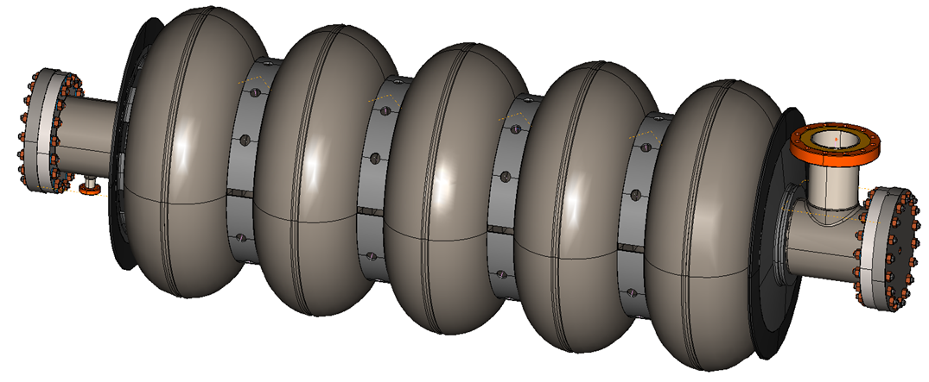
Cavity without helium vessel
(this is what we ordered)

Slide 6
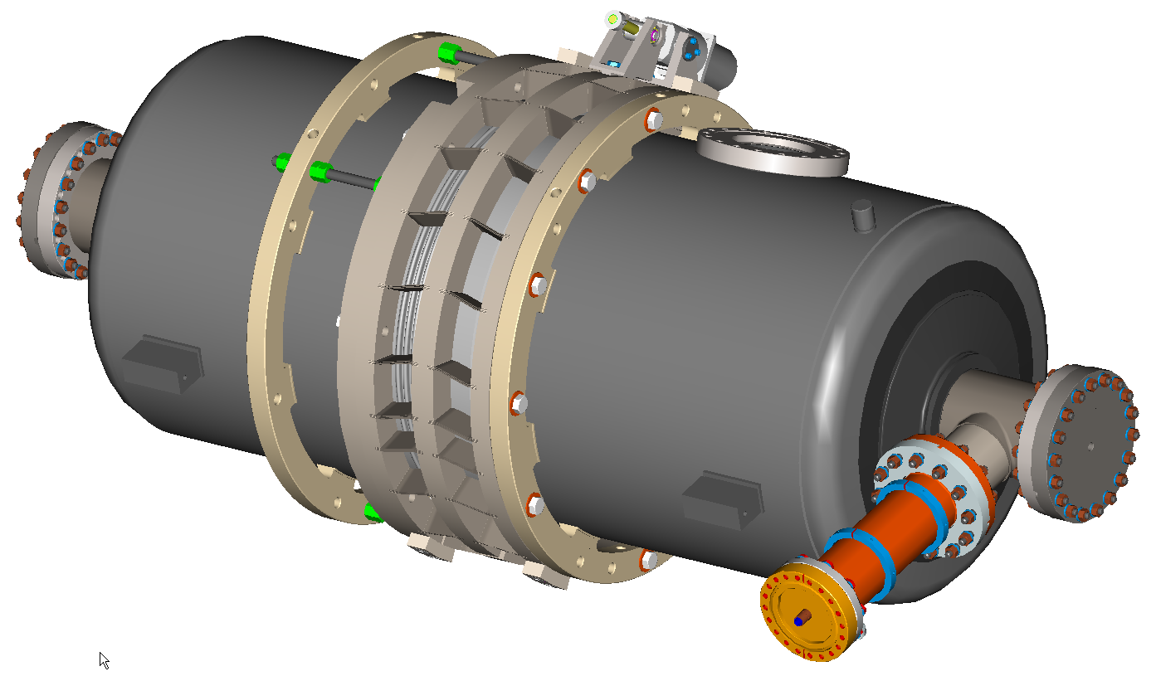
And here’s how it will look when ready for horizontal tests

Slide 7
650 MHz Cryomodule Design Status
Conceptual design work and 3D modeling is in progress
  Frequent working meetings with collaborators
Plan to transition to detailed design work at end of FY2012
Basic configuration settled, but many details to be addressed

Slide 8
Cryomodule requirements - major components
Eight (8) dressed RF cavities
Eight RF power input couplers
One intermediate temperature thermal shield
Cryogenic valves
  2.0 K liquid level control valve
  Cool-down/warm-up valve
  5 K thermal intercept flow control valve
Pipe and cavity support structure
Instrumentation -- RF, pressure, temperature, etc.
Heat exchanger for 4.5 K to 2.2 K precooling of the liquid supply flow
Bayonet connections for helium supply and return

Slide 9
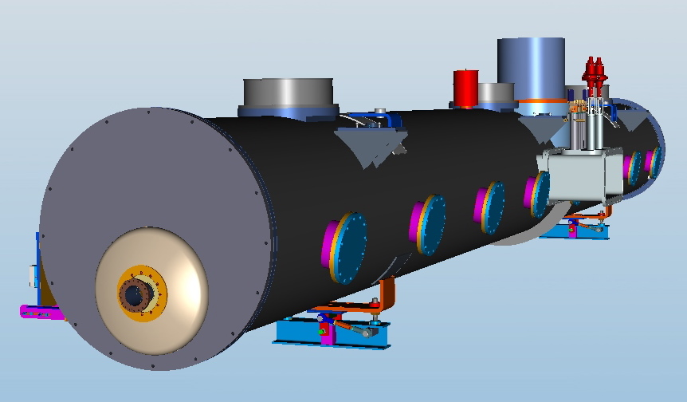
650 MHz, β=0.9, conceptual cryomodule design

Slide 10
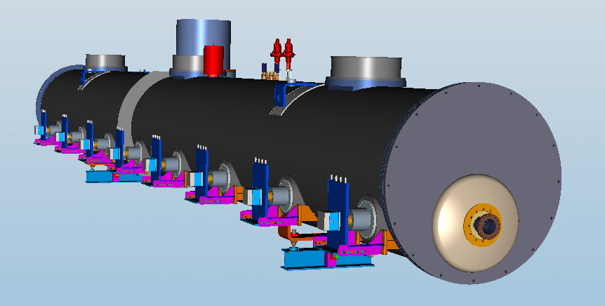

Slide 11
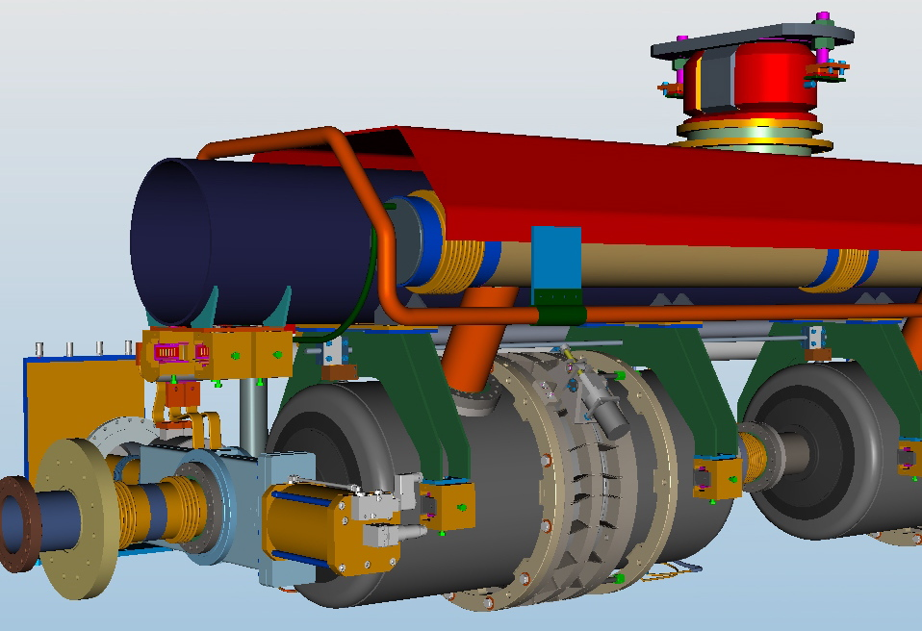

Slide 12
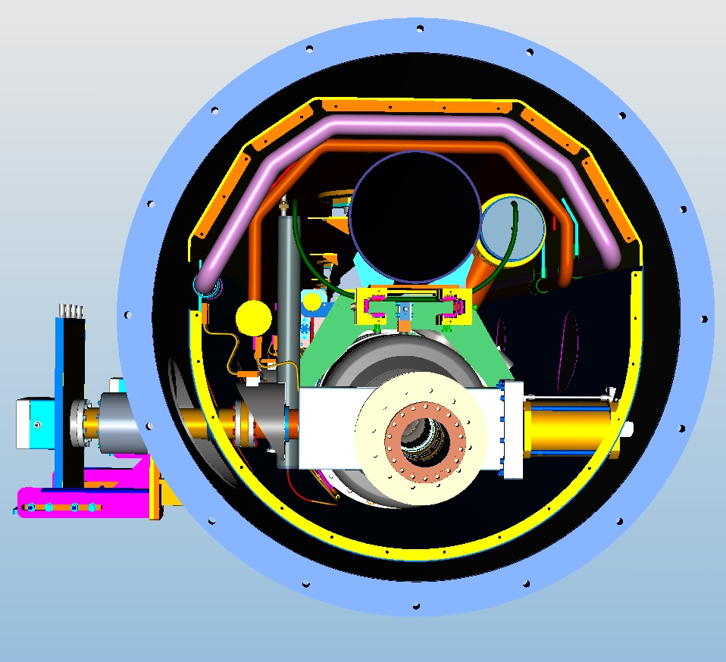

Slide 13
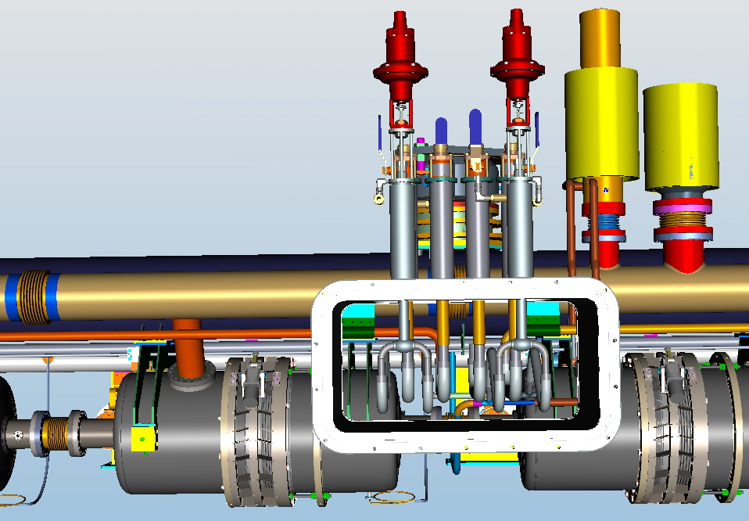

Slide 14
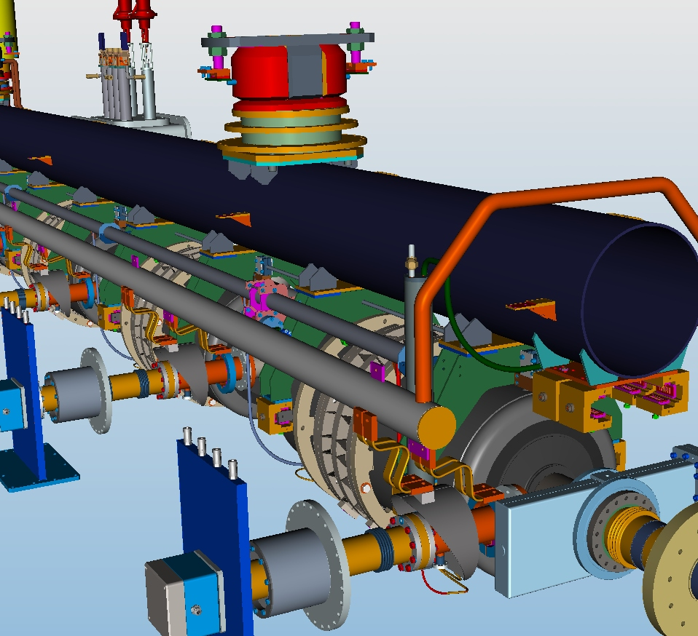

Slide 15
Conclusion and Acknowledgments
Prototype cavities on order; first deliveries expected late this calendar year.
Plan to conduct first 650 MHz cavity test at FNAL in next month.
Infrastructure for processing & testing of 650 MHz cavities is nearly complete and will be available as cavities begin arriving.
Cryomodule conceptual design is progressing and will transition to detailed design near end of fiscal year.
Thanks to Tom Peterson, Chuck Grimm, and Youri Orlov for contributions to this presentation.

