Slide 1
SSR1 cavity EM and Mechanical design
Leonardo Ristori
I. Gonin, M. Hassan, D. Passarelli
PX Collaboration Meeting – 26 Oct 2011

Slide 2
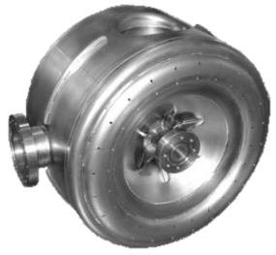
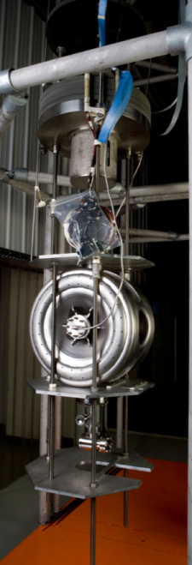
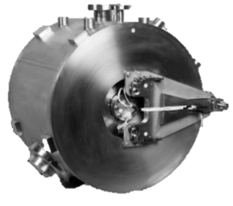
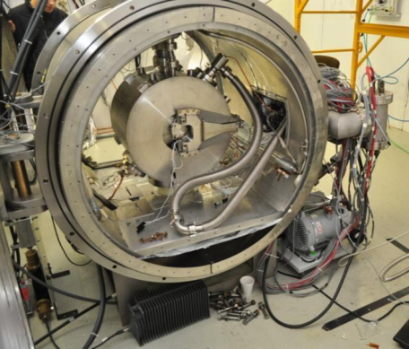
SSR1 overview
Single Spoke Resonators have been developed at Fermilab in the last few years
2 bare prototypes tested in VTS and 1 jacketed prototype tested in HTS
We are receiving an order of 10 resonators from US vendors, 8 needed for the PXIE cryomodule
1st prototype
By Zanon (Italy)
Main Parameters
Frequency | 325 MHz
β_{G} | 0.215
Aperture | 30 mm
Cavity diameter | 492 mm
Bandwidth | ~ 90 Hz
Gain/Cavity, nominal | 2 MeV
Max Surface Magnetic Field, nominal | 60 mT
Max Surface Electric Field, nominal | 39 mV/m
Power/Coupler, nominal | 4 kW (1 mA)
He temp, pressure | 1.8-2.1 K, 20 torr
Q₀ at E_{acc} | > 1.1x10¹⁰
df/dP (jacketed) | <25 Hz/mbar
1st prototype
Jacketed at FNAL
VTS
Spoke Cavity Test Cryostat

Slide 3
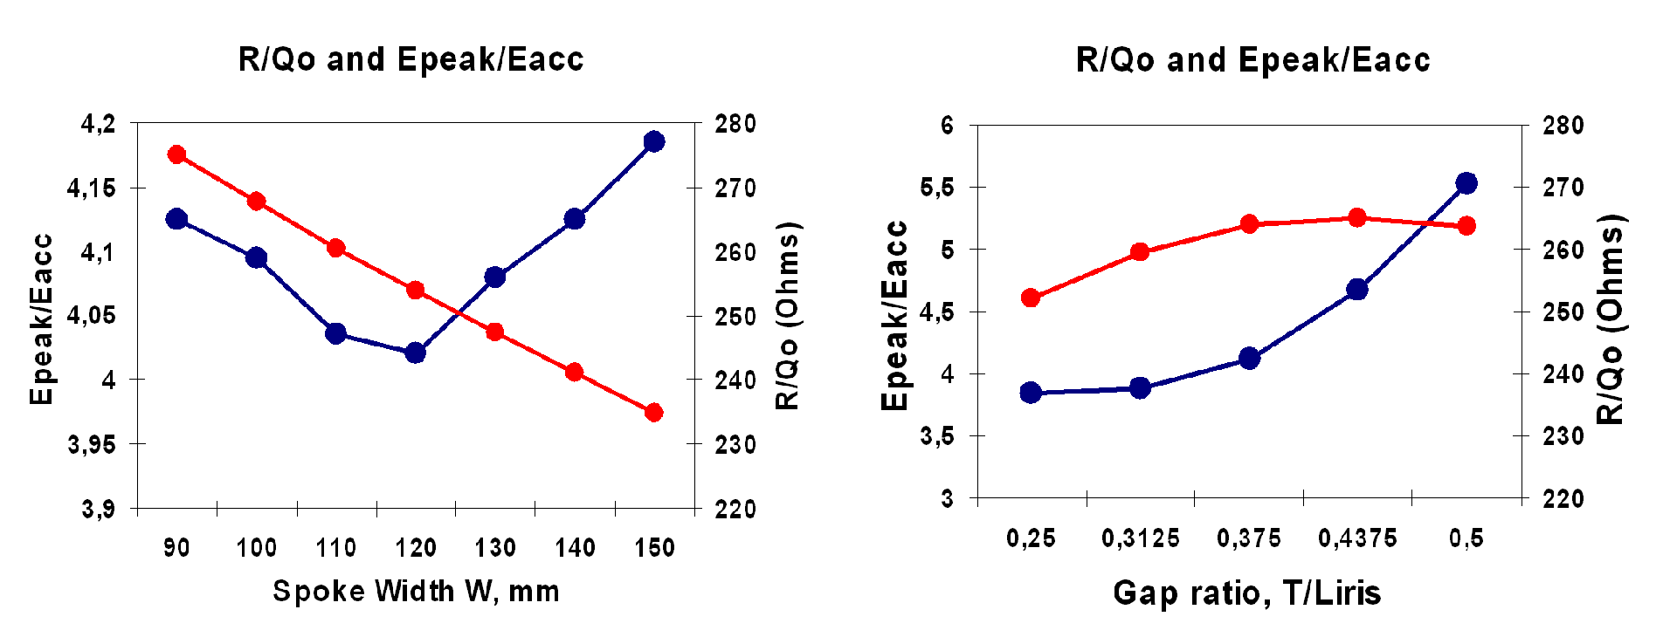
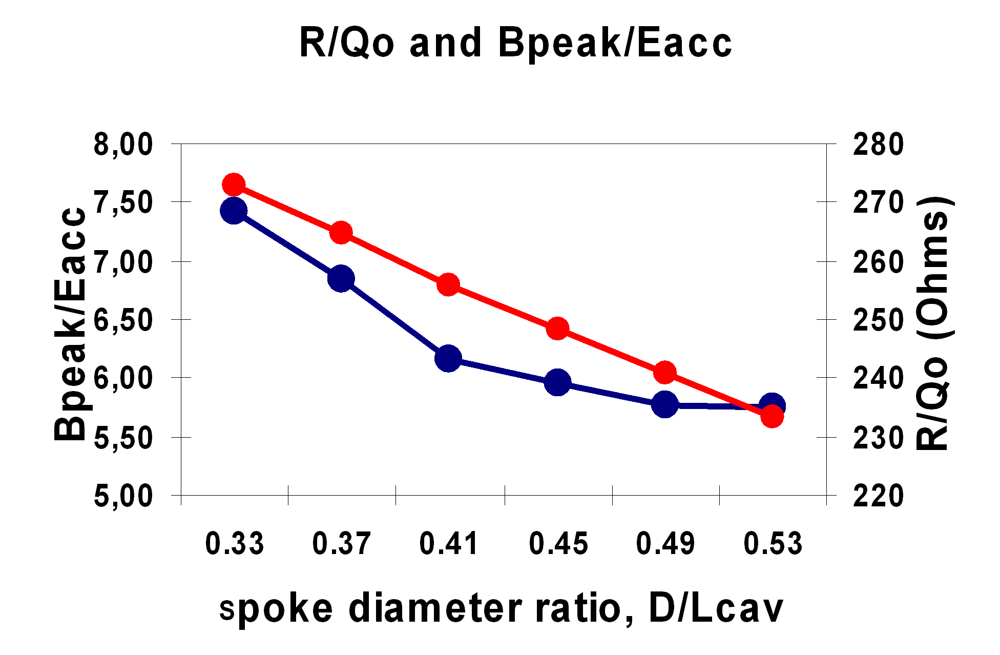
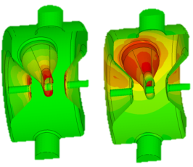
RF design of SSR1
The dimensions were varied in MWS to optimize the RF design.
RF design parameters
Epeak/Eacc | 3.84
Bpeak/Eacc | 5.81 mT/(MV/m)
Leff (2*βλ/2) | 198.5 mm
G | 84 Ω
R/Q | 242 Ω
Surface electric (left) and magnetic (right) fields in SSR1.
The field strength increases as the color changes from green to yellow to red.

Slide 4
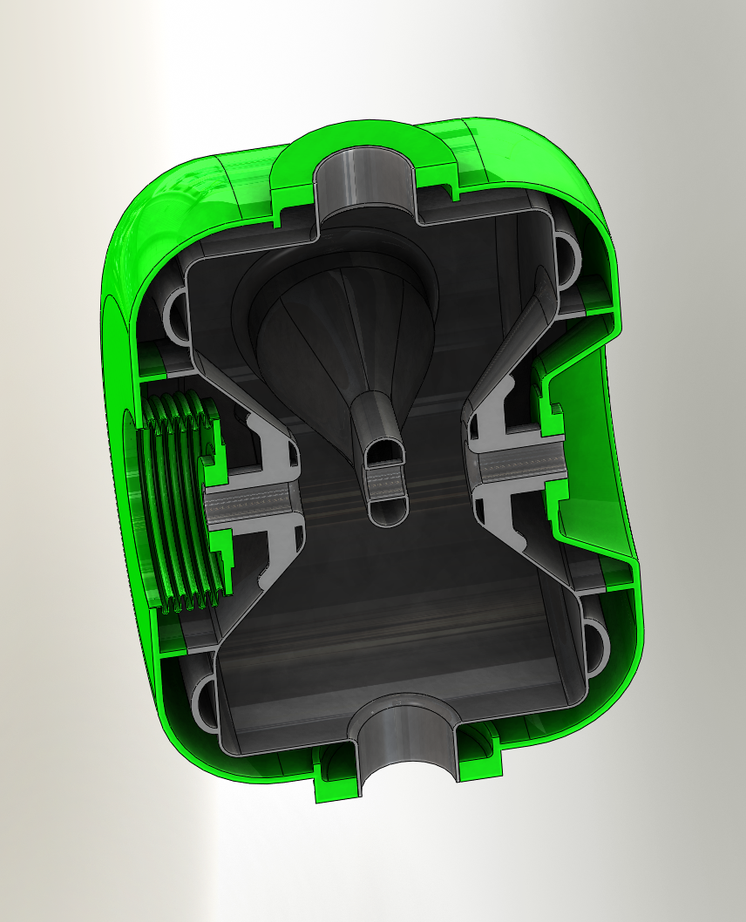
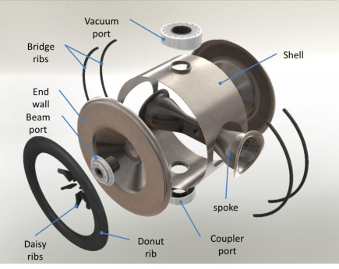
SSR1 Mechanical design
Requirements:
Pressure rating 2 bar
Pressure sensitivity df/dP < 25 Hz/mbar
Tuning range ±130 kHz without yield
Facts:
Cavity material: 3.1 mm
Helium Vessel made of 316L
Transitions are Cu-Brazed (ANL)
Flanges are Conflat (3-3/8” & 6”)
All stiffeners are made of RRR40 Nb
Tuning
forces

Slide 5
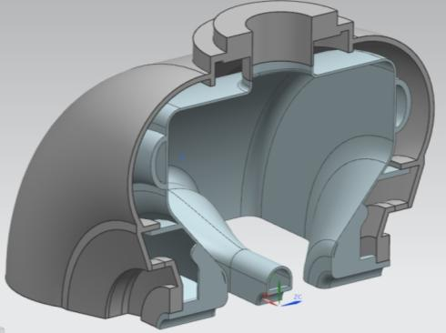
Pressure sensitivity – Vessel optimization
Circle Shape
Tk
D
R1
For example a solution is:
R1 = 125 mm, D = 200 mm, T = 7 mm
Various geometrical parameters of the helium vessel have been studied to meet the requirements for df/dP.
There are infinite solutions (e.g. the star on the plot).
Other considerations will define the design (ease of fabrication, tunability etc..)
The plot shows one of the studies for the ring diameter and vessel dome diameter.

Slide 6
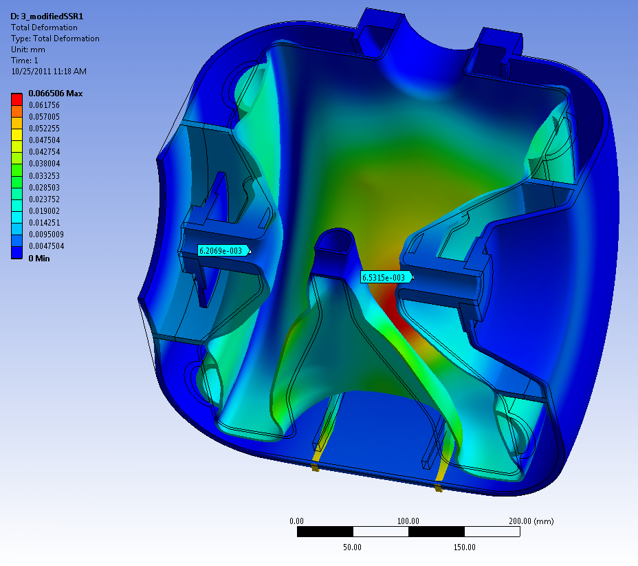
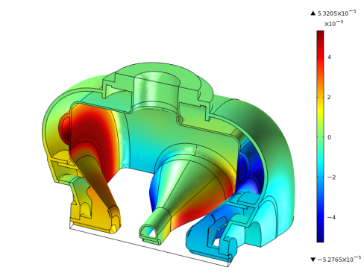
Pressure sensitivity - analyses
Comparison between analysis tools
High E
Comsol multiphysics
df/dp ~ 4.9 Hz/Torr
Ansys multiphysics
df/dp ~ -1 Hz/Torr
Ansys mechanical (explained in next slide)
df/dp ~ 2.6 Hz/Torr
High B
Figure shows deformations (enhanced x500) for a cavity under vacuum and Helium at 1 atm
Beam pipes deform only ~ 6 μm inward
df/dP < 10 Hz/torr
Deformations in high E and B regions balance out resulting in a small frequency shift

Slide 7
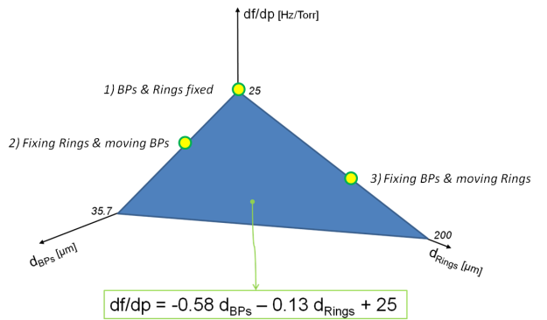
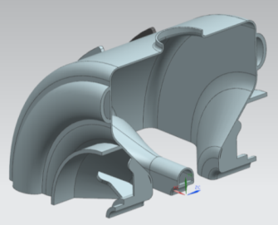
Mechanical analyses for df/dP estimation
The cavity is constrained to the helium vessel in several locations (e.g. d1, d2, d3, d4,..)
After a first series of RF-mechanical coupled analyses, we can perform mechanical only analysis to predict df/dP.
The computation time is reduced considerably
In the specific case of SSR1, only 3 RF simulations (3 points of the plane) are needed to define the mathematical relation to have an estimation of df/dp function of the displacements on Rings (d3, d4) and beam pipes (d1, d2)
d4
d2
d3
d1

Slide 8
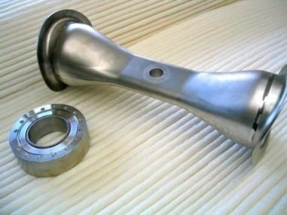
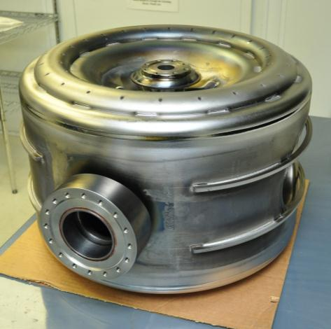
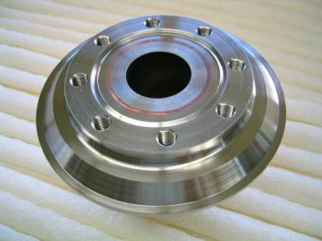
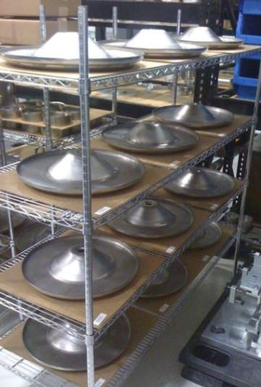
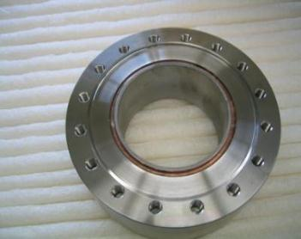
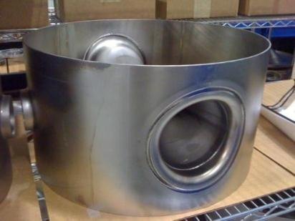
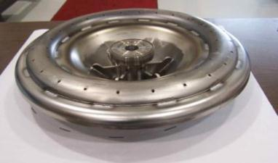
SSR1 Fabrication (Niowave-Roark, USA)
10 resonators ordered, 2 received. Balance expected by end of 2011.
Cu
Nb
SST
Spoke with collars
Beam Pipe port
ANL development
Power Coupler
port
Completed resonator

Slide 9
Plan for the 10 resonators
Bulk BCP at ANL (1st already in process)
Hydrogen degassing at FNAL (10h at 600 C)
Light BCP at ANL
Vertical tests at FNAL (1st expected in January 2012)
Jacketing operations to start in March 2012
Jacketed tests in cryostat to start in June 2012

