Slide 1
Discussion on Project X Energy Station
October 25, 2011
D. Wootan, D. Asner
david.wootan@pnnl.gov

Slide 2
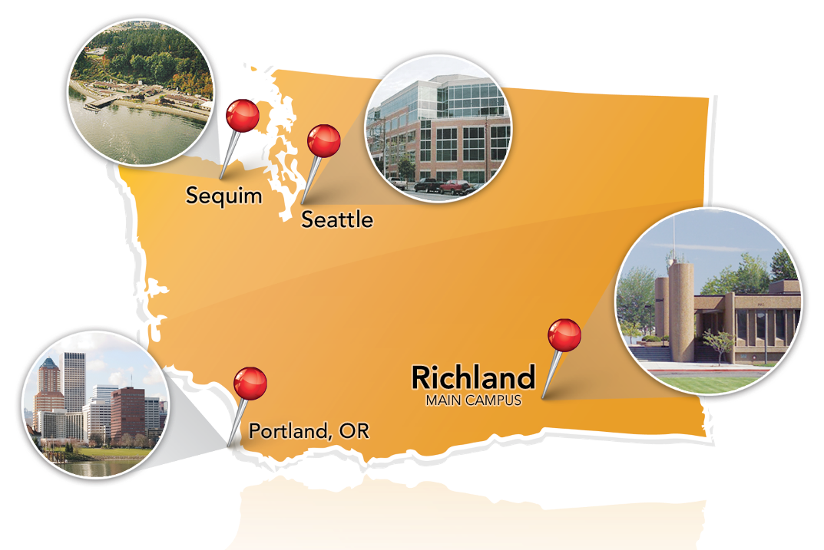
Pacific Northwest National Laboratory: Battelle-managed and mission-driven
DOE Office of Science is Laboratory “Steward”
Operated by Battelle since 1965
Unique S&T strengths and capabilities
Mission-driven collaborations with government, industry and academia
Our vision
PNNL will be recognized worldwide and valued nationally and regionally for leadership in science and for rapidly translating discoveries into solutions for challenges in energy, national security, and the environment.

Slide 3
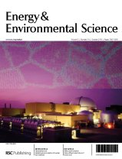
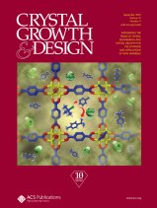
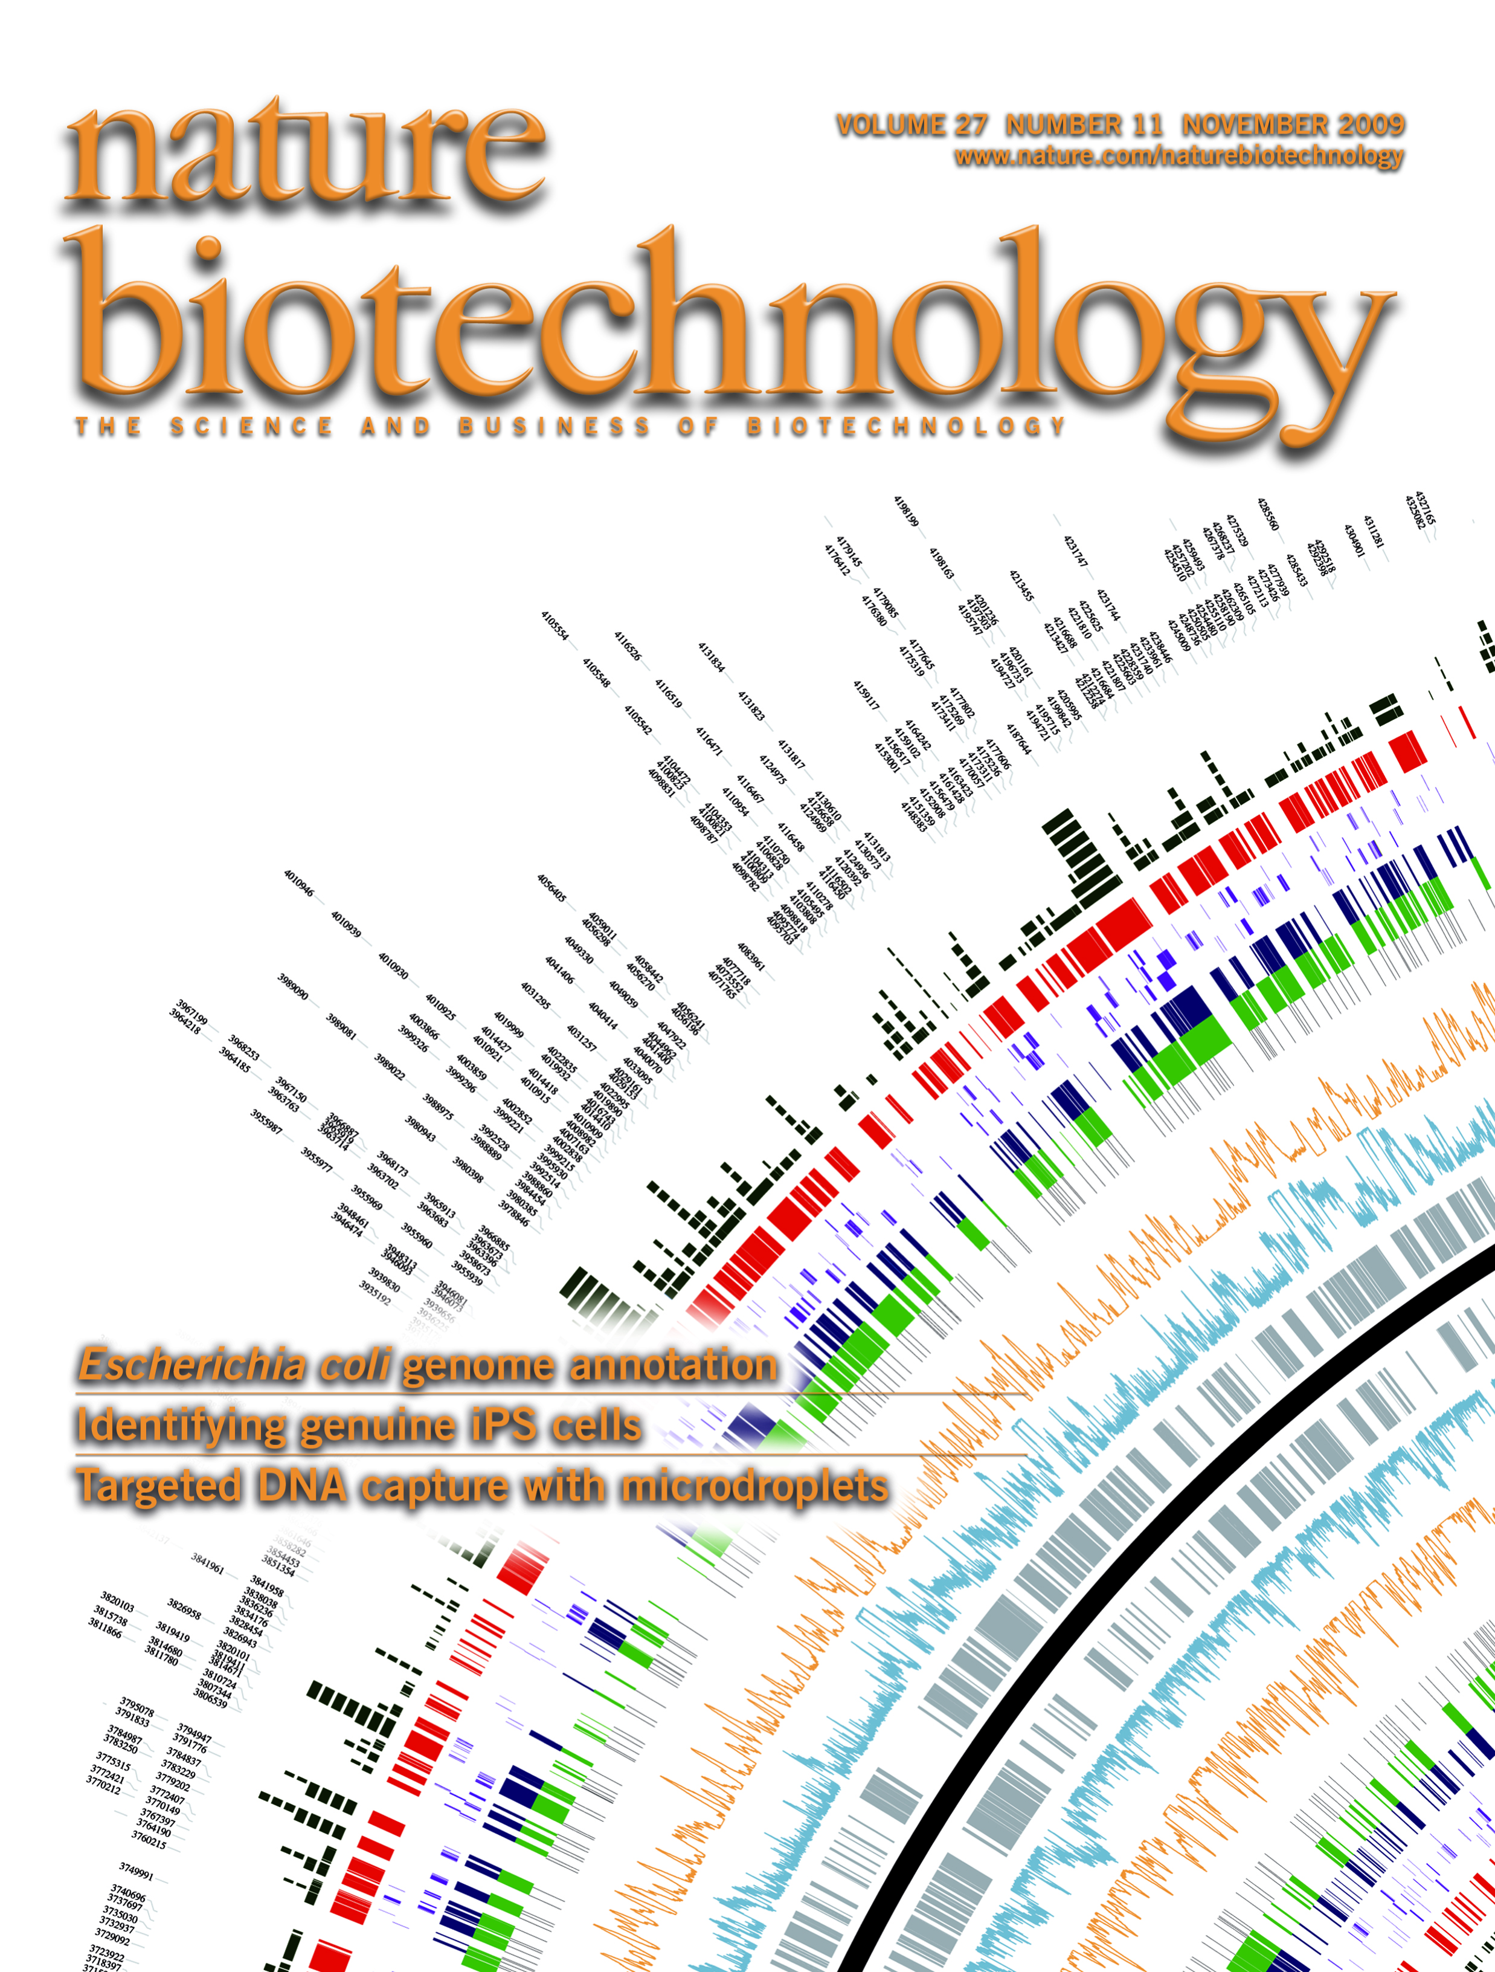
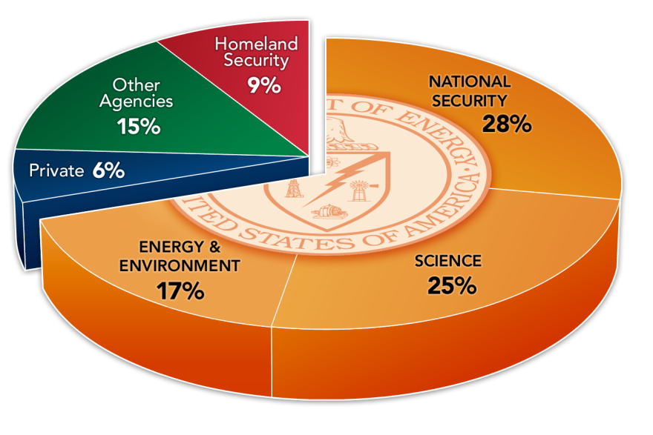
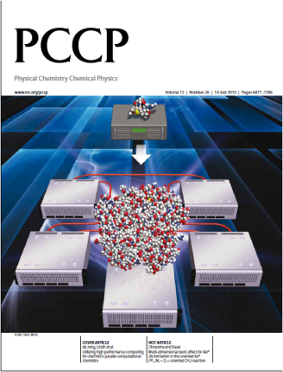
PNNL at a Glance: FY2010
$1.1B R&D budget
Nearly 5000 staff, including 3,000 technical staff
2000 users & visiting scientist
80 R&D 100 awards
National security: 50% of business
930 peer-reviewed publications
46 patents issued
Among top 1% of research institutions in publications and citations in:
Chemistry
Geosciences
Physics
Engineering
Biology & Biochemistry
Environment/Ecology
Materials science
Clinical medicine
Microbiology

Slide 4
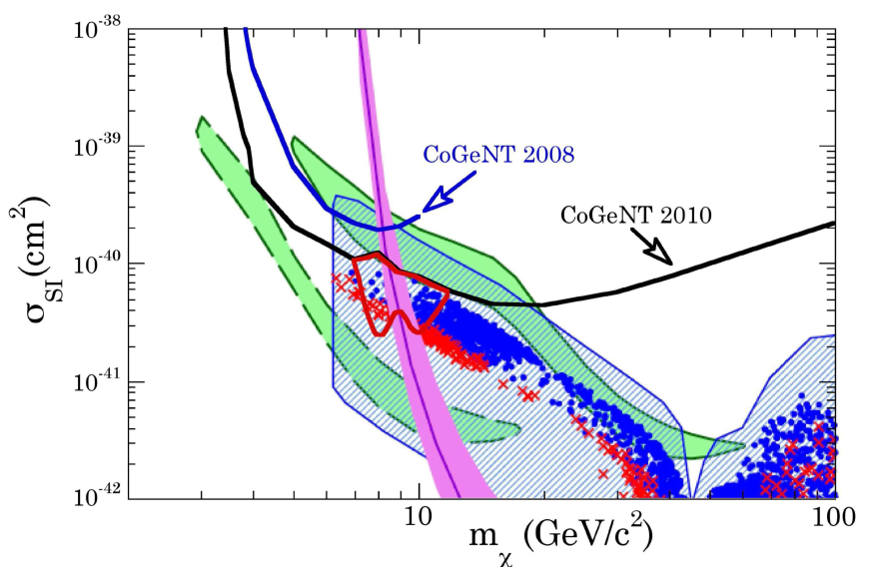
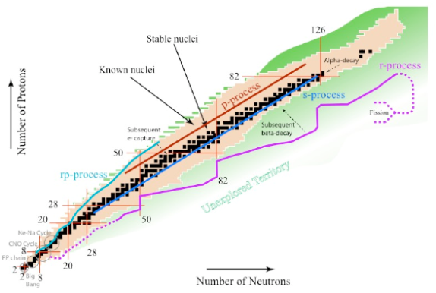
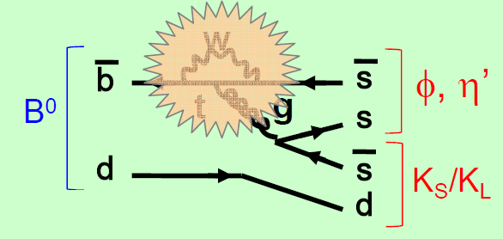
Nuclear & Particle Physics Research at PNNL Overarching Theme: Weak Interactions
PNNL staff are engaged in five broad areas:
Neutrino physics
Majorana, Project 8
Dark Matter (CoGeNt)
Flavor physics (Belle II)
Low Energy Nuclear Astrophysics
HPGe Array @ RIB
Neutron Induced Fission
Track α and fission products with TPC
Related R&D efforts include
Improved photocathode for electron LINAC
Ion processing of Cu to mitigate electron cloud
Belle/Belle II computing center
Nuclear LQCD calculations
Generic Detector R&D
e⁻
p⁺
p⁺
e⁻
n
ν_{e}
n

Slide 5
DOE Office of Nuclear Energy

Slide 6
DOE NE Programs Potentially Benefiting from Energy Station
LWR Technologies
Sustainability of current fleet of reactors
Aging and repairability
Material damage such as pressure vessel embrittlement
Repairability such as knowing when helium accumulation prevents weld repairs to structures
Safety

Slide 7
DOE NE Programs Potentially Benefiting from Energy Station
Advanced Reactor Concepts (ARC), includes Gen-IV
Thermal systems
Very High Temperature Reactor (VHTR)
Supercritical water cooled reactor (SCWR)
Molten Salt Reactor (MSR)
Fast systems
Gas cooled fast reactors (GFR)
Sodium cooled fast reactor (SFR)
Lead cooled fast reactor (LFR)

Slide 8
DOE NE Programs Potentially Benefiting from Energy Station
Fuel Cycle Research and Development (FCRD)
Long term science based R&D for fuel cycle technologies
Develop technologies to improve sustainability of current reactors
Develop improvements in affordability of new reactors
Small modular reactors
High temperature reactors
Improved structural materials
Improved fuels
Develop sustainable nuclear fuel cycles
Once through
Modified open
Full recycling (transmutation)
Minimize proliferation risks

Slide 9
DOE NE Programs Potentially Benefiting from Energy Station
Fuel Cycle Research and Development Areas
Structural materials
Nuclear fuels
Reactor systems
Instrumentation and controls
Power conversion systems
Process heat transport systems
Dry heat rejection
Separations processes
Waste forms
Risk assessment methods
Computational modeling and simulation
Small scale tests to provide proof or validation of system elements

Slide 10
DOE NE Programs Potentially Benefiting from Energy Station
Small Medium Reactors (SMR) Program
DOE support or partnerships with industry development and licensing examples
GEH PRISM sodium fast reactor with metal fuel
Toshiba 4S small safe sodium fast reactor
B&W mPower modular PWR
NuScale modular PWR
Westinghouse Small Modular Reactor
Hyperion Power Module – lead-bismuth cooled fast reactor
TerraPower Traveling Wave Reactor – sodium cooled fast reactor with ~50 year fuel life
General Atomics Energy Multiplier Module EM2 small gas cooled fast reactor
Basic physics
Material research and testing
State-of-the-art computer modeling and simulation of reactor systems and components
Probabilistic risk analysis of innovative safety designs and features
Development activities to establish concept feasibility for future deployment

Slide 11
There is a need for irradiation testing capability in the US and worldwide
Thermal Spectrum – US
HFIR –US thermal spectrum, water cooled, water moderated, limited volume, limited power
ATR –US thermal spectrum, water cooled, water and beryllium moderated, limited volume, limited power, non-interference with Navy primary customer
Fast spectrum – US
None
Fast spectrum – international
BOR-60 Russia near end of life
BN-600 not designed as test reactor
Chinese fast test reactor just started up
Joyo, Monju in Japan currently shutdown, fast reactor research on hold pending national evaluation of direction of energy policy

Slide 12
Very Limited Isotope Production Capabilities
²³⁸Pu
No domestic source for NASA use as power supply for deep space missions
DOE has responsibility for supplying
Past source was Russia
Beneficial Isotopes
Very limited production from ATR, HFIR, University reactors, cyclotrons

Slide 13
Advantages of Energy Station
Flexible, able to support multiple missions
Robust technology allows it to be designed and constructed with today’s technology in order to fill gaps in tomorrow’s technology
Spallation neutrons energy distribution similar to fast reactor fission spectrum but with high energy tail up to proton energy
H and He generation in materials higher than in reactor allowing accelerated aging testing
Continuous wave, high availability, high beam current provides potential for irradiation tests to high fluence
Ability to tailor gamma to neutron flux ratio
Ability to tailor neutron spectrum from fast to thermal
Spallation reactions on target (lead or lead-bismuth) produce broad range of reaction products similar to fission products – some gaseous and mobile, so a cleanup system is needed
Beneficial isotope production can be done simultaneous with irradiation testing

Slide 14
Energy Research Station Concept
Proton beam
Isotope production – ²³⁸Pu, ⁶⁰Co

Slide 15
Potential Flexible Test Matrix Capabilities
Test Zone | Characteristics
Materials | Miniaturized specimens, Instrumented, controlled temperature, pressure
ADS | Lead or lead-bismuth flowing loop, materials compatibility, corrosion, pin-type transmutation fuel and cladding tests, on-line cleanup
HTGR | Graphite structure, TRISO materials, pebble bed, compacts, He coolant
SFR | Sodium coolant loop, advanced high temperature long life materials, pin-type transmutation fuel and cladding tests
LWR | Pressurized water loop, LWR conditions, address sustainability issues
MSR | Molten salt loop, materials compatibility, corrosion, dissolved fuel
Fusion | Lithium loop, radiation damage in materials, fusion blanket tests
Other | Liquid He loop for cold neutrons, possible neutron beam extraction
Nuclear Data | Integral cross sections, isotopic burnup, fission product yields
Isotope Production | Spectrum tailoring for specific isotopes, rabbit system for rapid insertion, moderators: D2O, graphite, beryllium, metal hydride Beneficial use of leakage neutrons (²³⁸Pu, ⁶⁰Co)

Slide 16
Size of Spallation Target Depends on Beam Energy

Slide 17
Characteristics of Energy Station
Vertical spallation target with azimuthally arrayed test regions maximizes test volume (360 degrees)
Limited test volume < 1 liter for each test section
Independent cooling system for each test section
Modular test sections – each can be removed and the active section shipped offsite (PNNL, INL) for processing
Online cleanup of Pb-Bi spallation target could also be source of beneficial isotopes

Slide 18
Capabilities of Energy Station
Reconstitutable Irradiation Test Vehicle
Instrumented Testing Capability
Ability to Tailor Neutron Spectrum
Ability to handle variety of coolants in test region (He, sodium, lithium, lead, NaK, water)
Limited test power (single pin or small culster)
Share beam time – maybe 100 day cycles?
Testing Infrastructure
Design capabilities
Fabrication capabilities
Shipping capabilities
Postirradiation examination capabilities

Slide 19
National User Test Facility
Energy Station could be structured as a National User Facility (NUSF) similar to what has been done at ATR
Collaboration between DOE and Universities
Potential users propose tests that are evaluated by a committee
Open to international testing
Reconstitutable assemblies lessens testing costs
University educational resource

Slide 20
Test Facility Can Advance Technology Maturity
Materials Compatibility Issues
Thermal and Irradiation Stability Issues
Materials Properties Issues
Integrated Performance Issues

Slide 21
Materials Compatibility Issues
Coolant
Cladding
Target
Moderator
Transmutation products
Decomposition products

Slide 22
Thermal and Irradiation Stability Issues
Target material swelling
Cladding swelling
Moderator swelling
Target spalling
Irradiation damage effects
Chemical stability
Phase stability

Slide 23
Materials Properties Issues
Thermal conductivity
Heat capacity
Melting point
Emissivity
High temperature strength
Creep behavior
Thermal expansion
Vapor pressure

Slide 24
Integrated Performance Issues
Effects of fission or transmutation product buildup
Stoichiometry changes during irradiation
Gas release
Thermal performance
Target material restructuring
Power-to-Melt behavior
Changes in properties with burnup
Fabricability
Target burn efficiency

Slide 25
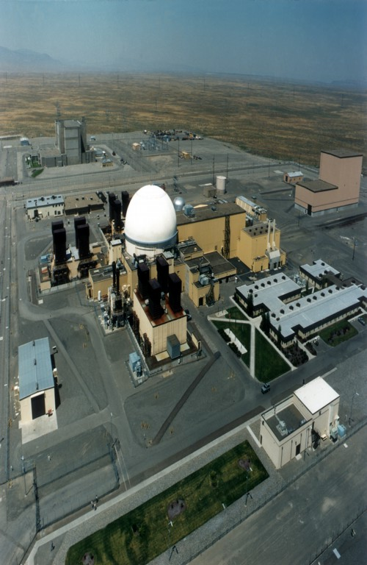
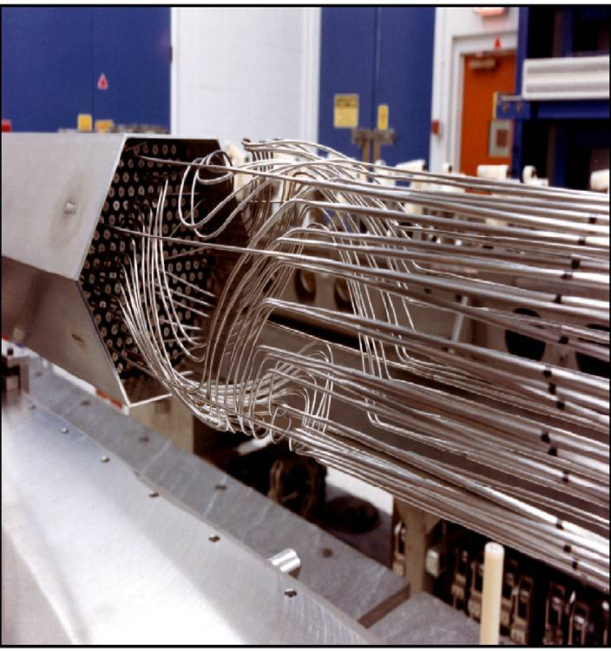
PNNL Experience Base
Fast Flux Test Facility (FFTF)
400MWth sodium cooled fast spectrum test reactor
Instrumented test assemblies
Reconstitutable test assemblies
Tests supported materials development, advanced reactor, transmutation, isotope production, space reactor, fusion, nuclear data
IEM cell - world’s tallest hot cell for examination, reconstitution, and maintenance
Liquid metal expertise – EM pumps, corrosion, cold traps for purification

Slide 26
PNNL Experience Base
Fusion Material Irradiation Test (FMIT)
35 MeV, 100 mA Deuteron accelerator on windowless flowing lithium metal target
US facility designed in 1980’s for fusion material irradiation tests.
Detail design and supporting tests completed and ready for construction when funding cut
Test assembly region designed for thousands of miniature material test specimens in one test
3.5 MW beam energy deposited in target (2 MW/cm³)
740 °C peak lithium temperature
33 liters/second flow rate

Slide 27
FMIT

Slide 28
FMIT High Flux Region Test Matrix

Slide 29
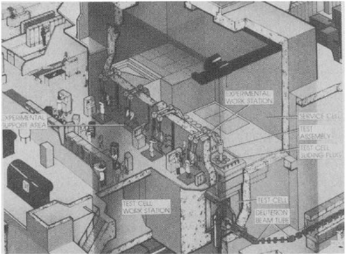
FMIT Vertical Test Assembly
Remote handling equipment design verified with full-scale mockups

Slide 30
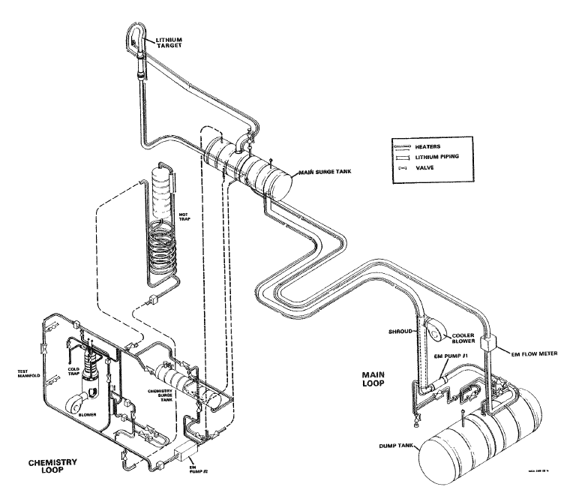
FMIT Lithium Test Loop
Full-Scale Mockup of FMIT lithium system
16,000 hours of safe reliable operation
Demonstrated satisfactory performance of system components: EM pump, target, purification and characterization systems, chemistry systems, argon systems, vacuum systems
Tested instrumentation, coolant chemistry, vapor/aerosol transport, corrosion

Slide 31
PNNL Capabilities
Engineering Development heritage
Facility design experience
Irradiation testing experience – FFTF, Tritium Target Program
Testing capabilities
Hazardous
Radioactive
Liquid metal
Path for waste disposal
Environmental Assessment
Licensing support
International collaboration
PNNL supports both DOE-Nuclear Energy programs and DOE-Office of Science programs

Slide 32
PNNL Tritium Target Testing Experience
Current program for design, irradiation, postirradiation examination of tests in ATR to support production
Identification of testing needs and incorporating results into production targets

Slide 33
Testing Program Follows Same Path as Fuel Development
Basic tests (TMED)
Ex-reactor testing to evaluate fundamental material properties
Separate-effects tests (TMIST-1, TMIST-2, TMIST-3)
In-reactor experiments evaluating effects of individual parameters
Allows development of performance models
Multiple-effects tests (some aspects of TMIST-3)
In-reactor experiments evaluating interactions of multiple parameters
Allows extension of model predictions to more prototypic conditions
Integral tests (e.g. TPBAR rodlet in ATR capsule or loop)
Verifies understanding of mechanisms and interactions
Identifies any remaining unknown phenomena
Full-size verification (LUA or Surveillance Rod)
Fully prototypic verification of scaling from integral test

Slide 34
PNNL Capabilities
Facilities and experience staff
RPL – Radiochemical Processing Laboratory (Hazard Category II nuclear facility)
MASF – FFTF Maintenance and Storage Facility (currently used for site waste cleanup testing and deveolpment
EMSL – Environmental Molecular Science Laboratory
APEL – Applied Process Engineering Laboratory
PSL – Physical Sciences Laboratory

