Slide 1
Project X – MAP
Task Force
Keith Gollwitzer
Accelerator Division
Fermilab
Project X Collaboration Meeting Oct 25, 2011

Slide 2
What is MAP?
Muon Accelerator Program
  Research and studies towards
    Neutrino Factory
    Muon Collider
  Recently established national program managed by Fermilab at DOE’s request
    Outgrowth from NFMCC & MCTF
    National Labs, Universities and SBIRs
    DOE is increasing research funds

Slide 3
Project X
Mission Goals
Provide a neutrino beam for long baseline neutrino oscillation experiments based on a capability of targeting at least 2 MW on proton beam power at any energy between 60-120 GeV.
Provide MW-class, multi-GeV, proton beams supporting multiple kaon, muon and neutrino based precision experiments. Simultaneous operations of the rare processes and neutrino programs are required.
Provide a path toward a muon source for possible future Neutrino Factory and/or Muon Collider.
Provide Options for implementing a program of Standard Model tests with nuclei and/or nuclear energy applications.
Project X: Accelerator Overview June 2011

Slide 4
Task Force
Steve Holmes and Steve Geer initiated a task force
Membership (see extra slide) comes from Project X and Muon Accelerator Program
Charge (see extra slide) is to outline a plausible solution to allow Project X become part of a Proton Driver
  Upgrade of Project X
    How affect RDR?
  Feasibility of proton beam reformatting
    Can it be done?

Slide 5
Proton Driver Requirement
IDS-NF
Muon Collider is same except
  1 Bunch per train at 12-15 Hz
Parameter | Value
Kinetic Energy | 5-15 GeV
Average Beam Power | 4MW (3.125 x 10¹⁵ protons/s)
Repetition Rate | 50 Hz
Bunches per train | 3
Total Time for bunches | 240 μs
Bunch Length (rms) | 1-3 ns
Beam Radius (rms) | 1.2 mm
Geometric Emittance (rms) | < 5 μm
β* at target | > 30 cm

Slide 6
Project X
Starting Point
CW Linac will support average beam current of 1 mA to 3 GeV
Pulsed Linac (3-8 GeV) will have a ~5% duty factor
Possible 8 GeV beam power of 320 kW
Programmable Chopper System (part of H- source) will provide appropriate bunch structure for the linac experiments as well as fill the appropriate part of the RF buckets in the accumulating Recycler Ring

Slide 7
Steps taken
With desired proton energy range, obvious to start with increasing beam power out of pulsed linac at 8 GeV
Project X upgrade
  Increase particles
    Per linac bunch & average beam current to 5 mA
  Increase pulsed linac duty factor
    Increase to 10%
Beam Reformatting
  Accumulation
    Stripping
  Bunch Compression
  Delivery to target
    Final Focus
    NF bunch train
    MC beam line trombone
Discussing instability limitation for rings

Slide 8
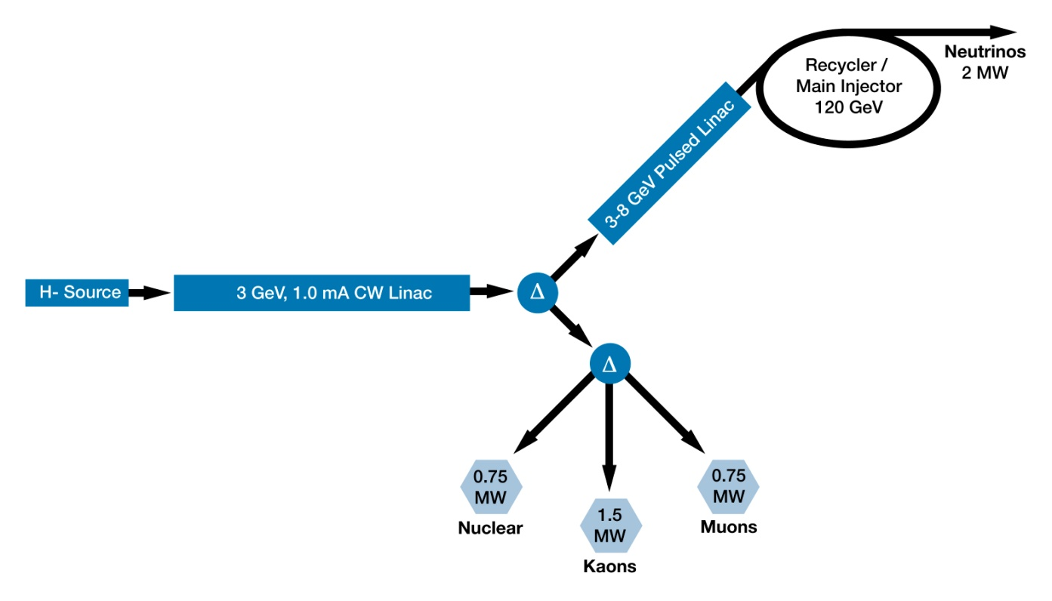
Proton Driver
Layout
4MW Target
Accumulator Ring
Compressor Ring
??
??
??

Slide 9

Project X Upgrade Proton Driver - 1
Front End (warm)
H- ion source, RFQ, MEBT, Programmable Chopper System
Initially 5mA
Run at 10mA (Ion source is capable)
Programmable Chopper
Capable of bunch by bunch 162.5MHz
Will suppress beam to limit beam current down stream to 5mA 1mA average
Entire front end is to be designed for 10mA

Slide 10
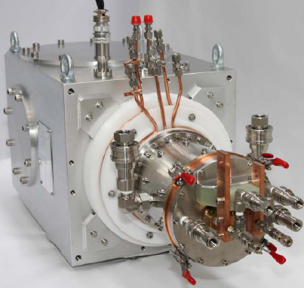
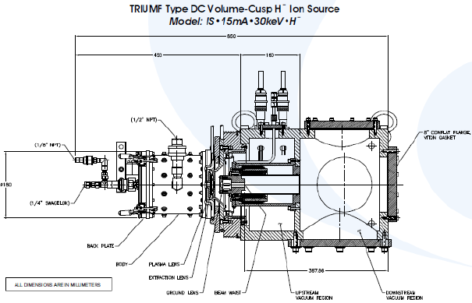
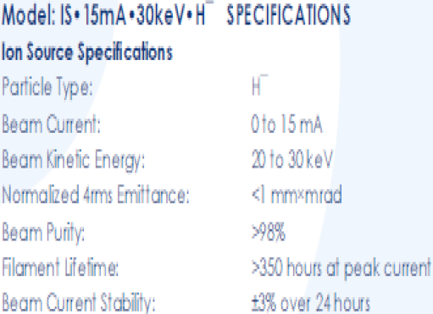
Ion Source

Slide 11
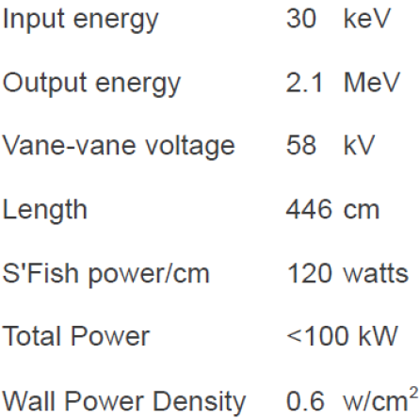
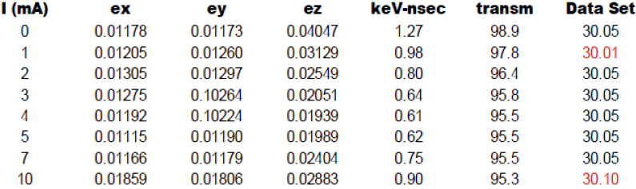
RFQ

Slide 12
Collimation
Systems designed to intercept beam will have to be able to handle the increased number of particles
  Factor of two prior to chopper system
  Factor of five downstream of chopper
Will also need to be able to handle increase in beam size
  See previous slide for 45-60% in RFQ

Slide 13
Project X Upgrade Proton Driver - 2
3 GeV CW SRF Linac
Average beam current 1mA 5mA
325 and 650MHz
Retuning of couplers to be efficient
May set initially for higher current

Slide 14
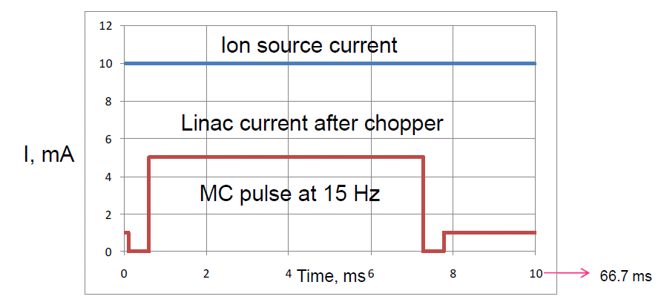
CW Linac
Worst Case
3 GeV physics program stay with average beam current of 1 mA.
  10% at 5 mA and 90% at 1 mA average current

Slide 15
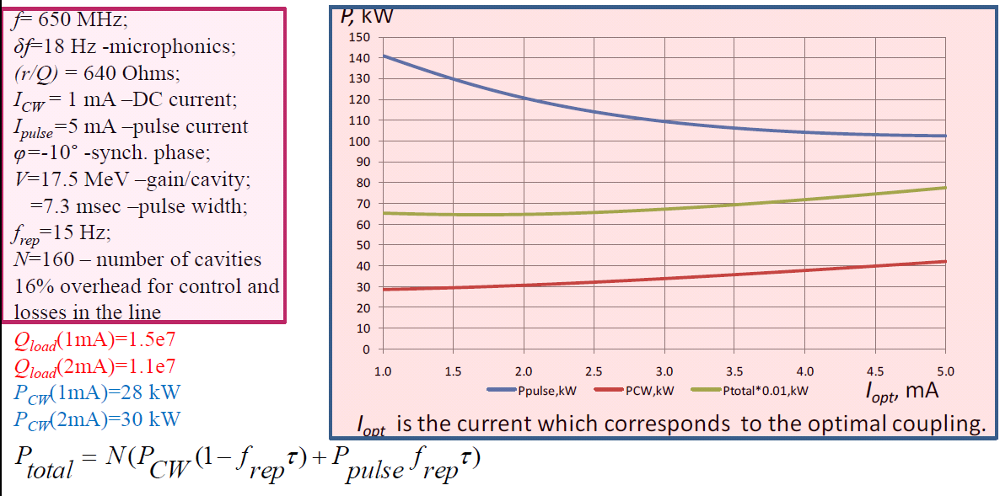
650 MHz RF Power

Slide 16
Project X Upgrade Proton Driver - 3
Pulsed Linac
1.3GHz SRF
3-8 GeV
10% 5% duty factor at 10Hz 15Hz
More RF power
Upgrade of couplers
More cryo capicity

Slide 17
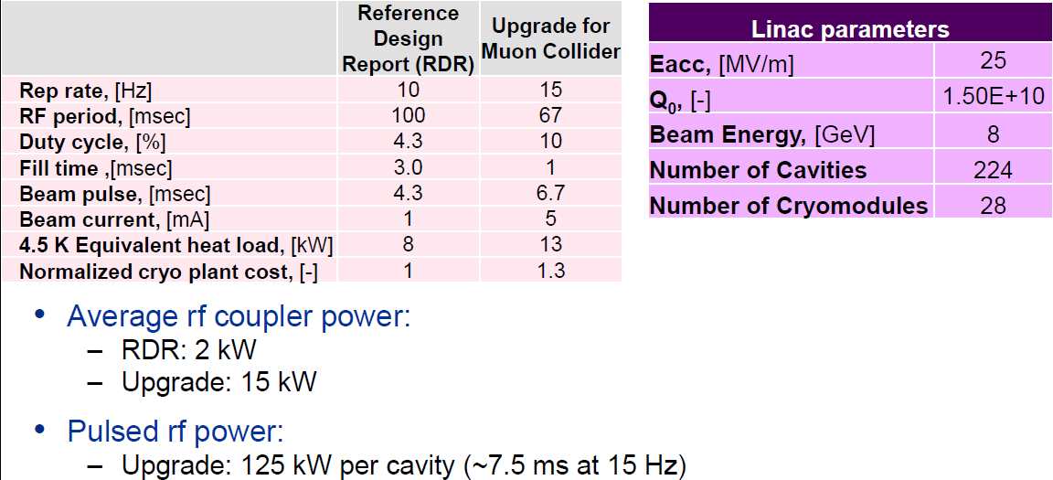
Pulsed Linac

Slide 18
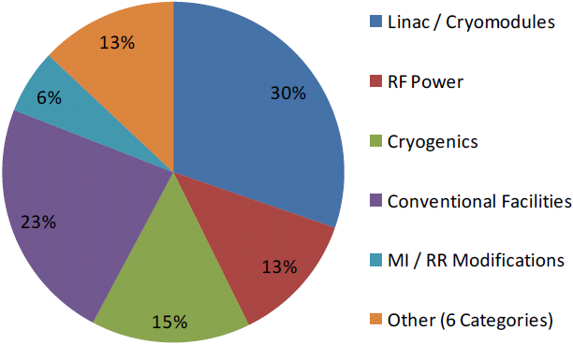
Project X Upgrade Proton Driver - 4
Conventional facilities
  More water cooling
  Building space
    More cryo capacity
    More Klystrons
An upgrade re-uses >75% of RDR cost

Slide 19
Rings’ Concepts
Simple numbers to start
  T_{rev} ~ 800 ns
  f_{rf} ~ 10 MHz
  h = 8
  Injection scheme
    ~50 ns beam ON followed by ~50 ns NO beam
Evolution of design
  Increase of circumference (~300m)
  Space for RF and Injection/Extraction components
  Concerns
    Injection: Stripping
    Instabilities
    Beam size in Compressor after bunch rotation
  Several designs and will settle on one

Slide 20
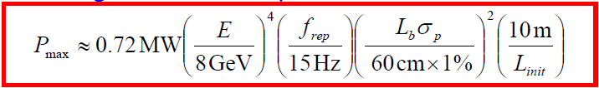
Longitudinal Instability
Lebedev has looked at stability criterion and rearranged terms to determine the maximum beam power per bunch
Final Bunch Parameters
(Compressor Ring)
Initial Ring Bunch Parameters
(Accumulator Ring)

Slide 21
Beam Delivery
Neutrino Factory example of 60Hz
  Accumulate beam at 15Hz in 12 bunches
  Transfer 3 bunches to Compressor ring
  Rotate bunches
  Extract to target a bunch every 120 μs
Muon Collider example of 15Hz
  Accumulate beam at 15Hz in 4 to 8 bunches
  Transfer all bunches to Compressor Ring
  Rotate bunches
  Extract all - sending each bunch to a different beam line - all arrive at target simultaneously

Slide 22
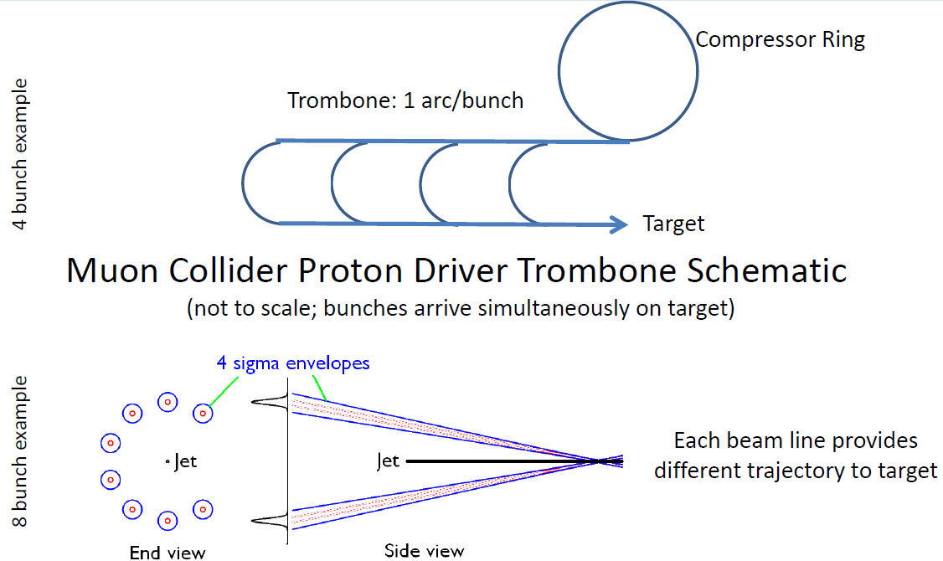
Muon Collider Trombone

Slide 23
Plan
Set rings and beam lines lattice
  Start studies of instabilities
Design final focus optics
  Design trombone delivery
Write Task Force report on feasibility

Slide 24
Extras

Slide 25
Task Force Membership
Alexahin, Yuri
Ankenbrandt, Chuck
Chase, Brian
Gollwitzer, Keith
Jenner, Leo
Kourbanis, Ioanis
Lebedev, Valeri
Nagaitsev, Sergei
Neuffer, Dave
Palmer, Bob
Popovic, Milorad
Yakovlev, Slava
Zisman, Mike

Slide 26
Charge
Neutrino Factories and Muon Colliders require high power (~4MW) proton beams with an energy in the range 5-15 GeV, packaged into short bunches (<3ns), incident upon a liquid Hg jet target. The required repetition rate differs between Neutrino Factories and Muon Colliders, the most demanding (lowest rate) being for a Muon Collider which typically requires a repetition rate of 12 Hz. It is desired that a viable scheme be identified that would enable Project X to be upgraded to meet these requirements.
The Project X – Muon Accelerator Program Joint Task Force should:
1. Identify the challenges.
2. Outline possible solutions, including basic calculations required to establish plausibility.
3. Identify the main technical challenges that must be met to implement the possible solutions.
4. Identify any changes to the existing Project X baseline design that are needed to make the possible solutions achievable.
An initial status report should be ready for presentation at the time of the Muon Collider meeting in Telluride (27 June – 1 July 2011). A final report should be completed by January 1, 2012.

Slide 27
Project X
H- Source
Composed of several pieces
  Ion Source
  RFQ
  Programmable chopper system
Parameters
  1.9x10⁸ particles/bunch
  162.5 MHz bunches out of RFQ
  Chopper system will limit beam to 1 mA average beam power over 1 μsec

Slide 28
Project X
Programmable Chopper
RFQ output will be 1.9x10⁸ particles per bunch at 162.5MHz
1μsec
Programmable Chopper can do any arbitrary pattern as long as the average cw linac current is <=1mA for 1μsec

Slide 29
Accumulation in RF buckets
Desire to have linac beam populate correct phase region of RF, programmable chopper will need to remove beam destined for wrong phase
Project X will populate +- 120 degrees

Slide 30
Chopping for injection (from Nagaitsev)
RF frequency at injection into the Recycler : ~53 MHz
Chopper needs to provide a kicker gap (~200 ns per 11 µs) and needs to remove bunches that fall into “wrong” phase of ring rf voltage.
162 MHz bunches to be removed
Recycler RF

Slide 31
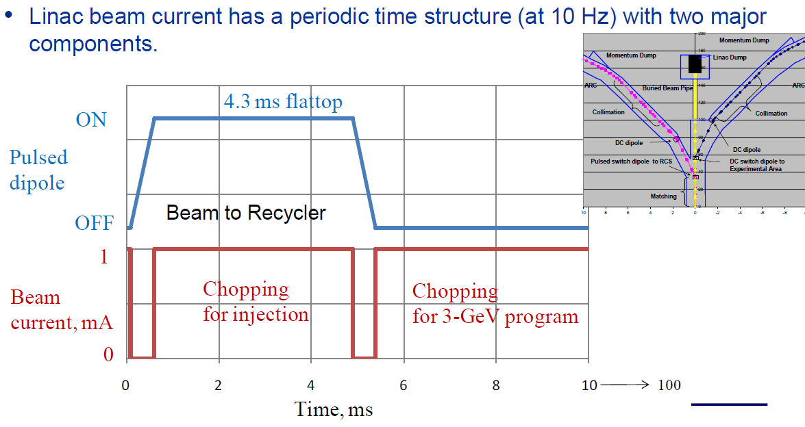
Chopping and Splitting
Average

Slide 32
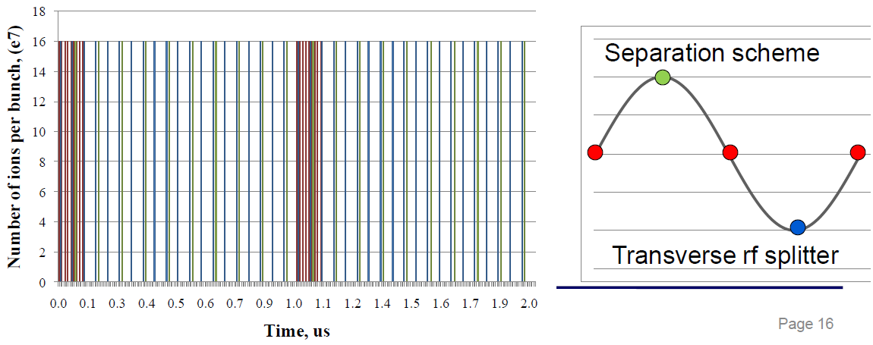
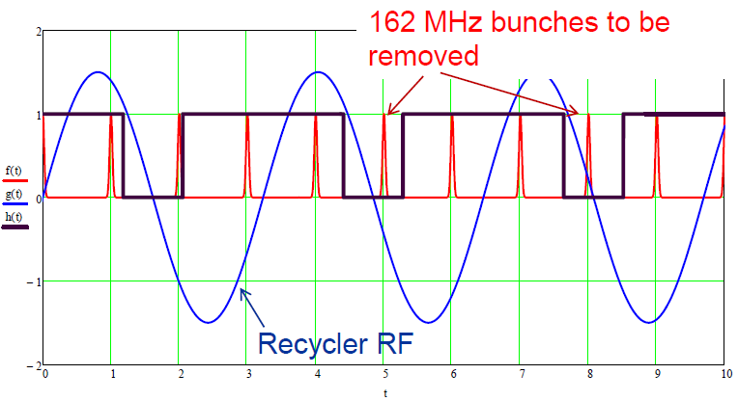
Fine Chopping
Average

Slide 33
Neutrino Factory
Upgrade Project X
  4 MW at 8 GeV
    Increase particles per linac bunch
    Increase pulsed linac duty factor
Repackage linac beam for ~60 Hz delivery
  Accumulator Ring
    Collect linac beam into bunches
  Compressor Ring
    Narrow bunches to <= 3 ns
  Single Bunch Transfer/Extraction

