Slide 1
Electron Cloud Experiments
Bob Zwaska
Fermilab
M. Backfish, D. Capista, K. Duel, N. Eddy, I. Kourbanis, T. McLaughlin,
D. Scott, C. Y. Tan, B. Tennis, C. Thangaraj, L. Valerio, X. Zhang
October 26, 2011
Project X Collaboration Meeting

Slide 2
Introduction
Electron Cloud experiments have been continuing
  Have been testing amorphous carbon from CERN
Plans for the long shutdown, or just before
  New, diamond-like carbon (DLC) coating from KEK
  SEY stations from Cornell
  Microwave measurements
Longer-term
  Measurements in a magnetic field

Slide 3
Electron Cloud Experimental Station
Initially installed summer 2009
2 experimental Chambers
  Identical 1 m SS sections, except that one was coated with TiN
  2010: TiN chamber replaced with amorphous carbon from CERN
4 RFAs (3 Fermilab & 1 Argonne)
3 microwave antennas and 2 absorbers
  Measure ECloud density by phase delay of microwaves
Primary Goal: validate coatings as potential solutions for Project X
Secondary Goals:
  Remeasure threshold and conditioning
  Further investigate energy-dependence
  Measure energy spectrum of electrons
  Test new instrumentation
  Directly compare RFA and Microwave
  Measure spatial extinction of ECloud
Coated Chamber
Fermilab RFAs
Uncoated Chamber
E:CLOUD3
E:CLOUD1
E:CLOUD2
Beam
E:CLOUD4
Microwave Antennas
Argonne RFA
Microwave Absorbers

Slide 4
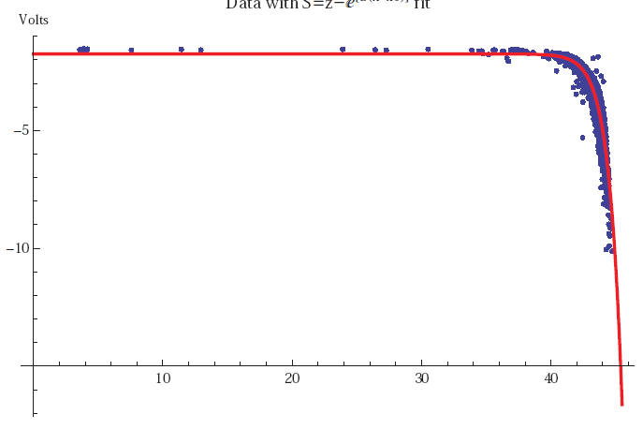
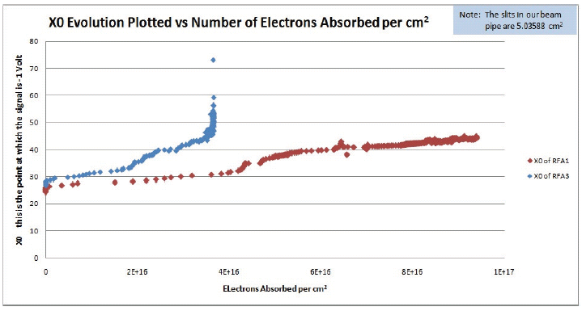
TiN Data
Data collected 2009-2010
  Data measured on every cycle
  Thresholds calculated daily
Thresholds increase over time
  Best measure is the total absorbed electron dose
    Integration under the data curve from the RFAs
Increase of threshold is evidence of conditioning
  Surface chemistry is changing to our advantage
  Limited by the available intensity in the Main Injector
    ECloud eventually disappeared for TiN
    Continued at a low level for stainless
Beam Intensity (e12)
TiN
SS

Slide 5
Conditioning in MI
Why does the material condition well in MI?
  Especially, in comparison to other proton rings like PSR or SNS
The major differences are the beam RF structure and the acceleration cycle
  MI h=588 vs h=1 for SNS & PSR
  MI has high-intensity beam for ~ 50,000 revolutions each second
    SNS & PSR have only a few hundred or thousand turns
In total, the same maximum cloud densities in the machines will produce at least 10,000 times more electron flux at the beam pipe of the Main Injector than the others
  The dose is too low at other machines to condition in a similar way

Slide 6
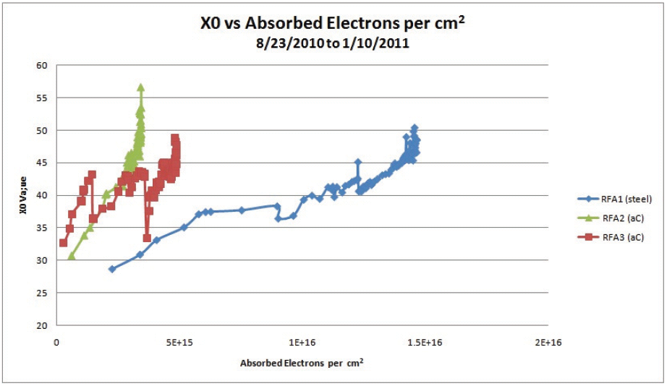
Carbon Pipe
Tests were interrupted by a vacuum leak
  Small leak at the edge of carbon pipe
  Seems to have poisoned a portion of the surface
    Detector close to leak saw behavior that was worse than SS until very late in conditioning
    Detector further away showed behavior more similar to TiN
Conclusions are ambiguous:
  Carbon conditions like TiN
    Maybe a bit worse
    Absolutely does require conditioning
  Carbon is perhaps fragile
    Will investigate surface after run
CERN is very interested in amorphous carbon
  See it as superior to TiN in perhaps not requiring as much conditioning
They built a chamber for us in short order and we installed it in the MI in 2010
  Replacing our TiN test chamber
  Conditioning history made like with TiN
Initial results were similar to TiN (required conditioning)

Slide 7
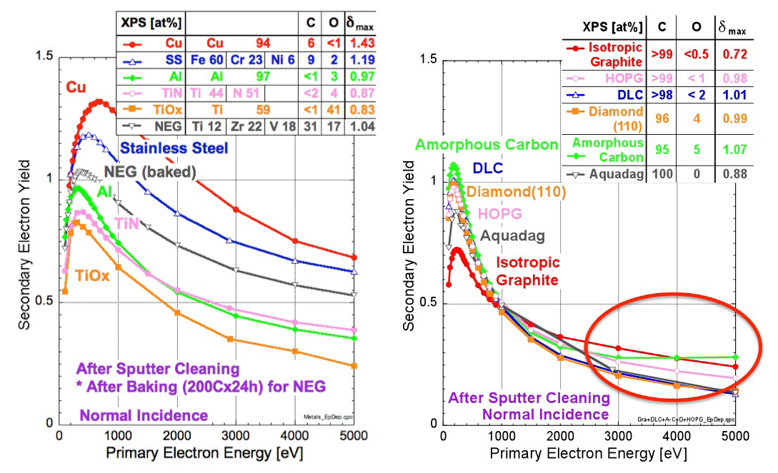
DLC (KEK)

Slide 8
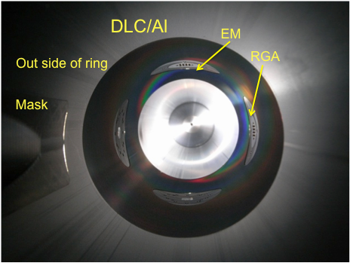
DLC Application
React acetylene brew in the pipe
  No magnetic field
  No sputtering
  Est. $800 / m
  Temperature needed is the question
KEK is building pipes to replace our present test chambers
  Our specs, but Japanese parts
They will do coating, and we expect to have these at the start of the year
  Install in long shutdown

Slide 9
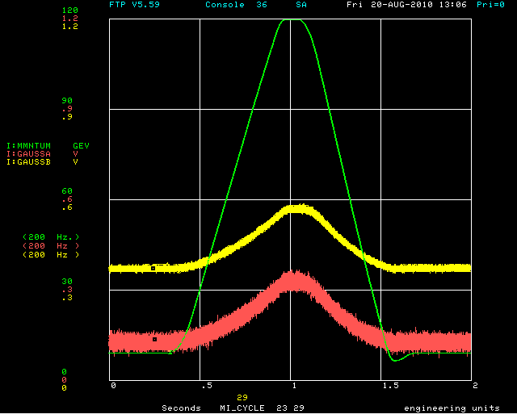
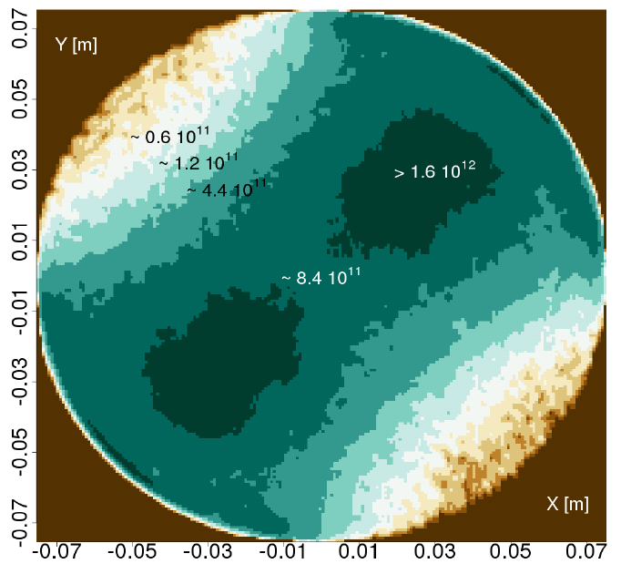
Issue with Measurements
Have always had an odd energy-(time-)dependence of cloud flux
  Difficult to explain by either simulation or first principles
Issue may be a time-dependent magnetic field in the area
  A few gauss is not enough to affect the RFA (bench tests & sims)
  However, it is enough to distort the cloud dynamics in the beam pipe
Future installations
  We will shield with mu-metal, but it is very difficult to get to the sub-gauss fields needed for pristine dynamics
  Real answer is that most of our accelerator is in a magnetic field, and the cloud is much better defined in that case, we should try to measure that way
Measured Time-dependent field of 3 Ga
Simulation of 10 Gauss

Slide 10
Direct SEY Measurement
SEY measurement station from Cornell
  Adapted from SLAC
  Allows in situ measurement of SEY on samples
Place sample “buttons” of materials as portion of beampipe circumference
  Beampipe made of standard materials – for us: Stainless 316L
Directly measure the SEY of the sample
  SLAC did this by removing the button and testing in a surface physics lab
  At Cornell, it has been modified for in situ measurement
Will allow comparison between conditioning in electron/positron ring and our proton ring
Other considerations:
  Change pieces without breaking accelerator vacuum
  Monitor electron flux for scrubbing history
  Differential scrubbing can be factored out
Stations have been built and we are preparing for installation

Slide 11
In Situ SEY TestStand
Test Position
Isolation Valve
Linear Motion in vacuum
Sample
Electrical isolation
Electron Gun

Slide 12
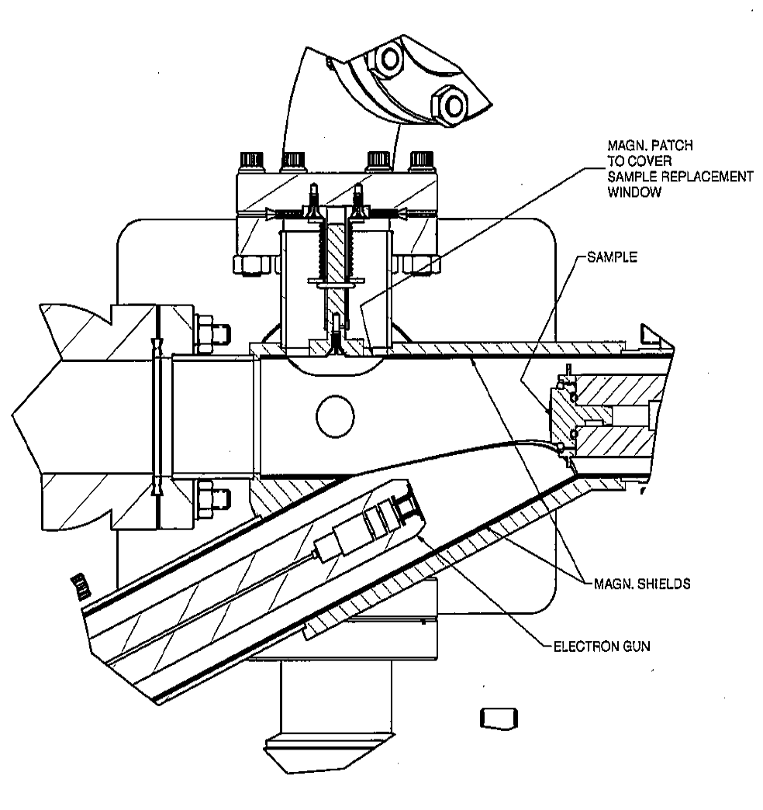
SEY Measurement
Sample is withdrawn from beampipe
Sample holder is electrically isolated from ground
  Attached to picoammeter
  Biased at -20 V to repel secondaries
Gun is permanently installed in setup
Power supply brought in for measurements
LabView controls the gun through the SEY scan
  Can include rastering across surface
  Picoammeter read out simultaneously
Scan should take ~ 30 minutes
  Still being optimized, could be longer or shorter
  Need to understand gun cathode heating time

Slide 13
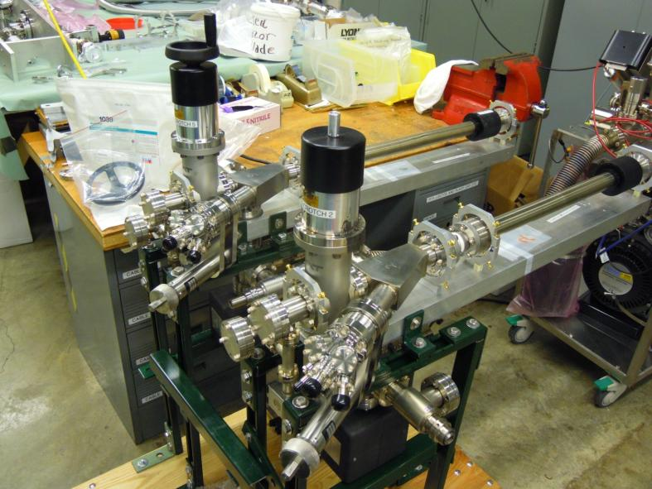
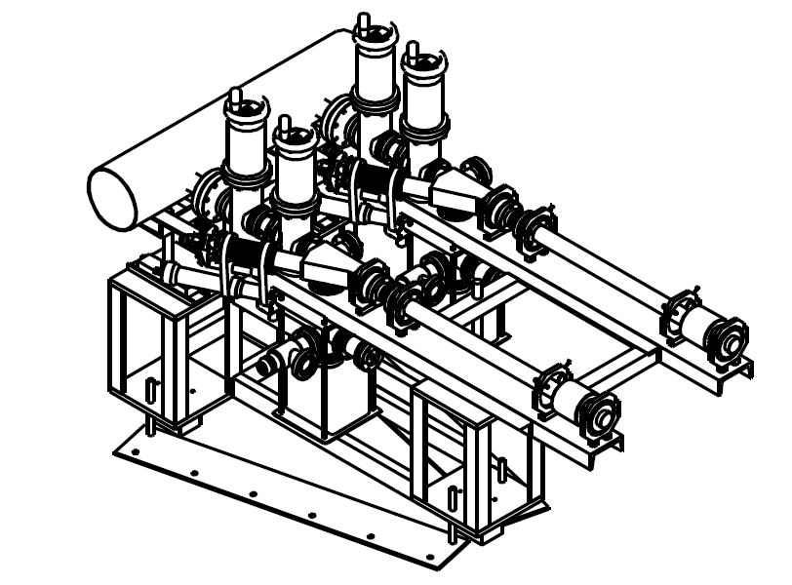
SEY Station Prep
Arms being staged at A0
  Have been pumped down for a few weeks
  Full integration with beam pipe is starting now
  Plan to do several test measurements and practice sample changeouts
On temporary stand now
  Final stand will allow simple installation to MI

Slide 14
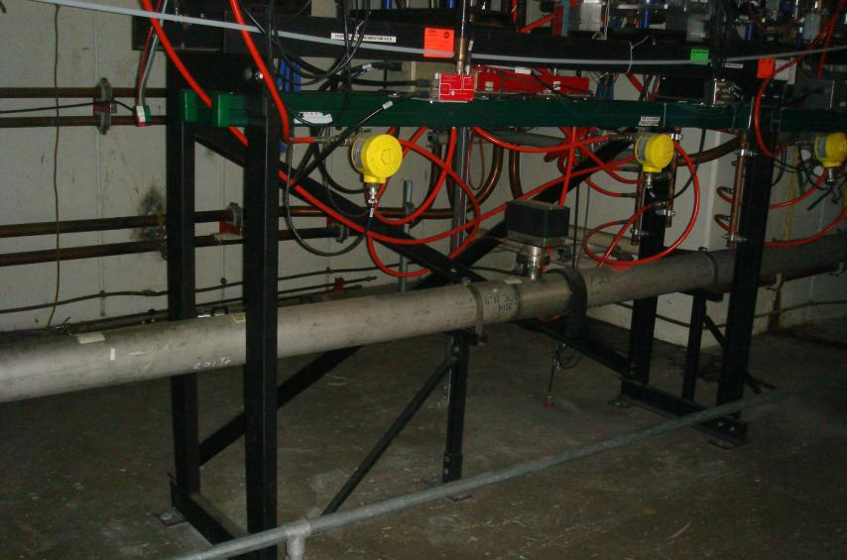
SEY Station Installation
Install in a MI-10 straight section
May require removal of stochastic cooling tanks
  Part of ANU plans
Also looking into providing dry nitrogen to keep ceramics from absorbing moisture
Need to prepare final buttons and coatings

Slide 15
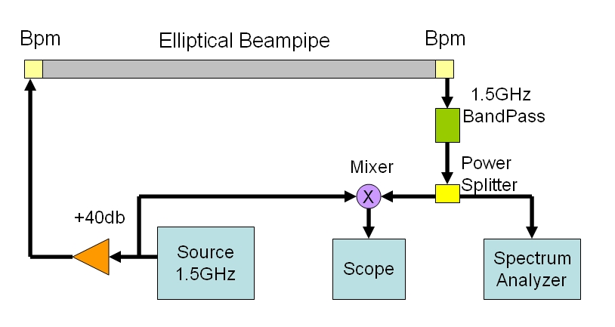
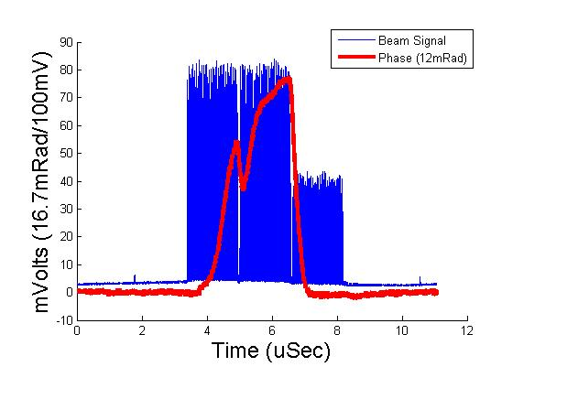
Microwave Measurements
ECloud induced phase shift
  Carrier is injected with BPMs at just above the cutoff for the elliptical beam pipe
  Beam modulates the ECloud
  ECloud cause PM of carrier
  PM accumulates over the distance
Sideband, zero-span, and direct phase measurements
  Sidebands come from modulation, give intensity (convolved with harmonic information)
  Zero-span gives a cycle-wide measurement of intensity
  Very good time-resolution with direct phase
    Issue is getting enough transmission
Allows measurement in dipole sections
  No room for RFAs in Main Injector Dipoles

Slide 16
Problems with Microwave Measurements to Date
The microwave technique is initially attractive, but suffers two significant flaws:
  Non-Locality: the measurement will most often not be representative of the targeted area, but a much larger expanse of beam pipe
  Normalization: a direct extraction of the electron density has been elusive
Chief problem is reflection
  Propagating a wave slightly above cutoff is asking for reflections
    Numerous reflections inside and outside of the target region create many, longer paths from the transmitter to the receiver
Observed this with the placement of ferrite absorbers around the measurement region
  Transmission of carrier dropped x20, and ECloud modulation was not extractable
I do not believe any of the microwave measurements
  They do probably see ECloud, but we can’t know where and how much
Planning for a new installation:
  Create a “cavity” with obstructions in the beam pipe, only slightly narrowing the aperture
    Prevents carrier from escaping the measurement region, providing locality
    Allows use of a carrier further above the beampipe cutoff
  Use reflections within the cavity to enhance the signal in a controlled way
    Allow normalization
  Test stand has been built, and we are testing out concepts

Slide 17
Other Plans
Magnetic fields
  ECloud measurements in fields are better controlled and more relevant
    But, much less convenient
  We are procuring the Tevatron IPM system – plan to make use of at least the dipoles
  Can make RFAs to fit within dipoles
  The gold standard would be a device to measure SEY conditioning of buttons exposed to a magnetic field

Slide 18
Simulation – P. Lebrun
This talk is not about simulation, but it is relevant to what we do
Have had extensive input from several codes, two make most of the impact:
  VORPAL (Tech-X & P. Lebrun)
  POSINST (M. Furman, LBL)
Paul has put a lot of effort into benchmarking the two codes
  Has put in a number of fixes to POSINST that allow it to run for very intense ECloud production
    Also a few that made it more correct
  Has developed 2D & 3D versions of VORPAL
  Still sees some difference in the center of the beam
    Likely an effect of electric field modeling

Slide 19
Summary
Experiments have shown that MI pipe and coatings condition with beam exposure
  Coatings condition more quickly and effectively than bare beam pipe
    Both TiN and amorphous carbon appear similar, though carbon may be more susceptible to contamination
  Ultimate conditioning has been limited by beam intensity
  Coating is a viable option for the Main Injector
    Lingering questions are whether it is necessary, and what procedure is best
Further experiments are in the plans
  SEY station to be installed in the next year (as available)
  New microwave technique may be ready
    We think that all previous measurements are invalid
  Looking at options for measurements in magnetic fields
Simulation is an important input
  Using mostly local resources now

Slide 20
Electron Cloud Experiments
Bob Zwaska
Fermilab for M. Backfish, D. Capista, K. Duel, N. Eddy, I. Kourbanis, T. McLaughlin,
D. Scott, C. Y. Tan, B. Tennis, C. Thangaraj, X. Zhang
October 26, 2011
Project X Collaboration Meeting

