Slide 1
Cryogenic BPM Pickups for PXIE HWR ‒ First Thoughts and Discussion ‒
Project X 2011 Fall Collaboration Meeting
October 25-27, Fermilab, Batavia, IL
Manfred Wendt
Fermilab

Slide 2
PXIE Beam Parameters & HWR BPM Requirements
Max. bunch frequency | 162.5 MHz
Nominal bunch charge | 30 pC (1.9x10⁸ H⁻)
Dynamic range | 3 – 60 pC per bunch
Transverse beam size (typically) | ~1 mm RMS
Longitudinal beam size (typically) | ~ 3 deg. RMS @ 162.5 MHz (~50 psec)
Minimum integration time | ~ 123 nsec (20 bunches) ???
Beam position accuracy | <0.5 mm
BPM offset | <1.0 mm (w/o BBA)
Position resolution | ~30 μm (@ ?? integration time)
Phase resolution | ~0.1 deg. (@ ?? Integration time)
Beam pipe aperture | Circular, ~30 mm ID (???)
BPM pickup real estate (length) | ~50 mm ??? (as short as possible!)
Environmental requirements | 2-10 K operating temperature, UHV, clean-room class 100 certification

Slide 3
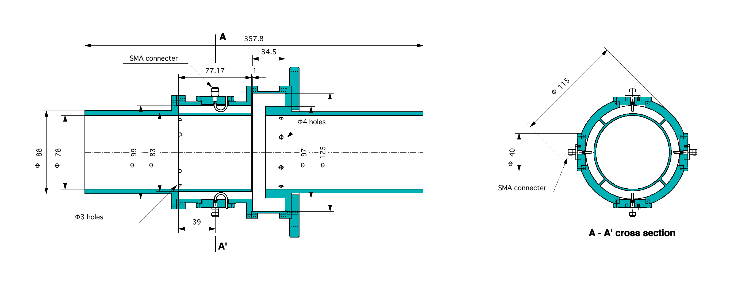
Cold Re-entrant BPM
KEK improved re-entrant BPM design, based on CERN / Saclay
< 1 μm resolution
2 GHz low-Q WG-loaded coaxial resonator
Cryogenic, UHV and clean-room compatible
Needs substantial R&D to be scaled to PXIE beam parameters
(Too) large physical dimensions (length!)

Slide 4
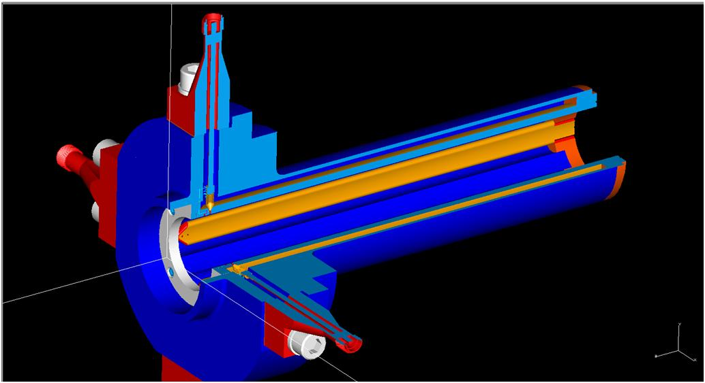
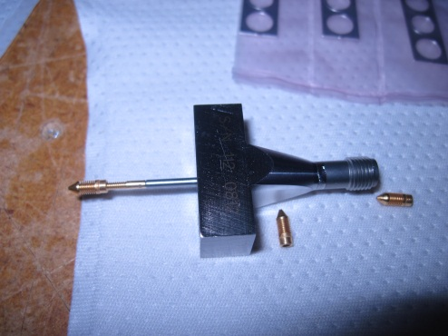
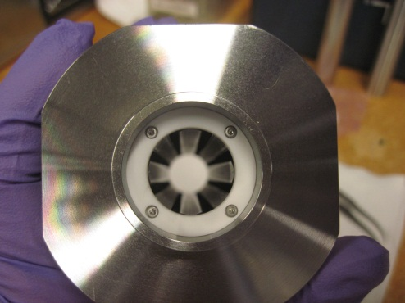
Stripline BPM
Complete prototype developed for HINS
Located inside the cold solenoid, not much extra space required.
Electrical length matched to the 2nd (325 MHz) bunch harmonic.
Feedthroughs and other long lead time parts are in quantities in house!
Requires some mechanical redesign.
Requires a larger bore of the SC solenoid!

Slide 5
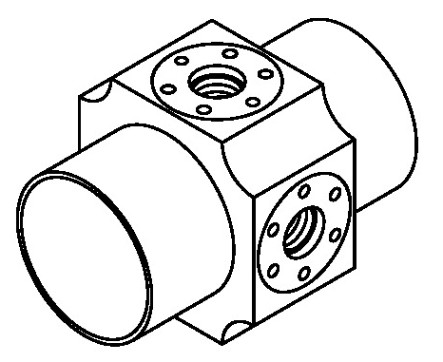
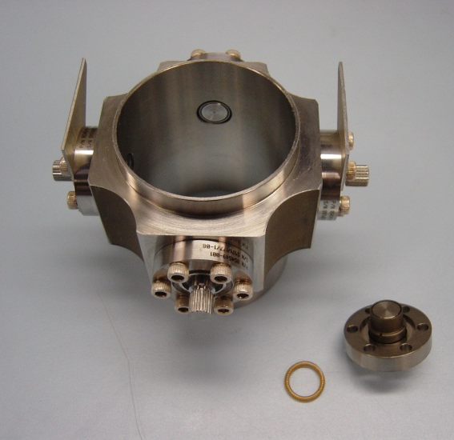
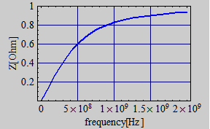
Button BPM
Compact, simple design
Based on commercial UHV RF button feedthroughs, standard, or custom made to specs (Al₂O₃ or glass-ferrite dielectric)
Well known properties (numerical simulation)
Meets environmental requirements
Design based on Meggitt (Kaman) feedthroughts
Currently tested in CM-1, but known to be not optimal for linac operation
$$Z_{button}\left(ω\right)=\frac{V_{out}(ω)}{I_{beam}(ω)}=φ R_{load}\left(\frac{ω_{1}}{ω_{2}}\right)\frac{\left(ω_{1}/ω_{2}\right)}{1+{\left(ω/ω_{1}\right)}^{2}}$$
$$ω_{1}=\frac{1}{R_{load} C_{button}}$$
$$ω_{2}=\frac{v_{beam}}{2 r_{button}}$$
$$ϕ=\frac{r_{button}}{4 R_{pipe}}$$

Slide 6
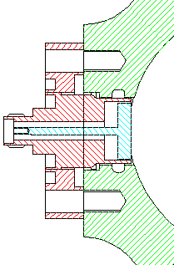
Coupling Impedance
Longitudinal coupling impedance
Additional effects due to the annual button-ground gap
TE₁₁ gap waveguide resonance at:
Try to minimize wake potential: (not required for proton linacs!)
Reduce r_{button}
Minimize w_{gap}
$$Z_{∥}=\frac{1}{I_{beam}(ω)}\int_{0}^{2πR}{E_{z}\left(ω\right)dz≈φ\frac{ω_{1}}{ω_{2}}Z_{button}(ω)}$$
$$w_{gap}$$
$$Z_{∥gap}≈\frac{Z_{0}ω{\left(r_{button}+w_{gap}\right)}^{3}}{8c_{0}R_{pipe}^{2}\left\{ln\left[32\left(r_{button}+w_{gap}\right)/w_{gap}\right]−2\right\}}$$
$$d_{button}$$
$$λ_{TE11}=2π\frac{r_{button}+\left(r_{button}+w_{gap}\right)}{2}$$

Slide 7
Meggitt Button Feedthrough

Slide 8
SST XFEL Button Feedthrough

Slide 9
HWR BPM Pickup Options
Stripline BPM inside the solenoid
Requires a larger bore of the solenoid.
Complicated mechanics compared to a button style BPM.
Better transfer impedance (2-3 times) than a button BPM.
Requires substantial mechanical engineering to scale the HINS design. Currently no ME support available at Fermilab!!
Feedthroughs and other long lead-time parts are in house!
Button BPM Pickup
Requires some minimum mechanical engineering.
Need to all purchase button feedthroughs, seals, contact springs, etc., $2,500 – $3,000 value per BPM.
Need to verify output level (S/N-ratio) at 3 pC / bunch for Meggitt and SST button electrode.

