Slide 1
Hardware Trends in HPC
A Report from SC2011

Slide 2
Credits
These slides were extracted from tutorials and technical presentations at SC2011. Copyrights retained by the original authors.
Michael McCool, Arch Robinson and James Reinders from Intel Software to appear in the book “Structured Parallel Programming Using Intel® Parallel Building Blocks”.
Michael Wolfe, Portland Group
Jeffrey Vetter, Georgia Tech and ORNL

Slide 3
Hardware Evolution: Transistors on a Chip
Moore’s Law continues:
Doubling of transistor density
every two years

Slide 4
Hardware Evolution: Clock Rate
Clock rate plateau:
Since about 2004, clock
rate growth has been flat.

Slide 5
Hardware Evolution
There are limits to “automatic” improvement of scalar performance:
The Power Wall: Clock frequency cannot be increased without exceeding air cooling.
The Memory Wall: Access to data is a limiting factor.
The ILP Wall: All the existing instruction-level parallelism (ILP) is already being used.
→ Conclusion: Explicit parallel mechanisms and explicit parallel programming are required for performance scaling.

Slide 6
Hardware Parallelism: Cores and Threads
Parallelism growth:
Number of hardware threads
(cores and hyperthreads) has been
growing dramatically since 2002.

Slide 7
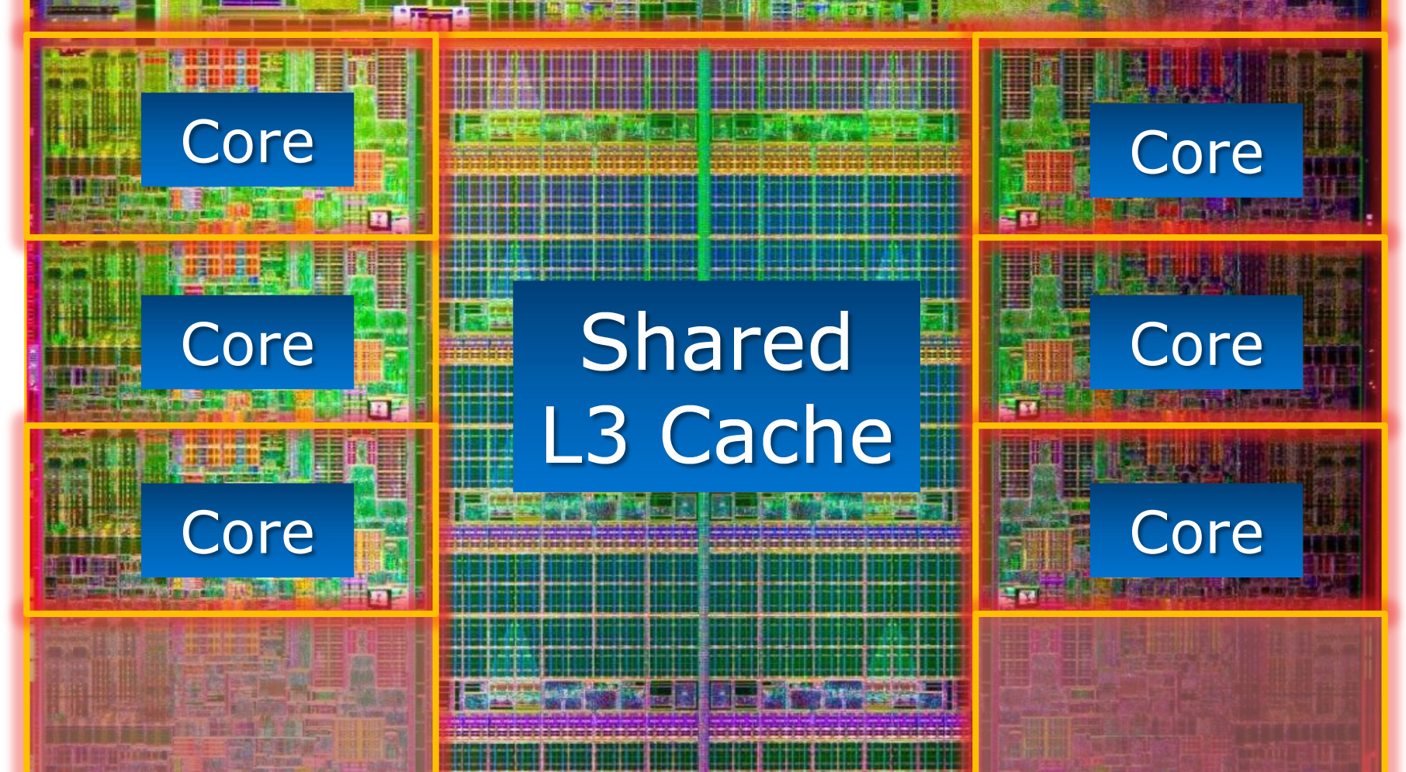
Intel Sandy Bridge
Photo: desktop die with two cores disabled
Intel Sandy Bridge: 8 cores / 16 threads
AMD Interlagos: 8 cores / 16 threads

Slide 8
TOP500: Cores per Socket

Slide 9
TOP500: Cores per Socket
500 systems total

Slide 10
More Cores: Cache Hierarchy

Slide 11
Vector Parallelism: Register Width
Parallelism growth:
Width of registers has also been
growing dramatically over time.
Vector Instruction sets e.g.: SSE4.x, AVX, FMA

Slide 12
Typical System Architecture
Cache hierarchy
NUMA
MPI
Heterogeneous (GPU) computing

Slide 13
Key Factors
Compute: Parallelism
What mechanisms do processors provide for using parallelism?
  Implicit: instruction pipelines, superscalar issues
  Explicit: cores, hyperthreads, vector units
How to map potential parallelism to actual parallelism?
Data: Locality
How is data managed and accessed, and what are the performance implications?
  Cache behavior, conflicts, sharing, coherency, (false) sharing; alignments with cache lines, pages, vector lanes
  NUMA
How to design algorithms that have good data locality?

Slide 14
Heterogeneous Computing the GPU Rationale
Heterogeneous Computing with Graphics Processors
Leverage commodity
High Flop per Watt
Productivity
CUDA
OpenCL
Reliability at Scale
High DP Flop Rate
Very High Memory Bandwidth
High SP Flop Rate

Slide 15
GPU capacity comparisons

Slide 16
TOP500: Accelerators

Slide 17
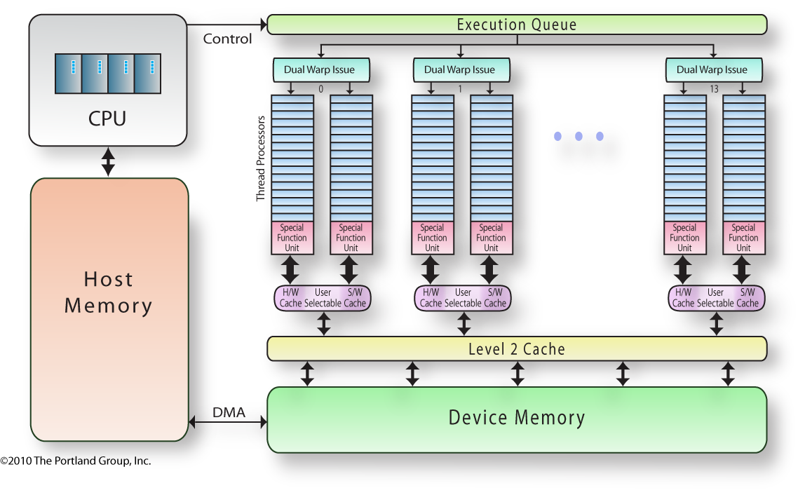
Abstracted x64+ Nvidia Fermi Architecture
Notes:
Relevant GPU architectural features:
massively parallel thread processors – up to 512 of them, organized into
multiprocessors; physically, there are two groups of 16 thread processors in each of 1
or 2 or 4 or 8 or ... or 16 multiprocessors. Logically, there are 32
thread processors in a group, called a warp. There is another level
of parallelism, the multiprocessors support multithreading, so many threads
from the same thread block or from multiple thread blocks may alternate
execution on the multiprocessor. Each multiprocessor issues one or two warp
instructions at a time.
The user manages the parallelism on the GPU. When you run a program
on the GPU, it runs in a grid of thread blocks. The grid is spread over the
multiprocessors; the grid may be large, even huge. A single thread block
is assigned to a single multiprocessor; the size of a thread block is limited,
at most 512 threads/block. The threads in a thread block are executed in
groups of 32, called a warp. The threads in a thread block may synchronize
with each other. Threads across the grid may not.
User also manages the memory hierarchy on the GPU, moving data
from the host to device memory, from variables in device memory to
varialbes in shared memory, or to variables that the user hopes will
get assigned to registers.
Your program has two components: a host part, and the GPU part.
The host part is in control; the host program issues commands to the
GPU and may continue asynchronously (or not). It may wait for completion
of the GPU part. The host essentially issues commands to the GPU command
queue, and the GPU executes these in order.

Slide 18
GPU Architecture Features
Optimized for high degree of regular parallelism
Classically optimized for low precision
  Fermi supports double precision at ½ single precision bandwidth
High bandwidth memory (Fermi supports ECC)
Highly multithreaded (slack parallelism)
Hardware thread scheduling
Non-coherent software-managed data caches
  Fermi has two-level hardware data cache
No multiprocessor memory model guarantees
  some guarantees with fence operations

Slide 19
Tesla-10 Features Summary
Massively parallel thread processors
  Organized into multiprocessors
    up to 30, see deviceQuery or pgaccelinfo
  Physically: 8 thread processors per multiprocessor
  ISA: 32 threads per warp
  Logically: Thread block is quasi-SIMD
Memory hierarchy
  host memory, device memory, constant memory, shared memory, register
Queue of operations (kernels) on device

Slide 20
Fermi (Tesla-20) Features Summary
Massively parallel thread processors
  Organized into multiprocessors
    up to 16, see deviceQuery or pgaccelinfo
  Physically: two groups of 16 thread processors per multiprocessor
  ISA: still 32 threads per warp, dual issue for 32-bit code
Memory hierarchy
  host memory, device memory (two level hardware cache), constant memory, (configurable) shared memory, register
Queue of operations (kernels) on device
ECC memory protection (supported, not default)
Much improved double precision performance
Hardware 32-bit integer multiply

Slide 21
Parallel Programming on CPUs
Instruction level parallelism (ILP)
  Loop unrolling, instruction scheduling
Vector parallelism
  Vectorized loops (or vector intrinsics)
Thread level / Multiprocessor / multicore parallelism
  Parallel loops, parallel tasks
  Posix threads, OpenMP, Cilk, TBB, .....
Large scale cluster / multicomputer parallelism
  MPI (& HPF, co-array Fortran, UPC, Titanium, X10, Fortress, Chapel)
Notes:
Compilers manage most of the ILP
users can help, or at least not hinder
large-scale parallelism is a topic for another forum
Let’s focus on thread-level parallelism

Slide 22
Parallel Programming on GPUs
Instruction level parallelism (ILP)
  Loop unrolling, instruction scheduling
Vector parallelism
  CUDA Thread Blocks, OpenCL Work Groups
Thread level / Multiprocessor / multicore parallelism
  CUDA Grid, OpenCL
Notes:
Compilers manage most of the ILP
users can help, or at least not hinder
large-scale parallelism is a topic for another forum
Let’s focus on thread-level parallelism

