Slide 1
Optical Communications for Future Trackers
ANL/FNAL/UC/VWS Meeting
Nov. , 2011
Alan Prosser
CD/ESE
Fermilab

Slide 2
Optical Communications for Future Trackers
Motivation
Future trackers will require more on-detector communications bandwidth than
is conveniently available from current optical transceivers (even arrays)
Increase in on-detector bandwidth requirements must be provided within
thermal and mass budgets
Past issues with VCSEL reliability indicate that a new approach NOT based upon
on-detector laser sources may be favorable
Proposed Solution: A 40 Gbps (per single mode fiber) link combining:
1. Rad hard optical modulator device technology
2. Coarse Wavelength Division Multiplexing

Slide 3
Optical Communications for Future Trackers
Track Trigger Architecture – An Example
Aggregate Bandwidth/sector = 576 Gbps/sector
Assuming 10 Gbps links: 58 optical transmitters/sector (too big, too much heat)
Source: “Track Trigger System”, Marvin Johnson, April 2010 presentation

Slide 4
Optical Communications for Future Trackers
Evolution of Versatile Link for ATLAS/CMS
Phase III R&D targeting:
1. Low Power GigaBit Transceiver (LP-GBT)
2. Small Footprint Versatile Link Transceiver (SF-VL)
The characteristics of links based on these components would be:
1. Low power laser driver for a 5 Gbps VCSEL-based transceiver
for tracker applications
2. 10 Gbps optical engine (VCSEL array) and package for calorimeter
applications
We propose to take the next step with a Modulator Based Array

Slide 5
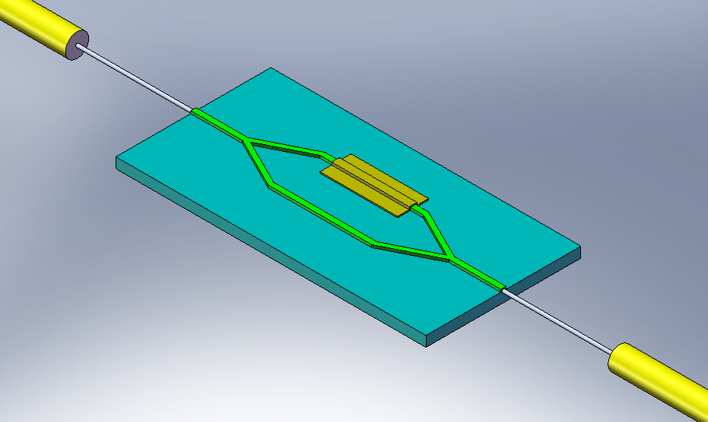
Mach-Zehnder Modulator (MZM)
Phase Control
V_{mod}
10-40Gbps Data Rate
Input Fiber:
CW laser
3dB Optical Splitter
Output Fiber:
10-40Gbps signal
InP substrate
Rad Hard Mach Zehnder Modulator
Intensity modulation achieved through phase shift of optical wave along one leg of
interferometer (phase control electrode)
Input laser operates as a continuous wave source located off detector (reduced detector
thermal load)
Compact rad hard assembly needed (current COTS devices are rather large)
High data rates achievable (10 Gbps – 40 Gbps in current devices) with minimal power dissipation

Slide 6
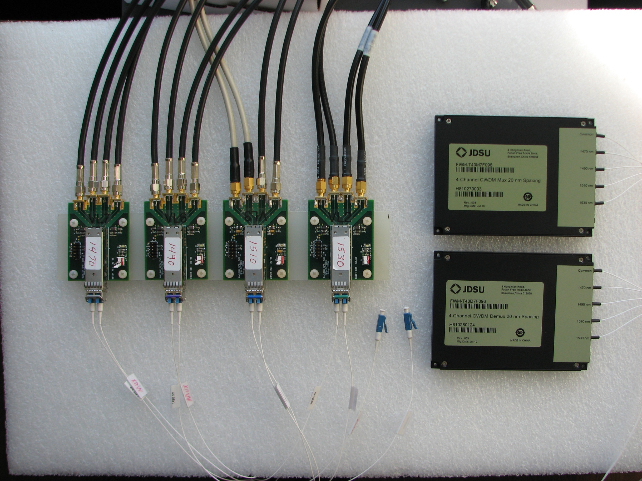
CWDM Modulator System
+
MZM x 4 (40 sq mm target)
COTS CWDM Components
40 Gbps line rates are a challenge (design, testing, costs)
Solution – Combine MZ Modulators (4) with Coarse Wavelength Division Multiplexing (CWDM)
10 Gbps line rates can be tested with our current equipment
Use of multiple line wavelengths and modulators reduces single point of failure issues
Wavelength implicitly encodes address of data source

Slide 7
Collaborators, Tasks, Contributions
Proof of Concept (Test System)
Collaborators:
Argonne National Laboratory (organization)
Fermi National Accelerator Laboratory (organization)
University of Chicago (organization)
Vega Wave Systems (Commercial partner)
Tasks:
Test System Design and Assembly (Partner)
Lab Performance Testing (Partner)
Radiation Testing (Partner)
Documentation of Results and Presentation (All)

Slide 8
Mach-Zehnder CWDM Demonstration System
All Single Channel Devices
SFP (Tx)
SFP (Rx)
1470 nm
SMF
COTS MZM
SMF
SMF
1470 nm
LVDS
Rx0
CW
10 Gbps
10 Gbps
10 Gbps
Driver_Tx0
1490 nm
SMF
COTS MZM
SMF
SMF
1490 nm
LVDS
Rx1
CW
10 Gbps
10 Gbps
10 Gbps
Driver_Tx1
CWDM
Mux
SMF
CWDM
DeMux
40 Gbps
1510 nm
SMF
COTS MZM
SMF
SMF
1510 nm
LVDS
Rx2
CW
10 Gbps
10 Gbps
10 Gbps
Driver_Tx2
1530 nm
SMF
COTS MZM
SMF
SMF
1530 nm
LVDS
Rx3
CW
10 Gbps
10 Gbps
10 Gbps
Driver_Tx3
Devices that need to be obtained for demo
Driver_Tx0
Tx0
COTS MZM Driver
LVDS
LVDS
Rx0
Driver_Tx1
10 Gbps
COTS MZM Driver
Tx1
LVDS
LVDS
Rx1
Driver_Tx2
10 Gbps
FPGA
COTS MZM Driver
Tx2
LVDS
10 Gbps
LVDS
Rx2
Driver_Tx3
Tx3
COTS MZM Driver
LVDS
LVDS
Rx3
10 Gbps
Notes:
In this test system, 4 SFP transceivers will provide the continuous wave power as inputs to the modulators (MZMs). The signal modulation is provided by MZM drivers driven by an FPGA and possibly amplifiers at 10 Gbps. The 4 modulated optical wavelengths will be multiplexed (by the CWDM Mux) on to one single mode fiber (SMF) with an aggregate date rate of 40 Gbps. The received optical signal will then be demultiplexed into 4 optical streams each at 10 Gbps with separate wavelengths and delivered to 4 SFP receiver channels. The electrical output of these receivers can then be returned to the FPGA inputs to complete the loop for BERT testing at an aggregate bit rate of 40 Gbps.

Slide 9
Mach-Zehnder CWDM Demonstration System
Single Channel and Array Devices
SFP (Tx)
Array Rx
1470 nm
SMF
COTS MZM
SMF
SMF
1470 nm
LVDS
Rx0
CW
10 Gbps
10 Gbps
10 Gbps
Driver_Tx0
1490 nm
SMF
COTS MZM
SMF
SMF
1490 nm
LVDS
Rx1
CW
10 Gbps
10 Gbps
10 Gbps
Driver_Tx1
CWDM
Mux
SMF
CWDM
DeMux
40 Gbps
1510 nm
SMF
COTS MZM
SMF
SMF
1510 nm
LVDS
Rx2
CW
10 Gbps
10 Gbps
10 Gbps
Driver_Tx2
1530 nm
SMF
COTS MZM
SMF
SMF
1530 nm
LVDS
Rx3
CW
10 Gbps
10 Gbps
10 Gbps
Driver_Tx3
Devices that need to be obtained for demo
Driver_Tx0
Tx0
COTS MZM Driver
LVDS
LVDS
Rx0
Driver_Tx1
10 Gbps
COTS MZM Driver
Tx1
LVDS
LVDS
Rx1
Driver_Tx2
10 Gbps
FPGA
COTS MZM Driver
Tx2
LVDS
10 Gbps
LVDS
Rx2
Driver_Tx3
Tx3
COTS MZM Driver
LVDS
LVDS
Rx3
10 Gbps
Notes:
In this test system, 4 SFP transceivers will again provide the continuous wave power as inputs to the modulators (MZMs). The signal modulation is provided by MZM drivers driven by an FPGA and possibly amplifiers at 10 Gbps. The 4 modulated optical wavelengths will be multiplexed (by the CWDM Mux) on to one single mode fiber (SMF) with an aggregate date rate of 40 Gbps. The received optical signal will then be demultiplexed into 4 optical streams each at 10 Gbps with separate wavelengths. However, instead of using the SFP receivers, an array receiver (such as the Avago MiniPod Rx) can be used (the performance may depend on the response of the pin diodes at these wavelengths). The electrical output of these array receivers can then be returned to the FPGA inputs to complete the loop for BERT testing at an aggregate bit rate of 40 Gbps.

Slide 10
Extra slides

