Slide 1
Energy Spread Compensation In BTL
Eduard Pozdeyev, Jean-Francois Ostiguy
April 10, 2021

Slide 2
Sources and Compensation of Energy Spread In BTL
Momentum spread of the beam at the end of the linac is ~2.2e-4 r.m.s.
At CDR, the BTL transport and Booster injection were simulated without the space charge.
Space charge doubles the beam momentum spread in BTL to ~4.3e-4.The linac energy jitter, specified at 1.5e-4 r.m.s., will effectively increase the momentum/energy spread.
The momentum spread increases the longitudinal emittance of the painted Booster beam and can increase losses at injection and beginning of the acceleration.
A buncher placed in BTL can be used to control the energy spread of the linac beam. The buncher will also reduce the energy jitter.
The injection energy offset and injection phase gate(s) can be optimized to improve injection and reduce losses.

Slide 3
Description of These Simulations
The injection process was simulated without space charge and no buncher, with space charge but without energy spread compensation, and with space charge and buncher
The following locations and frequencies of the buncher were considered:
Buncher located at 185m, cavity frequency 650 MHz
Buncher located at 325m, cavity frequency 325 MHz
The following injection scenarios were considered (phase is for the Booster bucket)
Energy offset: dp/p = 7e-4, single phase gate: -0.55𝜋 to 0.55𝜋
Energy offset: dp/p = 0, two phases gates: -0.65 to -0.1𝜋 and 0.1 to 0.65𝜋
Energy offset: dp/p = 2e-4, two phases gates: -0.65𝜋 to -0.1𝜋 and 0.1𝜋 to 0.65𝜋
Random energy jitter of 1.5e-4 rms was added for cases without buncher. It was set to 0 for cases with a buncher because the buncher reduced the jitter

Slide 4
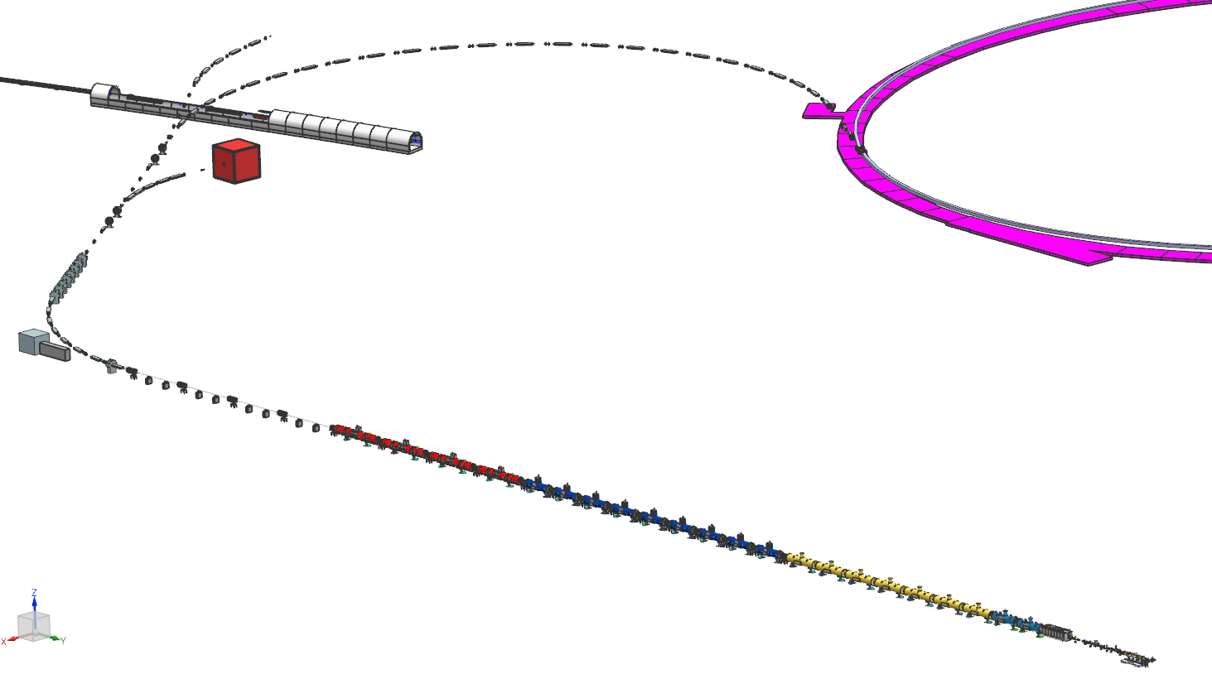
Linac and BTL Layout with Buncher Options
Location 2
z_{BTL} = 325 m
Location 1
z_{BTL} = 185 m
Another Possible Location
z_{BTL} = 50 m
(not considered in this documents)
Distance is from the end of
the fourth HB650 CM

Slide 5
CDR Design: no SC, no buncher
Comments:
This scenario is unrealistic because it does not include the space charge

Slide 6
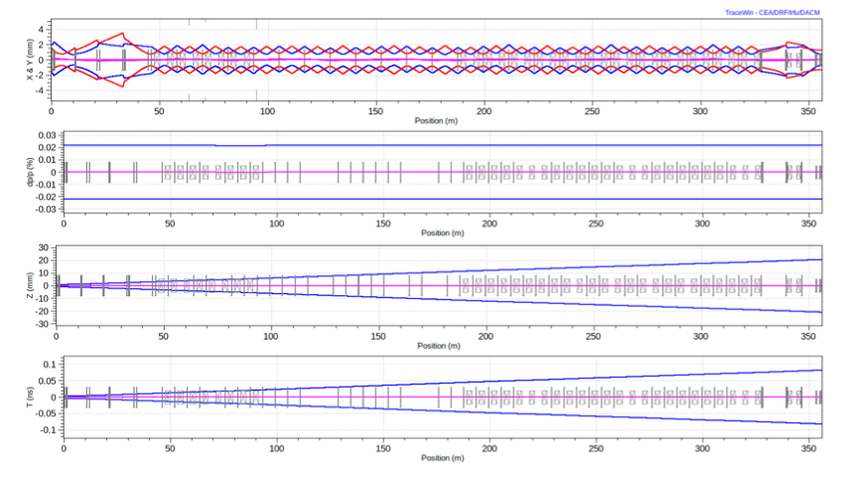
CDR design: No SC, No buncher, beam evolution in BTL
Comments:
This scenario is unrealistic because it does not include the space charge
Momentum spread is constant, 2.16e-4 (rms)

Slide 7
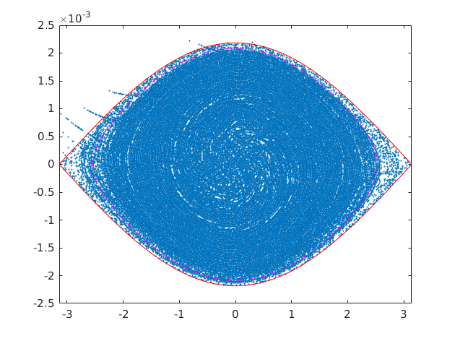
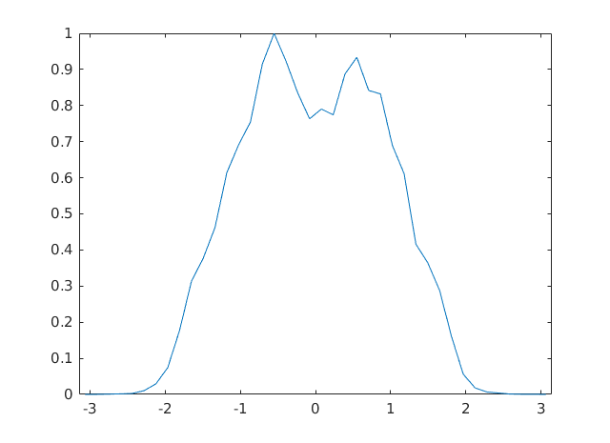
CDR design: off-energy injection
Linac beam parameters: std(dp/p) = 2.1698e-04, 1.5e-4 std dp from jitter
Injection parameters: off energy, dp/p_inj = 7e-4, dp ripple = 1.5e-4, one gate: -0.55Pi to +0.55Pi
Simulated results:
area of separatrix is 0.076627
area of the 99.9% of particles is 0.066238, ratio to the separatrix area is 0.864440
phase std 0.910944, energy std 1.046893
lost particles 1836 out of 5410001 injected, ratio is 0.000339
bunching factor 2.560398

Slide 8
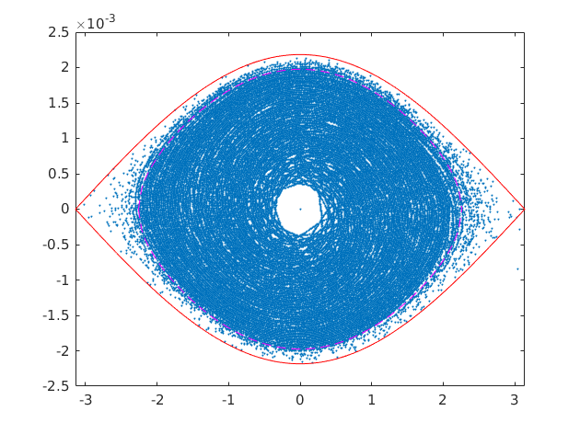
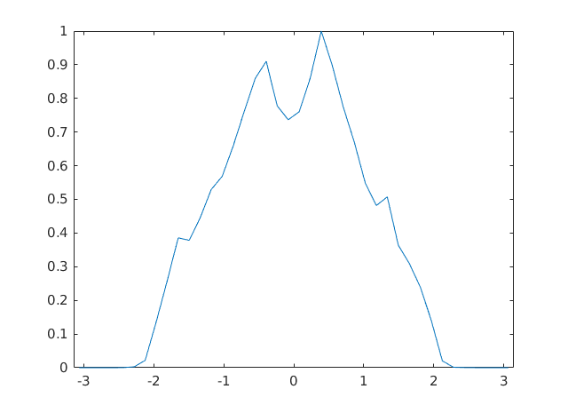
CDR design modified: on-energy injection
Linac beam parameters: std(dp/p) = 2.1698e-04, 1.5e-4 std dp from jitter
Injection parameters: on energy, dp/p_inj = 0.0, dp ripple = 1.5e-4,
two gates -0.65Pi - -0.1Pi and 0.1Pi - 0.65Pi,
Simulated results:
area of separatrix is 0.076627
area of the 99.9% of particle is 0.057329, ratio to the separatrix area is 0.748169
phase std 0.944689, energy std 1.064908
lost particles 85 out of 5420001 injected, ratio is 0.000016
bunching factor 2.665434
Comments:
On-energy injection with two gates yields smaller emittance and losses and can be beneficial in comparison to the CDR off-energy injection scheme
On-energy injection increases the number of foil hits by ~50%.This can affect lifetime of the foil.

Slide 9
Simulations with SC but without buncher

Slide 10
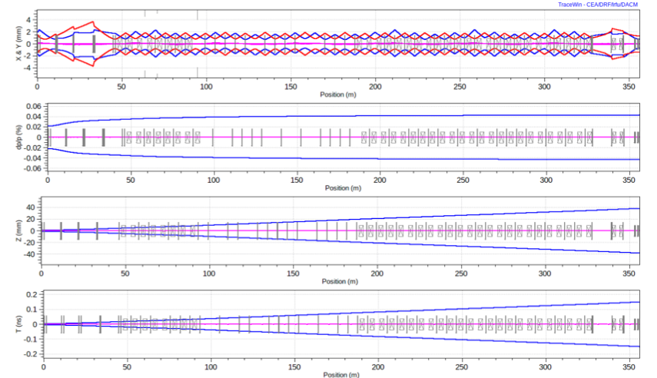
Actual Baseline (Dec 2019), With SC, No buncher
Comments:
This is expected beam dynamics if the energy spread is not compensated
Momentum spread nearly doubles to 4.3e-4 (rms)

Slide 11
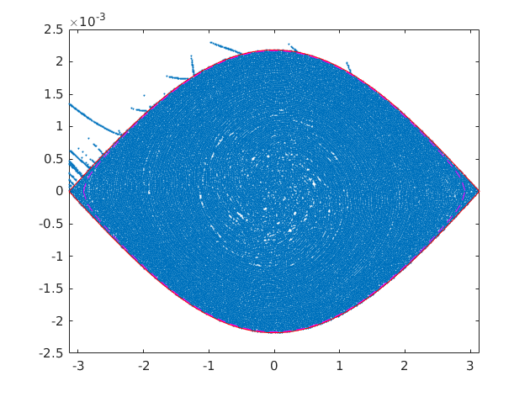
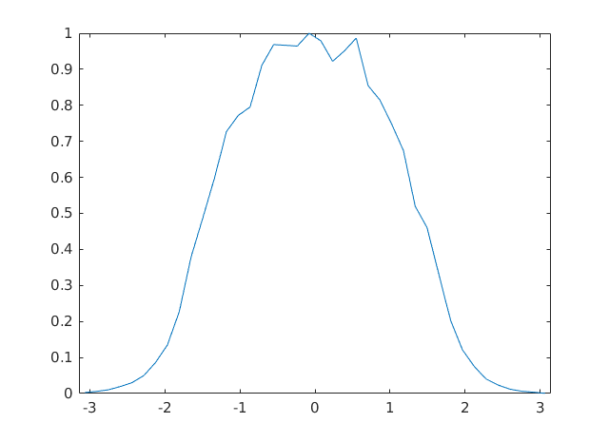
Actual Baseline: with SC, No Buncher: Off-energy Injection
Comments:
The bucket is full, leaving no margin between the beam distribution and separatrix
Linac beam parameters: std(p) = 4.3319e-04, 1.5e-4 std(dp/p) from jitter
Injection parameters: off energy = 7e-4, one gate -0.55pi - 0.55, dp ripple = 1.5e-4
Simulated results:
area of separatrix is 0.076627
area of the 99.9% of particles is 0.074723, the ratio to the separatrix area is 0.975161
phase std 0.975658, energy std 1.082379
lost particles 33930 out of 5410001 injected, ratio is 0.006272
bunching factor 2.238816

Slide 12
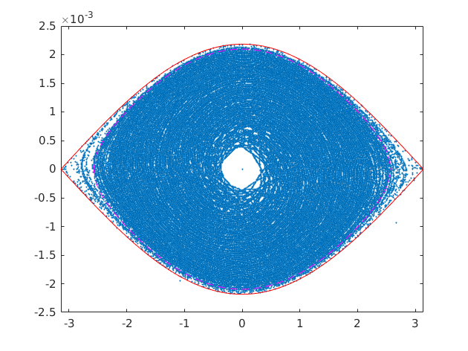
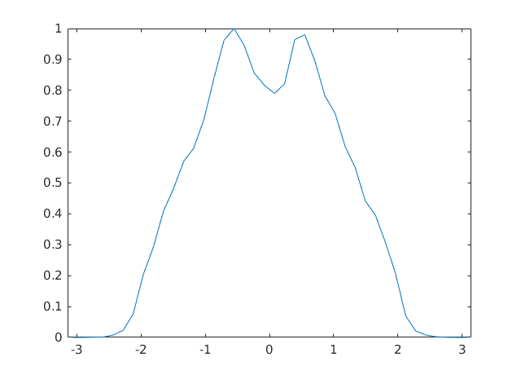
Actual Baseline : with SC, no buncher, on-energy injection
Comments:
The bucket is nearly full, leaving little margin between the beam distribution and separatrix
Linac beam parameters: std(p) = 4.3319e-04, 1.5e-4 std(dp/p) from jitter
Injection parameters: on energy, dp/p_inj = 0.0, dp ripple = 1.5e-4,
two gates -0.65Pi - -0.1Pi and 0.1Pi - 0.65Pi,
Simulated Results:
area of separatrix is 0.076627
area of the 99.9 % of particles is 0.067121, the ratio to the separatrix area is 0.875959
phase std 0.991292, energy std 1.109542
lost particles 520 out of 5420001 injected, ratio is 0.000096
bunching factor 2.302359

Slide 13
With SC and
Buncher at 185 m
(Location 1, middle of BTL),
F=650 MHz,V=2 MV

Slide 14
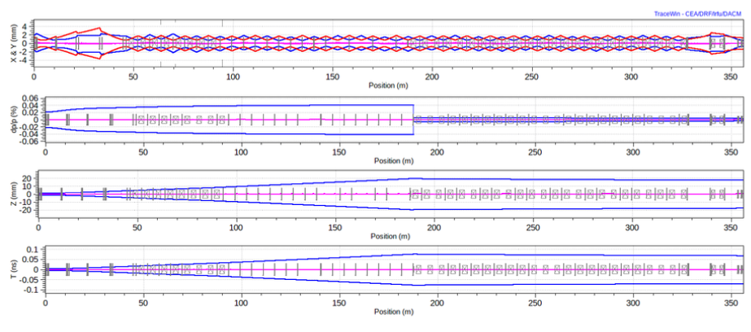
With SC, 650 MHz Buncher at 185 m, 2 MV
Comments:
The buncher suppresses the energy spread very effectively. The energy spread is suppressed by an order of magnitude.
Momentum spread compensated by the buncher. The spread is reduced from 4.3e-4 to 3.4e-5.

Slide 15
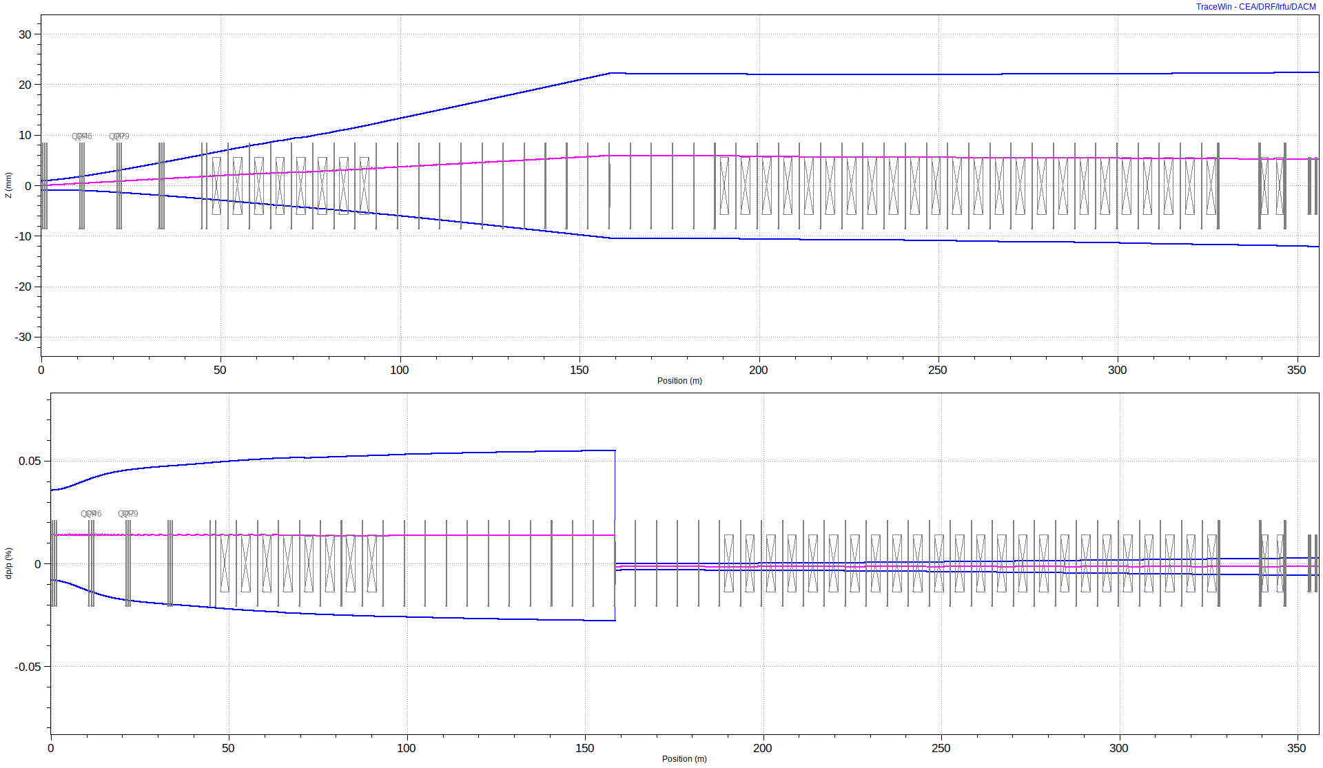
Buncher Compensates Energy/Momentum Jitter As Well
Momentum spread and jitter
are compensated by the buncher

Slide 16
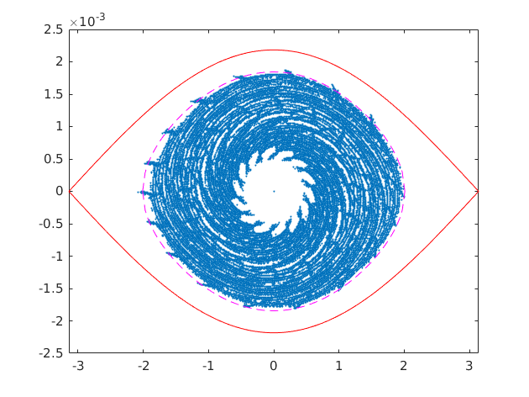
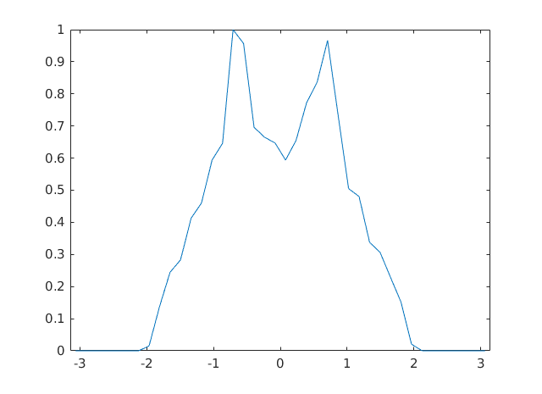
With SC, 650 MHz Buncher at 185m, Off Energy Injection
Comments:
Reduced energy spread leaves margin between the beam distribution and searatrix
The off-energy injection scheme (CDR design) of the beam with a small energy spread can produce sharp charge density peaks near the central hole.
Linac beam parameters: std(p) = 3.3875e-05, 0.0 std(dp/p) from jitter
Injection parameters: off energy, dp/p_inj = 7e-4, dp ripple = 0.0, one gate -0.55pi - 0.55pi
Simulated Results:
area of separatrix is 0.076627
area of the 99.9% percent of particle is 0.048451, the ratio to the separatrix area is 0.632313
phase std 0.879742, energy std 1.033700
lost particles 0 out of 5410001 injected, ratio is 0.000000
bunching factor 3.193759

Slide 17
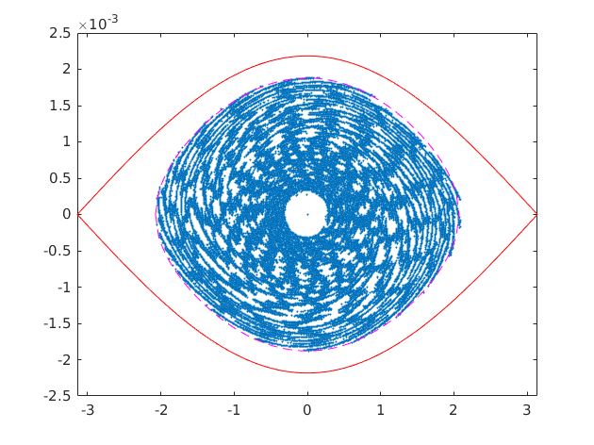
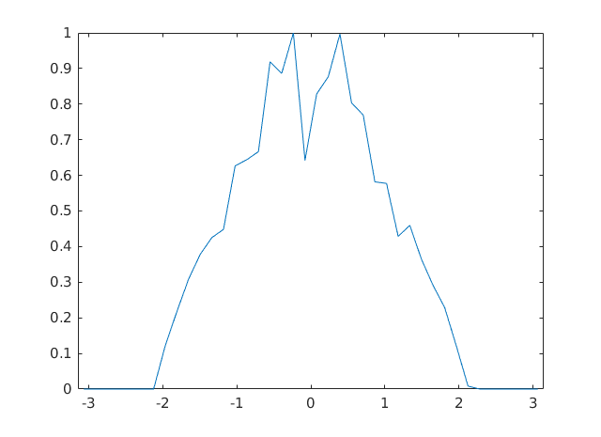
With SC, 650 MHz Buncher at 185m, On Energy Injection
Comments:
On-energy injection with two phase gates reduces the charge density peaks but keeps the longitudinal emittance small
Linac beam parameters: std(p) = 3.3875e-05, 0.0 std(dp/p) from jitter
Injection parameters: on energy, dp/p_inj = 0.0, dp ripple = 0.0
two gates -0.65Pi - -0.1Pi and 0.1Pi - 0.65Pi
Simulated Results:
area of separatrix is 0.076627
area of the 99.9% of particle is 0.050721, the ratio to the separatrix area is 0.661935
phase std 0.918701, energy std 1.047458
lost particles 0 out of 5420001 injected, ratio is 0.000000
bunching factor 2.736029

Slide 18
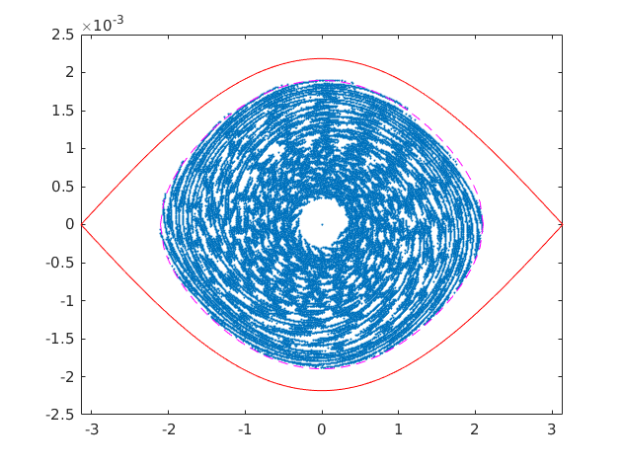
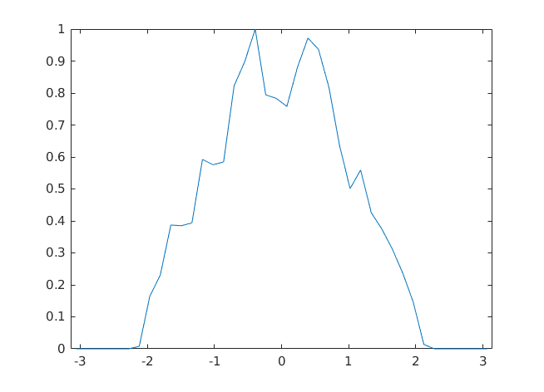
With SC, 650 MHz Buncher at 185m, Smaller Offset In Energy, Two Gates
Comments:
The injection scheme with a small energy offset and two phase gates reduces can deliver a more optimal initial distribution with a smaller peak density and emittance
Linac beam parameters: std(p) = 3.3875e-05, 0.0 std(dp/p) from jitter
Injection parameters: off energy, dp/p_inj = 2e-4, dp ripple = 0.0
two gates -0.65Pi - -0.1Pi and 0.1Pi - 0.65Pi
Simulated Results:
area of separatrix is 0.076627
area of the 99.9% of particle is 0.051846, the ratio to the separatrix area is 0.676616
phase std 0.932859, energy std 1.058489
lost particles 0 out of 5420001 injected, ratio is 0.000000
bunching factor 2.633948

Slide 19
With SC and
Buncher at 325 m
(Location 2, end of BTL),
F=325 MHz,V=2 MV

Slide 20
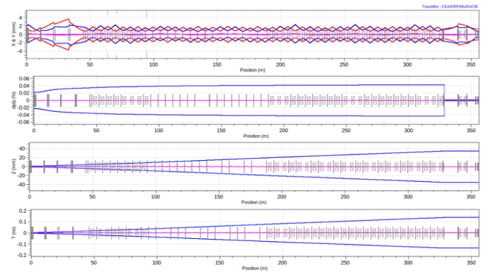
With SC, 325 MHz Buncher at 325 m, 2 MV
Comments:
The buncher suppresses the energy spread very effectively. The energy spread is suppressed by an order of magnitude.
The bunch length become somewhat long for 650 MHz although still acceptable.
I selected a 325 MHz cavity instead of 650 MHz
Comments:
The results and conclusions for this energy spread compensation scheme are similar to those of the scheme with the 650 MHz buncher located at 185 m.

Slide 21
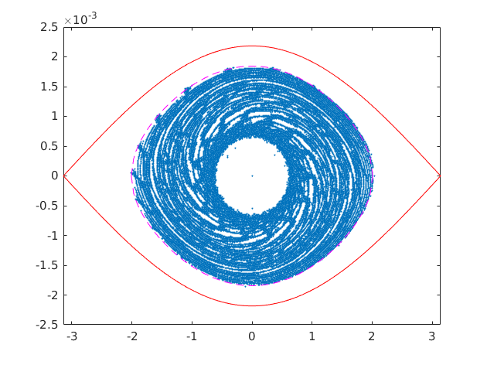
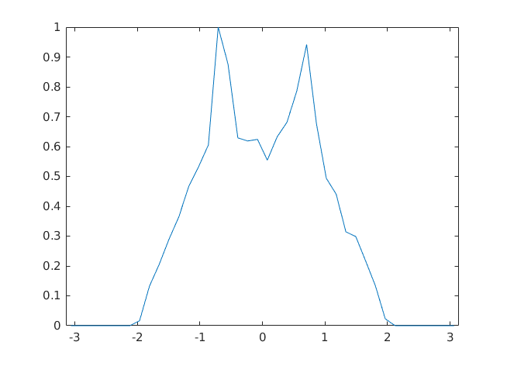
With SC, 325 MHz Buncher at 325 m, Off energy injection
Linac beam parameters: std(p) = 1.1143e-05, 0.0 std(dp/p) from jitter
Injection parameters: off energy, dp/p_inj = 7e-4, dp ripple = 0.0, one gate -0.55pi - 0.55pi
Simulated Results:
area of separatrix is 0.076627
area of the 99.9% of particle is 0.048451, the ratio to the separatrix area is 0.632313
phase std 0.879647, energy std 1.033756
lost particles 0 out of 5410001 injected, ratio is 0.000000
bunching factor 3.186195

Slide 22
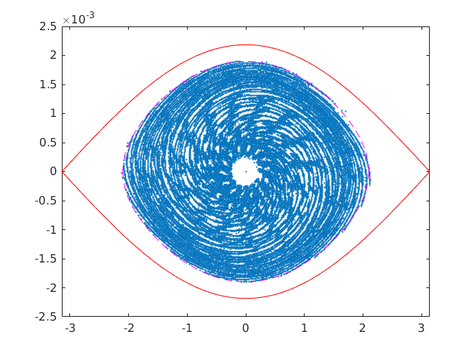
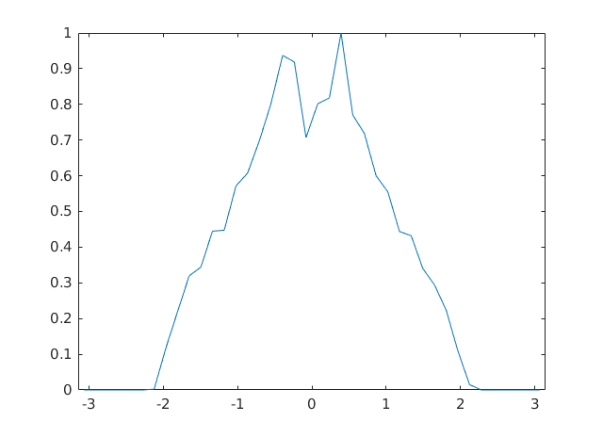
With SC, 325 MHz Buncher at 325 m, On energy injection
Linac beam parameters: std(p) = 1.1143e-05, 0.0 std(dp/p) from jitter
Injection parameters: on energy, dp/p_inj = 0.0, dp ripple = 0.0
two gates -0.65Pi - -0.1Pi and 0.1Pi - 0.65Pi
Simulated Results:
area of separatrix is 0.076627
area of the 99.9% of particle is 0.051846, the ratio to the separatrix area is 0.676616
phase std 0.918726, energy std 1.047091
lost particles 0 out of 5420001 injected, ratio is 0.000000
bunching factor 2.805933

Slide 23
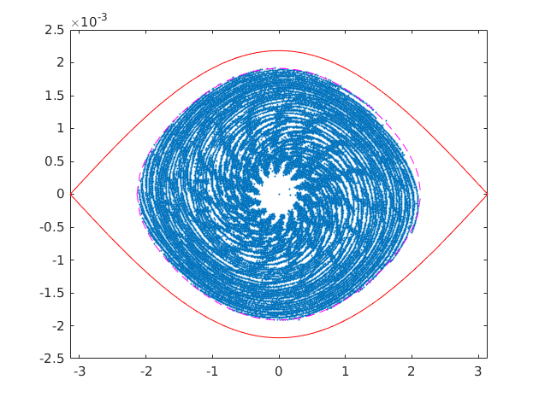
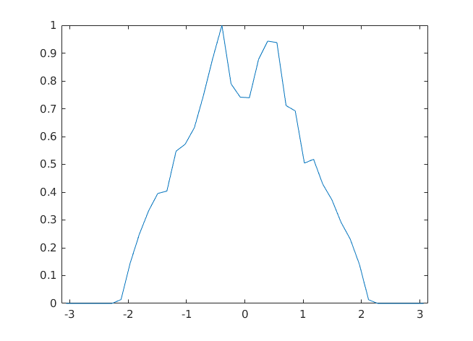
With SC, 650 MHz Buncher at 185m, Smaller Offset In Energy, Two Phase Gates
Linac beam parameters: std(p) = 1.1143e-05, 0.0 std(dp/p) from jitter
Injection parameters: off energy, dp/p_inj = 2.0e-4, dp ripple = 0.0
two gates -0.65Pi - -0.1Pi and 0.1Pi - 0.65Pi
Simulated Results:
area of separatrix is 0.076627
area of the 99.9 of particle is 0.052963, the ratio to the separatrix area is 0.691193
phase std 0.932499, energy std 1.058671
lost particles 0 out of 5420001 injected, ratio is 0.000000
bunching factor 2.692723

Slide 24
Summary: Off-Energy Injection
Injection energy offset dp/p_inj = 7e-4, one gate -0.55pi - 0.55pi
Parameter | Baseline, no SC | Baseline, with SC | 650 MHz @ 185 m | 325 MHz @ 325 m
Linac dp/p + Jitter, r.m.s. after buncher | 2.17e-04 + 1.5e-04 | 4.33e-04 + 1.5e-04 | 3.3875e-05 | 1.1143e-05
Ratio 99.9% to separatrix size | 0.86 | 0.98 | 0.63 | 0.63
Phase / Energy r.m.s. size | 0.91 / 1.05 | 0.98 / 1.08 | 0.88 / 1.03 | 0.88 / 1.03
Lost / Injected particles | 1836 / 5.41e6 | 33930 / 5.41e6 | 0 / 5.41e6 | 0 / 5.41e6
Bunching factor | 2.56 | 2.24 | 3.19 | 3.19

Slide 25
Summary: On-Energy Injection
Injection energy offset dp/p_inj = 0.0, dp ripple = 0.0, two gates -0.65Pi - -0.1Pi and 0.1Pi - 0.65Pi
Parameter | Baseline, no SC | Baseline, with SC | 650 MHz @ 185 m | 325 MHz @ 325 m
Linac dp/p + Jitter, r.m.s. after buncher | 2.17e-04 + 1.5e-04 | 4.33e-04 + 1.5e-04 | 3.39e-05 | 1.11e-05
Ratio 99.9% to separatrix size | 0.75 | 0.88 | 0.66 | 0.68
Phase / Energy r.m.s. size | 0.94 / 1.06 | 0.99 / 1.11 | 0.92 / 1.05 | 0.92 / 1.05
Lost / Injected particles | 85 / 5.42e6 | 520 / 5.42e6 | 0 / 5.42e6 | 0 / 5.42e6
Bunching factor | 2.67 | 2.30 | 2.74 | 2.81

Slide 26
Summary: Off-energy injection with a small energy offset and two phase gates
Injection energy offset dp/p_inj = 2.0e-4, dp ripple = 0.0, two gates -0.65Pi - -0.1Pi and 0.1Pi - 0.65Pi
Parameter | Baseline, no SC | Baseline, with SC | 650 MHz @ 185 m | 325 MHz @ 325 m
Linac dp/p + Jitter, r.m.s. after buncher | 2.17e-04 + 1.5e-04 | 4.33e-04 + 1.5e-04 | 3.3875e-05 | 1.1143e-05
Ratio 99.9% to separatrix size | — | — | 0.68 | 0.69
Phase / Energy r.m.s. size | — | — | 0.93 / 1.06 | 0.93 / 1.06
Lost / Injected particles | — | — | 0 / 5.42e6 | 0 / 5.42e6
Bunching factor | — | — | 2.63 | 2.69

Slide 27
Summary [1]
The CDR design did not include the growth of the energy spread driven by the space charge.
The space charge doubles the energy spread after the linac in roughly ~70m. The increased energy spread leads to a larger beam emittance and beam losses.
On-energy injection with two gates helps but only marginally. It also increases the number of foil hits by ~50%.
A buncher located in BTL can reduce the energy spread and beam jitter by an order of magnitude. A drift after the linac is required to convert the non-correlated energy spread to correlated one that can be removed by the buncher.

Slide 28
Summary [2]
Reduction of the energy spread of the beam injected into Booster reduces the emittance of the Booster painted beam, leaving a clear margin between the beam and the speratrix.
Off-energy, one-gate injection of the beam with a small emittance can lead to an increased peak charge density. On energy injection with two phase gates mitigates this effect. Simulations indicated that injection with a small energy offset and two phase gates might be optimal.
Although reducing the energy spread helps to reduce the emittance of the Booster beam, minimizing the energy spread to a very small number might not be optimal as it can lead to increased charge density and space charge tune shift.

Slide 29
Conclusions
Not controlling the energy spread in the BTL will lead to filling in the Booster beam bucket and losses at the injection comparable to 0.5%-1%
A buncher situated in BTL can be used to control the energy spread, leaving a margin between the painted beam distribution and the separatrix clear of particles.
A very small energy spread can result in local charge density peaks and might not be optimal. The energy spread and injection parameters (energy offset and injection phase windows) can be optimized to obtain optimal injected Booster distribution as shown in this presentation.

Slide 30
Addendum
Losses from Booster Bucket
During Accelerations

Slide 31
Description of these Studies
Simulate acceleration in the Booster and beam losses during acceleration for two different distributions:
Without energy compensation (no buncher), off energy injection (Slide 11)
With compensation of the energy spread using the buncher in BTL (Slide 16)
Try several different voltage ramp curves: slower and faster
Two codes used:
PyOrbit with the SC, impedances, transition crossing (J.-F. Ostiguy)
My nameless Python code, no SC, no impedances, stopped before transition crossing

Slide 32
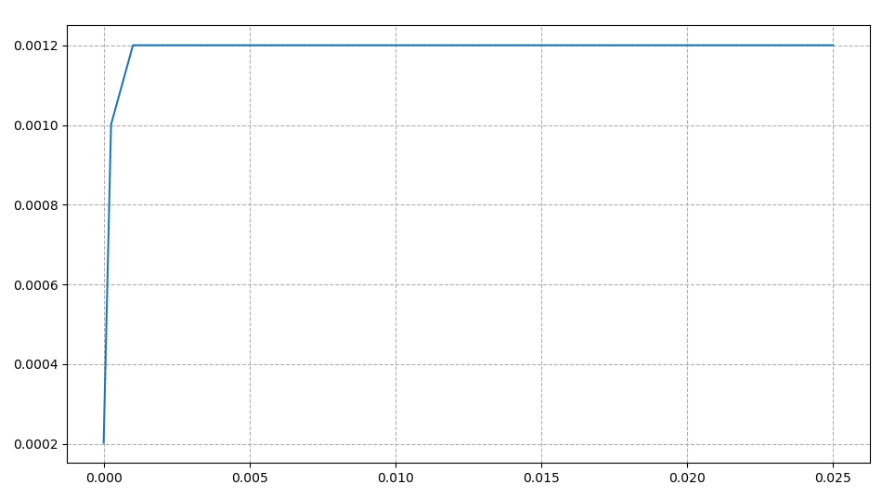
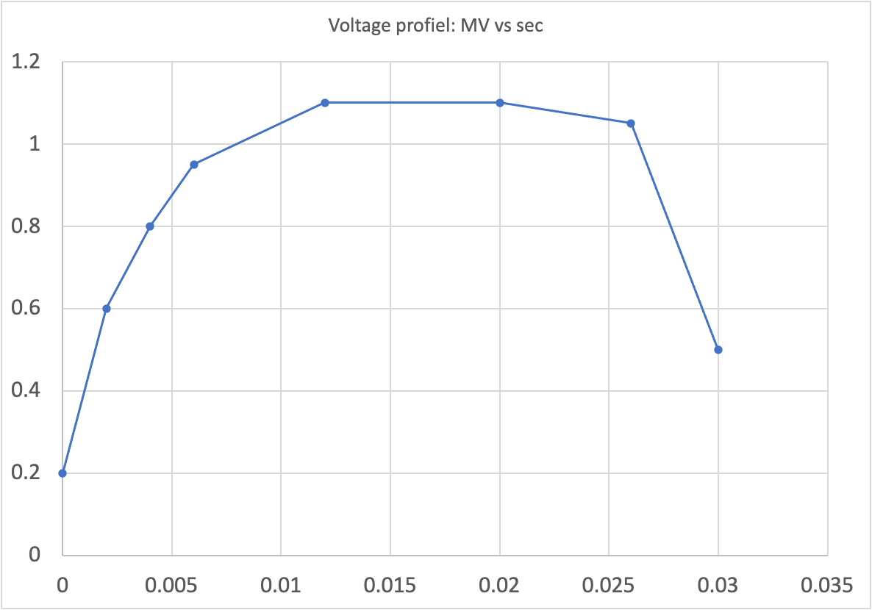
Voltage Profiles
Two Voltage curves used
Fast Slow

Slide 33
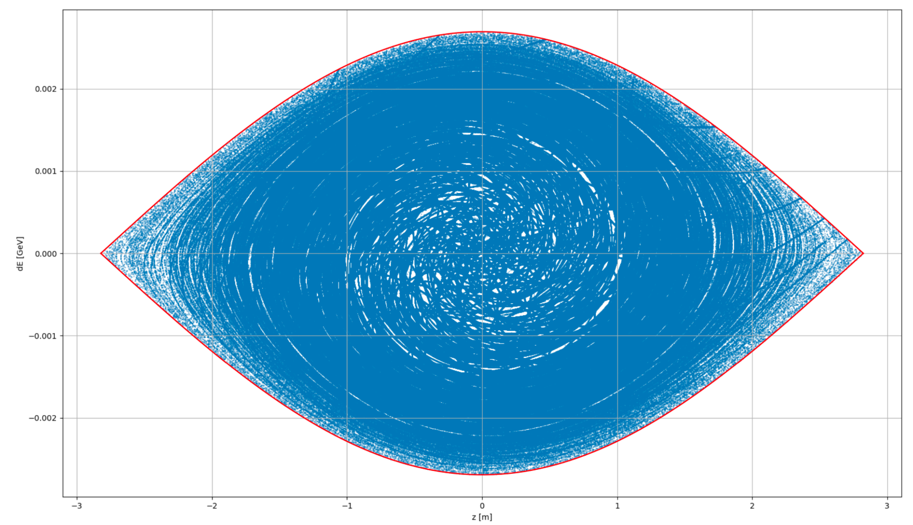
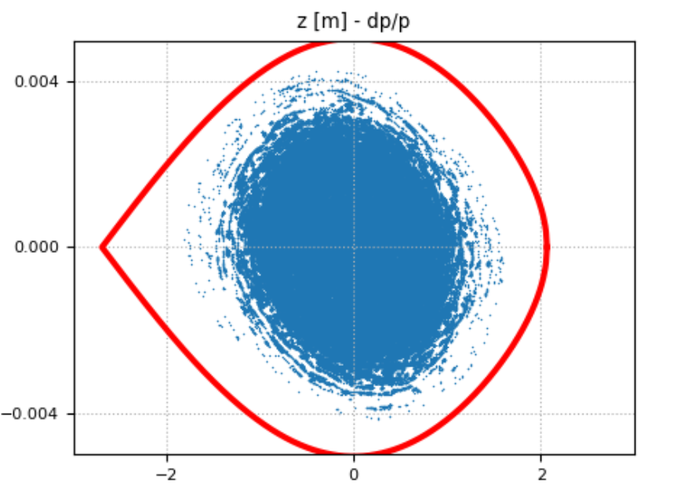
Without energy compensation (see Slide 11)
Initial
PyOrbit
Simulations: 500k particles, with SC, Impedance
Only fast voltage was simulated
Relative Particle loss after 500 turns 1.3e-4
My simplified code
Simulations: 5.3M particles, No SC, no impedance
Particle losses:
Fast voltage ramp: zero losses after 3000 turns
Slow voltage ramp: 0.7% particles lost after 500 turns
Something to worry about: Larger emittance at transition for both cases, simulated with Lee-Tang Gamma_t jump
After 500 turns

Slide 34
With Energy Spread Compensation (See slide 16)
PyOrbit
Not simulated
My simplified Python code
Simulations: 5.3M particles, No SC, no impedance
Particle losses:
Fast voltage ramp: zero losses
Slow voltage ramp: zero losses

Slide 35
Addendum Conclusion
Losses at acceleration will depend on the ramp rate of the voltage. Fast growing voltage at the slow acceleration (magnetic field variation at the bottom of the sine curve) will stabilize and move particles away from separatrix.
Large energy spread still can cause losses at injection due to particles missing the speratrix. Losses can reach a percent-ish level. Control of energy spread still can be beneficial.
Injection with a reduced energy spread will generate the beam with a smaller longitudinal emittance that can reduce losses at gamma_t.

Slide 36
Backup Slide:
Loss Requirements (Rough Estimate)
PIP-II will inject 17.6 kW of beam power into Booster
2% loss at injection will provide 350 W beam loss in Booster
0.2% loss at transition will provide additional 200 W loss in Booster
Combined these losses will add up to 1 W/m losses - roughly the loss limit
These considerations do not include collimators into account

