Slide 1
BTL Buncher Options
Eduard Pozdeyev
May 12, 2023

Slide 2
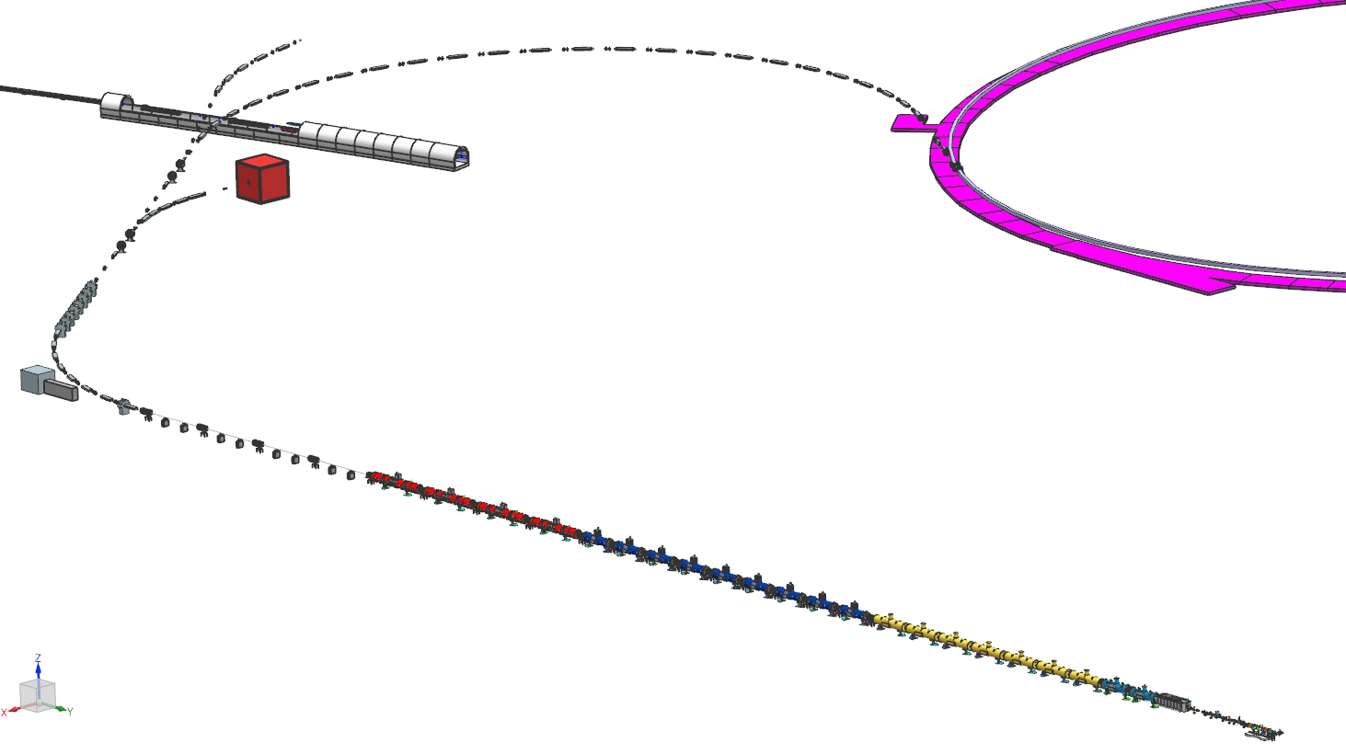
Linac and BTL Layout with Buncher Options
Case 4: Buncher is at the end of BTL
Case 3: Buncher in the middle of BTL, in cell 6.2 of BTL straight
Case 2B: buncher is right before the first BTL magnet. Last cavity of the last HB650 works as debuncher
Case 1: retune the last two cryomodules of the SRF linac

Slide 3
Case 1: HB650 CMs Retuning
Not recommended as the main option
Large tails, possible losses in BTL
Small energy spread reduction factor, up to 2
But can be tried if nothing else is available
Might not remove energy jitter

Slide 4
Case 2B: Buncher Before BTL
Advantages
Can be added later without modifications (see comment about SRF)
Disadvantages
Takes space of the beam switch yard/RF separator, requires higher voltage, benefits from retuning of the last HB cavity as a buncher, might not work well if two more HB CM added
Voltage:
5.5 MV with debunching last HB cavity,
7.1 MV without
Acceptable cavity type:
SRF, 650 MHz (HB650) or 1.3 GHz (LCLS)
SSA amplifiers 10-20 kW, requires cryogenic, long field rampup/rampdown time
This is not a particulate free area although the voltage is low
RT, 1%-2%, pulsed, 650MHz CCL or 1.3 GHz (?), two cavities
Requires Klystron, ~0.5-1MW total (Klystrons will be expensive one-item production)

Slide 5
Case 3: Buncher In the Middle of BTL
The most optimal solution from the physics point of view, there is space in the beam line
Disadvantages:
need to provide requirements to CF now, situated close to BAL and 25 kW dump
Voltage: 2.3 MV @ 650 MHz
Acceptable cavity type:
RT, pulsed 1% or 2%, 650MHz CCL or decoupled cell cavities (see Timergali’s presentation), two 1m long cavities, 6-7 cells each
Requires SSA amplifiers (~40-50 kW per cavity), ~2 total for CCL or 14 5 kW units for induvial cell cavities

Slide 6
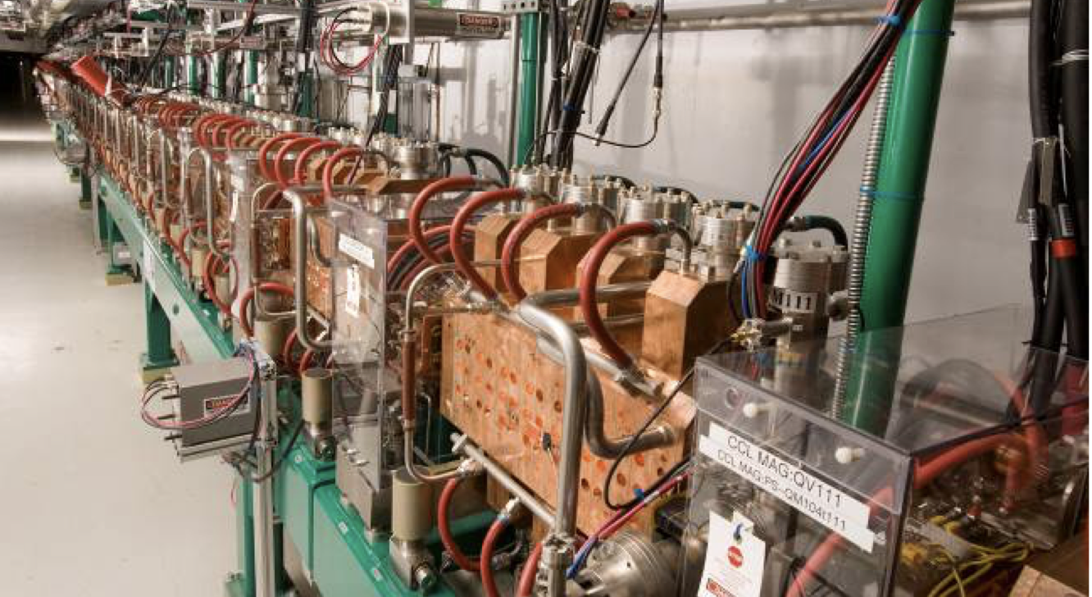
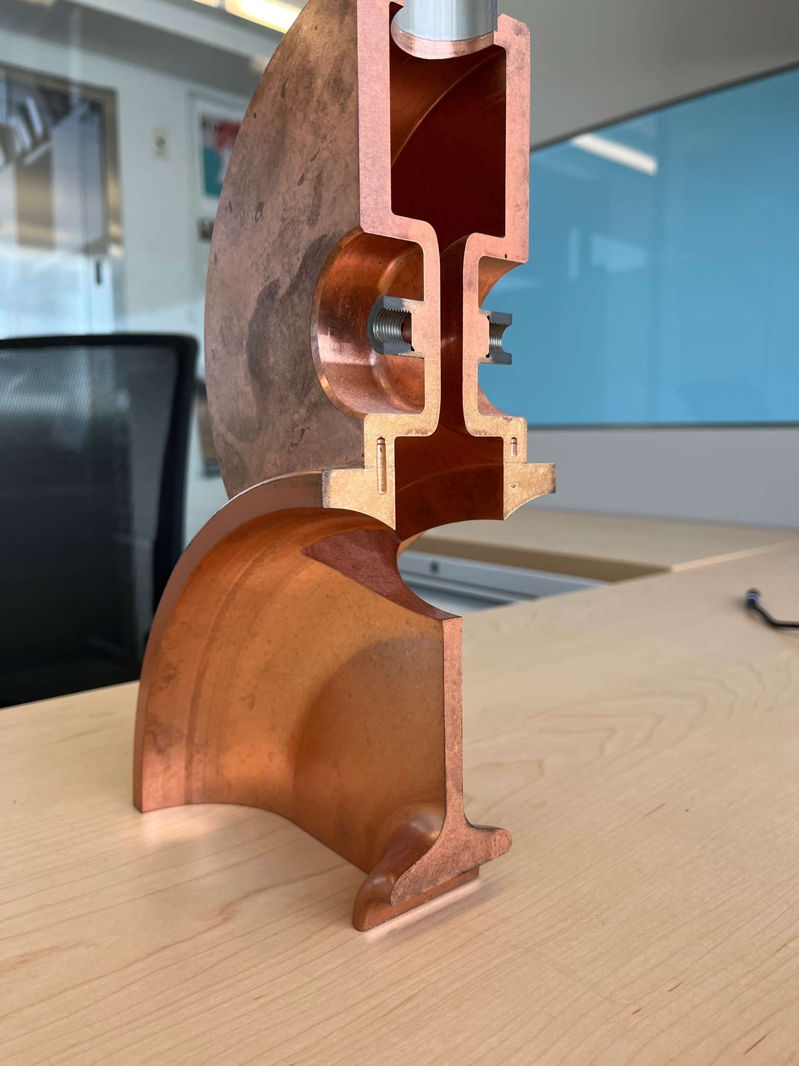
CCL Cavity Design
CCL is a typical structure choice for semi-relativistic proton beams
Fermilab, SNS, Los Alamos (805 MHz)
Advantages
Single coupler, low loss coax line, probe, control system per cavity – can be beneficial in case of limited space
Disadvantage
A bit more complicated cavity, ~30% lower shunt impedance than individual cells
Fermilab CCL
1/4 of cavity with coupling cell
SNS CCL

Slide 7
Case 4: Buncher at the End of BTL
Can require 325 MHz. 650 MHz still might be acceptable but can start producing nonlinearities in the beam distribution.
Advantages
Requires lowest voltage, might have access to Booster facilities, can produce the smallest energy spread
Disadvantages:
Might need 325 MHz cavity, requiring additional studies
Voltage: 2 MV @ 325 MHz or 1 MV @ 650 MHz
Acceptable cavity type:
RT, pulsed 1% or 2%, 650MHz CCL or decoupled cell cavities (see Timergali’s presentation), one 1m long cavity, 6-7 cells
Requires 1 SSA amplifier (~40-50 kW) for CCL or seven 5 kW units for induvial cell cavities
Design 325 MHz cavities needs to be developed

Slide 8
Buncher Locations and Options Summary
 | Case 1 | Case 2B | Case 3 | Case 4
Location | HB650 CM retuning | Buncher before BTL | Buncher in BTL around BAL | Buncher at the end of BTL
Frequency | N/A | 650 MHz 1300 MHz | 650 MHz 1300 MHz (maybe) | 325 MHz 650 MHz (maybe)
Buncher Voltage | N/A | 5.5 MV with debuncher 7 MV without @650 MHz | 2.3 MV @650 MHz | ~2 MV @325 MHz
Cavity Type | N/A | SRF RT | RT | RT
RF systems | N/A | SSA (SRF) Klystron (RT) | SSA | SSA

