Slide 1

LHC Crab Cryomodule
DOE-HEP SBIR Phase II
Terry Grimm
LHC Crab Cavity Engineering Meeting
FNAL, May 30, 2013

Slide 2
SBIR Phase II
DOE-HEP Phase II SBIR
  1 million dollars over 2 years
Schedule
  Contract Start April 2013
  Year 1 progress report due Feb 2014
  Year 2 final report due March 2015
Start transition to Phase III in late 2014

Slide 3
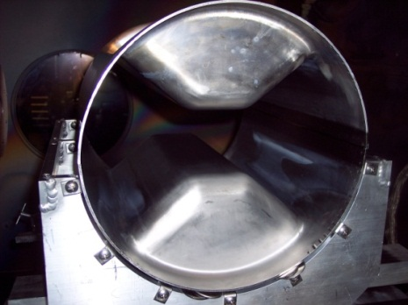
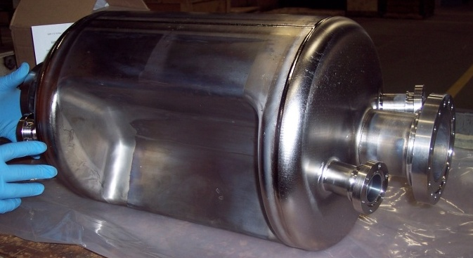
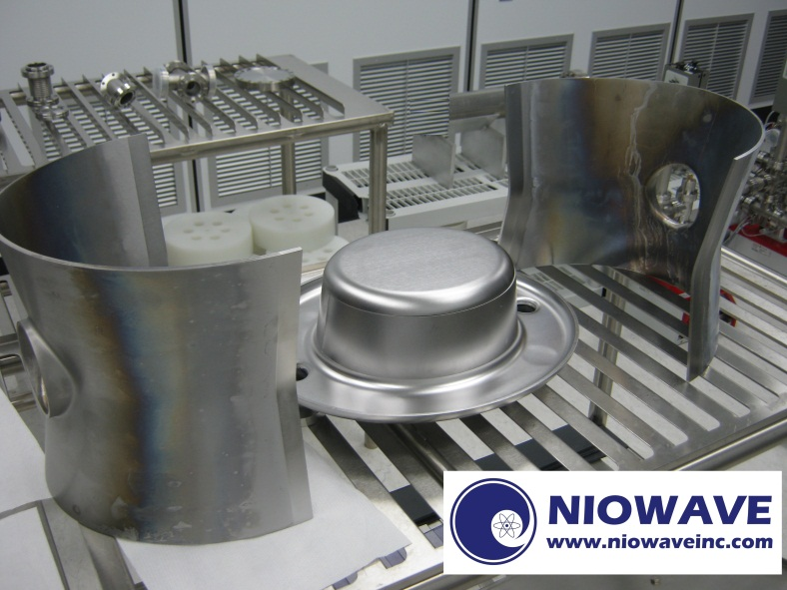
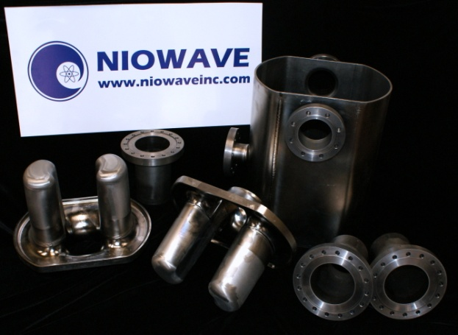
Crab Cavities for the LHC
Niowave became involved with crab cavities for the LHC first through DOE in collaboration with ODU, and later with the other designing groups.
ODU/SLAC RF Dipole (ODU – Jean Delayen)
Quarter-Wave Crab (BNL – Ilan Ben-Zvi)
4-rod Crab
(Daresbury – Graeme Burt)

Slide 4
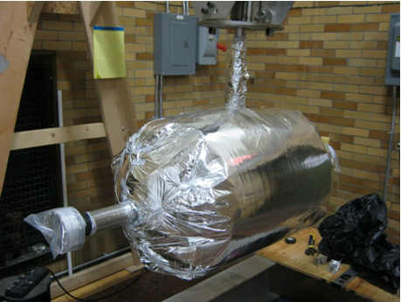
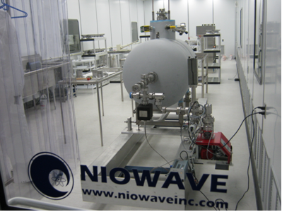
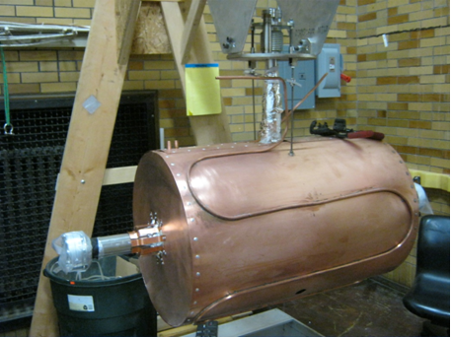
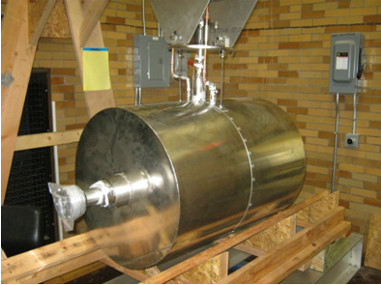
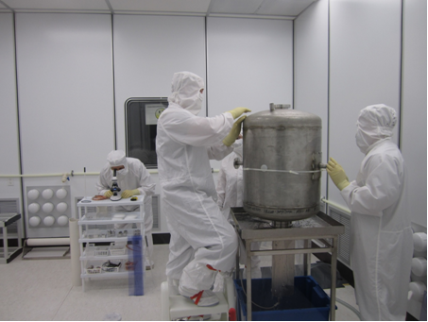
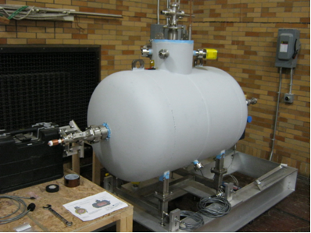
Horizontal Cryomodule Assembly (500 MHz Multi-spoke)
He vessel with superinsulation
final cavity preparation in clean room
LN₂ thermal shield
mu metal magnetic shield
insulating vacuum vessel
cavity high-pressure rinse

Slide 5
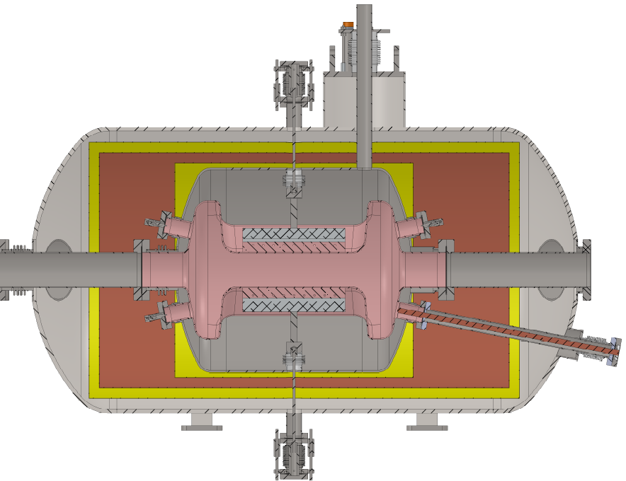
LHC Crab Cryomodule
Conceptual Design
Liquid He fill tube and exhaust
Liquid He vessel
2K magnetic shield
Three HOM couplers
or pick-up antennas
Nb cavity
Liquid N₂ thermal shield
Mu-metal magnetic shield
Vacuum vessel
Power coupler
Frequency tuner

Slide 6
Cryomodule Critical Dimensions
The crabbing cavity shown in the drawings is the DOE-HEP SBIR funded prototype that has been built and room-temperature tested at Niowave in March 2012.
Once a new cavity with smaller diameter is developed, the cryomodule design will be changed accordingly.
beam-to-beam separation (194 mm)

Slide 7
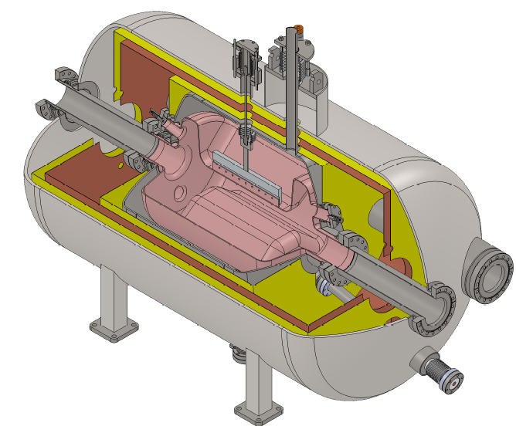
3D Cryomodule View
cavity tuner
beam tubes
niobium cavity
RF power coupler

Slide 8
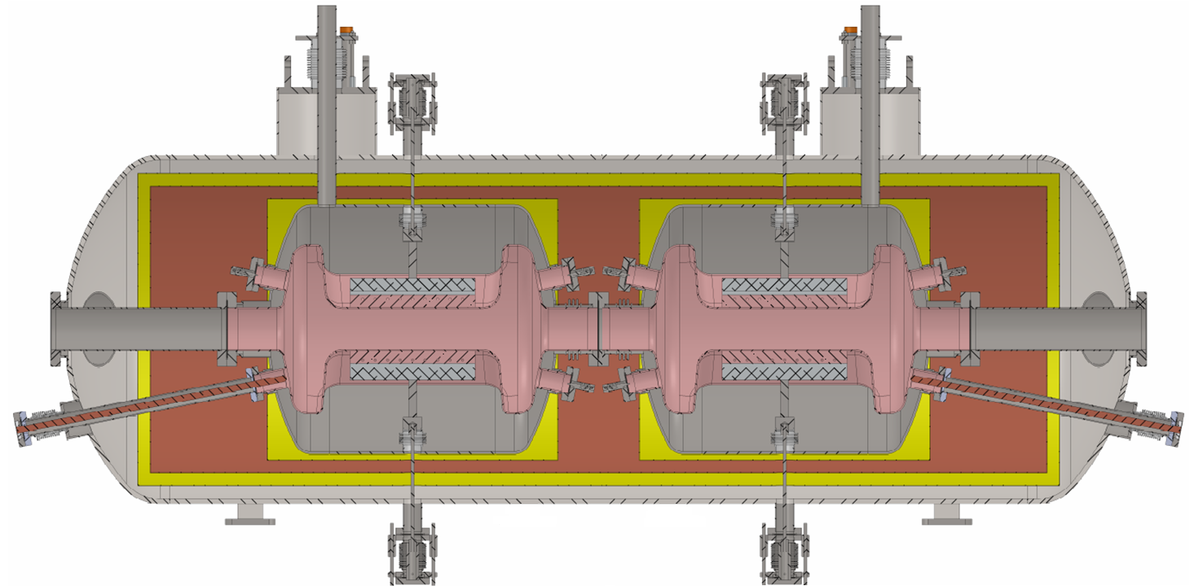
In-Line Double Cavity Cryomodule Concept
Cryomodule concept can be extended for multiple cavities – shown here with two cavities in-line: separate He vessels and fill, separate low-temperature magnetic shield, but combined thermal shield and insulating vacuum.

Slide 9
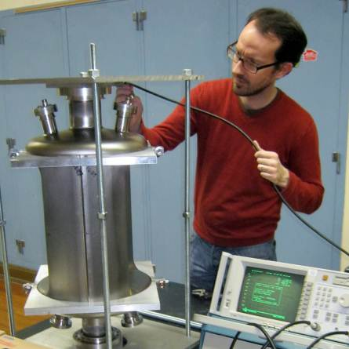
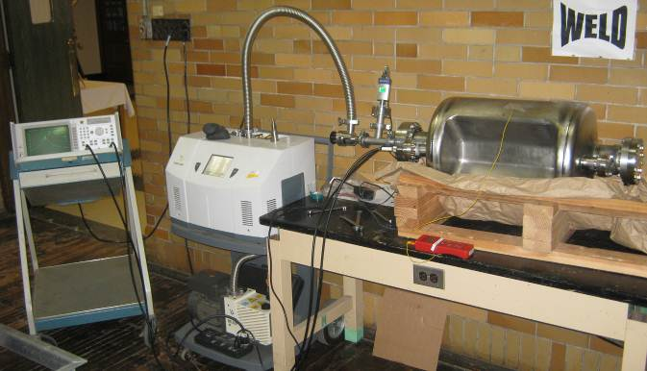
Room Temperature Measurements of the LHC Crab Cavity
Mode spectrum for the cavity measured before and after final welds
Room-temperature cavity Q confirms geometry factor within ~10%
Vacuum frequency shift measured (~300 kHz)

Slide 10
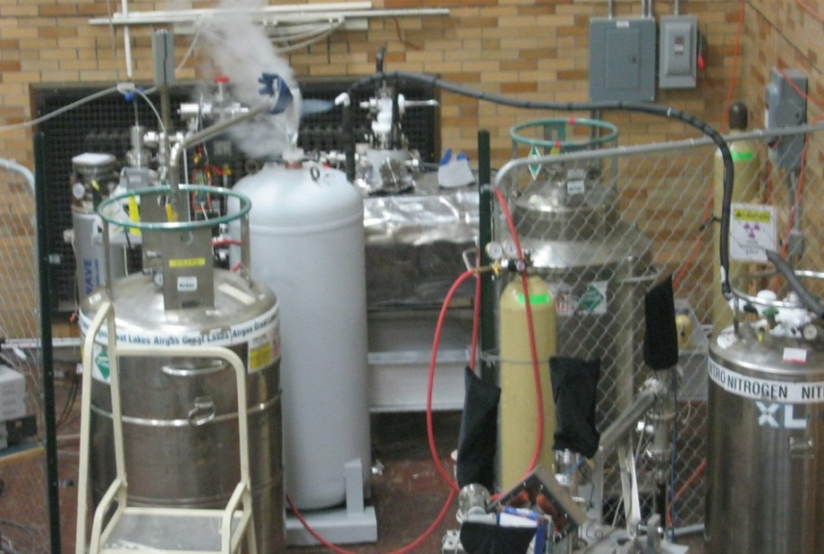
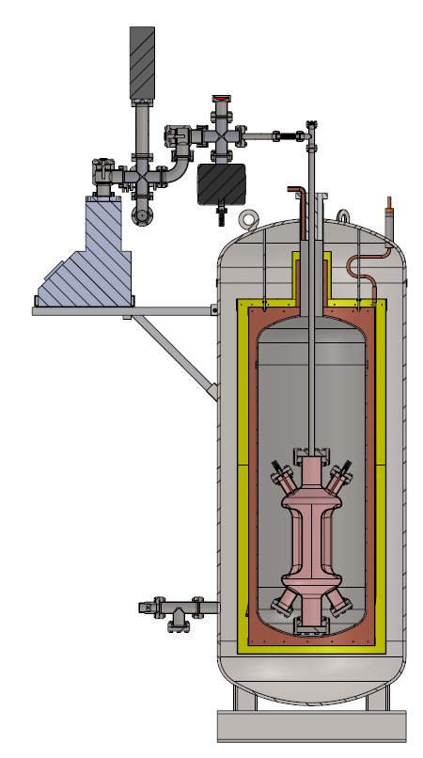
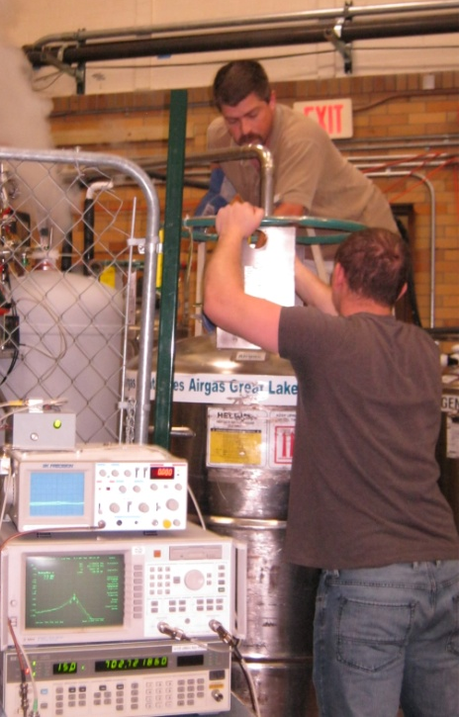
750 MHz Crab Cavity
Vertical Dewar Cryotest Setup
Similar crab cavity geometry developed with ODU for an electron-ion collider
DOE-NP STTR project
Approximately half the size of the LHC cavity

Slide 11

750 MHz Crab Cavity Test Results
The 750 MHz crab cavity reached an estimated maximum deflecting voltage >0.6 MV (radiation limited – no cavity quench).
multipacting barrier
pulsed conditioning progress
Notes:
11

Slide 12
Next steps
HOM coupler design
Detailing of mechanical design
  Pressure-code compliance
  Fast and slow tuners
Field stability requirements
Assembly plan

