Slide 1
Target enclosures: pro & cons of various solution
5th High Power Target Workshop
https://indico.fnal.gov/conferenceDisplay.py?confId=7870
Brainstorming session
M. Calviani (CERN)
With major contributions from: J. Hylen (FNAL), T. Ishida & T2K team (KEK/J-PARC), H. Vincke, C. Strabel, P. Vojtyla (CERN)

Slide 2
Disclaimer
This is not going to be a review of possible solutions, but a starting point for further discussions
Limited to few installations (sorry)
Complex matter, involving:
Physics optimisation
Engineering requirements
Radiation protection & environmental protection (site dependent)
Ventilation system design
Material studies and R&D
Project “strategic” decisions
Installation/laboratory configuration

Slide 3
Target installation types
Neutrino facilities
Usually constituted either by long tunnels or shallow/deep trenches/chase
Large volumes w/o shielding
Spallation sources
Usually inside pits or enclosed in shielding blocks with ports for neutron beams
Radioactive beams sources
Usually inside bunkers/halls as requires several “active” equipment around

Slide 4
What do we mean by enclosure?
Area where target and other associated beam equipment are located during beam operation
In general the enclosure needs to be equipped and relatively accessible in case of equipment exchange
Opening cover
Primary line
Target
Beam focusing (if any)
Dump/absorber
~5/10 meters
~5/20 meters

Slide 5
Enclosure atmosphere
A priori...
Air
Easiest solution in terms of handling
Activation levels penalizing (high mass spallation)
Helium
Radiation only produces ³H (+ impurities-driven spallation products)
Complex handling and operation – specialized devices needed
Vacuum
Best for activation and corrosion
NOx formation/humid environment → radiation-accelerated corrosion
Optimal corrosion resistance
Cumbersome for operation and higher costs for the vessel

Slide 6
T2K experience
T2K chose to use a huge He-vessel to enclose all beam elements
Air-to-He environment is achieved by pumping down the whole volume to 50 Pa
Quite large mechanical constraints, but very successful operation with lots of lessons learnt

Slide 7
Helium Vessel Enclosure at J-PARC Neutrino Beamline
Vessel filled w 1atm. He gas
L=~110m,V=1,300m³
Target Station
Beam Transport
From RCS to MLF
Beam Dump
Ishida-san & co. (JPARC)
Decay Volume
OA2º
OA2.5º
OA3º
6m-thick concrete wall
Target Station(TS), Decay Volume(DV) & Beam Dump(BD) in a gigantic vacuum/helium vessel, made of carbon steel plates (water-cooled).
Effective to prevent nitrogen oxide (NO_{x}) production / oxidization, thus damages to the apparatus inside.
We succeeded to use 1st apparatus for ~5 years without fatal troubles
He gas filling after evacuation
The entire structure was rigidly built with thick plates (100mm for TS / 16mm + anchors for DV / 200mm for BD) / welding with deep grooves.
He circulation at TS: 1,300m³/h, inlet plays role as horn stripline cooling duct. No forced circulation for DV/BD so far (piping at BD for future use)

Slide 8
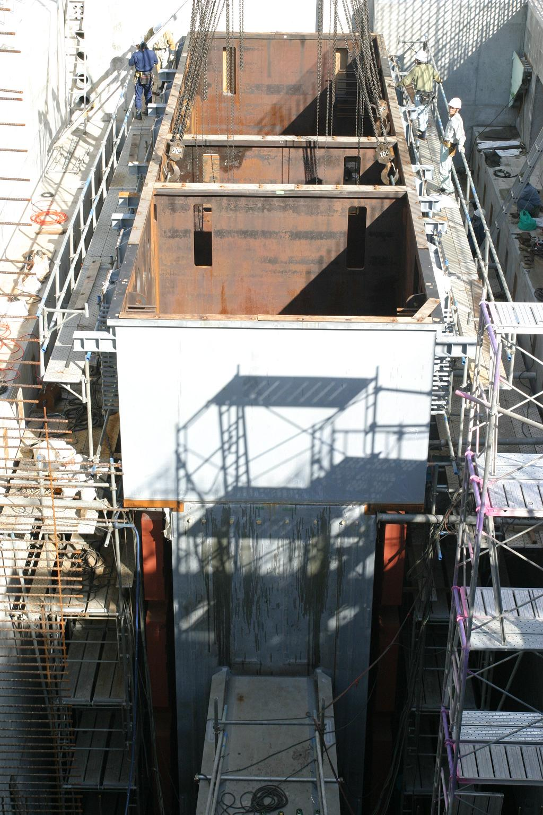
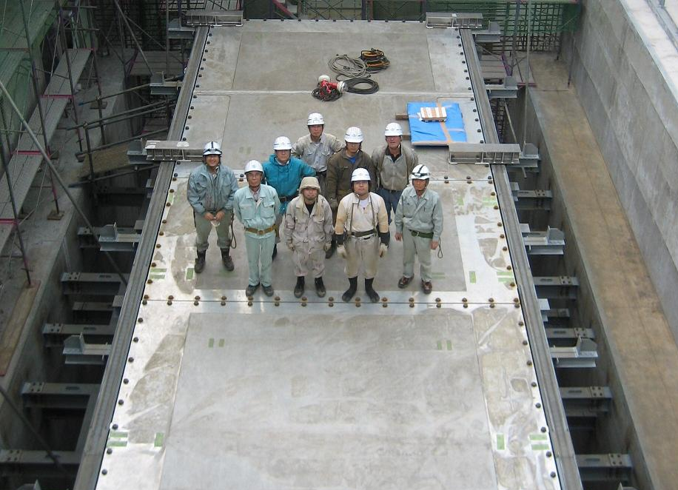
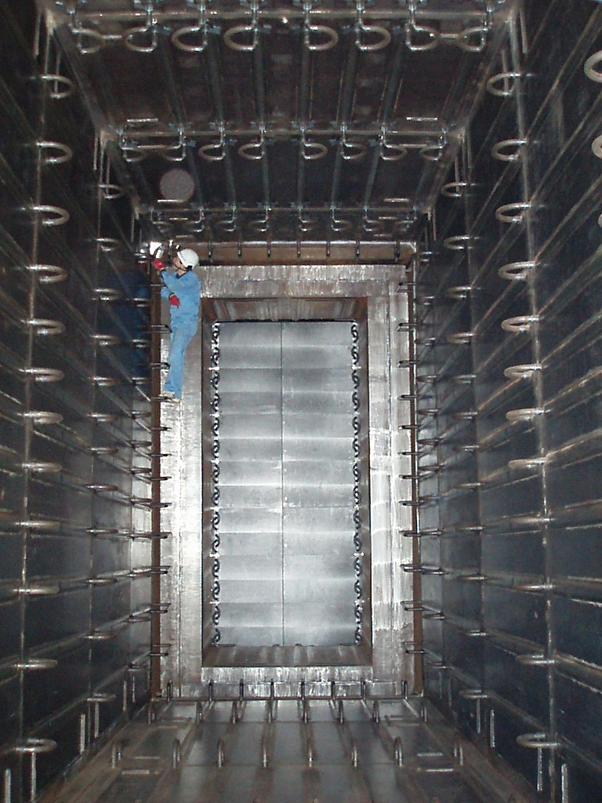
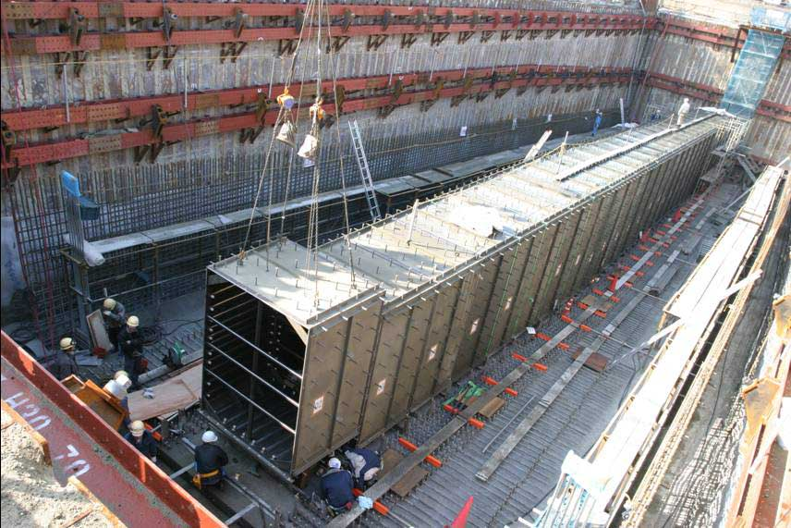
Helium Vessel Construction
TS
BD
Graphite
blocks
Top lids
(3 pieces of 120mm-thick Aluminum )
DV
Upstream DV
Support anchors
Embedded in concrete wall
Oct.05’07

Slide 9
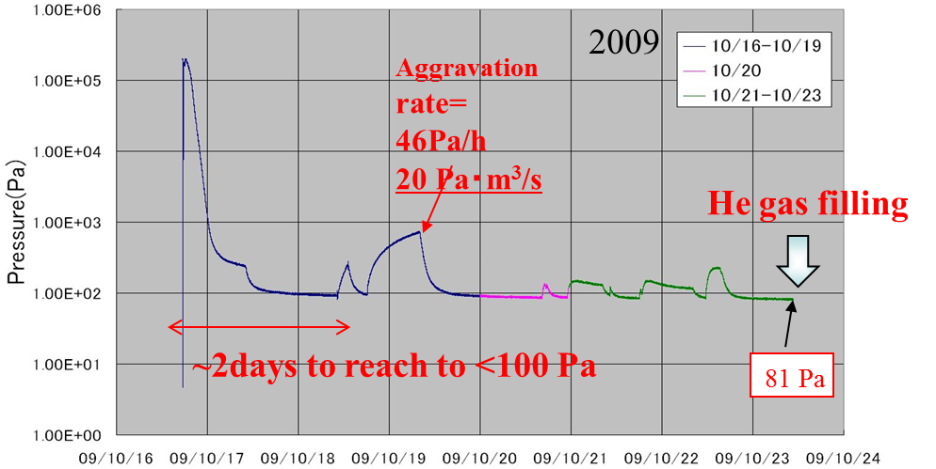
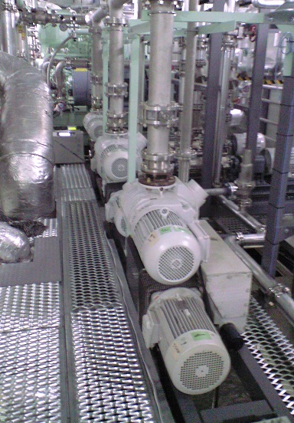
Evacuation / He-filling procedure
<100 Pa reached in a ~a week after vessel closure
Leakage in the vessel creates ~10⁻²-10⁻¹ Pa*m³/s = 1~10 ppm O₂/day
Solved by keeping the He-vessel in overpressure
O₂ contamination <100 ppm for entire beam period

Slide 10
Vessel opening and issues
After operation, He is vented and filled with air – raise of HTO up to ~1 Bq/cm³
In order to fix this dry air is blown from TS to absorber – it takes about 1 month to dry up inside – i.e. delay before access
T2K will try to fix it by performing an online dehumidification of the He gas
For more info, see NBI2012 presentation: (link)

Slide 11
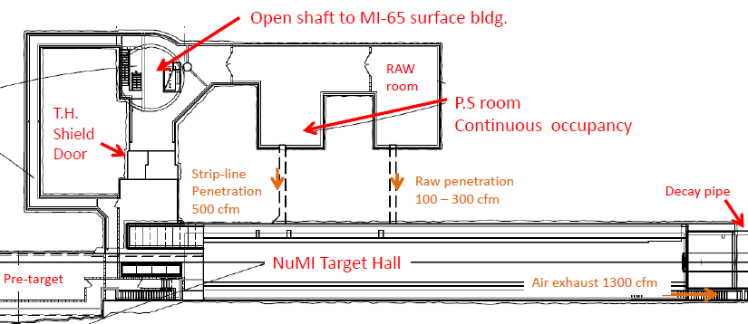
NuMI experience
NuMI target pile cooled with air
Kept at under pressure by sucking air via a passageway lateral to the DP
To protect utility rooms and open shaft
NuMI target hall deep, but “ran it an effectively shallow”
This method allows reduction of releases of short lived isotopes (but not enough for ⁴¹Ar)
See J. Hylen talk, this workshop

Slide 12
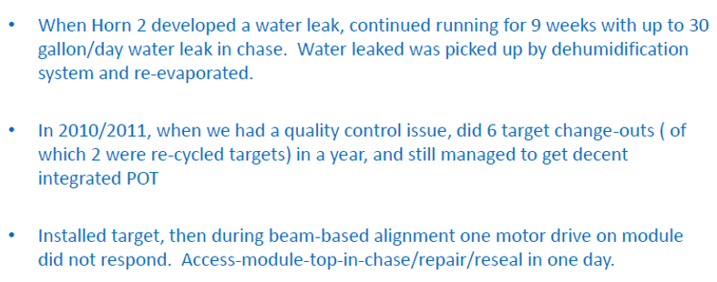
NuMI experience
During NuMI lifetime several access to the target area are/have been required

Slide 13
J. Hylen, NBI2012 (link)

Slide 14
LBNE studies
Target pile NuMI-style with air recirculation, but DP with static He
Short-lived isotopes strongly suppressed by using NuMI facilities as a huge “buffer tank”
⁴¹Ar emissions evaluated by means of scaling up NuMI releases
Uncertainty in extrapolation due to thermal neutrons
Extraction of air through a drier area (mitigation of tritium issue)

Slide 15
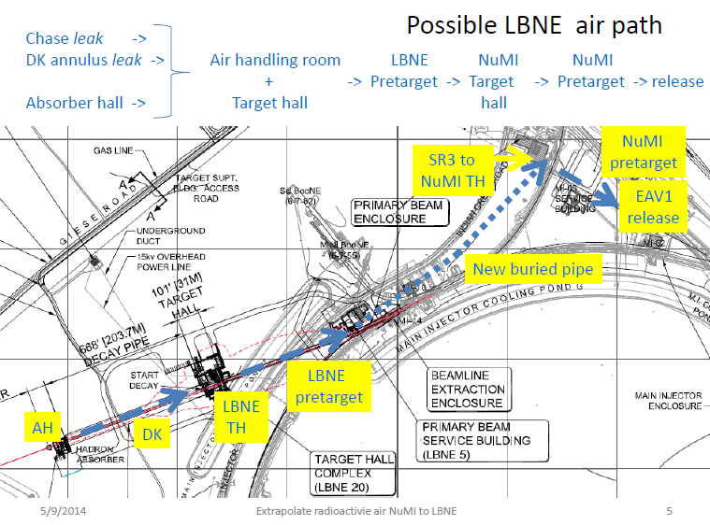
J. Hylen

Slide 16
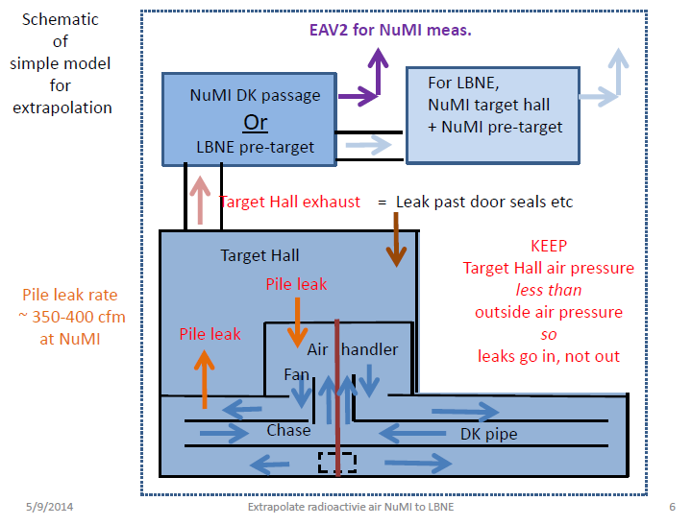
J. Hylen

Slide 17
CERN’s experience
CNGS – long tunnel, deep underground installation
Tritium production has been a constant problem, which have been dealt with:
Avoid “clean” water contact with tritiated air
Modification of the ventilation system
Access tunnel in overpressure rather than controlled leakage
From beam stop to access ~O(10 hours)
No issues with short lived isotopes
Lessons learnt: in complex tunnel systems, the actual air-flow may be difficult to predict
See H. Vincke NBI2012 presentation (link)

Slide 18
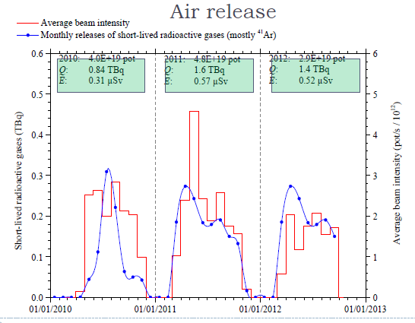
Air releases of short lived isotopes not a problem, minimal impact by Ar41

Slide 19
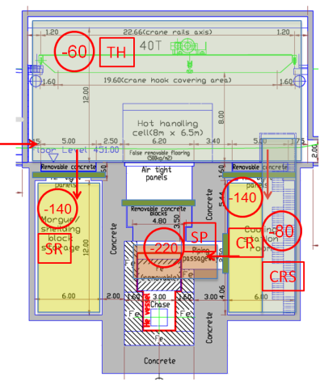
Comments from CERN point of view
Control of air path for new installations should follow the ISO17873:2004 with appropriate ΔP control
The use interconnected tunnels passing from different installation w/o pressure control would be difficult to accept
Huge volume for the required ΔP
Wet areas/sumps an issue

Slide 20
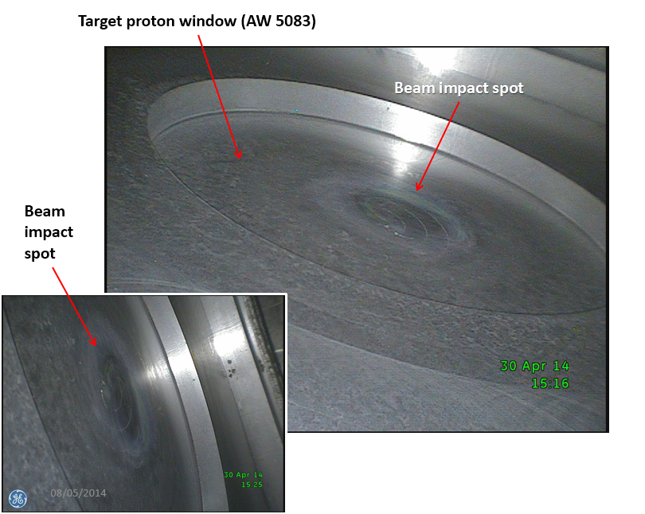
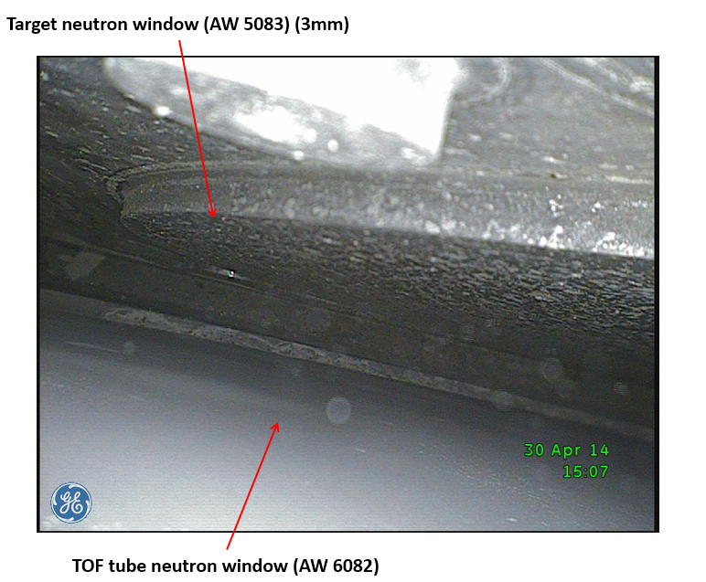
TOF spallation target
Target installed in a vertical pit, no specific atmosphere control (i.e. air)
Extensive oxidation stains observed
Future upgrades will consider dehumidification/recirculation or Helium enclosure

Slide 21
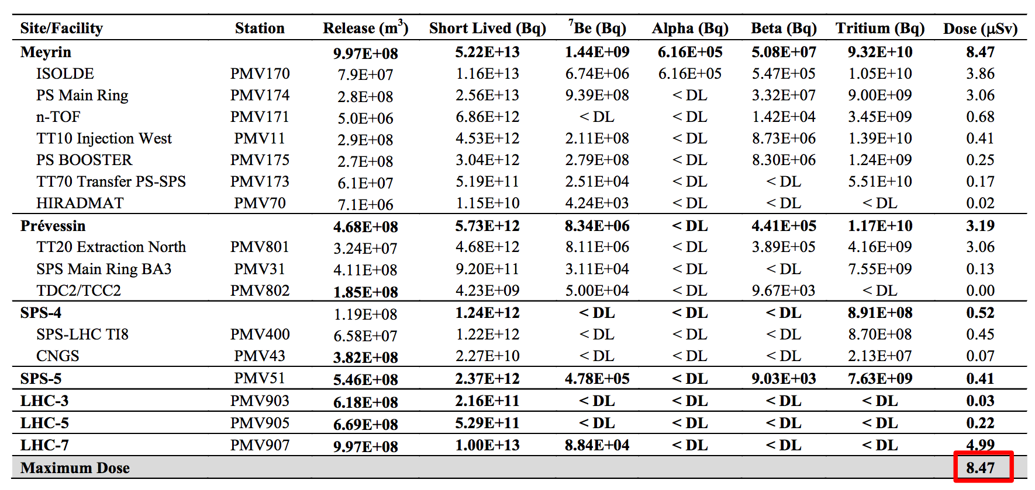
CERN studies
For both CENF and SHIP (and future projects) a He-vessel is sought:
Shallow installation
RP/environmental consideration
Hydrogeological situation above the water acquifier
Equipment protection and reliability
General situation for CERN’s releases
We cannot add much more respecting the internally imposed limit of 10 μSv/y to the public (all installations!)
However (true for all installation): helium do not solve ³H problems (if present)!

Slide 22
CERN studies
However (contrary to T2K) no vacuum vessel is presently considered:
Collaboration with external company to study a system that would perform an online purification (goal ~few days) down to 0.1% air
Seems to be possible with membrane and cryo traps
Reduce costs and structural requirements
No problem with expansion/shrinkage of vessel (i.e. structural alignment)

Slide 23
Summary
Every facility has his own specific requirements and external conditions imposed by law or laboratory rules
Air allows operational flexibility that He (or vac) enclosure could not provide
He allows reducing issues associated with light spallation products (¹¹C, ¹³N, ^{14,15}O, ⁴¹Ar)
Independently of the air treatment
³H still produced, but less “radiological relevant” if released in air
QA always important, but particularly for He enclosures where He leakage would potentially create operational difficulties

Slide 24
Discussion!

