Slide 1
Handling ESH Issues of a Water-cooled Proton Beam-on-Liquid Lithium Stripper Film Experiment
5th High Power Targetry Workshop
Presented at
Fermi National Accelerator Laboratory
May 23rd 2014
Claude Reed¹, Jerry Nolen^{2,3}, Yoichi Momozaki¹, James Specht^{2,3}, Dave Chojnowski¹, Felix Marti³
¹ Argonne National Laboratory, Nuclear Engineering Division
² Argonne National Laboratory, Physics Division
³ Michigan State University, Facility for Rare Isotope Beams

Slide 2
Outline
Background
Lithium and water hazard
LEDA source reconditioning and beam line design
Mating LEDA source to Li system
Proton beam-on-film experiment
Summary

Slide 3
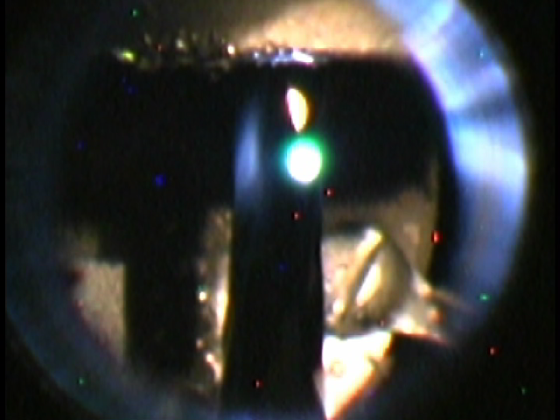
Background
Liquid Li appears as an attractive option for high power beam applications.
20 kW beam on
  Stable operation under 20 kW load or ~5 MW/cm³ at the peak in 2003⁽¹⁾.
  Stable formation of ~50m/s, ~10 µm thick Li jet in 2011^{(2),(3)}.
Next step
Further demonstration of the liquid lithium stripper under a high thermal loading by a proton beam.
High speed, thin Li jet in vacuum
Rev. Sci. Instrum. 76, 73501 (2005); http://dx.doi.org/10.1063/1.1942530
(2) JINST 4 P04005 doi:10.1088/1748-0221/4/04/P04005
(3) ANL/NE-11/01 (2011)
3

Slide 4
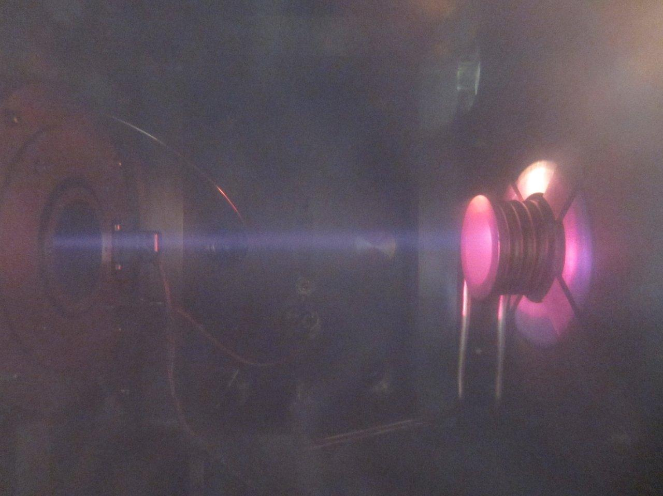
Background
Use a beam from the Low Energy Demonstration Accelerator (LEDA) ion source (75 kA, 110 mA) for the beam-on-film test.
+
Many water-cooled components!
4

Slide 5
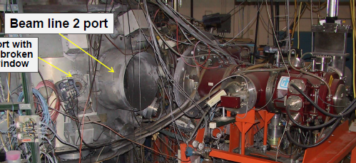
Lithium and water hazard
ANL, USA, Lithium spill and fire, Lithium Processing Test Loop, 1979
  due to incompatible material and stress cracking from cold working.
Sandia National Lab. (SNL), USA, Lithium fire, LIquid Metal Integrated Test System (LIMITS), 2005?
  due to incompatible material.
SNL, USA, Lithium-water explosion, Plasma Materials Test Facility (PMTF), 2011
  due to use of brittle, non-Li compatible material as a water pressure boundary.
Personal communication
ORPS: NA-SS-SNL-1000-2011-0007
Broken flange!
Not limited to, but all Li/H₂O boundaries must retain integrity under all conditions.
Status Report on Sandia Plasma Materials Test Facility (PMTF) and Actions after Li Fire on 26 Aug 2011, PFC Group Annual Meeting, 20-22 June 2012 - PPPL

Slide 6
Lithium and water hazard
In LEDA + Li system:
  Hot liquid lithium in the vacuum chamber
  Water cooled plasma chamber
  Water cooled injector
  Water cooled turbo pumps
  Water cooled LEBT solenoids
  Water cooled apertures

Slide 7
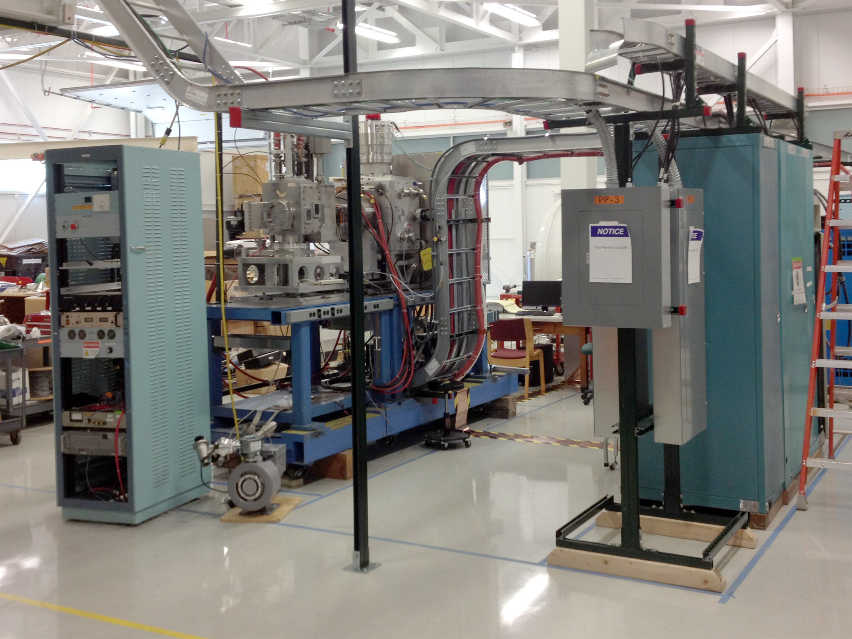
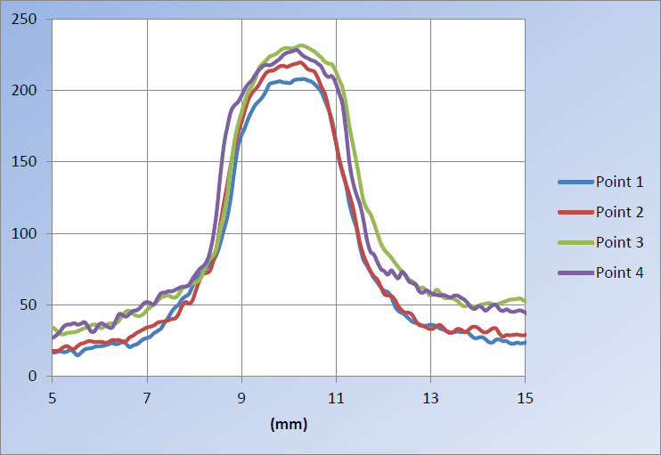
LEDA source re-conditioning and beam line design
Reconditioning, shake-down, new beam line design at MSU-FRIB.
LEDA source at MSU
First proton beam at 14 mA
Beam at aperture
Beam profile
7

Slide 8
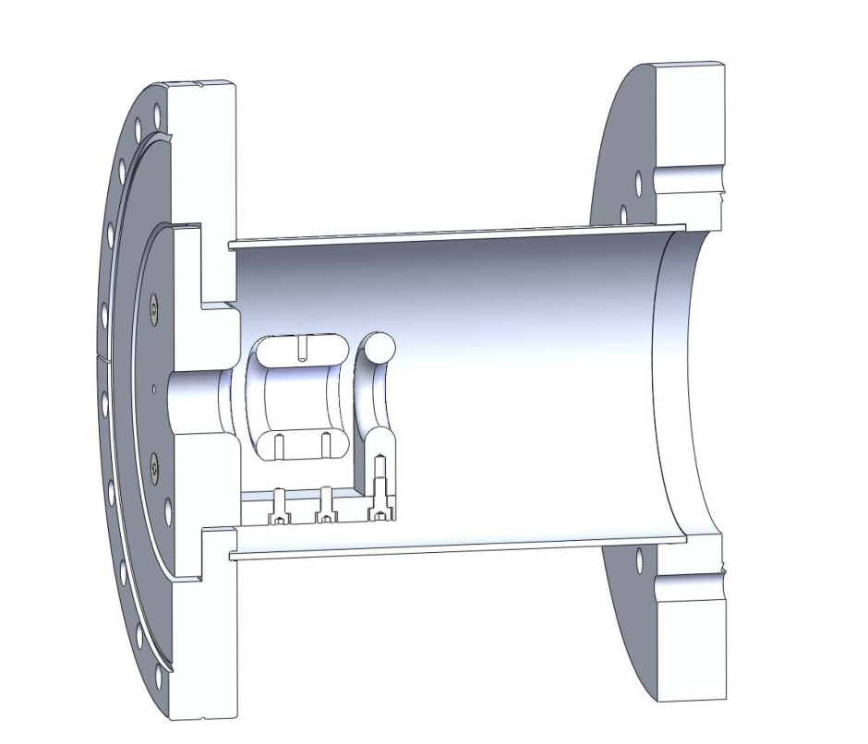
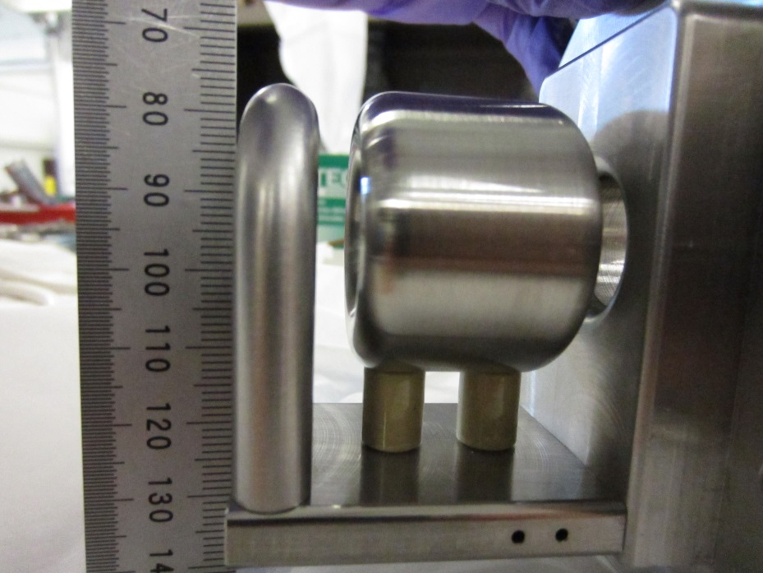
LEDA source re-conditioning and beam line design
Final focusing using an Einzel lens for no-water near Li.
Could image up to 4-5 mA @ 65 kV to 3-mm base-base spot size.
8

Slide 9
Mating LEDA source to Li system
Overall layout in ALEX, Bldg. 370 at ANL.
C-2: All metal containment designed for alkali metal experiments.
Top view
LEDA source
Li system
3.63 m
Beam line
3.00 m
2.95 m
9

Slide 10
Mating LEDA source to Li system
Extensive safety analysis for Li + water hazard.
10

Slide 11
Mating LEDA source to Li system
Extensive safety analysis.
Single wall isolation
Plasma chamber flange
  6420 bar
Injector mount
  277 bar (internal)
  13.2 bar (external)
Double wall isolation
Plasma chamber body
  56.6 bar
Turbo pump
Flange
  56.6 bar
4 mm aperture
  49.1 bar
5 mm aperture
  49.1 bar
Triple wall isolation
Plasma chamber solenoids
  56.6 bar
LEBT solenoid
  169 bar
Note: all pressure ratings based on the assumed operating temperature of 93 °C.
11

Slide 12
Mating LEDA source to Li system
Reentrant shroud prevents external water leak Into C-2.
12

Slide 13
Mating LEDA source to Li system
Additional safety features
  Apertures minimize Li ingress and potential water ingress in case of leakage.
  Gate valve closes if source side pressure increases due to potential water leakage to protect Li from water.
5 mm aperture
4 mm aperture
Pneumatic gate valve
13

Slide 14
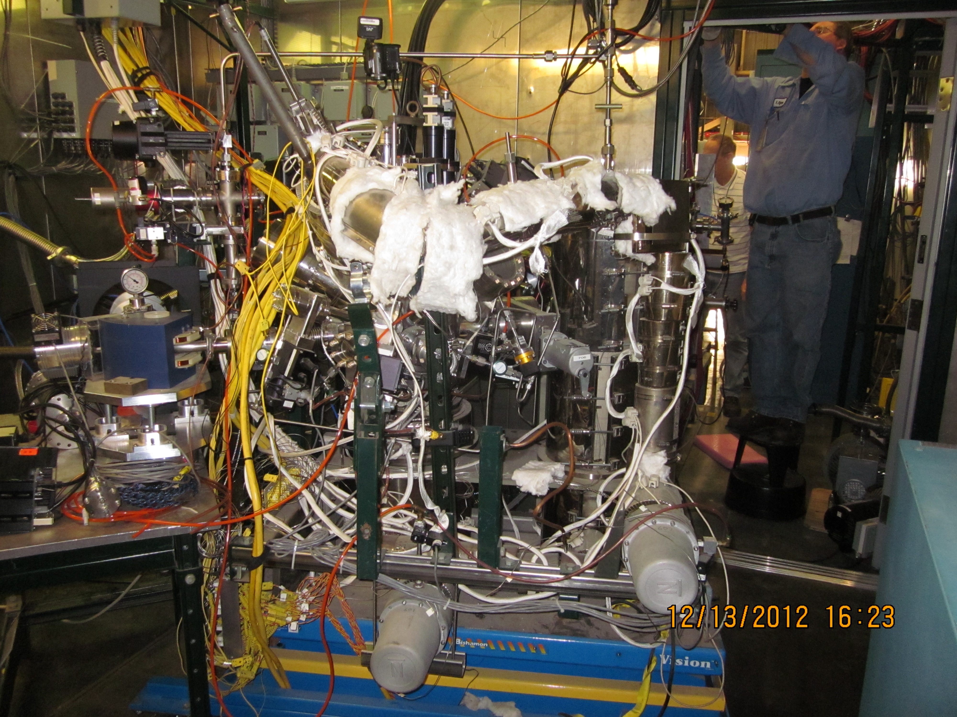
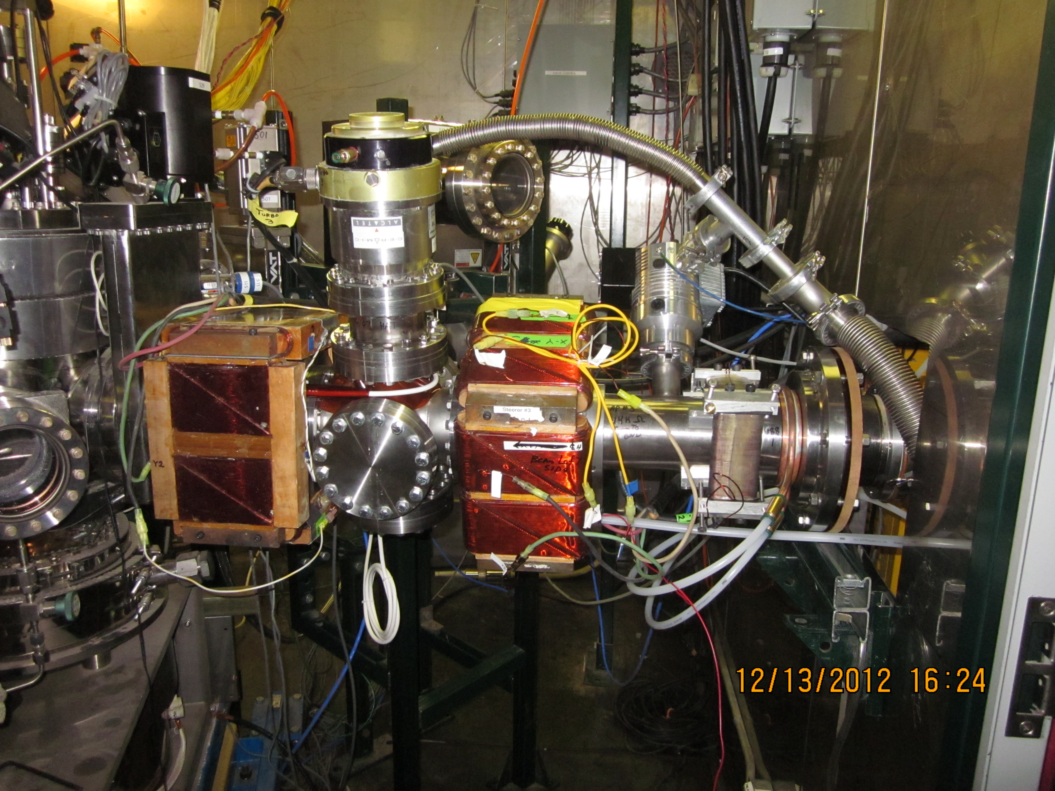
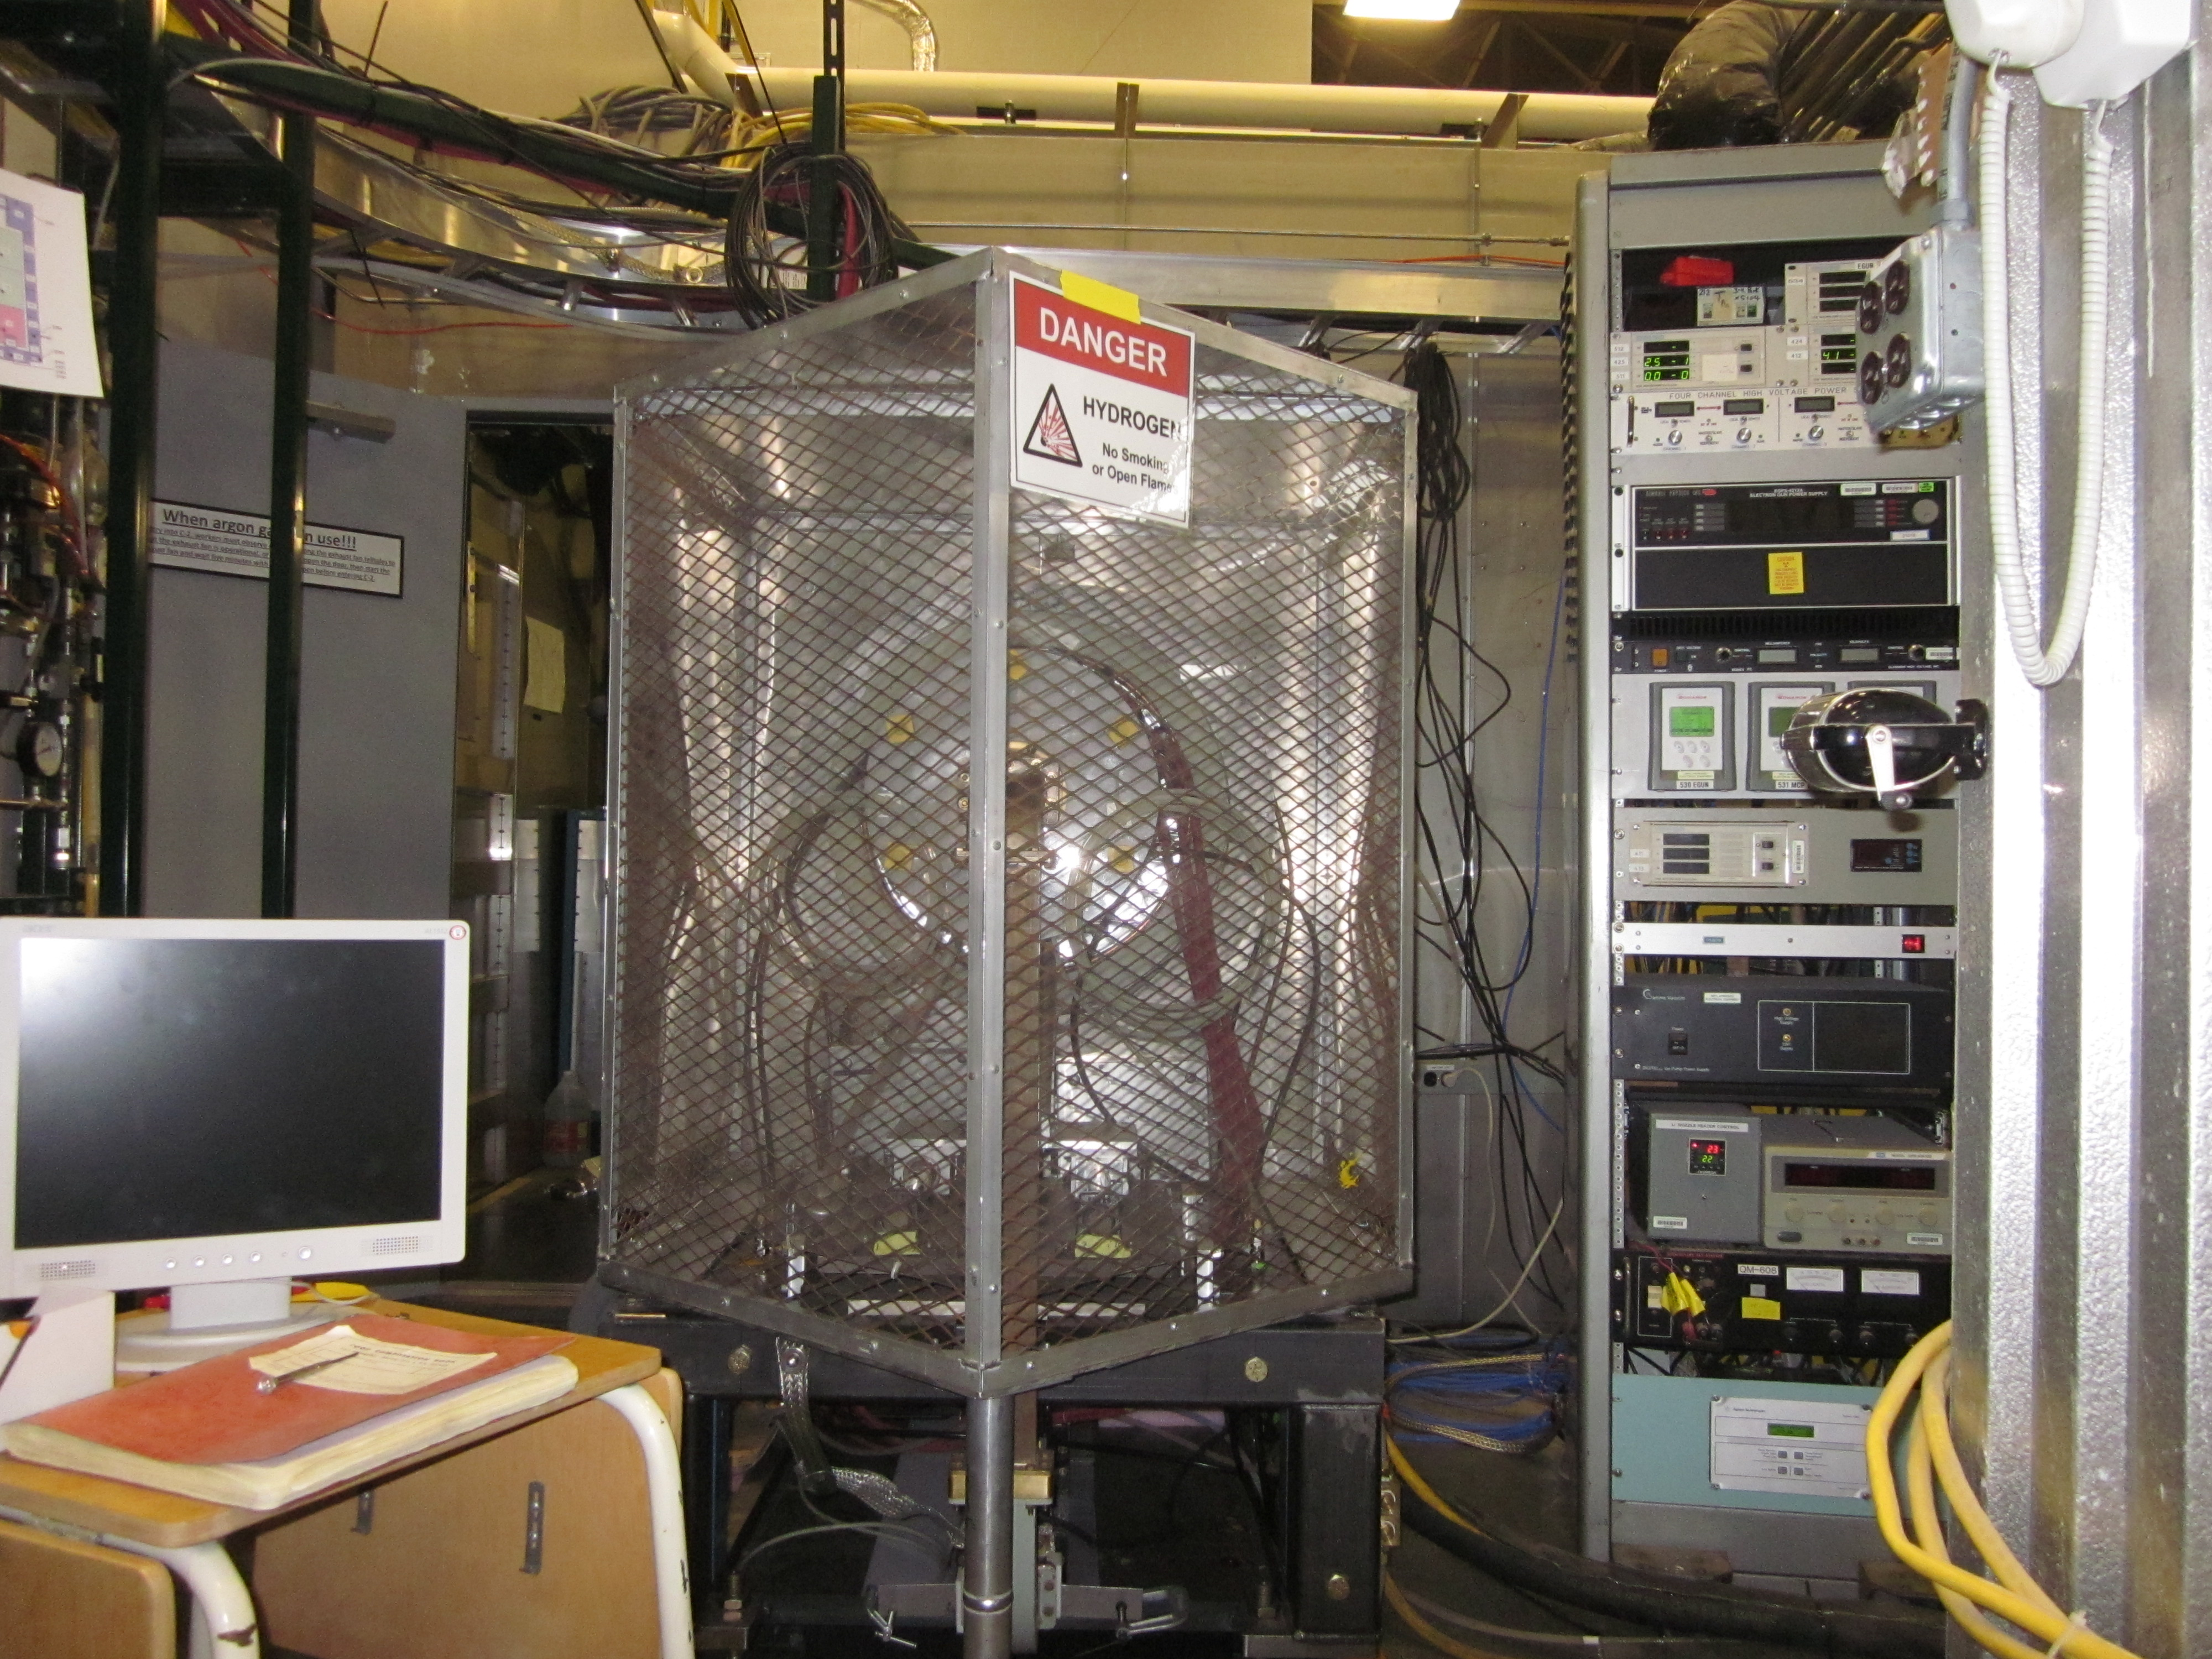
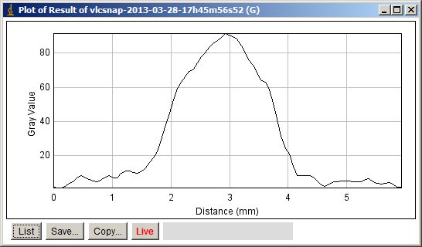
Mating LEDA source to Li system
Some pictures and beam profile.
Li system in C-2
Beam line without shroud
Beam profile
Achieved 3-mm base-base beam width at 4-5 mA, 65 keV at ANL; space charge effects at higher currents.
LEDA source
14

Slide 15
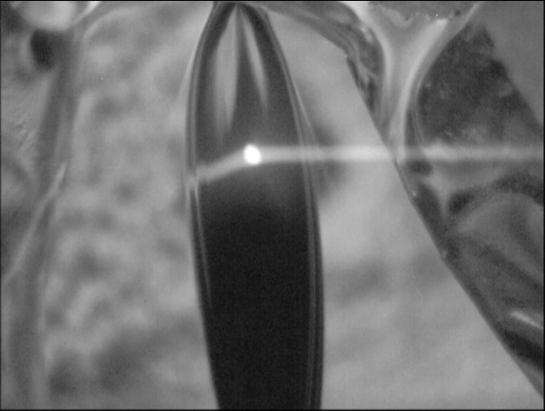
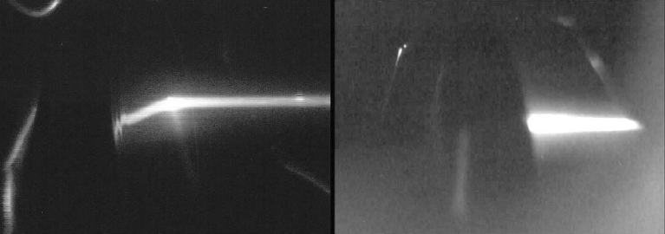
Proton beam-on-film experiment
Lithium thin film stays intact with proton beam.
Proton beam (65 kV, 4.6 mA, σ = 0.7 mm) on the liquid lithium film, ~ 10 μm thick, at 50 m/s.
Focusing variation via the Einzel lens. Film width ~15 mm.
April 5;
front view (left),
back view (right)
Beam viewing via neon gas additive; ~5E-6 Torr total pressure.
15

Slide 16
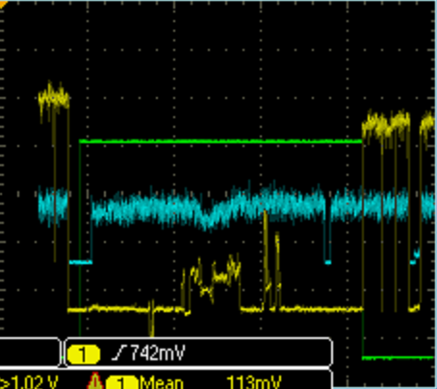
Proton beam-on-film experiment
Beam current data measured at beam dump.
Beam on without Li flow 5:22
beam off while establishing Li flow 5:22-5:49
Li valve opened 5:37
Beam on with Li flow 5:49-
Beam manipulation
Lost beam 10:18-10:24
Beam on with Li flow
Li valve closed 11:01
Beam on without Li flow
1
Beam dump
3
8
Li valve position,
green line (open)
2
5
6
7
9
4
Beam
Li film completely stopped beam!!
Beam zero point
Beam dump zero point
Li valve position,
green line (closed)
16

Slide 17
Proton beam-on-film experiment
Movie
http://www.youtube.com/watch?v=qPwdYQbp3Bg&t=2m26s
Additional movie (evolution of the Li film)
http://www.youtube.com/watch?v=iOv1D5LaId8
17

Slide 18
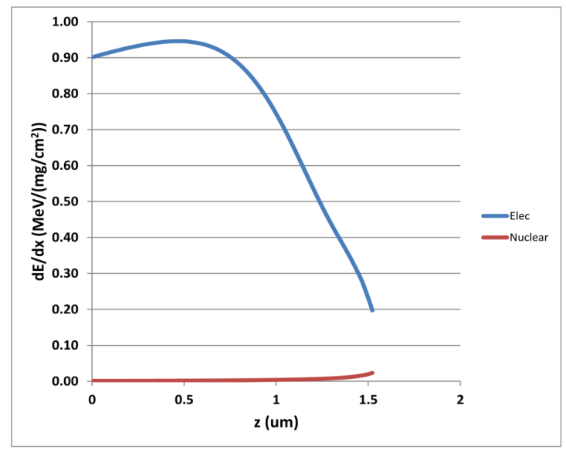
Proton beam-on-film experiment
Results
 | FRIB | Experiment | Ratio (Exp/FRIB)
Beam power (W) | 700 | 299 | 0.43
Beam σ (mm) | 0.62 | 0.70 | 1.17
Beam power/σ (W/mm) | 1129 | 427 | 0.38 (151 kW)
Beam power: 4.6 mA x 65 keV = 299 W
Linear power density ~38 % of the maximum power density at FRIB with a 400 kW of U at 200 MeV/u.
65 keV protons only penetrate 1.5 μm in the 10 μm thick Li film. The net effect would be a power density higher than FRIB by a factor 2 (~0.43 x 0.62/0.7 x 10/1.5).
Uncertainties: Faraday cup correction factor, beam fluorescence profile, effect of short range of protons.
18

Slide 19
Summary
First time that a thin liquid lithium film (~ 10 μm) was successfully used to stop an ion beam with a high power deposition.
The 65 keV protons stopped in the first 2 μm depositing ~300 W on a beam spot with σ = 0.7 mm.
For FRIB we expect 700 W in full thickness (~10 μm) on a beam spot with σ = 0.62 mm.
This was the most important validation of the choice of liquid lithium as the charge stripper medium.
19

Slide 20
20

