Slide 1
High Power Targets and Performance Optimization versus Costs or
How much shall one pay for a useful neutron?
F. X. Gallmeier
5th High Power Targetry Workshop
May 20, 2014

Slide 2
Outline
Illustration of neutron path
Neutron accounting
Improvement options
Second target station - an opportunity

Slide 3
Path of Useful Neutron from Birth to Death
Detector
Proton
Sketch of CNCS

Slide 4
Neutron Economy at SNS
1.4 MW SNS produces: 2 ×10¹⁷ n/s
Thermal neutrons at beamline start: 2×10¹² n/s
Neutrons at sample position (white): 2×10¹¹ n/s
Neutrons at sample (chopped): 2×10¹⁰ n/s
Neutrons scattered: 2×10⁸ n/s
Neutrons counted: 5×10⁷ n/s
Neutron counted/Neutrons produced: 3×10⁻¹⁰

Slide 5
Costs Analysis
SNS construction cost: $ 1.4×10⁹
Yearly SNS budget: $1.7×10⁸
SNS expected life: 40 yrs
Yearly hours of operations: 5000h
Yearly counted neutrons: 9×10¹⁴ n/yr
Neutrons per dollar: 4×10⁶ n/$

Slide 6
Handles to Improve #neutrons/$
Beam power increase
Target/Moderator/Reflector optimization
Neutron optics optimization
Detector coverage
Background reduction
New instrument concept

Slide 7
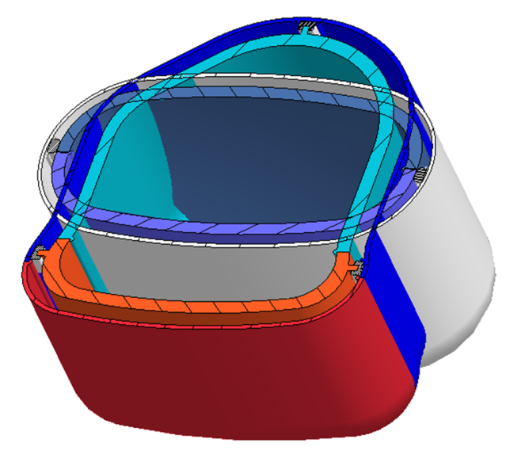
SNS Source Improvement
Next-generation IRP:
  Cadmium poison for decoupled moderators (increases IRP life from 6MWyr to 8 Mwyr)
  Coupled hydrogen moderator enlargement (increases flux output by 50%)
Enforce full para-hydrogen conversion in coupled moderator
Replacing of IRP light-water by heavy water (10-20% flux increases)
Increase power within two years to promised 1.4 MW
A factor 2 can be envisioned
Curtesy: Harada/JPARC

Slide 8
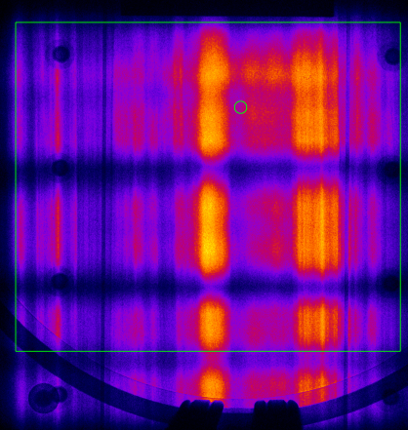
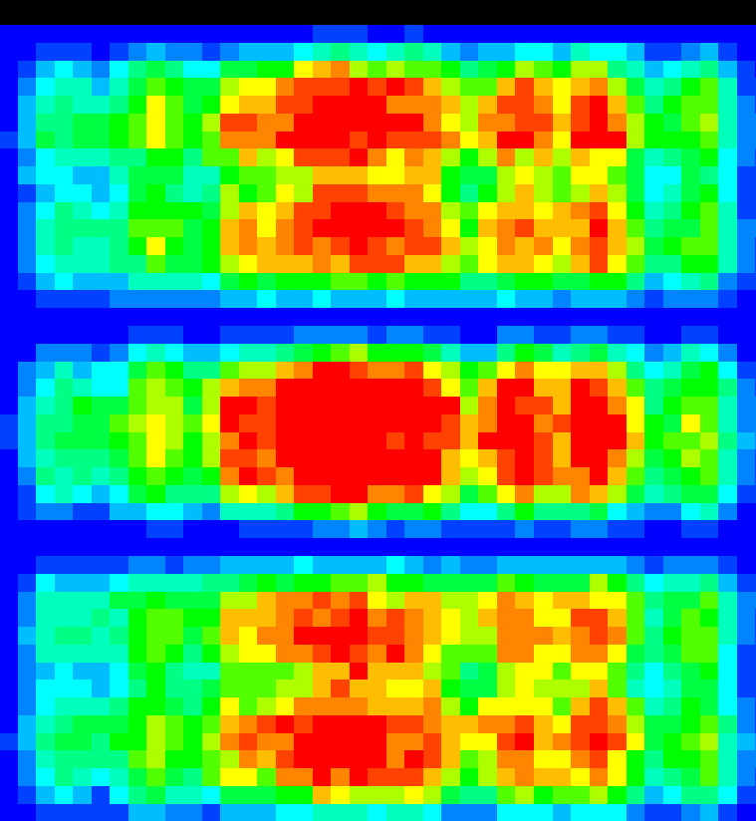
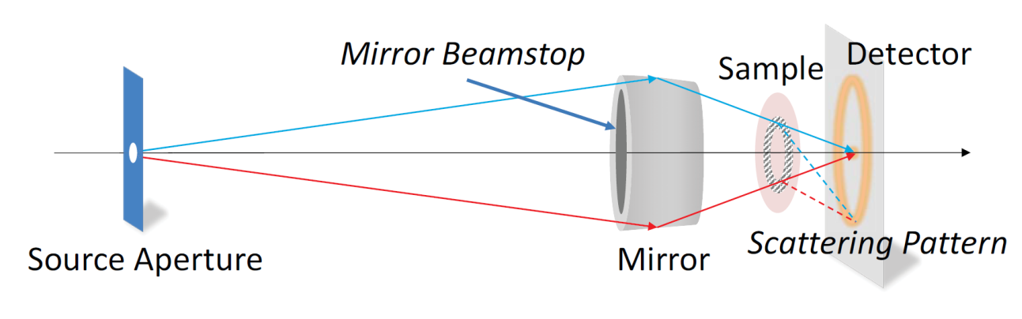
Neutron optics improvements
Recent developments
  High m-value mirrors (m ≥ 7 today)
  True curved guides – elliptical, parabolic
  Guides may not be the answer – curved single
  mirrors (HFIR IMAGINE: 15 x 18 mm² ⇨ 2x3mm² with
  uniform divergence. Solution: 2 bandpass mirrors + 2 elliptical
  focusing mirrors)
Strategy
  Match new technologies to instrument requirements
  Test devices with collaborators (e.g. Wolter optics, K-B mirrors, novel combinations of guide shapes, adaptive optics)
CG1 measured and simulated guide exit
Compact SANS employing Wolter optic tested at HFIR
Notes:
Structure in CG1 is real and largely expected based on simulation model. Specifics of installation and alignment, however, make prediction of detailed performance extremely difficult. - one of the reasons for in situ alignment and adjustment needed – (guide is 11 mm wide by 15 cm tall).

Slide 9
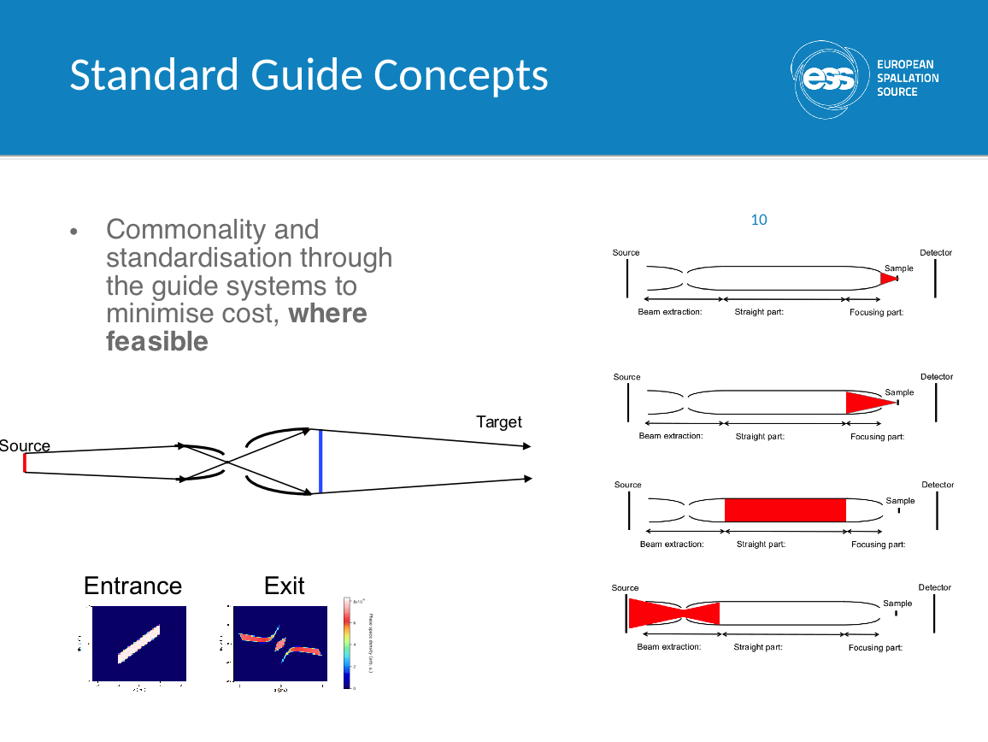
Curtesy: Phil Bentley/ESS

Slide 10
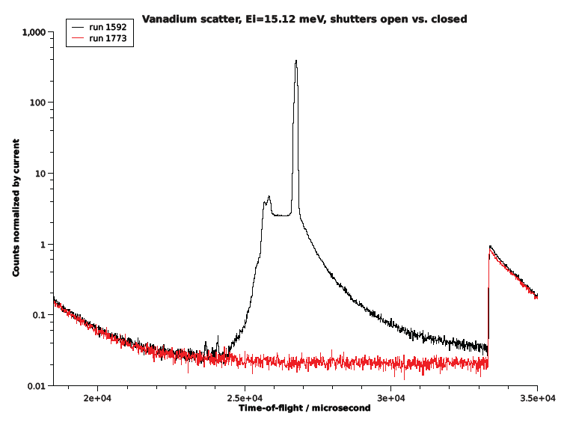
Working on Background Reduction
Elastic scattering
from Vanadium
Inelastic feature from
Vanadium
Spallation
Event every
16.7 ms
(1/60 Hz)
HYSPEC: Background tail ends about 3.5 ms beyond spallation event

Slide 11
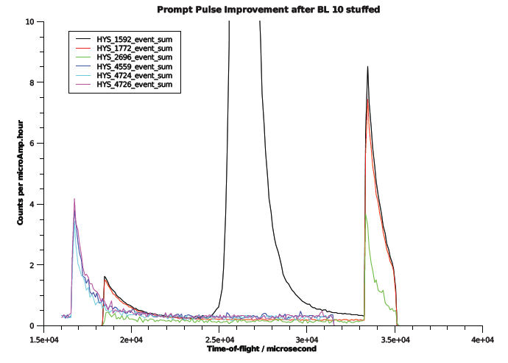
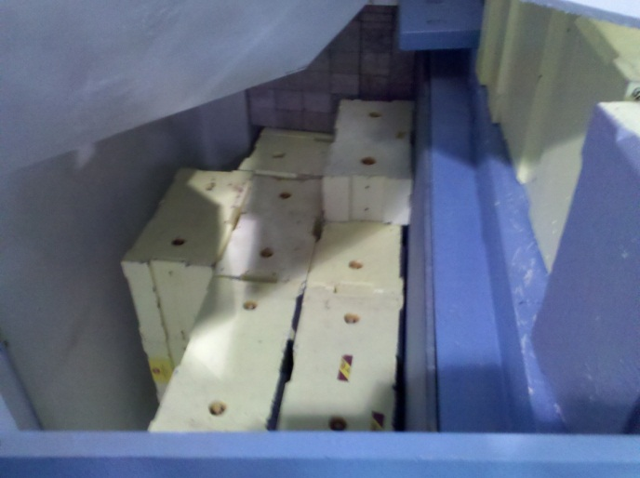
Before
Now
Wrap-around

Slide 12
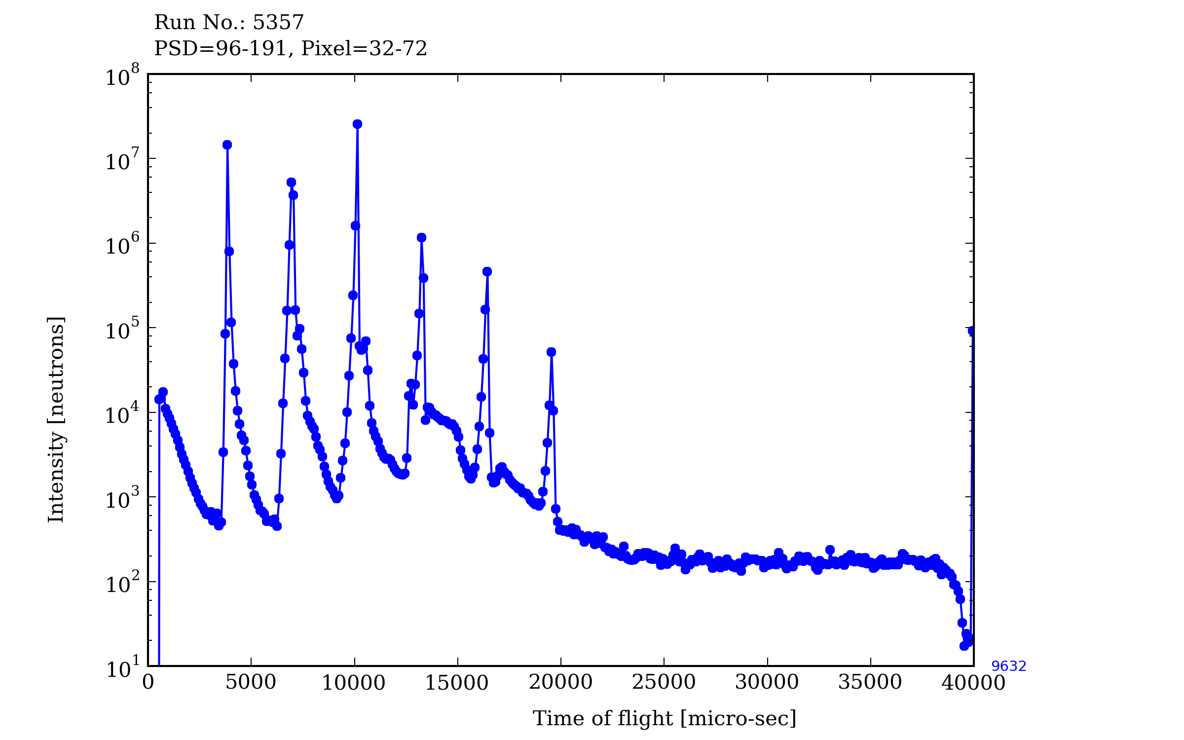
“Time-constant” Background
First indication of delayed neutron contribution in neutron scattering instrument
Also a photo-neutron based background is expected
Elastic peak
inelastic signal
curtesy: M. Harada/JPARC

Slide 13
Second Target Station – a chance to do it better
A second target station uses the same accelerator frontend
A second target station allows to copy positive experience from first target station, and solve incidents of negative experience
A second target station can be complementary in instrumentation to a first target station
ISIS has demonstrated how this is done
SNS thinks heavily about STS
JPARC also has ideas of a second target station

Slide 14
FTS+STS Baseline Parameters
Parameter | STS Short-Pulse | FTS Short-pulse
Power (kW) | 467 | 2000
Repetition Rate (Hz) | 10 | 50
Pulse Length (ms) | <1e-3 | <1e-3
Assumptions based on accelerator build-out to 2.8 MW power at 1.3 GeV proton energy according to PUP.

Slide 15
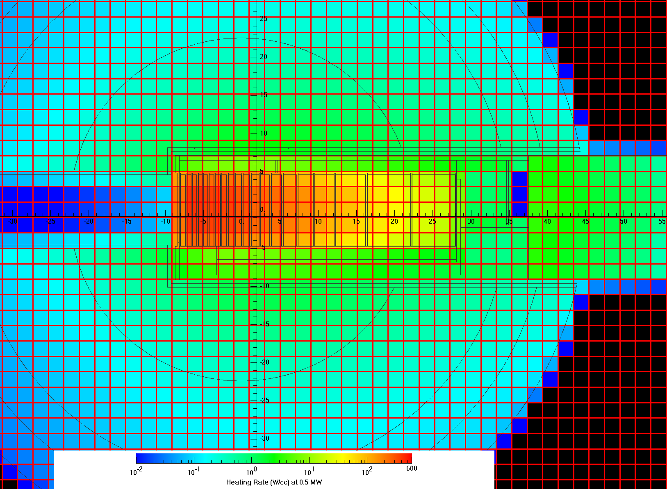
What are the drivers for moderator performance?
Choice of target material: tantalum-clad tungsten (high atomic mass, high density, suppressed fission)
Compact proton beam footprint: 30 cm²
Intermediate energy proton beam:1.3 GeV proton will result in neutron yield of about 33
Bright compact neutron source: 10 cm x 10 cm high luminosity

Slide 16
Choices of Moderator materials
Hydrogeneous materials for fast neutron slowing down and moderation
Liquids for heat extraction
Radiation resistance
Para-hydrogen moderator T=20 K
Ambient water as pre-moderator and ambient temperature moderator
Carbo-hydrates, ammonia?
ortho
para

Slide 17
Coupled Moderator Parameter Space
PMR
VIEWW
2*MBR
VIEWH
PMT
PBH
PMB
TZO
x-z y-x z-y
Fixed parameters:
Viewed area: VIEWW x VIEWH
Proton beam area: PBW x PBH = 30 cm²
Moderator height: MBH = VIEWH
VIEWHxVIEWW Configurations: 10x10, 7x7, 5x5, 3x3, 2x2 cm

Slide 18
Short Pulse Coupled Hydrogen Moderator Studies

Slide 19
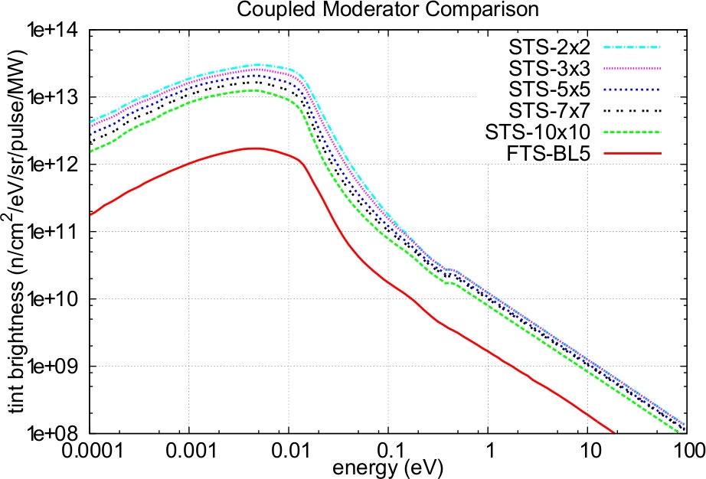
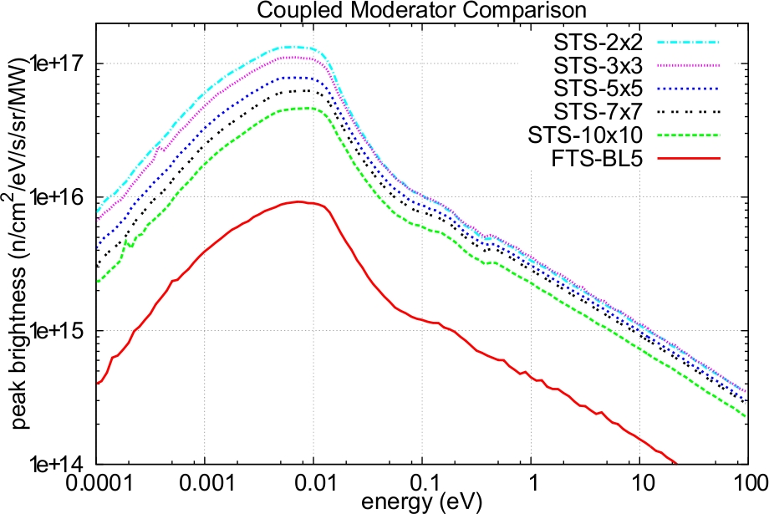
Coupled Moderator Performance
Gains in time-integrated and peak brightness of a factor of 5 are possible for SP-STS compared to FTS on a per unit power basis for moderators with 10x10cm viewed area
Another factor of 3.2 can be gained in brightness by reducing the viewed area to 2x2cm.

Slide 20
Crossing new thresholds in instrument capabilities requires total optimization
> x100 Performance Gains
Source Parameters
Beam Transport
Sample
Detectors
Data Acquisition/Data Reduction
Data Analysis
Repetition Rate
Target
Moderators
Small Moderators to Small Samples
Size
Beam Divergence
Sample Environment
Spatial Resolution
Count Rates
Area
$$$
Integrated
Live Results
Computational Sciences
High Performance Computing
Theory
Polarization
Visualization
Curtesy: K. Herwig/ORNL
Notes:
Science mission dictates the neutron phase space that is required at the sample position.
Instruments will likely be more narrow in what they can do – but do that much better in order to obtain these types of gains (e.g. smaller samples)

Slide 21
STS small sample cold spectrometer multiplies gains across elements
Source
1.5
Beam Divergence
2
Detector Coverage
3
280x
Gain over CNCS (1.4MW)
High Brightness Moderator
2.6
Repetition Rate Multiplication
12
Curtesy: K. Herwig/ORNL
Notes:
Source gain is peak brightness 467 kW STS 10/10 cm2 moderator compared to 2MW FTS coupled moderator.

Slide 22
Planning Suite of 19 instruments for STS
Instrument | Description | Length (m) | Sample size (cm) | Moderator Type | Moderator Size HxV (cm²) | Beamline
DIFFRACTION
NeSCRY | Magnetic diffraction for small crystal and epitaxial materials | 90 | 2 | Cold, coupled p-H2 | 5x5 | 14
 |  | 40 | 2 | Cold, decoupled p-H2 | 5x5
VERDICT | Long-wavelength neutron diffractometer for magnetic structure determination similar to ISIS-TS2 WISH | 40 | 2 | Cold, coupled p-H2 | 5x5➔3x3 | 13
HiRes | High resolution powder diffractometer | 100 - 120 | 3 | Cold, decoupled p-H2 | 7x7 | 20
EWALD | Macromolecule single crystal diffractometer (1 mg samples) | 90 | <0.1 | Cold, coupled p-H2 | 3x3 | 16
DYPOL | Macromolecule dynamically polarized single crystal diffraction | 90 | <0.1 | Cold, coupled p-H2 | 5X5➔3x3 | 12
REFLECTOMETRY
TLR | Kinetics liquids reflectometer | 15-20 | 2 | Cold, coupled p-H2 | 5x5➔3x6 | 2
mmLR | Small sample liquids reflectometer | 30-40 | 1 | Cold, coupled p-H2 | 3x3 | 4
M-STAR | Polarized neutron reflectometer | 20-30 | 2 | Cold, coupled p-H2 | 3X3 | 7
M-WASABI | Polarized reflectometer combined with GISANS | 20-30 | 2 | Cold, coupled p-H2 | 3x3 | 6
SANS
SWANS | High-resolution small and wide-angle neutron scattering. (Molecular ordering to nanostructures) | 20 | 1 | Cold, coupled p-H2 | 3x3 | 15
FLOODS | Flux Optimized Order-Disorder SANS. Fast kinetics and out-of-equilibrium behavior | 20-30 | 1 | Cold, coupled p-H2 | 3x3 | 5
INELASTIC/QUASI-ELASTIC
superCNCS (SBIS) | Cold neutron chopper spectrometer optimized for high flux on small samples (10 mg) and polarization | 60 – 120 | 1 | Cold, coupled p-H2 | 3x3 | 17
superLET | Cold neutron chopper spectrometer optimized for large single crystals and polarization | 25 | 5 | Cold, coupled p-H2 | 10x10➔5x5 guide at 75 cm | 11
MiBARS | Mica-based very high resolution backscattering spectrometer | 60 | 3 | Cold, decoupled p-H2 | 7x7 | 19
WAVESS | Very broad dynamic range using wide-angle velocity selector as analyzer | 15-17 | 3 | Cold, decoupled p-H2 | 7x7 | 18
JANUS | Hybrid spectrometer (low-Q chopper spectrometer, backscattering analyzer spectrometer) | 50 | 3 | Thermal-Cold, decoupled | 7x7 | 10
CAMEA-type | Extreme environment/inverse geometry | 40-50 | 1 | Thermal-Cold, decoupled | 3x3 | 8
SPHIINX | SPHerical Indirect Inelastic Xtal spectrometer (70 meV elastic, 1% dw/w) | 35-40 | 3 | Thermal-Cold, decoupled | 7x7 | 9
EXTREME CONDITIONS
Zeemans | Versatile instrument designed for studies at the highest magnetic fields | 60 | 2 | Cold, coupled p-H2 | 5x5➔3x6 | 1

Slide 23
Conclusion
Power is only one of many wheels to improve performance/efficiency of a neutron source

Slide 24
Backup slides

Slide 25
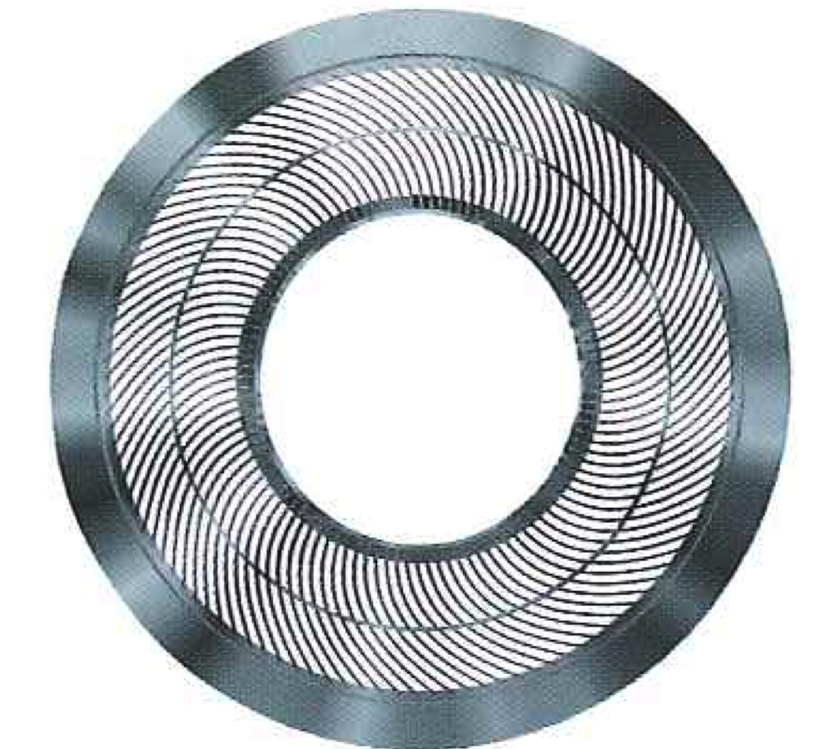
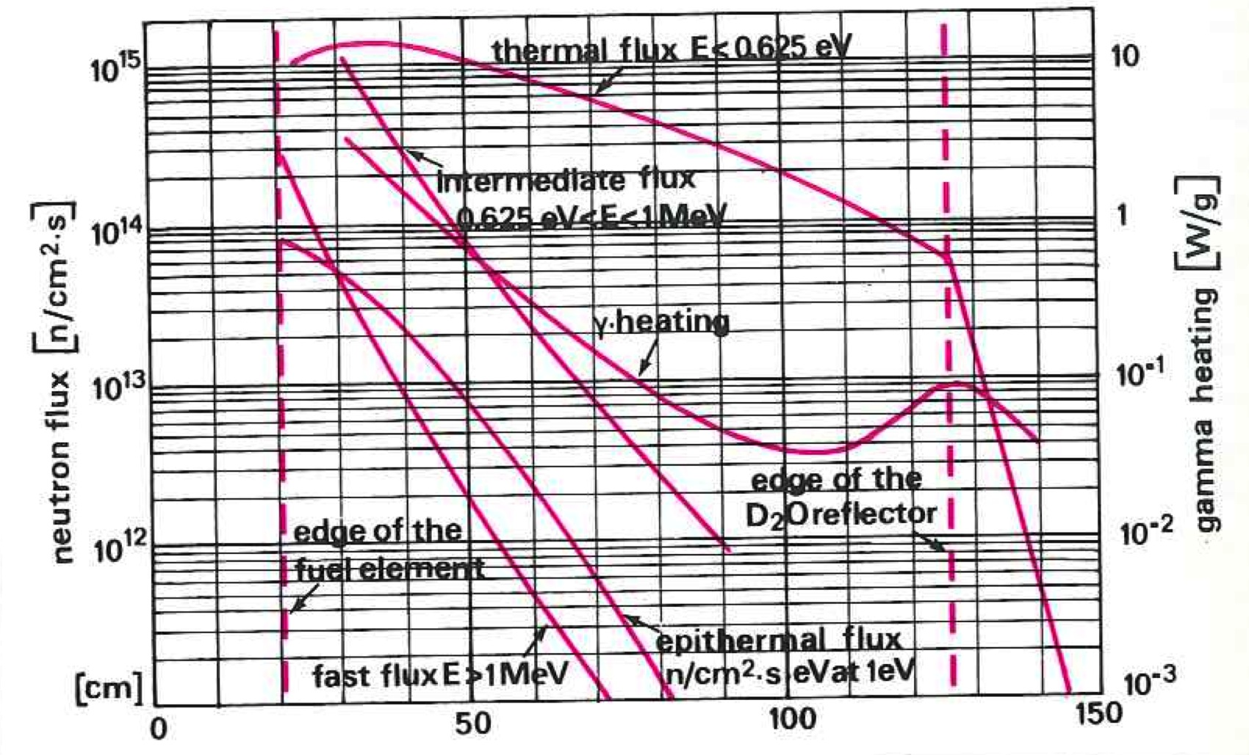
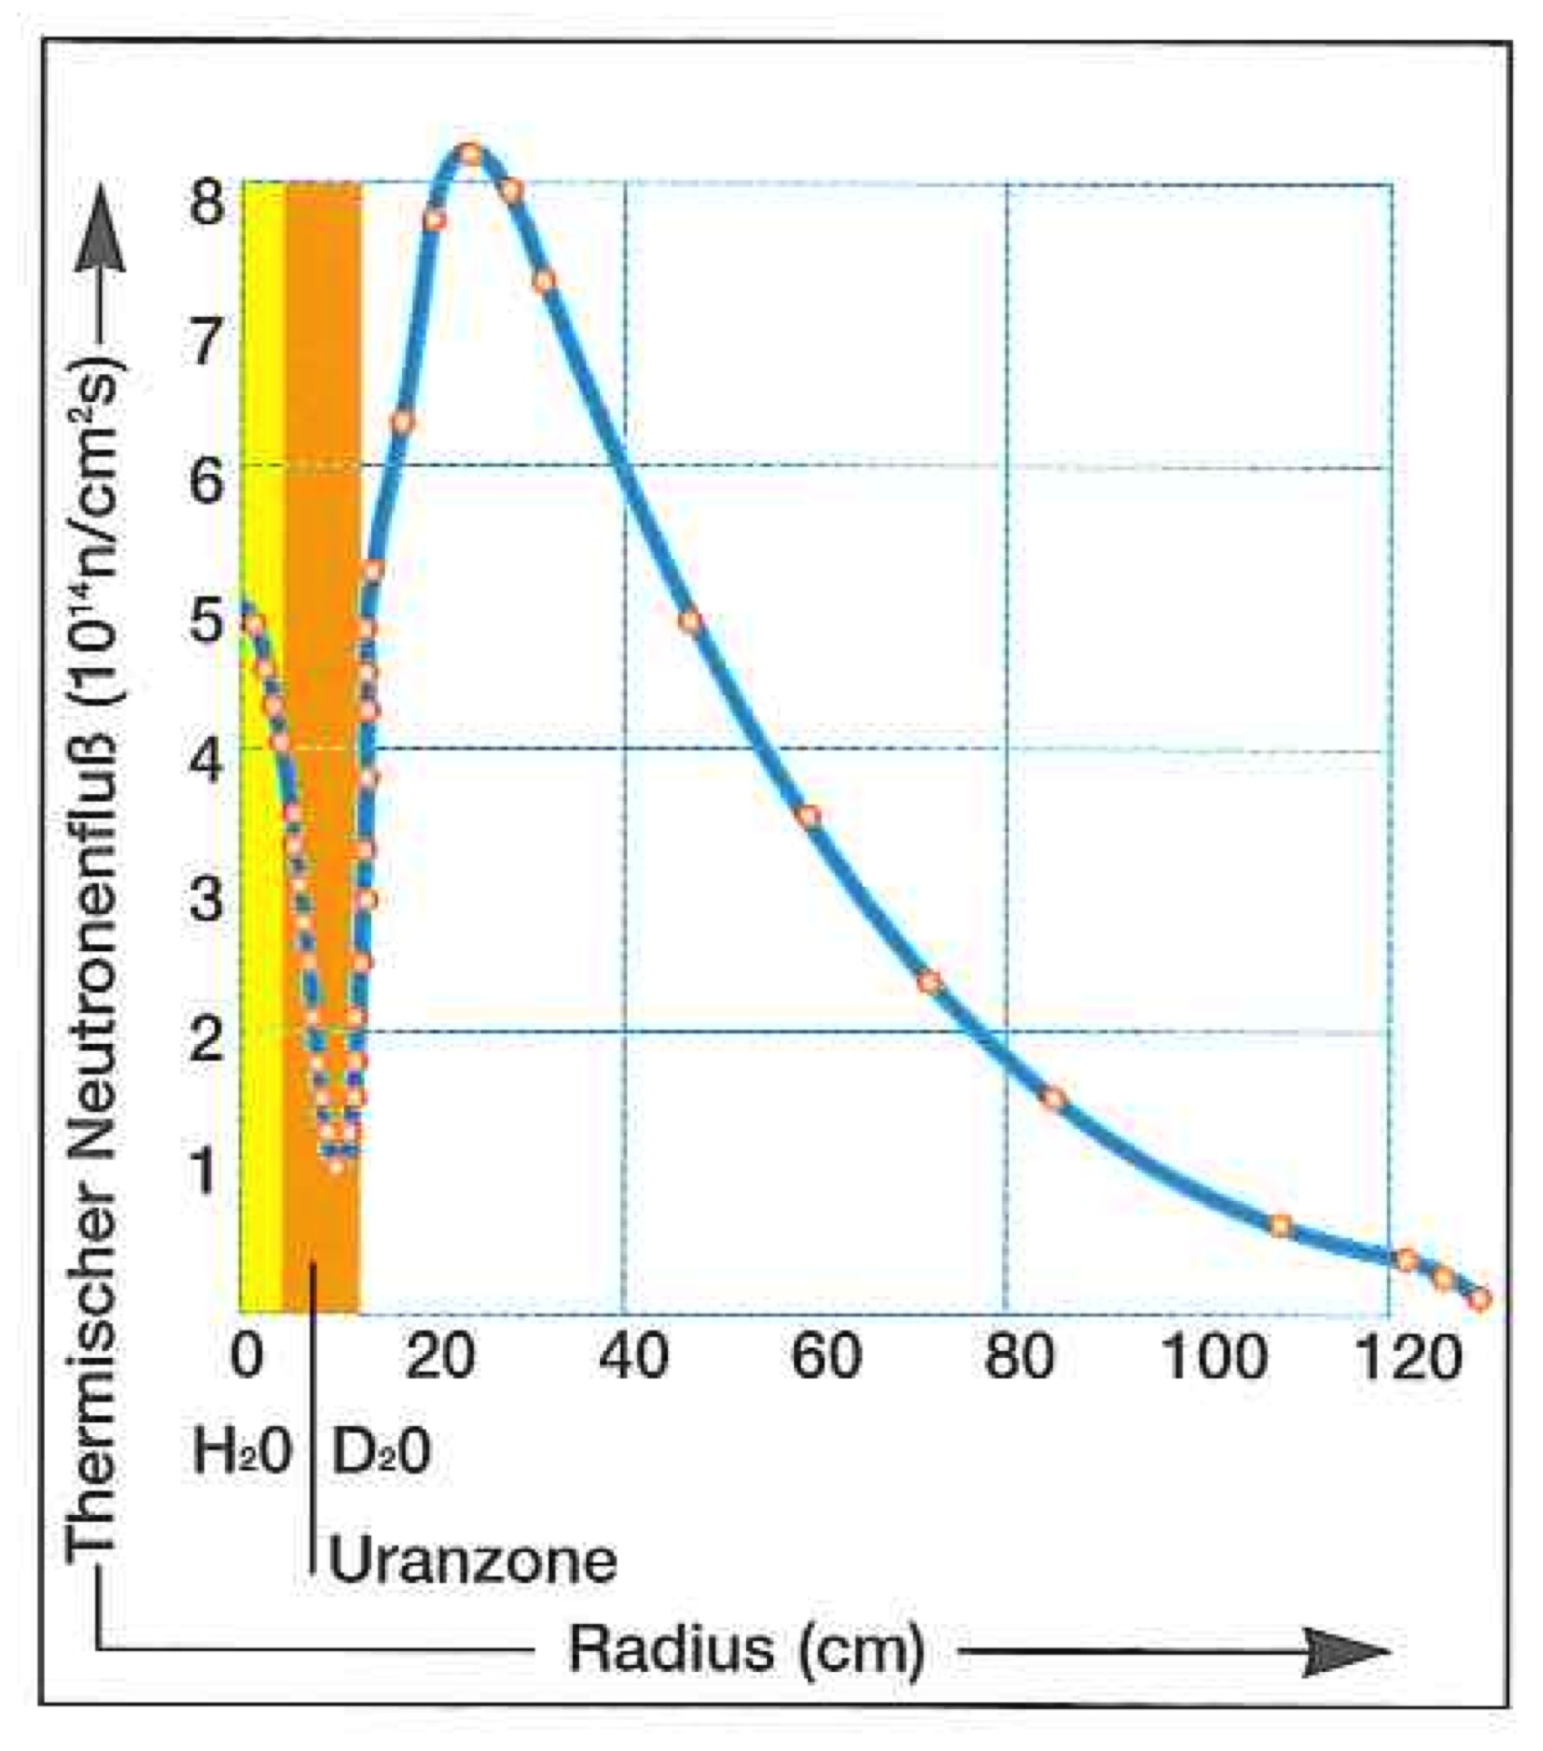
ILL vs FRM2
Power:
60 MW vs 20 MW
3:1
Unperturbed thermal Neutron Flux in reflector:
1.5×10¹⁵ vs 8×10¹⁴
n/cm²/s
2:1

