Slide 2
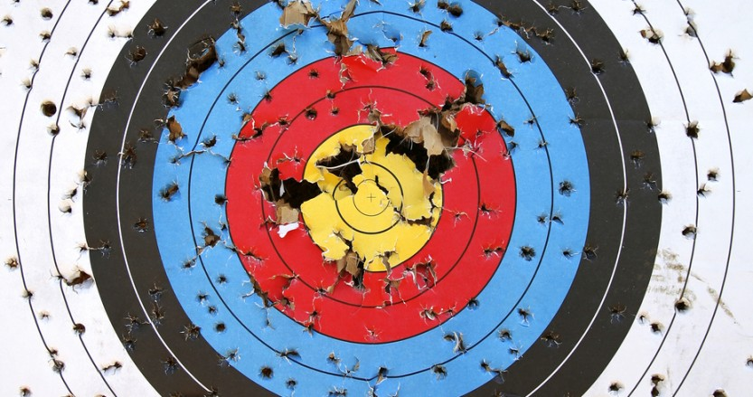
A well used target…

Slide 3
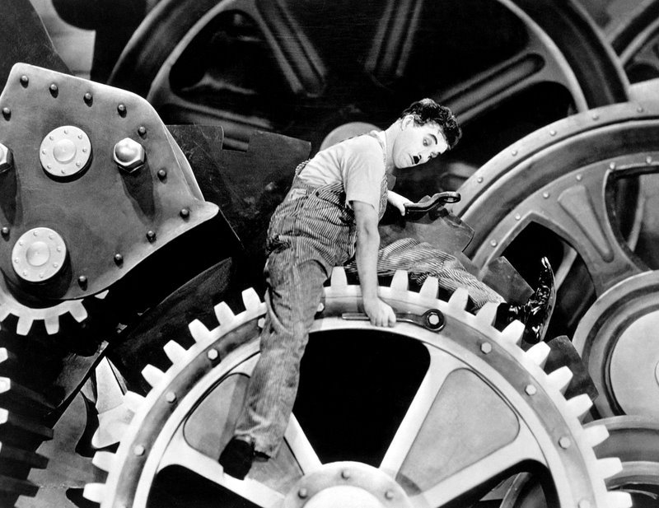
Targetry: A Vital Cog of the Accelerator Machine
Recently major accelerator facilities have been limited in beam power not by their accelerators, but by their target facilities
“When things go wrong, they can really go wrong” - Me
“The SNS accelerator power is restricted today by the targets” – M. A. Plum, IPAC’13
“When you have no spare, you must repair” – J. Hylen, NuMI-MINOS, 2009

Slide 4
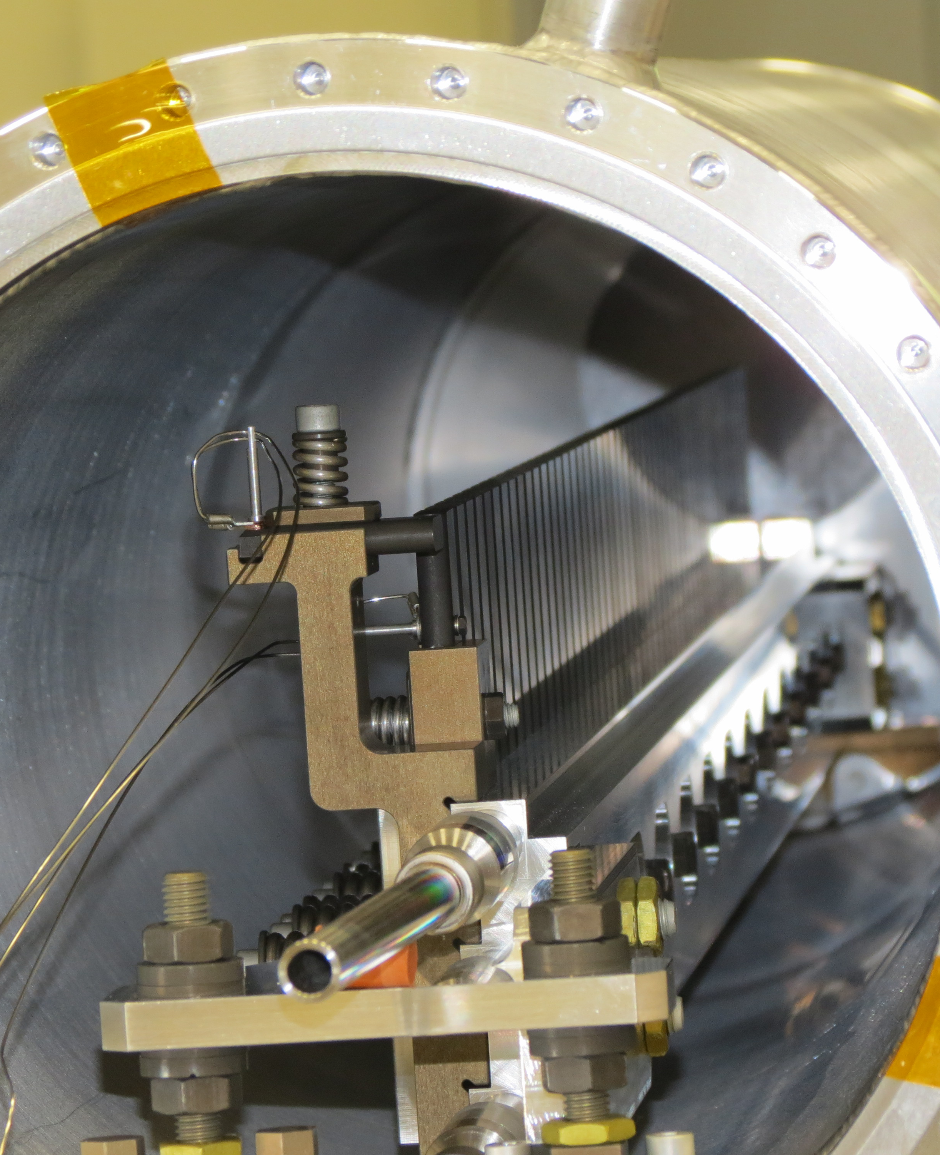
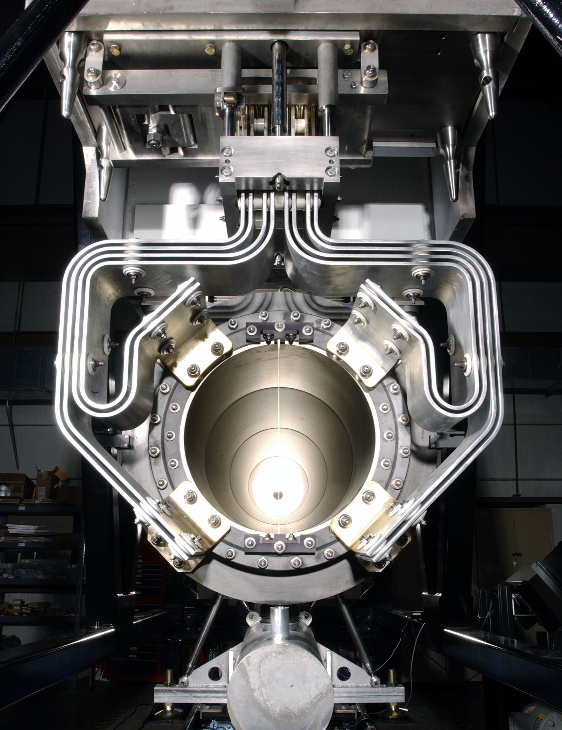
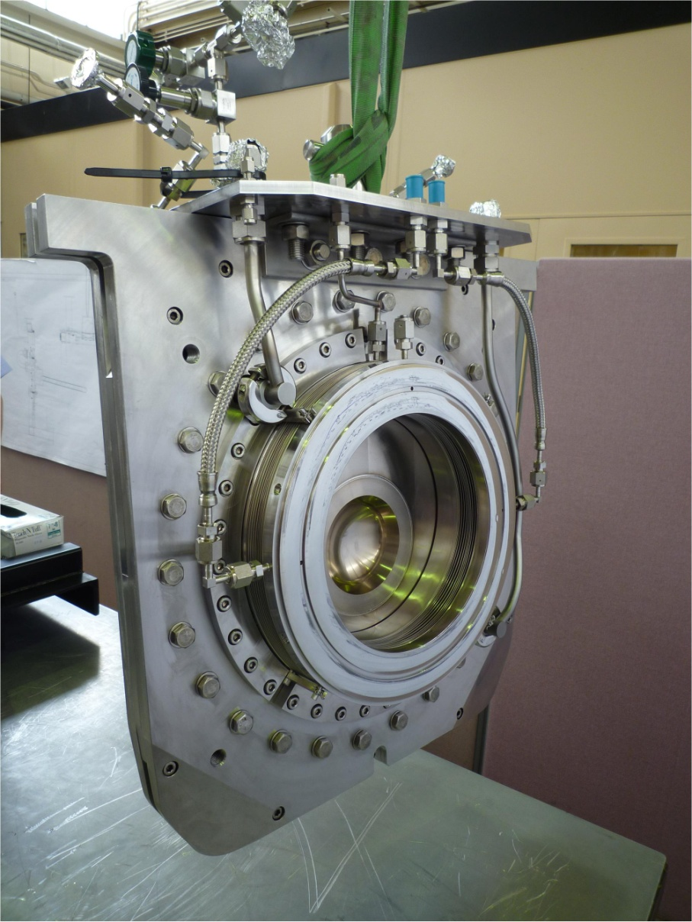
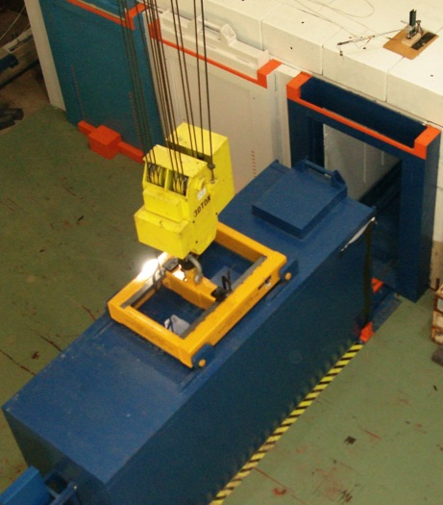
High Power Targetry Scope
Photo courtesy of CJ Densham (RAL-STFC)
Target
Solid, Liquid, Rotating, Rastered
Other production devices:
Collection optics (horns, solenoids)
Monitors & Instrumentation (high radiation/temperature)
Primary Beam window
Absorbers/Collimators
Facility Operations:
Remote Handling
Shielding & Radiation Transport
Air Handling
Cooling Systems
Waste stream

Slide 5
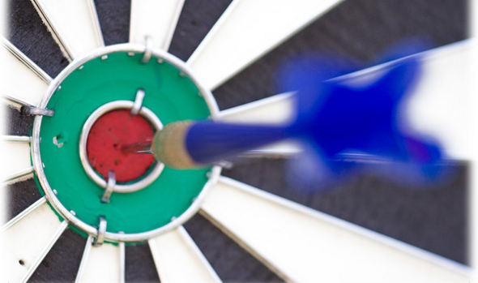
Focus Sessions
Target Design Challenges
C. Densham, B. Riemer
Radiation Damage and Material Limits
Y. J. Lee, S. Maloy
Target Facility Simulation Challenges
O. Caretta, N. Mokhov
Target/Beam Monitoring & Instrumentation
T. Shea, K. Thomsen
Target Facility Challenges
K. Haga, R. Losito

Slide 6
Overlap is Expected
No parallel sessions
Everyone can attend every session
Discussion encouraged
Cross-topic questions ok
e.g. How to simulate radiation damaged properties?
Talk to your co-conveners about presenting unscheduled, relevant information (especially operational experiences!)
Results in fewer talks than usual
We apologize
Please take advantage of all the interesting posters!

Slide 7
Conveners Instructions
For each session:
What is the largest, common challenge facing the field today?
What is the most promising strategy/technology/method to overcome that challenge?
Name at least one idea/concept/project ripe for collaboration between disciplines/facilities/institutions?
If none, why not?
To answer these questions, they need your input!

Slide 8
Workshop Logistics
Workshop picture during morning break today
Using indico to upload talks
See Kavin Ammigan, Brian Hartsell, or Bob Zwaska for help
Poster Sessions
Poster Session Book of Abstracts
Ordered by board number (focus session number)
In your registration packet and on web-site
Posters can be mounted (by board number) starting today at lunch and are expected to remain posted through Friday
This evening from 5:30 – 7:00 during reception
Thursday afternoon from 1:30 – 5:00 during tours
Presenter attendance encouraged as practical

Slide 9
Thursday Tour
Includes tour of:
MINOS near detector underground cavern
MI-8 facility for target support (target and horn fabrication)
Thursday afternoon in 4 groups (A, B, C, & D)
Sign up at Workshop Admin Desk
Limited capacity (4 groups of 11) due to elevator capacity
Groups A & B leave at 1:30 pm
Groups C & D leave at 3:30 pm
Required safety briefing at 1 pm in 1-West
No open toe shoes or sandals!

Slide 10
Virtual Proceedings
Don’t Panic
There are no organized proceedings for HPT 2014
“Virtual” Proceedings through arxiv.org
Submit articles under physics.acc-ph
Physics: Accelerator Physics
Include note in the comments that the article is associated with the workshop
Articles will be associated with the workshop on Inspire
http://inspirehep.net/record/1286700
Articles are fully citable, but will not be peer-reviewed
Articles can be submitted to journals in this or updated form
Suggest to use the “arXiv.org perpetual, non-exclusive license”
Acceptable to most journals for later publication
Online articles can be modified
See discussion here:
https://arxiv.org/help/license

Slide 11
RaDIATE
1st Annual Collaboration Meeting May 19 2014
Welcome and News & Notes
Radiation Damage In Accelerator Target Environments

Slide 12
Similarities?

Slide 13
Here’s to a great workshop!

