Slide 1
Proton beam monitors at JSNS of J-PARC
(J-PARC/JAEA) Shin-ichiro MEIGO

Slide 2
Introduction
Beam monitor system at JSNS
  Multi Wire Profile Monitor
  Beam Halo Monitor
Beam flattering system
Proton Beam window
ADS program at J-PARC (TEF-T, TEF-P)

Slide 3
Beam transport to MLF
Ep: 3GeV
Power: 1MW
Rep.: 25Hz
Length of BT: 314m
50-GeV MR
road to
coast
g-2 experiment at J-PARC
Sterile neutrino existance
3NBT
Neutrino line
MUSE
MLF
JSNS
3-GeV
RCS
3-50BT
Muon target
Neutron target

Slide 4
Whole length 320m
B： 9
Q： 54
STR： 45
Pulse
600ns
FWHM ~150ns
33m

Slide 5
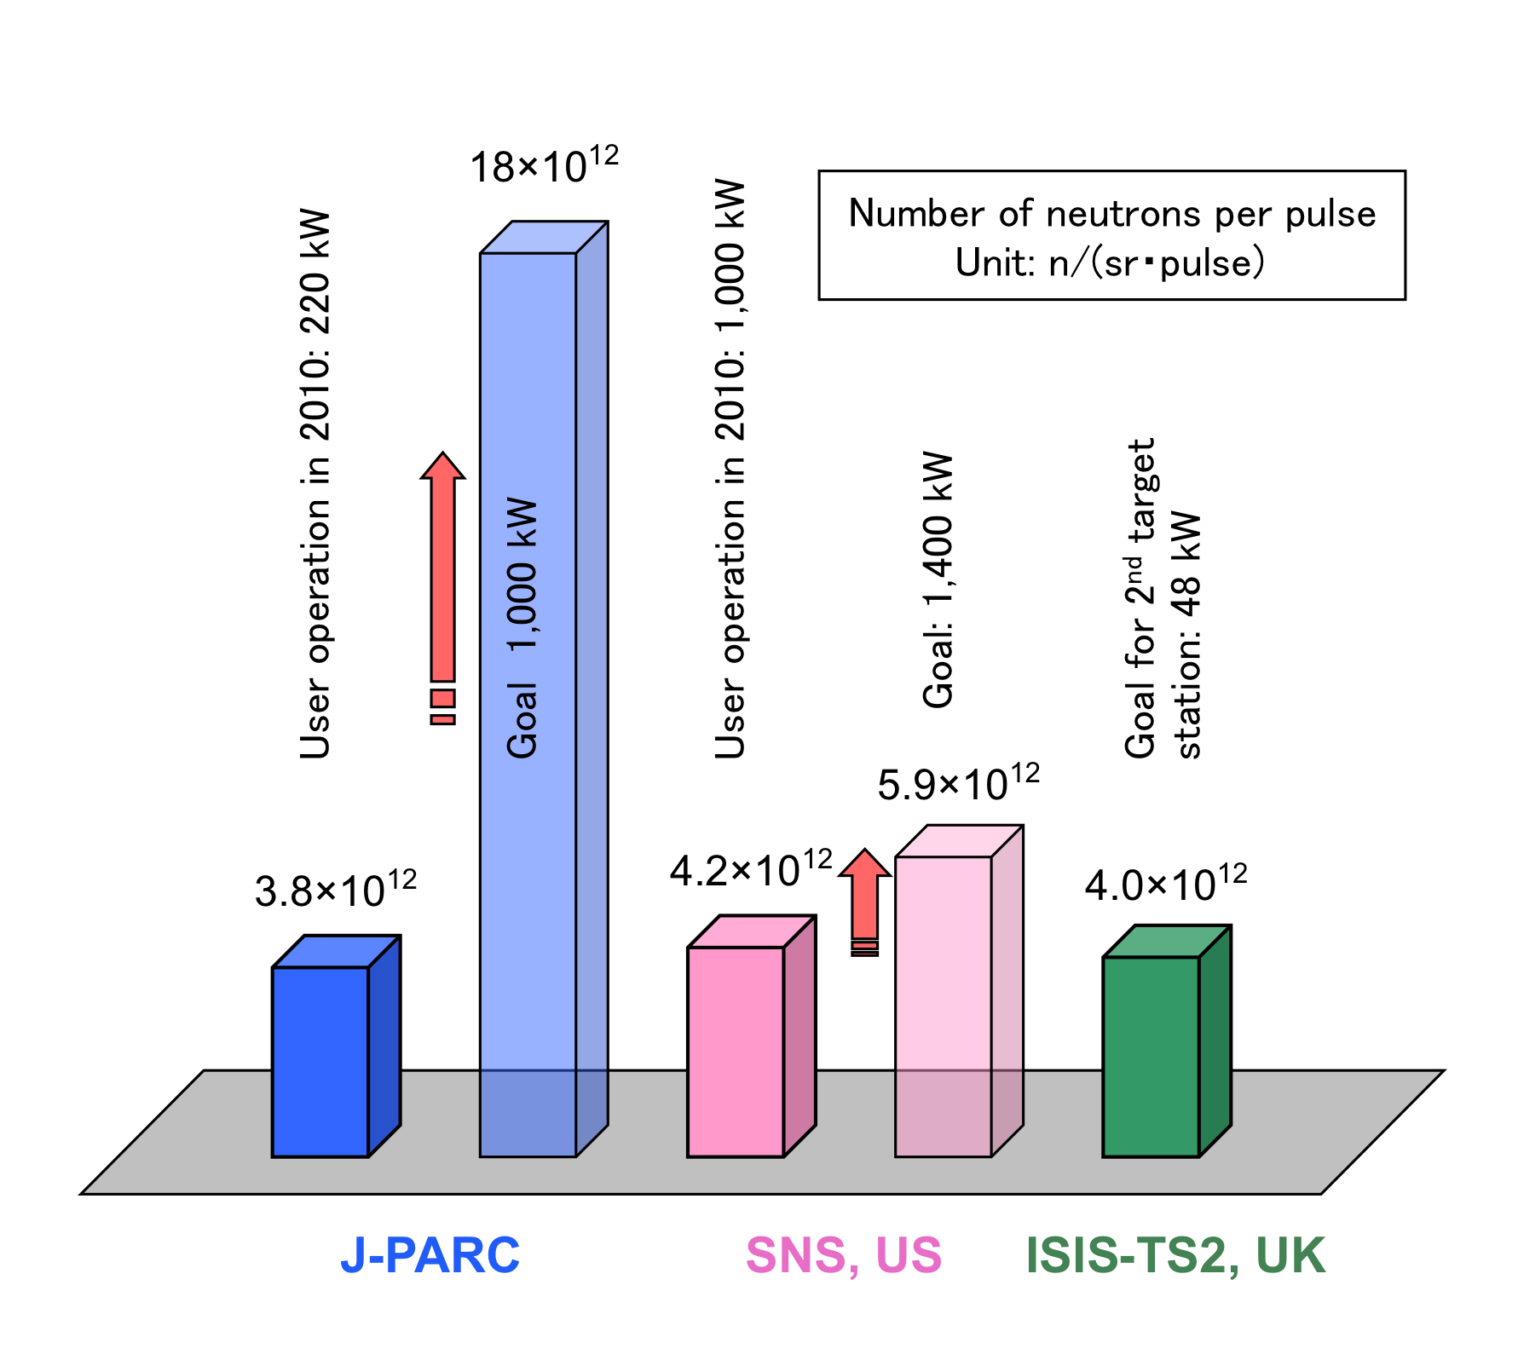
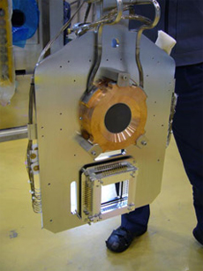
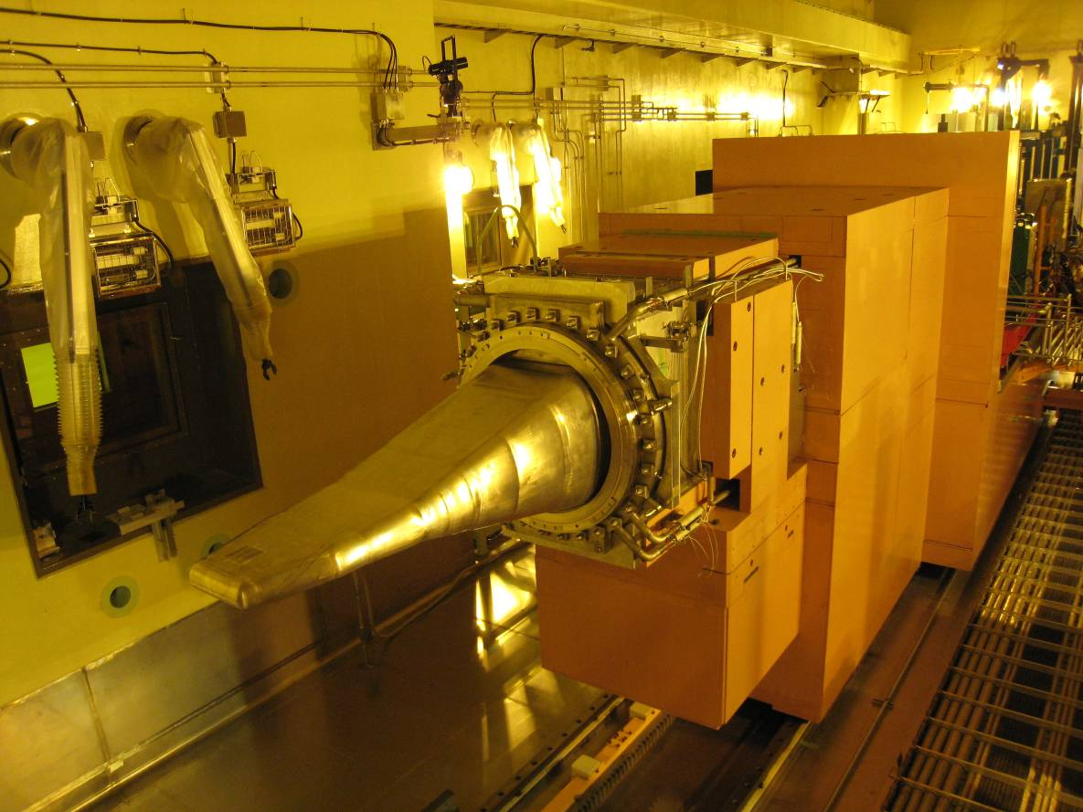
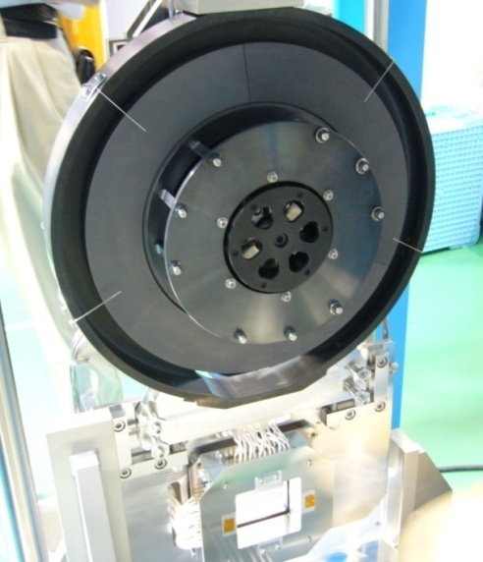
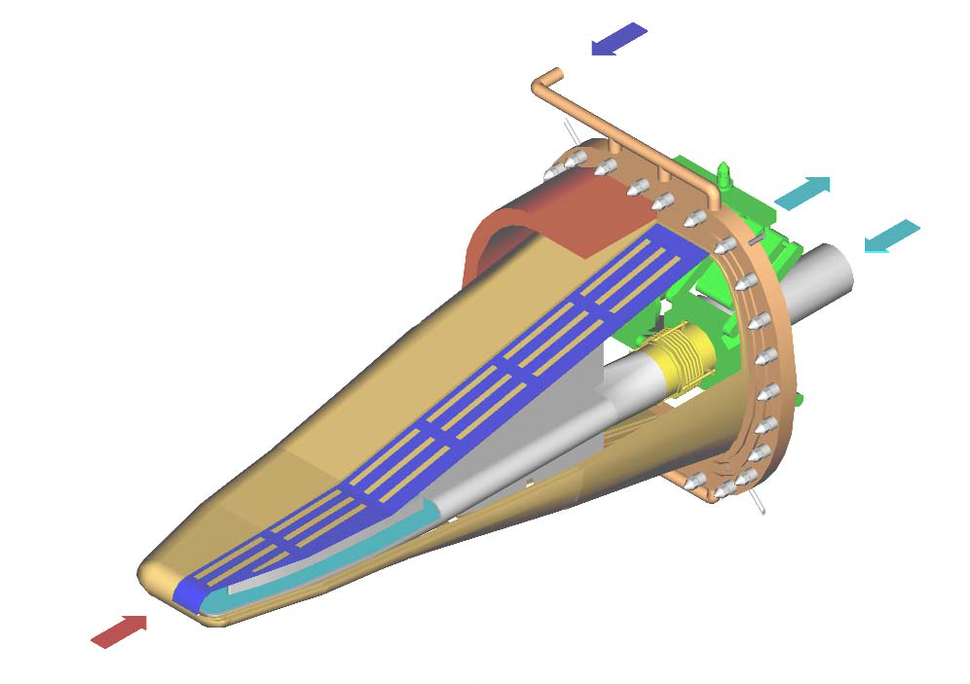
Targets located at MLF
Muon target(Stationery type)
  Carbon graphite (IG430)
  Highest intensity in the world
Neutron target
  Mercury
  Highest pulse intensity in the world
Rotating type
(6rpm)
Mercury target trolley
Thick. 2cm
Diam. 7cm
Width 34cm
Length 2m
Makimura et al.
Light Water
Safety shroud
Double wall structure
Hg
Proton

Slide 6
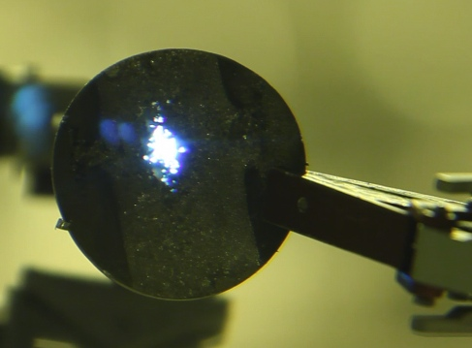
Proton beam at the target
3NBT・MLF beam operational status
  Beam study with 0.6 MW beam
  User operation with 0.3MW beam
  1 MW study planned Oct 2014
Handling of high intensity proton beam
  Importance of beam profile
  Pitting damage proportional to 4th power of the peak current density at target (P4 Law)
    Rastering does not help mitigation.
JSNS harder condition than SNS
  SNS: 60Hz, Storage ring without muon target
  JSNS: 25Hz, RCS with muon target
Although helium bubbling mitigates the pitting damage, peak reduction is essential. Beam flattening by the non linear beam optics was developed.
王(king) sign appearing
5 cm
Damage at
JSNS target
Pin holes at target of SNS
Pin holes are permitted at the inside wall of SNS but not allowed at JSNS due to wall structure.
here
Target vessel
SNS: 4 walls
JSNS: 3 walls -> 4 walls in next

Slide 7
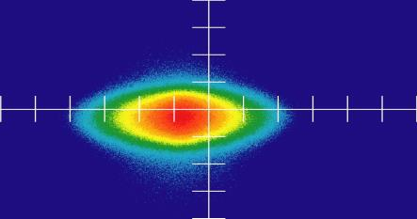
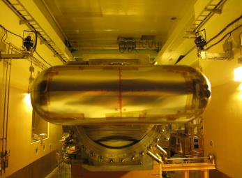
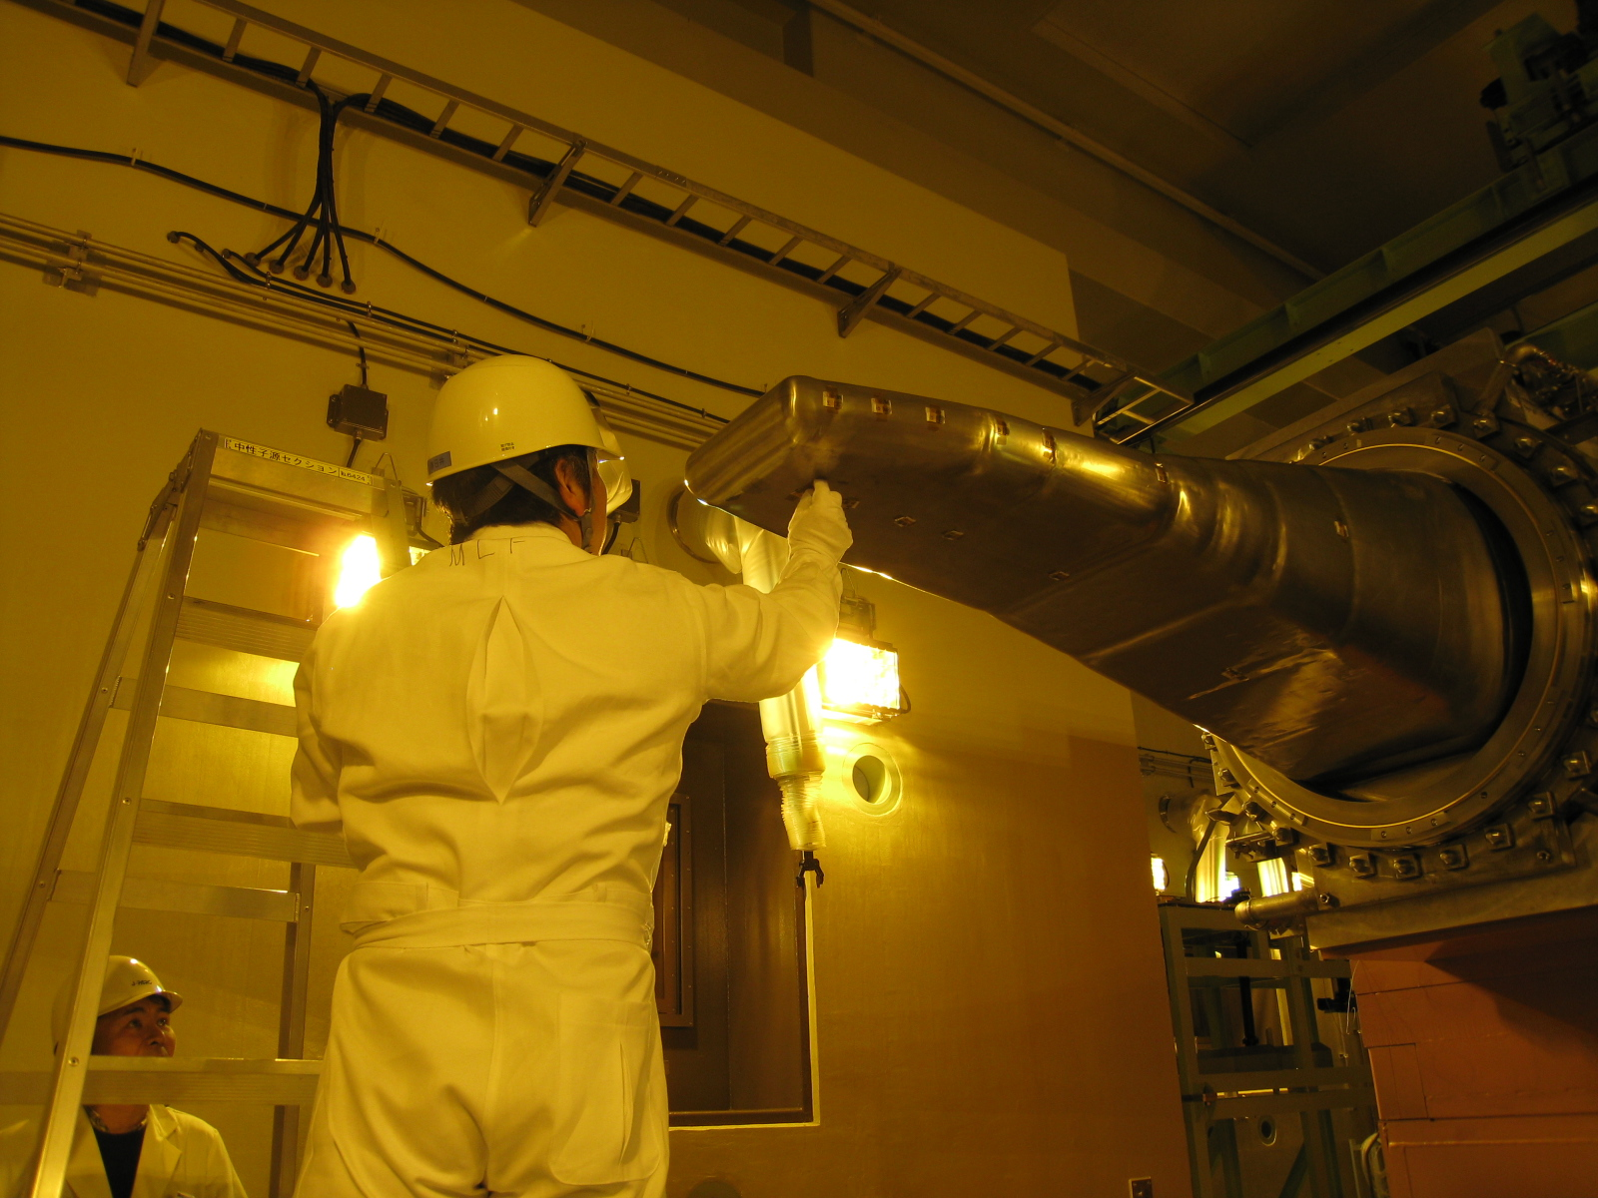
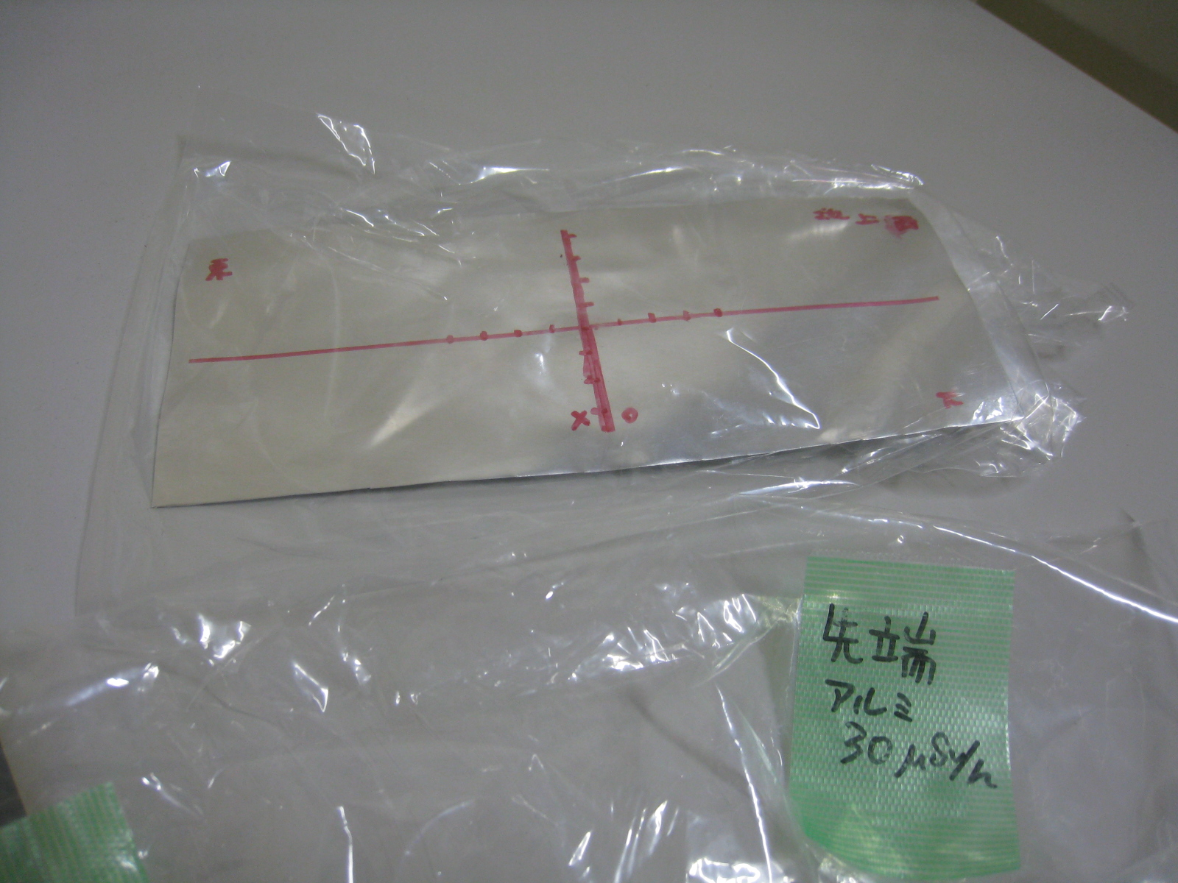

First beam measurement with foil activation
2D profile required for confirmation of tilting beam
Placing aluminum foil (Al: 1mm-t) placed at the target vessel, residual does was observed by imaging plate (IP).
No tilting of beam found
2D profile obtained by foil with IP
1cm
Good agreement with MWPM
Placed Al foil 1st beam
Removed after irad.
30cm
Only perform 1st beam

Slide 8
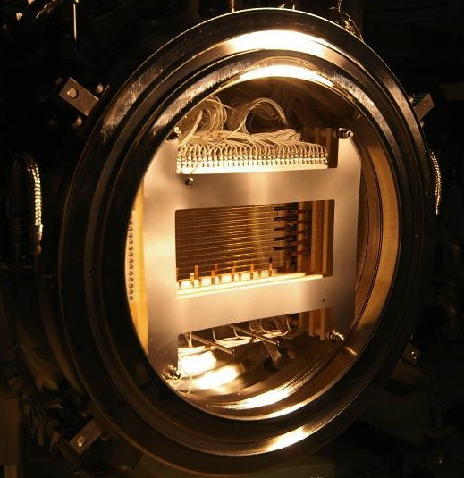
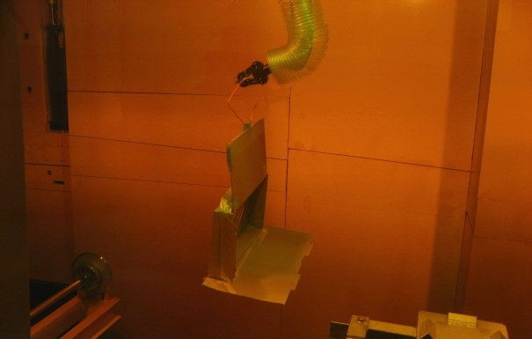
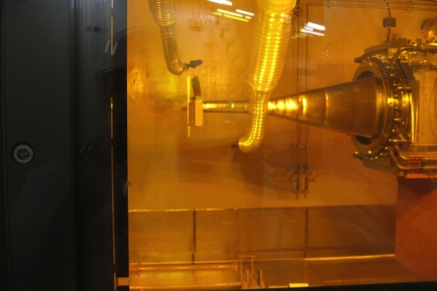
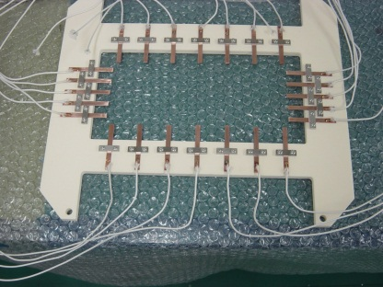
Beam diagnostics for profile and halo
Profile monitor and halo monitor (Online type)
  Multi Wire Profile Monitors (MWPMs) (15 sets located) : SiC wires
  Stationary MWPM at proton beam window (PBW) placed at 1.8 m upstream of the mercury target
2D profile： Residual radiation read by the IP (Offline type)
After beam operation: IP was attached at the target by the remote handling
MWPM
Hot cell
IP
Halo monitor
・SEC
・ TC
Target
TC
Placed by RH
MWPM
Monitors at PBW
Imaging Plate(IP)

Slide 9
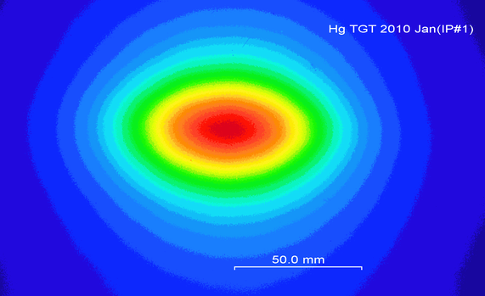
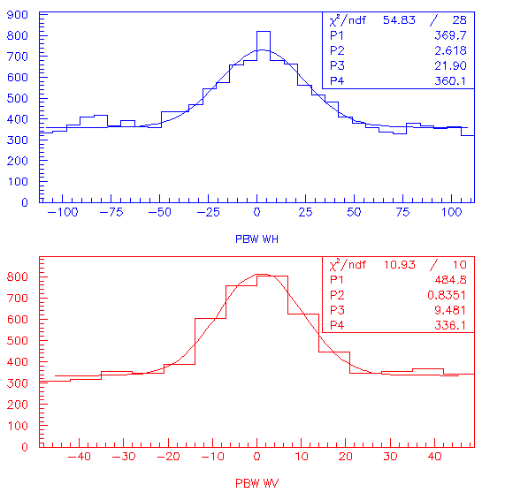
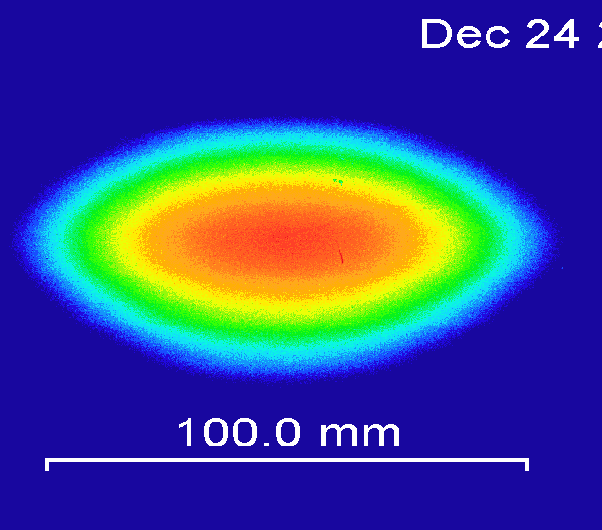
Beam profile at the mercury target
2-D measurement by IP
MWPM at PBW
0.1 MW operation (2009 Dec)
0.2 MW operation (2010 Dec)
Obtained only 6 days of cooling duration after irradiation of 0.2 MW beam
⇒ Possible for 1MW with certain cooling time
Result by MWPM
Fitting by Gaussian
Width and position for each pulse obtained
Beam width transformed to the width at the target
Profile result by the IP
Fitted by two Gaussian curves
Contribution of primary protons and secondary particles (almost neutrons)

Slide 10
Trend of beam width at the mercury target
Comparison of experimental results
To obtain low peak density, beam width gradually expanded
 | 2009 Apr (Run#22) |  | 2009 Nov (Run#27) |  | 2009 Dec (Run#28) |  | 2010 Jan (Run#29) |  | 2010 Dec (Run#36 200kW)
 | σh | σv | σh | σv | σh | σv | σh | σv | σh | σv
MWPM | 17.3 | 10.3 | 22.8 | 11.0 | 24.4 | 11.7 | 33.8 | 16.6 | 54.3 | 22.6
IP | 17.3 | 12.3 | 23.8 | 11.5 | 27.0 | 12.7 | 33.2 | 15.4 | 55.7 | 20.6
Unit: mm
Both results by MWPM and IP show good agreement
  Demonstration of reliable method
  Reliable peak density on real time can be obtained by MWPM.
Anomaly beam status observed by MWPM, beam stopped by MPS
22
27
28
29
36

Slide 11
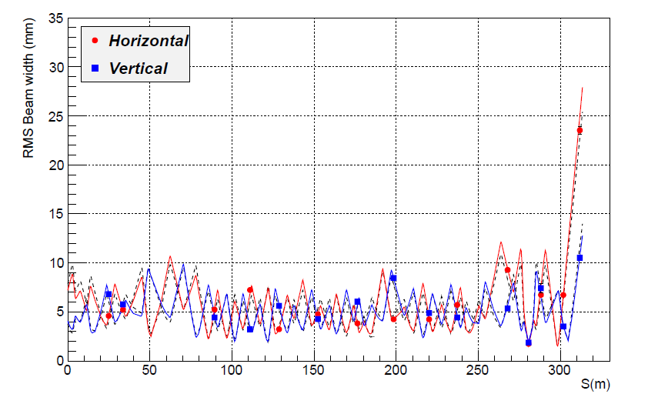
Beam width obtained by MWPM
Transverse emittance (RMS) and twiss parameters fitted with the beam width
⇒ Good agreement in whole beam line
Being analyzer of beam at RCS extraction
Result of RMS emittance
unit: mm mrad
300kW:
ε_{h,v} 5.7, 4.9 π
Twiss parameter
300kW twiss parameter
αx -1.84, βx 20.4m
αy 0.57, βy 5.26m
Calculation of 300 kW case (by RCS group)
ε 5.4 π
αx -2.35, βx 24.8m
αy 0.89, βy 5.88m
Residual dose at beam transport:
Back ground except several points
Good agreement with the design calculation

Slide 12
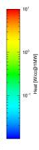

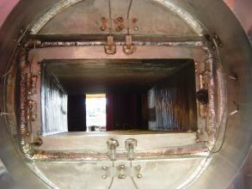
Beam halo measurements
Heat distribution at entrance of target station
  Scattering beam at PBW producing heat load at target vicinities ( < 1W/cc), which is allowable level.
Vertical (cm)
Hg target
PBW (Al 5mm-t)
Proton beam entrance at target station
PBW Halo monitor TC-type
Thermocouples

Slide 13
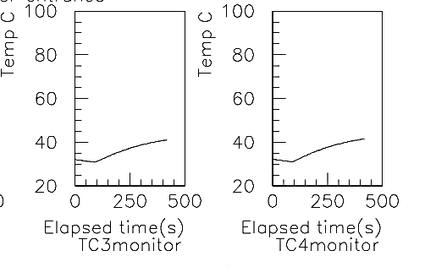
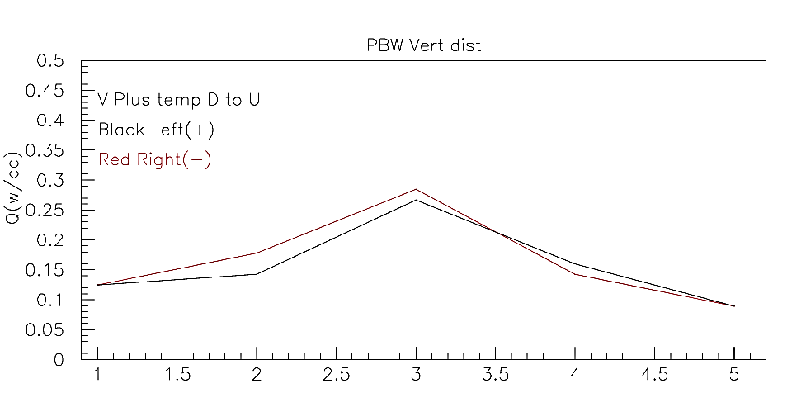
Beam halo measurement
Heat deposition obtained by the thermo couples
  After 6 hours operation, temperature will saturate.
Heat deposition density deduced by temp rising due to beam
  Q(w/cc)=ρC dT/dt
  ρ：Density(g/cc), C: Thermal capacity (J/g/K), T:Temp (K),t: Time(s)
Temperature trend at halo monitor
Horizontal position
For beam of 0.3 MW: Heat at target vicinity ～0.3W/cc
Peak density and beam halo ⇒ Giving optimum operation parameter
Developed expert system for beam control (Beam orbit and profile)
  Even a rookie can control the beam with confident as an expert.

Slide 14
Limit of beam expansion by linear optics
MWPM shows that the distribution is monotonous Gaussian.
Expanding Gaussian beam to decrease the peak density
  Vicinity of the target < 1W/cc(0.04J/cc/pulse)
  Target blade < 90W/cc(3.5J/cc/pulse)
Beam distribution can be approximated by monotonous Gaussian.
Conserve beam aspect ratio
H:V=2.2:1
Heat deposition at vicinity＜1W/cc
σ_{h} <37mm, σ_{v} <17mm
Target blade: no issues
Limit for 1MW operation with linear optics
Peak heat at the target: 14J/cc/pulse

Slide 15
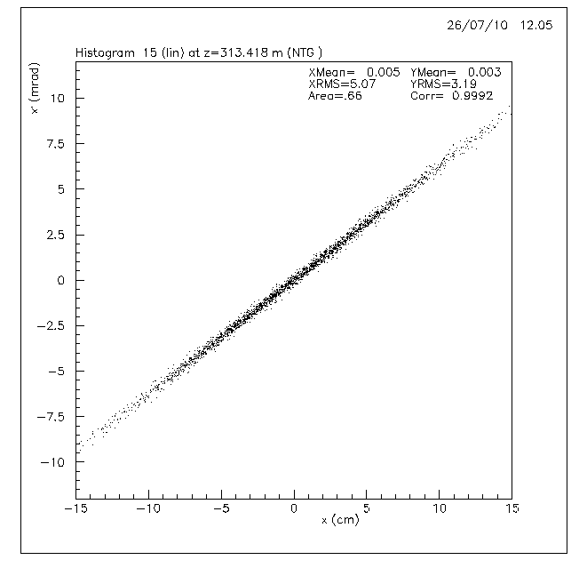
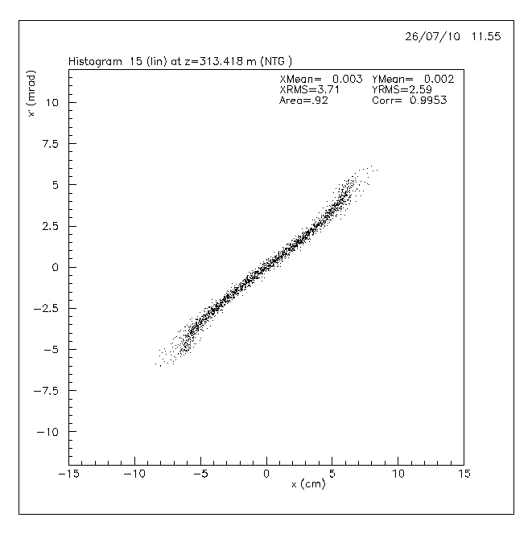
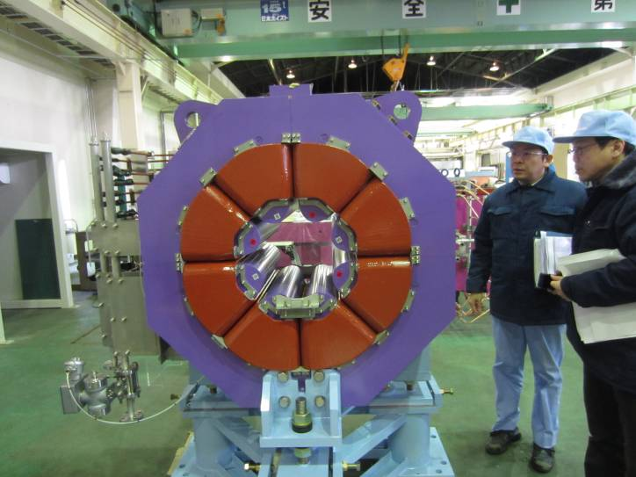
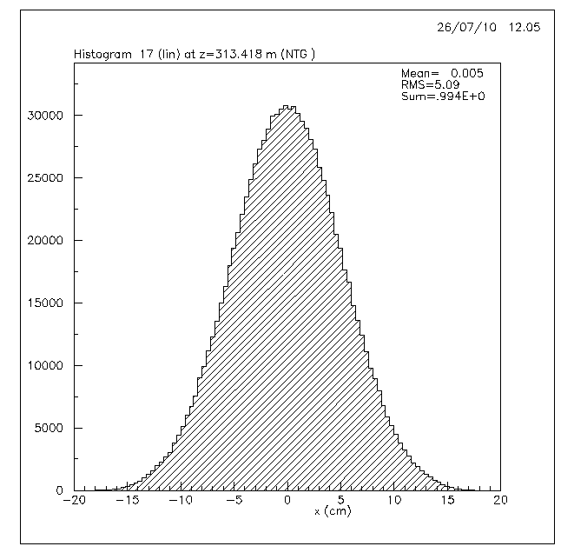
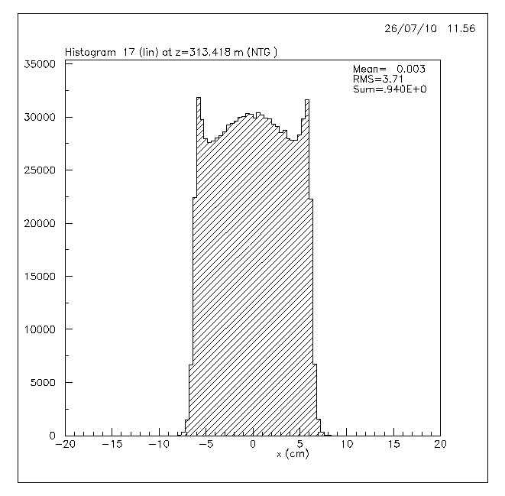
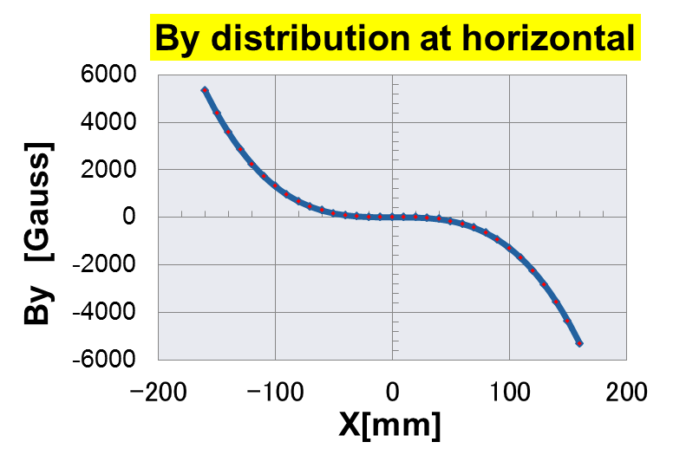
Beam flattening system
Beam edge folding by non-linear optics (octupole magnet)
Linear
Non-linear
Octupole magnet
Divergence
Divergence
Phase space
distribution
Position
Position
Horizontal distribution
Position
Position

Slide 16

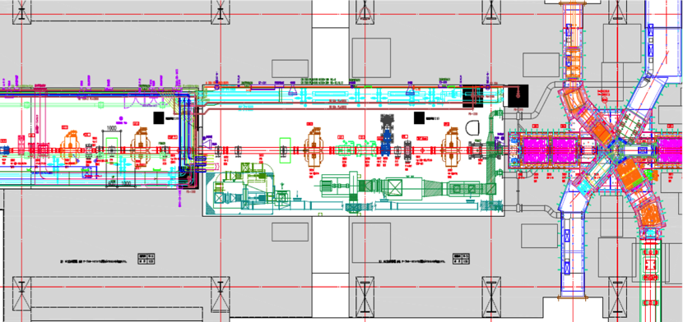
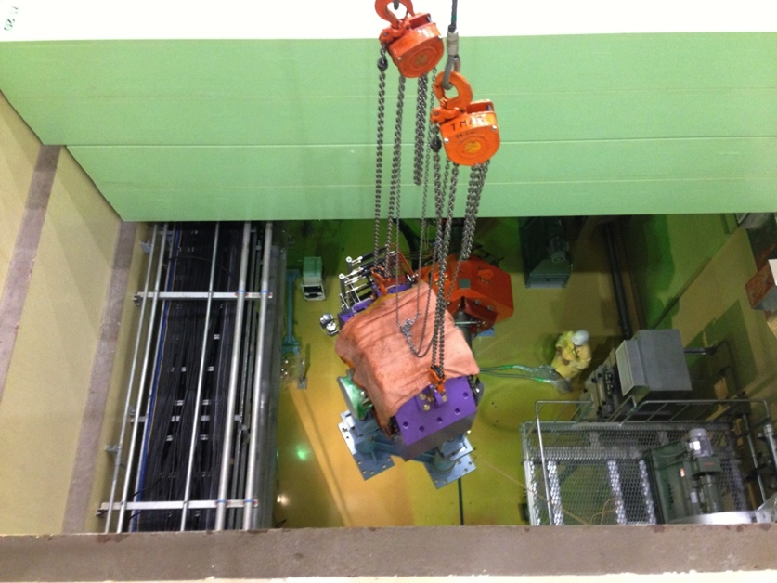
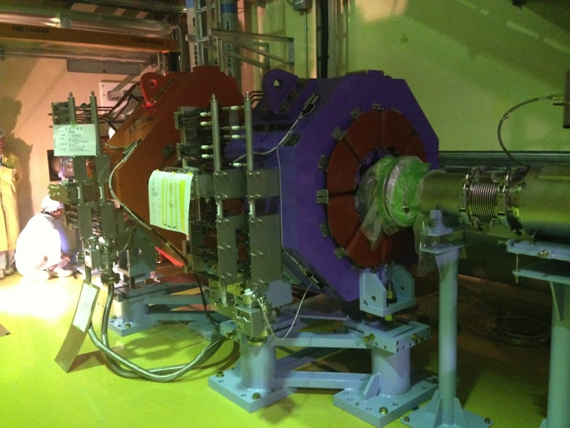
Installation of OCT magnets
For peak reduction, octupole magnets were installed on July 2013.
  OCT1 and OCT2 installed at downstream 3NBTand M1 tunnels
  Beam Position Monitor (BPM) placed at OCT1,2 for beam centering
OCT1
OCT2
1m
Horizontal view
Completed installation of OCT1 at downstream of 3NBT tunnel
Shields above M1 tunnel opened for transport OCT2 to tunnel

Slide 17
Beam profile with OCTs
Simulation (DECAY-TURTLE PSI ver.) shows good agreement. Muon target does not give worse influence on vertical distribution.
Heat load at target vicinities and radiation dose at entrance of target station became 1/3.
Not found significant radiation loss due to OCT magnets. This system will use Oct 2014.
Beam position trend at muon target
V
R4mm
H
Beam position rotates instead of rotating target

Slide 18
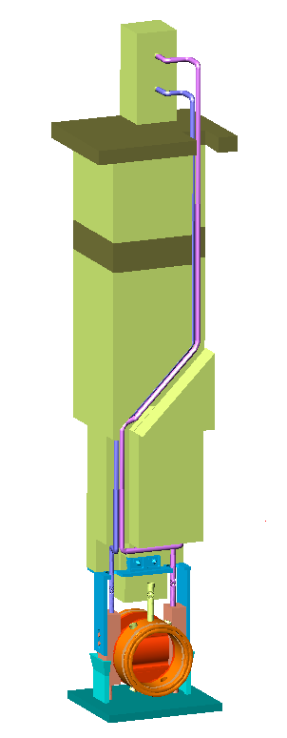
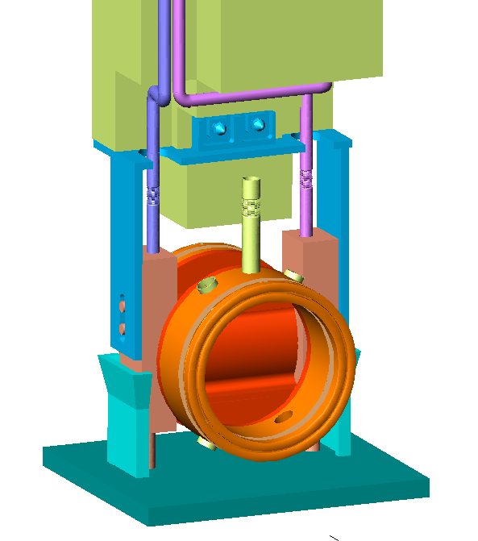
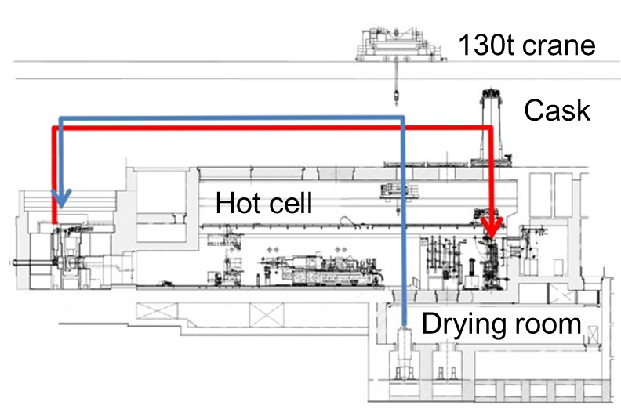
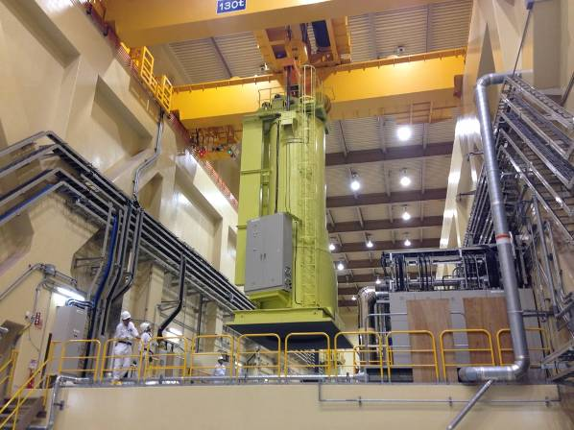
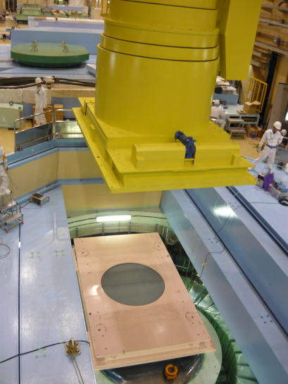
Proton beam window (PBW)
Connectors
Pipe for H₂O
Flange
Concrete shield
Plenum
Multi-purpose hole
Supporter
of ASSY
Feedthrough for
monitor
Iron shield
Duct
Pin for placement
PBW
Height: 5 m
Weight: 10 t
Rough guide
（mounted He vessel）
Pillow seal
Base for PBW
Remote Handling (RH) devices at JSNS
PBW: a boundary between vacuum and helium region
Remote handling replacement
Cask
Floor valve

Slide 19
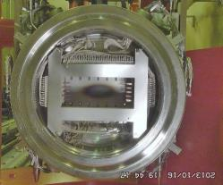
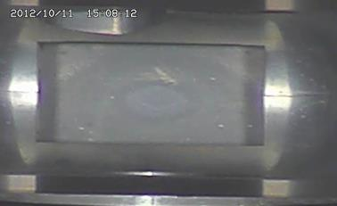
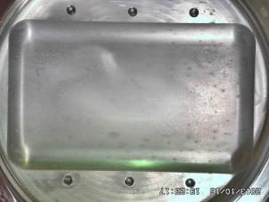
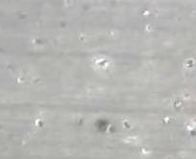
Replacement of Monitor/PBW
Accumulated power: 2GWh, which was 1/5 of design (Lifetime of PBW 2years H: 2000 appm, He 1000appm determined based on the PIE result at PSI)
In 2012 Oct., strange spots were found at helium side and replacement was decided.
Strange spots may be caused erosion by the radiolytic acid in vessel. Leakage of helium vessel found.
Status of PBW#2 will be observed this summer.
PBW at vacuum side
Inspection 2012
by high-zoomed camera
Received 2GWh
2x10²¹ pot
4x10²⁰ p/cm²
PBW at helium vessel side
Zoom (x32）

Slide 20
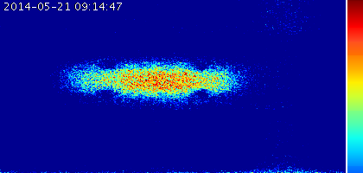
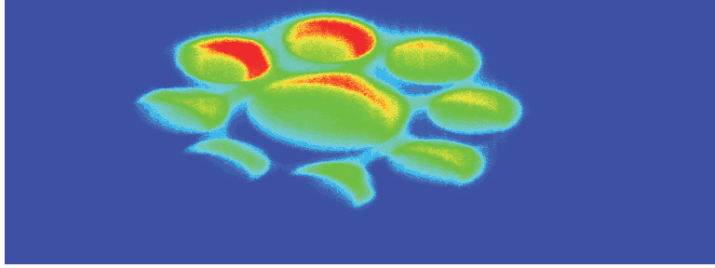

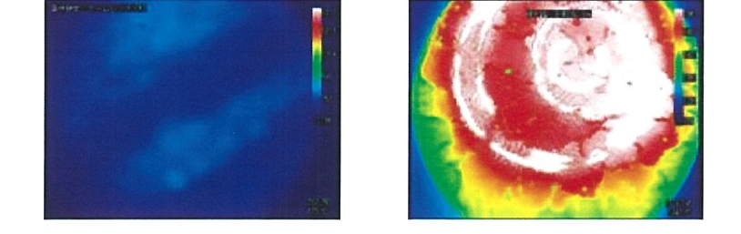
Profile Monitor
SNS monitor
SINQ VIMOS
SNS web page
K. Tomsen, IBIC2012
Rad hard Fujikura fiber utilized for transfer imaging
IR system developing
High temp:
Watch status of rotating
carbon target
Low temp(<100C)
Watch JSNS and
TEF-T target
(new technique req.)

Slide 21
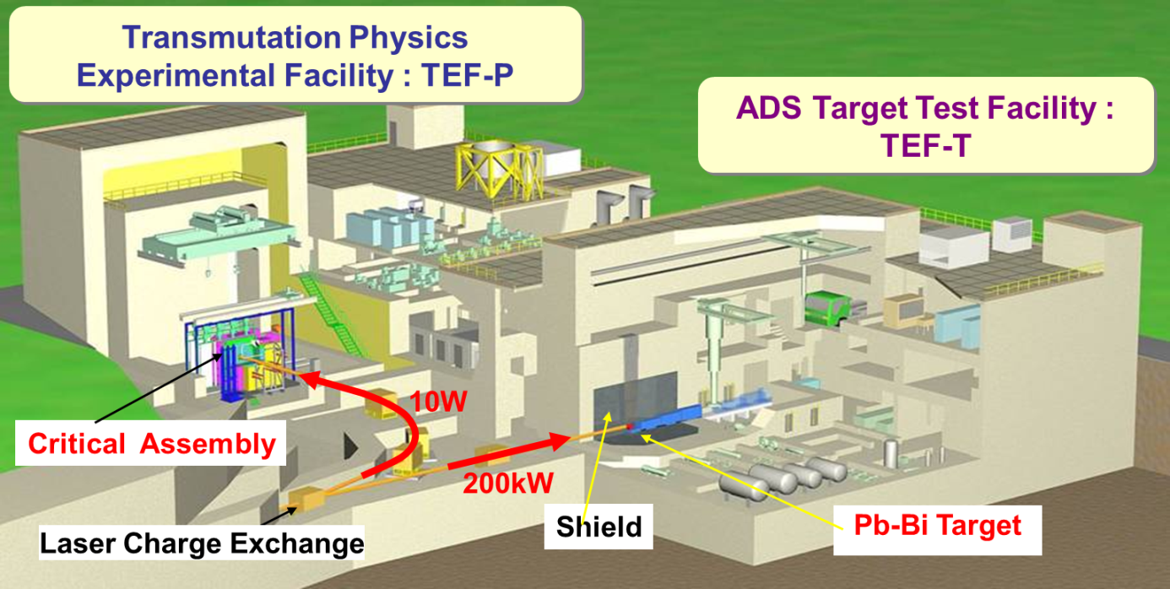
TEF-P and TEF-T
TEF-T
To RCS
TEF-P
H⁻
H⁺
H⁻ beam
250kW
LINAC
Lower beam extraction based on Laser charge exchange
Some budget including beam diagnostic TEF-T approved by government.
At TEF-T beam line, non-linear optics or rastering system will be installed
First beam ~2019

Slide 22
Conclusion
Using present beam monitor system based on MWPMs and halo monitors, high power beam operation can be performed with highly confident.
Beam flattening system based on octupole magnets was installed, which can reduce peak heat density from design condition by 30-40 %.
PBW was replaced. (corrosion spot?)
New monitor system developing
ADS program beginning at J-PARC

Slide 23

Thank you for your attention

