Slide 1
Experience with the SNS* Target Imaging System
Willem Blokland
Spallation Neutron Source
T.R. Ally, G. Bancke, A. Brunson, M. Dayton, D. Feldman, R. Fiorito, F.D. Garcia, K. C. Goetz, K.E. Hasse, J. Janney, E. Kenik, M. Lance, C. Maxey, T. McManamy, M.A. Mitchell, S. McTeer, F. Montgomery, S. Murray, P. Rosenblad, S. Sampath, T. J. Shea, A. Shkvarunets, K. Thomsen, R. White, M. Simpson, D. Winder.

Slide 2
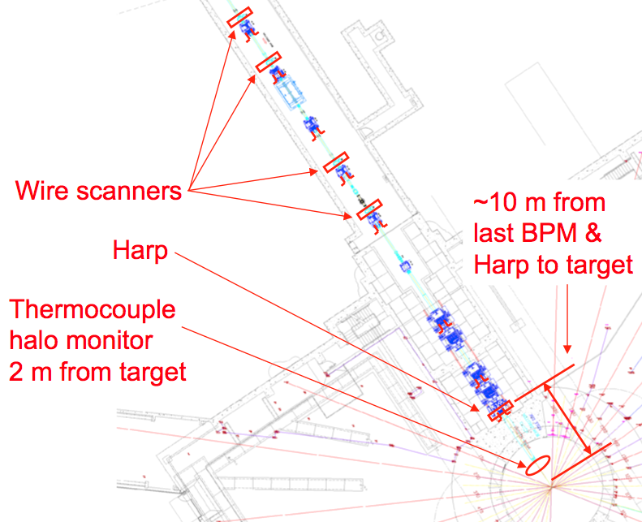
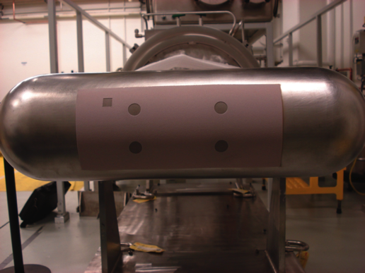
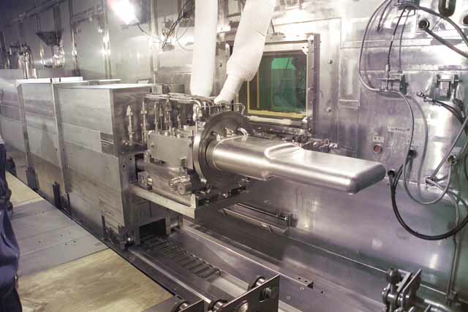
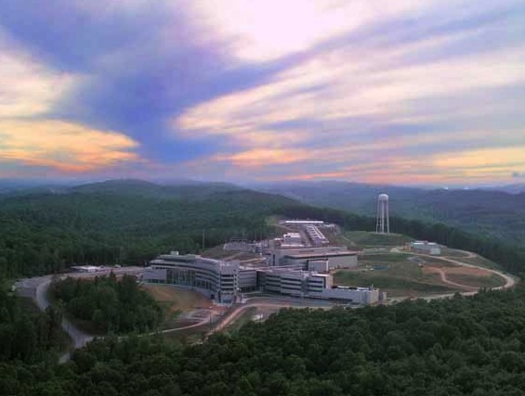
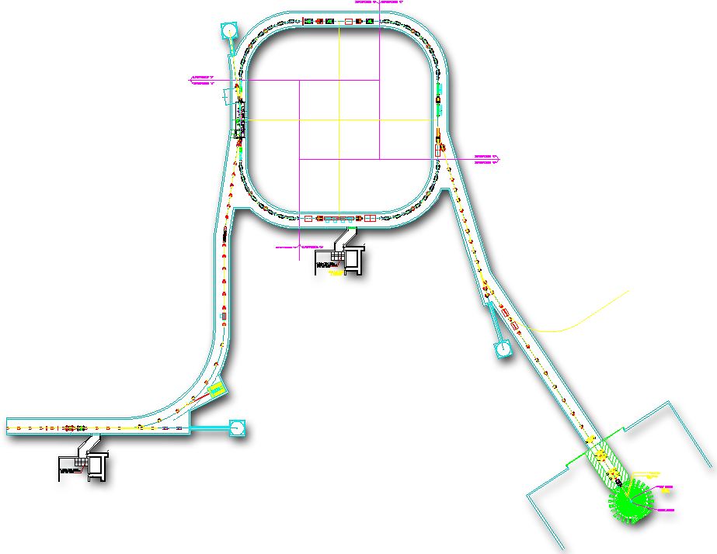
1060 mini-pulses
1.4MW: 60Hz of up to 1.5x10¹⁴ protons per pulse
1 mini-pulse
Current
2 mini-pulses
3 mini-pulses
Collimators
Injection
Extraction
1ms
RF
2.5 MeV
87 MeV
186 MeV
387 MeV
1 GeV
RTBT
Ion Source
HEBT
RFQ
DTL
Liquid Hg Target
CCL
SCL1
SCL2
Animation: D. Bartkoski

Slide 3
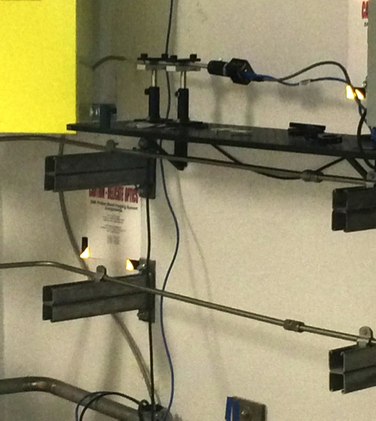
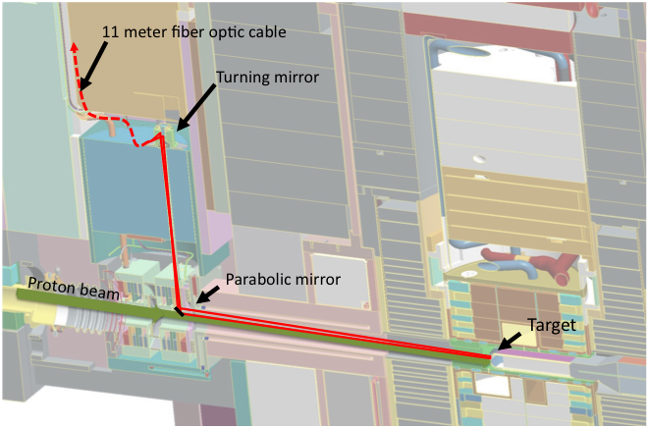
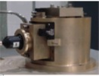

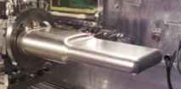
TIS optical path
GigE Camera
2.2 meters
Optical path of the TIS

Slide 4
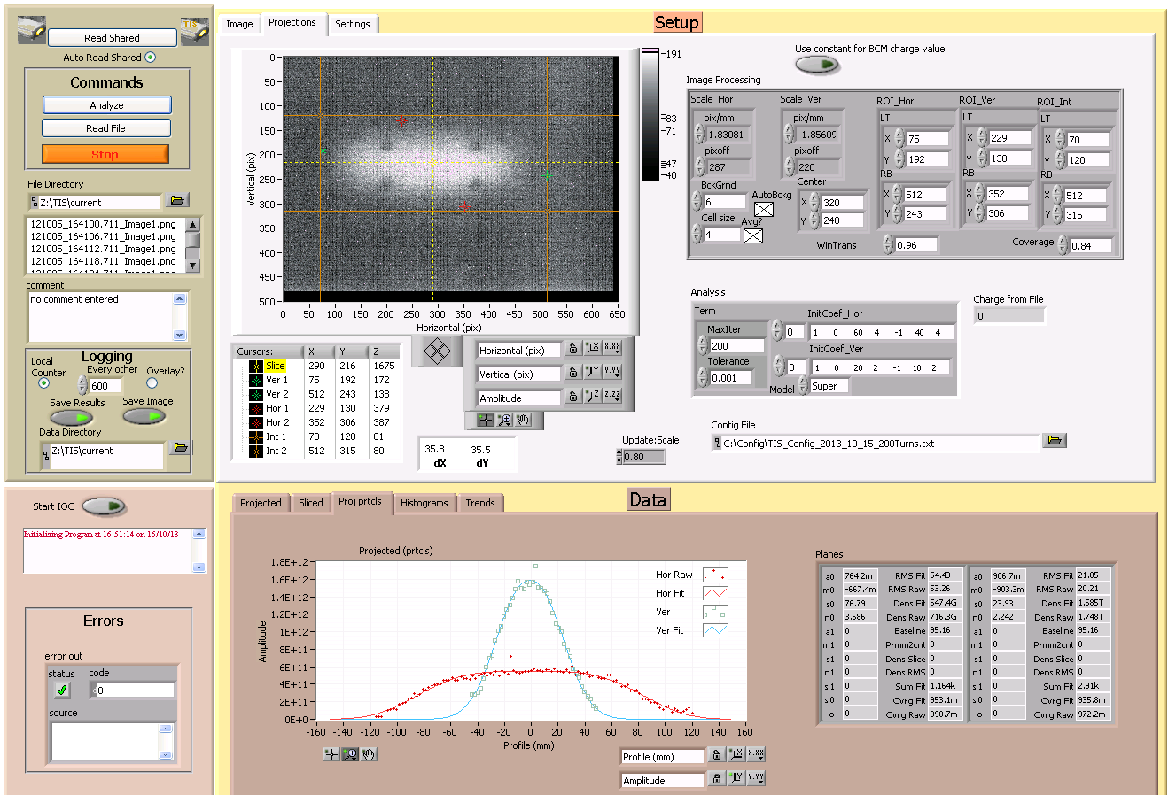
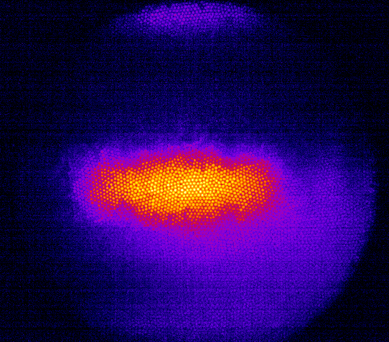
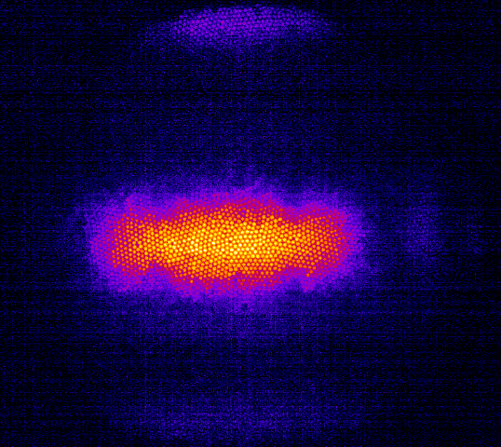
TIS Main Program
With and without gas scintillation
Image Acquisition and Processing, Archiving, and EPICS interface, up 24/7.

Slide 5
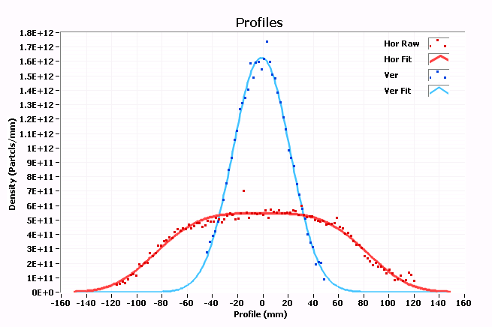
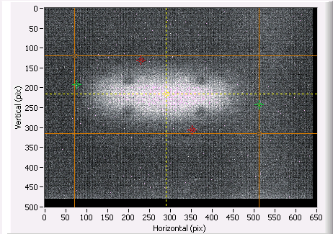
TIS Profile Analysis
Fitting Function
Analyzed areas
Use pixels in boxes to create horizontal and vertical profiles
Fit a function to those profiles (one or two super-Gaussians) to derive position and beam widths
Use beam charge and total image intensity count (with correction for proton beam window loss, marker blackouts, and coating coverage) to calculate peak density

Slide 6
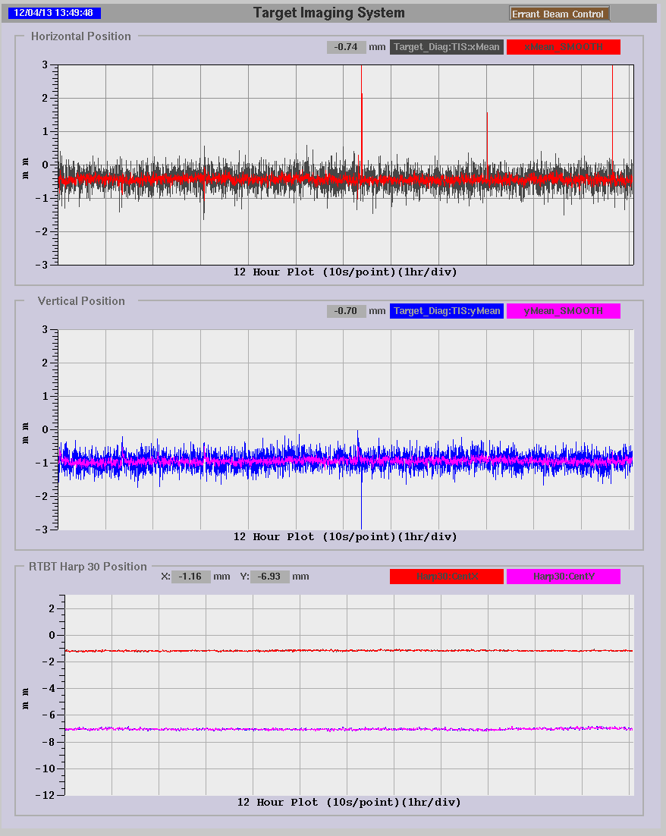
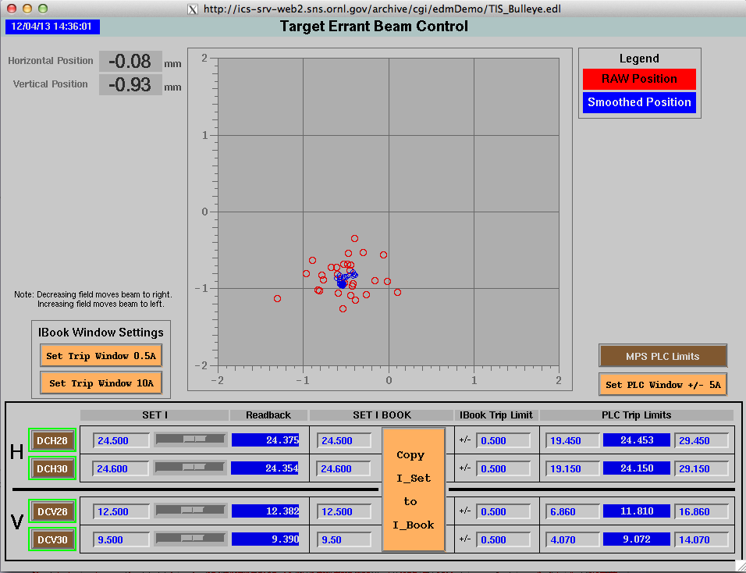
TIS use for operations
Errant Beam: Monitor the position, width, and peak density of the beam on the target to stay within the production envelope using TIS (Setup: RTBT Wizard)
Errant beam also monitors thermocouples and harp, magnet settings, and more.
Position over 12 hours
Steer beam if indication show beam is off. The average position is in sub mm resolution

Slide 7
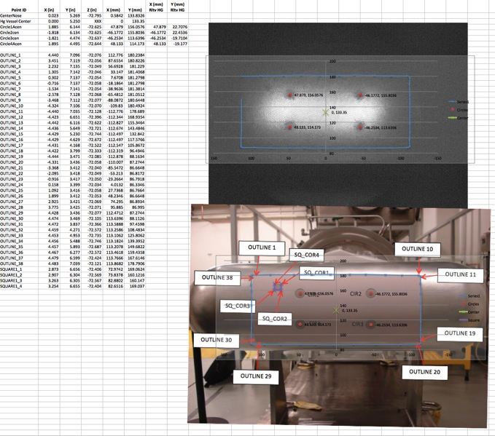
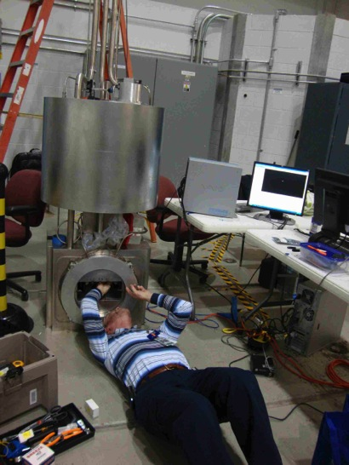
TIS Alignment and Calibration
Alignment done every time when the Proton Beam Window (PBW) is replaced. This is very time intensive and happens right before installation.
Calibration of image relative to target when either the camera, target, or PBW has been replaced. This takes about one hour of (first) beam on target and is based on alignment group measurements.
Mirror Installation
Calibration of coating

Slide 8
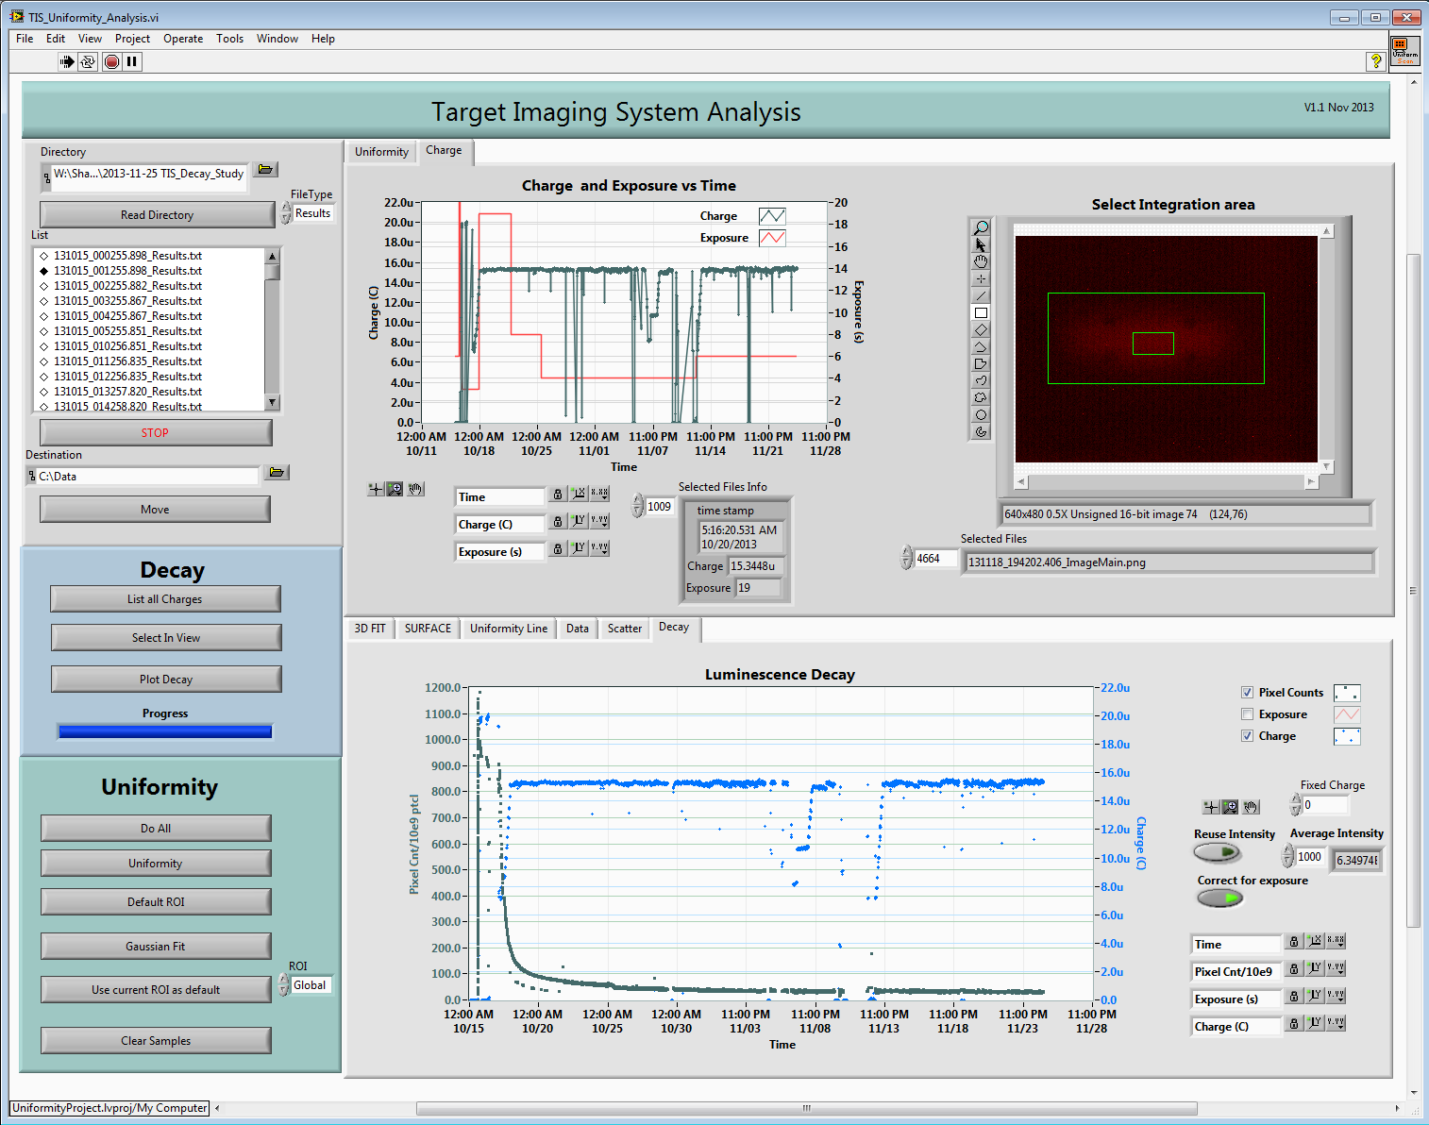
Target Off-line Analysis Programs
Offline programs to study:
Luminescence decay
Uniformity
Calibration
Effects of sample tubes in front of image
Analysis of luminescence decay and uniformity

Slide 9
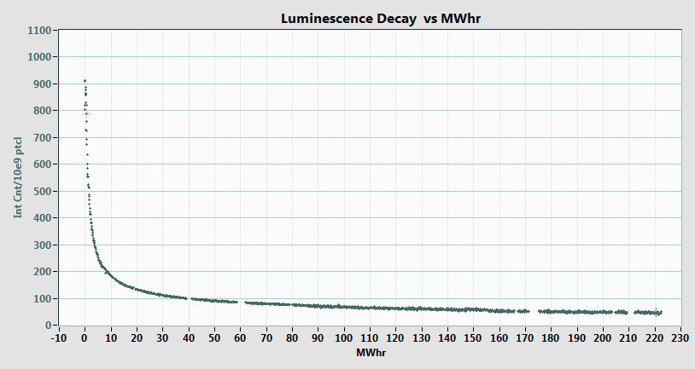
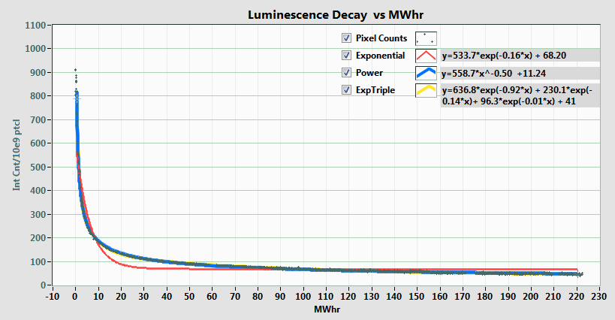
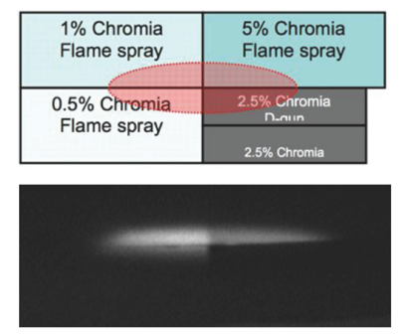
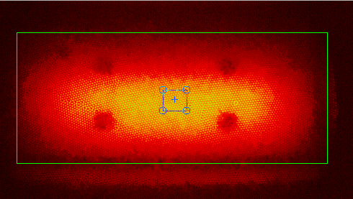
Target Luminescence Decay Analysis
Corrections for variations in exposure, beam pulse intensity, and background light.
Fits triple exponential or 1/√(x) function
Decay related to DPA with approx. uniform distribution due to neutrons
Previous luminescence studies
2 days
New study with automated analysis on fresh target

Slide 10
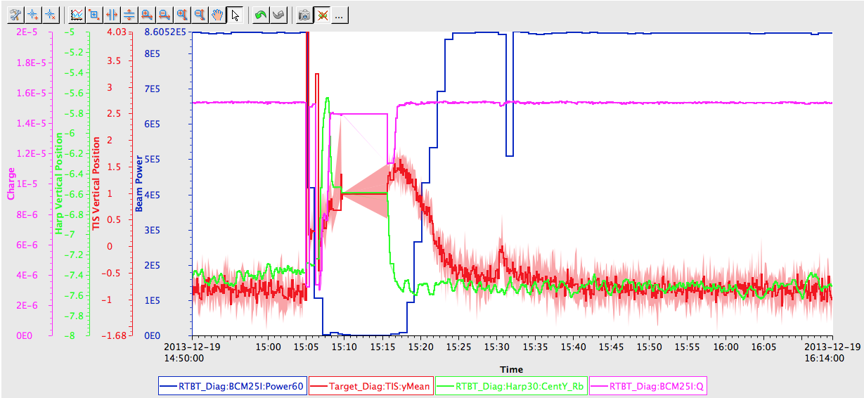
TIS Position Variation
The TIS (red) shows position change (~2mm) when power on target varies but there is minimal change in position from Harp (green) !
(There is actual position change when beam pulse intensity is varied)

Slide 11
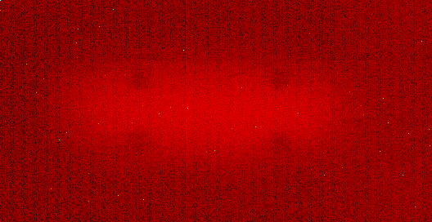
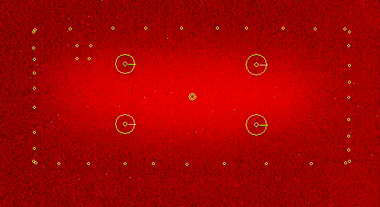
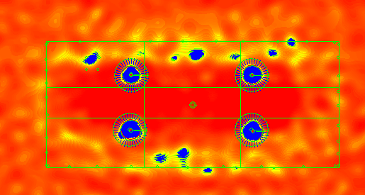
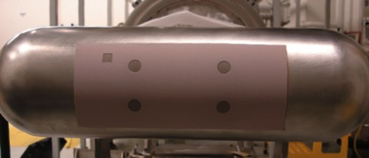
TIS Position Variation
Processing of the images to find the markers

Slide 12
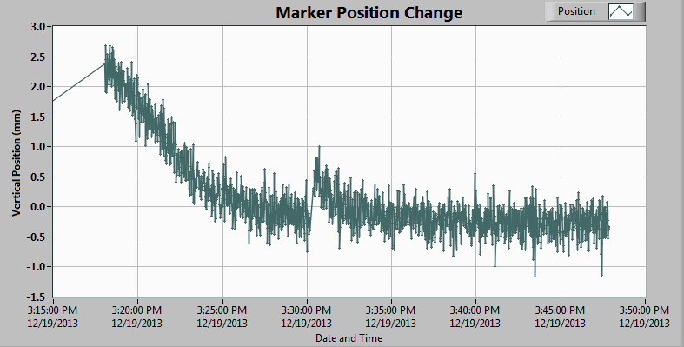
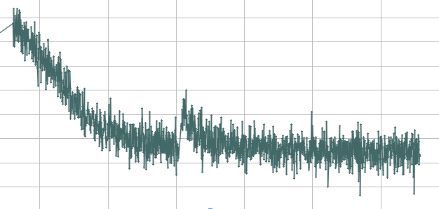
TIS Position Variation
Compare marker changes with observed position
!Movement of markers correlates with position movement → most likely due to movement of the mirrors and correlates with heating of proton beam window.

Slide 13

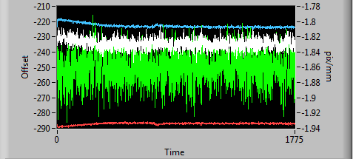

TIS Position Variation
Results: 2013 Dec 19 15:18 to 15:47, analysis at ~1Hz:
  Offsets are changing: Vertical about 4 pixels or ~2.2mm, Hor about 3 pixels or ~1.6mm
  Vertical scale has 3 times higher standard deviation (markers are closer)
  Pix/mm are also slightly changing: ~0.5%
  Good robustness
  Changes are slow
Results of analyzing ~1800 images

Slide 14
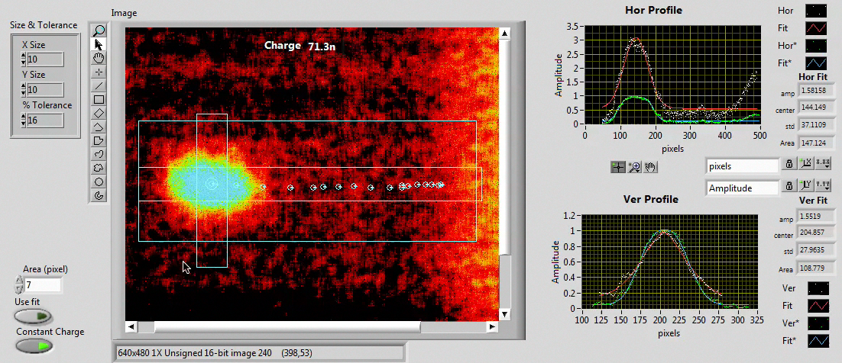
TIS Uniformity Scan
Script to steer beam across target
Analysis to track position and correlate with beam charge
Example of automated uniformity analysis

Slide 15
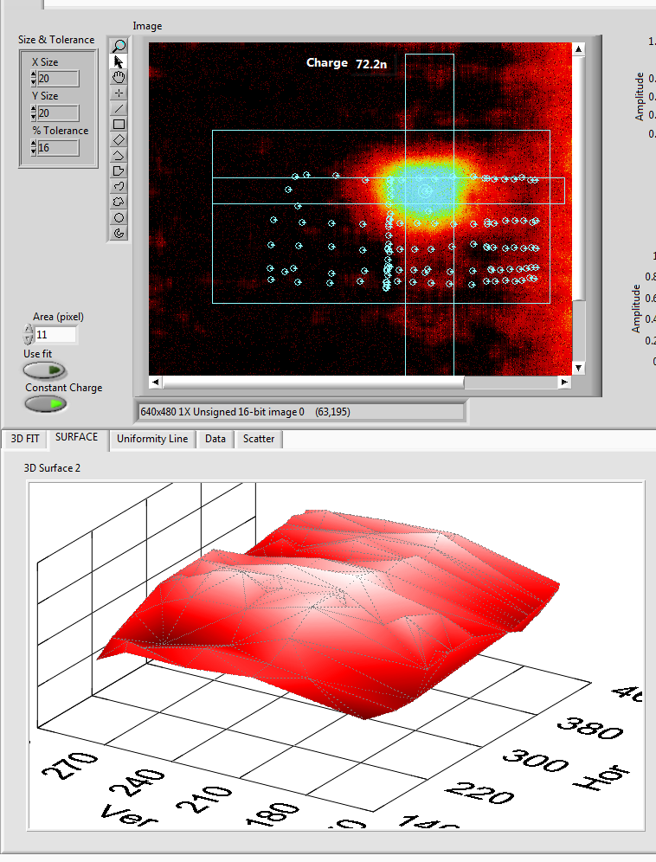
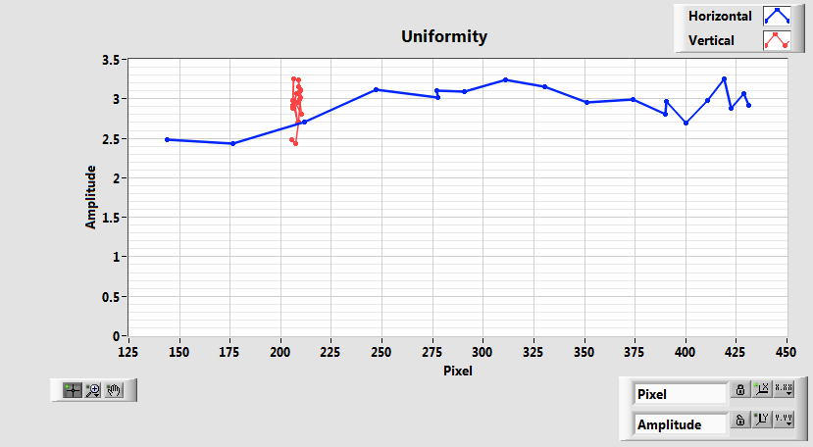
TIS Uniformity Scan
Horizontal Middle scan
Surface plot of all scans
Results:
About ±12.5 % variation measured but the amount of light is minimal (<100Watts per second or 100 Joule per pulse) and some of the variation is due to noise on beam charge measurements and image background noise
Due to low beam charge requirements when beam is off-center, we can only do this with a fresh coating

Slide 16
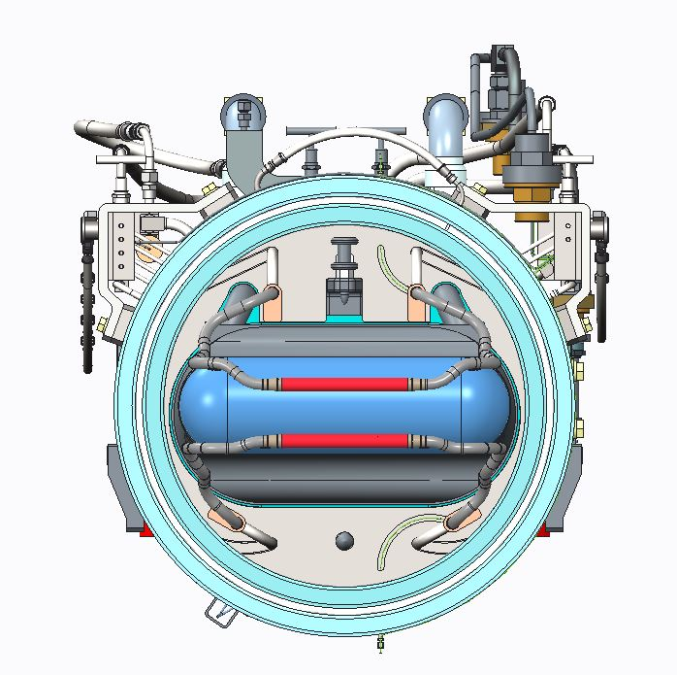
Fusion Material Irradiation Test Facility Effect on TIS Study
What is the effect on the TIS measurements when FMITS tubes are installed in front of the target fluorescent coating?
  What happens to the accuracy?
  Can it be compensated for in the analysis software?
  What happens if the tubes have a coating?
  What happens if the coatings of the tubes and target have a different luminescence?
FMITS Layout by V. Graves

Slide 17
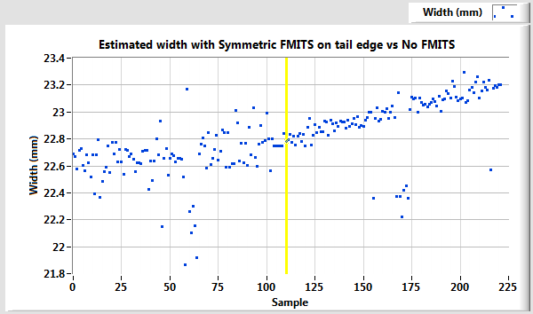
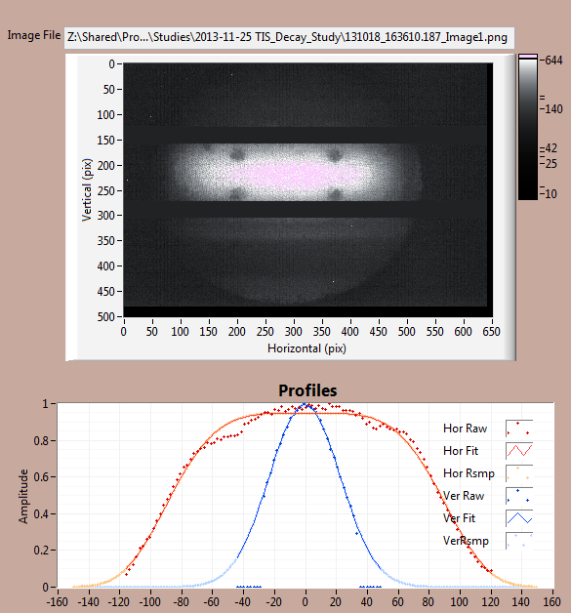
FMITS Effect on TIS Study
Tubes
With FMITS
Without FMITS
The estimated widths trends when FMITS covers both tails compared to no FMITS
Exclusion
Analysis excluding blocked points
Only affects vertical
Worst case if both tails are covered
Position variation of 0.5mm (compare to +- 4mm requirement)
Width variation ~2%
More studies to do: mockup, coating on tubes,

Slide 18
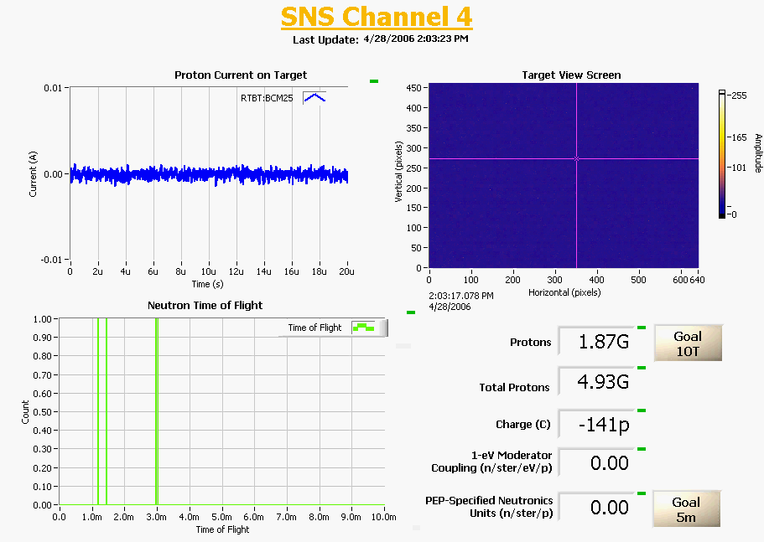
Summary
Target Imaging System is part of operations.
Luminescence decay is very rapid: should find coating that decays less rapid (instead of high initial luminescence).
Tracked issue with power vs. reported position to proton beam window heating, added auto-cal.
SNS Commissioning
Uniformity measurement indicates ~12.5% but noisy
Adding optical port for studies
Coating might be partially blocked in the future

Slide 19
References
T. McManamy, et. al., “SNS Target Beam Profile Viewscreen Design and Operation”, AccApp 2007, Pocatello, Idaho, July 29-August 2, 2007, p. 160.
T. Shea, et. al., “Status of Beam Imaging Developments for the SNS Target”, DIPAC 2009.
T. Shea, et. al., “Installation and Initial Operation of an On-Line Target Imaging System for SNS”, ICANS 2010.
L. C. Maxey et al. "A hybrid reflective/refractive/diffractive achromatic fiber-coupled radiation resistant imaging system for use in the Spallation Neutron Source (SNS)", Proc. SPIE 8142, Hard X-Ray, Gamma-Ray, and Neutron Detector Physics XIII, 81420N (September 27, 2011); doi:10.1117/12.894125;
W. Blokland et. Al., SNS Target Imaging System Software and Analysis, Proceedings of BIW10, Santa Fe, New Mexico, US

