Slide 1
Dose Limit Philosophies Implemented at the Spallation Neutron Source
David McClintock
5th High Power Targetry Workshop
May 20-23, 2014
Fermilab, Batavia, Illinois

Slide 2
Question for Group…
Does your facility have fixed administrative lifetime limits for “high dose” components based on concerns with radiation-induced changes in mechanical properties?

Slide 3
Outline
Overview of the Spallation Neutron Source
  Dose Limited Components
  Target PIE
Dose Limit Philosophies
Discussion

Slide 4
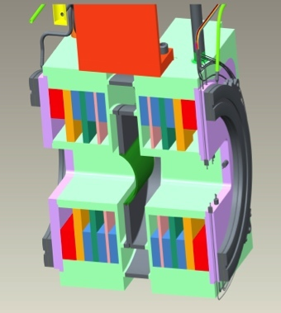
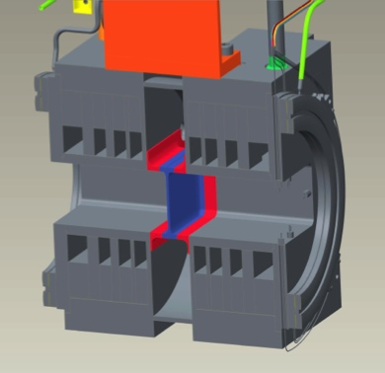
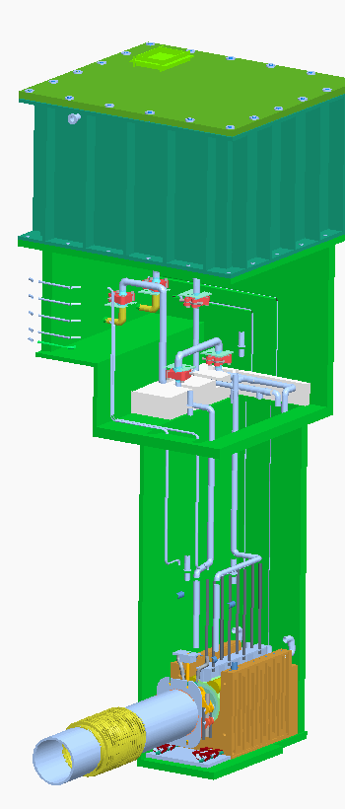
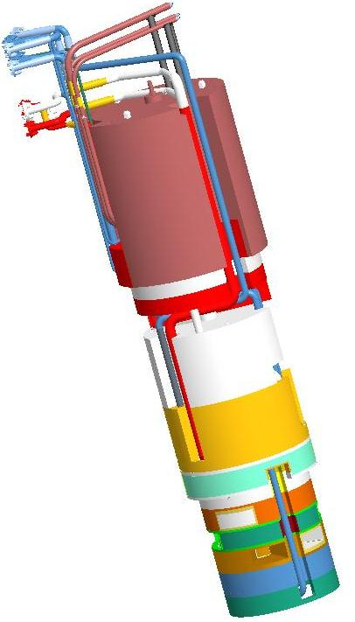
Four Major Components at the SNS are Dose Limited
Target Module
  AISI 316L
Ring Injection Dump
  AISI 316L
Proton Beam Window
  Inconel 718 (solution annealed)
  Al 6061-T651
Inner Reflector Plug
  Lifetime determined by burnup of Ga in moderator poison sheets
Figure Credit: Ken Gawne
Figure Credit: Jim Janney

Slide 5
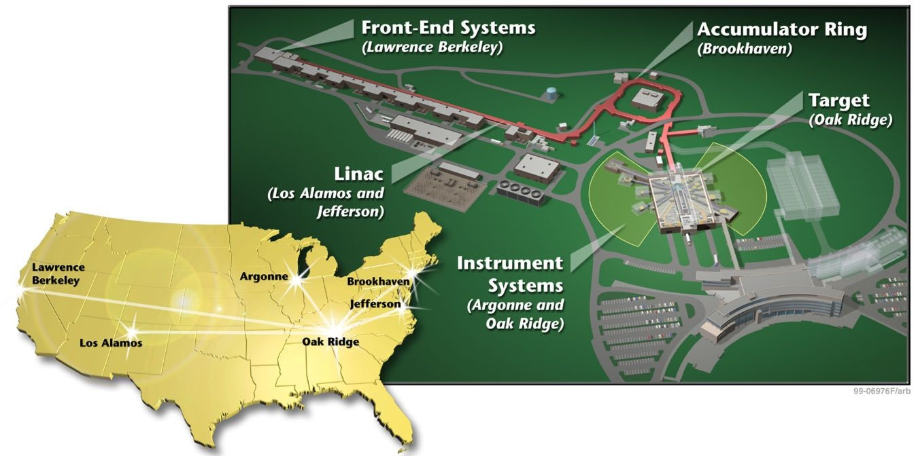
Four Major Components at the SNS are Dose Limited
Ring Injection Dump
Target
Proton Beam Window
Inner Reflector Plug
Notes:
Designed to 1.4 MW (what needs to be changed to go to 2 MW?)
Pulse frequency = 60 Hz
Pulse time is approximately 700 nsec

Slide 6
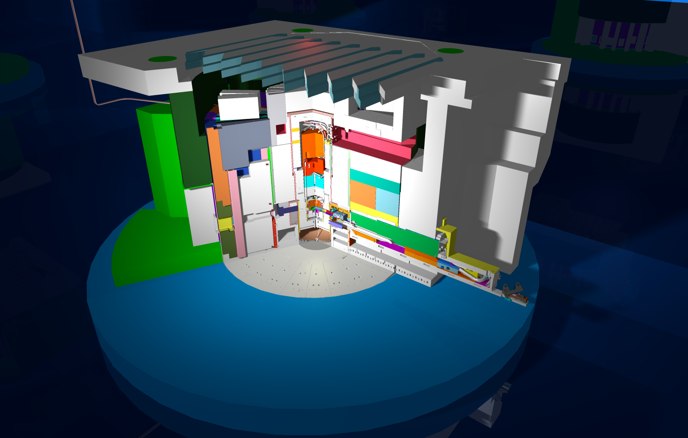
The target is inserted into a large monolith structure during operation
Shutter Gate
Service Cell
Neutron Beam Line
Target and Carriage Assembly

Slide 7
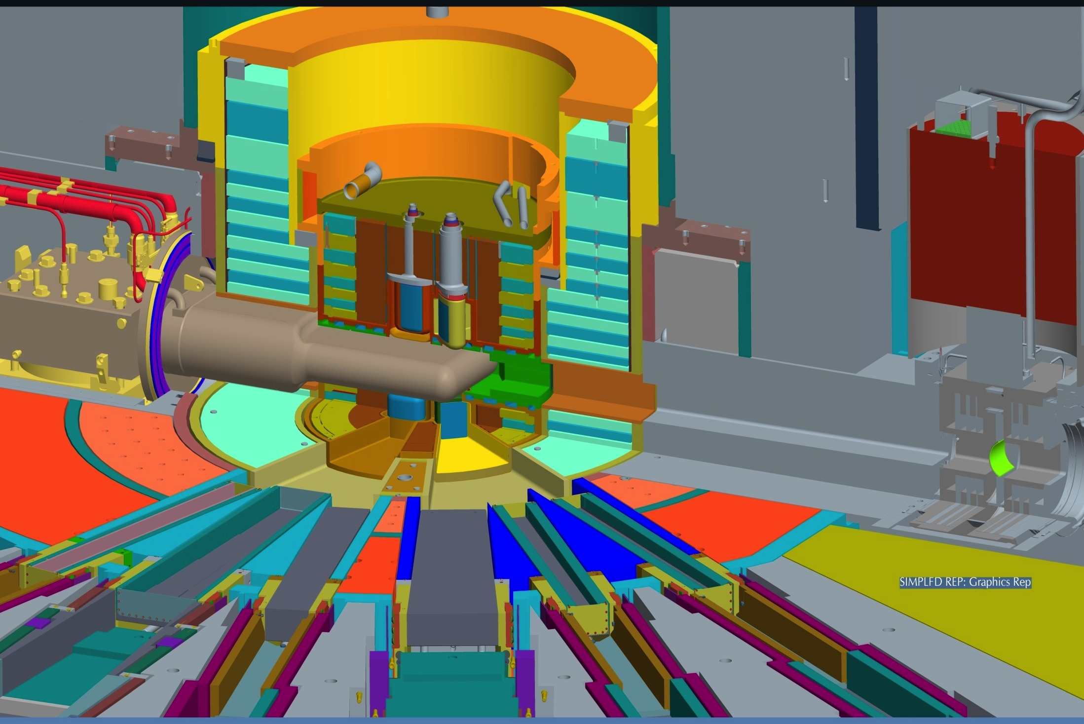
The target provides neutrons to 24 beam lines
Target
Inner Reflector Plug
Outer Reflector Plug
Core Vessel
Core Vessel Insert
Shutter
Proton Beam Window
Figure Credit: D. McClintock
Notes:
The SNS has 4 Moderators:
1. Two downstream and one upstream liquid hydrogen
2. One upstream ambient water
Proton Beam Window:
Currently – Inconel 718 (precipitation hardened nickel alloy)
Next Generation Design – 6061-T651

Slide 8
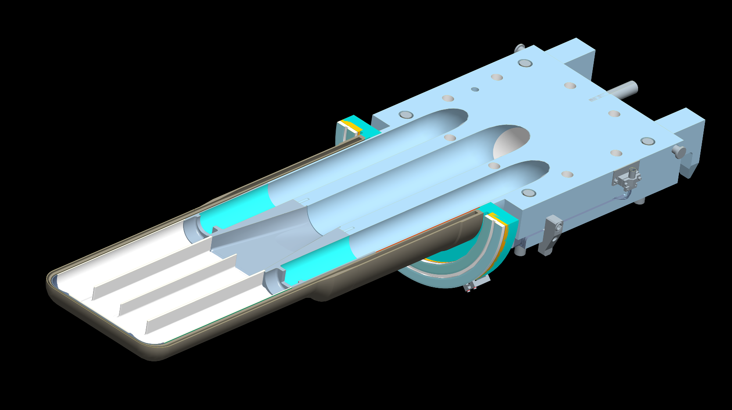
Mercury enters through side supply passages and returns through the center return passage
Figure Credit: D. McClintock
Notes:
Target has two mercury supply passages and one central return passage
Center baffle was added to SNS Target design to suppress a “breathing” modal resonance that was identified during early target design development

Slide 9
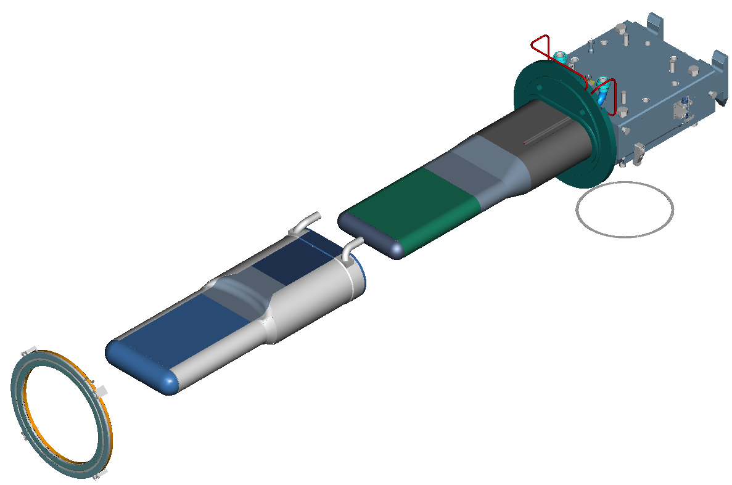
SNS target is composed of two “vessels” welded to a manifold block
Mercury Target Vessel
Target-to-Carriage
Gasket
Water-cooled Shroud
Target-to-Core
Vessel Inflatable Seal
Notes:
Mercury flows through “mercury target vessel”
Water flows through the “water-cooled shroud”
Water-cooled shroud acts as a barrier to the aluminum intensive core vessel, moderators, IRP…
Target is sealed to carriage by dual knife edges into a soft iron (98-99% Fe) gasket

Slide 10
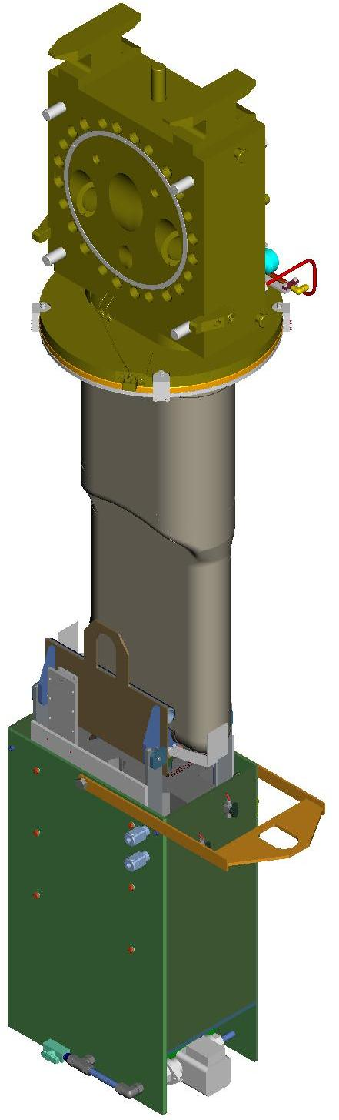
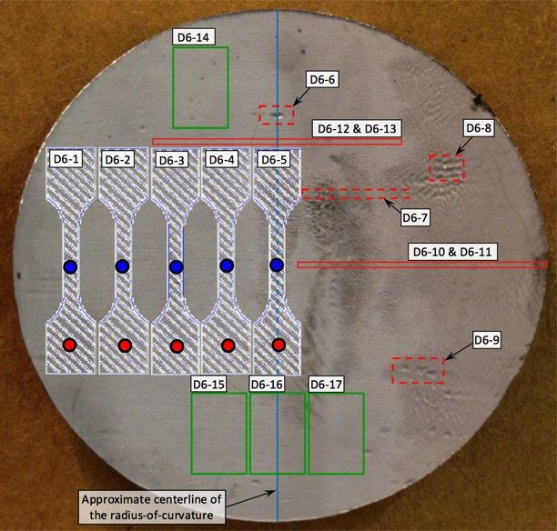
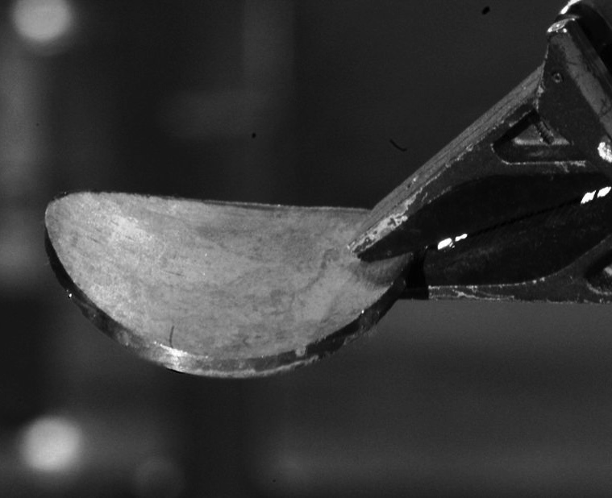
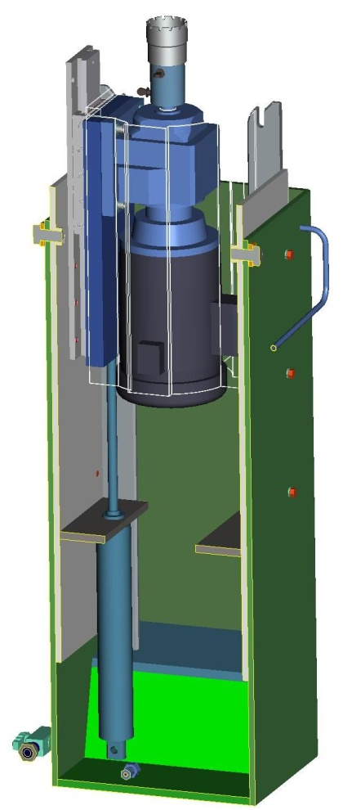
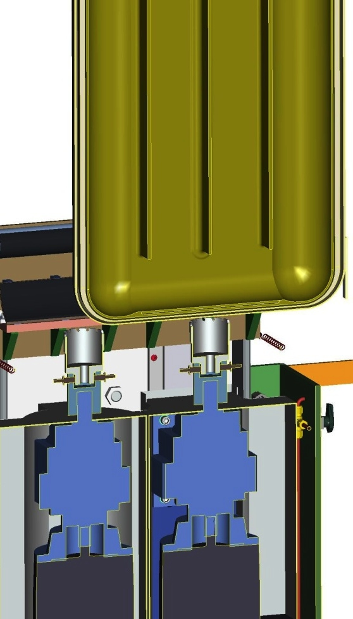
Specimens were removed from Targets 1-8 after service and characterized by mechanical testing and microscopy
Target in Center-cut Position
Annular Cutter
Low-profile Linear Slide
Specimen Map
Electric Drill Motor
Pneumatic Piston
Figure Credit: Adam Carroll
EDM Machining Map

Slide 11
Component lifetime limit philosophies are generally based on Acceptable Risk
What is a lifetime limit?
  A lifetime limit for a component in a nuclear system is an administrative tool used to limit the risk of component failure originating from radiation-induced changes in mechanical properties of the component material.
How is the lifetime determined for a component?
  Component lifetime limits are determined by establishing a minimal level of acceptable risk to operation of a facility.
What criteria are used to set limit?
  Limits are established after consultation with: (1) experience from facilities with similar operational conditions and (2) data from mechanical properties studies in the available literature.
How are limits revised?
  Lifetime limits are revised based on information gathered during post irradiation examination (PIE) of components in question and additional data on radiation-induced changes in mechanical properties.

Slide 12
Lifetime limits at the SNS are based on different considerations
AISI 316L and Inconel 718
  Limit Basis: Maximum dpa
  Concern: Loss off fracture toughness and ductility
Aluminum PBW
  Limit Basis: He concentration
  Concern: Grain boundary embrittlement by He
Inner reflector plug
  Limit Basis: Burnup of gadolinium coating on the moderator poison plates
  Concern: Loss of resolution and performance of instruments serviced
 | Material | Lifetime Limit | Current Level*
Target | 316L | 10 dpa | 5.9 dpa
PBW | Inconel 718 | 15 dpa | 10.6 dpa
 | AL 6061-T651 | 2,000 appm-He | NA
RID | 316L | 10 dpa | 4.3 dpa
IRP | Gadolinium | 32,000 MW-hr | 21,840 MW-hr
*May 2014

Slide 13
316L – Target and RID Windows
316L and similar alloys have a long history in nuclear applications
Numerous studies have been published on radiation-induced changes in mechanical properties of 316L variants
  Including irradiations in spallation spectrums
From: L.K. Mansur and J.R. Haines, J. Nucl. Mater. 356 (2006) 1-15.
From: S. Maloy et al., J. Nucl. Mater 296(2001) 119-128.

Slide 14
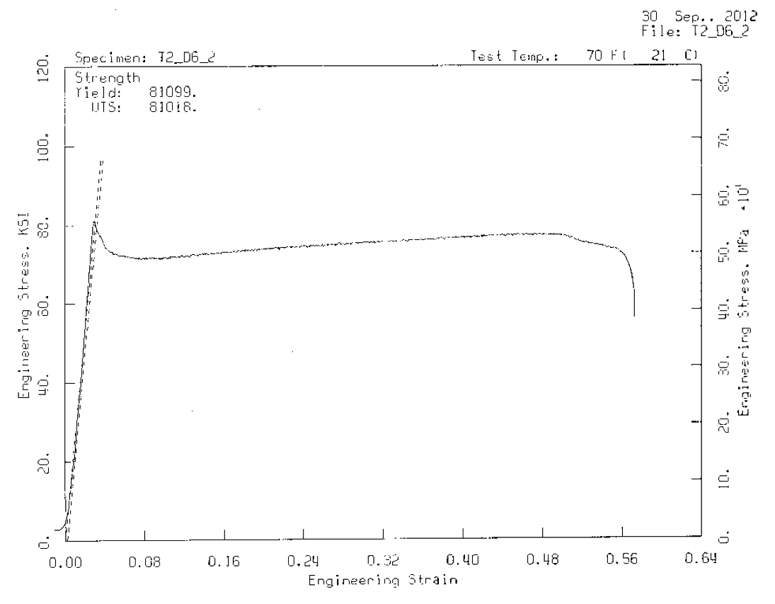
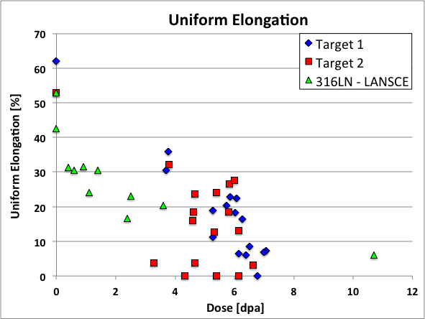
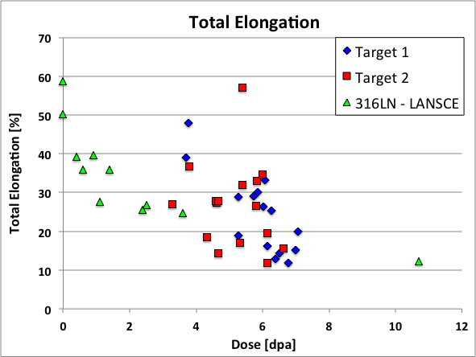
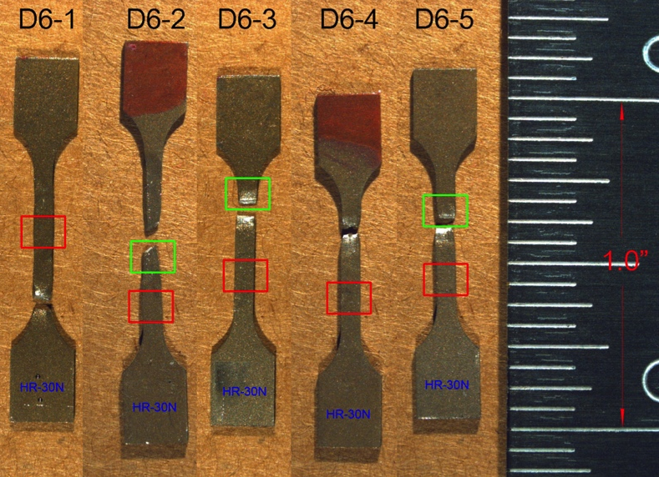
Unanticipated behavior can complicate the assessment of lifetime limits
Reduction in uniform elongation observed in Targets 1 and 2 are generally consistent with previous LANSCE data* [*K. Farrell and T.S. Byun, Journal of Nuclear Materials, 296 ( 2001) 129-138]
Two specimens displayed irradiated to ~5.4 dpa almost zero uniform elongation but significant total elongations (~57%)
Abnormally high elongations might have been caused by deformation-induced phase transformation in the gauges section
Figure Credit: D. McClintock
Notes:
Doses were calculated using MCMPX with Tom McManamy’s proton beam profile (peaking factor ~1.18)
Irradiation temperature = 50-125°C
Test temperature = room temperature (~22°C)

Slide 15
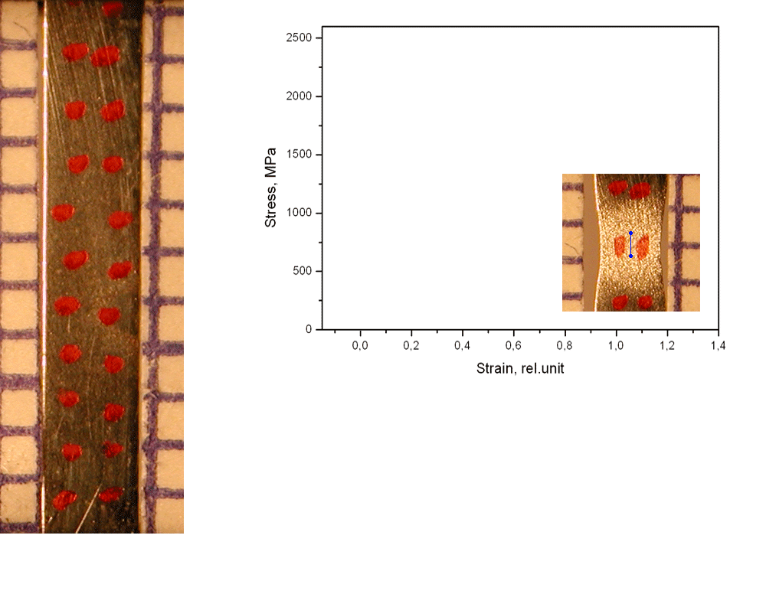
Localized deformation is typical post-yielding behavior in irradiated austenitic steels*
*Slide Courtesy of: Frank Garner and Maxim Gusev
Engineering and true stress-strain curves
Austenitic steel Cr16Ni11Mo3
Analog of 316 SS
12 dpa at 300⁰С
BN-350 reactor
Strain rate of
0.5 mm/min
true
engineering
~9-11% total elongation of specimen but >100% local deformation
Notes:
15
Typically highly irradiated austenitic components plastically deformation is localized after yielding and only a small volume fraction of the gauge section participates in plastic deformation.
Therefore, after yielding all the deformation is concentrated in one location on the gauge section

Slide 16
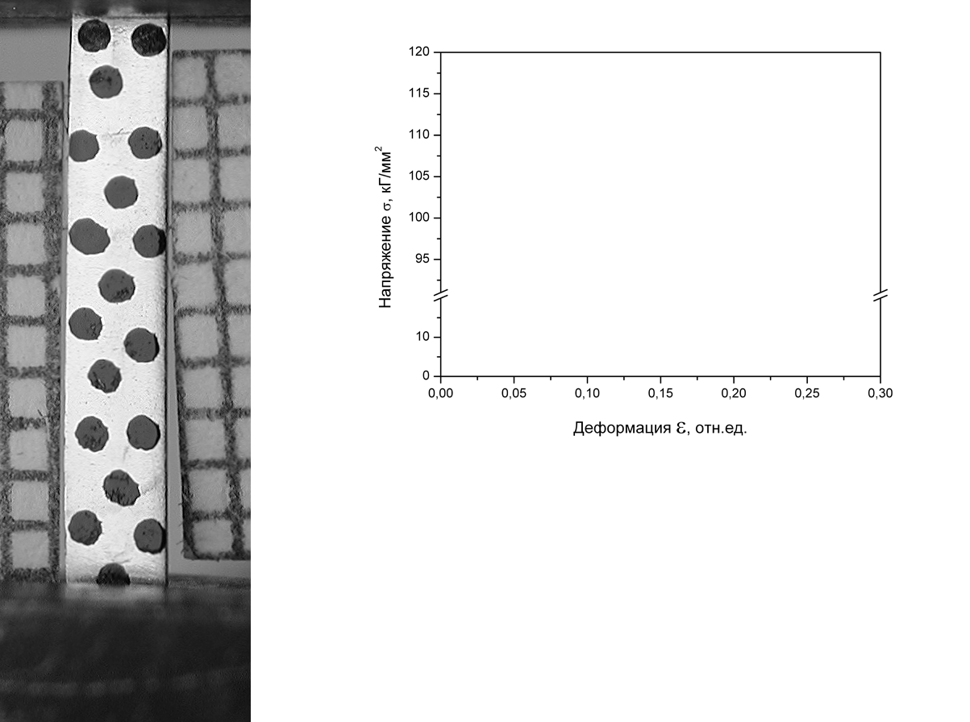
Inability to neck may produce a “deformation wave” in highly irradiated stainless steel* – Is this occurring in the SNS Target?
*Slide Courtesy of: Frank Garner and Maxim Gusev
55 dpa, 310°C
in BN-350
Russian analog to 321 stainless steel
room temperature test
Stress, kg/mm²
Deformation, rel.unit.
A “deformation wave” appears on the surface and moves along the specimen gauge section
Gusev et al., J. Nucl. Mater. 386–388 (2009) 273–276
Gusev et al., J. Nucl. Mater. 403 (2010) 121–125
Notes:
16
Plastic deformation behavior after yielding is quite different when a deformation wave is generated. As the specimen begins to yield, usually near the specimen shoulder where the grips are concentrating stress, the material that undergoes plastic deformation begins to transform from austenite (face center cubic, fcc, crystal structure) to a martensitic (body centered cubic, bct, crystal structure) and the deforming material is hardened to the point where the material below the transformed volume begins to yield and transform into martensite. The subsequent yielding causes a “wave of deformation” to propagate down the length of the gauge section, which allows more material in the specimen gauge section to participate in the plastic deformation. The wave continues to propagate until fracture occurs.
By permitting more volume of the gauge section to participate in the test, the elongation values increase relative to specimens that experience localized plastic deformation.

Slide 17
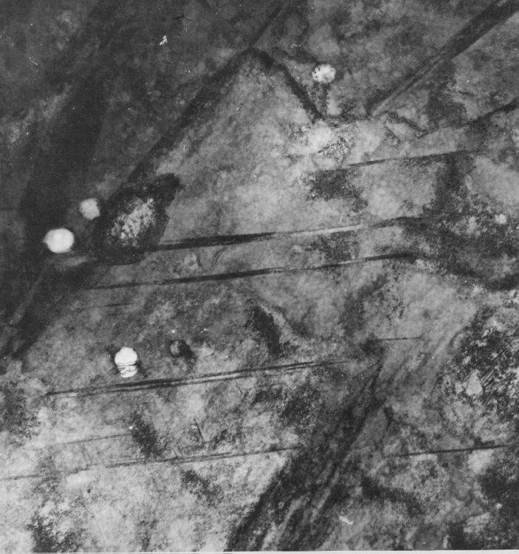
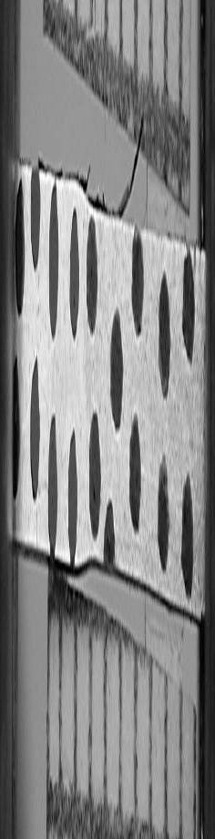
Deformation waves are caused by a martensitic transformation in the gauge section during plastic deformation*
*Slide Courtesy of: Frank Garner and Maxim Gusev
Typical amount of martensite in deformed non-irradiated sample:
V_{α} ~ 5-10 %
Distribution of martensite along gage section of Cr18Ni10Ti specimen
Specimen Dose ~26 dpa
Deformed region
α
Area of moving
deformation band
V_{α} ~ 30-35% martensite
Specimen Dose ~55 dpa
Photo Credit: Maksimkin O.P. et al., Institute of Nuclear Physics, Almaty, Kazakhstan.
Notes:
17
Typically, the amount of martensite present in non-irradiated and non-deformed austenitic steels is approximately 5-10% (depending on the relative amounts of alloying elements)
Post testing microscopy has verified the presence of elevated volume fraction of martensite in the deformed regions of the gauge section.
The deformation wave (band) was clearly resolved in the plot of the volume fraction of martensite along the specimen gauge section.

Slide 18
Solution Annealed Alloy 718 – PBW
Very little data on the radiation-induced changes in mechanical properties exist for alloy 718 in the solution annealed condition
The Alloy 718 (SA?) PBW at the ISIS First Target Station experienced an estimated 30-90 dpa maximum dose without failure…
The radiation-induced changes in mechanical properties of Alloy 718 is expected to be similar to other austenitic stainless steels (304L, 316L, 321…)
From: T.S. Byun and K. Farrell, J. Nucl. Mater. 318 (2003) 292-299.

Slide 19
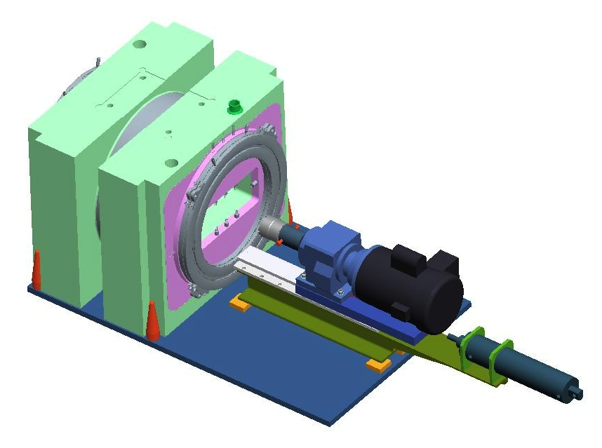
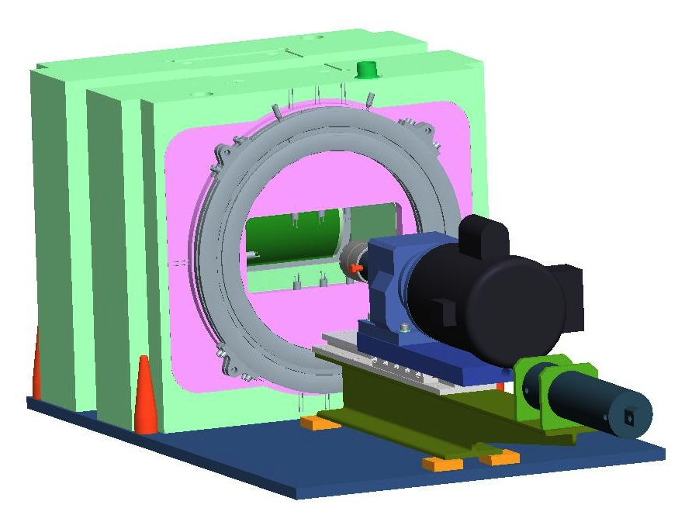
PIE of Proton Beam Windows at the SNS
Lifetime limit for the upcoming Al 6061-T651 PBW was established based on the experience with the AlMg₃ safety hull of the SINQ target
Admittedly, the SINQ safety hull is not a direct comparison with spectrum or alloy type (solid-solution hardened verses precipitation hardened)
Lack of mechanical properties data from Inconel 718 and Al 6061-T6 irradiated in a spallation spectrum reinforces the need for PIE of PBWs at the SNS
Figure Credit: M. Dayton

Slide 20
What are your lifetime limit philosophies?
What is a lifetime limit?
How is the lifetime determined for a component?
What criteria are used to set limit?
How are limits revised?

Slide 21
Backup Slides

Slide 22
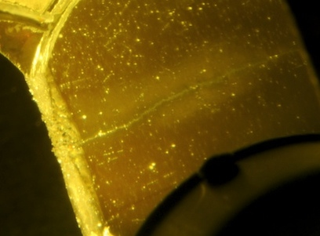
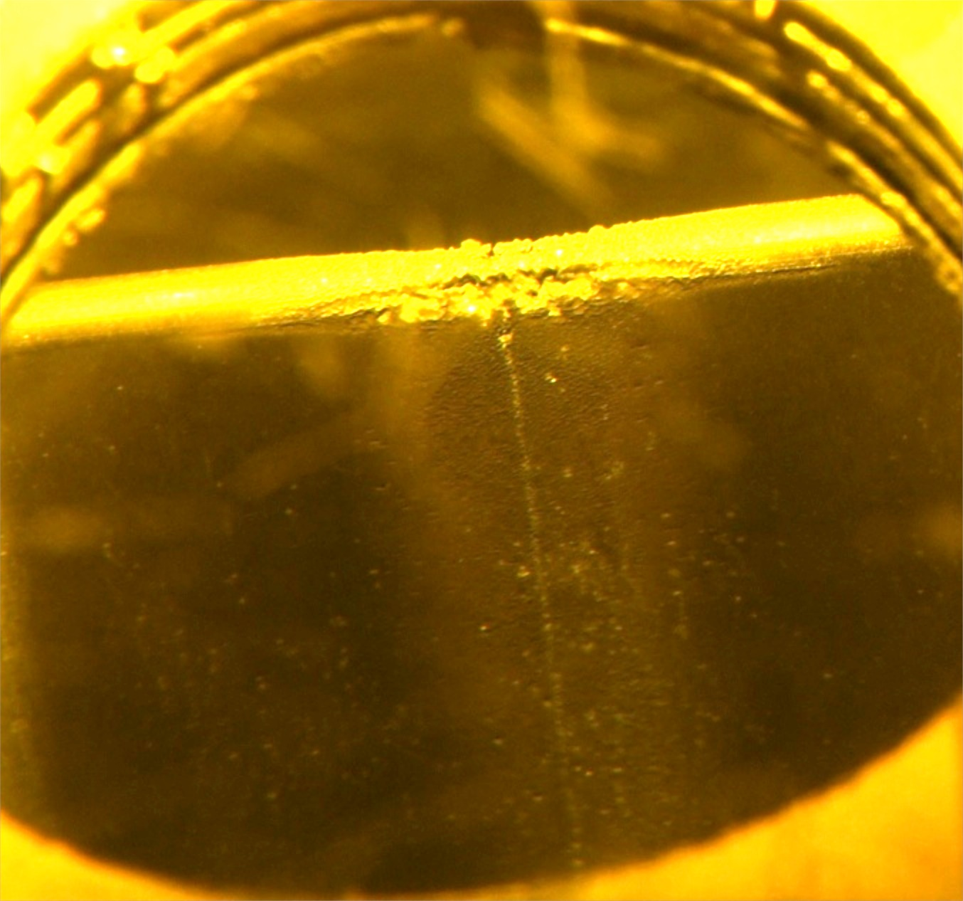
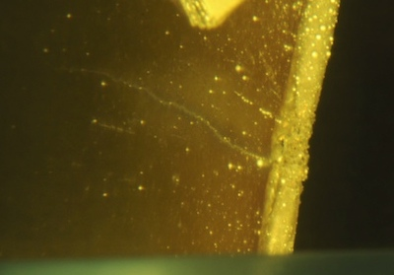
A crack-like feature was observed on the center flow baffles of Targets 2-6
Current PIE capabilities do not allow sampling of the center flow baffle
Target 5 “Passenger Side”
Target 4
Target 5 “Driver Side”
Crack-like feature observed on center baffles of Targets 2-5
Figure Credit: D. McClintock
Notes:
Want to understand functionality of center baffle with respect to design changes for future targets
Some engineers would like to delete center baffle, and uncertainty of the modal analysis would be resolved if we could…
At higher power the center baffle becomes overstressed and removing would elminate a thermal stress limitations and reduced pressure pulse stresses overall.

Slide 23
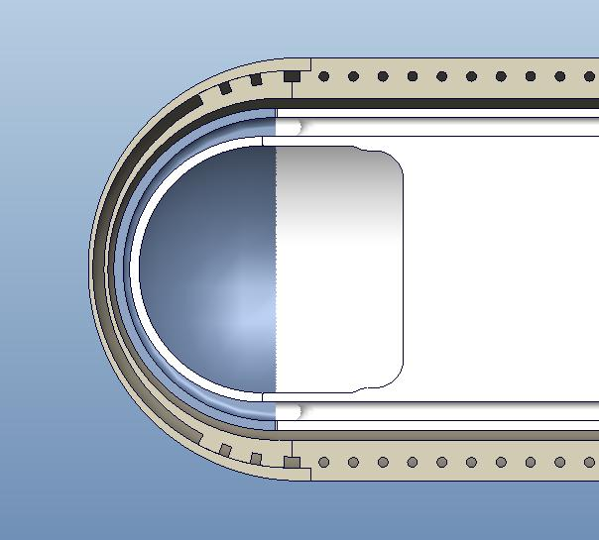
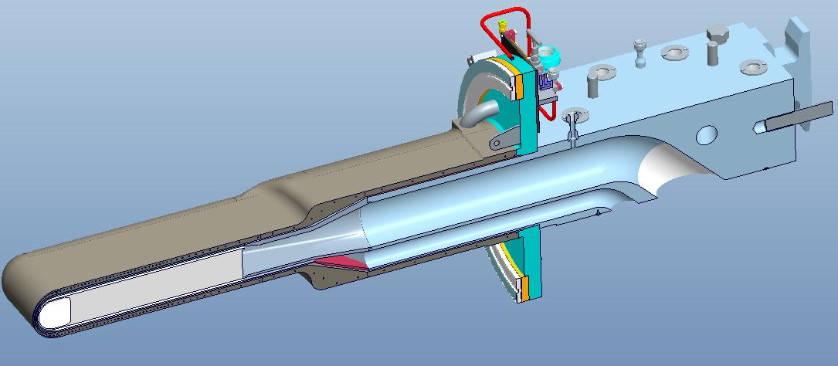
Mercury flows between layers two walls of the target vessel beam entrance region
Beam entrance region of the mercury target vessel is cooled by a uniform high-velocity (2.5 – 3.0 m/s) “window-flow” of mercury
The high velocity mercury and narrow channel appear to play a role in mitigation of cavitation-induced erosion
Mercury Window Flow Supply Passage
Mercury Window Flow
Notes:
Window flow is designed to cool the 316L vessel material…and has the added benefit of providing a “sacrificial” wall for cavitation-induced erosion
Mercury is supplied by a separate mercury supply on the target carriage

Slide 24
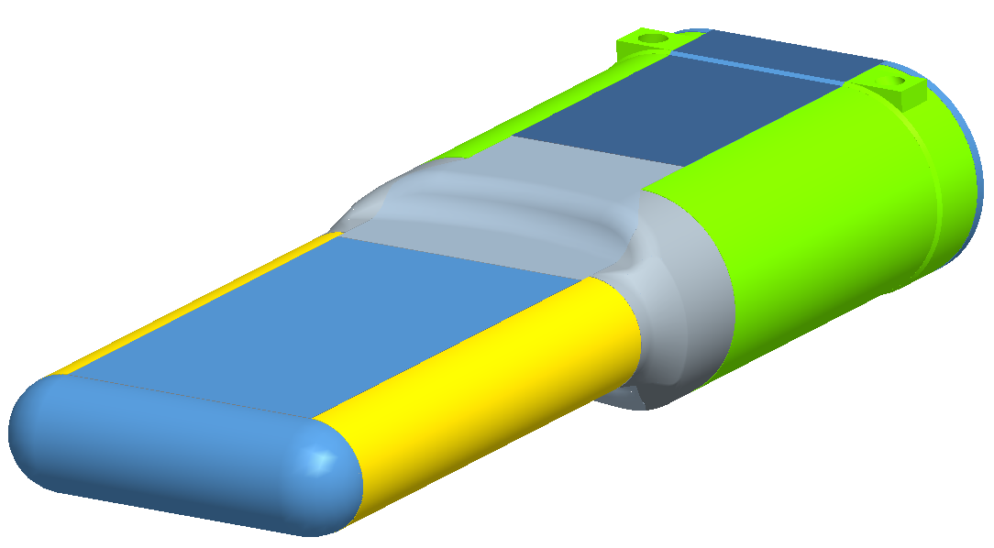
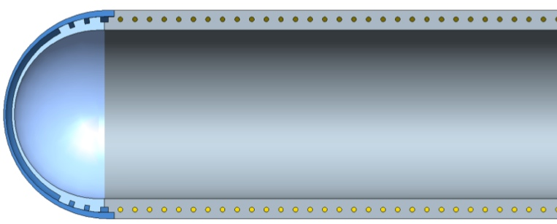
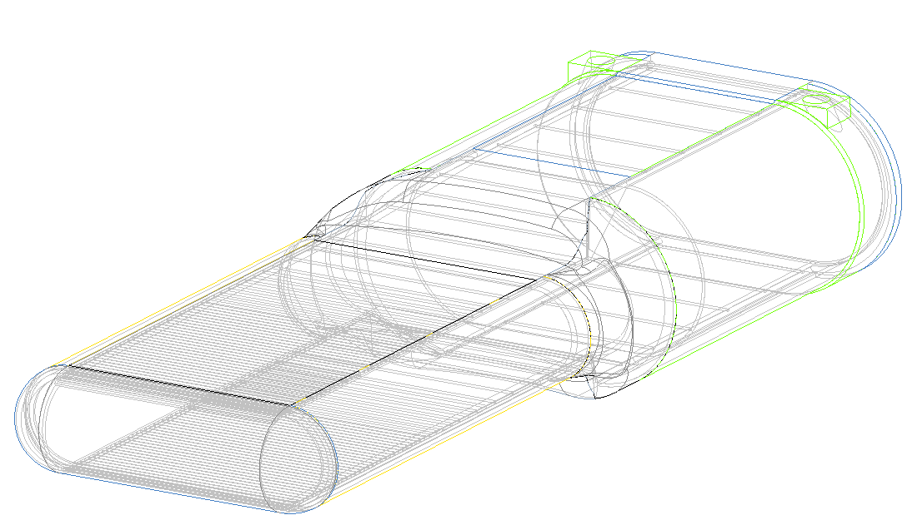
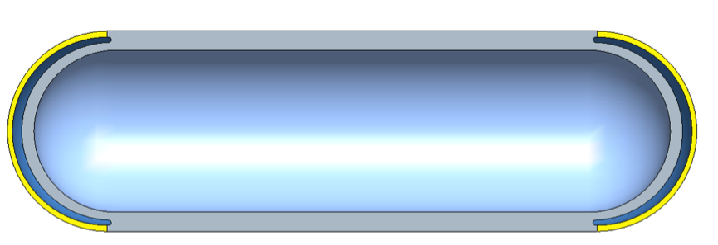
Shroud vessel is cooled by flowing water
Cross Flow Channels
Window Flow Outlet
Window Flow Inlet

Slide 25
Target Power Histories
Figure Credit: Bernie Riemer

