Slide 1

Accelerator-based Materials Irradiation Facilities
J. Knaster (IFMIF-EVEDA Project Team), A. Ibarra (CIEMAT)

Slide 2
Outline
Materials irradiation needs
Ion irradiation sources
Accelerator-based neutron sources
Summary

Slide 3
Outline
Materials irradiation needs
Ion irradiation sources
Accelerator-based neutron sources
Summary

Slide 4
Primary radiation effects
Transmutation
  Due to nuclear reactions, new ions appear inside the materials, giving rise to new impurities (main ones are H and He, but others can be also relevant)
  It can induce also the activation of the material (some of these new impurities can be radioactive isotopes). This is the main reason for the development of low-activation materials.
  The amount and specific new ions is a function of the type of incident particle, its energy and the target ion. If enough information of the target material (impurities can be very relevant) is available, usually it is feasible to make a rough stimation
Point defects (holes and interstitials)
  It is a complex function of the incident particle, its energy, the materials characteristics and temperature
  After their creation, they can move around being trapped in previous defects or on new ones giving rise to extended defects (dislocations, bubbles, loops, precipitates,…)
  If dose/dose rate is high enough, it can be produced strucutral changes in the material (amorphization, new cristalline phases, new compounds,…)

Slide 5
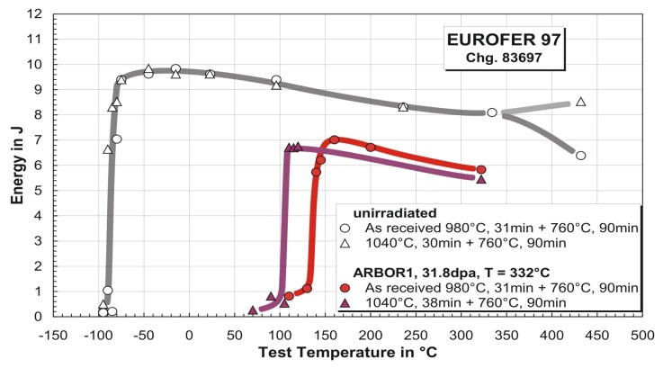
Macroscopic radiation effects
Both the dose, dose rate and the shape of the energy spectra of the incident particle, have important consequences in the materials properties and on the design of an irradiated component.
Main changes in mechanical properties of interest for irradiated components design:
  Increased hardening
  Decreased ductility
  Decreased heat conduction
  Swelling
  Embrittlement
  Blistering
  …
Consequences to be taken into account in the design of irradiated components:
  Changes in the mechanical properties of structural materials
  Changes in physical properties (corrosion, diffusion, conductivity, luminescence,…)
  Welding, joins,… must be evaluated
  Systems behaviour under radiation (radiation enhanced phenomena)
  Remote Handling
  …
~32 dpa, 332°C, ARBOR 1 irradiation
Irradiation effects
Ductile-Brittle Transition
-30%
Unirradiated
~ 200 K
Irradiated
EUROFER 97
C. Petersen, FZK

Slide 6
Main materials irradiation needs
Materials irradiation needs are coming from very different fields:
Fission reactors (specially for GenIV development)
  Very high doses of (quasi) thermal neutrons.
  Main concern are effects on mechanical properties
Fusion reactors
  Very high doses of 14 MeV neutrons and/or low energy charged particles
  Main concern are effects on mechanical properties (but also physical ones) and/or surface degradation
Spallation sources and other accelerator-related machines
  Window and/or target lifetime evaluation
  Main concers are effects on mechanical properties and in the case of the liquid alternative cavitation and corrosion effects
Space applications
  Fluxes of charged particles up to very high energy.
  Integrated dose not very high
  Main concern are effects on physical properties
Medical applications

Slide 7
Outline
Materials irradiation needs
Ion irradiation sources
Accelerator-based neutron sources
Summary

Slide 8
Irradiation sources
Very different irradiation sources can be used, as a function of the issues to be investigated
(note that the use of a irradiation source different to the “original” one assumes the capability to extrapolate between different irradiation conditions –something that is not obvious at all-): role of modelling and the use of normalized samples
A materials irradiation facility should be able to provide control of different irradiation parameters (dose, dose rate, temperature, …)

Slide 9
Irradiation sources
Types of irradiation sources:
Ionizing radiation sources
Displacement damage sources.
    Ion accelerators (ion irradiation)
    Nuclear reactors
    Accelerator-based neutron sources
      Spallation sources
      Stripping
      Others (DT sources)

Slide 10
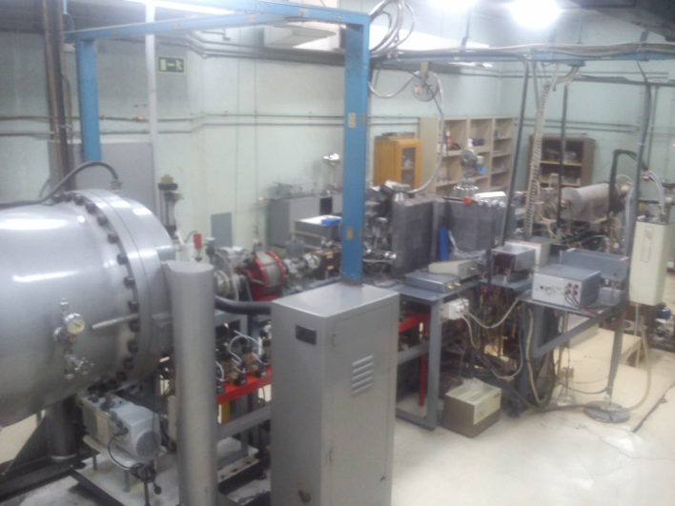
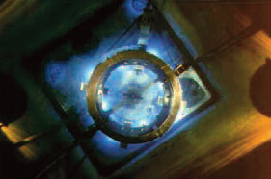
Irradiation sources
Types of irradiation sources:
1) Ionizing radiation sources: gamma sources, electron accelerators or ion accelerators (using the electronic excitation region)
    Many different ones all around the world
    Typicaly used to investigate in-beam effects on physical properties (RIC, RID, OL, OA, permeation,…)
    Very high localized power density is feasible, but usually not very high power beams and, no beam window is needed, so no significant target issues

Slide 11
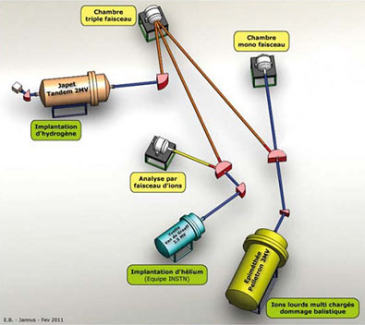
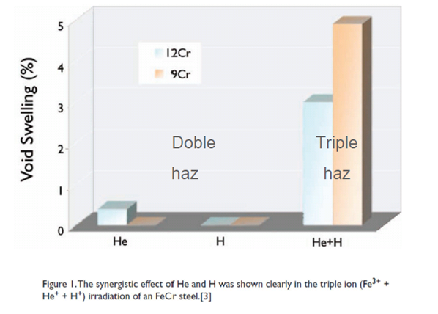
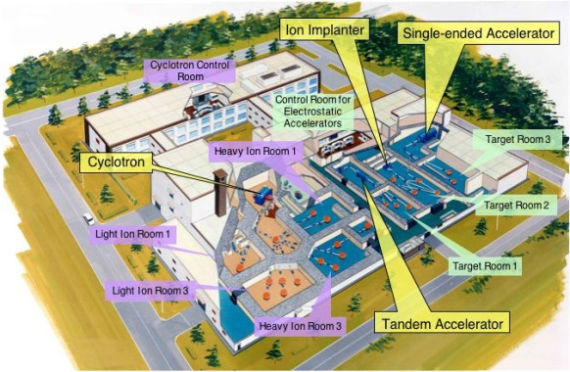
Irradiation sources
2) Displacement damage sources. Ion accelerators (ion irradiation):
Single and multi-ion beam facilities
    Wide range of particles and energies
    Main advantage: high damage rate (accelerated testing), adjustable He/dpa and H/dpa ratio, no activation, very high flexibility
    Main drawbacks: high damage rate, limited range (microns), recoil energy spectrum
    Many single/dual ion facilities
    Main triple beam facilities: TIARA (JA), JANNUS (FR), Michigan Univ. (US)
Swelling measured after Fe irradiation, combined with simultaneous H and/or He irradiation
T.Tanaka, 2003

Slide 12
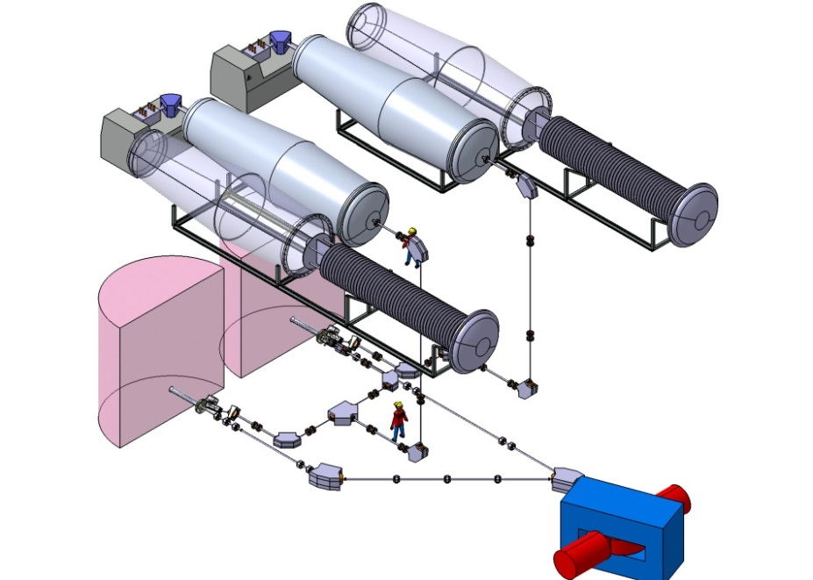
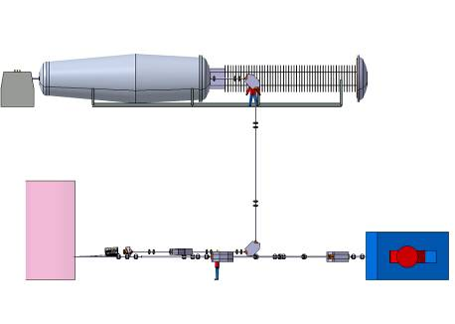
CIEMAT proposal:
TF-triple beam facility
Techno
Fusión
Presently in standby, but conceptual design is finished and available
A Facility to contribute to the evaluation of radiation effects on fusion materials
Three simultaneous ion accelerators will emulate the neutron irradiation effects
Includes:
Two light ions tandem-type, electrostatic accelerators (mainly for He and H irradiation)
One heavy ion cyclotron (isochronous type) accelerator (Fe -400 MeV-, W -400 MeV-, Si -300 MeV-, C -100 MeV-, … and k = 110)
Also experiments under high-field magnet
Irradiation volume up to tens of microns –relevant for volume effects-

Slide 13
Outline
Materials irradiation needs
Ion irradiation sources
Accelerator-based neutron sources
Summary

Slide 14
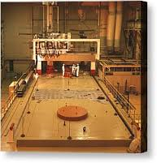
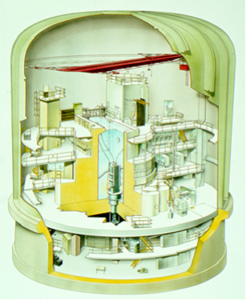
Irradiation sources
3) Displacement damage sources. Nuclear reactors
    Mixed neutron spectra: HFIR –ORNL-, HFR –Petten-, BR2 –Mol-. Most important future project: JHR (France)
    Fast spectra: SM3 –Rusia-, JOYO –Japan-, BOR60 –Rusia-
    Main advantages: volumetric irradiation, “high” volume
    Main drawbacks: only relatively low energy neutrons available (low He/dpa ratio), limited flexibility, long irradiations, activation of materials
Up to now the most important neutron sources used for materials irradiation
(also He effects using isotopically tailored or B doped materials)

Slide 15
Irradiation sources
Displacement damage sources. Accelerator-based neutron sources Spallation sources –with materials irradiation facility-
    (nonexhaustive list for low power ones)
    Running: LANSCE, ISIS, SINQ
    Planned: SNS (TBC), MaRIE (TBC), MYRRPHA, JPARC
    Under study: ESS
    Main characteristics: Very efficient for producing neutrons, high He and H production, generation of other transmutation products , usually pulsed irradiation, usually mixed proton/neutron damage, materials irradiation usually secondary facility
  Target can be of a solid one (W for example) or liquid metal (Hg or PbBi). Usually liquid metal case can manage higher power disipation.
  Main target issues: radiation damage effects on materials (synergetic effects by dpa –in some cases mixed p/n spectrum-, He and H production), for liquid metal case: risk of cavitation and corrosion

Slide 16
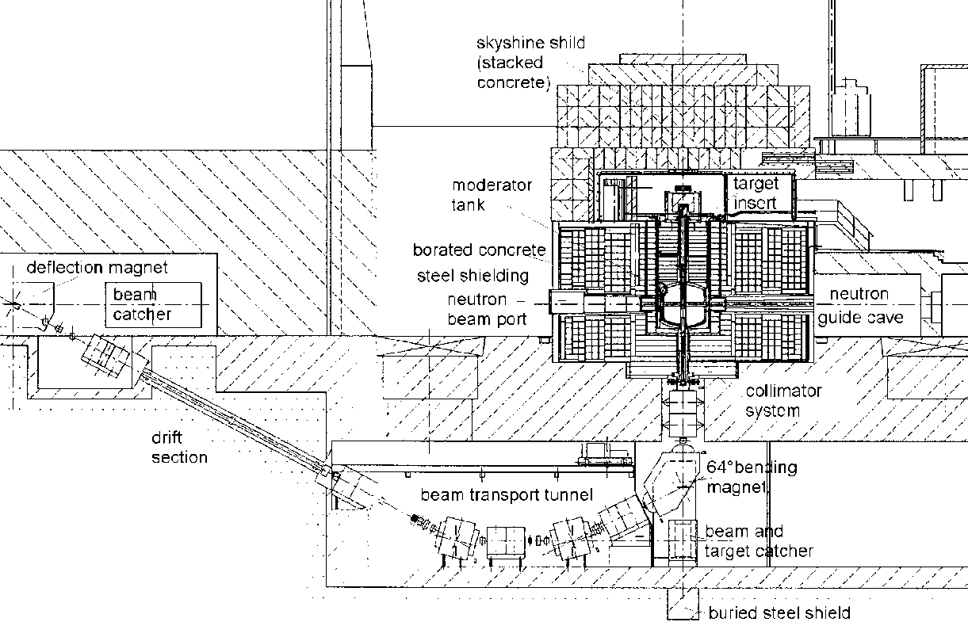
SINQ-MEGAPIE
Probably the most important materials irradiation facility (excluding nuclear reactors) in the last 10-15 years
Based on a proton accelerator and two ciclotrons
Proton energy up to 600 MeV, max power 0.8-1.3 MW, continous source
Two main programs:
  STIP
  MEGAPIE
From F. Groeschel, 2014

Slide 17
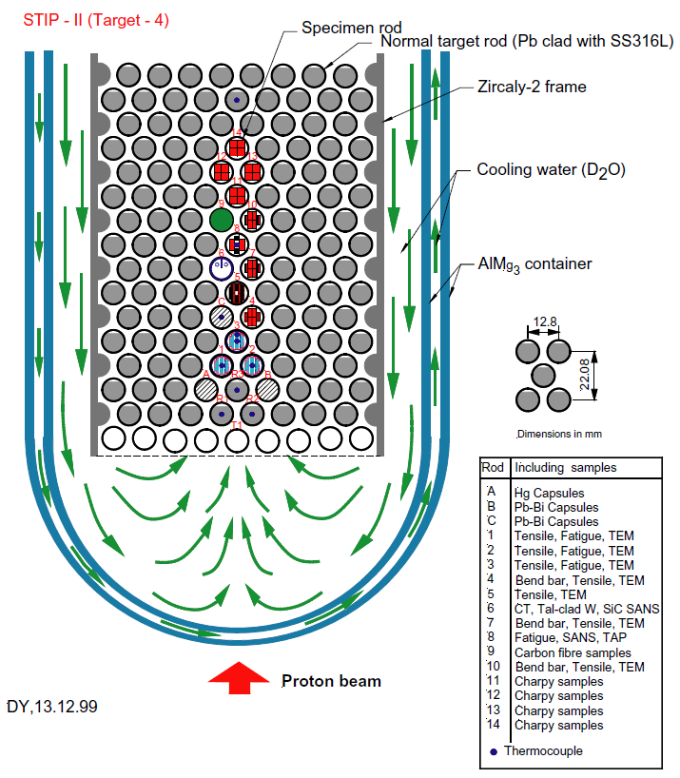
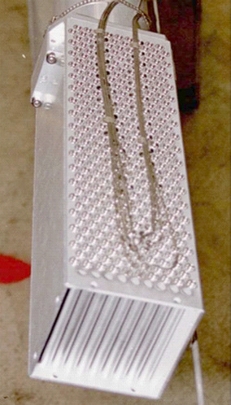
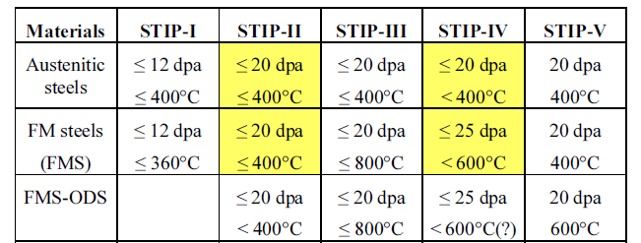
SINQ-Materials Irradiation (STIP)

Slide 18
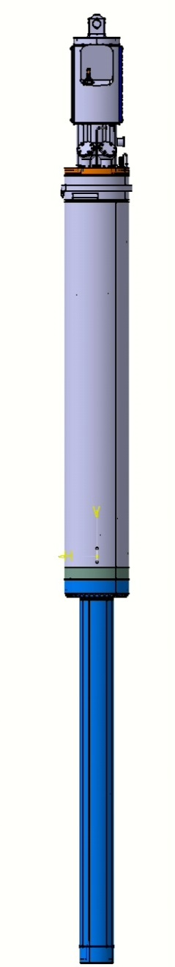
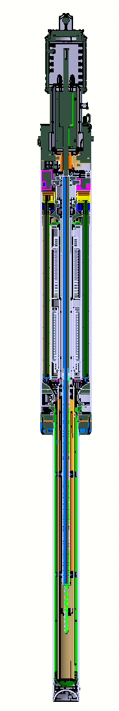
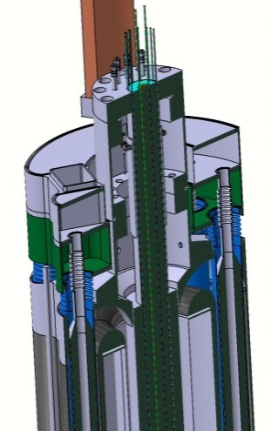
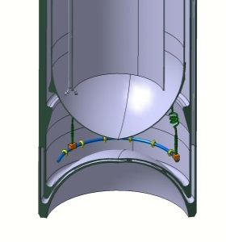
MEGAPIE Target
First PbBi cooled irradiation experiment in the MW range
Main objective: Increase of the neutron flux in SINQ
Materials irradiation limited to structural materials: T91 at 230-350 ºC range, 316L, AlMg3
Target: 5.35 m long
LBE. 82 l T=230 –380°C
575 MeV – 1.74 mA – 1 MW
650 kW thermal power – Diphyl THT oil loop
Cover Gas Pressure 0.5 – 3.2 bar
Beam Windows
Plenum and Heat Exchanger Inlet
From F. Groeschel, 2014

Slide 19
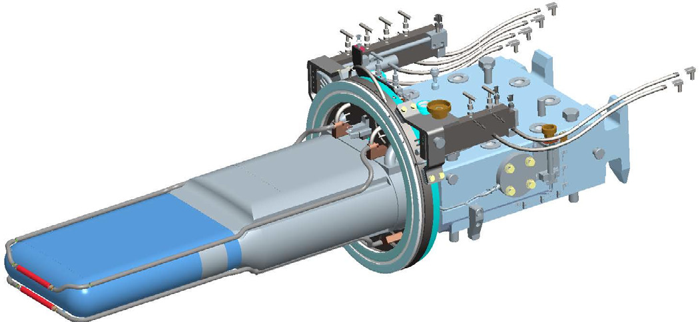
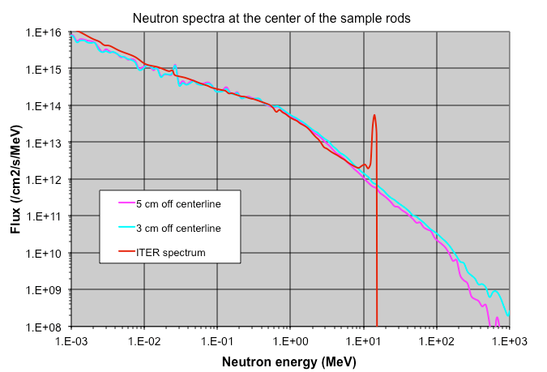
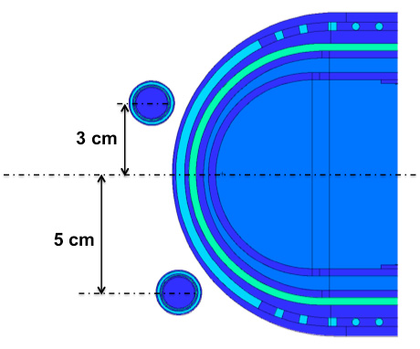
SNS (FMITS)
Proposal under study
SNS: 1GeV protons – 1.4 MW on Hg target. Pulsed operation
Proton/neutron mixed spectra
2-5 dpa/y feasible
He/dpa ratio 13-75
From W. Lu et al, J. Nucl. Mater. (2014)

Slide 20
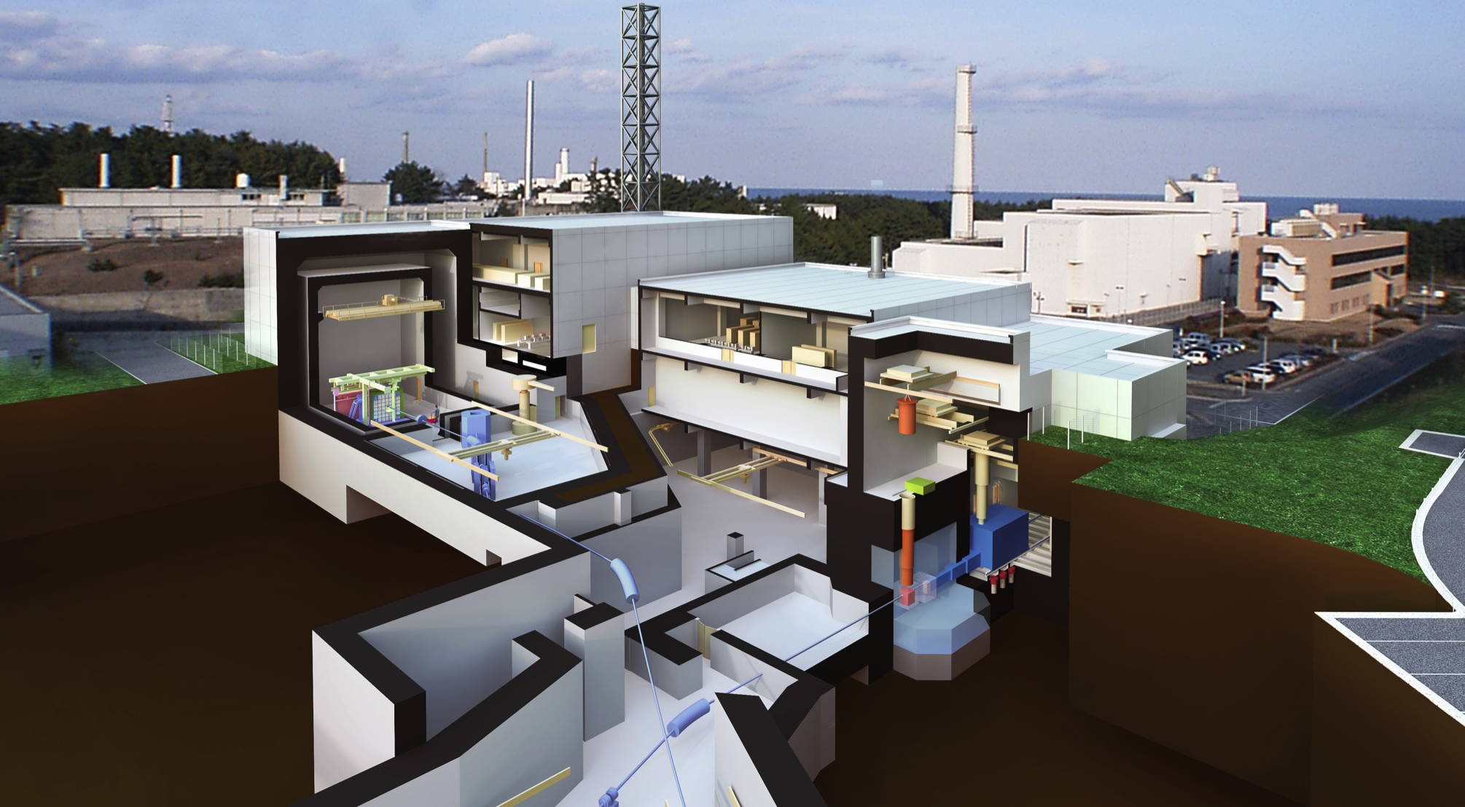
JPARC-Transmutation Experimental Facility
TEF-P:Transmutation Physics Experimental Facility
TEF-T:ADS Target Test Facility
Purpose : Material Irradiation
Category : Radiation Application
Proton Power：400MeV-250kW
Target Material：Lead-Bismuth
Purpose : Reactor Physics
Category：Critical Assembly
Proton Power：400MeV-10W
Thermal Output： Less than 500W
臨界集合体
多目的照射エリア
レーザー光源
10W
核破砕ターゲット
陽子ビーム
250kW

Slide 21
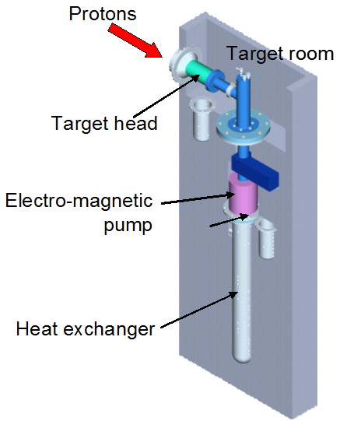
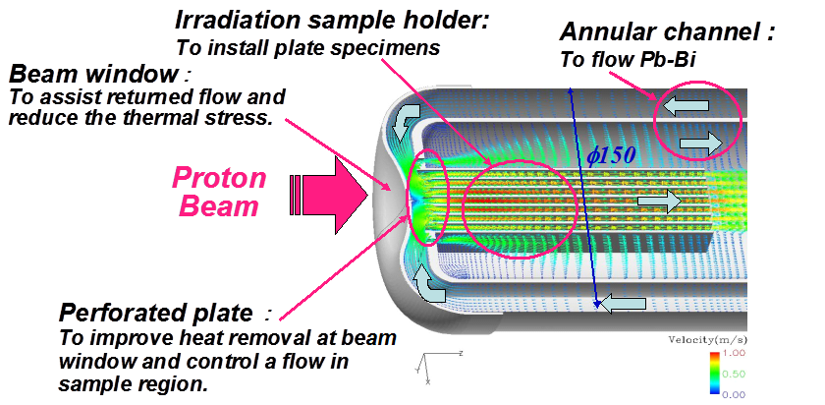
400 MeV p in PbBi target
250 kW irradiation
Dose rate: 10 dpa/y, 400 He ppm/y
Irradiation sample holder: 15 x 4 x 4 cm

Slide 22


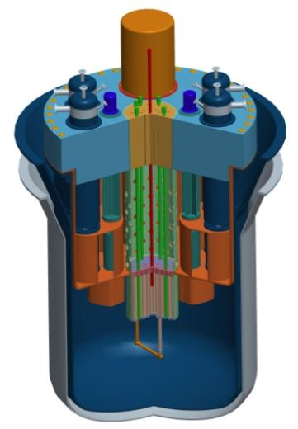
MYRRHA - An Accelerated Driven System
Accelerator
(600 MeV - 4 mA proton)
Reactor
Subcritical or Critical modes
65 to 100 MWth
Innovative & Unique
Spallation Source
Multipurpose
Flexible
Irradiation
Facility
Fast
Neutron
Source
Lead-Bismuth
coolant
From A. Hamid, IFMIF Workshop Kyoto January 2014

Slide 23
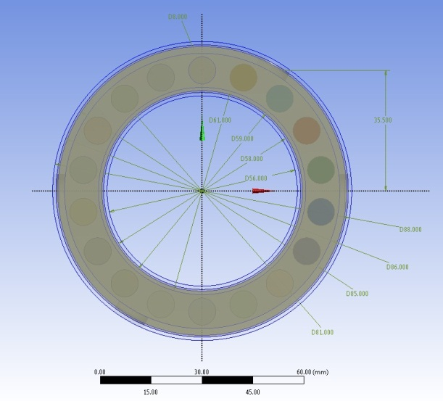
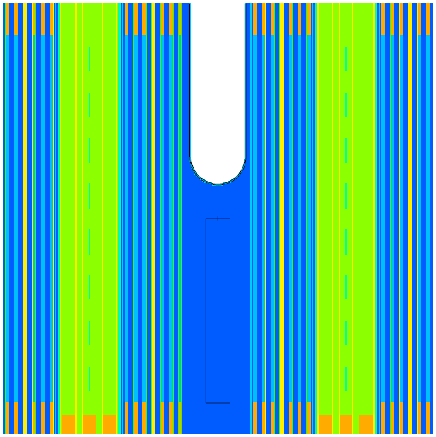
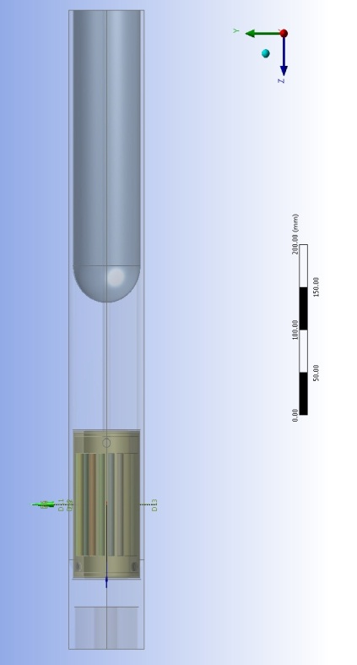

MYRRHA-IMIFF for fusion material
Material samples loaded in the spallation target vicinity
Core lay-out:
  Irradiation in sub-critical mode
  600MeV proton beam hitting the beam tube, with spallation directly in reactor coolant LBE, creating high energetic neutrons
  A few litters of irradiation volume with 20-30 dpa/fpy and 5-20 He/dpa
  Sample holder cooled by He, temperature range: 200°C – 550°C
  Sample temperature = controlled
From A. Hamid, IFMIF Workshop Kyoto January 2014

Slide 24
Irradiation sources
Displacement damage sources. Accelerator-based neutron sources
Stripping reaction
Planned: LiLiT, IFMIF
Under study: FAFNIR
    Main characteristics: Required ligth ions, Fusion-like He and H production, continous irradiation, materials irradiation main objective
    Target can be of a solid one (C for example) or liquid metal (Li). Usually liquid metal case can manage higher power disipation.
    Main target issues: radiation damage effects on materials , for liquid metal case: risk of cavitation and corrosion
Others (DT neutron sources)
    Under study: SORGENTINA
    Main characteristics: Fusion-like neutrons

Slide 25
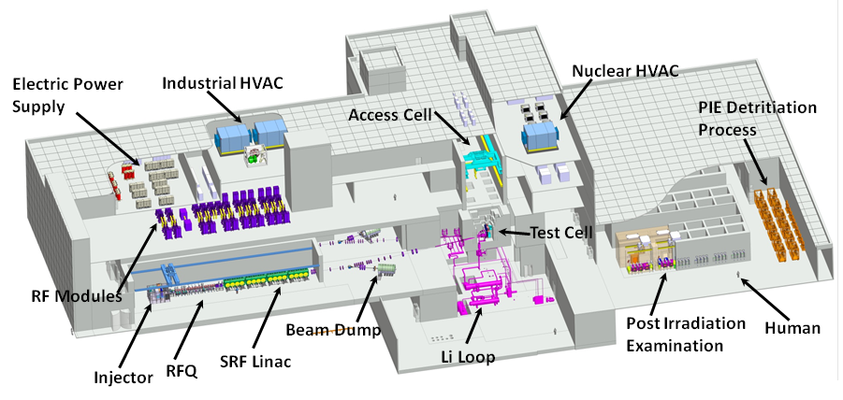
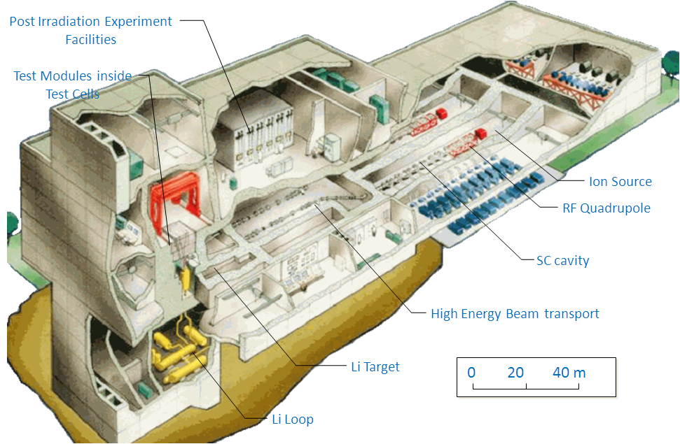
IFMIF
IFMIF is an accelerator driven neutron source designed to provide adequate flux at a suitable energy to simulate the neutron induced damage conditions expected in future Fusion Power Plants

Slide 26
IFMIF main elements
Target
Irradiation module
Accelerator
Deuterons: 40 MeV 250 mA (10 MW)
Li Flux
Samples
D⁺
neutrons
~10¹⁷ n/s
Heat exchanger
Deuterons at 40 MeV
collide
on a liquid Li screen
flowing at 15 m/s
20-50 dpa/year in 0.5L
T: 250<T<1000℃
EM Pump
Heat removal by high velocity Li
A flux of neutrons of ~10¹⁸ m⁻²s⁻¹ is generated with a broad peak at around 14 MeV

Slide 27
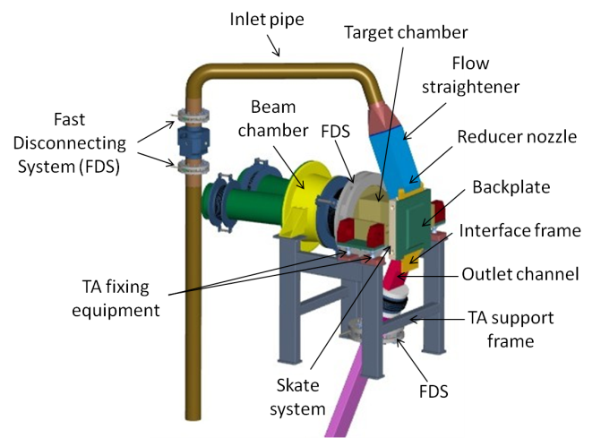
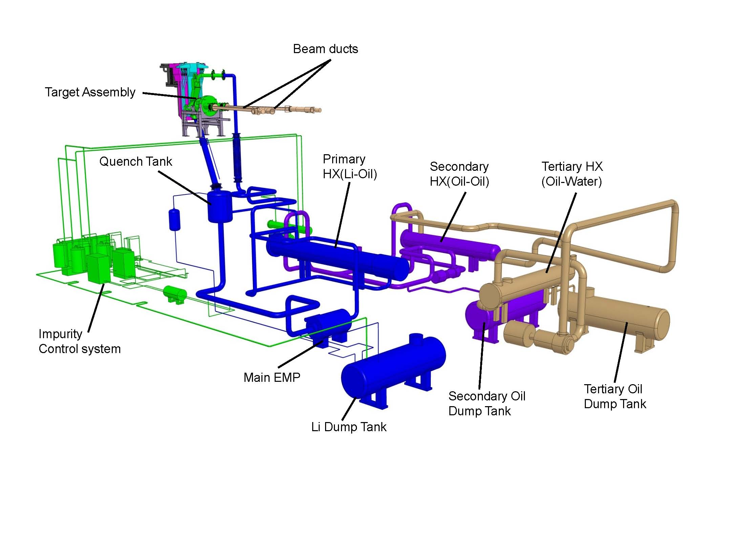
IFMIF target description-I
Target design
Beam low energy
Li thermal expansion
Risk of Li evaporation
Concave target
high Li velocity
Risk of stationary waves
Risk of pressure waves

Slide 28
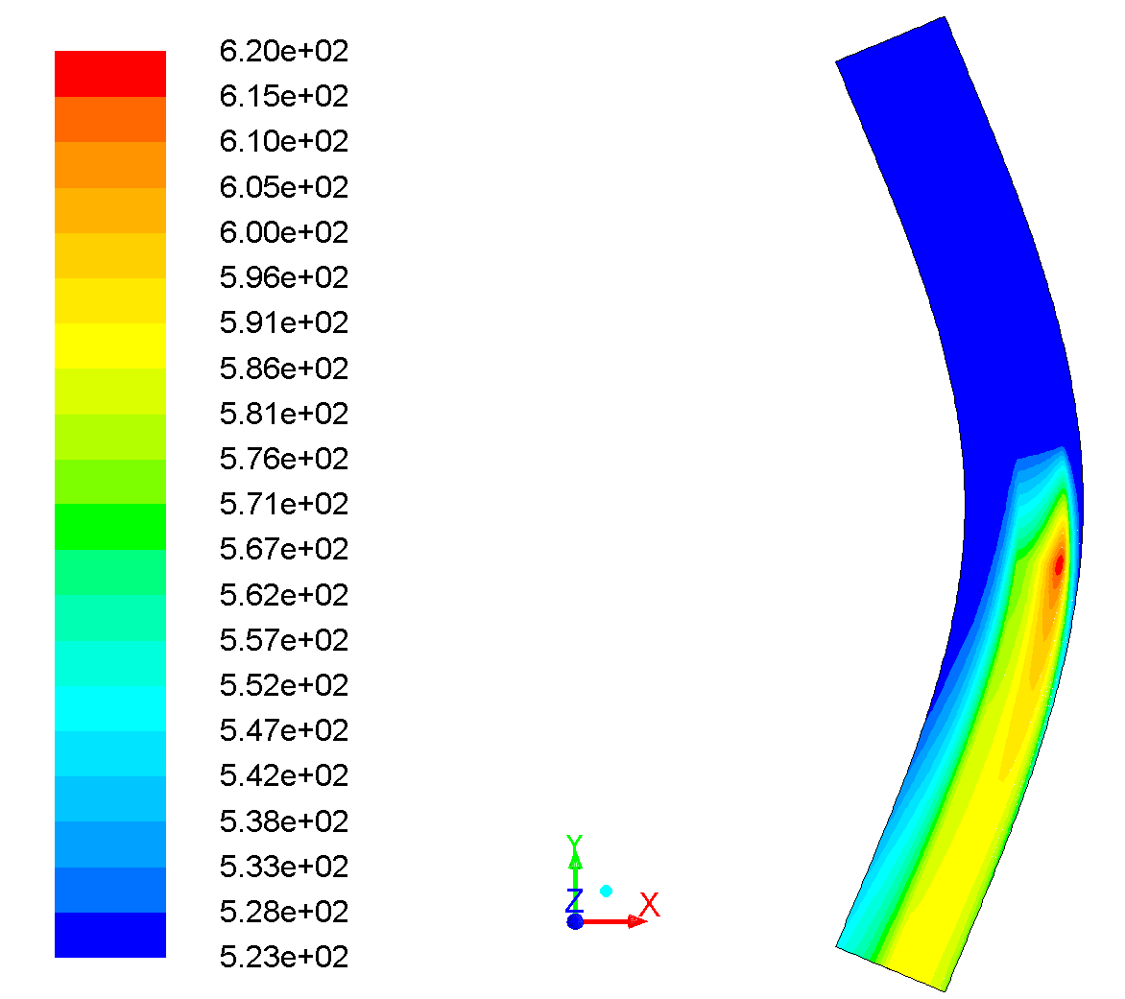
IFMIF target description-II
Some numbers
Concave Li jet generates kPa centrifugal forces (pressure waves amplitude 32Pa)
Li speed 15 m/s (if V> 0,5 m/s no pressure resonances foreseen) mean 3.3 ms exposure to the beam
Vacuum near the surface: 10-3 Pa
Main issues (concerns):
Impurity control required (to avoid corrosion and to reduce evaporation)
Real vaporization rate (design margin for vaporization near the surface)

Slide 29
IFMIF target description-II
Some numbers
Concave Li jet generates kPa centrifugal forces (pressure waves amplitude 32Pa)
Li speed 15 m/s (if V> 0,5 m/s no pressure resonances foreseen) mean 3.3 ms exposure to the beam
Vacuum near the surface: 10-3 Pa
More details during this Workshop by:
F. Groeschel, Friday morning
G.Micchice, Friday morning
D. Bernardi, poster 103
F. Nitti, poster 133
Main issues (concerns):
Impurity control required (to avoid corrosion and to reduce evaporation)
Real vaporization rate (design margin for vaporization near the surface)

Slide 30
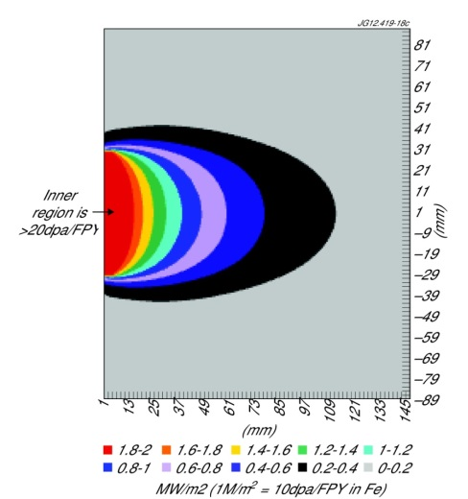
FAFNIR
injector & LEBT
90kV
RFQ & MEBT
90kV- 3MV
DTL
3MV- 40MV
HEBT
R
40 MeV, 5/30 mA D accelerator on C solid rotating target
Main target issues:
Radiation damage (lifetime 6 months, 2 dpa)
Heat removal
Beam current | Volume 25cm³ | Volume 150cm³
5mA | 4 dpa/fpy | 1 dpa/fpy
30mA | 20 dpa/fpy | 5 dpa/fpy
From E. Surrey, ISFNT-11 Barcelona September 2013

Slide 31
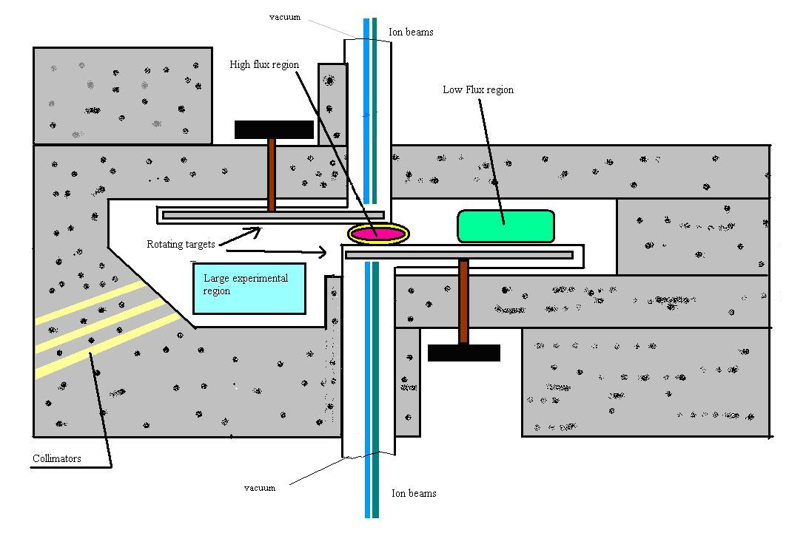
SORGENTINA
Two intense D-T 14 MeV rotating targets facing each-other
Two beams of 160 kV, 25 A (4 MW) each fire 50-50% Deuterons and Tritons on a 2 m radius rotating target
Deuterium and Tritium are implanted during the beam bombardment on a Titanium layer covering the rotating targets.
The Titanium layer is continuous reformed using a sputtering source
2 x 10¹⁵ n/s of 14 MeV neutrons
2 dpa/year in 50 cm³
7 x10¹² n/cm²/s in 1200 cm³
Main uncertainties
To asses the use of PINI in a continuous mode;
reforming the Titanium layer during operation
thermo-mechanical and stress analysis
heat removal from the target
From M. Pillon, ISFNT-11 Barcelona September 2013

Slide 32
SORGENTINA
Two intense D-T 14 MeV rotating targets facing each-other
Two beams of 160 kV, 25 A (4 MW) each fire 50-50% Deuterons and Tritons on a 2 m radius rotating target
Deuterium and Tritium are implanted during the beam bombardment on a Titanium layer covering the rotating targets.
The Titanium layer is continuous reformed using a sputtering source
More details in the poster 108 by P. Console
2 x 10¹⁵ n/s of 14 MeV neutrons
2 dpa/year in 50 cm³
7 x10¹² n/cm²/s in 1200 cm³
Main uncertainties
To asses the use of PINI in a continuous mode;
reforming the Titanium layer during operation
thermo-mechanical and stress analysis
heat removal from the target
From M. Pillon, ISFNT-11 Barcelona September 2013

Slide 33
Outline
Materials irradiation needs
Ion irradiation sources
Accelerator-based neutron sources
Summary

Slide 34
Comparison criteria
High-dose radiation effects in materials can only be properly understood if many different irradiation sources are used and a proper “common” model is developed.
How they can be compared? (the neutron/particle spectra is not so important: the important thing is the effects on the materials –NOTE: the effects can be different for different materials-)

Slide 35
Comparison criteria
High-dose radiation effects in materials can only be properly understood if many different irradiation sources are used and a proper “common” model is developed.
How they can be compared? (the neutron/particle spectra is not so important: the important thing is the effects on the materials –NOTE: the effects can be different for different materials-)
Particle type (E_{kin} = 1 MeV) | Typical recoil (or PKA) feature | Typical recoil energy T | Dominant defect type
Electron |  | 25 eV | Frenkelpairs (FP: Vacancy-Insterstitial pair) Cascades & sub-cascades
Proton |  | 500 eV
Fe-ion |  | 24 000 eV
Neutron |  | 45 000 eV
PKA
Typical impact on materials properties:
FPs as “freely migrating defects”: Alloy dissolution, segregation, irradiation creep
Cascades & sub-cascades: Irradiation hardening, ductility reduction

Slide 36
Comparison criteria
High-dose radiation effects in materials can only be properly understood if many different irradiation sources are used and a proper “common” model is developed.
How they can be compared? (the neutron/particle spectra is not so important: the important thing is the effects on the materials –NOTE: the effects can be different for different materials-)
Radiation effects in materials are very complex processes that can strongly depend on many parameters (total dose, dose rate, irradiation temperature, time from irradiation, material characteristics,…).
The comparison is based in the initial phases of interaction of radiation particles with the material:
i) scattering of particles. This is measured with the parameter “dpa”-total dose and dose rate- and with W(T) –damage function- (a parameter that describes in a qualitative way the “type” of damage in the material)
ii) Nuclear reactions, giving rise to “new” ions not previously in the matrix. In the case of fusion-like neutrons the main impurities induced are He and H. This is measured with the He/dpa, H/dpa ratios and other impurities production.
+ other obvious comparison criteria like irradiation volume, feasible temperature range,…

Slide 37
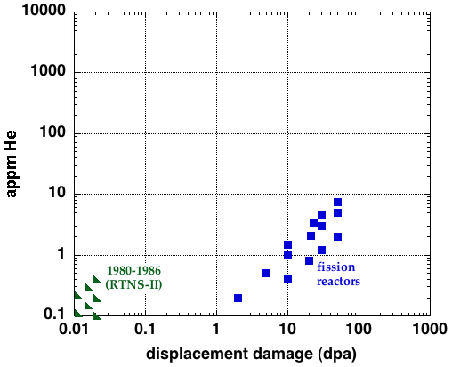
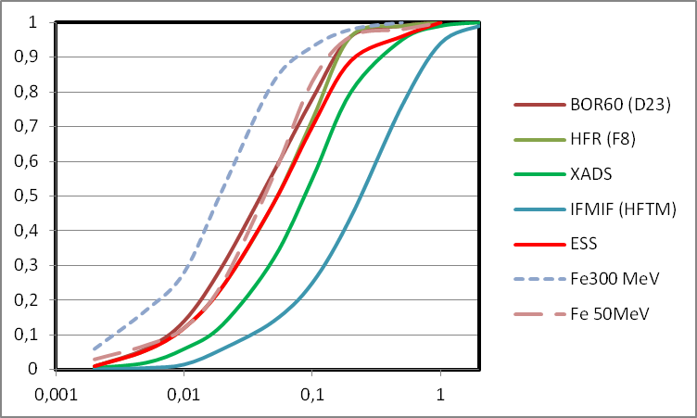
Spallation
neutrons
Fusion
reactor
IFMIF
ITER
Damage funcion
PKA Energy (MeV)
Notes:
37
37

Slide 38
Neutron source Short description Neutron Heat Example
type production efficiency (1) release (1)
Nuclear fission 1n/fission 180 MeV/n
Spallation 800 MeV p on W 15-30 n/p 30-55 MeV/p SINQ
Stripping 40MeV D on Li 7 10-2 n/D 3500 MeV/n IFMIF
D-T in solid target 4 10-5 n/D 10000 MeV/n Sorgentina
Neutron source typical dpa/y He/dpa ratio
type
Nuclear fission <10 0.1
Spallation <10 20-200 (strong design dependence)
Stripping <40 8-15
D-T in solid target <5 10
(1) Claussen (2008)

Slide 39
Conclusions
An increasing number of applications requires materials irradiation test beds including dedicated high flux accelerator driven neutron sources
A significant number of Materials Irradiation Facilities is presently proposed and under study. We all hope that the next 10-20 years will show an impressive progress in this area
Other facilities, like multi beam ion accelerators in the MeV range can also be very useful
Do not forget efforts for sample size normalization and modelling

Slide 40
Thank you!!!

