Slide 1
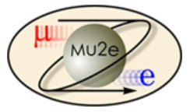
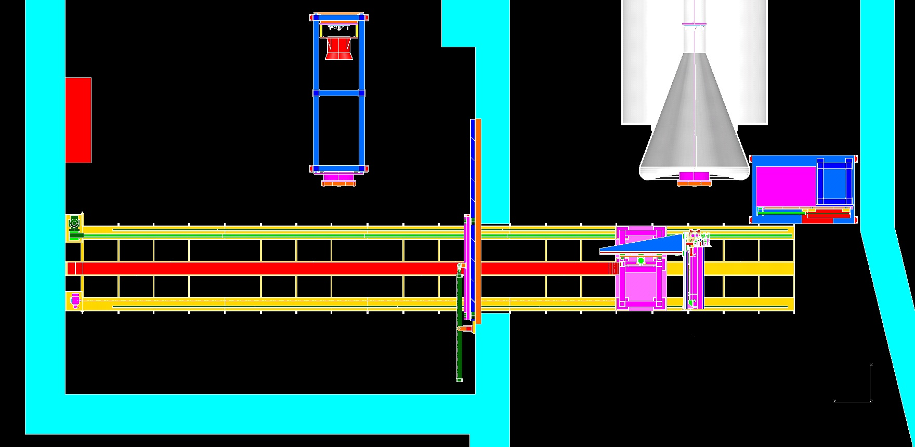
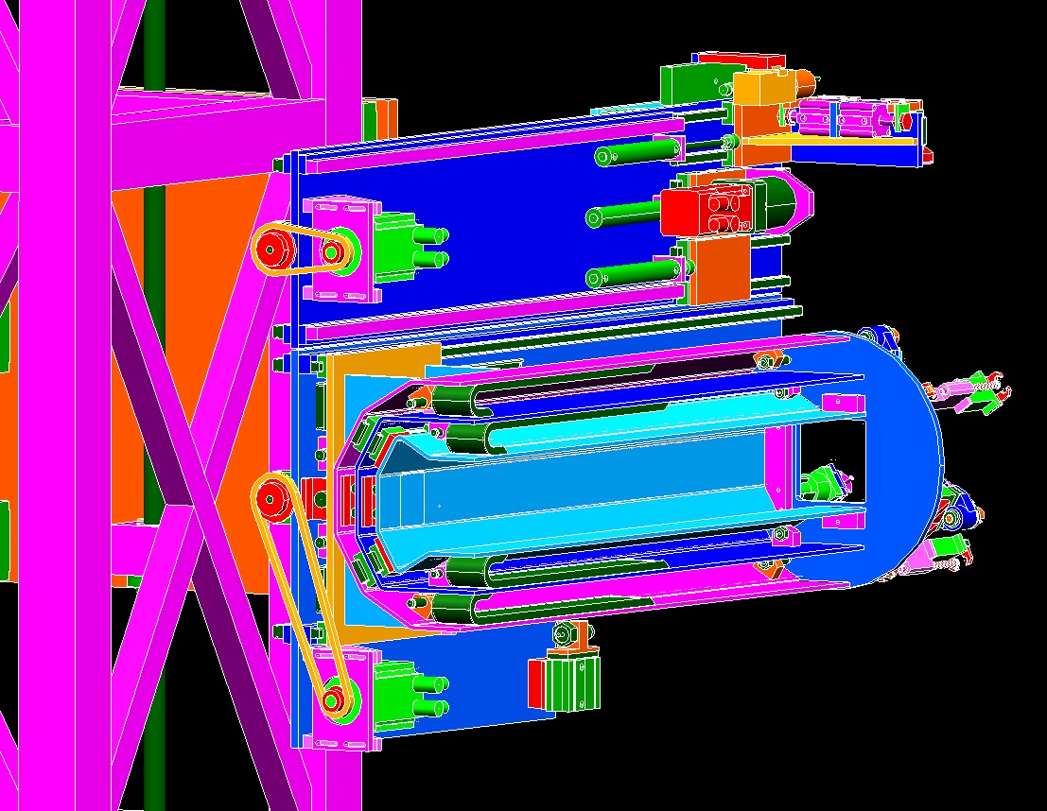
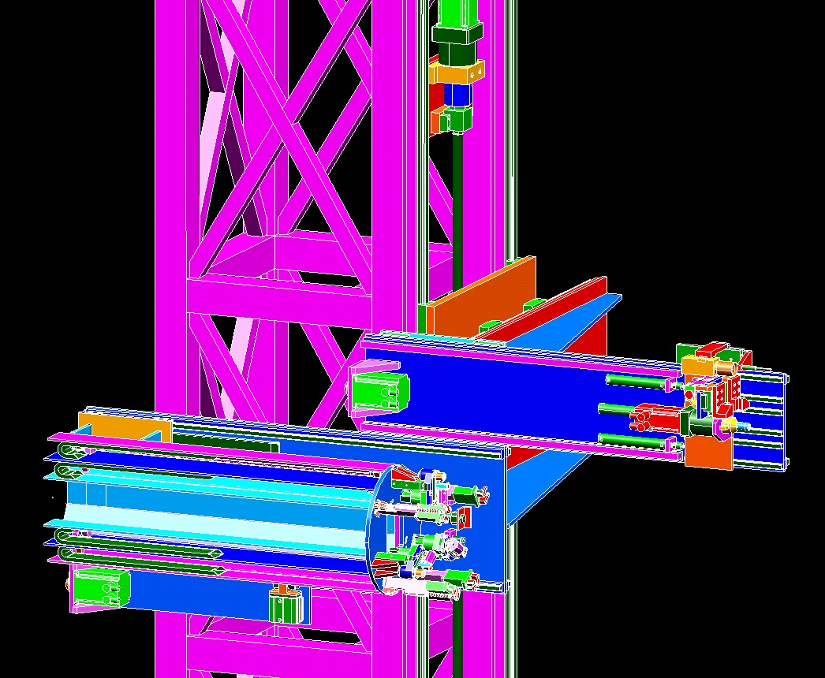
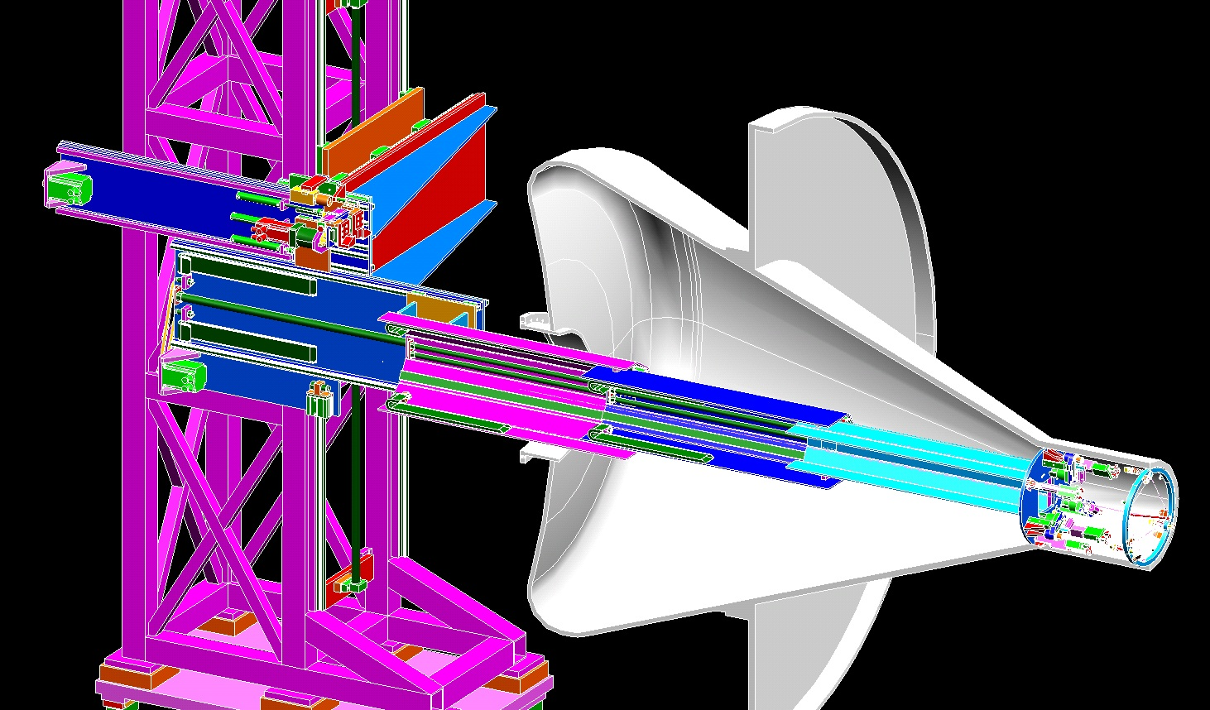
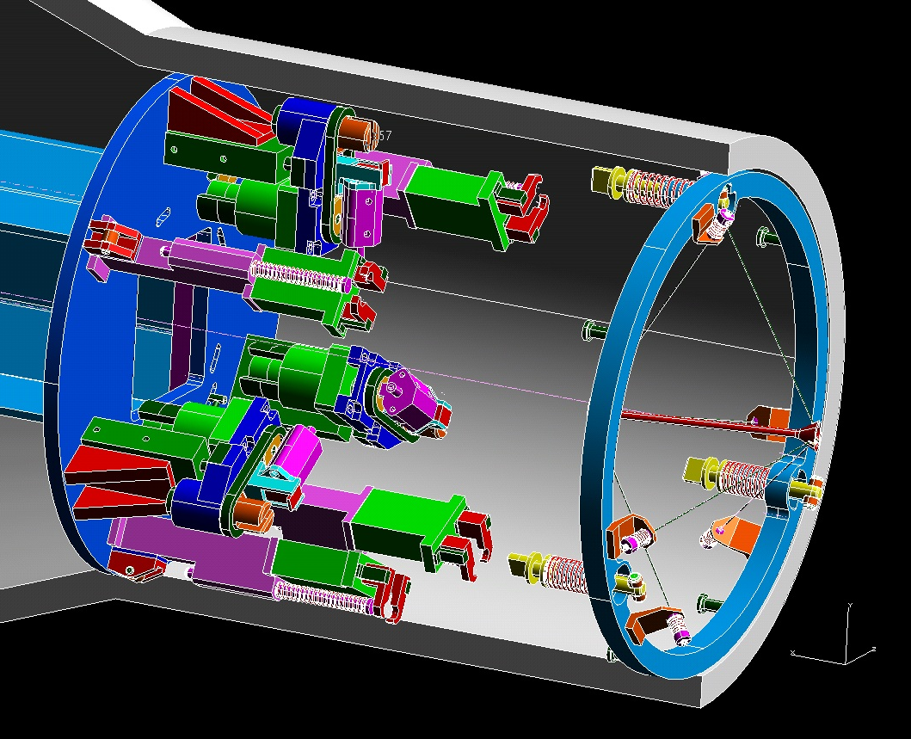
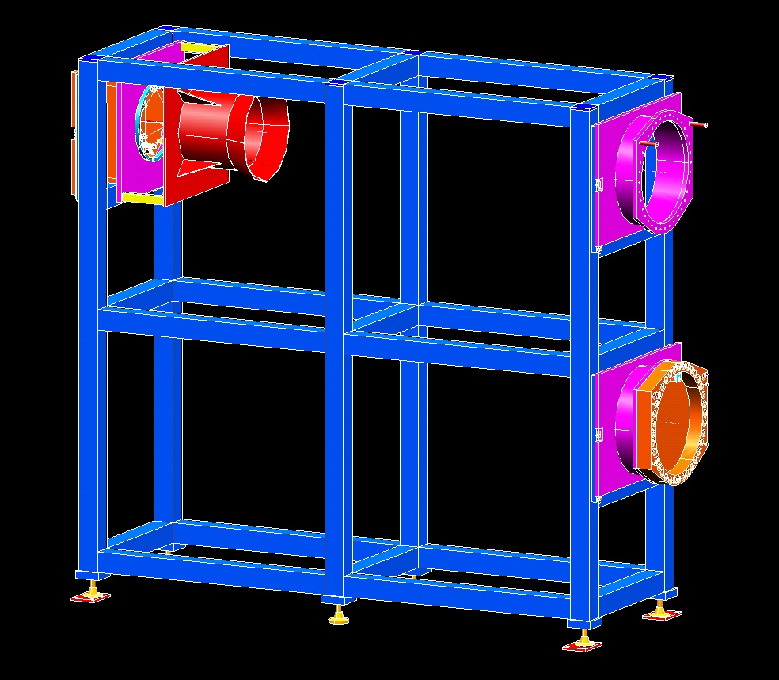
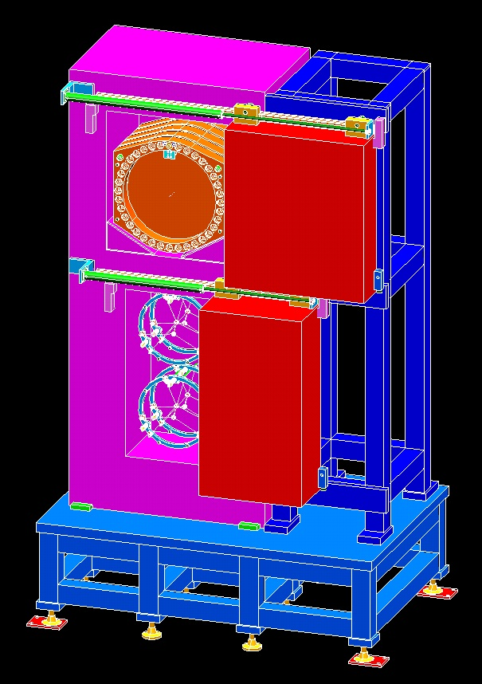
Mu2e Production Target Remote Handling
By: Michael R. Campbell, Fermi National Accelerator Laboratory, 630-840-6495, mikecam@fnal.gov
System Layout
Target
Production
Solenoid
Endcap
The Production Target Remote Handling system for Mu2e primarily consists of a robotic machine that travels from a side room into the target hall on floor rails. The robot is able to autonomously remove and replace both the target access window and the target assembly from the production solenoid. Both of the old components are placed into a radioactive storage cask. Figure (A) shows the overall system layout. Figure (B) shows the robot positioned in front of the production solenoid.
Staging Frame
5’ wide
Sliding
Door
12’-6”
Floor Rails
Production Solenoid
Window
42’-8”
Cask
A
Robot
Target Hall
B
Basic Robot Structure
Robot
Base
Frame
Guided
Cable
Chain
Y-Axis Motor:
vertical
motion
Upper Z-Axis Motor: horizontal motion in/out
towards window
Figure (C) shows the robot on it’s floor rails. The robot frame is constructed of welded stainless steel tubing. The floor rails are embedded in the concrete floor of the facility. The floor rail motion axis is driven by a motorized push/pull chain system. Also included is a pull-wire encoder to measure the robot’s position in the room. Figure (D) shows the X and Y axes of motion. Both are powered by servo motors and ballscrews. Figure (E) shows the two Z axes of motion, both also powered by servo motors and ballscrews. The upper Z axis is for handling the window. The lower Z axis is for handling the target.
11’-8”
Floor Rail
Position
Encoder
X-Axis
Motor:
horizontal
motion
C
Floor Rail
Drive System
D
E
Lower Z-Axis Motor:
horizontal motion in/out
towards target
Upper Z-Axis: Handles the
Target Access Window
Upper Z-Axis in extended position,
ready to perform
window operations
Camera / machine vision + pneumatic extend
LVDT locate X,Y,Z coordinates of window and
it’s mounting bolts
Window gripper in pneumatic extend position
(with bolt driver in retract position)
Figure (F) shows the upper Z-axis extended forward to perform remote handling tasks for the window. When the upper Z-axis is extended, the lower Z-axis is retracted out of the way. The upper Z-axis contains up to 3 actuators to perform it’s tasks. Figure (G) shows the bolt driver in the out position, ready to remove/install the 36x bolts in the window bolt circle. Figure (H) shows the gripper in the out position, which is used to remove/replace the window. There is also space to add a 3rd actuator.
F
Lower Z-Axis in
retract position
G
Bolt driver in pneumatic extend position
H
Spare tool plate
Lower Z-Axis: Handles Target
Upper Z-Axis in
retract position
Production Solenoid Endcap
3x Spring Clamps
Target Assembly
outer ring, a.k.a.
the “bicycle wheel”
In Figure (I), the robot is shown with its’ lower Z-axis extended to perform remote handling tasks for the target. This axis includes a 3-stage telescoping extend mechanism to enable a forward reach of over 12 feet. Figure (J) is a close-up view of the robot end-effector tooling as it approaches the target. The target assembly is held in place by 3 spring-loaded clamps around its’ outer ring. These clamps must each be pushed-in, turned 90°, and backed out to release the ring from its’ mount. Once released, the ring is held by the robot’s 4 grippers. Installation of the new target is the same process in reverse order.
Lower Z-Axis in full
extend position,
including 3-stage
pneumatic
telescoping motion
4x Grip
Handles
Robot end-of-arm
tooling approaching
target assembly
3x Clamp
push / rotate
actuators
6x
Spokes
I
J
4x Grippers
Target Rod
Other System Components:
Staging Frame, Cask, Door
Pneumatic
Opening
Doors
The remote handling system also includes a staging frame, the radioactive storage cask, and the sliding shield door. The staging frame, shown in Figure (K), is the place where the new window and target are staged so that the robot can come back and autonomously get them after the old ones have been removed. Figure (L) shows the cask where the old window and target are placed. Figure (M) shows the sliding shield door that separates the target hall from the side room.
Matching features
simulate mounting
inside experiment
Cask
Upper
Chamber:
holds up to
5 windows
Overhead
Roller Track
Actuating
Cylinder:
pneumatic
or hydraulic
New
Target
Assembly
in staged
position
New
Window
in staged
position
Cask
Lower
Chamber:
holds up to
4 targets
8” thick
Stainless
Steel Sliding
Door
K
Staging Frame
L
M

