Slide 1
Stability Study on HOMBPMs
Liangliang Shi

Slide 2
Review of HOM based Diagnostics
HOMs do cause problems, so we make efforts to damp them, but they are also gifts for us to do diagnostics.
1. Align the beam.
2. Determine the electrical center of a cavity.
3. Beam phase monitor
4. Beam position monitor (today)
5. Other possibilities

Slide 3
Outline
HOMBPM system and motivation of stability study
HOMBPM calibration process
Results of HOMBPM calibration based on DLR,PCA,SVD
Reflections on the HOMBPM calibration
Conclusion and outlook
DLR: Direct Linear Regression
PCA: Principal Components Analysis
SVD: Singular Value Decomposition

Slide 4
FLASH layout and HOMBPM system
Module ACC39:
four 3.9 GHz cavities
Module ACC5:
eight 1.3 GHz cavities
Electronics for 1.3 GHz cavities:
BP filter at 1.7 GHz
Mixer at 1.68 GHz
ADC 108.3 MHz
Electronics for 3.9 GHz cavities:
BP filter at 5 or 9 GHz
Mixer at 5 or 9 GHz
ADC 108.3 MHz
Electronics
Server/DOOCS
User defined DAQ program

Slide 5
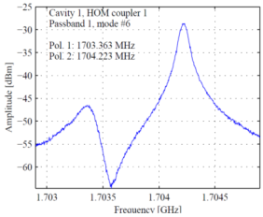
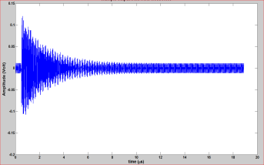
Principle of HOMBPM
Amplitude of dipole modes
depends linearly on the
beam offset ---HOMBPM
HOMBPMs based on such principle were developed and installed at FLASH.
Beam offset [mm]
BP filter
Mixer
ADC
HOM signal
HOM signals are down converted to intermediate frequency (IF) signal and then get sampled

Slide 6
Motivation of stability study
Position information is buried in dipoles. So we need calibration before it can be used as a BPM. After calibration, the HOMBPMs can only work for a short time properly.--- Instability of HOMBPM
To make the HOMBPM work reliably, we need to understand why it is unstable overtime.
Such instability can be caused by the calibration techniques employed or the dipole signals or both.
HOMBPMs for both 1.3 GHz and 3.9 GHz cavities suffer such instability problem
Notes:
Compare with Cavity BPM.

Slide 7
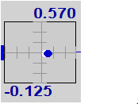
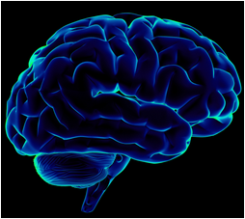
HOMBPM calibration
HOMBPM calibration correlates a measured dipole signal to the beam position inside cavity.
Dipole signals are from HOMBPM system.
Beam positions are interpolated with two cavity BPMs (magnets between the BPM and modules are on).
Calibration:
Beam Position
Dipole signal
Knowledge of correlation

Slide 8
Model overview
Currently, we use linear regression to obtain the knowledge of correlation.
$$\left[\begin{matrix}d_{11} & ⋯ & d_{1n} \\ ⋮ & ⋱ & ⋮ \\ d_{m1} & ⋯ & d_{mn}\end{matrix}\right]\left[\begin{matrix}\begin{aligned}C_{11} \\ ⋮\end{aligned} & \begin{aligned}C_{12} \\ ⋮\end{aligned} \\ C_{n1} & C_{n2}\end{matrix}\right]=\left[\begin{matrix}\begin{aligned}X_{11} \\ ⋮\end{aligned} & \begin{aligned}Y_{12} \\ ⋮\end{aligned} \\ X_{m1} & Y_{m2}\end{matrix}\right]$$
dipole data matrix calibration matrix position matrix
Where data matrix is m*n (m number of measurements, n number of predictors and intercept), and calibration matrix is n*2,and the position matrix is m*2.
1. If the data matrix is formed by measured dipole signal directly, the whole calibration process is called DLR (Direct Linear Regression) based calibration
2. If the data matrix is formed by transforming the dipole signal matrix and extract the principal components, the whole calibration process is called PCA (Principal Component Analysis) based calibration
3. If the data matrix is formed by transforming the dipole signal matrix and extract the Eigen-dipole signal accordingly, the whole calibration process is called SVD (Singular Value Decomposition) based calibration

Slide 9
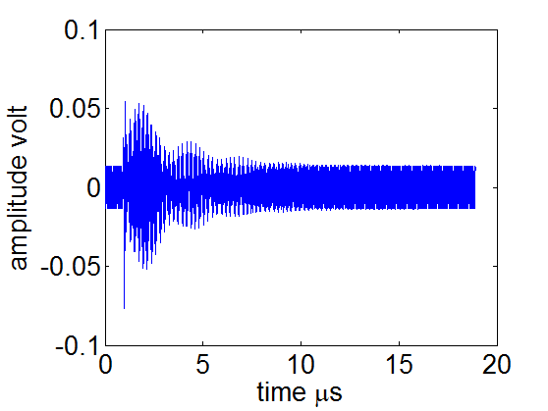
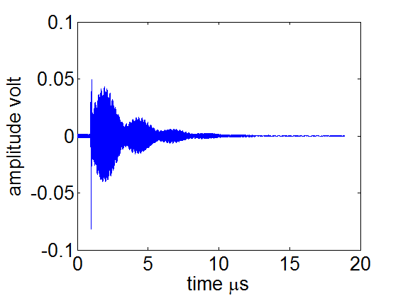
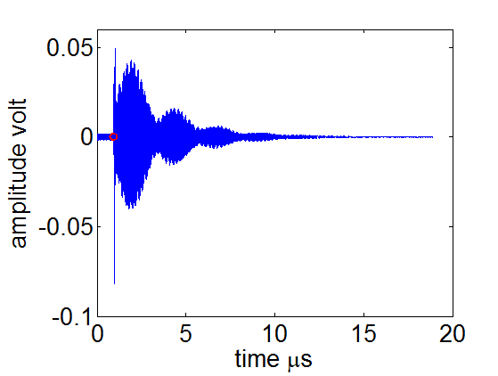
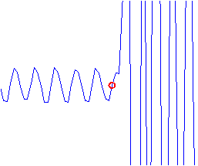
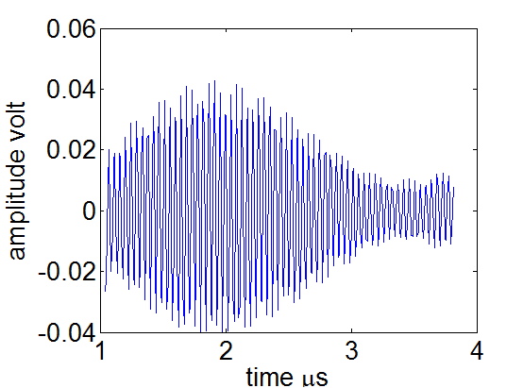
HOMBPM Calibration workflow
Data Acquisition
Dipole mixed with
calibration signal from electronics
Preprocessing
Remove calibration
Determine start
Remove transient
Feature selection
Linear Regression
300 data samples
are selected
Evaluation
Since each cavity is equipped
with 2 HOM couplers,
dipole signals are concatenated
for calibration

Slide 10
DLR based calibration
DLR (Direct Linear Regression):
$\left[\begin{matrix}\begin{aligned}Dipole signal 1 \\ ⋮\end{aligned} \\ Dipole signal m\end{matrix}\right]\left[\begin{matrix}\begin{aligned}C_{11} \\ ⋮\end{aligned} & \begin{aligned}C_{12} \\ ⋮\end{aligned} \\ C_{n1} & C_{n2}\end{matrix}\right]=\left[\begin{matrix}\begin{aligned}X_{11} \\ ⋮\end{aligned} & \begin{aligned}Y_{12} \\ ⋮\end{aligned} \\ X_{m1} & Y_{m2}\end{matrix}\right]$
Data matrix was split into two parts randomly: 90% was used to do the calibration(training) while 10% was used to validate the model (validation).
Overfitting will occur when the data matrix is under-determined (m < n). So the data matrix was tailored by a window with 300 samples width column wise.

Slide 11
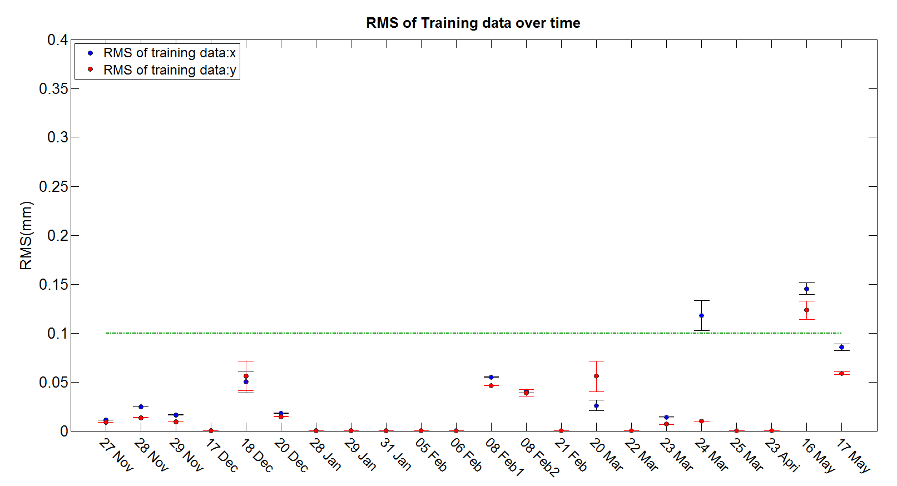
RMS of training data over time with DLR based calibration

Slide 12
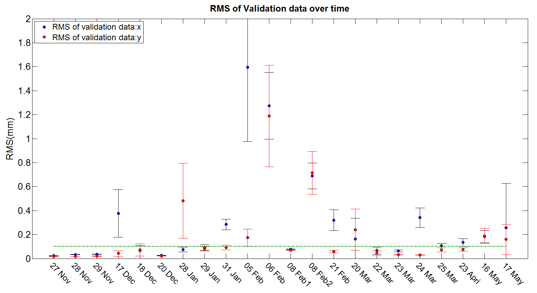
RMS of validation data over time with DLR based calibration

Slide 13
Conclusion of DLR based calibration
Due to the limited number of data files compared with the number of predictors used, several datasets get overfitted.
Two datasets show larger RMS ( >0.1mm) even in training datasets. There are datasets can not be best described by the model in terms of RMS.
Besides statistical fluctuation of resolution, we observed the resolution variation over time. This is related to the instability of HOMBPM.
DLR method is sensitive to each data points (predictors) used in the model. Highly correlated predictors in the data matrix makes the situation even worse.

Slide 14
PCA based calibration
PCA (Principal component analysis):
$\left[\begin{matrix}\begin{aligned} Amplitude 1 \\ ⋮\end{aligned} \\ Amplitude m\end{matrix}\right]\left[\begin{matrix}\begin{aligned}C_{11} \\ ⋮\end{aligned} & \begin{aligned}C_{12} \\ ⋮\end{aligned} \\ C_{n1} & C_{n2}\end{matrix}\right]=\left[\begin{matrix}\begin{aligned}X_{11} \\ ⋮\end{aligned} & \begin{aligned}Y_{12} \\ ⋮\end{aligned} \\ X_{m1} & Y_{m2}\end{matrix}\right]$
Data matrix will be projected onto new axis defined by principal components to get amplitudes. Top 20 principal components (which can account for 99% the data matrix’s variation) were selected to form such subspace.
The data matrix was split into two parts: 90% was used to do the calibration while 10% was used to validate the model.

Slide 15
Conclusion of PCA based calibration
Compared with DLR, there is no dataset get overfitted.
Using the transformed predictors (compared with DLR case), the resolution show less spread (the error bar) as we expected.
But we still observe the resolution fluctuations over time.

Slide 16
SVD based calibration
SVD (Singular Value Decomposition):
$$\left[\begin{matrix}\begin{aligned} Amplitude 1 \\ ⋮\end{aligned} \\ Amplitude m\end{matrix}\right]\left[\begin{matrix}\begin{aligned}C_{11} \\ ⋮\end{aligned} & \begin{aligned}C_{12} \\ ⋮\end{aligned} \\ C_{n1} & C_{n2}\end{matrix}\right]=\left[\begin{matrix}\begin{aligned}X_{11} \\ ⋮\end{aligned} & \begin{aligned}Y_{12} \\ ⋮\end{aligned} \\ X_{m1} & Y_{m2}\end{matrix}\right]$$
Data matrix D (same in DLR based calibration) can be decomposed as $D = USV^{T}$, where rows of matrix $V^{T}$ contain the Eigen-dipole signal thus they form an Eigen-dipole space. Amplitudes of each waveform in such Eigen-space were placed in each row of new data matrix $D_{SVD}$.
Top 50 Eigen-dipoles were selected according to the singular value in a descent way. Thus the data matrix is now m* 50+1.
Data matrix was split into two parts: 90% was used to do the calibration while 10% was used to validate the model.

Slide 17
Conclusion of SVD based calibration
Compared with PCA based calibration, SVD does ‘rescue’ some datasets. But several datasets get overfitted due to the same reason as DLR.
In general, SVD shows comparable results as PCA. It is a bit better than DLR in terms of resolution.

Slide 18
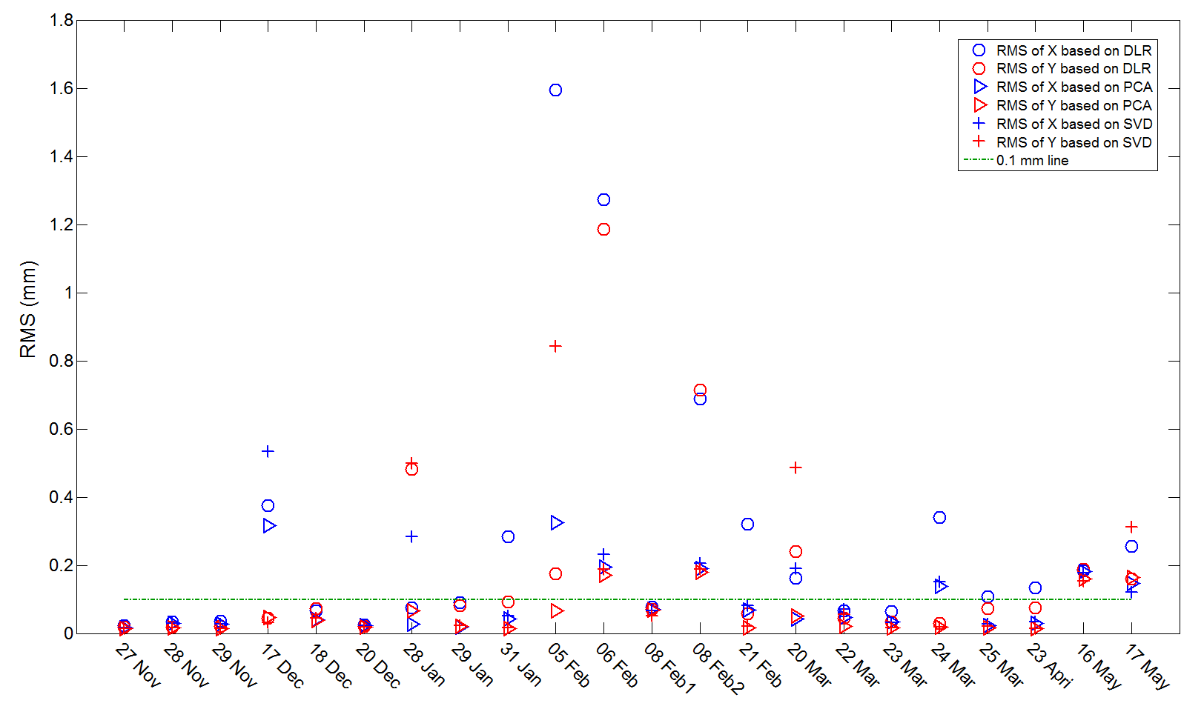
Summary of DLR, PCA, and SVD
overfitted
On some days (good days), results of three methods are comparable with
each other. For others, we see variations among different methods.

Slide 19
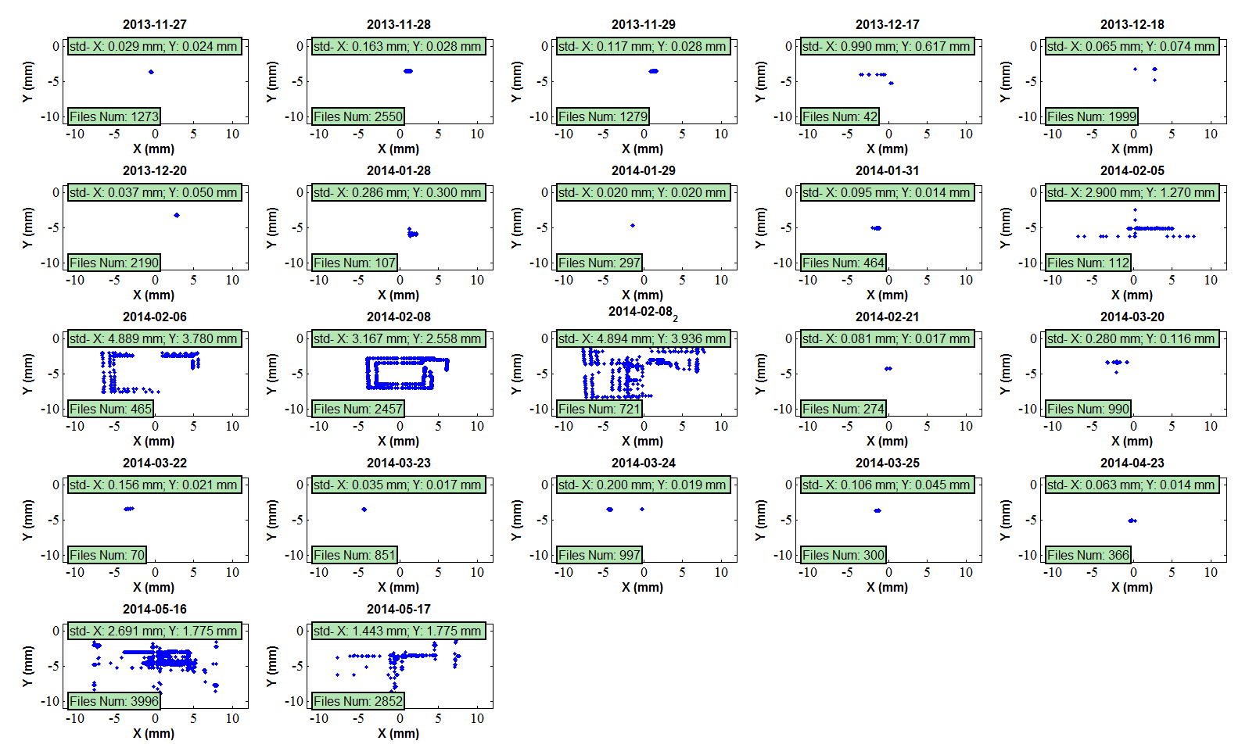
Summary of DLR, PCA, and SVD
The resolution is less than 0.1 mm in all three methods
DLR, PCA, SVD
The resolution is more than 0.1 mm in all three methods
DLR, PCA, SVD

Slide 20
Summary of DLR, PCA, and SVD
Datasets show good resolution when the beam positions are well clustered with less spread.
Datasets show bad resolution when the beam positions cover a wide range while there are less data files available.
When there are not enough data files available, the model can not extrapolate or interpolate properly.
Either PCA or SVD looks for proper vector space to transform data matrix so that we are able to extract some ‘invariant features’ of the data to correlate to the position information reliably.
But, the vector space (PCA) or mathematical modes in (SVD) are very difficult to correlates to physical quantity in our case.

Slide 21
Reflections on the HOMBPM calibration
In DLR, basically we are solving a set of linear equations. As long as the new dipole waveform appear in the data matrix again, we are able to get the position with acceptable resolution with less efforts. --- the dipole signal should be stable over time.
Many factors can affect the dipole signal quality: detuning, stability of electronics, cavity vibration etc.
In either PCA or SVD, we can suppress the fluctuations to certain extent. However, the result is still not acceptable for some datasets.
…

Slide 22
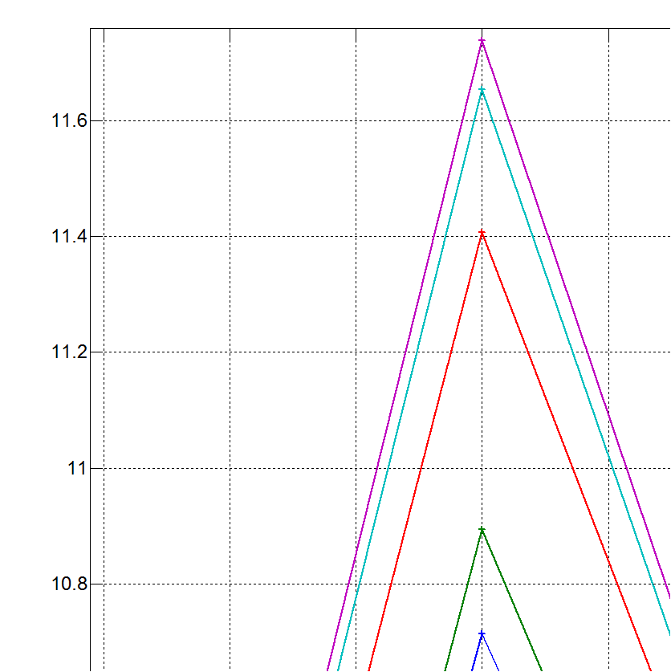
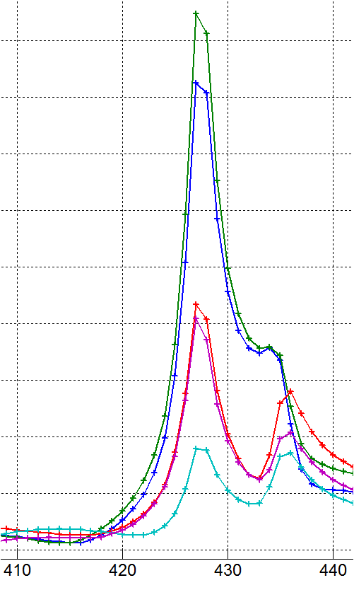
Initial study on stability of dipole signal---1.3 GHz cavity
Normalized with charge,
around 0.5 nc
FFT of dipole signals
with similar beam
positions
Spectrums of dipole when beam are in the ‘same’ positions over time

Slide 23
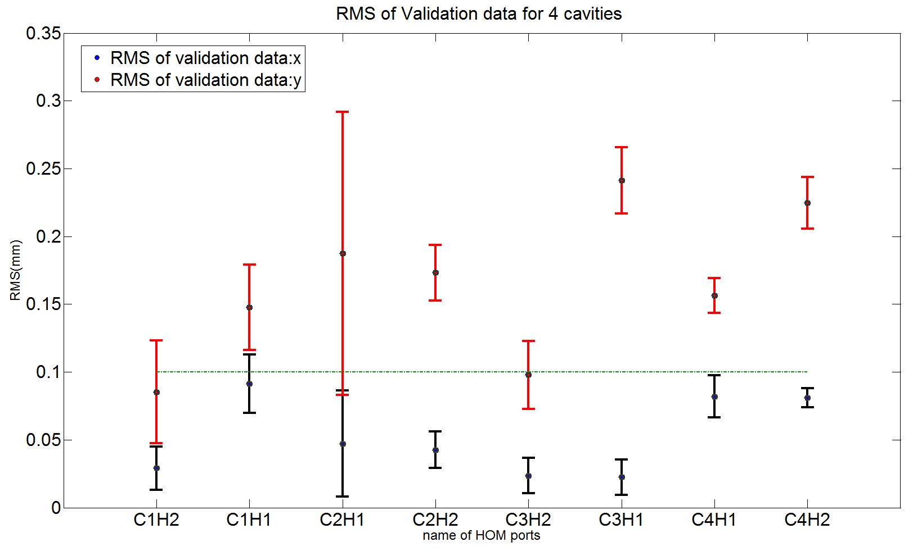
HOMBPM Calibration for 3.9 GHz cavities --- in time domain
C2H2 5GHz
C1H2 5GHz
C1H1: Cavity 1 HOM port 1
The data was obtained on 17th May.
The calibration method was
based on DLR.
The whole calibration process is
similar with the 1.3 GHz cavity ones.
Beam direction

Slide 24
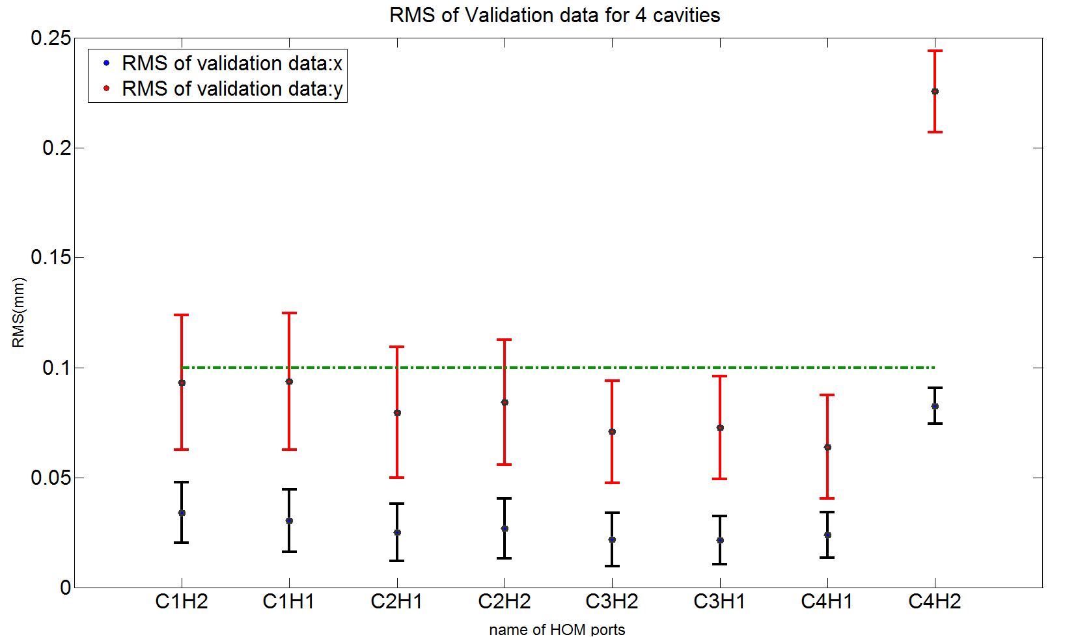
HOM BPM Calibration for 3.9 GHz cavities – in frequency domain
The dipole signal
were transformed in frequency domain. A band of amplitudes was selected to do the calibration based
on DLR.
We obtain better
resolution than in time domain.
In all the analysis results with 3.9 GHz cavities, the resolution in y direction is
worse than x systematically. This may be due to the worse resolution in y from
the BPMs that used to interpolate the position inside cavity.

Slide 25
Conclusion and outlook
Issue:
HOMBPM instability: is it due to the calibration techniques we used or the instability of the dipole signal or both?
Conclusion:
We observed the resolution spread around 100 micros over time.
SVD or PCA can suppress the instability of the dipole signal to some extent, but still we need further improve the resolution.
Very initial stability of the dipole signal study in frequency domain shows the signals vary more than we expected. However, can we trust the positions from BPMs used for calibration?
Analysis on the 3.9 GHz cavities data shows positive news for the electronics.
Outlook:
1. The stability of the dipole signal study over long time.
2. Refine the calibration process and model.
3. Look for suitable feature space, in which we can describe the dipole signal in a stable and reliable way.
Comments:
1. The resolution is limited by thermal noise in principle.
2. Cables and electronics can be replaced by low noise optical components.
3. Such instability study has a huge parameter space to look at.

Slide 26
Thanks for your attention!

Slide 27
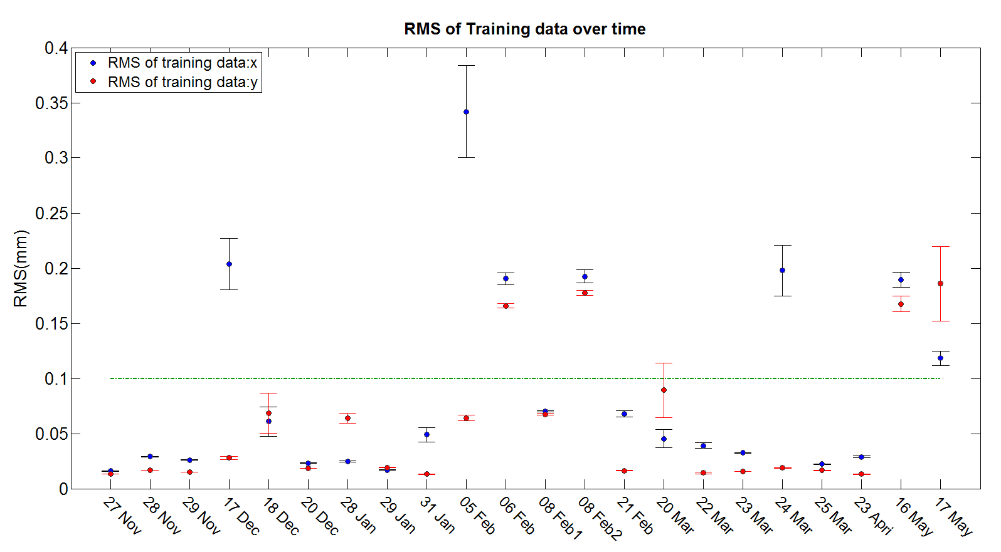
RMS of training data over time with PCA based calibration

Slide 28
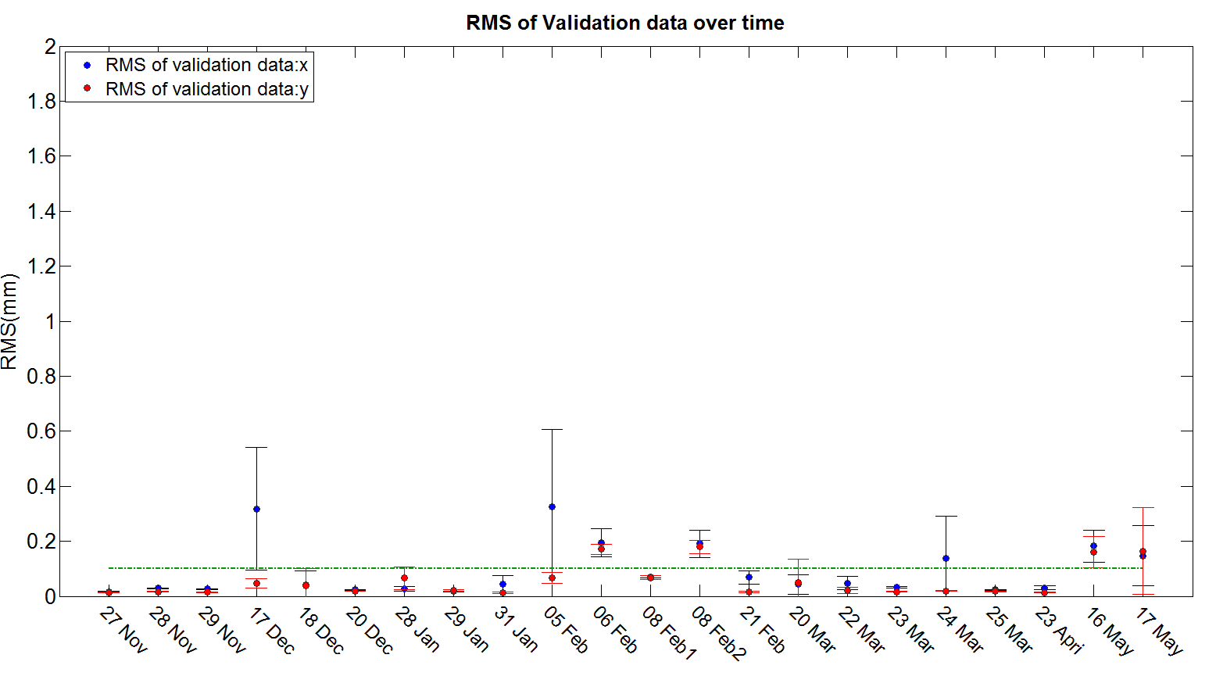
RMS of validation data over time with PCA based calibration

Slide 29
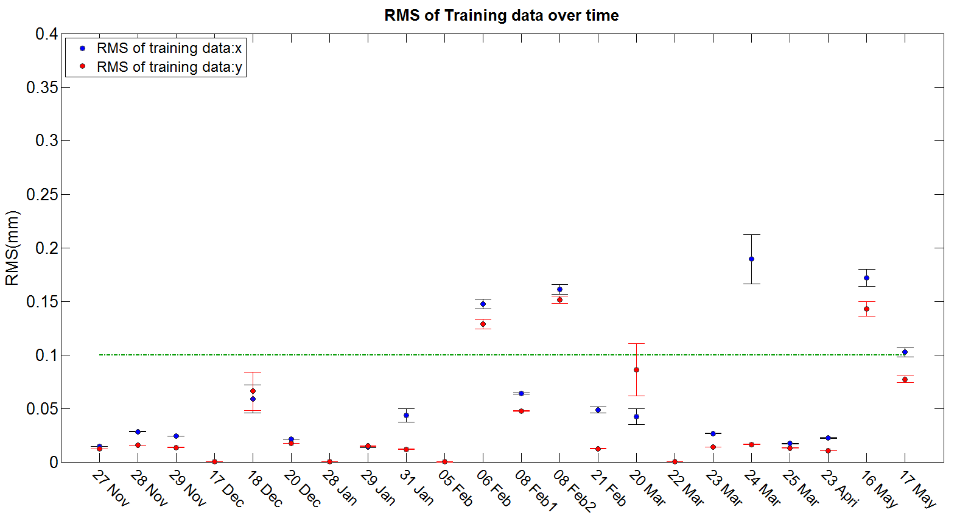
RMS of training data over time with SVD based calibration

Slide 30
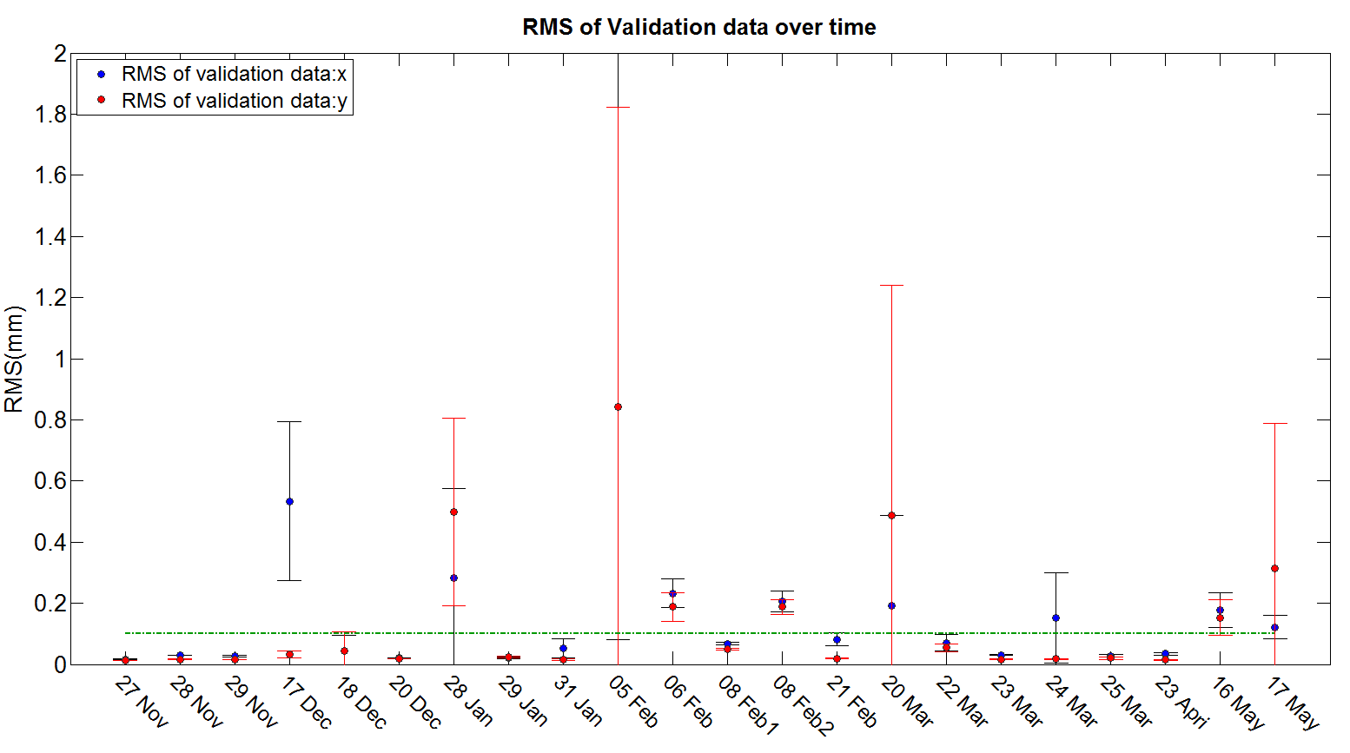
RMS of validation data over time with SVD based calibration

Slide 31
Backup slides

Slide 32
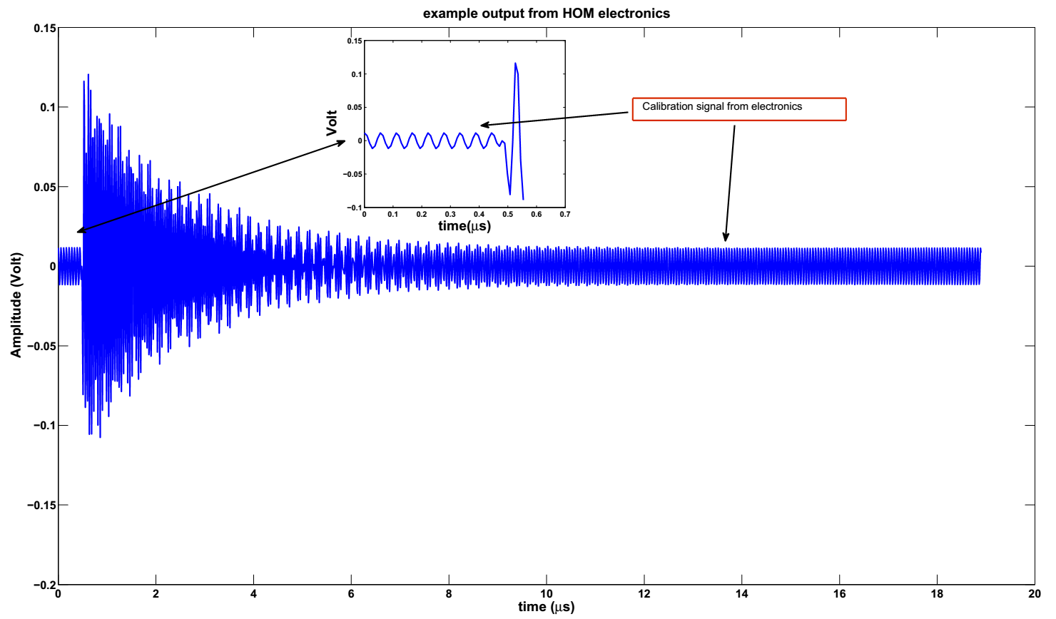
Example output of dipole mode signal
Calibration signal
from electronics
300 samples
2048 samples

