Slide 1
Single Sign On, Identity and Access management at CERN
Alex Lossent
Emmanuel Ormancey, Alberto Pace
CERN IT/IS

Slide 2
Agenda
History and current situation
Identity and Access Management concepts
CERN authentication
Web Single-Sign-On system
Non-web applications
Links

Slide 3
History
A few years ago, a user had to type in:
Credentials to open a Windows session
Credentials to open a Linux session
Credentials to read mail
Credentials to manage holidays
Credentials to upload a presentation in Indico
…
All with different user names and passwords
Different databases of users
Each application had its own authentication and authorization mechanisms
Single Sign On, Identity and Access Management at CERN - 3

Slide 4
Now
In 2007, situation is better
2 pairs of login/password: AFS + Windows
But…
Some experiments/applications still have their own databases of users and credentials
…sometimes stealing passwords to synchronize them with private user database
Problem of data synchronization between databases of users
Situation is not yet optimal
Single Sign On, Identity and Access Management at CERN - 4

Slide 5
What do we want?
Central Identity and Access Management
Identity Management
Information about persons, and processes to manage this information
Ability to identify a person
Access Management
Information about who is allowed to do what on a resource
Possible restrictions on when/where/how
Single Sign On, Identity and Access Management at CERN - 5

Slide 6
IAM Architecture
The AAA Rule. Three components, independent
Authentication
Identification of the person who is trying to connect.
Several methods (username + password, certificate, smartcard + pin code, biometry, …)
Authorization
Verification that the connected user has the permission to access a given resource
Best practice: “Role-Based Access Control”
grant permissions to groups instead of persons (role creation)
manage authorization with group membership (role assignment)
Accounting
Traceability of all changes and transactions rollback
Single Sign On, Identity and Access Management at CERN - 6

Slide 7
Benefits of central IAM
Simplify !
One user database
One login/password pair to remember
+ support alternate authentication methods (certificates…)
Use roles to control access to services
No more: Creating/Blocking/Deleting separate accounts for Windows/Mail/Indico
But: Allow/Disallow access to Windows/Mail/Indico
Centralize
Provide global Group/Role membership (RBAC)
Support External accounts (lightweight registration)
Improve security
Block all accesses to applications in one click
Use permissions and delegation instead of sharing credentials
Complexity does not increase security !!!
Single Sign On, Identity and Access Management at CERN - 7

Slide 8
Components
CERN authentication (deployed)
A central authentication system
Single account, single password for all services (more and more joining in)
Single-sign-on between web applications
Support for certificates/smartcards
Central group management system
Used for role assignment
“Automatic” (based on queries in HR databases) or “manual” groups
Currently: Simba mailing lists (limited)
To be replaced with eGroups
Single Sign On, Identity and Access Management at CERN - 8

Slide 9
The direction
Identity Management
Made by CERN Administration
Computing Services at CERN:
Mail, Web, Windows, Unix, EDMS,
Administration, Indico, Document Server
Remedy, Oracle, …
Account
Database
HR
Database
Authentication
Access granted
Global
E-Group management
Role membership
Authorization
Authenticated and
authorized end-user
receiving services
Unique account
Unique set of groups / roles
(for all services)
Resource owner and Service manager give authorization using :
Accounts
E-groups: based on HR data or custom
Single Sign On, Identity and Access Management at CERN - 9

Slide 10
Single-Sign-On for web apps
Goal:
Enable web apps to easily use CERN authentication and central groups
Support different authentication methods
Classic Forms (login and password)
Certificates (CERN CA, Grid Certificates, smartcards)
Windows Integrated
Provide support for External Accounts
An application can authenticate non-CERN users
A single External Account for all apps
Single Sign On, Identity and Access Management at CERN - 10

Slide 11
Single-Sign-On for web apps
Web application receives user information
Name, email, building, etc… from central user database
Group/Mailing Lists membership is available
Application takes authorization decisions based on group membership
Authentication is independent
All Web Applications use the same login page: https://login.cern.ch
Does not re-ask credentials if user is already authenticated on another application
A Linux web application can use Windows Integrated
Authentication with certificate comes for free!

Slide 12
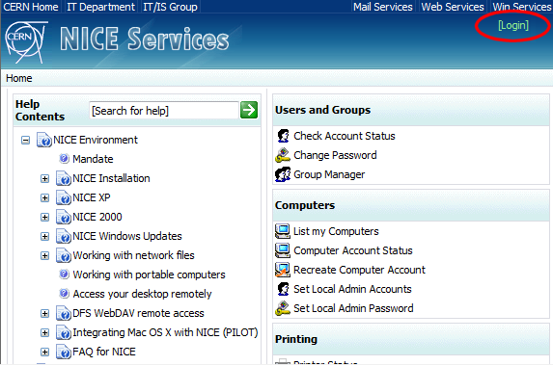
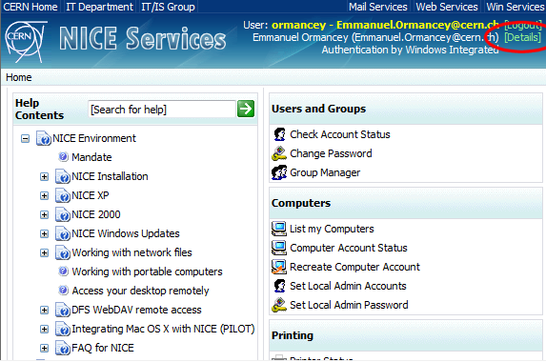
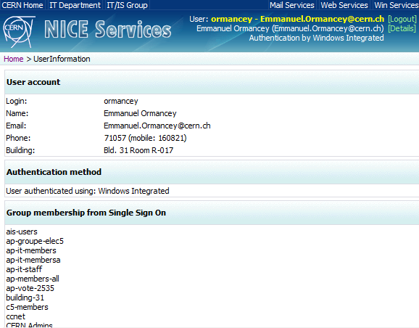
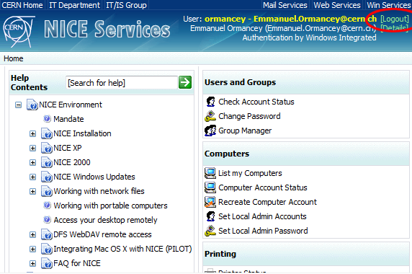
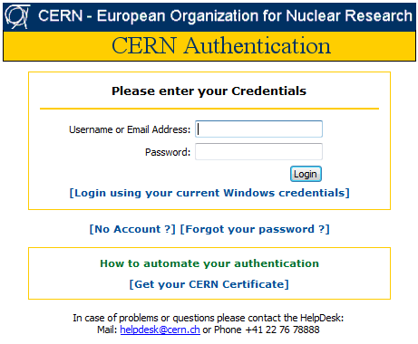
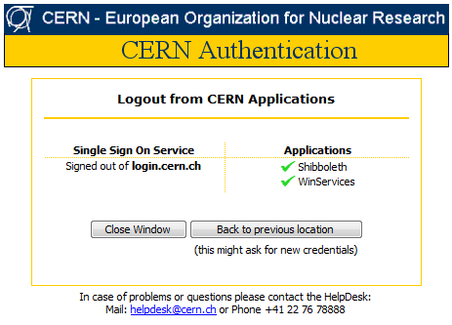
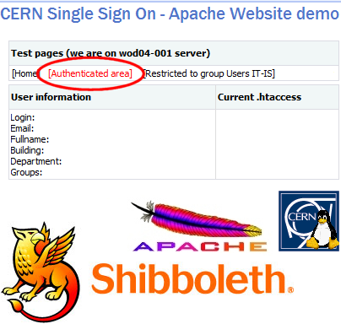
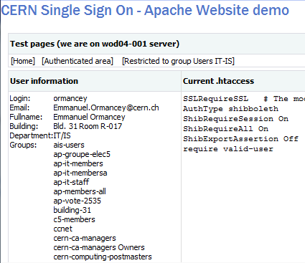
CERN Authentication
Overview
Single Sign On, Identity and Access Management at CERN - 12

Slide 13
Technical background
Overview
Service Provider
Identity Provider
Windows + IIS
Microsoft ADFS or Shibboleth SP
Microsoft ADFS
Linux or Unix + Apache
Shibboleth SP
Single Sign On, Identity and Access Management at CERN - 13

Slide 14
Technical background
Identity Provider
Checks identity, supports various authentication methods
Loads and shares user information: “Claims”
Microsoft ADFS based
Active Directory Federation Services
Credentials are checked in Active Directory
WS-Federation Passive Requester Profile (WS-F PRP) compliant
Hosted on load balanced servers, in critical UPS area
Minimize downtime: authentication is critical !
Single Sign On, Identity and Access Management at CERN - 14

Slide 15
Technical background
Service Providers
SSO ‘clients’
Allow a Web Application to use SSO ‘identities’
IIS module, Apache module, or application module (i.e. Java)
Windows hosted Websites
IIS (Internet Information Services) module comes with Windows 2003 R2.
Linux/Apache hosted Websites
Shibboleth Apache module, Open Source project (Internet2)
IIS or Apache modules replace the basic authentication modules
Transparent for the Application
Single Sign On, Identity and Access Management at CERN - 15

Slide 16
Non-web applications
CERN authentication for NON Web applications
Use a SOAP Web Service
To verify credentials (username/password only)
To get and verify group membership
Requires some coding:
Write a SOAP client
Send credentials and decode return codes
Not a standard: a CERN made interface (but based on SOAP standard)
Single Sign On, Identity and Access Management at CERN - 16

Slide 17
Links and documentation
CERN Authentication
http://cern.ch/login
Microsoft ADFS
http://technet2.microsoft.com/windowsserver/en/technologies/featured/adfs/default.mspx
Shibboleth
http://shibboleth.internet2.edu
Single Sign On, Identity and Access Management at CERN - 17

Slide 18
Questions
Questions ?
Single Sign On, Identity and Access Management at CERN - 18

