Slide 1
Windows Vista and Office 2007 deployment @ CERN
Rafal Otto
CERN, IT/IS

Slide 2
Outline
Vista
Motivations
Issues
Deployment policy at CERN
Office 2007
Summary

Slide 3
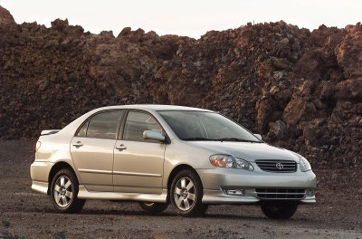
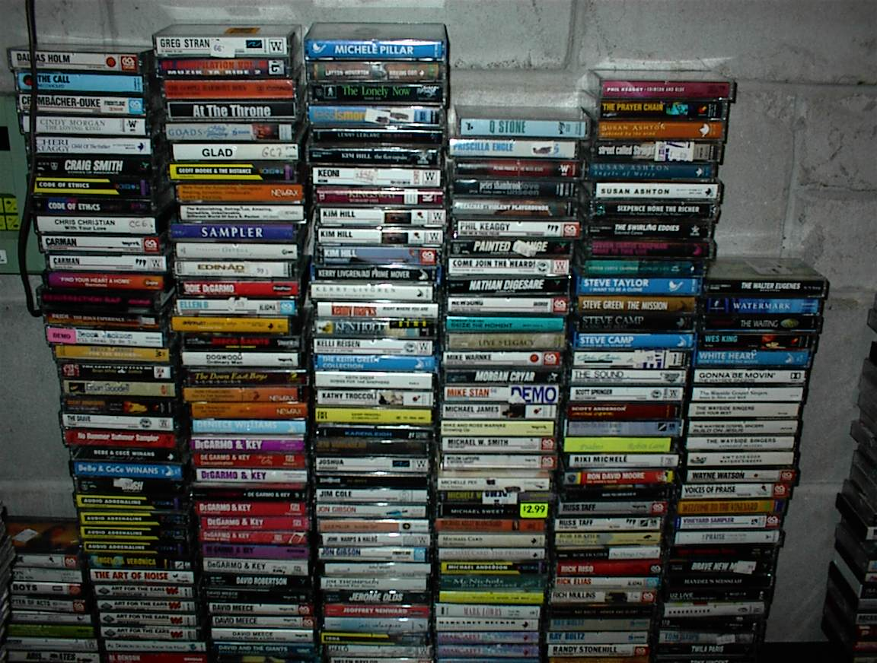
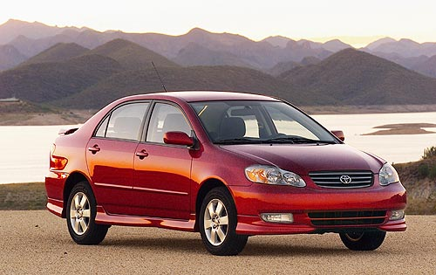
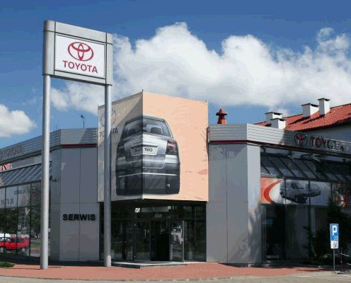
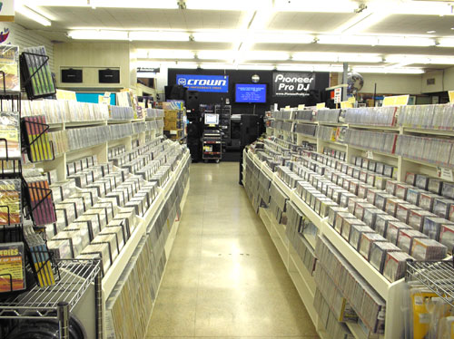
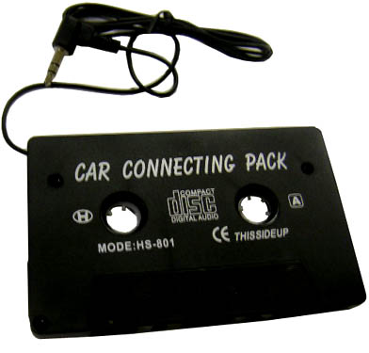
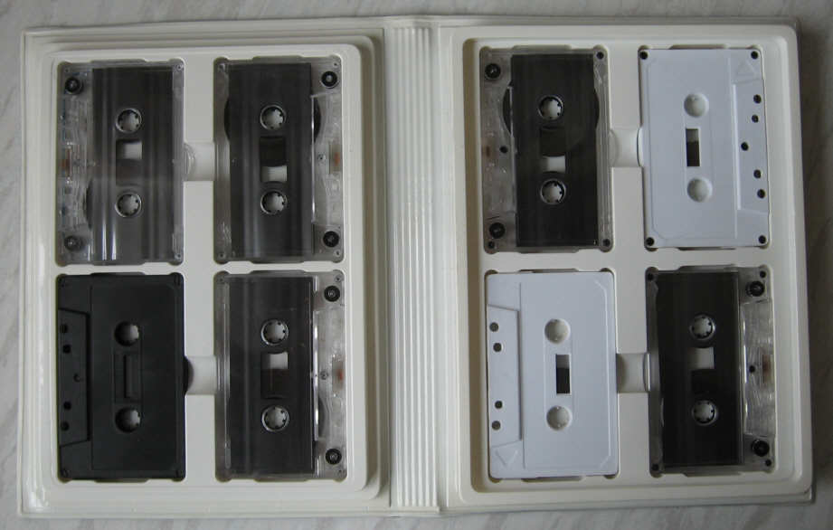
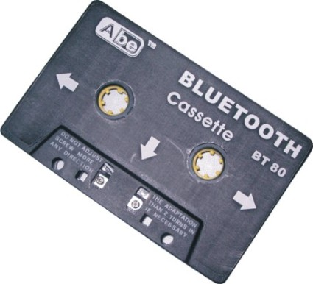
A short story
1998 – Toyota Corolla gives CD player as an option
1999 – My father decides to buy Toyota Corolla
1999 – My father decides to buy Toyota Corolla but he still has a lot of cassettes
2003 – Toyota Corolla comes always with CD player
2003 – Toyota Corolla comes always with CD player You cannot buy cassettes anymore My father piled up some more cassettes
2003 – Toyota Corolla comes always with CD player You cannot buy cassettes anymore
2007 – The new technology becomes not so new, however workarounds for old cassettes players still on the market

Slide 4
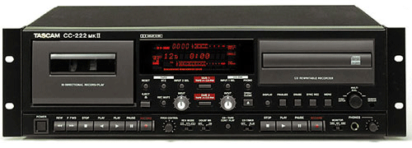
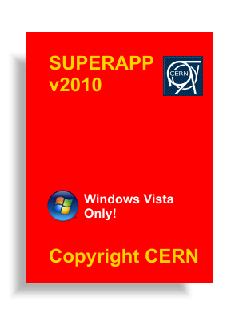
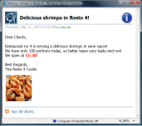
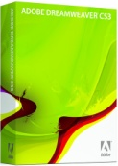
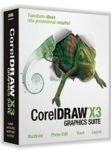
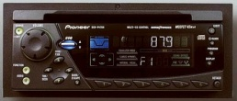
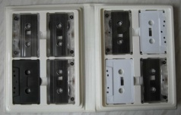
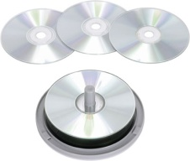
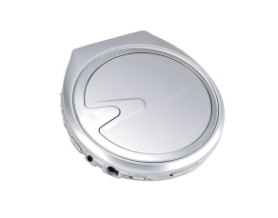
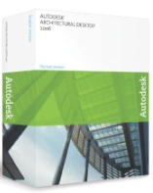
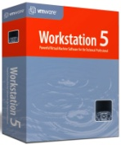
Two options

Slide 5
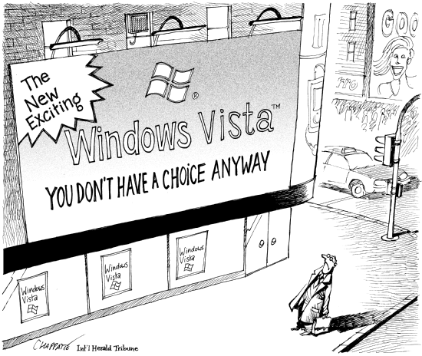
Motivation I
© Chappatte in "International Herald Tribune"

Slide 6
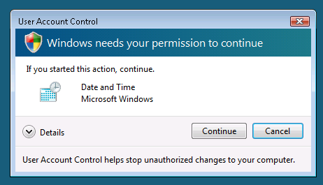
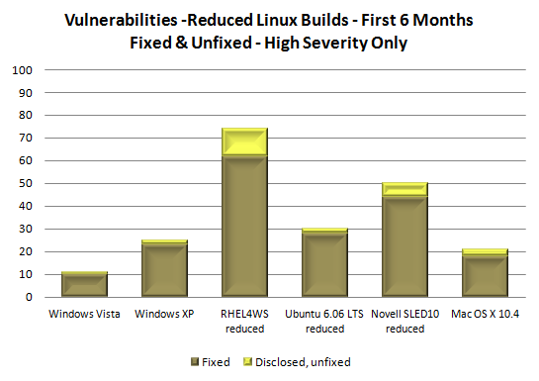
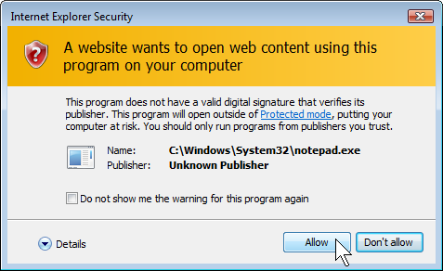
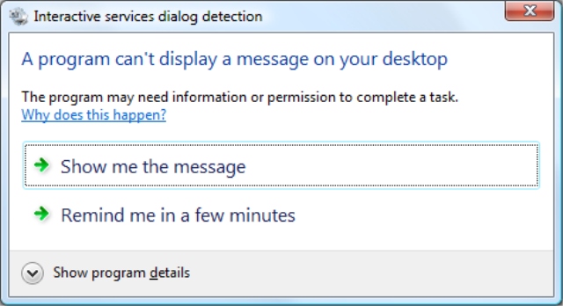
Motivation II - Security
Promising Statistics
User Account Control
Windows Service Hardening
Running with Least Privilege
Service Isolation (SID per service)
Session 0 Isolation
Internet Explorer Protected Mode
Security by Numbers Blog by Jeff Jones: http://blogs.csoonline.com/windows_vista_6_month_vulnerability_report
Notes:
Windows Service Hardening:
Least Privilege by default
Service Isolation – each service has it’s own SID, which can be defined in the ACLs of the resources
Restricted Network Access
- Session 0 Isolation

Slide 7
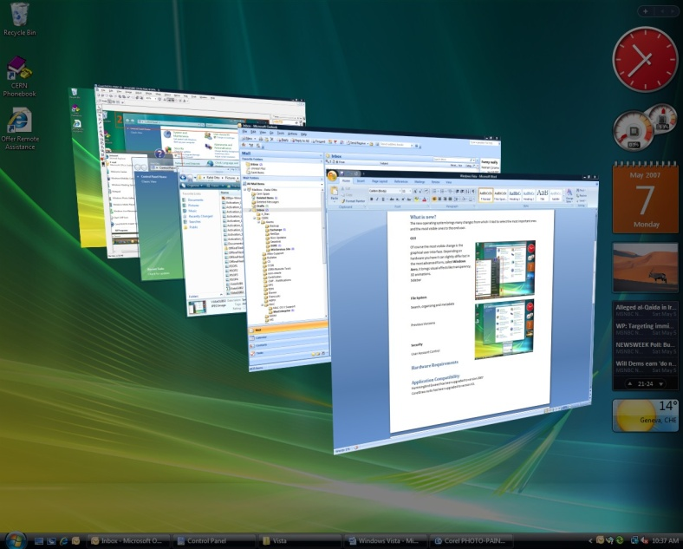
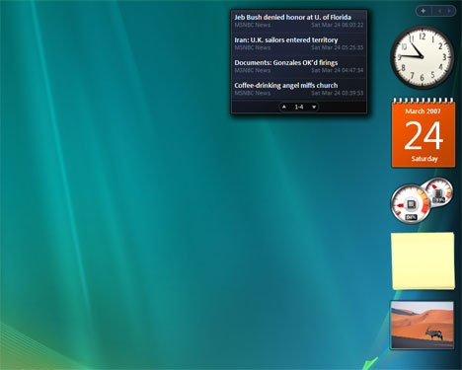
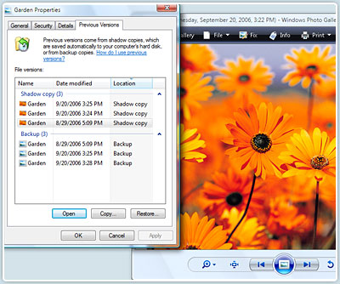
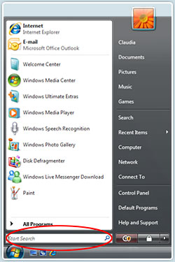
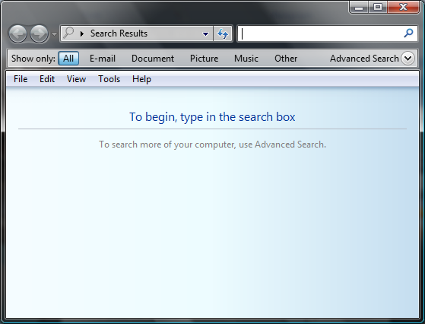
Motivation III – User Experience
Windows Aero
Flip 3D (Windows+Tab)
Glass Effect
Taskbar Preview
Windows Sidebar (Windows+Space)
Previous Versions
Instant Search (Windows + F)
Outlook content
Offline files
Menu Start

Slide 8
Issue I - Hardware Requirements
 | Microsoft | CERN recommendation
Memory | 1 GB | 2 GB (*)(**)
Disk Free Space | 15 GB | 30 GB
CPU | 1 GHz | 1 GHz
(*) The memory requirement may drop to 1.5 GB if your computer has a graphics card with dedicated memory.
(**) 1 GB is enough if Vista is configured without the AERO user interface

Slide 9
Issue II - Activation
 | KMS | MAK | Problem
Internet Access Required |  | X | Isolated Network
Reactivation needed each 6 months | X |  | Laptops
First attempt
Technical Network – KMS activation
General Purpose Network – MAK activation
but… KMS needs at least 25 computers connected to start to work
Second attempt
Desktop PCs – KMS activation
Laptops – MAK activation
once we have at least 25 active Vista computers on the isolated network, we go back to the original idea
Need for the second MAK key
Sometimes we need to burn DVD and give to someone
Helpdesk should be given to be able to recover from Reduced Functionality Mode

Slide 10
Issue III – Other
Several bugs fixed:
WebDAV - KB907306,
Remote Assistance – KB937385,
Offline Files – KB933860
Folder Redirection – KB939021
DFS Home Folder Reorganization in parallel
Application compatibility
Macromedia Dreamweaver 8 -> Adobe Dreamweaver CS3
CorelDraw 12 -> CorelDraw X3
Symantec Antivirus - Version 10.2 for Vista deployed
Remedy client
can run in the compatibility mode
or the web interface has to be used
CAD applications - still being tested but they run smoothly in most of the cases
\\cernhomer.cern.ch\Desktop_r\rotto
\\cernhomer.cern.ch\Favorites_r\rotto
\\cern.ch\dfs\Users\r\rotto
\\cern.ch\dfs\Users\r\rotto\Desktop \\cern.ch\dfs\Users\r\rotto\Favorites
\\cern.ch\dfs\Users\r\rotto\Documents

Slide 11
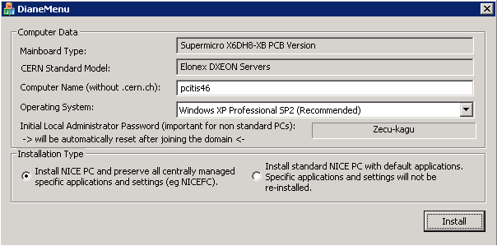
Vista Deployment
Vista is proposed only on selected models of PCs and Laptops
Windows XP is still the default OS
If a computer is running Windows XP, it is possible to perform Vista Readiness check
Vista Supported Desktop Models | Windows Aero
HP dc7700 | √
HP dc7600 | √
HP dc5750 | √
Elonex ProSentia | √
Vista Supported Laptop Models | Windows Aero
HP Compaq 6910p | √
HP Compaq nc6400 | √
HP Compaq nc6220
NEC Versa P550 | √
NEC Versa M360 | √

Slide 12
Vista Deployment Progress
Vista will be a default OS on new computers once:
a significant number of Vista computers is installed (~200)
we do not have any new issue
Probably it will be at the same time as Service Pack 1 is released

Slide 13
Office 2007
What’s new?
User Interface
Office button,
Ribbon,
Live preview
New features in Outlook
Instant Search (when Outlook is in cache mode only)
Categories
SharePoint Designer (replaces FrontPage)
Issues
Hardware requirements
We recommends to have at least 1GB of memory
OpenOffice is not able to open *.docx, *.xlsx, *.pptx files
It is advised to use CERN Terminal Services in such cases

Slide 14
Office 2007
Office 2007 is a default version installed on new computers since early August
Anyone can voluntarily upgrade to Office 2007 at any time
We have currently around 1000 desktop computers having Office 2007 installed
Office 2007 is not yet deployed on Terminal Services, however there is no technical stopper

Slide 15
Summary
Vista
It is a time to start Vista deployment
better sooner then later!
security improvement
rich user experience
The main issue is the hardware requirement for memory
Application compatibility is not a big issue
Office 2007
big change in the user interface
hard at the beginning, great after some time
the biggest issue is inability of OpenOffice to open Office 2007 format

Slide 16
Thank You!

