Slide 1
CERN Alerter
Rafal Otto
IT/IS

Slide 2
Outline
What is the CERN Alerter?
Functionality
Architecture
Client Implementation

Slide 3
What is the CERN Alerter?
The tool for broadcasting urgent messages across the campus network
displays a message on each screen within maximum 10 minutes
allows to target messages only to selected PCs/users
History
SPM_quotMESSAGE – on CERNVMS
Zephyr – push mechanism
NICE Alerter – pull mechanism based on NNTP
NNTP support at CERN finished at the end of June 2007, therefore a new solution had to be proposed - based on standard products having a long life time
MS SharePoint as a Database and posting user interface
RSS as transport protocol
Internet Explorer 7.0 + CERN.Win.Alerter.dll assembly as a Windows client
Any RSS reader as Non-Windows client (with limited functionality)

Slide 4
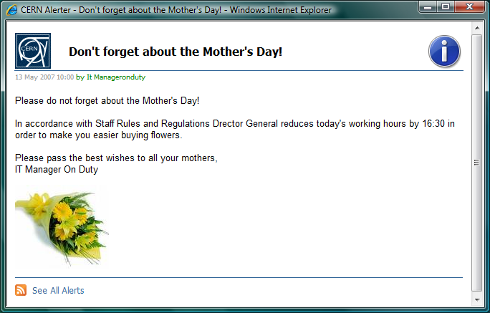
Message Attributes
Message Content
Title
Body
Author
Publication Date
Severity
Enclosure
Message Behavior
Message Type
Valid From Date
Expiration Date
Message Scope
Department
Building
Operating System
Standard fields defined by the RSS specification
Fields processed on the server side
Extra fields interpreted by the client

Slide 5
Message Content
Content of the message is determined by the following attributes:
Title
Body
Author
Publication Date
Severity
Enclosure

Slide 6
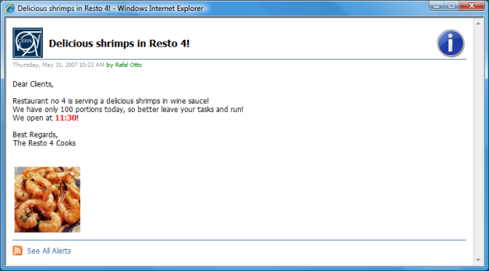
Message Behavior
Behavior of the message depends on three attributes:
Valid From Date
Expiration Date
Message Type

Slide 7
Message Scope
By default each message is dedicated to all CERN users and computers, however it is possible to constraint scope of a message by the following attributes
Department
Building
Operating System
AND logic between attributes
OR logic inside attributes
PH
DSU
Bld. 4
Dept.: DSU
OS:
Bld. 58
Dept.: PH
Bld.: 4
Bld.: 58
OS:

Slide 8
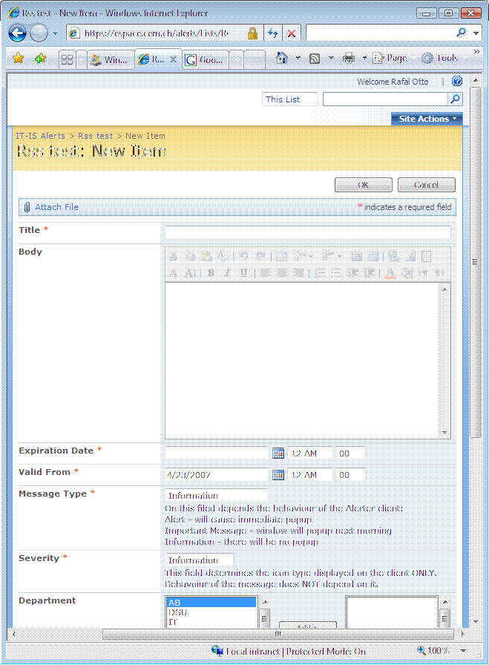
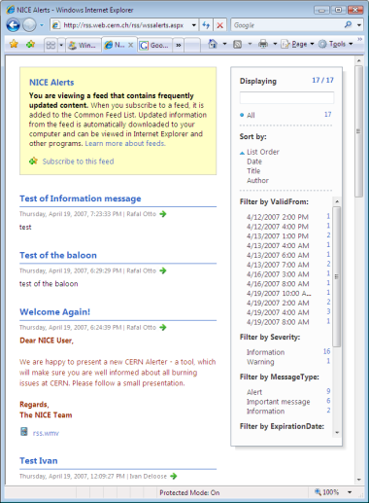
Architecture
https://cern.ch/alerts/_layouts/listfeed.aspx?List=50ba07%2...
http://cern.ch/cernalerts/alerts.aspx?login=rotto&computername=PCITIS51
Back-End
Front-End
Thin Client
Active Directory
CMF
Filtered RSS
Full RSS
Posting
Alerting
History
IT Manager on Duty
Users

Slide 9
Windows Client Implementation
Windows client is the .Net 2.0 assembly with 4 methods exported:
ProcessAlerts – returns a hashtable containing all new messages found in the local feed store, which have not been processed yet – should be called periodically (i.e. every 5 minutes)
ShowAlert – displays a popup window containing an alert message
ShowHistory – opens the browser window with the RSS feed content displayed
ShowSettingsDialog - provides GUI for alerter settings
There is a need of a process, which would consume the assembly
At CERN we use CMF (Computer Management Framework) – an application developed at CERN, used normally for the application deployment
It could be just a PowerShell script running as a scheduled task:
[Reflection.Assembly]::LoadFile(“.\CERN.Win.Alerter.dll")
(new-object CERN.Win.Alerter.CERNAlerter).ProcessAlerts()

Slide 10
Non-Windows clients
There is no special client available at the moment
Users of those systems should subscribe to the RSS feed with any RSS reader (could be Firefox or Safari)
Targeting functionality will stay as scope of the message is resolved on the server side. Users should subscribe to the feed in the following form: http://cern.ch/cernalerts/alerts.aspx?login=[XXX]&computername=[YYY]
Behavior of the messages will not remain - popup windows will be missing

Slide 11
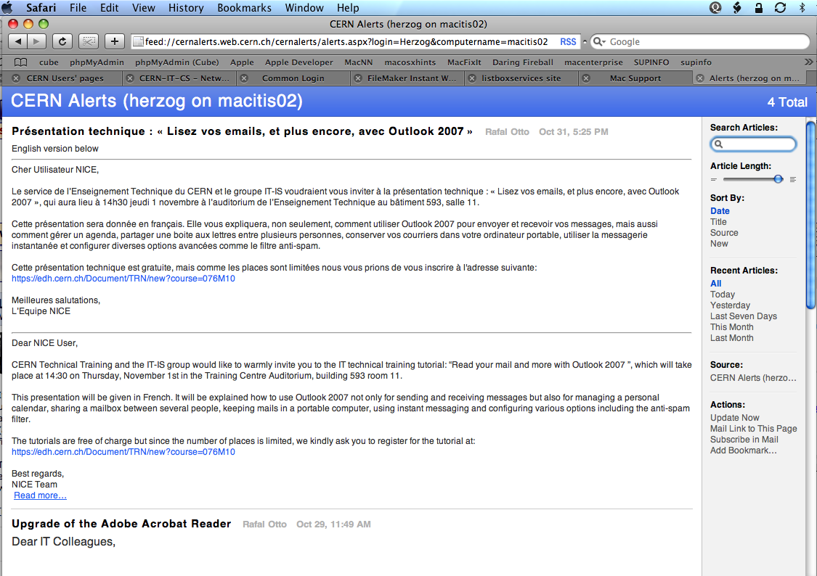
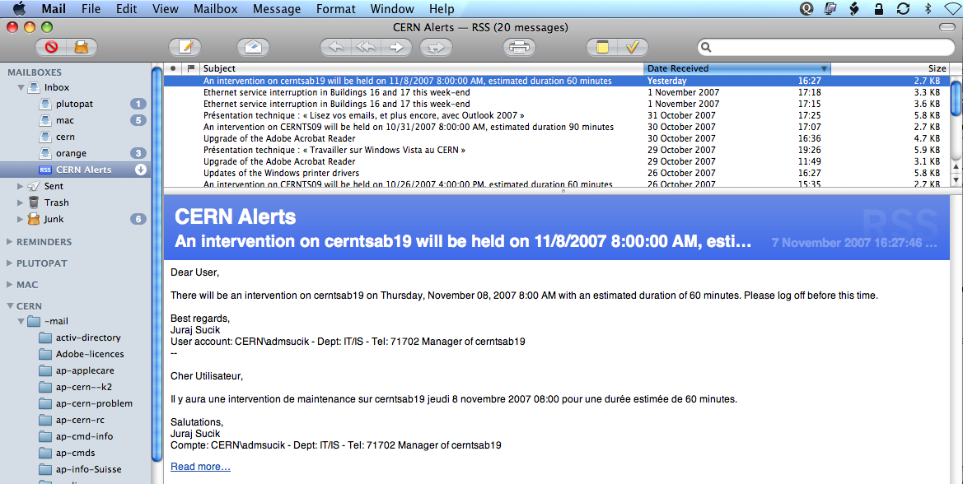
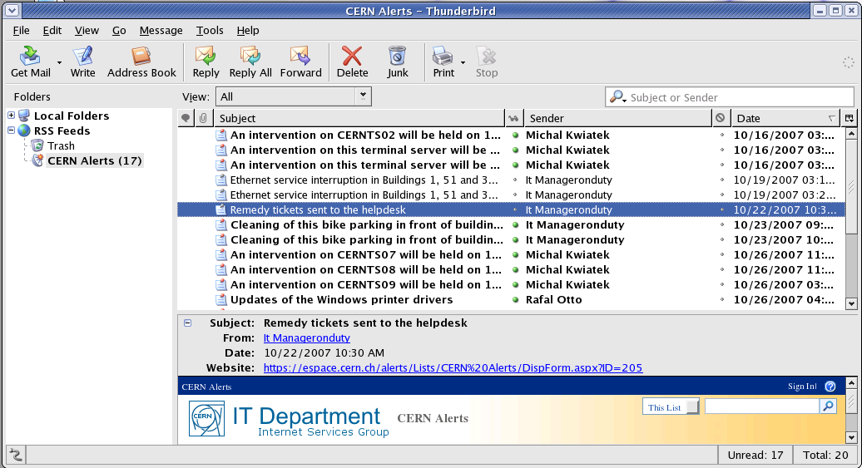
Non-Windows clients
Mail on Mac OS X
Thunderbird on SLC4
Safari on Mac OS X

Slide 12
Thank You!
Documentation:
https://cern.ch/winservices/Help/?kbid=060810

