Slide 1
RaDIATE
1st Annual Collaboration Meeting May 19 2014
Welcome and News & Notes
Radiation Damage In Accelerator Target Environments

Slide 2
A Little History…
Proton Accelerators for Science and Innovation 2012 “12-month Deliverable”:
Form an inter-disciplinary team between STFC, Fermilab and allied institutions to foster long term expertise in understanding the response of materials to radiation damage in the high energy proton regime. This represents an excellent opportunity to attract experienced radiation material scientists working with material science post-docs as core members of the team. This expertise is also broadly applicable to developing carbon-free energy technologies, thereby promoting knowledge exchange.

Slide 3
Collaboration with Oxford’s MFFP Group
Synergy found between nuclear materials researchers and accelerator target facilities
Materials for Fusion & Fission Power Group (led by S. Roberts)
“White-board Parameter Space Table”

Slide 4
Added BNL and PNNL
BNL
Radiation damage studies using BLIP
Graphite, tungsten, Albemet, Gum metal, Titanium, C-C composite, and more…
Nick Simos
PNNL
Radiation damage research on nuclear materials
Radiation damage studies using research reactors
Full-suite Radio-chemical Processing Laboratory
The 3 Davids (Asner, Senor, and Wootan)

Slide 5
MOU Signed June-July of 2013
First Multi-party, International MOU approved by the DOE since the rule changes by ex-Secretary Chu

Slide 6
Meetings!
Kick-off Meeting
November 16, 2012
Looking for a Logo
9 Monthly Meetings
Creep and toughness of Be
Graphite research at FRIB-MatX
Graphite research at BLIP
More
3 Tech and 1 Admin
FRIB- Ti alloy research
PNNL- Mini-Micro Scale Tests
DPA Calculation

Slide 7
Logo Found and Web-site Founded!
Thanks to Brian Hartsell for both!

Slide 8
And Post-Doc Found!
Viacheslav Kuksenko’s student years and the beginning of the scientific career were spent in Ukraine where studied low-alloyed steels for civil engineering. As a PhD student of the GPM laboratory of the University of Rouen (France), Viacheslav joined the European GETMAT project in 2008 and studied neutron and ion irradiation effects in Fe-Cr alloys mainly using Atom Probe Tomography. He completed his Ph.D. in Physics in 2011. During his farther post-doc in PSI Viacheslav continued an experimental work in a domain of radiation effects in material science, in particular, in steels irradiated in spallation neutron source environment. Viacheslav joined the Materials department of University of Oxford in January 2014 and within the international RaDIATE project is investigating the radiation damage effects of high energy proton beam in beryllium.

Slide 9
Today’s Collaboration Meeting

Slide 10
Today’s Collaboration Meeting

Slide 11
News and Notes
Ion Beam Irradiation Workshop at UMich (G. Was)
RaDIATErs Present:
FNAL: P. Hurh, K. Ammigan
LANL: S. Maloy
FRIB: F. Pellemoine, A. Amroussia
Oxford: S. Roberts
New Contact Made:
S. Donnelly (Huddersfield)
MIAMI in-situ TEM with He beam irradiation (will look at Be for us!)
Learned much more about using ion irradiation for the study of damage effects in materials (including sparking our DPA mtg)

Slide 12
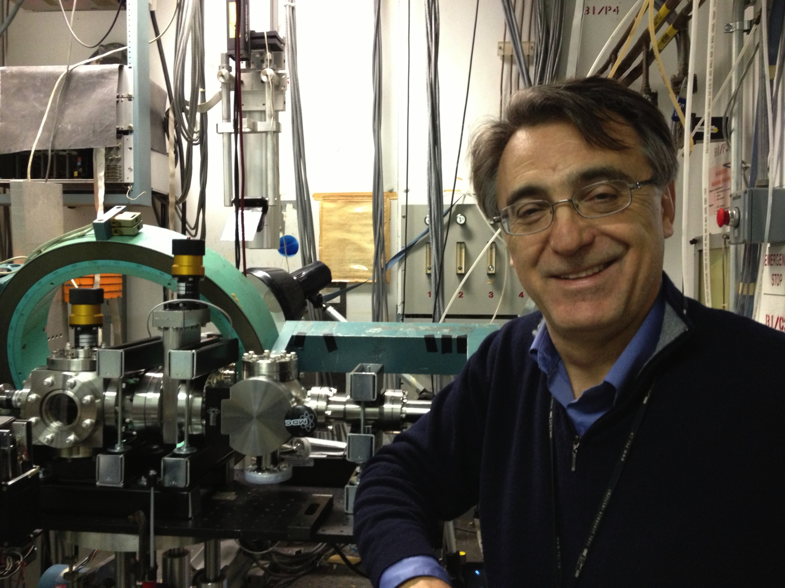
News and Notes
NSLS-1 Hard X-ray diffraction experiment at BNL
First run took place April 29 – May 5
Took data on LHC collimator materials, nano-coatings, and graphite
Irradiated vs Un-irradiated
Loaded vs Unloaded (4 point bend)
Preliminary data on graphite confirms tensile properties measured in previous tensile tests at BLIP
Hopefully another 2 runs in July and September
Rutgers University ran the beamline and will perform data analysis

Slide 13
News and Notes
HiRadMat (CERN) beam test of Be
All signs look positive for approval for beam-time in early 2015
Will explore the limits of Be with high intensity beam
No irradiated material in this first test
Oxford (Kuksenko) will help with Be sample preparation and possibly post-irradiation examination
Hoping to use EBSD on some samples before and after beam
Predicted plastic deformation includes a measureable bump-like feature
Poster on this during the High Power Targetry Workshop

Slide 14
News and Notes
Exploration of using FETS (Front End Test Stand) at RAL as an irradiation station
3 MeV protons
60 mA (average current)
2 ms pulses at 50 Hz
Interesting to Fusion researchers in UK
Issues
Cooling of samples (beam sigma needs to be >10 cm)
No gas production (needs energy upgrade or implant beam)
Penetration relatively shallow for high-Z target samples

Slide 15
News and Notes
DPA Calculation (RaDIATE technical meeting)
Very useful discussion
Encourage all to look through presentations and meeting notes
Major outcome: Two DPA calculations
Physical DPA (DPA_{P})
Uses energy dependent displacement efficiency
Used by most simulation codes (MARS, FLUKA)
More realistic, but does not match ASTM standard
Standard DPA (DPA_{S})
Uses fixed 0.8 as the displacement efficiency
Matches the ASTM standard for use when comparing to nuclear materials data
N. Mokhov has committed to adding this capability to MARS

Slide 16
News and Notes
Stage 1 Final Report complete several months ago
Will distribute to “official” RaDIATE members (at this mtg)
Cannot make publically available due to copyright issues
Contains very good information and recommendations from nuclear materials experts (Oxford, NNL, Manchester)
Graphite
Beryllium
Tungsten
Will publically distribute a summary and recommendations version without graphs and tables
Currently negotiating with NNL to obtain rights to material in the full report so that we can publish the 173 page report.

Slide 17
Goals of Today’s Meeting
Hear and Discuss the status and future plans of the various materials studies
Learn about the materials studies and capabilities of CIEMAT (Dr. Ibarra)
Learn about the role of ion beam irradiations in the study of radiation damage (Dr. Was)
Review and Discuss the MOU Revision for the purpose of adding new institutions
Brainstorm and Identify cost-effective irradiation strategies for future RaDIATE studies
Brainstorm and Identify new topics for Technical Meetings

Slide 18
RaDIATE
10 keV protons into Beryllium (simulated with SRIM 2008 and artistically rendered with Graphic Converter by P. Hurh)
Radiation Damage In Accelerator Target Environments

