Slide 1
Proton Improvement Plan II
Lionel Prost, on behalf of the PIP-II Team
48th Annual Fermilab Users Meeting
10-11 June 2015

Slide 2
Outline
Motivation
Design strategy and performance goals
Project status
R&D program

Slide 3
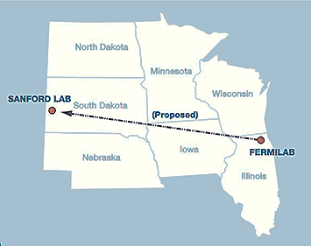
Fermilab’s goal
Construct & operate the foremost facility in the world for particle physics research utilizing intense beams.
  Neutrinos
    MINOS+, NOvA @ 700 kW
    LBNF @ >1-2 MW
    SBN @ 10’s kW
  Muons
    Muon g-2 @ 17-25 kW
    Mu2e @ 8-100 kW
  Longer term opportunities
The Proton Improvement Plan-II (PIP-II) goal is to support long-term physics research by providing increased beam power to LBNF, while providing a platform for the future.

Slide 4
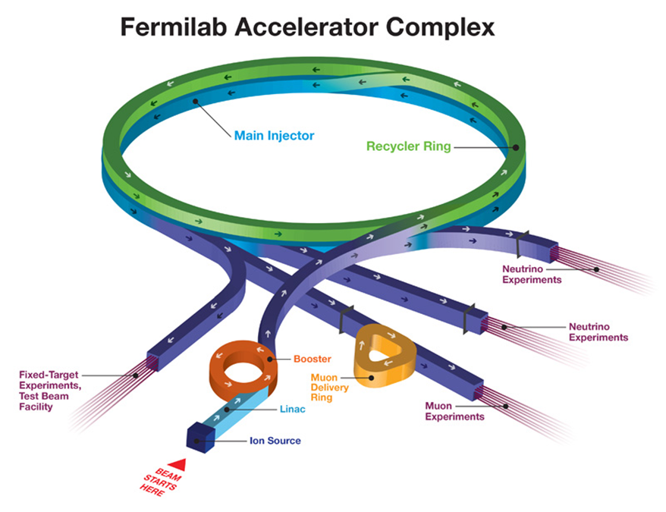
Context
The Proton Improvement Plan (PIP) will support the initial goals (e.g.: 700 kW to NOvA) by establishing a base capability of operating the Booster at a 15 Hz beam rate.
  Limitations
    Booster pulses per second (15 Hz)
      Total power available to the 8-GeV
      program is limited by the repetition
      rate
    Booster protons per pulse
      Limited by space-charge forces at
      Booster injection, i.e. the linac
      energy
    Reliability
      Linac/Booster represent a
      non-negligible operational risk
P5 report, Recommendation 14:
  Upgrade the Fermilab proton accelerator complex to produce higher intensity beams. R&D for the Proton Improvement Plan II (PIP-II) should proceed immediately, followed by construction, to provide proton beams of >1 MW by the time of first operation of the new long-baseline neutrino facility.

Slide 5
Design strategy
Increase Booster/Recycler/Main Injector “per pulse” intensity by ~50%
  Requires increasing the Booster injection energy to ~800 MeV
    30% reduction in space-charge tune shift w/ 50% increase in beam intensity
Increase Booster repetition rate to 20 Hz
  Maintain 1 MW down to 60 GeV or,
  Provide factor of 2.5 increase in power to 8 GeV program
Modest modifications to Booster/Recycler/Main Injector
  Accommodate higher intensities and higher Booster injection energy
New
⇨ 800 MeV superconducting pulsed linac, extendable to support >2 MW operations to LBNF and upgradable to continuous wave (CW) operations

Slide 6
PIP/PIP-II Performance Goals
Performance Parameter | PIP | PIP-II
Linac Beam Energy | 400 | 800 | MeV
Linac Beam Current | 25 | 2 | mA
Linac Beam Pulse Length | 0.03 | 0.5 | msec
Linac Pulse Repetition Rate | 15 | 20 | Hz
Linac Beam Power to Booster | 4 | 18 | kW
Linac Beam Power Capability (@>10% Duty Factor) | 4 | ~200 | kW
Mu2e Upgrade Potential (800 MeV) | NA | >100 | kW
Booster Protons per Pulse | 4.2×10¹² | 6.5×10¹²
Booster Pulse Repetition Rate | 15 | 20 | Hz
Booster Beam Power @ 8 GeV | 80 | 160 | kW
Beam Power to 8 GeV Program (max) | 32 | 80 | kW
Main Injector Protons per Pulse | 4.9×10¹³ | 7.6×10¹³
Main Injector Cycle Time @ 60-120 GeV | 1.33* | 0.7-1.2 | sec
LBNF Beam Power @ 60-120 GeV | 0.7* | 1.0-1.2 | MW
LBNF Upgrade Potential @ 60-120 GeV | NA | >2 | MW
*NOvA operates exclusively at 120 GeV

Slide 7
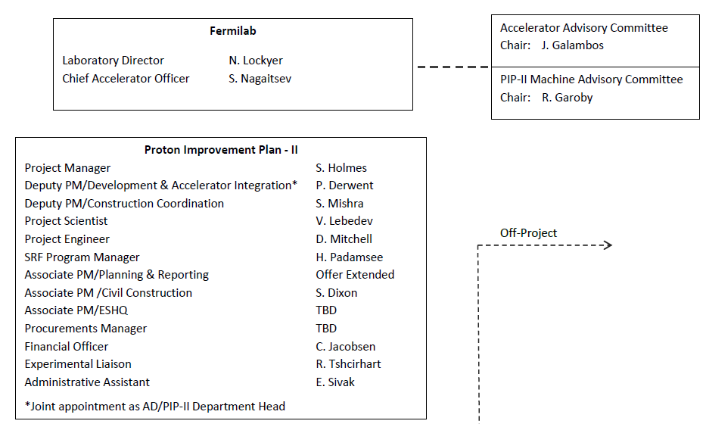
Project status
CD-0 Review next week (June 16-17) !
  Reference Design Report released (http://pip2-docdb.fnal.gov/cgi-bin/ShowDocument?docid=1)
PIP-II Department within Accelerator Division
  Support the development of the PIP-II project, with special emphasis on the research program at PXIE
  Head: P. Derwent
  The department is
  the home in AD of
  the PIP-II project
  office
  S. Holmes remains
  the PIP-II Project
  Manager

Slide 8
Research & Development
On-going R&D to mitigate “risk”
  i.e. mitigate technical and cost risks by validating the choices made in the PIP-II facility design and by establishing fabrication methods for major sub-systems and components, including the qualification of suppliers
  Front-end (PXIE) and superconducting RF development
  R&D plan for Booster/Recycler/Main Injector is under development to address issues such as:
    RF needs for acceleration and transition
    crossing in the Booster
    RF needs for slip-stacking in the Recycler
    at cycle times as low as 0.7 sec (i.e. 60 GeV)
    Needs for new collimators or collimator
    upgrades for all 3 rings
    …
SSR1 cavity

Slide 9
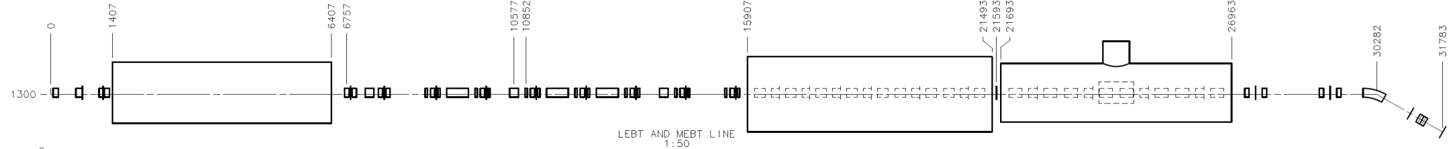
Proton Improvement Plan II Injector Experiment (PXIE)
PXIE is part of the R&D program, which addresses the risks associated with the front-end of PIP-II
  LEBT pre-chopping
  Vacuum management in the LEBT/RFQ region
  Validation of chopper performance
  Bunch extinction
  MEBT beam absorber
  MEBT vacuum management
  Operation of HWR in close proximity to 20 kW absorber
  Operation of SSR with beam, including resonance control and Lorentz force detuning compensation in pulsed operations
  Emittance preservation and beam halo formation through the front end
New
Now
2015
2016
2017
2018
30 keV
2.1 MeV
10 MeV
25 MeV
RFQ
MEBT
HWR
SSR1
HEBT
LEBT

Slide 10
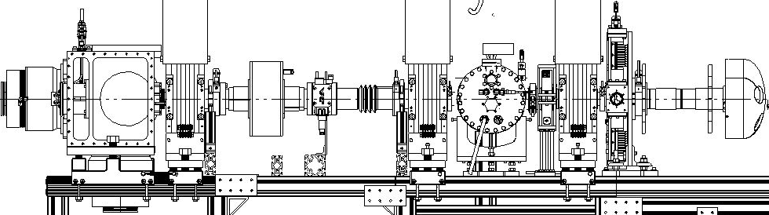
PXIE status
IS/LEBT almost complete for RFQ commissioning
  RFQ delivery end of July (from LBNL)
  Nominal beam parameters
  demonstrated
ε_{n, rms} = 0.13 mm mrad
X’, mrad
1 RFQ module (i.e. ¼ of the full length RFQ)
X, mm
Solenoid #1
Solenoid #2
Solenoid #3
Ion source
DCCT
LEBT chopper

Slide 11
SRF development status (5/26/15)
*
*
* HWR & SSR1 part of PXIE
In parallel, “high Q₀” R&D program is progressing toward industrialization of the Nitrogen doping process

Slide 12
PIP-II collaboration
Organized as a “national project with international participation”
  Fermilab as lead laboratory
Collaboration MOUs for the development phase (through CD-2) :
  National IIFC
  ANL ORNL/SNS BARC/Mumbai
  BNL PNNL IUAC/Delhi
  Cornell UTenn RRCAT/Indore
  Fermilab TJNAF VECC/Kolkata
  LBNL SLAC
  MSU ILC/ART
  NCSU
Annex I to the U.S. DOE-India DAE Implementing Agreement signed in January 2015
  Significant Indian contribution to PIP-II R&D and construction
  Joint DOE-DAE evaluation of R&D accomplishments in 2018 → final deliverable table from DAE to DOE for PIP-II by 2023

Slide 13
Summary
Fermilab is committed to establishing LBNF as the leading long-baseline program in the world, with >1 MW at startup
PIP-II is a complete, integrated, cost effective concept, that meets this goal, while
  Building on the accomplishments of PIP
  Leveraging U.S. superconducting rf investment
  Attracting international partners
  Providing a platform for the long-term future
PIP-II represents a first step in the realization of the full potential of the Fermilab complex
  LBNF >2 MW
  Mu2e sensitivity ×10
  MW-class, high duty factor beams for future experiments
The PIP-II R&D program targets primary technical and cost risks
  Organized to support a 2019 construction start

Slide 14
Back-up slides

Slide 15
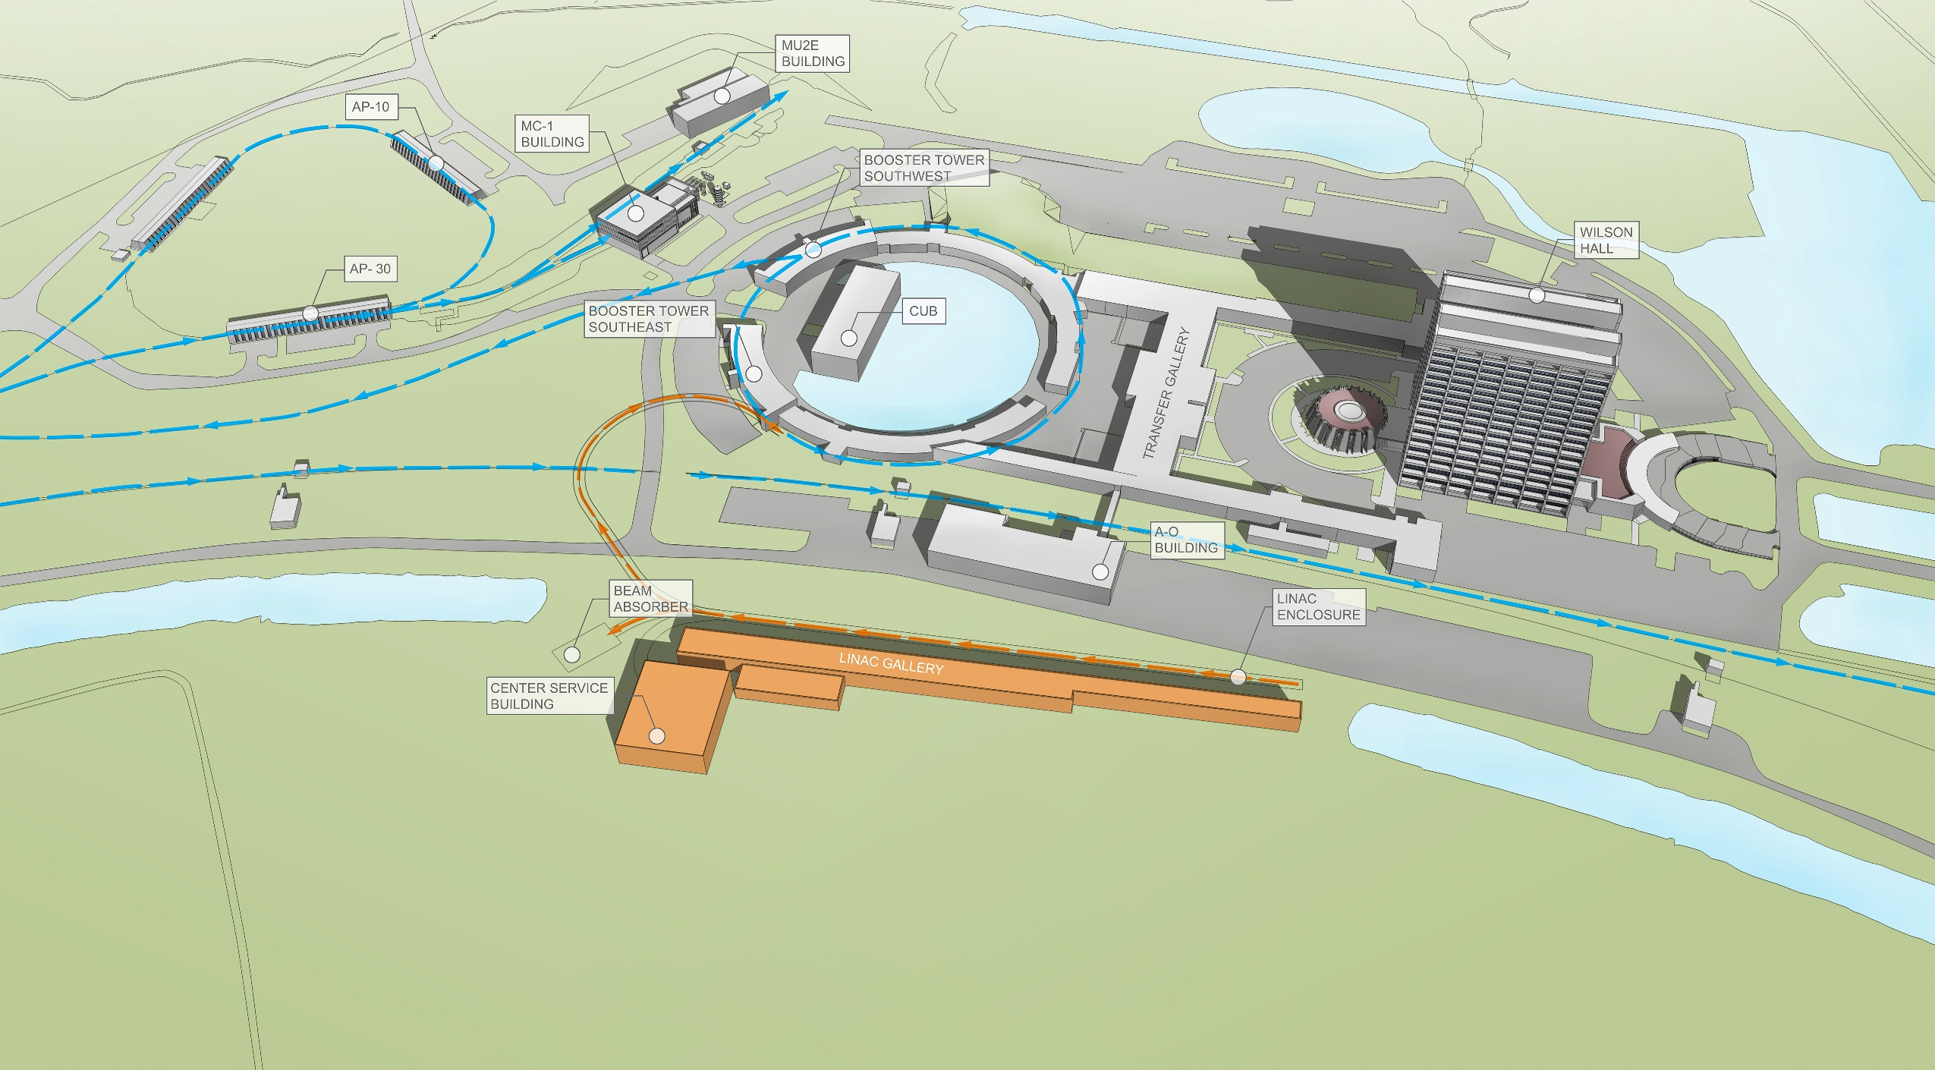
PIP-II site layout (provisional)

Slide 16
Primary areas to address risk
Development and integrated systems testing of PIP-II Front End components (PXIE)
Development of a Booster injection system design capable of accepting extended beam pulses from the PIP-II linac
Development and demonstration of cost effective superconducting radio frequency acceleration systems at four different frequencies and with rf duty factors ranging from 10% to 100%
Development of systems designs capable of supporting a 50% increase in the proton beam intensity accelerated and extracted from the Booster/Recycler/Main Injector complex
Development of requisite capabilities at international partner institutions to successfully contribute to PIP-II construction

