Slide 1
The Search for Dark matter’s particle identity (circa 2015)
Dan Hooper – Fermilab, Theoretical Astrophysics Group
48th Annual Fermilab Users Meeting
June 11, 2015

Slide 2
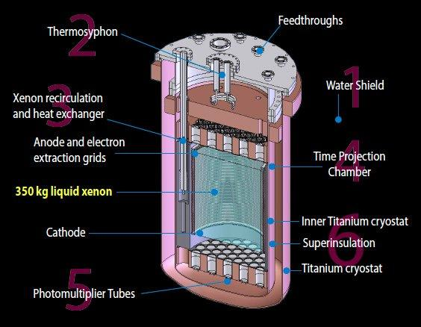
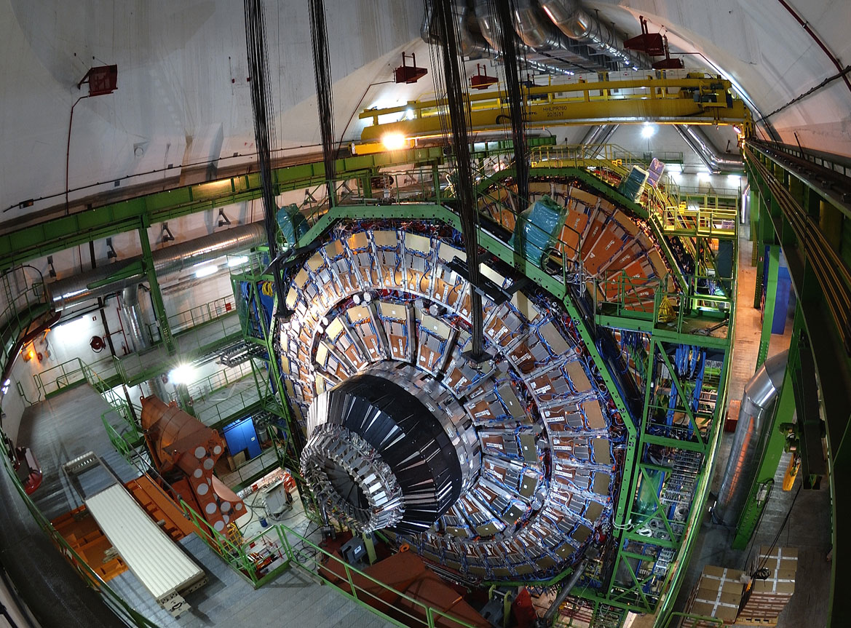
Dan Hooper – The Search For Dark Matter
A Changing Dark Matter Landscape
Over the past few years, attitudes of many within the dark matter community have noticeably shifted; driven by the fact that dark matter particles have not yet been observed in underground detectors, or at the LHC
My personal view is that this is response is probably premature; I continue to find WIMPs very compelling
That being said, if a discovery does not occur within the next decade or so, it will force us to revisit our ideas about what the dark matter is likely to be made up of

Slide 3
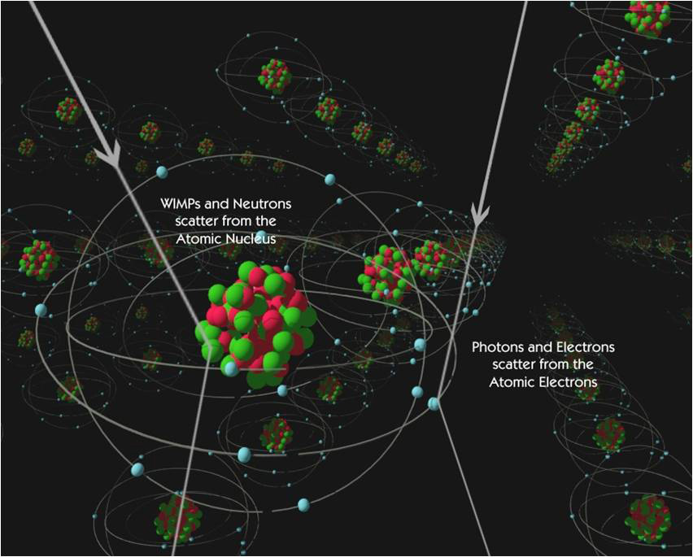
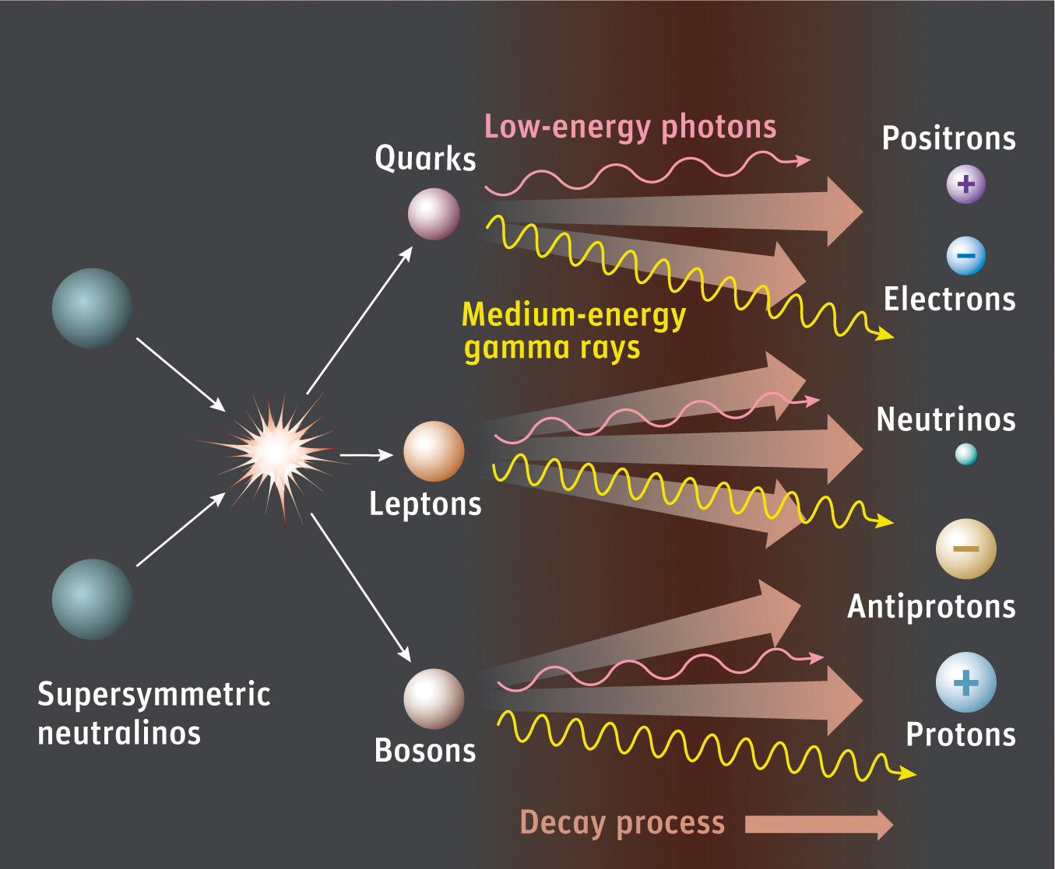

The Trinity of Dark Matter Searches
Dan Hooper – The Search For Dark Matter

Slide 4
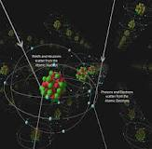
Direct Detection (scattering with nuclei)
Dan Hooper – The Search For Dark Matter
A GeV-TeV particle moving a typical halo velocities (~300 km/s) striking a nucleus imparts a recoil of ~1-100 keV; potentially observable combinations of scintillation, ionization and phonons
Current state-of-the-art experiments make use of ~100-1000 kg heavy nuclei targets (Ge, Xe), instrumented and located deep underground to minimize backgrounds
The LUX Experiment

Slide 5
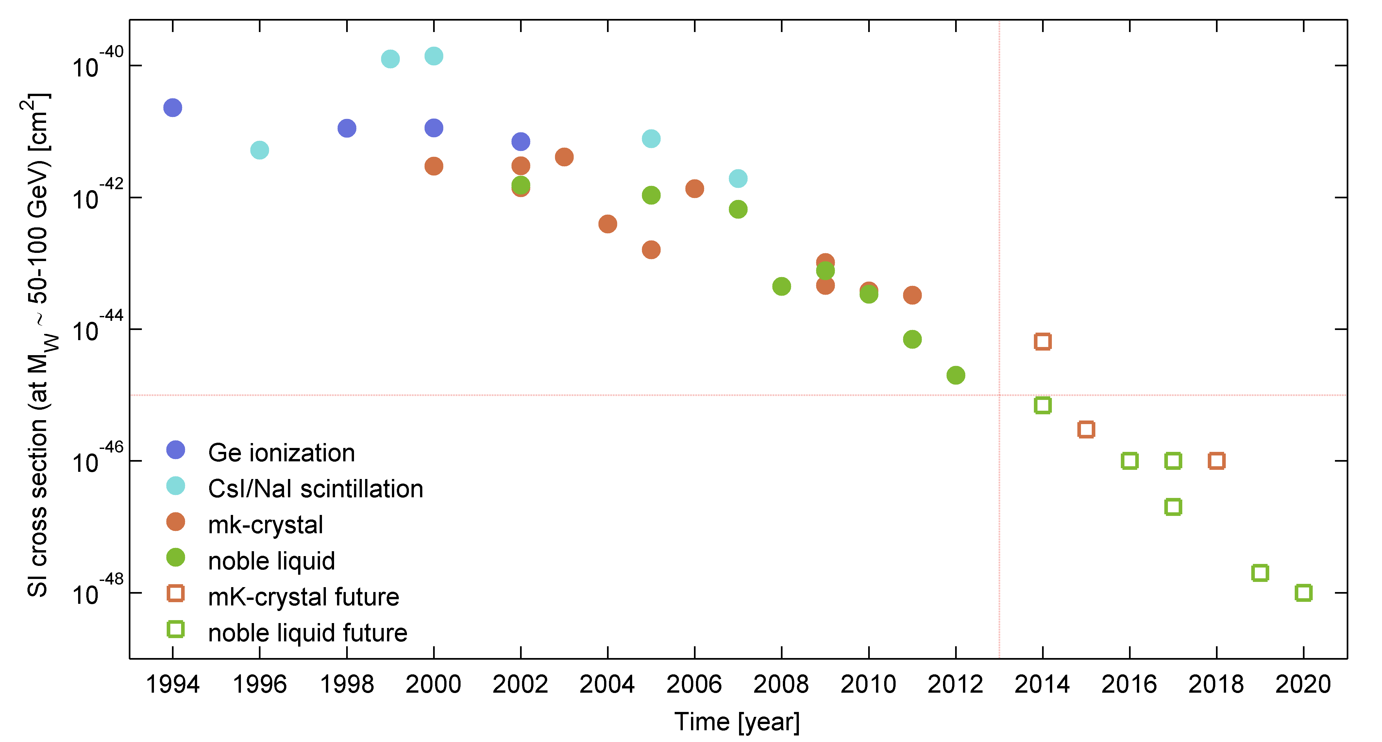
Direct Detection
Dan Hooper – The Search For Dark Matter
Over the past 15 years, constraints from direct detection experiments have improved with a Moore’s-law like behavior (a factor of 2 every 15 months)

Slide 6
Direct Detection
Dan Hooper – The Search For Dark Matter
Over the past 15 years, constraints from direct detection experiments have improved with a Moore’s-law like behavior (a factor of 2 every 15 months)
Some important benchmarks:
  -1990s: Experiments excluded the cross sections predicted for a WIMP that scatters and annihilates through Z-exchange

Slide 7
Direct Detection
Dan Hooper – The Search For Dark Matter
Over the past 15 years, constraints from direct detection experiments have improved with a Moore’s-law like behavior (a factor of 2 every 15 months)
Some important benchmarks:
  -1990s: Experiments excluded the cross sections predicted for a WIMP that scatters and annihilates through Z-exchange
  -Now!: Experiments are currently testing
  WIMPs that interact through Higgs exchange (including many SUSY models)

Slide 8
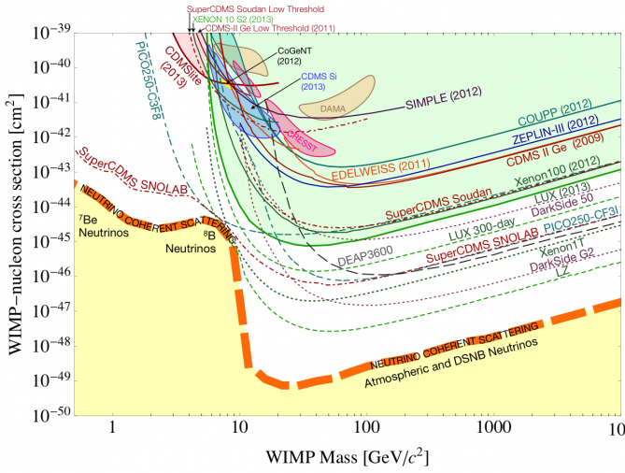
The Future of Direct Detection
Dan Hooper – The Search For Dark Matter

Slide 9
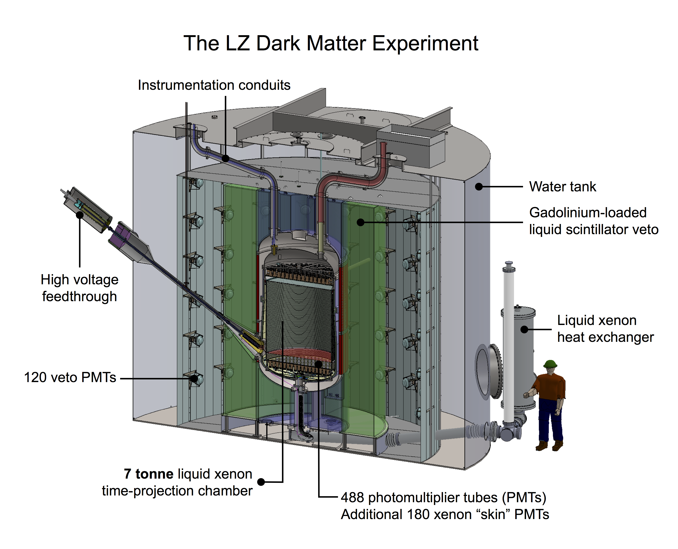
The Future of Direct Detection
Dan Hooper – The Search For Dark Matter
Further extending the reach of LUX are planned large volume liquid xenon experiments, XENON1T and LZ

Slide 10
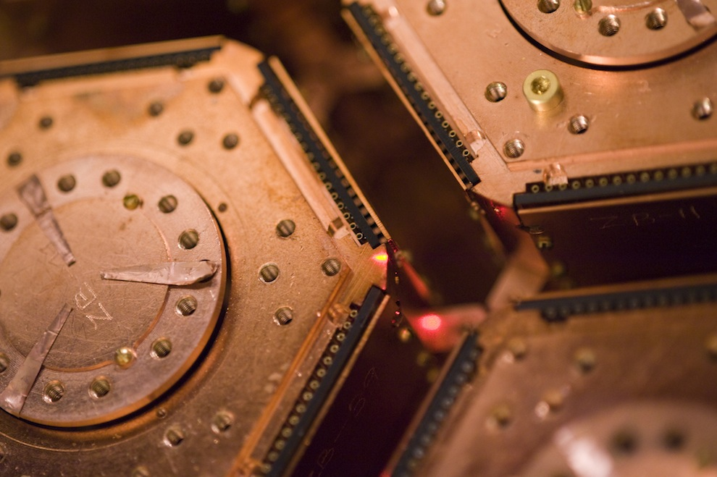
The Future of Direct Detection
Dan Hooper – The Search For Dark Matter
Further extending the reach of LUX are planned large volume liquid xenon experiments, XENON1T and LZ
In parallel, SuperCDMS, DAMIC, and other experiments will advance our sensitivity to low-mass WIMPs

Slide 11
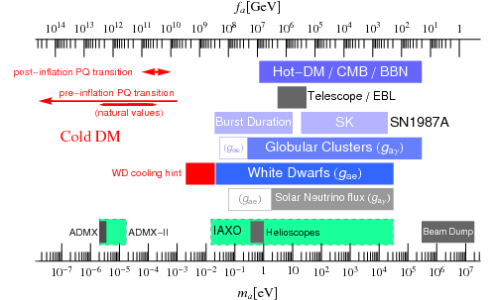
Dan Hooper – The Search For Dark Matter
Axions
Proposed in 1977 as part of an effort to solve the Standard Model’s Strong CP problem, axions are among the best motivated candidates for dark matter
The first axion models were quickly ruled out; presently viable models include axions with masses below ~10⁻³ eV and with extremely feeble couplings
Essig et al., New Light Weakly Coupled
Particles Working Group, arXiv:1311.0029

Slide 12
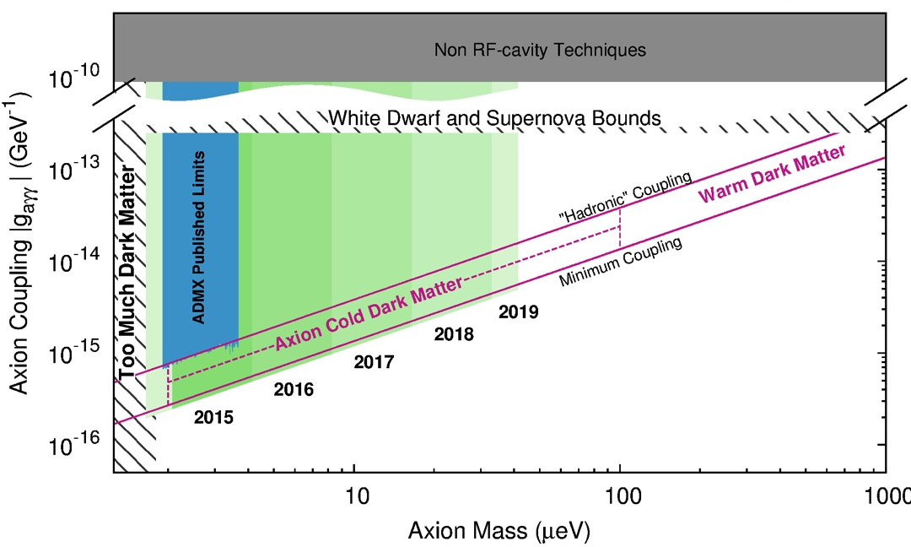
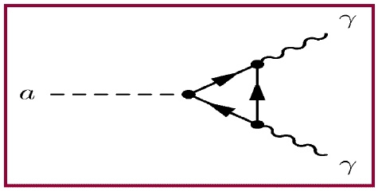
Dan Hooper – The Search For Dark Matter
Axions as Dark Matter
It is difficult to reliably calculate the abundance of axions produced in the Big Bang – depends on the temperature of post-inflation reheating, and on how many axions were produced in the decays of topological strings and domain walls
That being said, under reasonable assumptions, one finds that ~10⁻⁵ eV axions could make up all of the dark matter
The microwave cavity experiment ADMX is working to obtain sensitivity to this mass range
Fermilab is playing a leading role in the development of ADMX’s high frequency cavities, enabling them to push toward higher masses

Slide 13
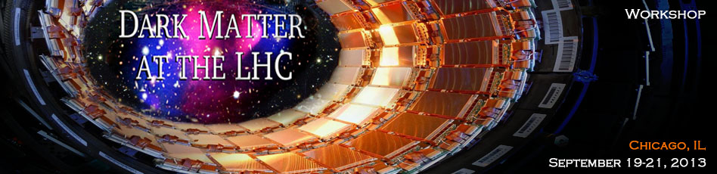
Dark Matter at the LHC
Dan Hooper – The Search For Dark Matter
The LHC provides us with our most comprehensive view of the TeV scale, possibly including the physics of dark matter
Very different search strategies could be optimal, depending on the nature of dark matter

Slide 14
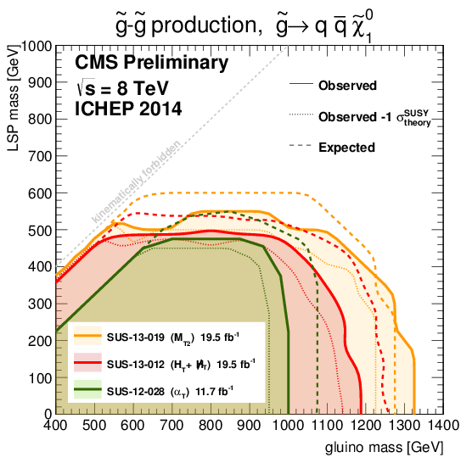
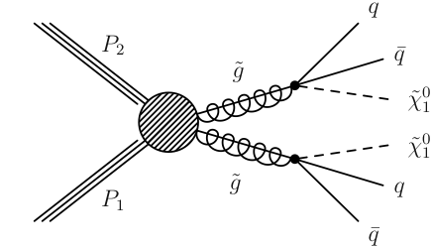
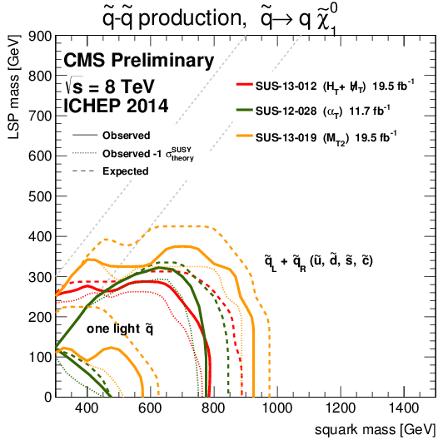
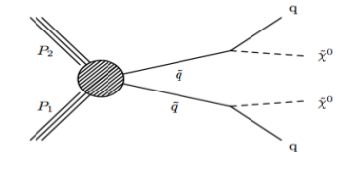
Dark Matter at the LHC
Dan Hooper – The Search For Dark Matter
Case 1: Models with strongly interacting particles (typical SUSY-like)
Produce colored superparticles (squarks, gluinos), and detect missing energy in their decays
Very powerful and broad coverage… if such strongly interacting states exist below a few TeV

Slide 15
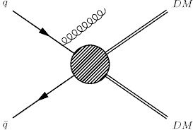
Dark Matter at the LHC
Dan Hooper – The Search For Dark Matter
Case 2: Models without strongly interacting partners
Processes that allow dark matter particles to annihilate into Standard Model particles in the early universe can be reversed in colliders
Dark matter production leads to events with one or more jets and missing energy (among many other possible signals)

Slide 16
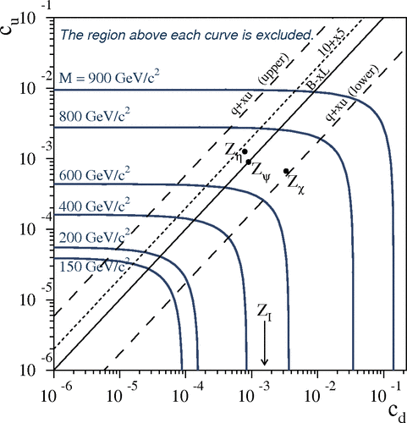
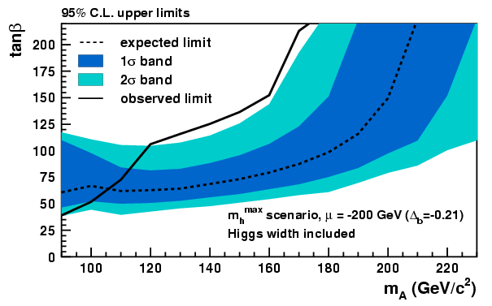
Dark Matter at the LHC
Dan Hooper – The Search For Dark Matter
Case 2: Models without strongly interacting partners
Processes that allow dark matter particles to annihilate into Standard Model particles in the early universe can be reversed in colliders
Dark matter production leads to events with one or more jets and missing energy (among many other possible signals)
In many models, dark matter interacts with the Standard Model through new mediators, with masses near the electroweak-scale
Searches for Z’s, additional Higgs bosons, sleptons, etc. have direct consequences for dark matter

Slide 17
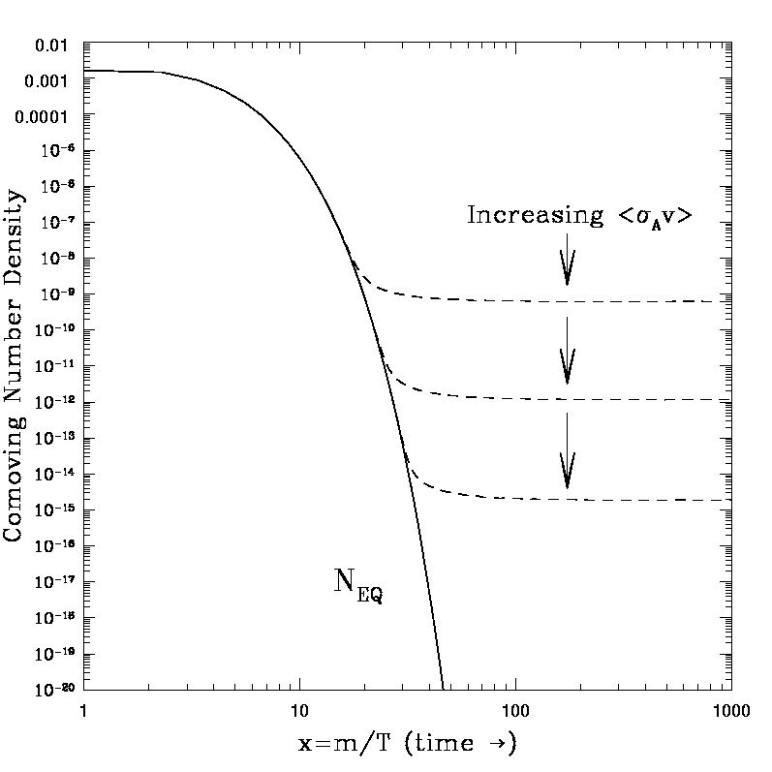
The Motivation for Indirect Searches
Dan Hooper – The Search For Dark Matter
To account for the observed dark matter abundance, a thermal relic must have an annihilation cross section (at freeze-out) of σv~2x10⁻²⁶ cm³/s
Although many model-dependent factors can cause the dark matter to possess a somewhat lower annihilation cross section today, most models predict current annihilation rates that are within an order of magnitude or so of this estimate
Indirect detection experiments that are sensitive to dark matter annihilating at approximately this rate will be able to test the majority of WIMP models

Slide 18
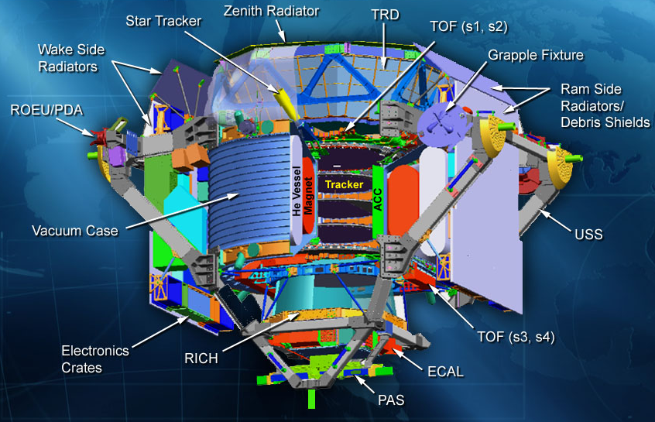
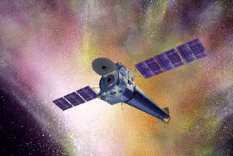
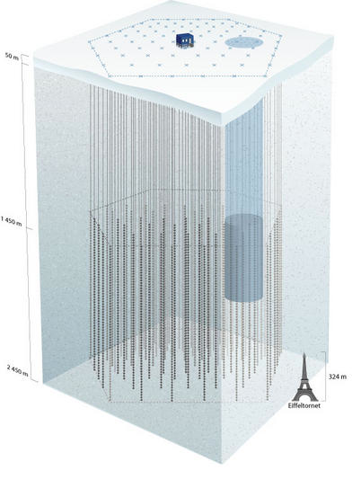
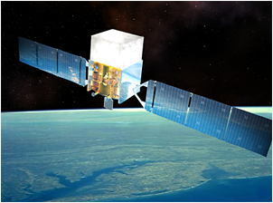
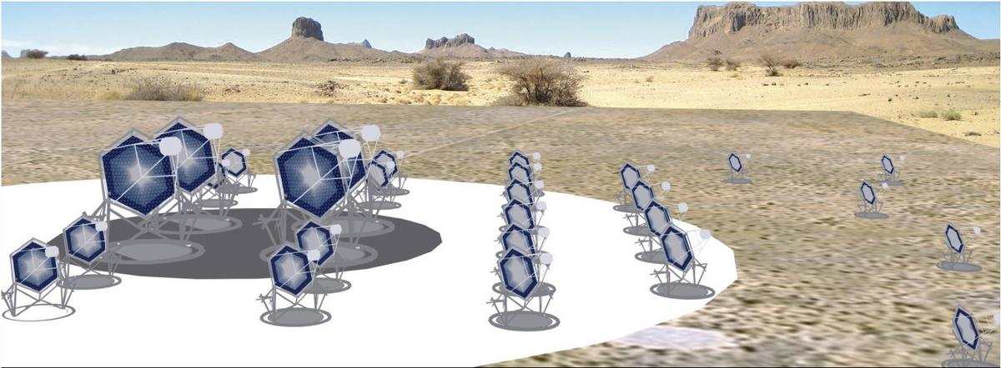
Indirect Detection (annihilation/decay products)
Dan Hooper – The Search For Dark Matter
X-Rays/Multi-Wavelength
Cosmic Rays
Neutrinos
Gamma Rays

Slide 19
Indirect Detection With Fermi
Dan Hooper – The Search For Dark Matter
In my opinion, no single indirect detection experiment has more potential to constrain or discover dark matter than the Fermi Gamma-Ray Space Telescope
Fermi’s Large Area Telescope (LAT) offers far more effective area (~8000 cm²), better angular resolution (sub-degree), and energy resolution (~10%) than any other space-based gamma-ray telescope
Unlike ground-based telescopes, Fermi observes the entire sky and can study gamma rays down to ~100 MeV (ACTs are limited to ~100 GeV and up)

Slide 20
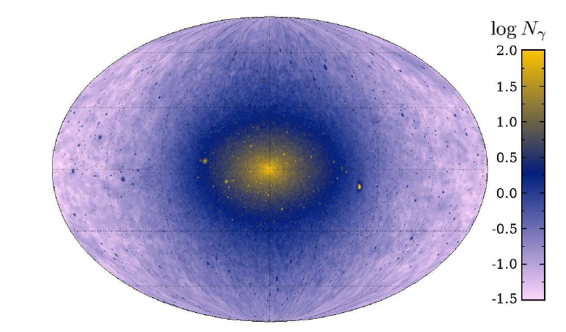
Dan Hooper – The Search For Dark Matter
Where To Look With Fermi?

Slide 21
Dan Hooper – The Search For Dark Matter
Where To Look With Fermi?
The Galactic Center
-Brightest dark matter signal on the sky; significant backgrounds

Slide 22
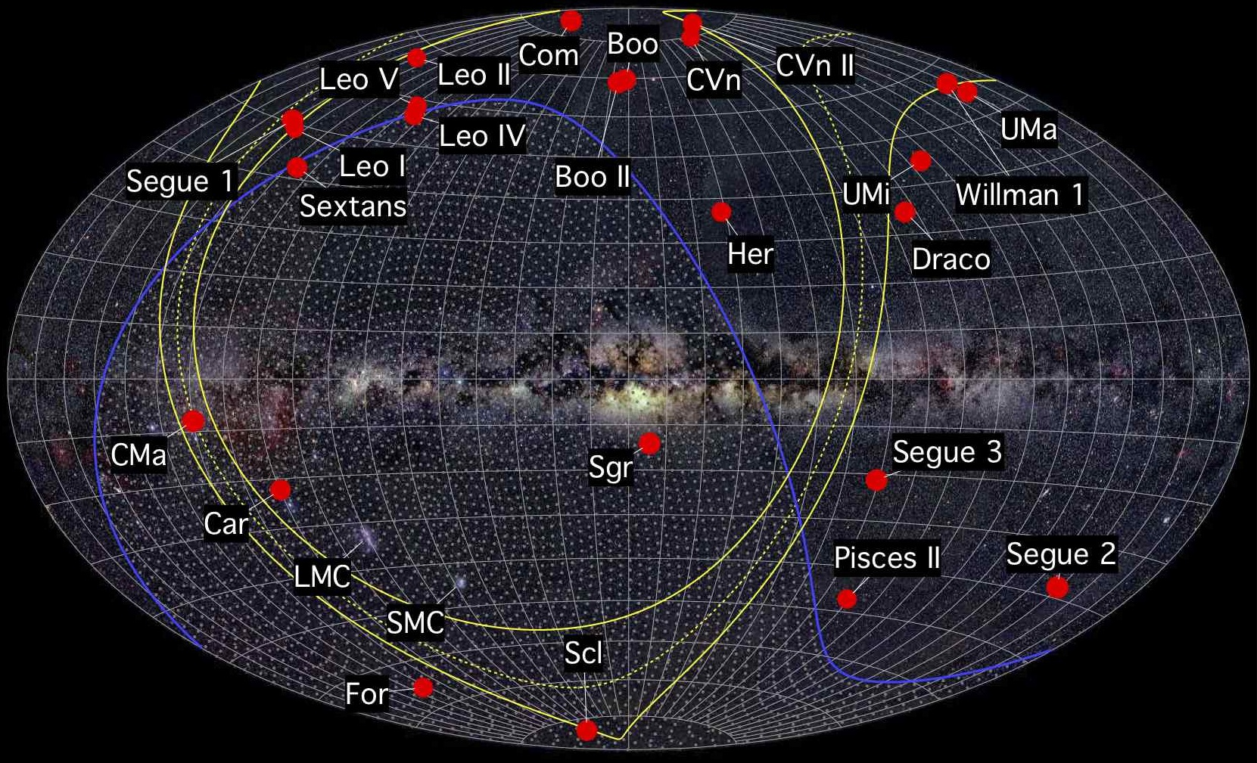
Dan Hooper – The Search For Dark Matter
Where To Look With Fermi?
Dwarf Spheroidal Galaxies
-Faint, but low background
-Direct measurements of dark matter profiles
The Galactic Center
-Brightest dark matter signal on the sky; significant backgrounds

Slide 23
Dan Hooper – The Search For Dark Matter
Where To Look With Fermi?
Dwarf Spheroidal Galaxies
-Faint, but low background
-Direct measurements of dark matter profiles
The Galactic Center
-Brightest dark matter signal on the sky; significant backgrounds
The Gamma-Ray Background
-Largely from blazars, radio galaxies, starforming galaxies; but still room for dark matter

Slide 24
Dan Hooper – The Search For Dark Matter
Where To Look With Fermi?
Dwarf Spheroidal Galaxies
-Faint, but low background
-Direct measurements of dark matter profiles
The Galactic Center
-Brightest dark matter signal on the sky; significant backgrounds
The Gamma-Ray Background
-Largely from blazars, radio galaxies, starforming galaxies; but still room for dark matter
Searches for Nearby Subhalos
-Population studies of unidentified Fermi sources

Slide 25
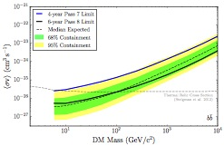
We Are Testing the Thermal Relic Paradigm!
Dan Hooper – The Search For Dark Matter
Each of these gamma-ray strategies (GC, dwarfs, subhalos, IGRB) as well as cosmic-ray antiproton and positron measurements from AMS, are sensitive to dark matter with the annihilation cross section predicted for a simple thermal relic, for masses up to ~100 GeV
This program is not a fishing expedition, but is testing a wide range of well-motivated dark matter models
Bergstrom, Bringmann, Cholis, DH, Weniger, arXiv:1306.3983
Fermi Collaboration, Dwarf Galaxies arXiv:1503.02641

Slide 26
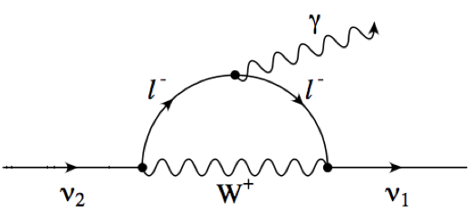
Dan Hooper – The Search For Dark Matter
A 3.57 keV Line?
In early 2014, two groups reported the observation of an unexpected X-ray line from a collection of galaxy clusters
A signal of decaying dark matter? Perhaps sterile neutrinos?
Bulbul et al. (1402.2301), Boyarsky et al. (1402.4119)

Slide 27
Dan Hooper – The Search For Dark Matter
A 3.57 keV Line?
In early 2014, two groups reported the observation of an unexpected X-ray line from a collection of galaxy clusters
A signal of decaying dark matter? Perhaps sterile neutrinos?
Searches for such a line from dwarf galaxies (Malyshev et al.) and galaxies (Anderson et al., Riemer-Sorensen) appear to be in tension with a decaying dark matter interpretation
Future observations by high-resolution X-ray telescopes (ASTRO-H) should be able to clarify this situation
Bulbul et al. (1402.2301), Boyarsky et al. (1402.4119)

Slide 28
Dan Hooper – The Search For Dark Matter
The Galactic Center GeV Excess
A bright and highly statistically significant excess of gamma-rays has been observed from the region surrounding the Galactic Center, difficult to explain with astrophysical sources or mechanisms, but very much like the signal predicted from annihilating dark matter
The excess is distributed with approximate spherical symmetry about the Galactic Center, with a flux that falls off approximately as r ^{-2.4} (implying ρ_{DM} ~ r ^{-1.2} )
The spectrum of this excess peaks at ~1-3 GeV, and is in good agreement with that predicted from a ~35-50 GeV WIMP (annihilating to bb)
To normalize the observed signal with annihilating dark matter, a cross section of σv ~ 10⁻²⁶ cm³/s is required
DH, Goodenough (2009, 2010), DH, Linden (2011), Daylan et al (2014) Calore, Cholis, Weniger (2014)

Slide 29
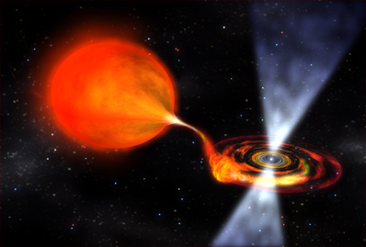
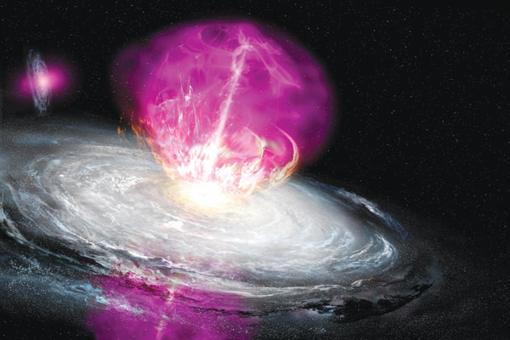
What Produces the Excess?
Dan Hooper – The Search For Dark Matter
A large population of centrally located millisecond pulsars?
A recent outburst of cosmic rays?
Annihilating dark matter?

Slide 30
Dwarf Galaxies
Dan Hooper – The Search For Dark Matter
The Fermi Collaboration recently presented an update of their analysis of dwarf spheroidal galaxies, making use of 6 years of (Pass 8) data
Remains compatible with a dark matter interpretation of the Galactic Center excess
That being said, if the Galactic Center signal is coming from annihilating dark matter, one might expect gamma rays from dwarfs to be detected soon
Fermi Collaboration, 1503.02641

Slide 31
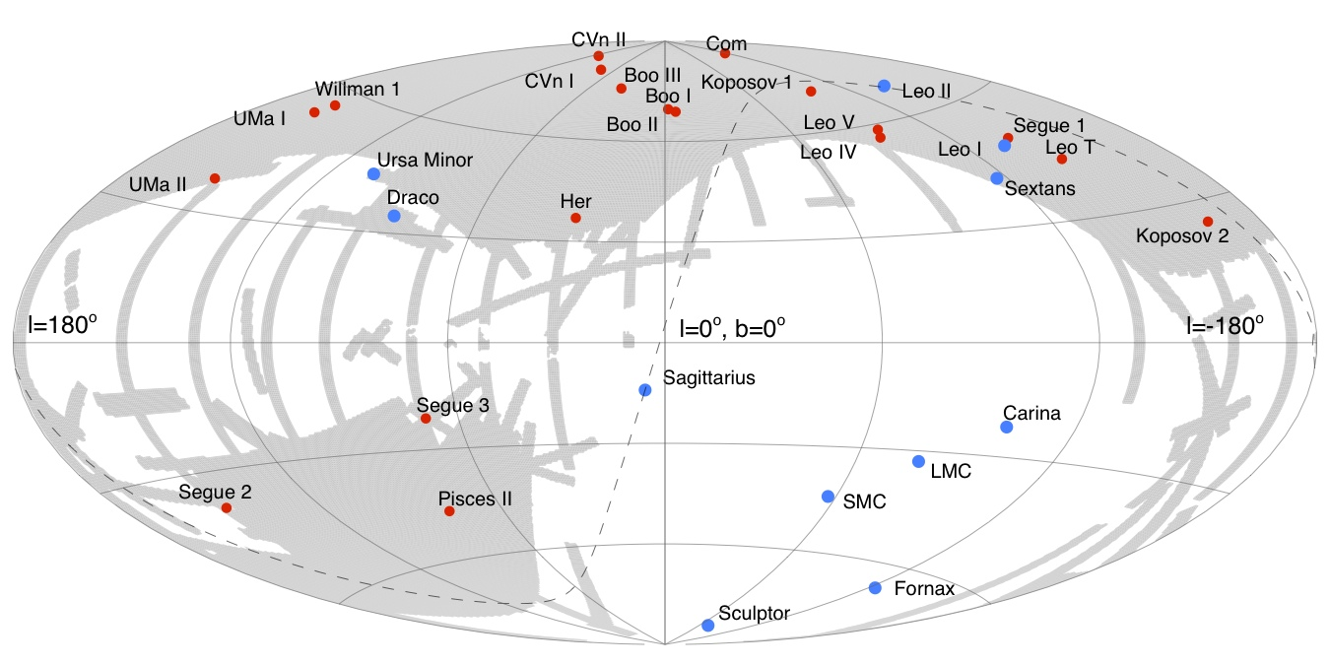
Dwarf Galaxies
Dan Hooper – The Search For Dark Matter
Past searches for gamma-rays from dwarf galaxies made use of both “classical” dwarfs (Draco, Sagittarius,...), and “ultra-faint” dwarfs discovered more recently by SDSS (Segue 1, Ursa Major II,...)
Much of the sky was not explored by SDSS, leaving us with the expectation that many dwarfs remained to be discovered

Slide 32
New Dwarf Galaxies!
Dan Hooper – The Search For Dark Matter
DES Collaboration arXiv:1503.02584; see also 1503.02079
This spring, discoveries of more than a dozen new dwarf galaxy candidates have been reported, using data from the Dark Energy Survey, SDSS, and Pan-STARRS
Particular exciting is Reticulum II, which is particularly nearby (~30 kpc) and has been confirmed to be an ultra-faint dwarf galaxy
New dwarfs + more Fermi data will likely significant extend the sensitivity of Fermi, potentially providing a test of the Galactic Center excess

Slide 33
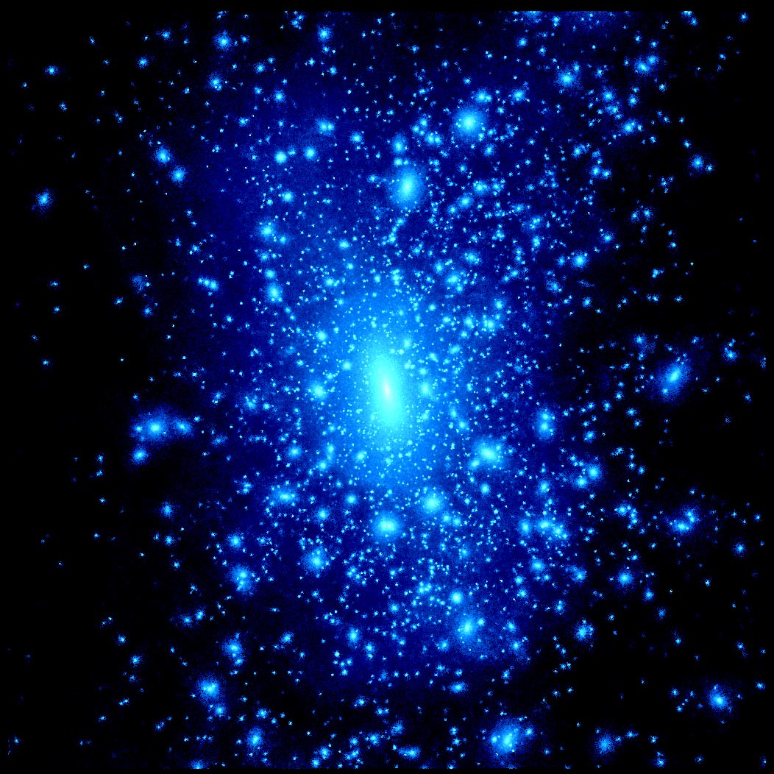
Nearby Dark Matter Subhalos
Dan Hooper – The Search For Dark Matter
The Milky Way’s dark matter halo is predicted to contain huge numbers of smaller subhalos, the vast majority of which are too small to retain gas and form stars, leading to a population of invisible dark matter clumps
The most massive and nearby of these objects could be detectable as spatially extended gamma-ray sources, without observable emission at other wavelengths – a population of such sources would be a smoking gun for annihilating dark matter
The Fermi sources J2212.5+0703 and J0318.1+0252 each fit this description – is this the beginning of a dark matter subhalo population?
Bertoni, DH, Linden, 1504.02087

Slide 34
Summary
Dan Hooper – The Search For Dark Matter
Direct detection experiments have improved in sensitivity at an exponential rate over the past 15 years, and have ruled out many well-motivated models; many others will be explored over the next decade
The LHC is our most comprehensive tool to explore the TeV-scale; many different analyses and search strategies are relevant to dark matter
Indirect searches using gamma rays and cosmic rays are currently testing the range of annihilation cross sections predicted for a thermal relic, for masses up to ~100 GeV
Direct, LHC, indirect searches are collectively testing the WIMP paradigm!
The Galactic Center’s GeV excess is particularly compelling: highly statistically significant, robust, distributed spherically out to at least 10° from the Galactic Center, and difficult to explain with known or proposed astrophysics
The spectrum and angular distribution of this signal is very well fit by a ~45 GeV WIMP; future observations of dwarf galaxies and searches for subhalos will be important to confirm a dark matter origin of this signal

Slide 35


