Slide 1
Fermilab Test Beam Facility
Mandy Rominsky
FTBF Coodinator
Notes:
Today I’m going to talk about the FTBF.

Slide 2
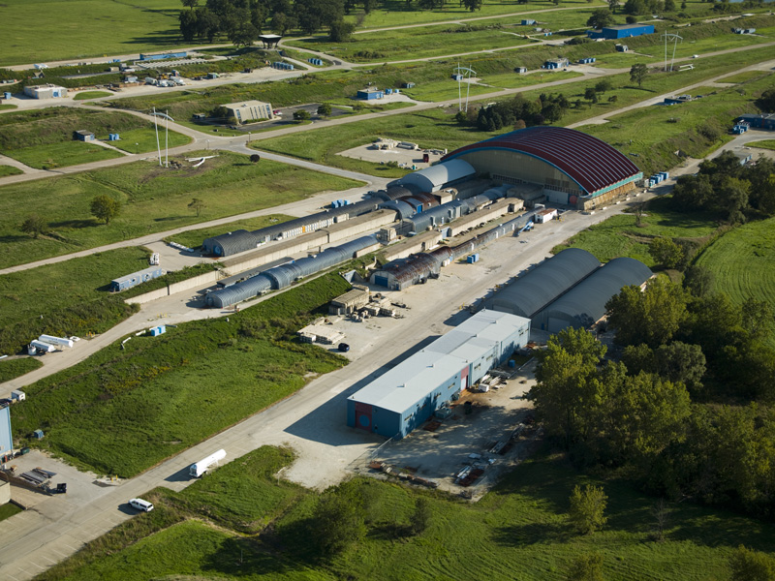
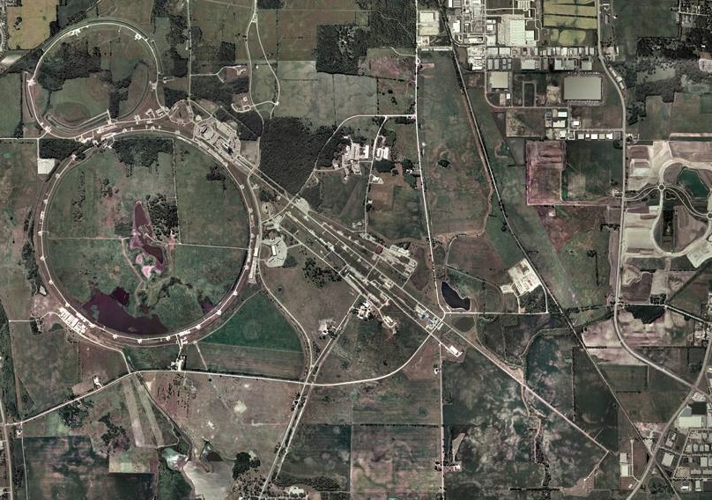
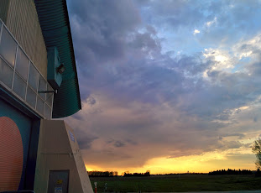
Location
Fermi National Accelerator Laboratory
Meson Detector Building – West
Notes:
FTBF is located straight out from WH at the Meson Detector Building, west, with the familiar roof, even if you haven’t gone insde.

Slide 3
Facility Layout
Beam Areas
Work Areas
Control Rooms
Notes:
Insie, we have 2 beamlines: Mcenter and Mtest, and accompanying control rooms. Mtest typically houses short term (1-2 week) experiments while Mcenter’s users are more long term. In addition to the beamlines and control rooms, we are working on a cosmic ray stand and other user areas not necessarily in a beam enclosure.
2 Beamlines
MTest for short-term (weeks) experiments
MCenter for make-up and long-term (months) experiments

Slide 4
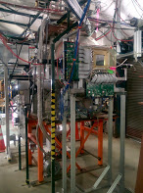
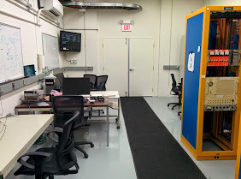
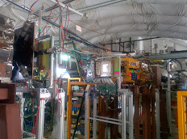
MCenter Beamline
MCenter now delivering beam to the LARiAT experiment.
Will further develop this beamline for future users
Can provide cryogenic support for future users
Notes:
I should point out that Mcenter had beam delivered by this time last year –but in the last few months Lariat has turned on and we’ve been running stable beam for several months.

Slide 5
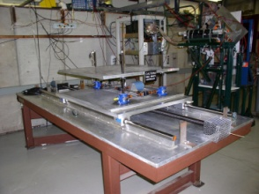
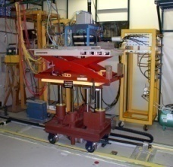
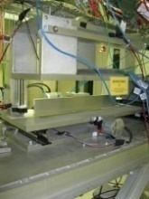
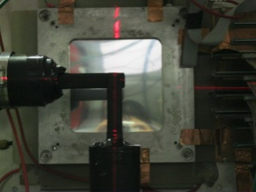
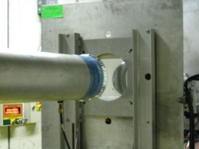
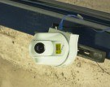
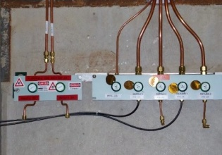
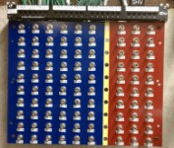
Infrastructure at MTest
ACNET controlled Motion Tables
Laser Alignment
Helium Tubes
Web-based Cameras
Crane Coverage (30 tons)
Climate controlled Huts
Gas Patch panels
Signal, Network, & High Voltage cable patch panels
Notes:
The facility at Mtest offers users remote controlled motion tables, laser alignment, helium tubes to reduce scattering, cameras to observe the enclosure during beam time. We also have a climate controlled hut and a crane for heavy experiments. There are gas, signal, HV and network patch panels all over the enclosure for easy detector hook ups.

Slide 6
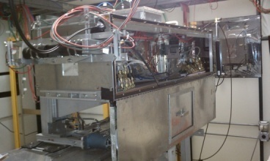
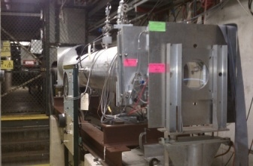
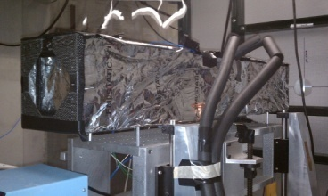
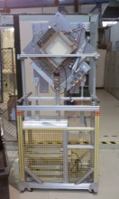
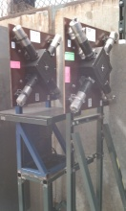
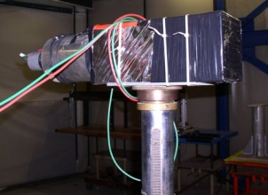
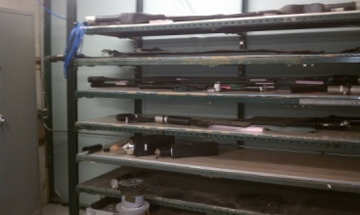
Facility Instrumentation
2 Cerenkov Detectors
2 Pixel Telescopes
4 MWPC Tracking System
Time of Flight System
Lead Glass Calorimeters
Assorted Trigger scintillators
**Possible upgrade over the summer shutdown with more beam instrumentation
Notes:
In addition to the detectors our users bring we offer a variety of auxilary detectors. We have Cerenkov detectors, pixel telescopes, tracking chambers, TOF system, lead glass calorimeters, and trigger paddles. We are looking at upgrading over the summer and putting in a spectrometer to do beam studies with. In addition, we have plans to have a DAQ and uniform data output for all the detectors to make integration with users easier.

Slide 7
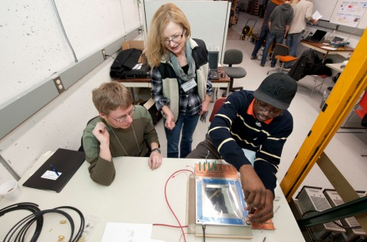
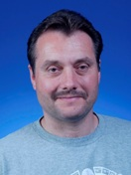
Support Team
Notes:
The facility does what it does because of the great support of all the people working at test beam. Go team!

Slide 8
Beam Information
MTest
Linac
MCenter
8GeV Line
Booster
Main Injector
SY120
P3 Line
Neutrino Line
P2 Line
Beam Available 24 hrs /day
6 sec event (4.2 sec spill) every 60 seconds
Control room manned during beam hours
P1 Line
120 GeV proton beam with 7mm spatial spread, 100 μrad divergence, and tunable rate (100 Hz to 100,000 Hz).
Tunable secondary beams (1- 66 GeV). Beam composition and spread are a function of beam energy
Notes:
The beam is available 24/7 and we get a 4.2 sec spill every 60 seconds. Our primary beam is 120 GeV protons and we have a secondary beam from about 1-66 GeV of protons,pions, kaons, electrons, and muons, with composition depending on energy

Slide 9
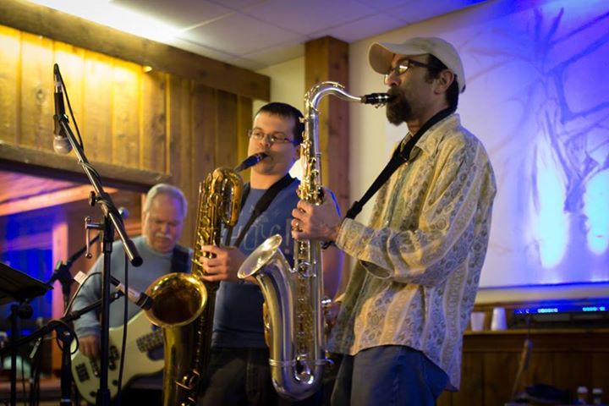
Great group of support from AD
Working with AD personnel to make improvements over the summer shutdown. (Tom Kobilarcik, Michael Backfish and Adam Watts)
Notes:
We have a great team of people working with our beamline in AD. As you can see, they are a lot of fun. Over the summer shutdown, we’ll work together to discuss any upgrades we can do to the beamlines and other work to characterize the beam as it gets to Mtest and Mcenter.

Slide 10
User Statistics
T1064 STAR Forward Calorimeter System
T1065 Secondary Emitters Study for Shower Maximum
T992 Radiation-hard Sensors for the SLHC
T979 Fast Timing Counters for PSEC
T977 MINERvA (A1)
T1059 Optical Time-Projection Chamber
T1058 Secondary Emission Calorimeter
T1043 Mu2e CRV Scintillation Counters
T1042 Muon g-2 straw tracker
T1041CMS Forward Calorimetry
T1034 LArIAT: Liquid Argon TPC In A Test beam
T1018 Spacordion Tungsten Fiber Calorimeter
T1015 DRO Calorimetry ently for FY15
T994 JASMIN
Notes:
Moving on to who uses the test beam. This year we’ve had 14 different groups come in, with 2 HS groups yet to come. They are split up among LHC and muon/neutrino users and from all different countries. Groups come in to test a new concept, or decide on which technology/configuration to use, or just characterize the behavior of their detectors in a known beam.

Slide 11
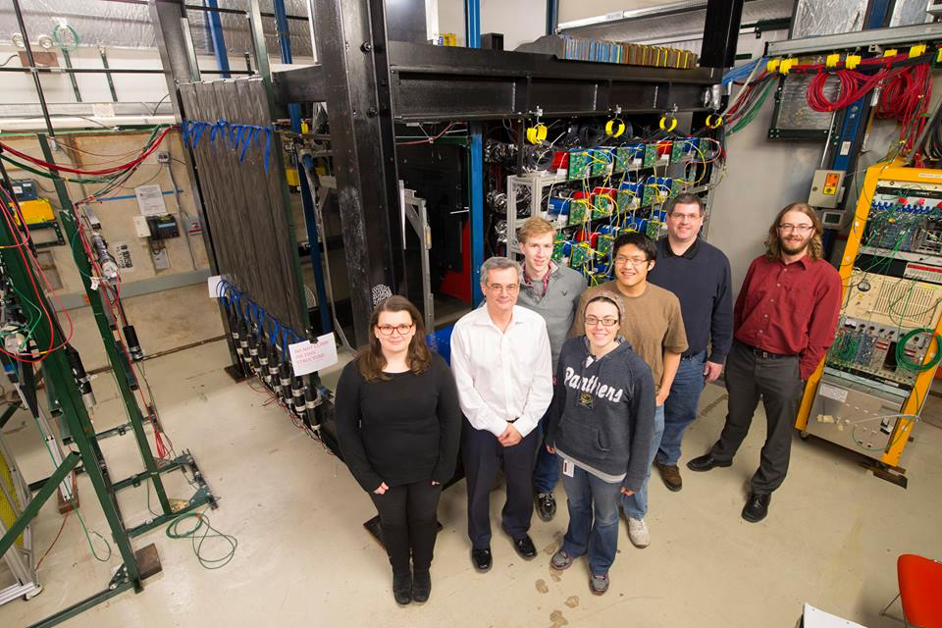
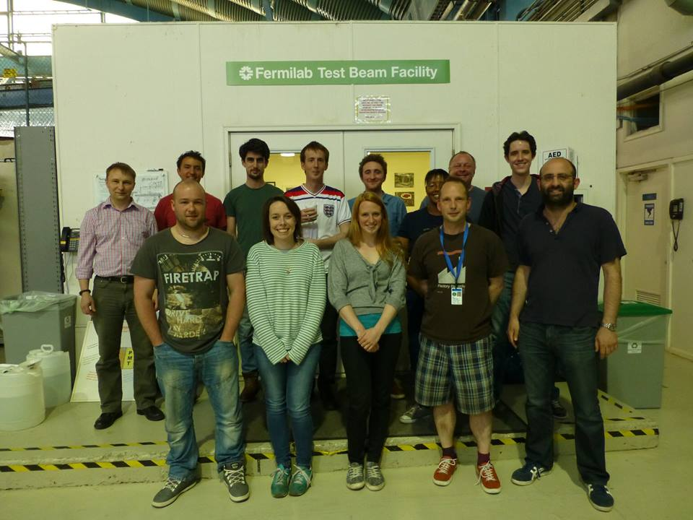
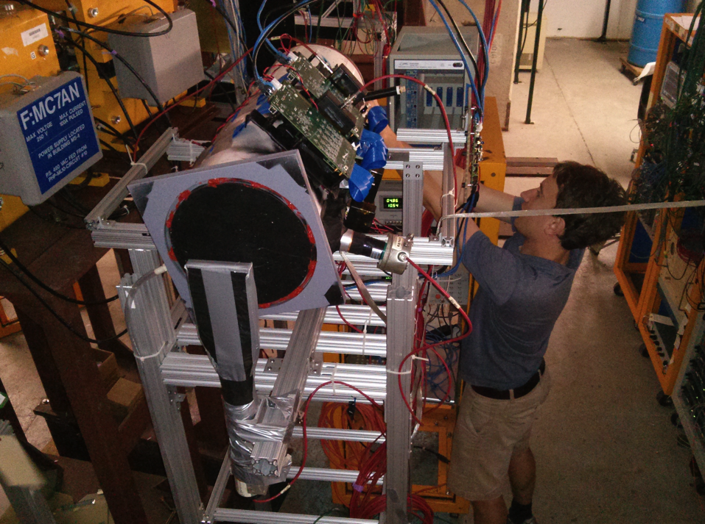
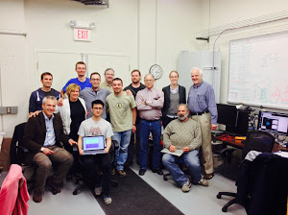
Users
g-2 Team
Minerva Detector and Team
T1059 Team
Lariat Team

Slide 12
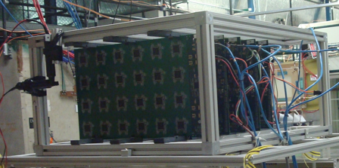
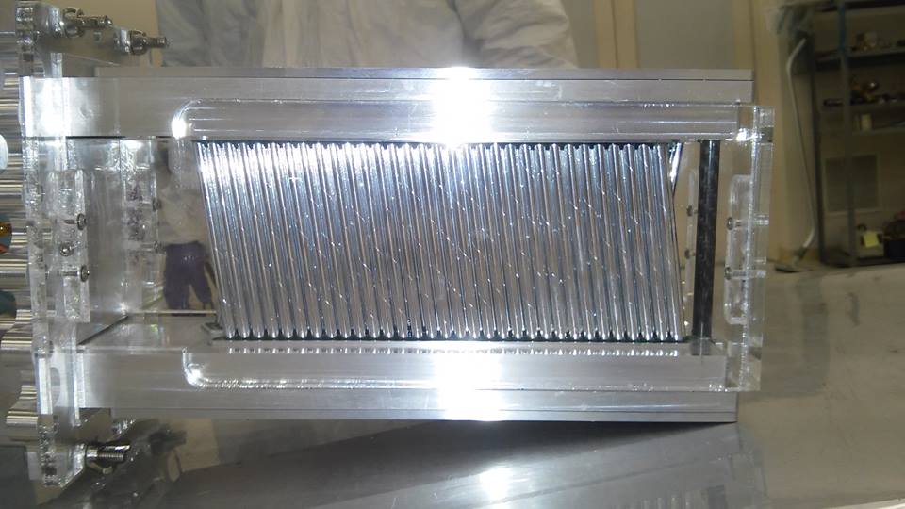
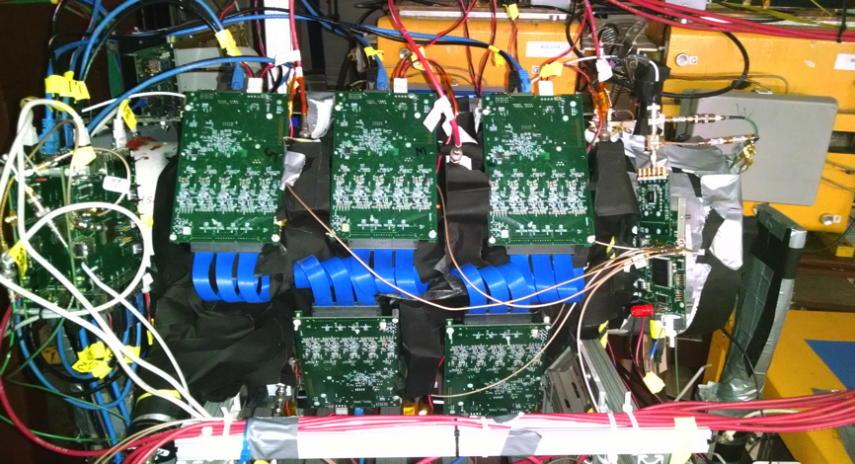
Detectors
g-2 straw prototype
Calorimeter prototype for CMS
Mu2e Cosmic Ray Veto Counter

Slide 13
Going Forward
The Testbeam program is reviewed by an external committee
Currently implementing some recommendations from the most recent review (Safety recommendations, facility upgrades)
Improving instrumentation and DAQ capabilities at the Test Beam
Beam studies
Instrument beamline and have information displayed for tracking the beam, the beam energy and the composition of the beam.
Still have a few users left until the shutdown!
Including Quarknet group

Slide 14
Become a User!
Now taking requests for beam time (FY16): https://docs.google.com/forms/d/1mKLy12EWH6jyc25INKvfVYRlGGoqsGNjJ8kFGcOe8i0/viewform?usp=send_form
Also follow this link for more information:
http://ppd.fnal.gov/ftbf/BeAUser/Page1.html

