Slide 1
Analysis of APAs for the dynamic LCs.
CERN
May 2021

Slide 2
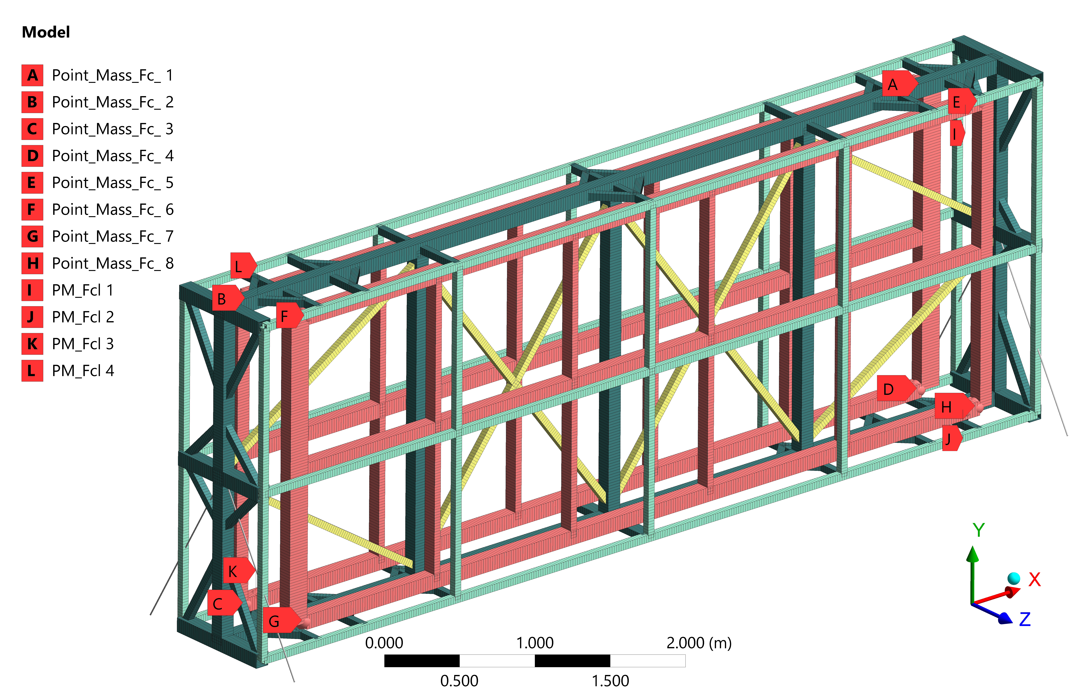
Modelling Approach for ASF dynamic analyses
Global model including APAs, ASF, base structure and WRAs
Nonlinear Model of WRAs stiffness and Accounting for damping
Detailed and/or Nonlinear analyses using code related input data (shock impulse, acceleration PSD)
Output at APA support points can be used for analyses of detailed APA model

Slide 3
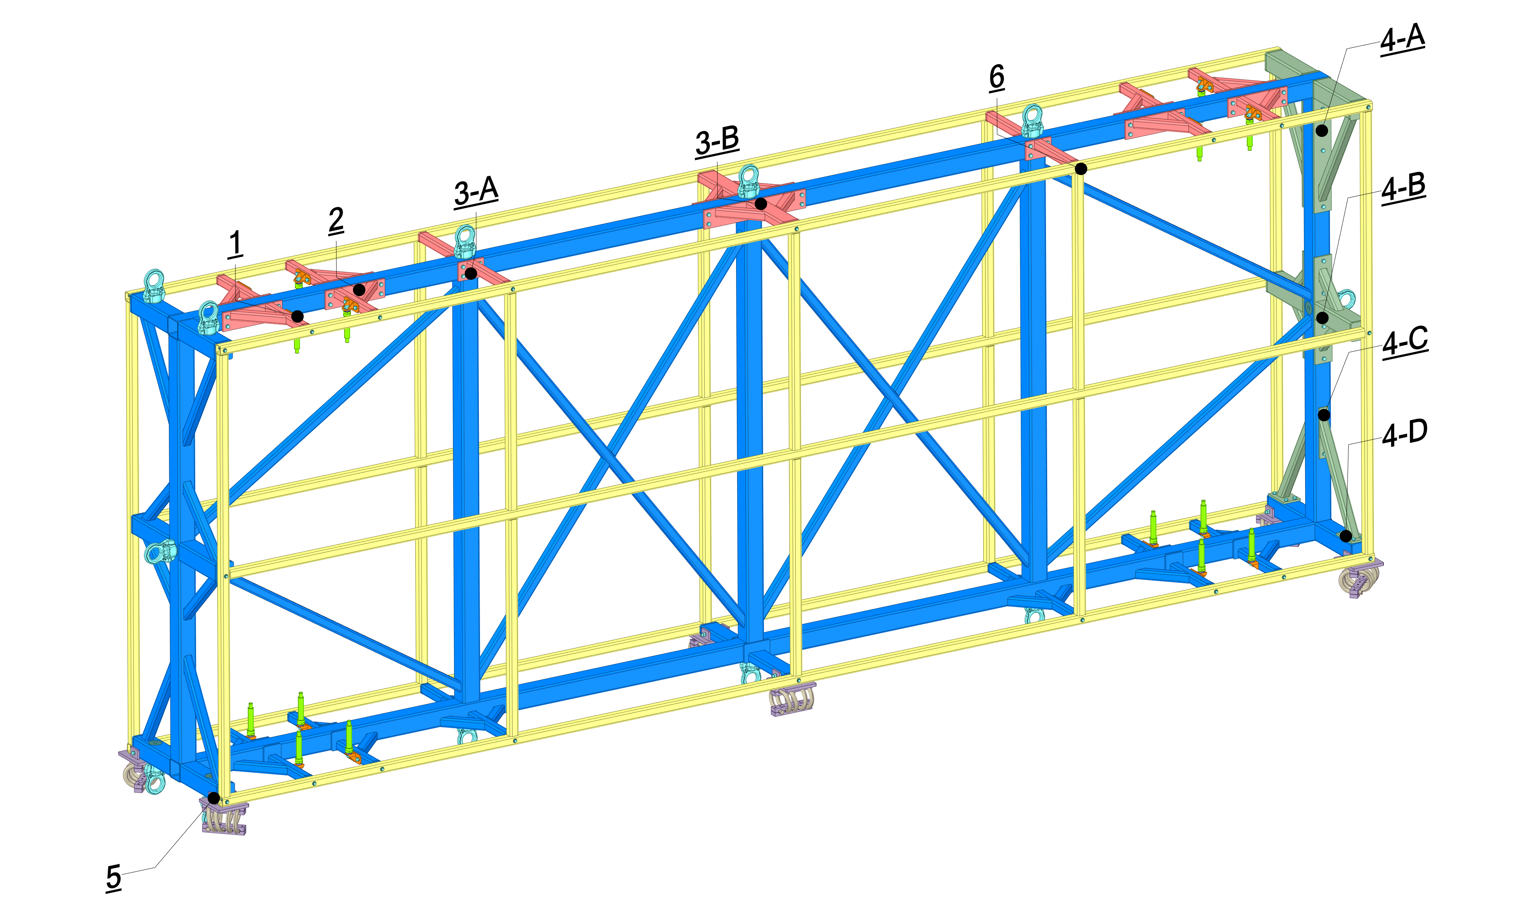
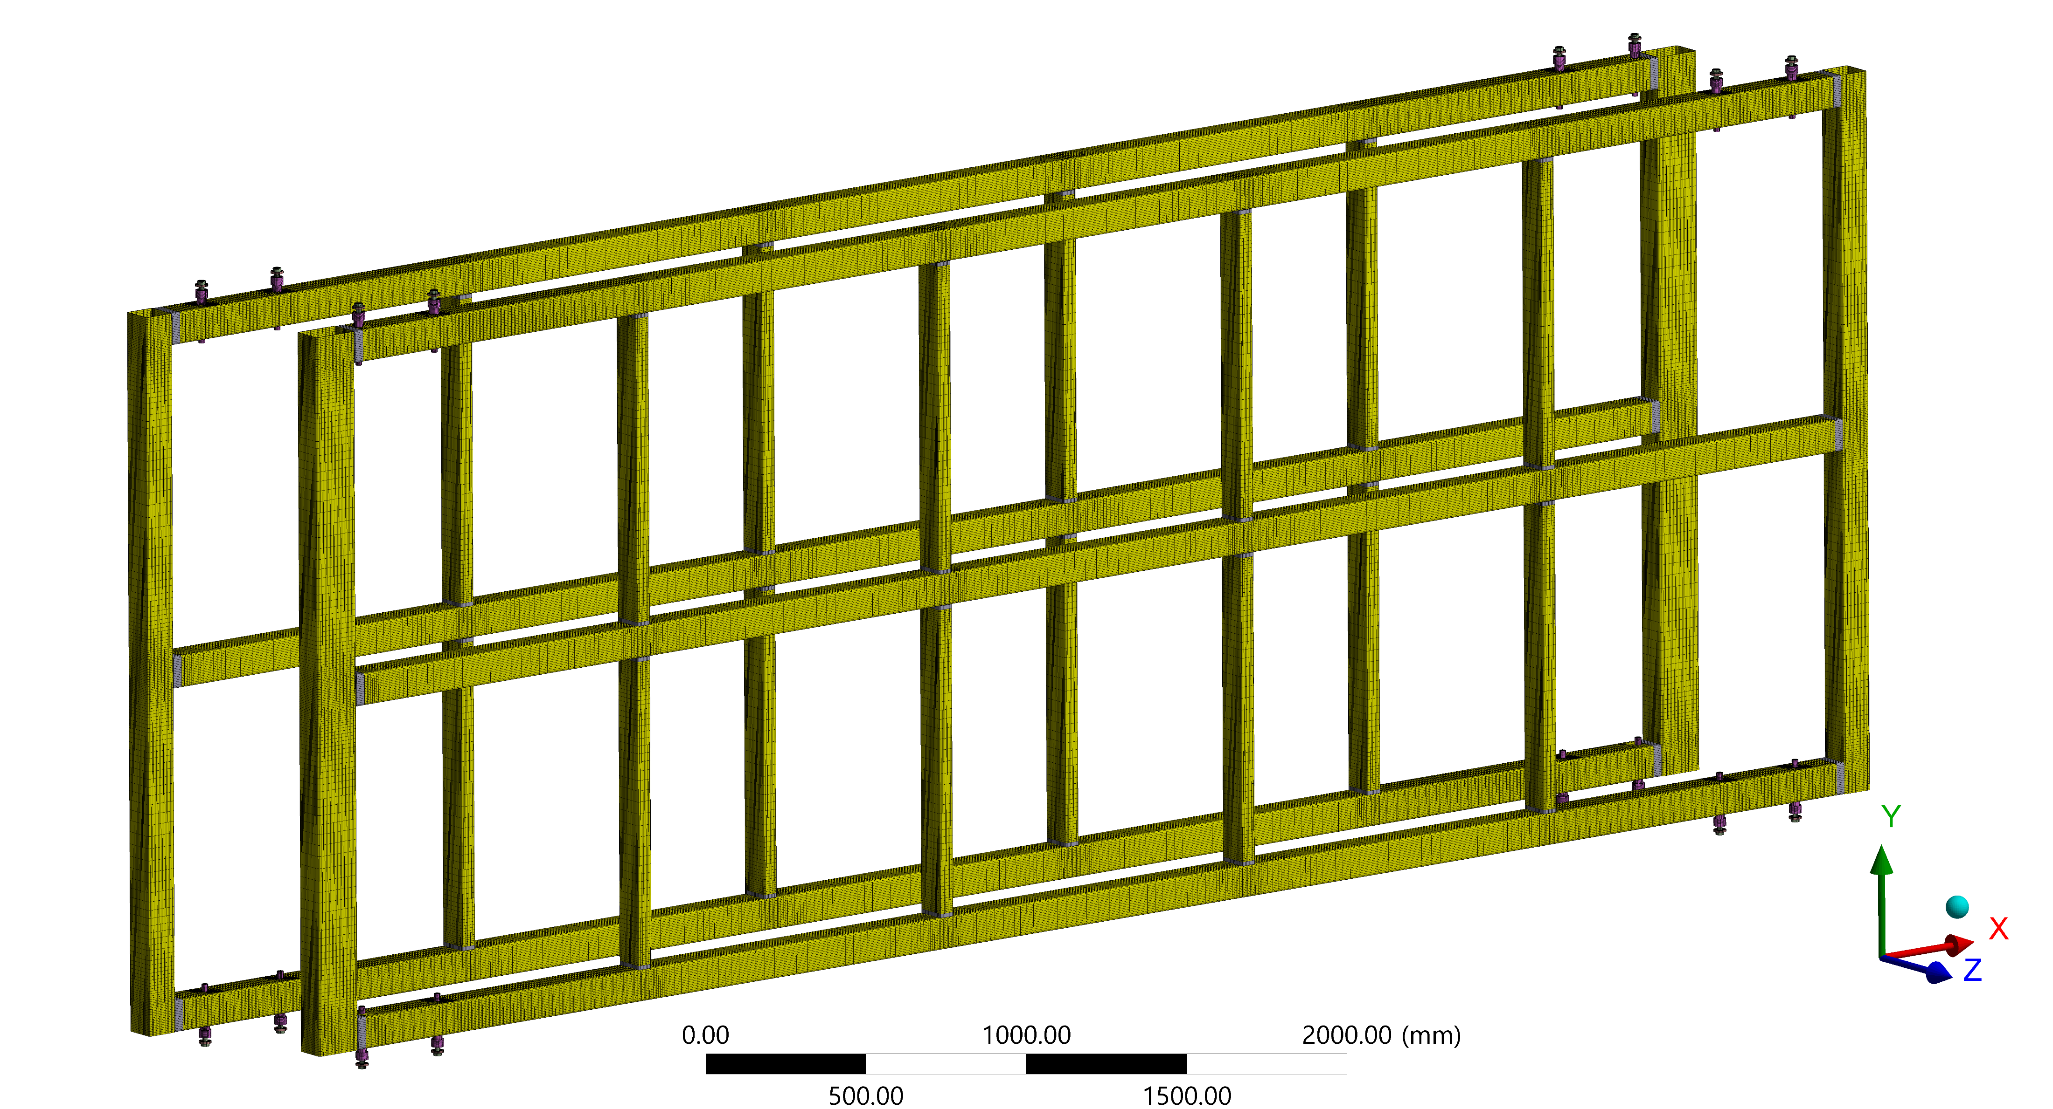
Modelling Approach for APA dynamic analyses
Detailed model of APAs
Analysis methods adjusted to the complexity of the model for e.g., Response spectrum instead of Transient for Shock.
The APAs input loads (extracted from global model) are accounting for the WRAs damping effects.
Global model | APA model
 | Analysis type | Loading
Quasi-static | Quasi-static | Displ. + Acceleration
Random Vibrations | Random Vibrations | Response PSD (Couplers)
Harmonic response | Harmonic response | Sinusoidal excitation
Transient | Response spectrum | Response function

Slide 4
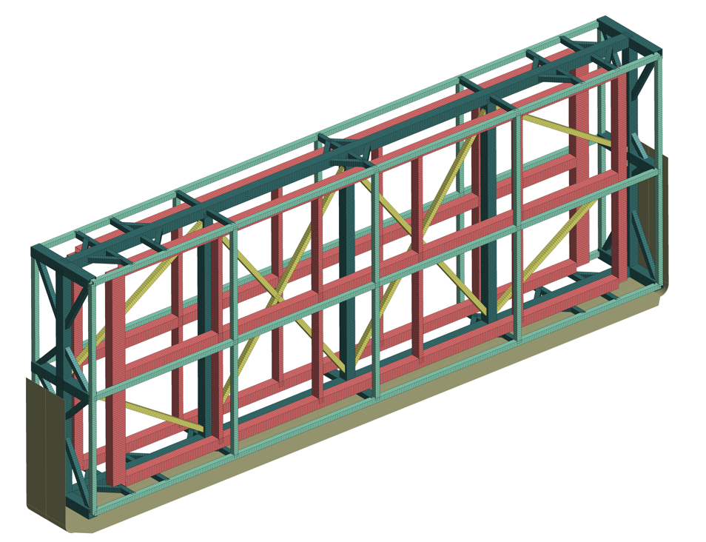
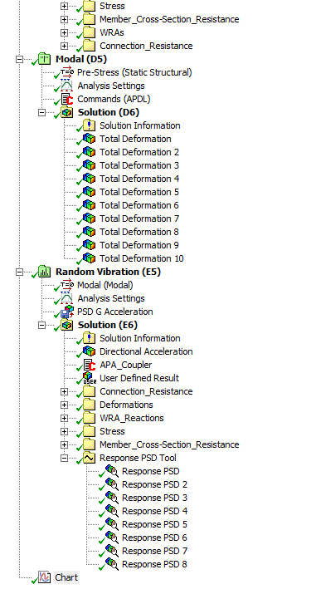
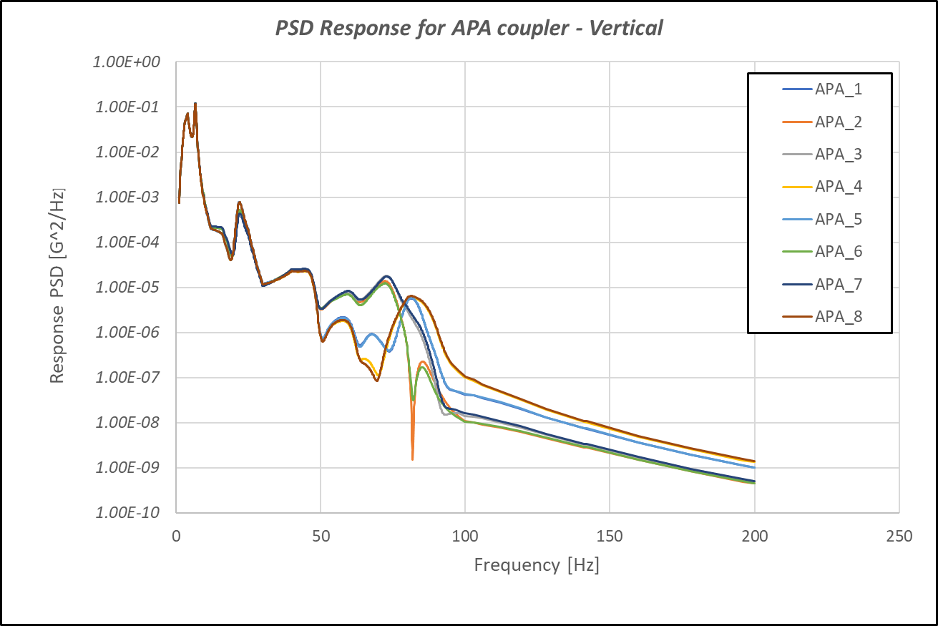
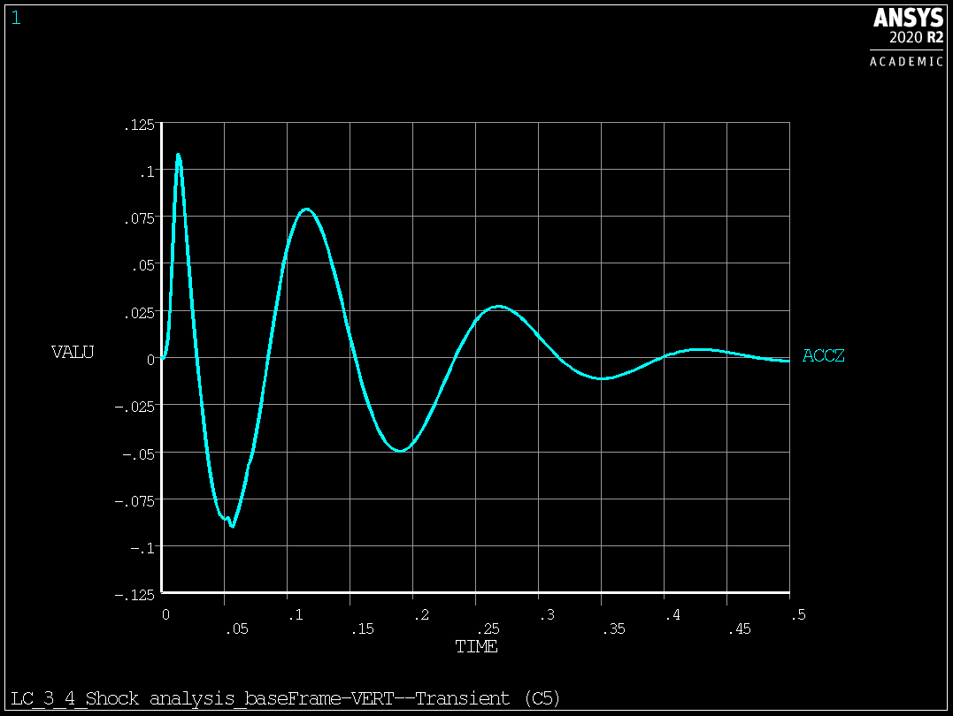
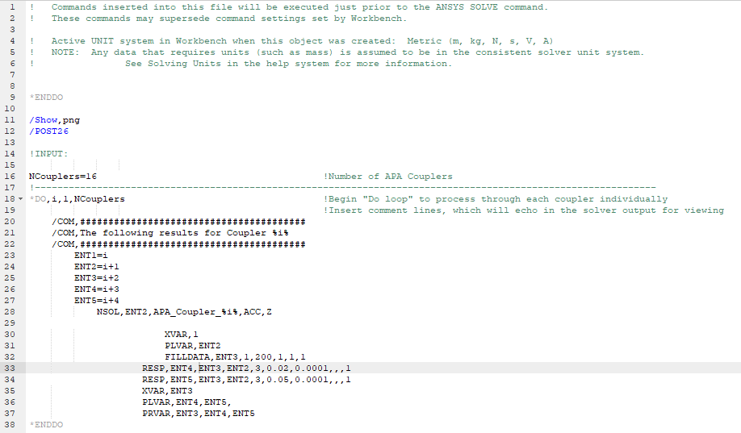
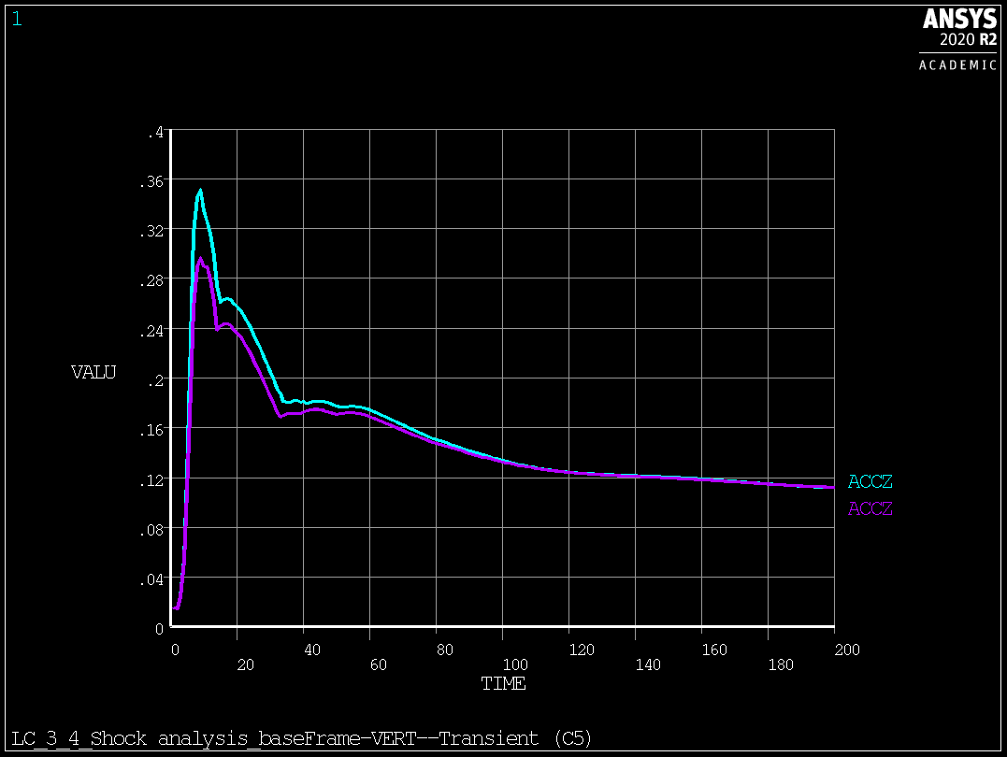
Random vibration to Random vibration
Transient to Response spectrum

Slide 5
Next steps
Excel file with loading within 2 working days
We believe that you go ahead with the model preparation
In case of any question, do not hesitate to contact us (always happy to help)
Note, that our findings are conservative and in case of any issues, do not hesitate to come back to us

