Slide 1
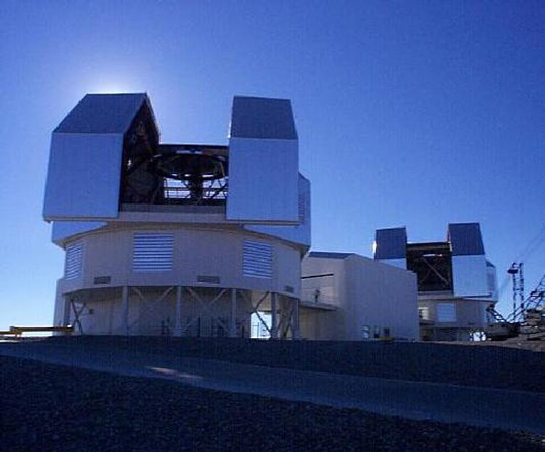
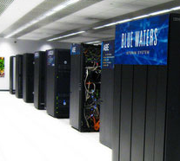
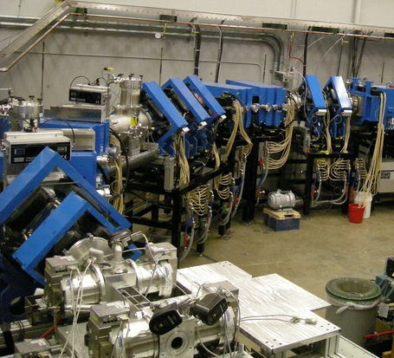

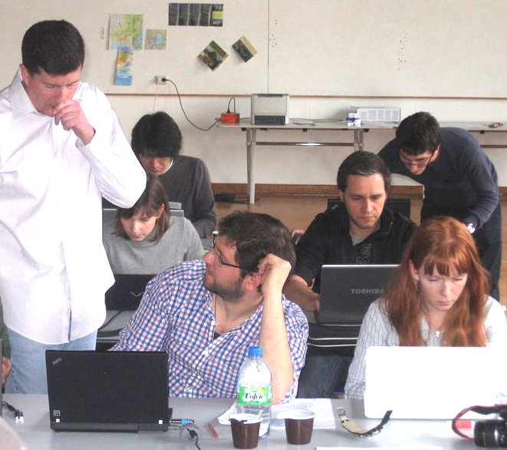

The Joint Institute for Nuclear Astrophysics
Center for the Evolution of the Elements – jinaweb.org
Collaborative network:
  Origin of the elements
  Neutron stars
Website: jinaweb.org
Schools, Workshops, Conferences,
online courses coming
65 Senior Investigators, 22 Institutions,
6 Countries
Astronomy
Computing
Nuclear Experiment
Theory
Education
and Outreach
JINA-CEE Virtual Journal
On jinaweb.org

Slide 2
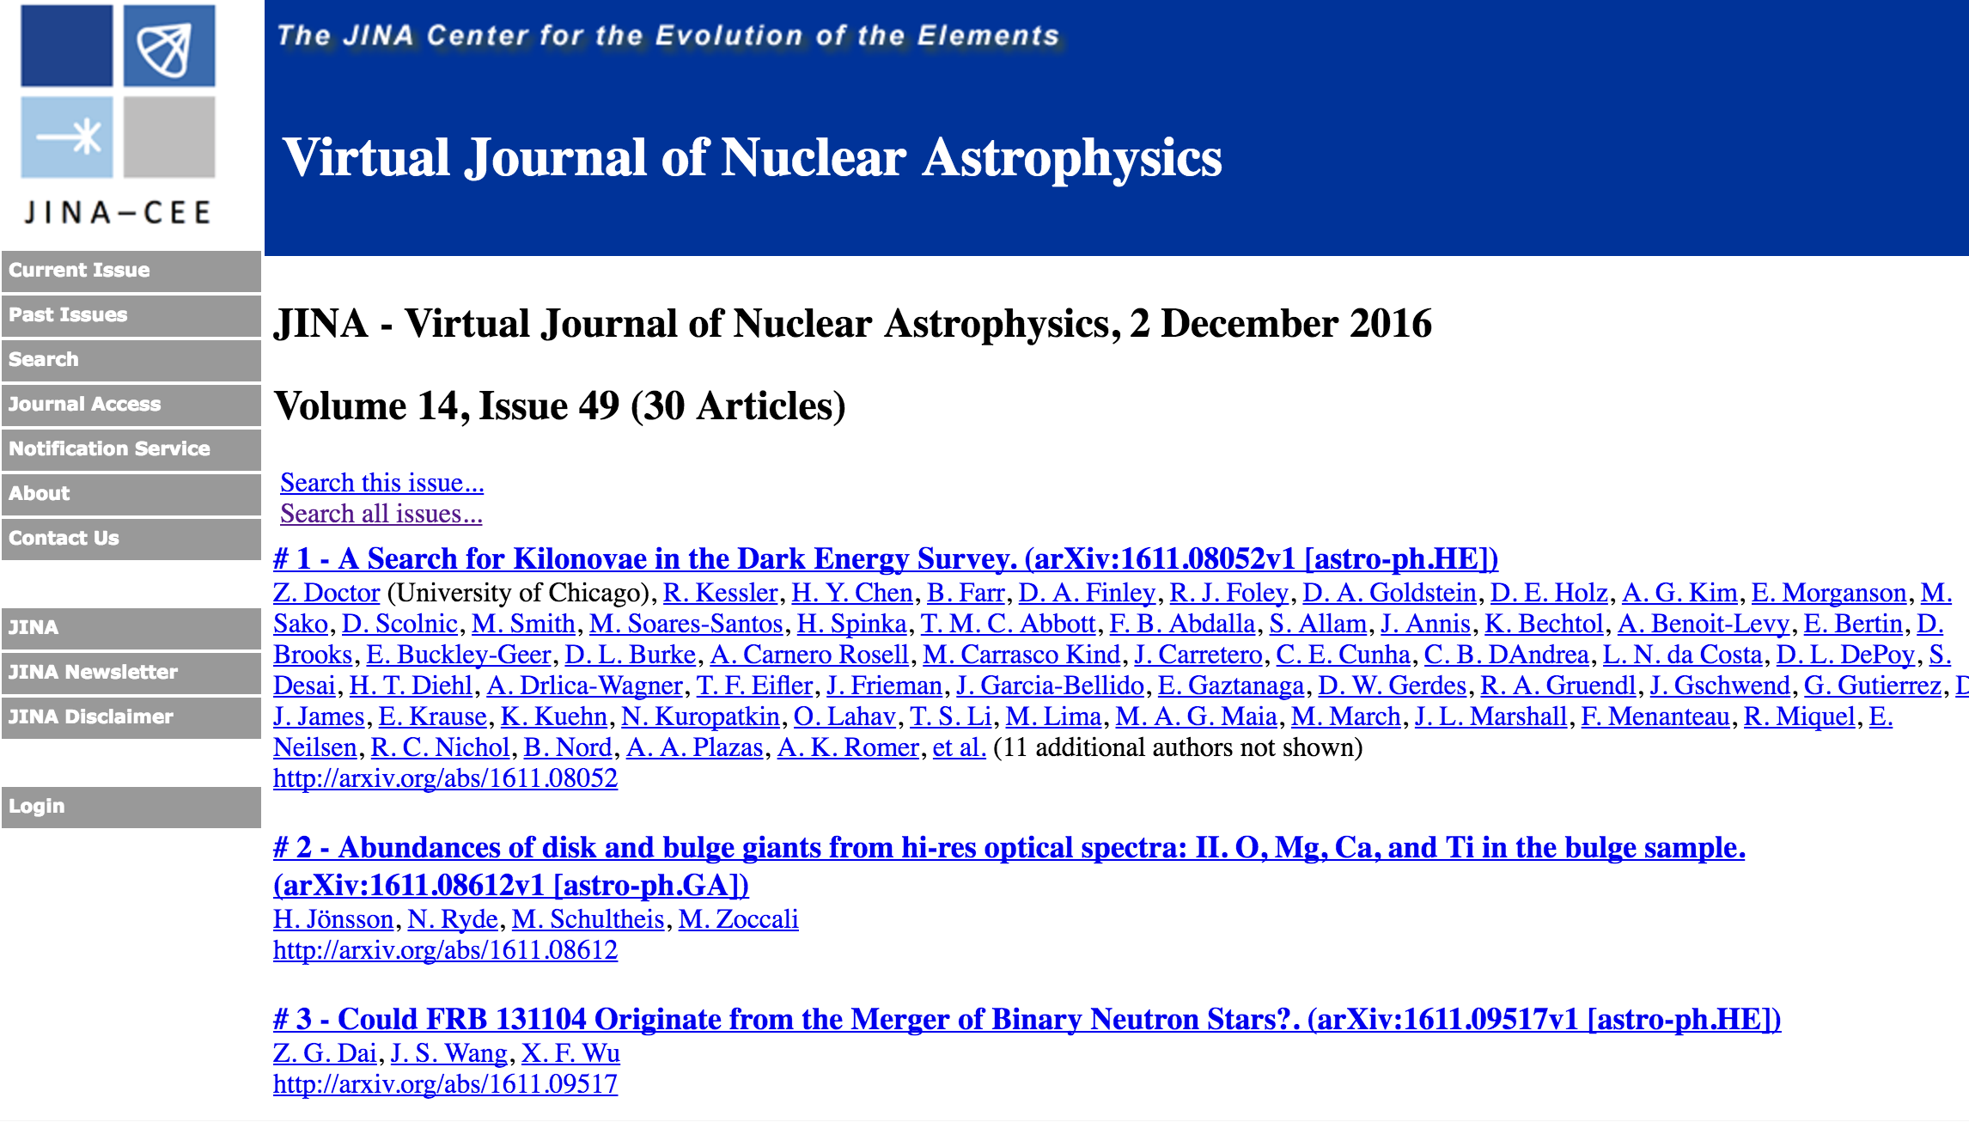
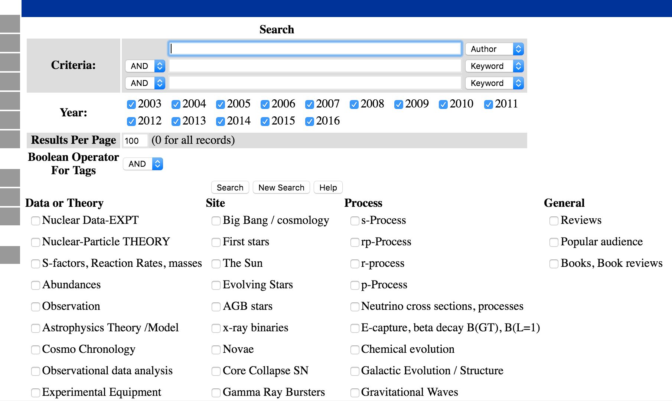
JINA-CEE Virtual Journal of Nuclear Astrophysics

Slide 3
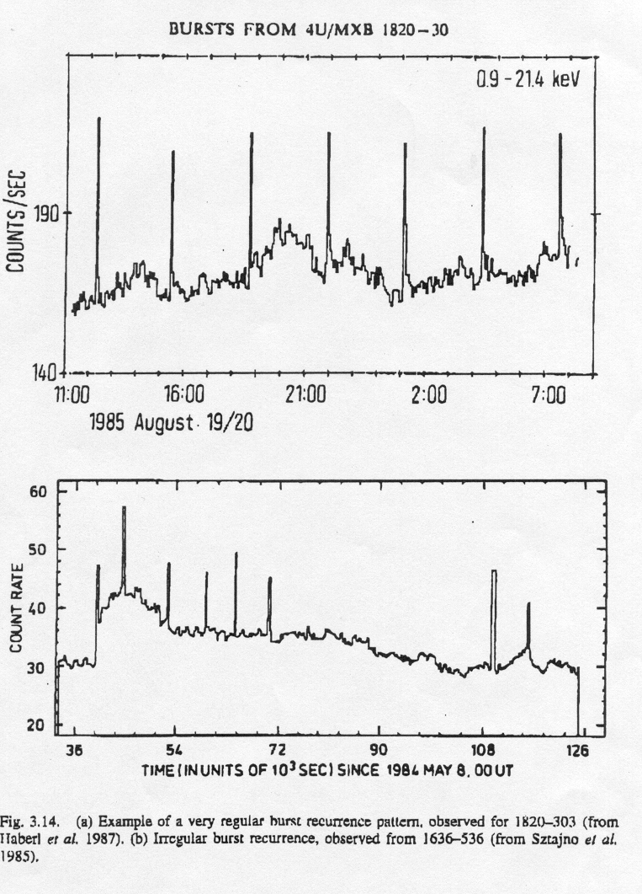
X-ray Burst characteristics
Typical X-ray bursts:
10³⁶-10³⁸ erg/s
duration 10 s – 100s
recurrence: hours-days
~100 sources
Frequent and very bright
phenomenon !
(stars 10³³-10³⁵ erg/s)

Slide 4
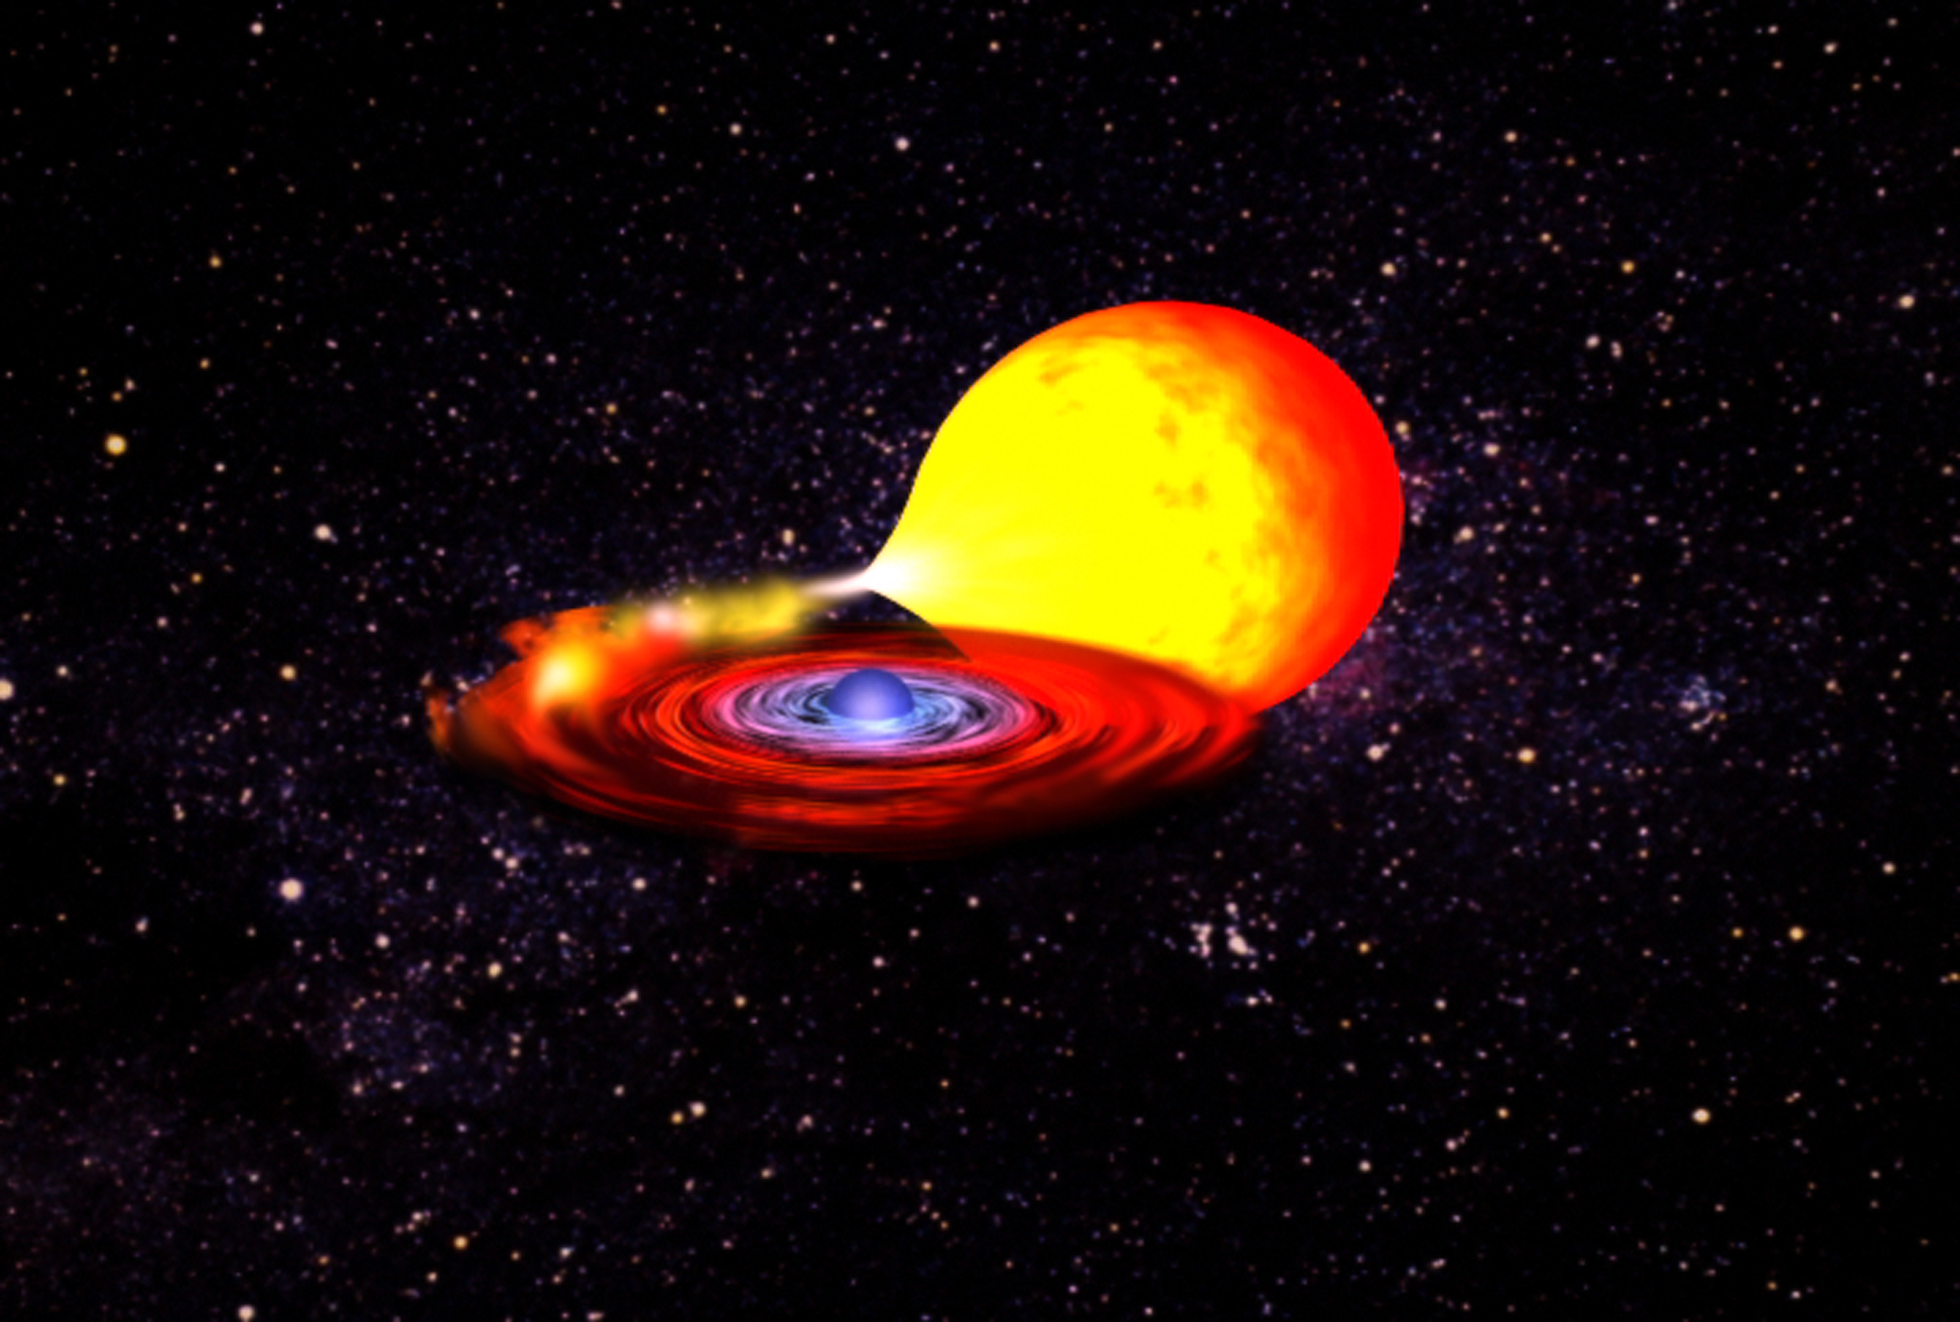
Accreting neutron stars

Slide 5
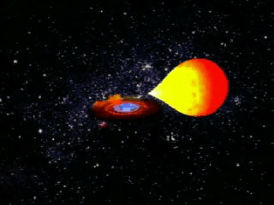
Accreting neutron stars

Slide 6
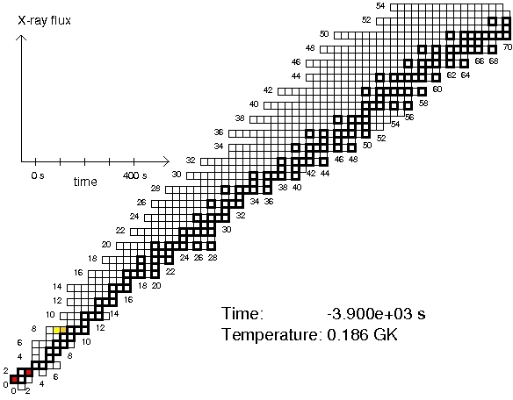
Deepest zone of first burst (model zM of Woosley et al. 2007)
Model by Heger, Woosley et al.;

Slide 7
Burst Ignition:
71s
122s
What reaction types?
Prior to ignition : hot CNO cycle
~0.20 GK Ignition : 3α
: Hot CNO cycle II
~ 0.68 GK breakout 1: ¹⁵O(α,γ)
~0.77 GK breakout 2: ¹⁸Ne(α,p)
(~50 ms after breakout 1)
Leads to rp process and
main energy production
Notes:
Why o14(a,p)… more important as breakout ?
PLUS: ask here for possible endpoints

Slide 8
Burst Ignition:
rp-process
αp-process
Prior to ignition : hot CNO cycle
~0.77 GK breakout 2: ¹⁸Ne(α,p)
: Hot CNO cycle II
(~50 ms after breakout 1)
Leads to rp process and
main energy production
~0.77 GK breakout 2: ¹⁸Ne(α,p)
(~50 ms after breakout 1)
Leads to rp process and
main energy production
Notes:
Why o14(a,p)… more important as breakout ?
PLUS: ask here for possible endpoints

Slide 9
Intermission
What makes the rp-process end?

Slide 10
The endpoint of the rp-process
Possibilities:
Cycling (reactions that go back to lighter nuclei)
Coulomb barrier
Runs out of fuel
Fast cooling
Proton capture lifetime of nuclei near the drip line
Event
timescale
Notes:
Not in handout !!!

Slide 11

Endpoint: Limiting factor I – SnSbTe Cycle
The Sn-Sb-Te cycle
Known ground state
α emitter
(Schatz et al. PRL 86(2001)3471)
Collaborators:
L. Bildsten (UCSB)
A. Cumming (UCSC)
M. Ouellette (MSU)
T. Rauscher (Basel)
F.-K. Thielemann (Basel)
M. Wiescher (Notre Dame)

Slide 12
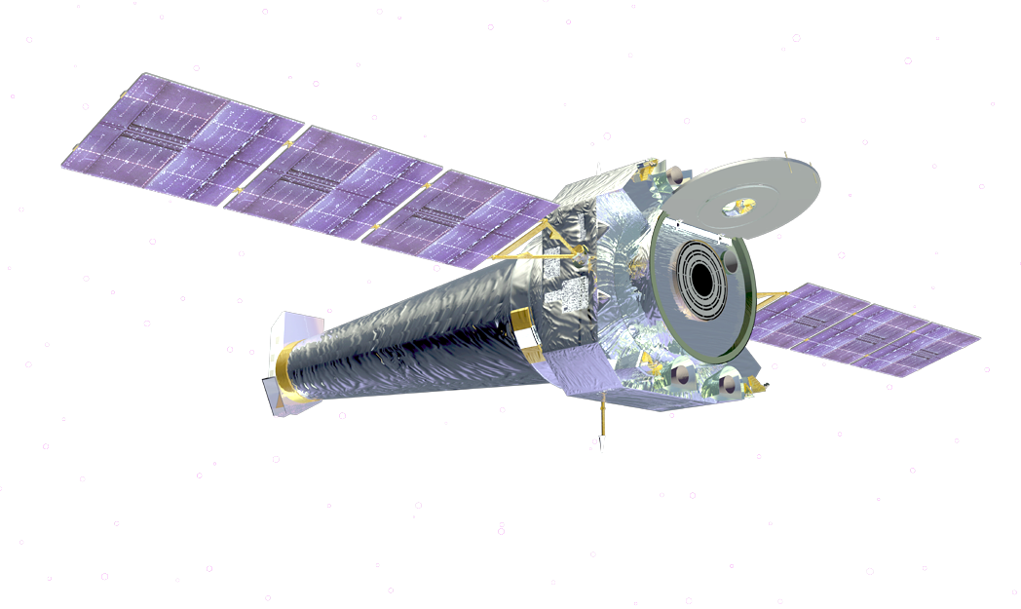
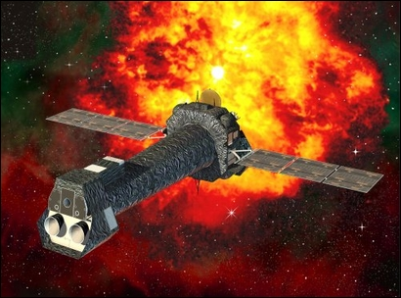
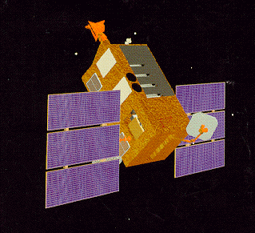
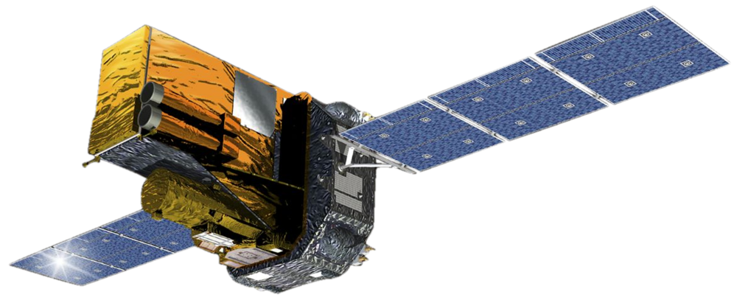
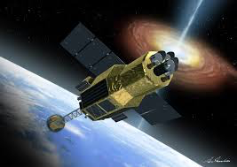
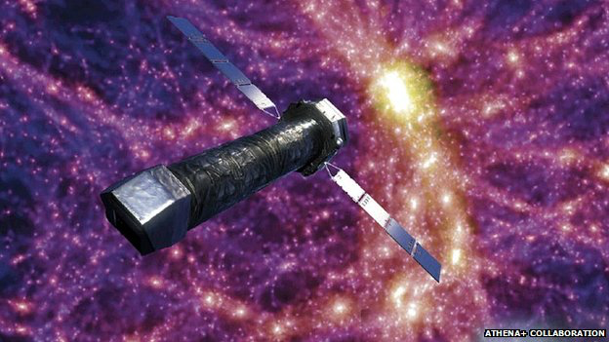
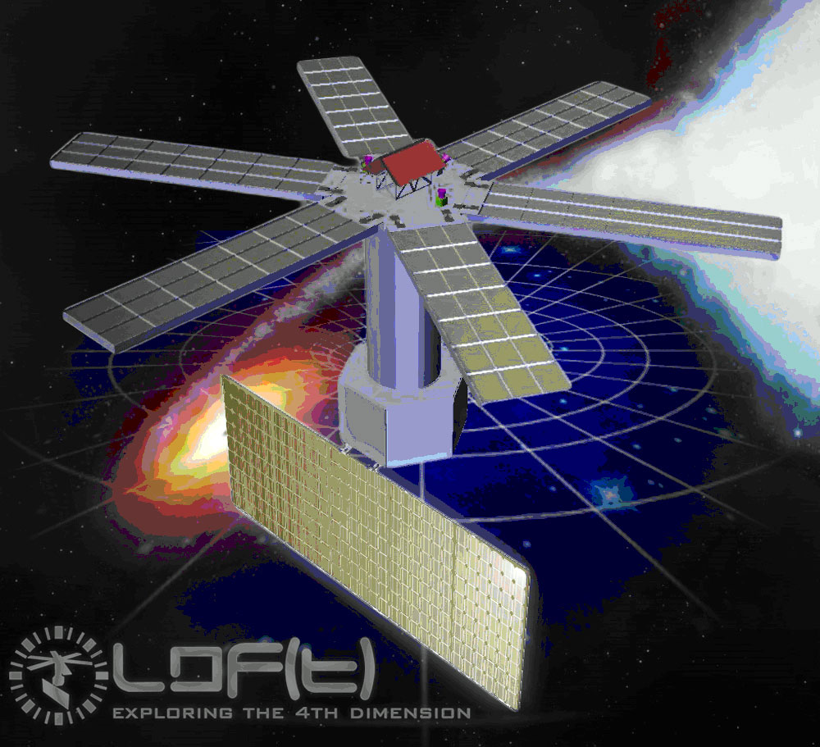
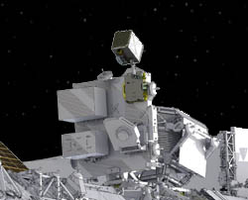

Golden Age for X-ray Astronomy ?
Chandra
RXTE
INTEGRAL, SWIFT
XMM Newton
ATHENA
ASTRO-H
RXTE
XMM
LOFT
NICER, MAXI
ASTROSAT
Notes:
MAXI: all sky monitor, finds rarer types of bursts

Slide 13
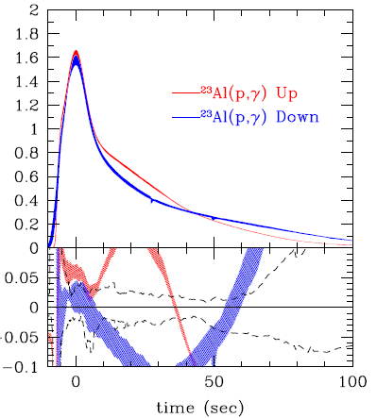
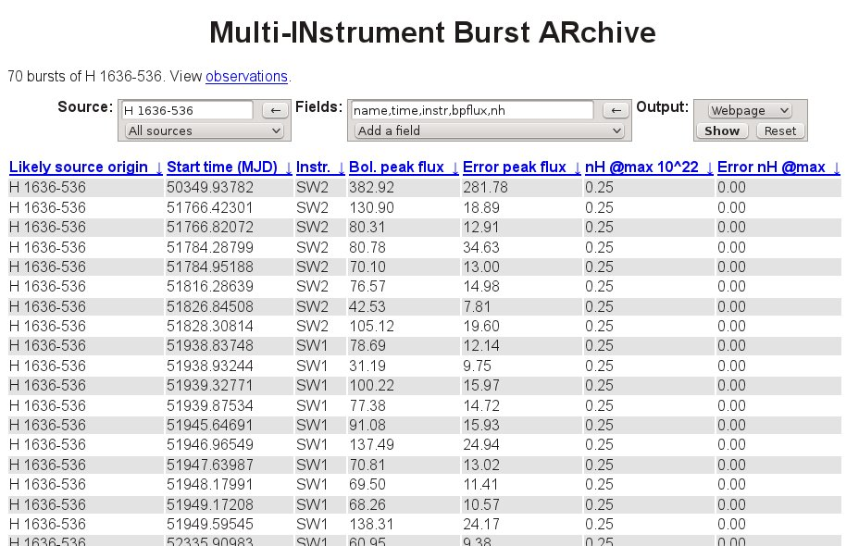
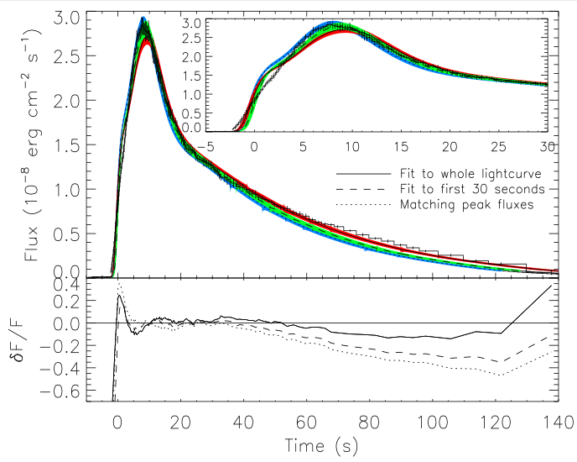
Interpretation of X-ray Burst Observations
Major progress in observations
MINBAR archive ~5000 widely varying bursts
Lightcurves depend on nuclear data
Amthor, Cyburt, Keek et al. 2012
Galloway
GS 1826-24
Example Template Analysis:
Determine surface redshift
Neutron star compactness
Also: brightness, distance,
accretion rate, accreted comp.
Redshift
variation
Data
Zamfir et al. 2012
Notes:
(1+z) blue: 1.26 best fit to peak
But redshift also stretches in time – additional constraint
Red: 1.44 (best fit to entire curve) and Green: 1.32 (best fit to first 30s)

Slide 14
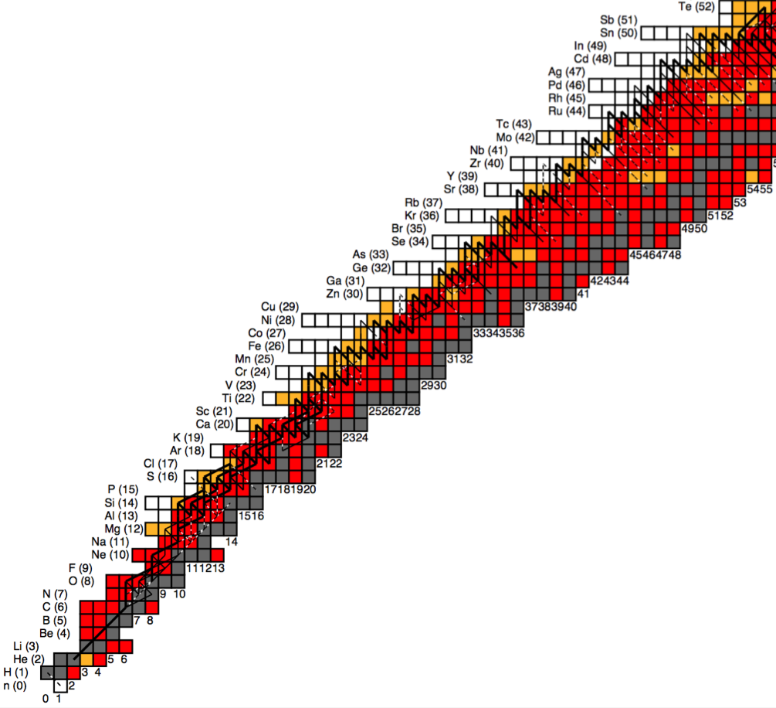
Exp. Nuclear Physics Status
Half-lives known
(except thermally excited states,
some β-p branchings?)
Most masses known
Reaction rates are a challenge
Penning Traps:
ISOLTRAP, LEBIT, JYFLTRAP
Masses beyond the drip line
β-delayed p-emission, NSCL
Breakup with p-emission, NSCL
CSR Lanzhou
RIB Indirect (p,dγ), (d,n) GRETINA NSCL
RIB Indirect
Coul. Dis. (RIKEN, GSI)
RIB indirect
(d,n) FSU
Direct (p,γ):
(TRIUMF, ORNL,FRIB SECAR)
Mass known <10 keV
Mass known <100 keV
RIB direct (α,p)
(ANL HELIOS,
CRIB TPC,NSCL JENSA,
NSCL AT-TPC,
NSCL/FSU ANASEN)
Nuclear Theory
Half-life modifications (modest)
(recent: Sarriguren 2016, Nabi 2016)
Shell model rates
→ need to push past A~60
(recent ⁶⁵As(p,γ) Lam 2015)
Reaction theory to interpret
(d,n) and Coulomb Breakup data
Stable:
(p,t), (⁴He,⁶He), (³He,t)
(Yale, RCNP, iThemba,
TUM, FSU, TUNL Spectr.)
RIB Indirect (p,p)
(ORNL, CRIB,
NSCL ANASEN)
Stable: (ANL)
fusion-evaporation-γ
Stable:
(³He,n) ND

Slide 15
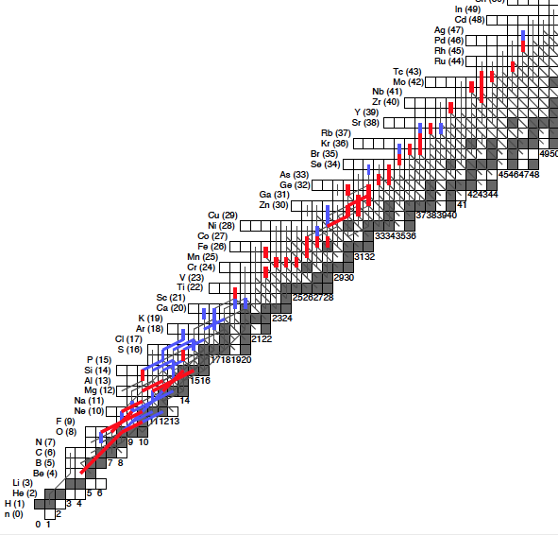
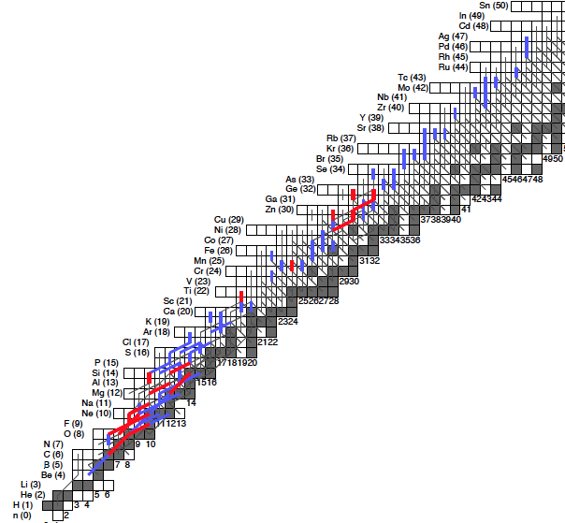
X-ray Burst Sensitivity to Nuclear Reactions
Full 1D model close to GS 1826­24
Sensitivity through 1-by-1 variation
Varied 1931 rates in single zone model
→ ID 84 key rates
Varied 84 rates in full 1D Model
- sequence of ~12 bursts
- variation inspired by possible uncertainty
Composition Impact
Lightcurve Impact
No significant impact
(Impact limited to single zone model)
Significant impact
Identified reaction uncertainties
that may affect:
Light curve (19 reactions)
Composition (47 reactions)
Cyburt, Heger, et al. 2016
For masses see Schatz & Ong 2016 arXiv:1610.07596
Notes:
Never had the ressources for this without JINA-CEE – its truly intersectional work that would fall through the cracks

Slide 16
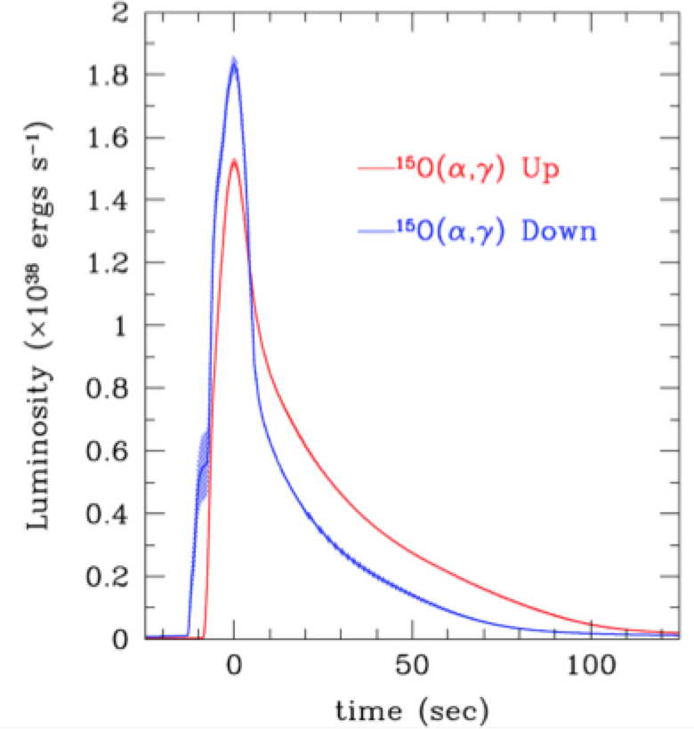
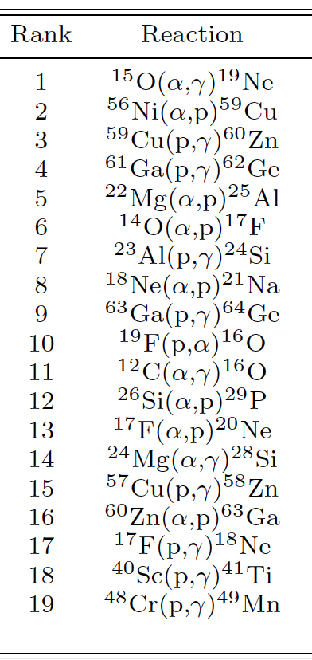
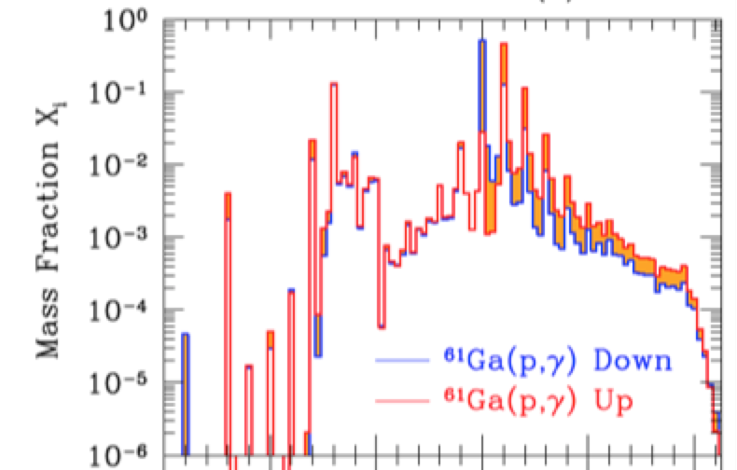

X-ray Burst Sensitivity to Nuclear Reactions
Results differ from previous studies
  Post-processing studies do not take energy
  generation into account (Hu 2014, Parikh 2008)
  Different bursts (Parikh 2008)
  Genuine model differences for ¹⁵O(α,γ) Fisker 2008
Parikh et a. 2008: correlations not critical

Slide 17
Why are some rates more important than others?
Slow reactions → extend energy generation
→ abundance accumulation
(steady flow approximation λY=const
or Y ~ 1/λ)
Critical “waiting points” can be easily identified in abundance movie
Decide between different waiting points
Cycles
Branchings

Slide 18
⁵⁷Cu + p → ⁵⁸ Zn Reaction
⁵⁸Zn energy level structure
determines resonant reaction rate
Question: where
are these levels?
2⁺
2⁺
2⁺
4⁺
⁵⁷Cu+p
2⁺
0⁺
⁵⁸Zn

Slide 19
Astrophysical Reaction Rate
Rate of reaction per s and cm³
<σv>
example: in terms
of energy axis
E=1/2 m v²
Max
velocity
corresponds
To E=kT

Slide 20
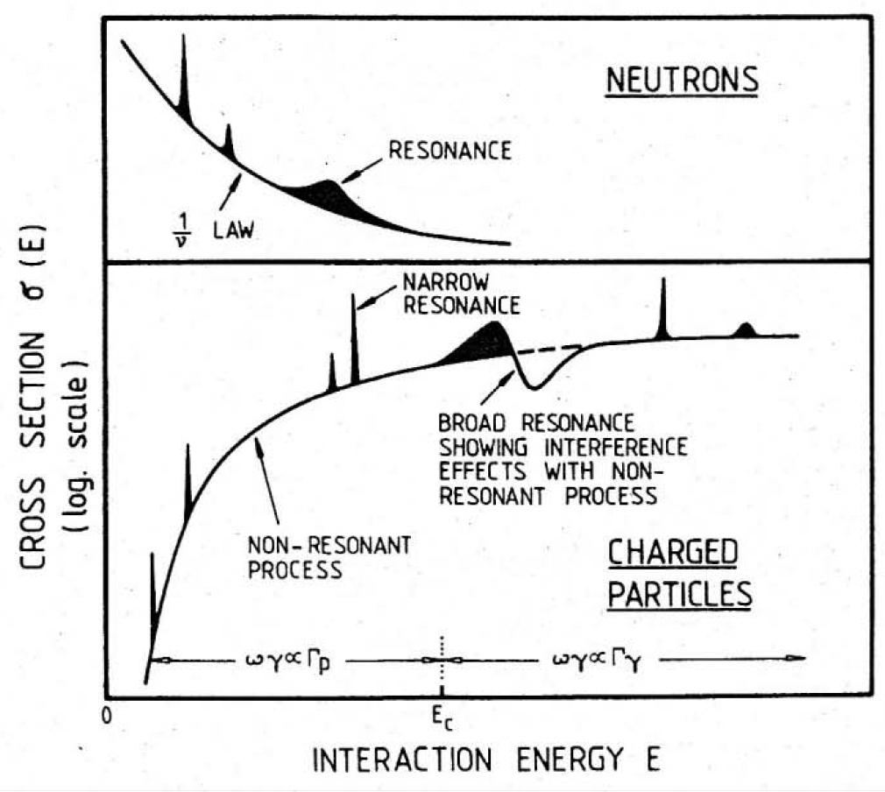
σ(E)

Slide 21
Then one can carry out the integration analytically and finds:
For the contribution of a single narrow resonance to the stellar reaction rate:
III.68
The rate is entirely determined by the “resonance strength”
III.68a
Which in turn depends mainly on the total and partial widths of the resonance at
resonance energies.
→ A measurement of E_{r}, J_{r}, Γ_{p}(E_{r}), Γ_{γ} completely defines rate
→ A measurement of E_{r}, J_{r}, Γ_{p}, Γ_{g} completely defines rate
Exponential dependence!

Slide 22
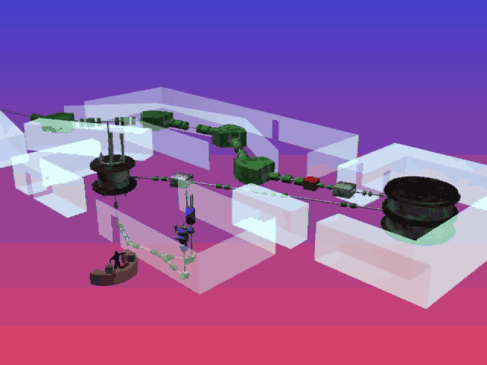

Slide 23
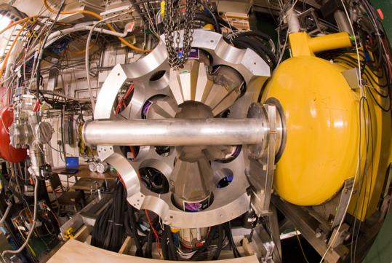
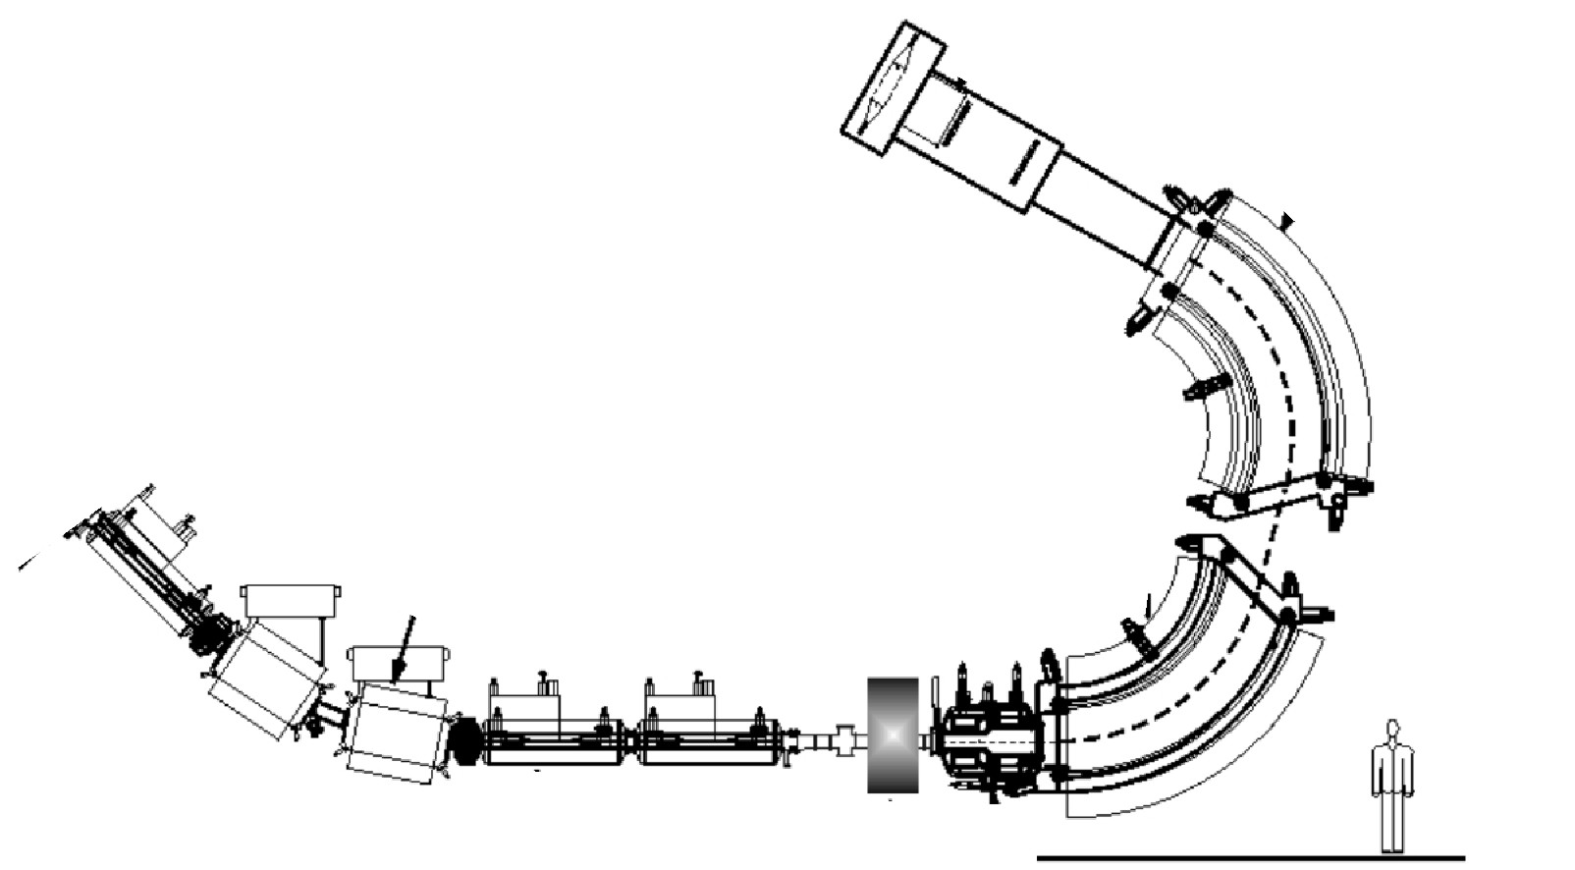
First experiment with GRETINA γ-array at MSU
Christoph Langer
Fernando Montes
Focal plane:
identify ⁵⁸Zn
Beam
blocker
⁵⁸Zn
GRETINA
⁵⁷Cu
GRETINA
Radioactive ⁵⁷Cu beam
3x10⁴ pps
75 MeV/u
Deuterated plastic target (225 mg/cm²)
⁵⁷Cu + d → ⁵⁸Zn + n
Notes:
28 Crystals, 36 segments each, 7.2% efficiency, 40% peak to total
2% energy resolution, 4.5% inflight efficiency at 1.4 MeV (SEGA: 2.5% and 2%)

Slide 24
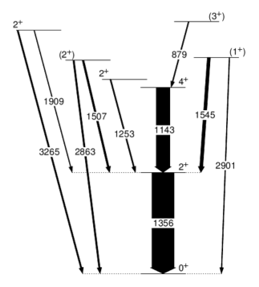
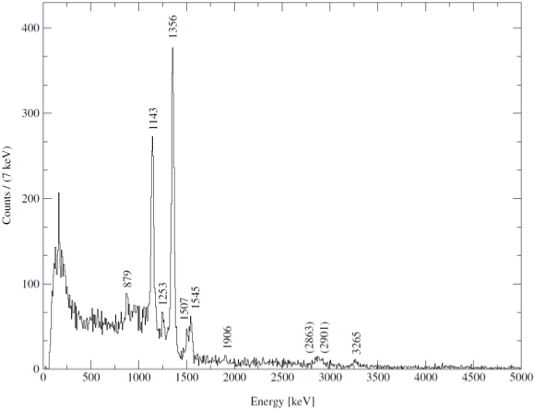
Results
Deduced levels
Measured γ-ray spectrum
24⁺
23⁺
22⁺
⁵⁷Cu+p
Counts/(7keV)
23⁺
24⁺
22⁺
⁵⁸Zn
Energy [keV]
Langer, Montes, et al. 2013

Slide 25
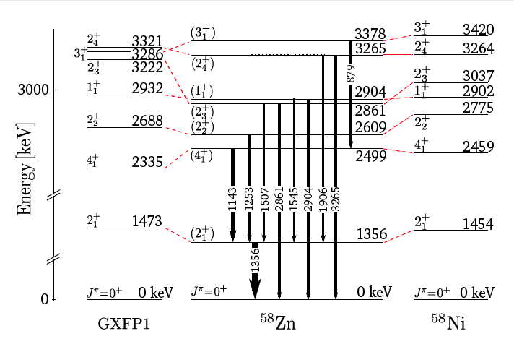
Level scheme comparison with theory
2279(50) S_{p}
Notes:
2904 has a small gs branching, but not zero
Mirror: 2775 and 2902 have small gs branching !!

Slide 26
Then one can carry out the integration analytically and finds:
For the contribution of a single narrow resonance to the stellar reaction rate:
III.68
The rate is entirely determined by the “resonance strength”
III.68a
Which in turn depends mainly on the total and partial widths of the resonance at
resonance energies.
→ A measurement of E_{r}, J_{r}, Γ_{p}(E_{r}), Γ_{γ} completely defines rate
→ A measurement of E_{r}, J_{r}, Γ_{p}, Γ_{g} completely defines rate
Exponential dependence!

Slide 27
Astrophysical Reaction Rate
Astrophysical ⁵⁷Cu(p,γ) rate
Shell model only
Temperature [GK]

Slide 28
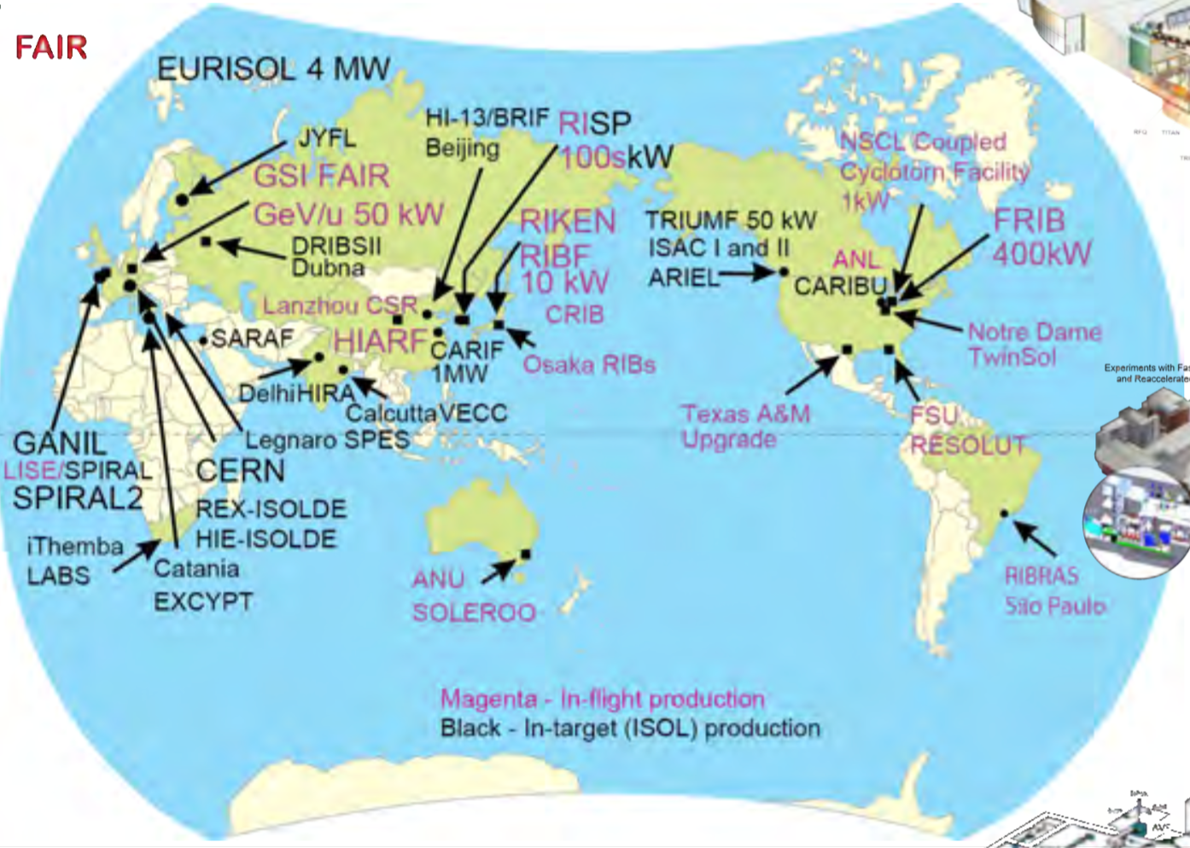
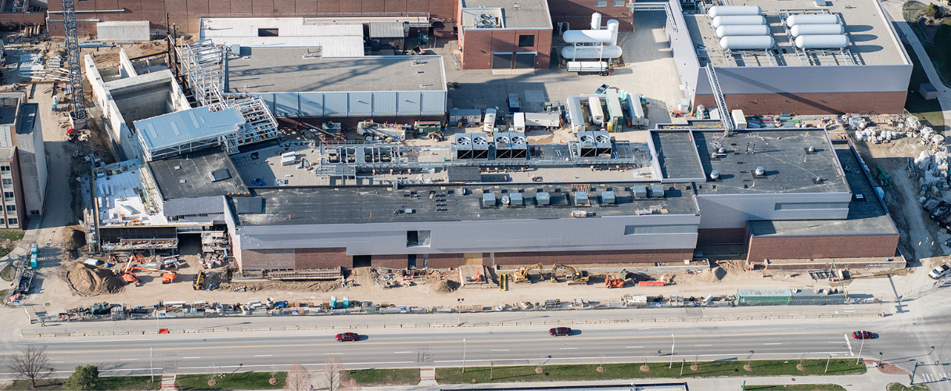
A New Generation of Facilities
Will Transform Rare Isotope Science – Including Astrophysics
FRIB@MSU

Slide 29
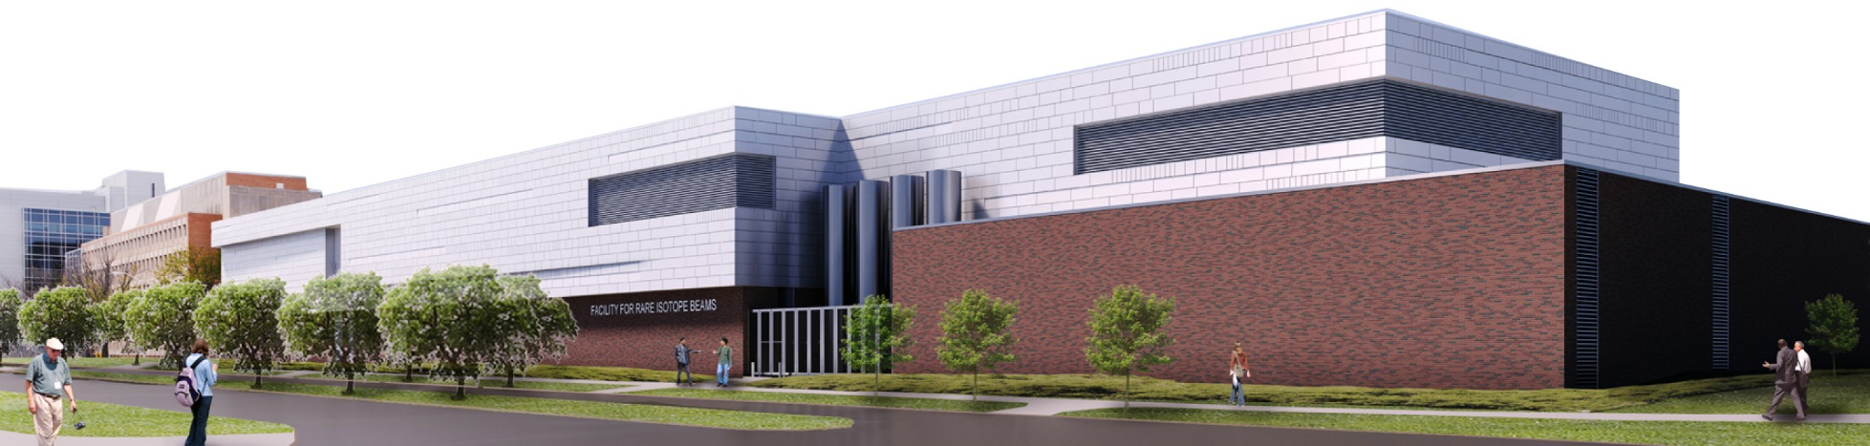
FRIB at Michigan State University
FRIB will be a $730 million national user facility funded by the Department of Energy Office of Science (DOE-SC), Michigan State University, and the State of Michigan
FRIB Project completion is in 2022, managing to an early completion in fiscal year 2021
FRIB will serve as a national user facility for world-class rare isotope research
  FRIB will enable scientists to make discoveries about the properties of these rare isotopes in order to better understand the physics of nuclei, nuclear astrophysics, fundamental interactions, and applications for society
Notes:
Other Points to Mention:
FRIB enables scientist to make discoveries in properties of atomic nuclei, nuclear astrophysics, tests of fundamental symmetries, and isotope research for society
More than 1,400 world-class scientists are engaged and belong to the FRIB Users Organization (FRIBUO)
Made possible by partnerships with the best in the nation and world; 13 active Work-for-Others agreements and 14 active MOUs

Slide 30
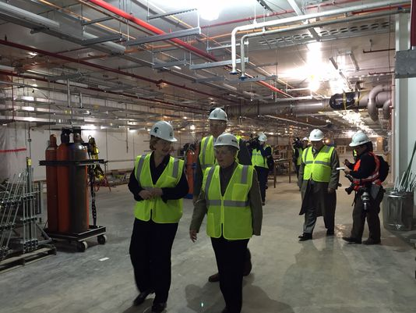
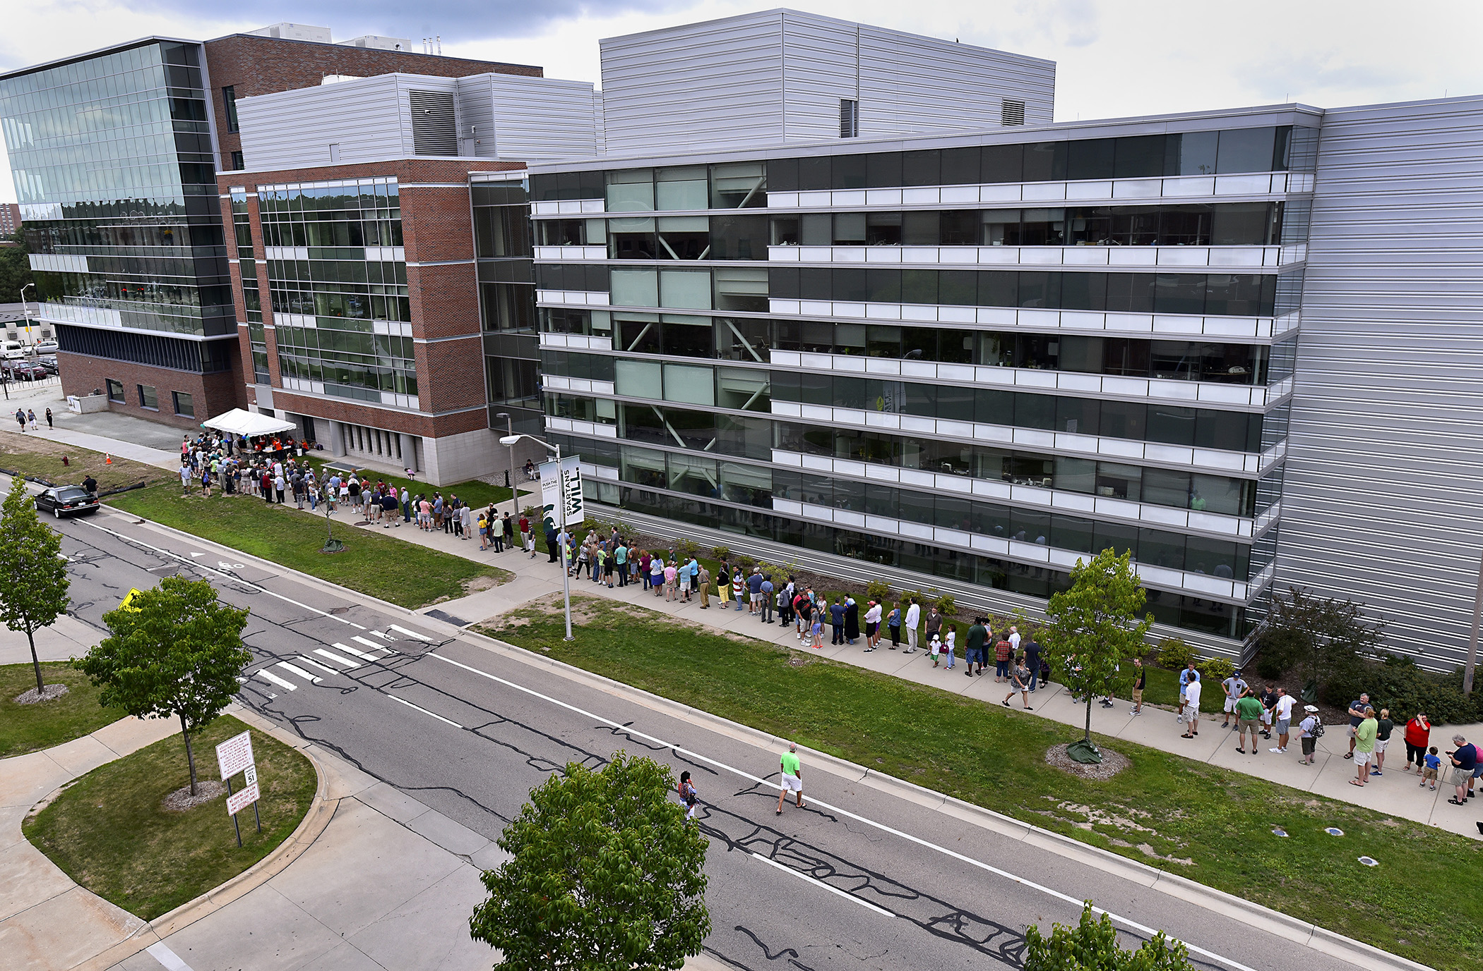

Slide 31
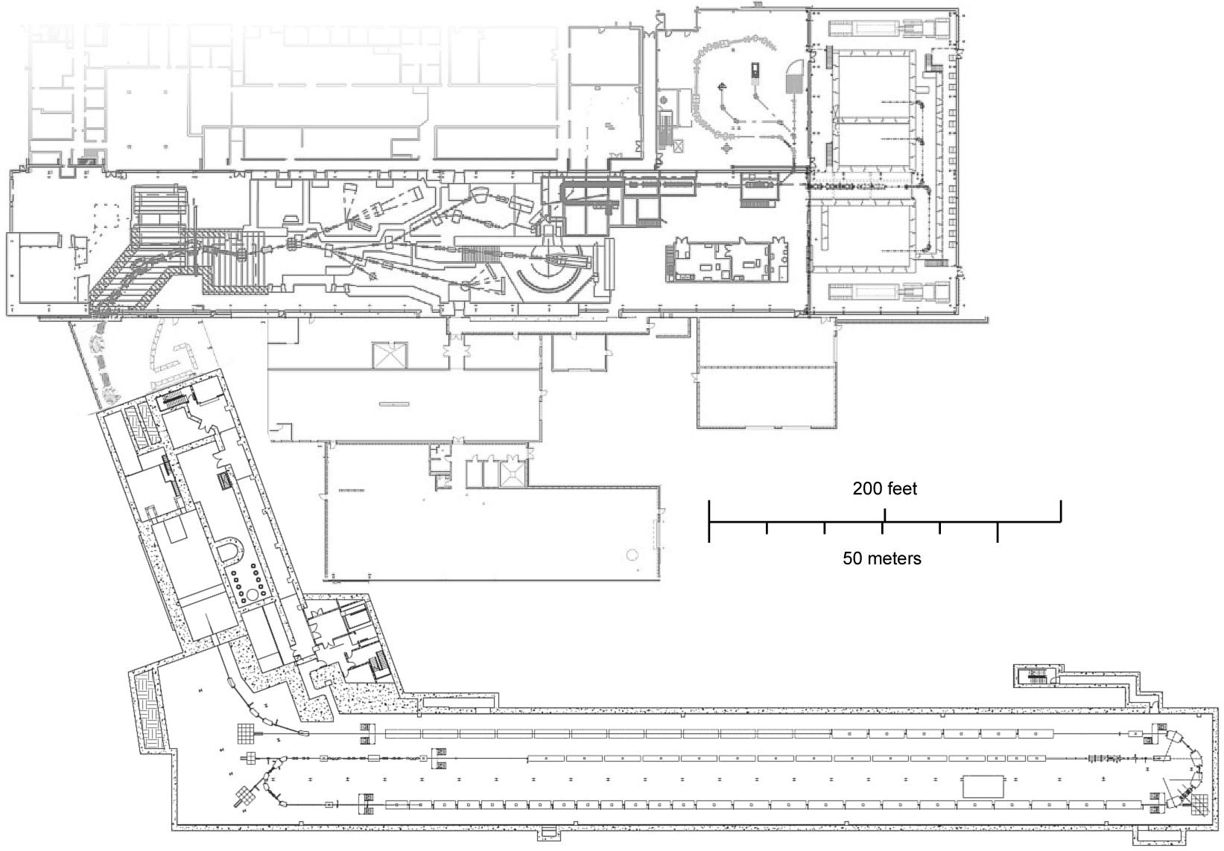
Low Energy Astrophysics Beams at NSCL/FRIB
Fast Beam Area
Gas Stopping
Stopped Beam Area
Reaccelerated Beam Area
Gas Stopping
ReA3 Hall
Low Energy Beams
ReA3
Reaccelerator →
Low energy beams
at astrophysical energies
(0.3-2 MeV/u)
Fragment Separator
Fragment
separator
Reaccelerator
Target
Target
Front End
Folding Segment 2
Beam Delivery System
LINAC > 200 MeV/u
Linac Segment 1
FRIB Completion:
2022
Folding Segment 1
Linac Segment 2
Linac Segment 3

Slide 32
SECAR Enables Direct Measurements of Astrophysical Reactions with ReA3 Beams
UPP: 10⁻¹⁷ rejection up to A=65
Typical experiment: 10⁸ pps – 1 event/day
No background in 2 week: 1:10
Note: just one mass unit difference!
Radioactive (⁵⁷Cu)
beam from ReA3
reaccelerator
JENSA Gas Target,
Incl γ-ray detectors:
U. Greife (CSM),
K. Chipps (ORNL)
Recoil
FP4
Focal Plane Design:
J. Blackmon (LSU)
H or He
gas target
Focal
Plane 1
(FP1)
FP3
VF1
“Scattered
Beam”
VF2
Beam
Separator Design:
G. Berg and M. Couder (Notre Dame)
FP2

Slide 33
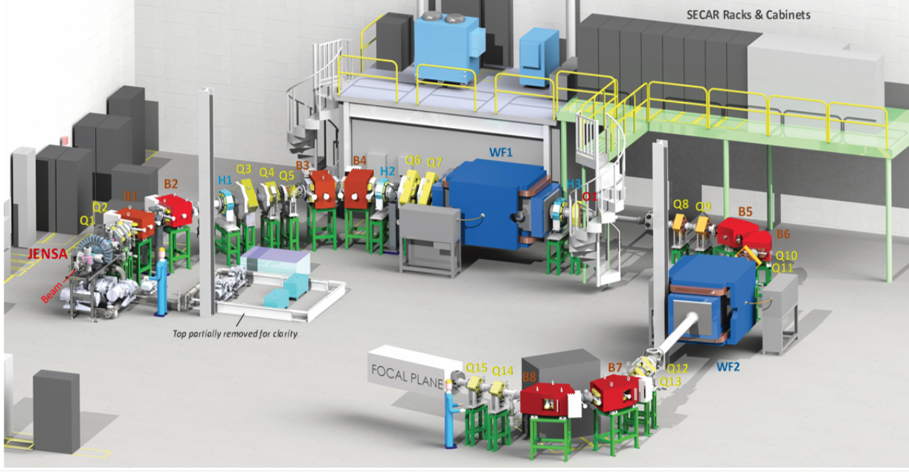
SECAR Project
Completion: 2021

Slide 34
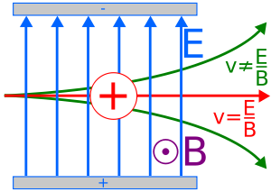
Wien Filter

Slide 35
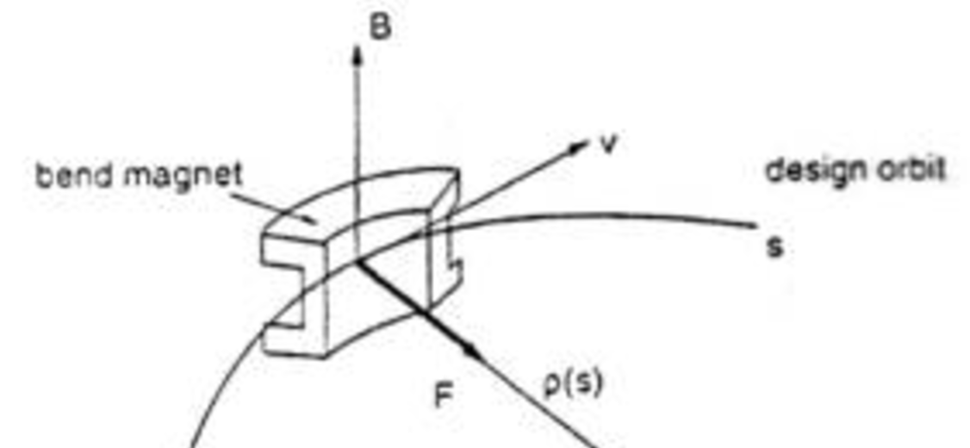

Why can’t we use magnets?
Magnet
bending
radius:
ρ
³⁰P
→ ³¹S
^{p}
After collision:
p?
q?
v?

Slide 36
Summary
X-ray bursts are the most common astrophysical thermonuclear explosions observed
Nuclear physics involves unstable nuclei and needs to be understood
  To interpret light curves in terms of system parameters and physics
  To predict neutron star crust composition, atmosphere composition, and possible compositional signatures
  To validate models using observations
Broad range of radioactive beam experiments (together with stable beam experiments) are needed
With new radioactive beam facilities like FRIB,

Slide 37
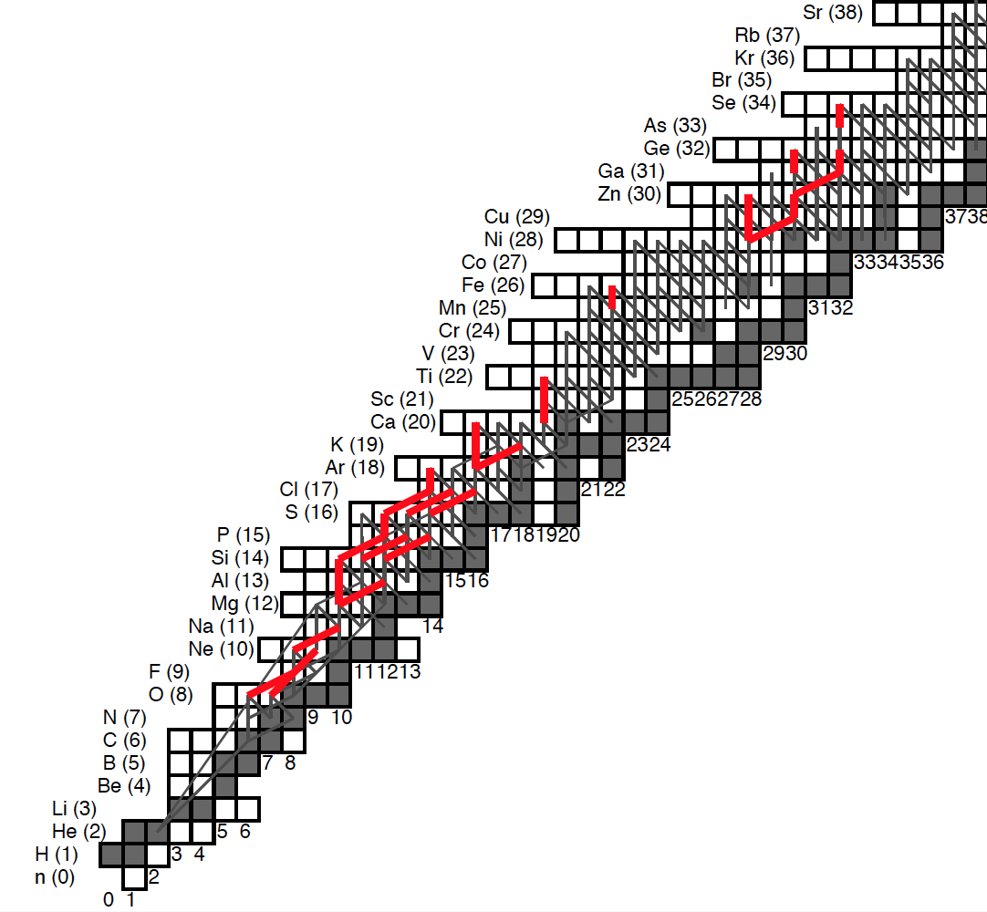

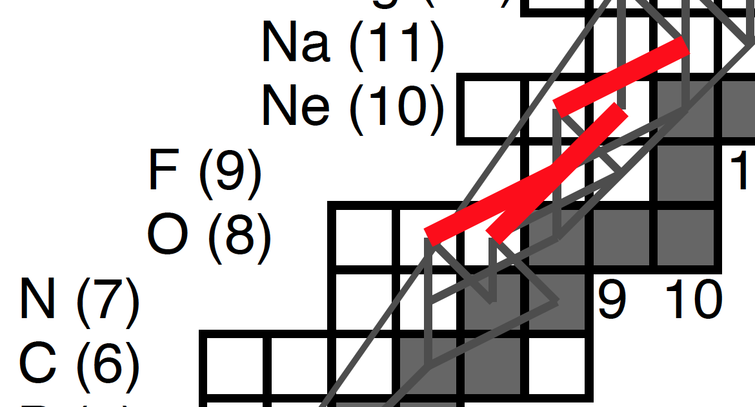
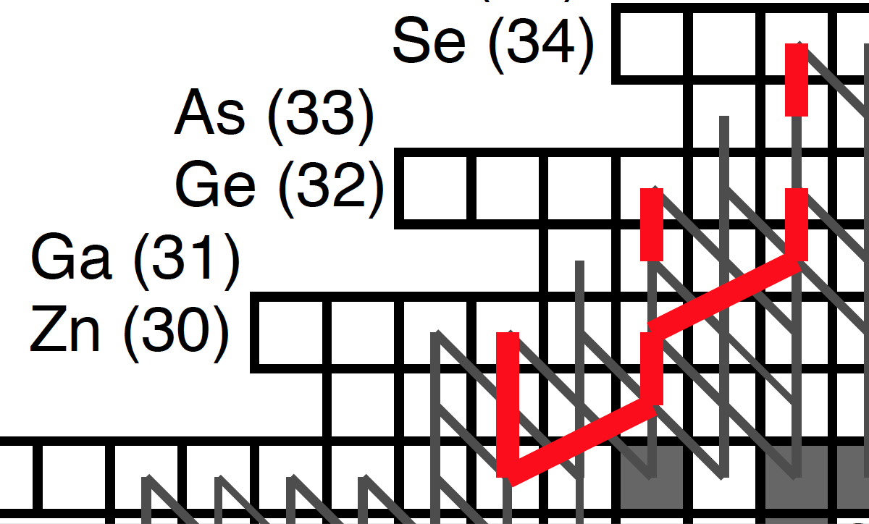
Sensitivity to Reaction Rates
αp process
(a,p) rates vs p-capture
1-Zone
Light Curve Impact
CNO Breakout
14O(a,p), 15O(a,g), 18Ne(a,p)
Cycles and
Major Waiting Points
(p,a) rates vs p-capture; p-capture on WP+p

Slide 38
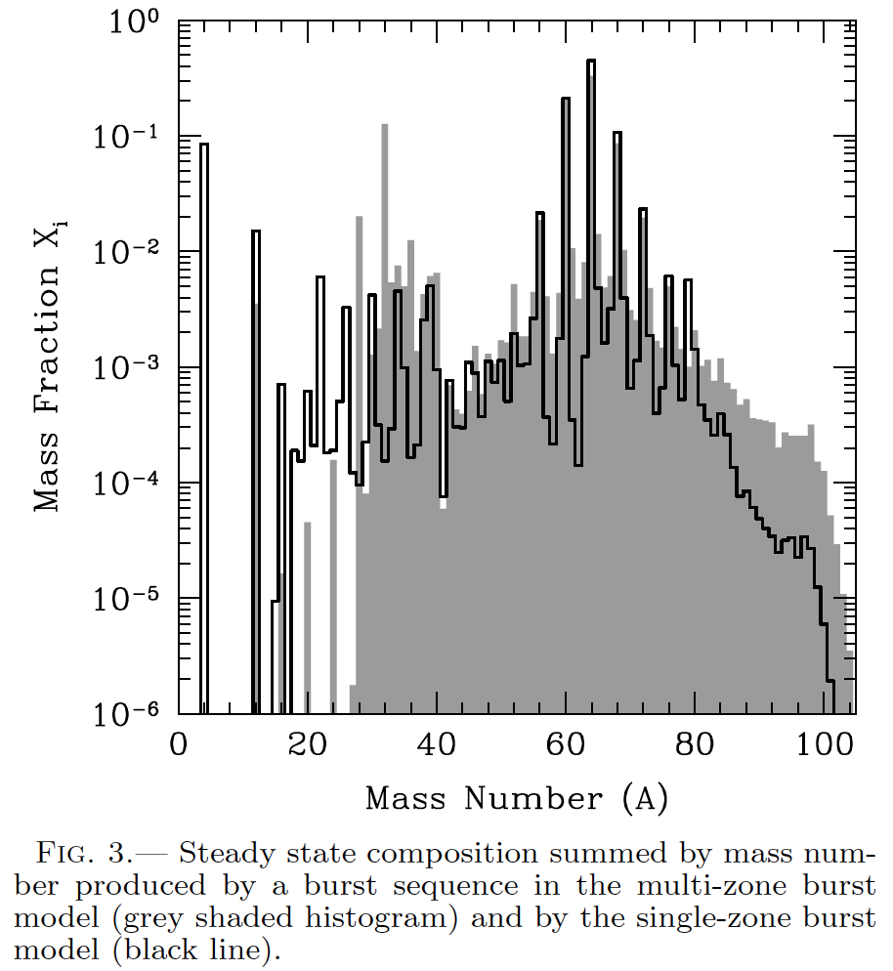
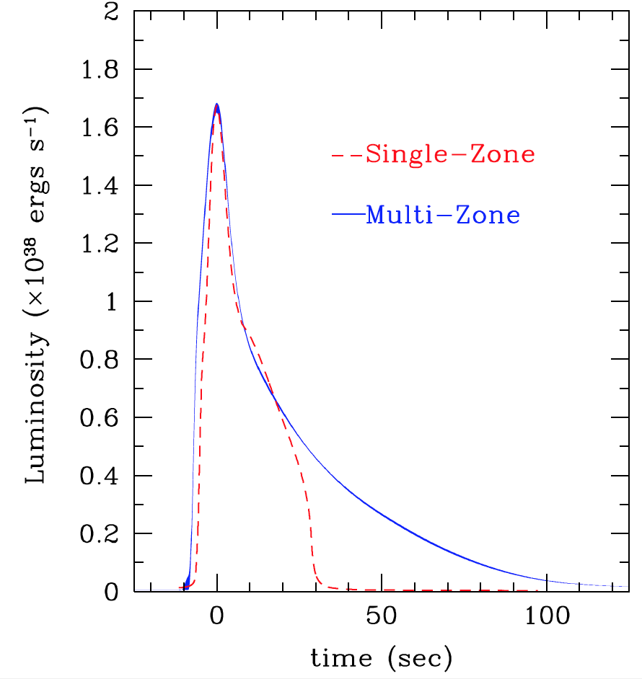
Model B: Calibrated to 1D

Slide 39
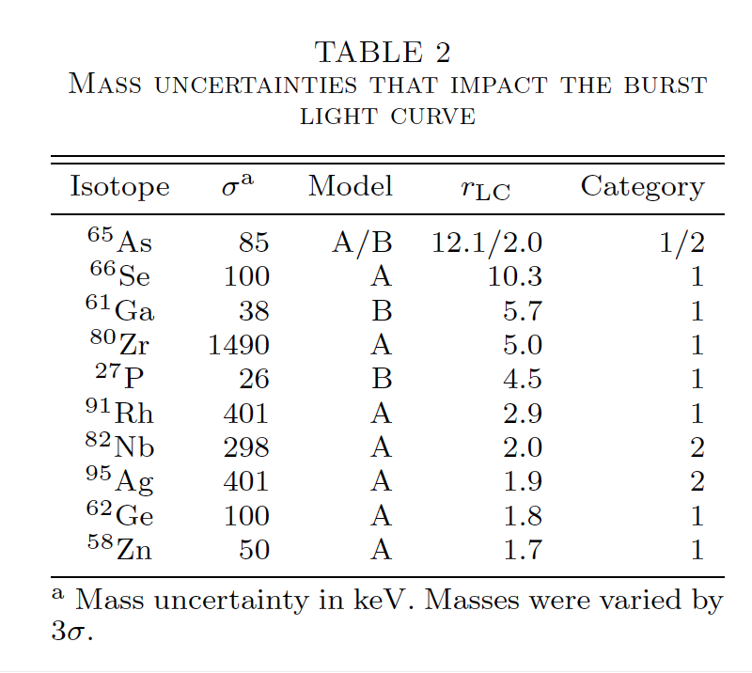
Light curve impacts

Slide 40
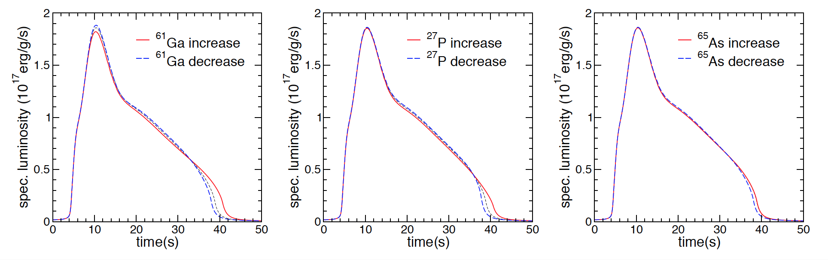
Examples – Model B

Slide 41

Examples Model A

Slide 42


Composition > 20%
24 masses in model A
11 masses in model B
²⁷P

Slide 43
Question 1
Why does new 2M_sol neutron star not have X-ray bursts?
  Classes of neutron star phenomena
  Accreting/non-Accreting, high B/low B

Slide 44
Burst ignition
Burst trigger rate is “triple alpha reaction”
3 ⁴He ¹²C
dε_{nuc}
dε_{cool}
ε_{nuc}
Nuclear energy generation rate
Ignition:
>
dT
dT
ε_{cool} ~ T⁴
Cooling rate
Triple alpha reaction rate
Ignition < 0.4 GK:
unstable runaway
(increase in T increases
ε_{nuc} that increases T …)
degenerate e-gas helps !
BUT: energy release dominated by subsequent reactions !

Slide 45

X-ray pulsar
> 10¹² Gauss !
High local accretion rates due to magnetic funneling of material on small surface area

Slide 46
Question 2
What sets the peak of the burst?

Slide 47
Question 3
How do important reactions affect light curve?

Slide 48


Slide 49
Question 4
Connection between resonance strength and cross section
  Resonance strength is related to the rate ( <σv>)

Slide 50
<σv>
For narrow resonance (constant over resonance: λ², Γ, Φ) one can carry out the integration:

Slide 51
Question 5
Charge state distribution of low energy radioactive beams after passing through material
⁵⁷Cu^{range}
⁵⁷Cu¹¹⁺
⁵⁸Zn^{range}
Fraction
H Gas
⁵⁷Cu
⁵⁸Zn
Q

