Slide 1
CMS Phase 2 Upgrades
Vivian O’Dell
Fermilab PAC
24 June 2015

Slide 2
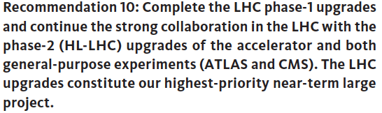
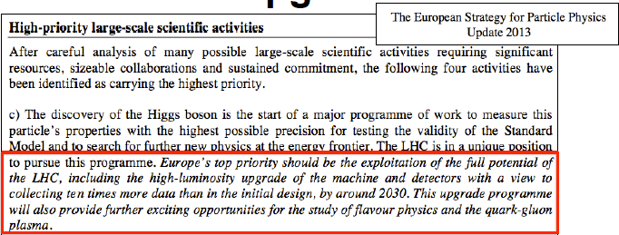
LHC Upgrades: High Priority!
US HEP community (P5) report June 2014

Slide 3
Outline
LHC machine schedule
International CMS Phase 2 upgrades
US CMS role in CMS Phase 2 upgrades

Slide 4
LHC machine schedule

Slide 5
LHC Upgrades: Timeline towards HL-LHC
Run I
0.75 10³⁴ cm⁻²s⁻¹
50 ns bunch
high pile up ∼40
Run II
1.5 10³⁴ cm⁻²s⁻¹
25 ns bunch
pile up ∼40
Run III
1.7-2.2 10³⁴ cm⁻²s⁻¹
25 ns bunch
pile up ∼60
Run IV
~5(7.5!) 10³⁴ cm⁻²s⁻¹
25 ns bunch
pile up ∼140 - 200
50 ⇒ 25 ns

Slide 6
LHC Upgrades: New long-term schedule (approved by CERN Council in June)
Run 3
Run 2
LS 2
LIU installation
PHASE 1
Run 4
Run 3
LS 3
Run 4
HL-LHC installation
PHASE 2
LS 4
LS 5
LS 4
Run 5
LS 5
Run 2 extended by 6 months (ends in 2018)
LS2 delayed by 6 months, extended by 6 months
LS3 delayed by 1 year (starts in CY 2024)
Run 4 (HL-LHC) begins Q4 of CY 2026
Physics
Shutdown
Beam commissioning
Technical stop

Slide 7
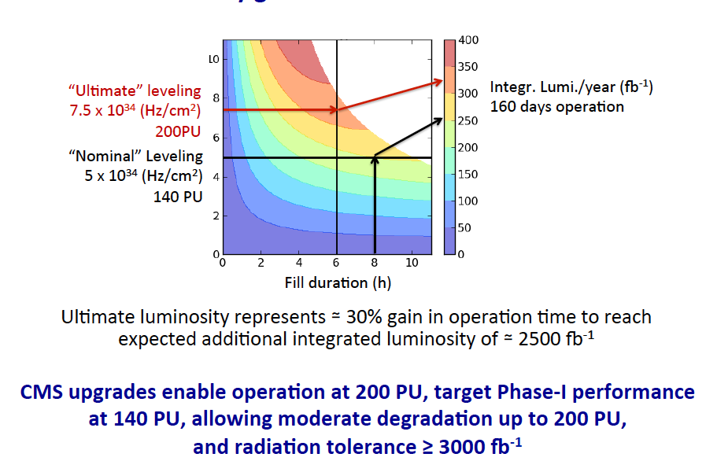
HL-LHC Luminosity Goals

Slide 8
Outline
International CMS upgrades / schedules

Slide 9
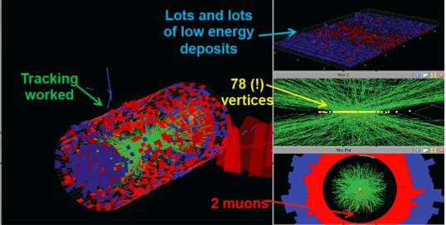
CMS Upgrades for HL-LHC: High pileup!
Extreme conditions for:
radiation
pileup
Trigger / DAQ
Data handling
The CMS upgrade program involves a series of upgrades and improvements to maintain physics performance as the accelerator conditions become ever more challenging
9
9

Slide 10
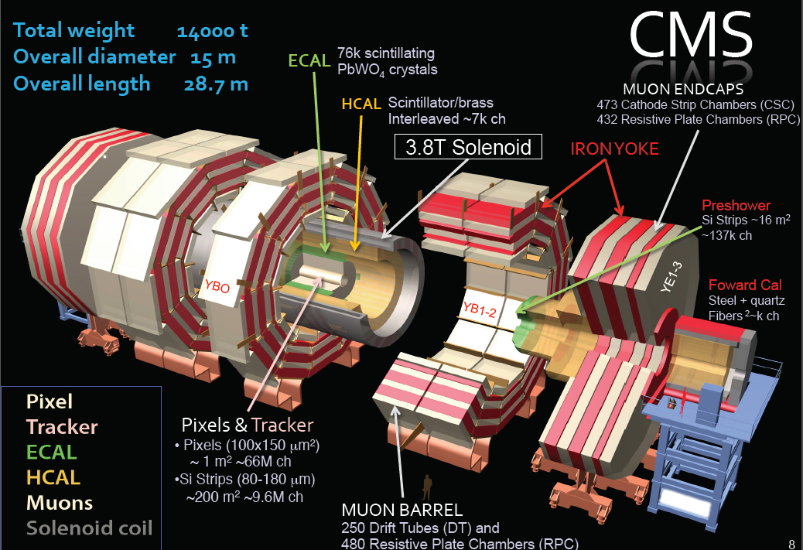
The CMS detector

Slide 11
International CMS Upgrades: From now through 2026+
  Phase 2 Upgrades: TPhttps://cds.cern.ch/record/2020886
Tracker Replacement, Track Trigger
Endcap Calorimeter replacement
Barrel ECAL Electronics upgrade / Barrel HCAL active material replacement (inner)
Trigger/DAQ upgrade
Tracker & Muon extension
  From |η|=3 to |η|~4
LS1 Projects
Complete muon coverage (ME4)
Improve muon operation (ME1), DT electronics
Replace HCAL photo-detectors in Forward (new PMTs) and Outer (HPD→SiPM)
Tracker operation at -15º C
DAQ1 → DAQ2
LS1 Run II LS2 Run III LS3 Run IV
Phase 1 Upgrades
New L1-trigger systems (Calorimeter – Muons – Gobal) (ready for 2016)
New pixel detector (ready for installation in 2016/2017 Year End Technical Stop)
HCAL upgrade: photodetectors and electronics (HF 2015 YETS, HE 2016 YETS, HB during LS2)
Preparatory work during LS1
  New beam pipe
  Install test slices (Pixel , HCAL, L1-trigger)
Latest LHC schedule
LS1: January 2013 – December 2014 (24 mos)
Extended Year End Technical Stop (EYETS):
December 2016-April 2017 (19 weeks)
LS2: January 2019 – December 2020 (24 mos)
LS3: January 2024 – June 2026 (30 mos)

Slide 12
Outline
Phase 2 upgrades

Slide 13
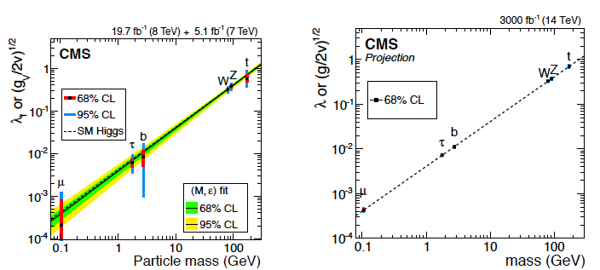
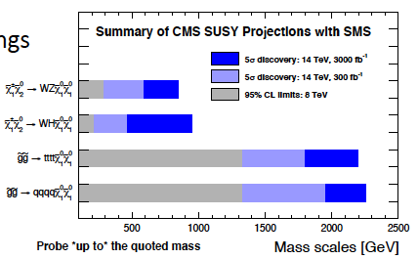
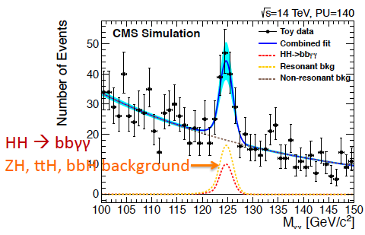
Physics Reach at HL-LHC
2-10% on Higgs couplings
  (currently up to 30%!)
Evidence of di-Higgs production
Access to small cross section SUSY processes
Several other SM rare processes and BSM physics predictions
… and increased mass range

Slide 14
Requirements for the upgrades
HL-LHC enables a broad physics program: all physics objects – detectors – remain equally important
Enhanced role of forward region, particularly to study VBF/VBS processes
Maintain low momentum / energy thresholds in event selection
For more information / details see CMS Technical Proposal
  CERN-LHCC-2015-010 https://cds.cern.ch/record/2020886

Slide 15
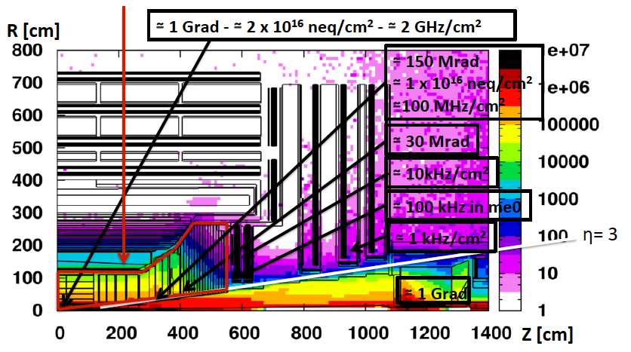
HL-LHC: a hostile environment
3000 fb-1 Dose map in [Gy] simulated with MARS and FLUKA
Numbers in boxes indicate maximum doses – neutron equivalent fluence – particle rates (for 5x10³⁴ Hz/cm²) seen by various detectors
Aging studies show that Tracker / Endcap must be replaced
15

Slide 16
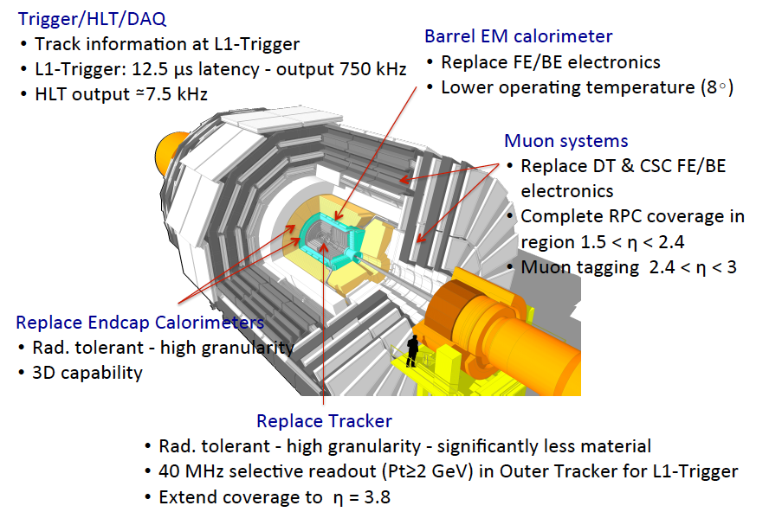
CMS Upgrades for HL-LHC: Summary
16

Slide 17
CMS HL-LHC upgrades
Brief outline of upgrades

Slide 18
CMS HL-LHC upgrades
Tracker

Slide 19
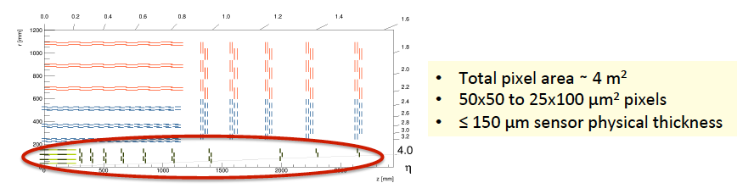
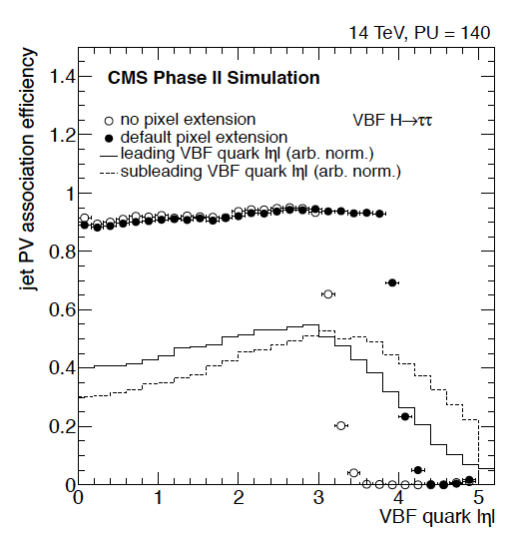
Phase 2 Pixels
Barrel pixel with 4 layers
Forward pixel with 10 disks extending coverage to |η|=3.8
  FPIX is the NSF flagship project!
Jet efficiency without & with pixel
coverage extension (140 PU)
Notes:
Current TOP: designed to handle 500fb-1 & 50 pileup events
(Pixel detector replaced in PI @ ~150fb-1).
Both detectors will have to be replaced during LS3 (no other convenient time during HL-LHC).
Also restrict DAQ to 100KHz – 4 microsec latency.
Current detector: red is single sided, blue mounted back-to-back
For upgraded tracker: 2S modules: pairs of strip censors, PS = 2 sensors, 1 segmented in 2.5cm strips, 100 micron pitch, the other is “macro-pixel” 100 microns x 1.5mm

Slide 20
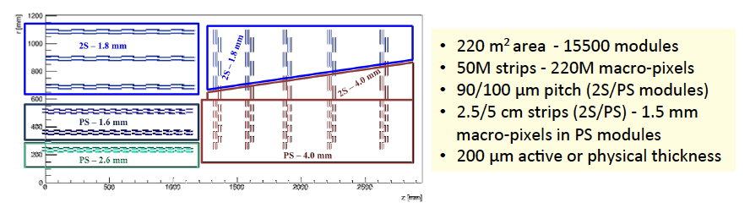
Phase 2 Outer Tracker configuration
Several configurations investigated to define baseline
  6/5 barrel/endcap layers/disks – instead of 10/11 in current OT
  Increased granularity through short strips - ~ x4 current OT
  2 sensor modules in all layers for L1 Trigger purpose
  Long pixel in 3 inner layer modules (PS) for z-coordinate measurement
  Light module design and mechanics – CO2 cooling (-30) – DC/DC powering
Ongoing study of tilted design to reduce material / costs
Notes:
Current TOP: designed to handle 500fb-1 & 50 pileup events
(Pixel detector replaced in PI @ ~150fb-1).
Both detectors will have to be replaced during LS3 (no other convenient time during HL-LHC).
Also restrict DAQ to 100KHz – 4 microsec latency.
Current detector: red is single sided, blue mounted back-to-back
For upgraded tracker: 2S modules: pairs of strip censors, PS = 2 sensors, 1 segmented in 2.5cm strips, 100 micron pitch, the other is “macro-pixel” 100 microns x 1.5mm

Slide 21
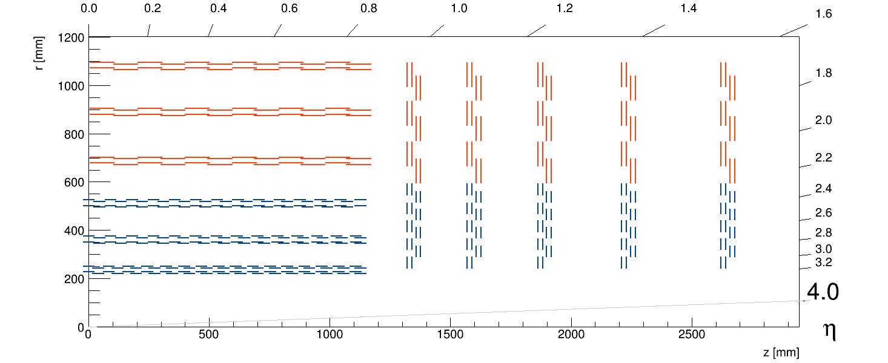
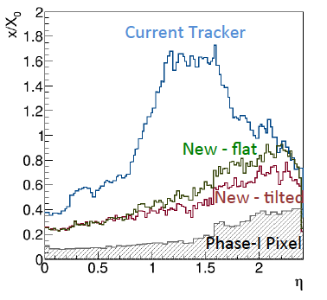
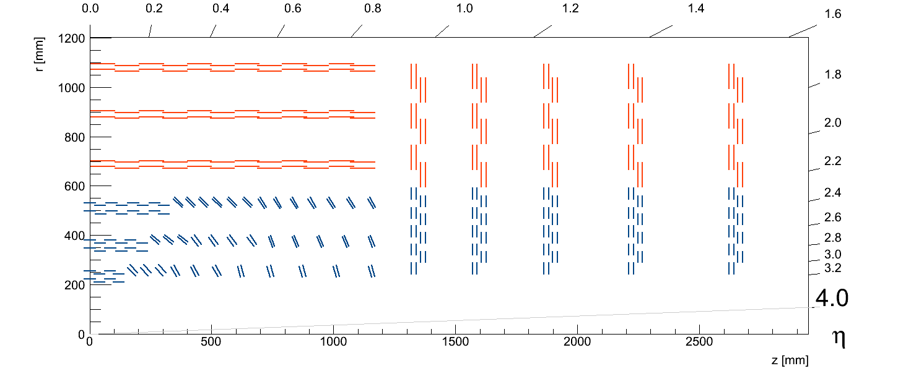
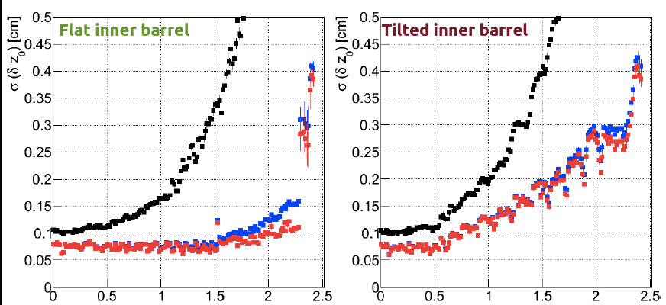
Outer Tracker – tilted barrel example
TB2S
TEDD
TBPS
TB2S
TEDD
TBPS
Less material, equal or better tracking performance
Less modules / cost saving
Slightly degraded z0 resolution for L1 tracks
Choice of geometry: this fall
Flat TBPS
Tilted TBPS
L1 tracks (no pixel)
Z-resolution

Slide 22
Using the Phase 2 tracker in the L1 Trigger
3 approaches
  Associative Memories + track fitting
  Time Multiplexed architecture + Hough Transform + track fitting
  Tracklet seeded road search
  Aiming for system demonstrator for L1 track finding Q4 2016
“stub”
pass
fail
.
→
y
1 ÷ 4 mm
B
z
x
≤ 100 μm
Notes:
Current TOP: designed to handle 500fb-1 & 50 pileup events
(Pixel detector replaced in PI @ ~150fb-1).
Both detectors will have to be replaced during LS3 (no other convenient time during HL-LHC).
Also restrict DAQ to 100KHz – 4 microsec latency.
Current detector: red is single sided, blue mounted back-to-back
For upgraded tracker: 2S modules: pairs of strip censors, PS = 2 sensors, 1 segmented in 2.5cm strips, 100 micron pitch, the other is “macro-pixel” 100 microns x 1.5mm

Slide 23
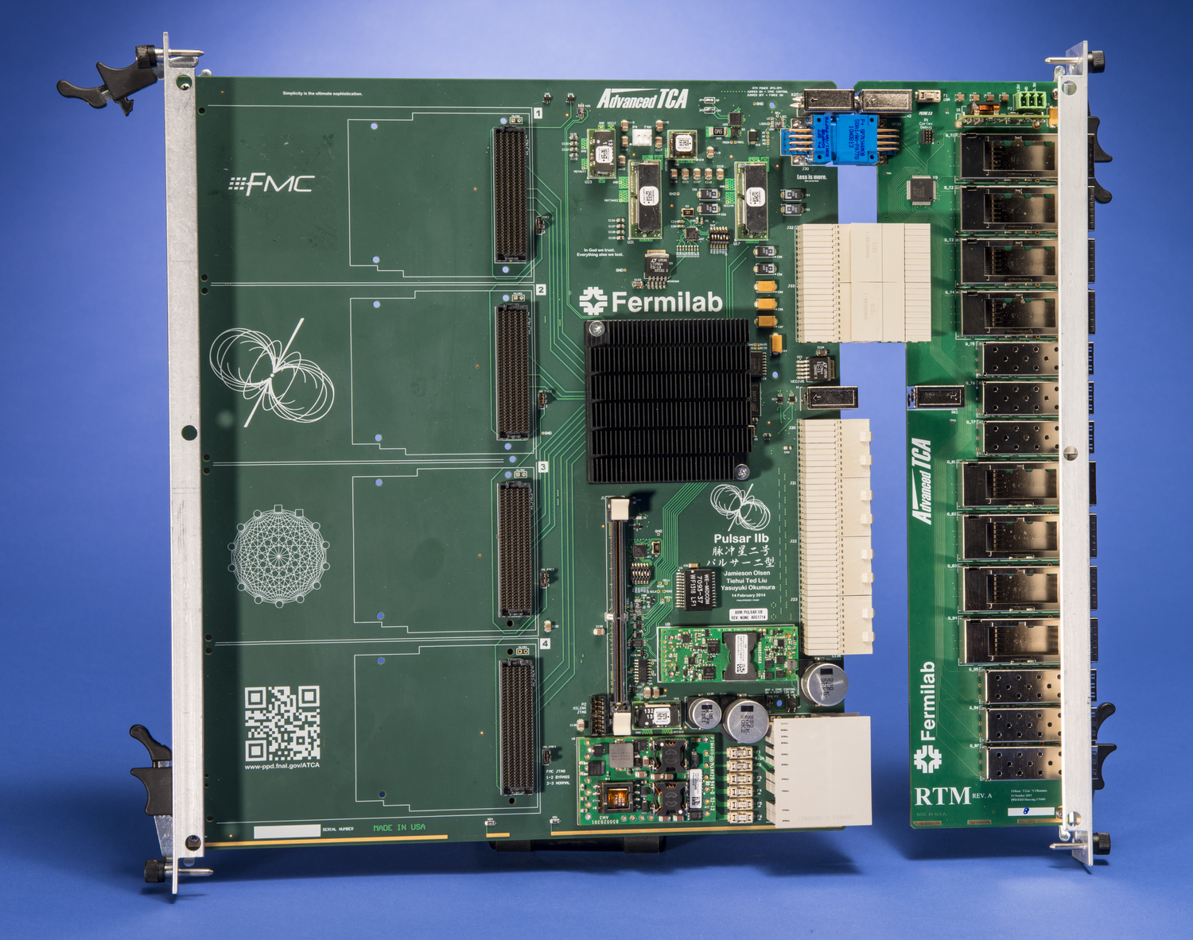
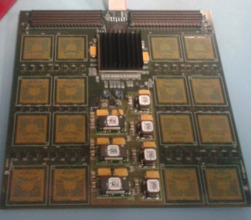
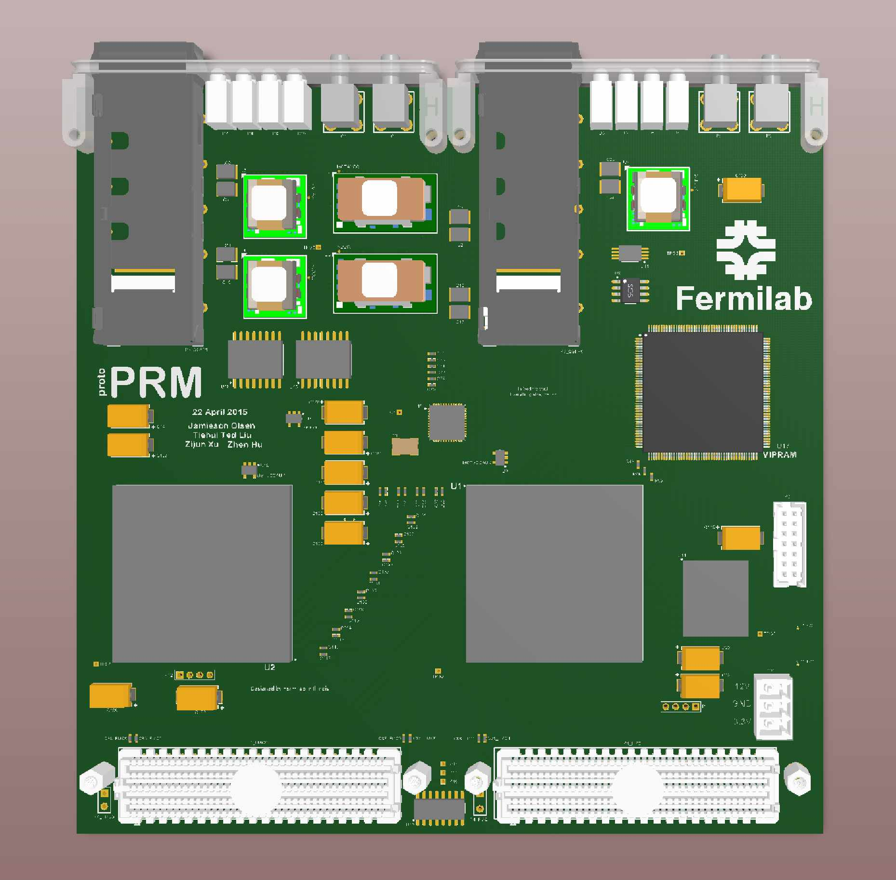
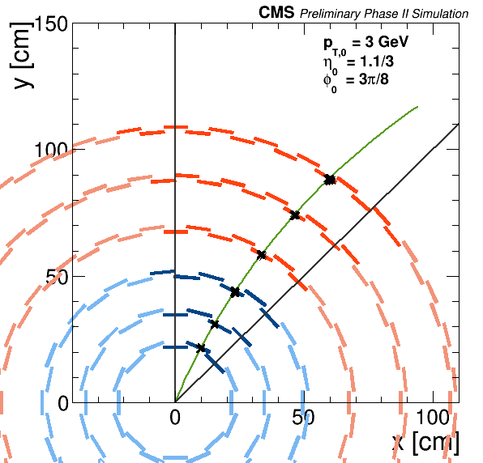
Phase 2 Track Trigger: AM approach
Data Source (FNAL/Brazil):
emulating ~40 modules
PRB
Δt1 (Data Delivery) + Δt2(AM) + Δt3 (TF)
INFN mezzanine card
FNAL mezzanine card
select
~40 modules
Notes:
Current TOP: designed to handle 500fb-1 & 50 pileup events
(Pixel detector replaced in PI @ ~150fb-1).
Both detectors will have to be replaced during LS3 (no other convenient time during HL-LHC).
Also restrict DAQ to 100KHz – 4 microsec latency.
Current detector: red is single sided, blue mounted back-to-back
For upgraded tracker: 2S modules: pairs of strip censors, PS = 2 sensors, 1 segmented in 2.5cm strips, 100 micron pitch, the other is “macro-pixel” 100 microns x 1.5mm

Slide 24
Phase 2 Track Trigger: Tracklet (pure FPGA) approach
Sector n+1
~100 Gbit/s*
80 Gbit/s
80 Gbit/s
DTC Emulation
200 Gbit/s
Sector n
L1Track Sink
(Trigger)
20 Gbit/s
80 Gbit/s
80 Gbit/s
~100 Gbit/s*
Sector n-1
Full Sector Demonstration:
Covers |η|<2.4
Uses factor 4 time MUX
p_{T}>2 GeV
* Only need to receive stubs
needed to demonstrate functionality
of the central sector
Sector board
Input: 360 Gbit/s
Output: 180 Gbit/s
Board used for DTC emulation and the L1Track receiver can be the same
Demonstrator based on CTP7 board developed for phase-1
Demonstrate full tracking in a sector, including communication with neighbour sectors
Measure latency from DTC output to L1 tracks available
Notes:
Current TOP: designed to handle 500fb-1 & 50 pileup events
(Pixel detector replaced in PI @ ~150fb-1).
Both detectors will have to be replaced during LS3 (no other convenient time during HL-LHC).
Also restrict DAQ to 100KHz – 4 microsec latency.
Current detector: red is single sided, blue mounted back-to-back
For upgraded tracker: 2S modules: pairs of strip censors, PS = 2 sensors, 1 segmented in 2.5cm strips, 100 micron pitch, the other is “macro-pixel” 100 microns x 1.5mm

Slide 25
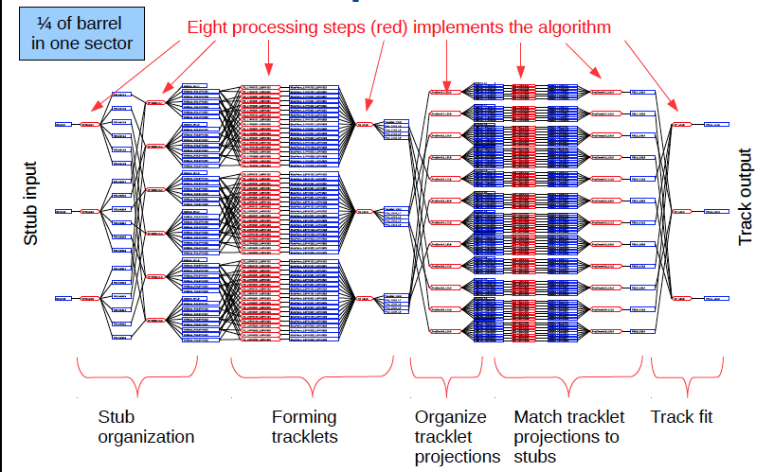
Phase 2 Track Trigger
Notes:
Current TOP: designed to handle 500fb-1 & 50 pileup events
(Pixel detector replaced in PI @ ~150fb-1).
Both detectors will have to be replaced during LS3 (no other convenient time during HL-LHC).
Also restrict DAQ to 100KHz – 4 microsec latency.
Current detector: red is single sided, blue mounted back-to-back
For upgraded tracker: 2S modules: pairs of strip censors, PS = 2 sensors, 1 segmented in 2.5cm strips, 100 micron pitch, the other is “macro-pixel” 100 microns x 1.5mm

Slide 26
CMS HL-LHC upgrades
Calorimeters

Slide 27
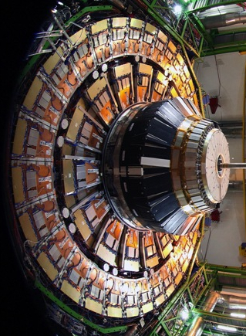
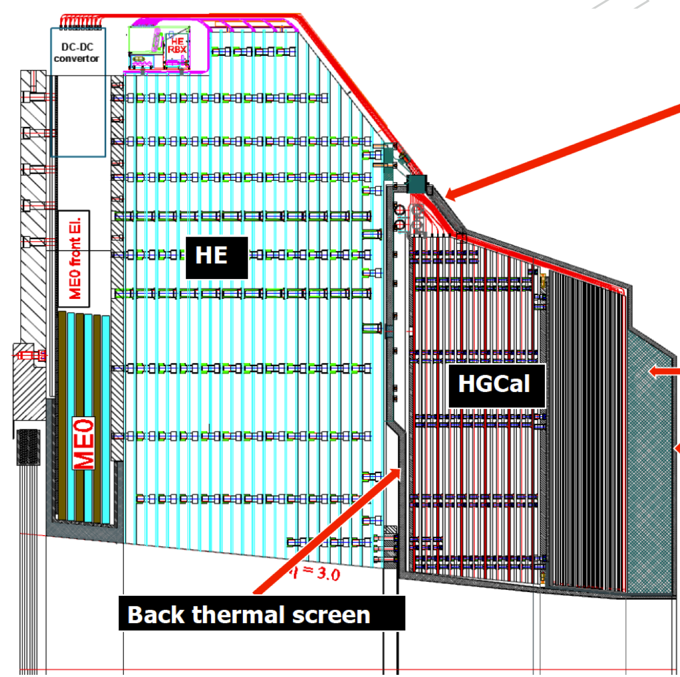

Endcap Calorimeter for HL-LHC: High Granularity Cal
Integrated sampling Silicon ECAL+HCAL and Backing Calorimeters
HGCAL
FH
EE
BH
neutron
moderator
Front thermal screen
EE Cu-W / Si
26 X₀ (1.5 λ)
FH Brass / Si
3.5 λ
BH Brass / scint. tiles
5 λ
27

Slide 28
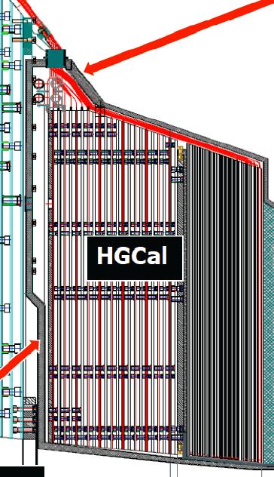
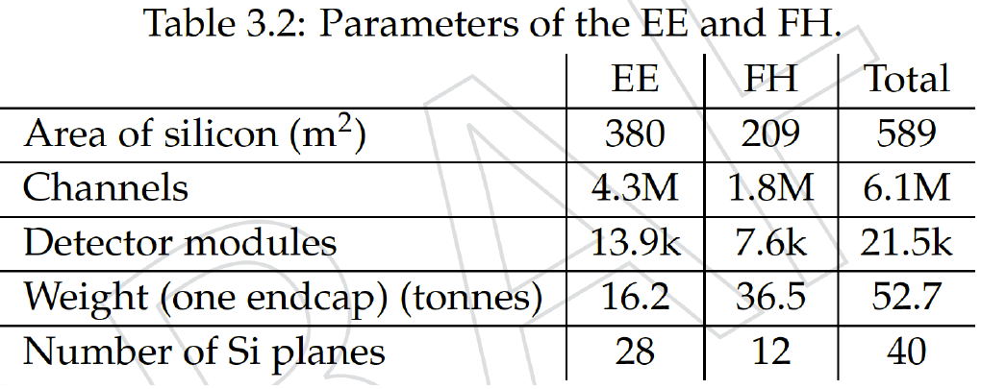
Endcap Calorimeter for HL-LHC: HGCal
Operate at -30 °C
CO₂ cooling
Si/W-ECAL Section (Σ_{depth}>25X₀, 1.5λ)
10 × 0.65X₀
10 × 0.88X₀
8 × 1.26X₀
Si/Brass Front HCAL (FH) Section (Σ_{depth}> 3.5λ)
12 × 0.3λ
Scint/Brass Backing HCAL(BH)Section(Σ_{depth}> 5λ
12 × 0.45λ
Total Depth >10λ

Slide 29
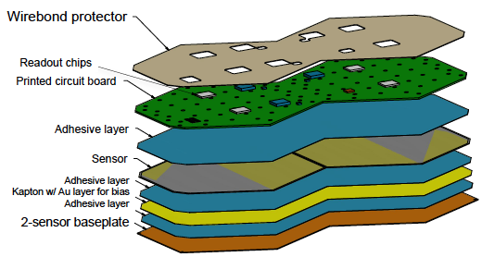
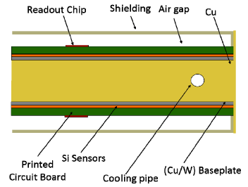
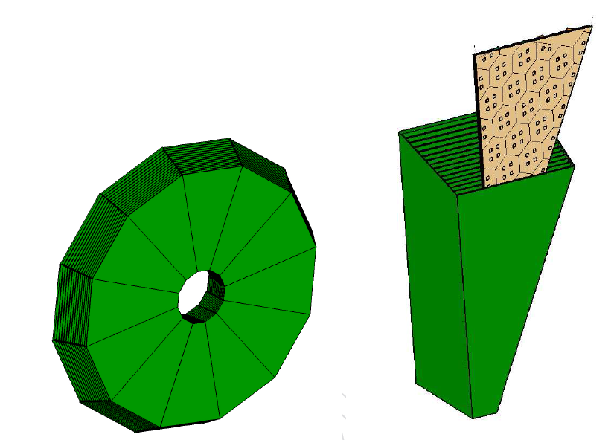
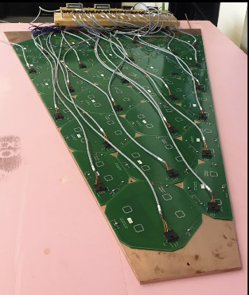
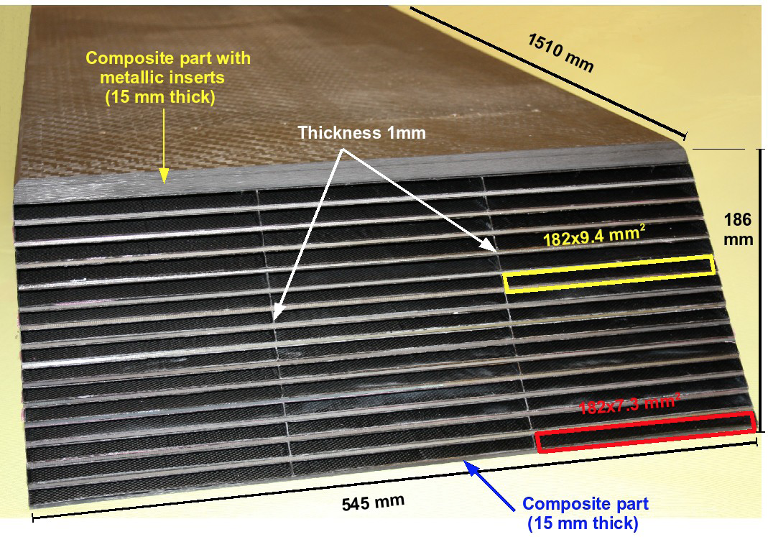
Endcap Calorimeter for HL-LHC: HGCal
Cassette thermal tests
W absorber
CALICE Prototype
C-fibre structure with embedded W plates

Slide 30
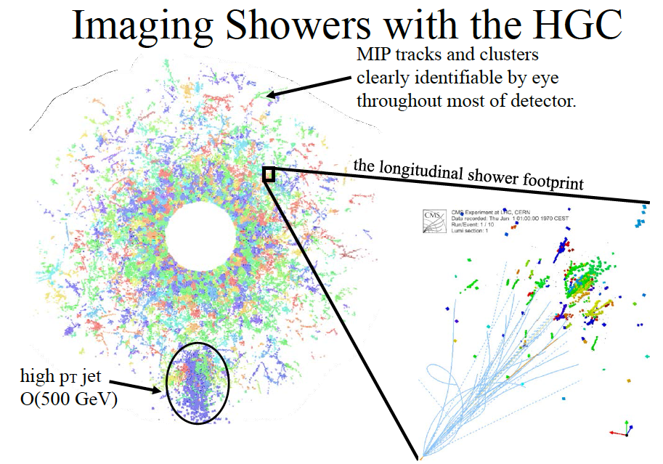
Net effect: extends tracking into calorimeter!

Slide 31
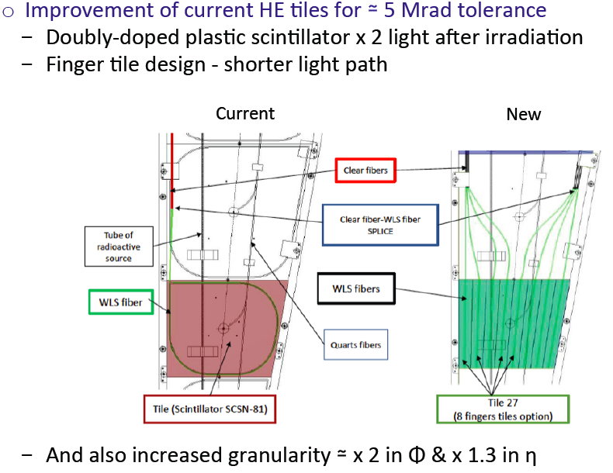
Endcap Calorimeter: Backing Hadronic
Synergy with Barrel HCAL upgrade – same scintilltor, different geometry depending on location (i.e. expected radiation doses)

Slide 32
Endcap Calorimeter: L1 Trigger
Architecture of level one trigger for HGCal is based on the upgraded (2016) calorimeter trigger
  Two processing layers
    The first one with a regional view of the calorimeter
    The second one with a global view
  Time multiplexing to concentrate all data in second layer
The design relies on existing or near-existing technology
  FPGAs with similar capabilities to next generation Xilinx Vertex Ultrascape
  10 Gbps links will be used for the transfer of data from the detector and the trigger system (moderate radiation area)
  20 Gbps will be available for communication between off-detector trigger modules (no radiation)

Slide 33
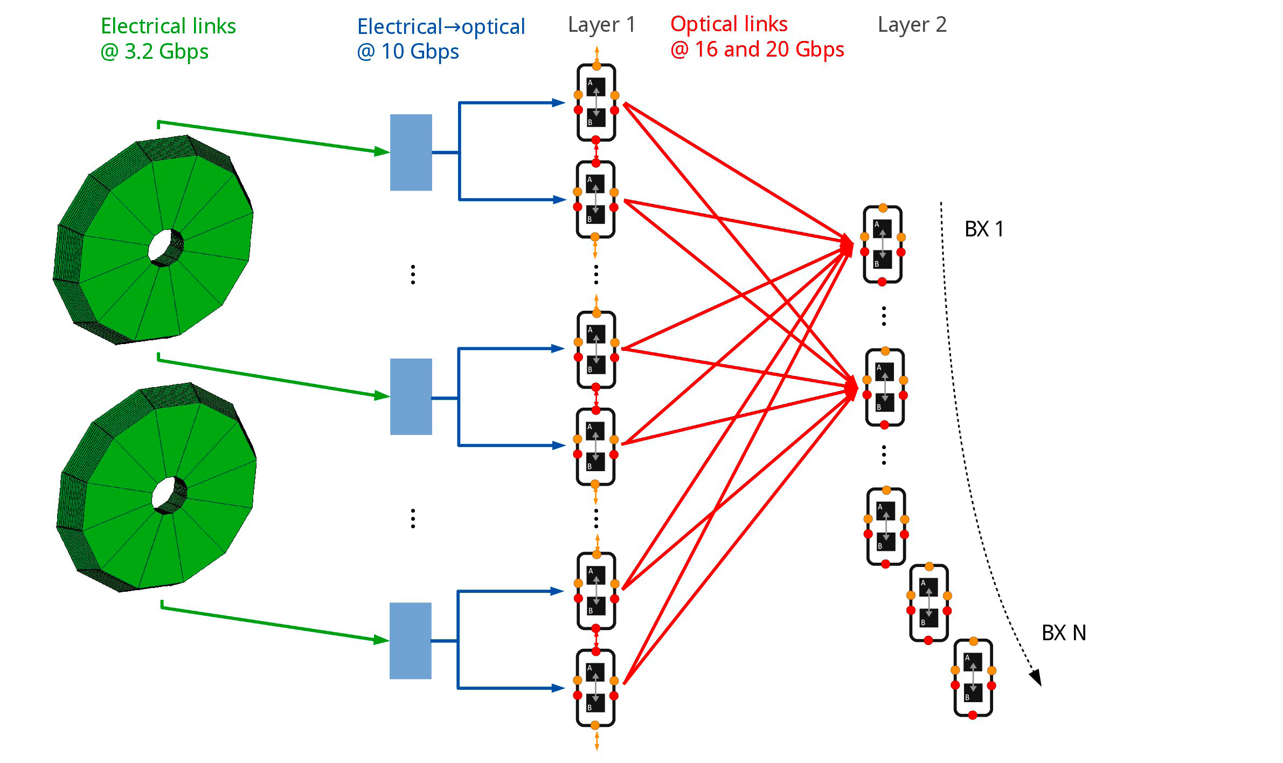
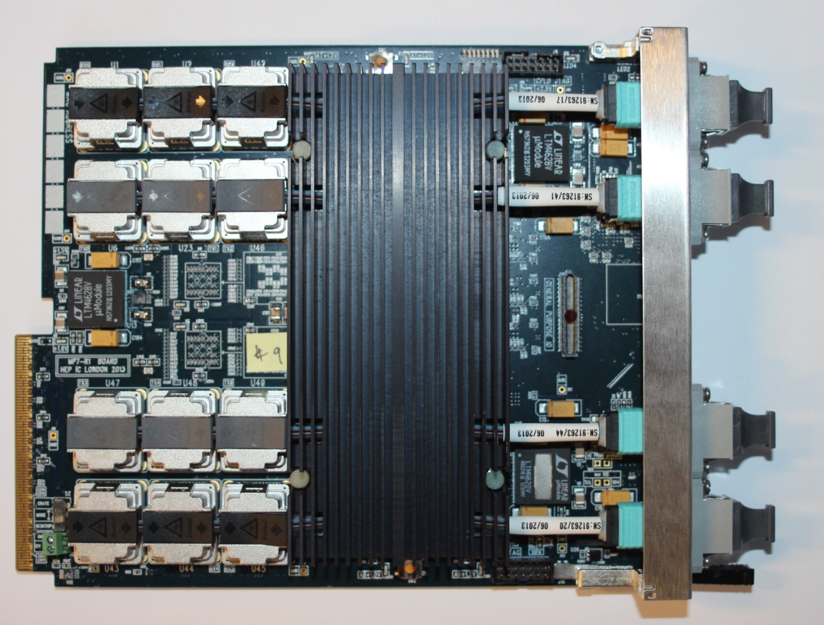
Endcap Calorimeter: Trigger
Group 4 cells to get a trigger cell every 2nd layer
Simple data compression
Current trigger hardware (Xilinx Vertex 7)

Slide 34
CMS HL-LHC upgrades
Muons, Trigger, DAQ

Slide 35
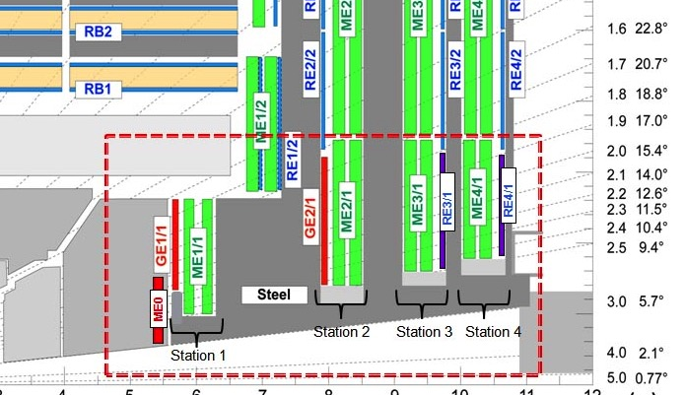
CMS HL-LHC upgrades: Muons
Upgrades of existing muon detectors and associated electronics.
  R&D on chamber longevity, electronics
Forward 1.6 < |η| < 2.4 enhancements
  L1 trigger rate reduction, additional efficiency through redundancy
    GEMs: GE1/1 (LS2 installation), GE2/1
    iRPCs: RE3/1 and RE4/1
  Very forward extension (2 < |η| < 3)
    Extend muon coverage behind new EC (ME0)

Slide 36
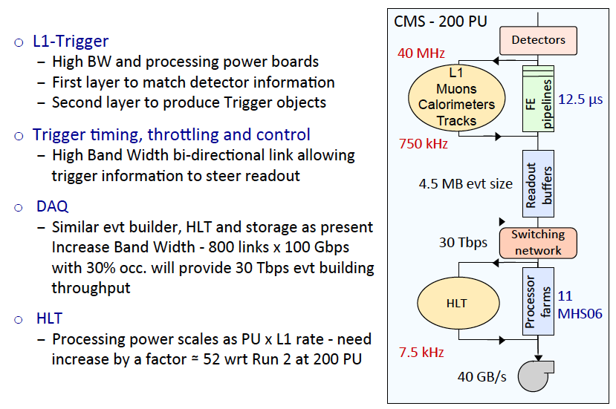
CMS HL-LHC: Trigger / DAQ

Slide 37
CMS HL-LHC: Costs / Schedules
CMS HL-LHC Costs/Schedules

Slide 38
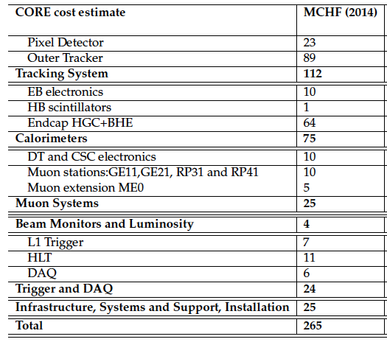
International CMS Upgrade Cost and Schedule
The Technical Proposal has been submitted to the LHCC
  CERN-LHCC-2015-010 https://cds.cern.ch/record/2020886
“CORE” costs of the full HL-LHC CMS upgrade
Note that CORE is only M&S and only for construction
(i.e. no labor, R&D, preproduction, contingency, escalation, etc)
US costs would be on the order of $265M (including labor, preproduction, contingency, escalation, etc., based on our current level of participation in CMS)

Slide 39
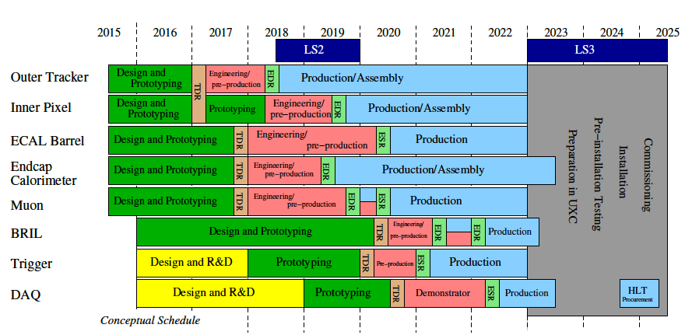
International CMS Upgrade Cost and Schedule
Overall schedule from the TP
Does not take into account new LHC schedule

Slide 40
CMS HL-LHC: Costs / Schedules
The bottom line CORE cost of the project as proposed is 265MCHF
We have been asked to design also for a total CORE contribution of 235MCHF and 200MCHF
These scenarios will come in the form of a “scoping” document
The scoping document will document the performance of an upgraded CMS to within the cost scenario
It is being actively worked on now, a preliminary version will be given to the LHCC at the end of July and the final version in September

Slide 41
CMS HL-LHC: USCMS plans
USCMS plans

Slide 42
USCMS HL-LHC upgrades
The USCMS part of the CMS HL-LHC upgrades will be ~$230-260M
  NSF ~$70-80M
  DOE ~$160-180M
These numbers are “fully burdened”, including technical labor time, pre-production, production, all steps up to delivering the upgrades to CERN
This is commensurate with our ~29% fraction of the entire CMS collaboration
The NSF money will come from a Large Facilities grant (MREFC), which is joint with ATLAS and will be in the $150M range
  For USCMS this will be mainly focused on the NSF “flagship” detector, the forward pixel detector (i.e. extending tracking to |η|~4)
  Not only critical for interesting physics, but US NSF groups have considerable FPIX experience on CMS (construction / Phase 1)

Slide 43
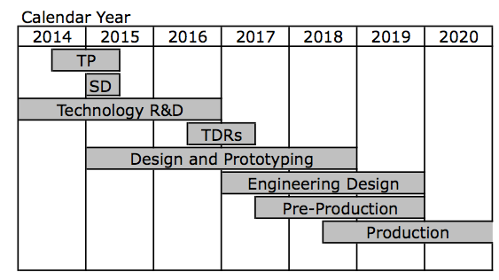
CMS HL-LHC: USCMS project schedule
The USCMS HL-LHC upgrade project is being established
TDRs
NSF Physics case
Joint ATLAS/CMS
Spring 2015
DOE CD3a
NSF Conceptual Design report (~CD1)
DOE CD0
NSF Preliminary Design Report (~ CD2)
DOE CD1
NSF Final Design Report (~CD3)
DOE CD2
DOE CD3 at the same time or soon thereafter
This is the big review step for NSF
This is the big review step for DOE

Slide 44
USCMS interests in HL-LHC
Based on CMS needs / priorities and on US needs / priorities
  Forward Pixel Detector
    US designed/built original FPIX and Phase 1 upgrade
    This is the NSF flagship project for the HL-LHC
  Outer Tracker + Track Trigger
    USCMS has a long history of building trackers, and is playing a leading role in R&D for the Track Trigger
  Barrel Calorimeter (EB / HB)
  Muon detectors
    CSC electronics / GEM electronics
  Trigger / DAQ
    We have a strong history and leadership roles in trigger / DAQ
    Will continue to build on this – however Trigger/DAQ TDR comes later.
  Endcap calorimeter (HGCal)
    R&D needs to ramp up now for HGCal. US will be building modules / cassettes, participating in ASIC development, mechanics, cooling, powering, etc.
  BRIL (Beam, Radiation, Intensity, Luminosity)
    US has a strong community in luminosity and luminosity detectors.

Slide 45
CMS HL-LHC: USCMS project organization
P2 Upgrade Project
402.01 Project Office
Project Manager: V. O’Dell
Deputy(s) PM: A. Ryd
CMS liaison: J. Spalding
R&D coordinator: M. Chertok
ESH&Q Coordinator: NN
Project Controls: M. Kaducak (interim)
Project Finance: J. Teng
Risk Manager: L. Taylor
Project EE NN
Project ME NN
Phase 2 Advisory Board
John Cumalat
Aaron Dominguez
Jay Hauser
Jim Hirschauer
Joe Incandela
Markus Klute
Steve Nahn
Colin Jessop, ND
402.04 Endcap Calo
402.04.03 HGCal
402.04.04 BH
A. Safonov, TAMU
Chris Hill, OSU
Karl Ecklund, Rice
Jeremy Mans, Minn
TBN
TBN
402.02 Tracker
402.02.03 FPIX
402.02.04 OT + TT
402.03 Barrel Calo
402.03.03 ECAL Barrel
402.03.04 HCAL Barrel
402.05 Muons
402.05.03 CSC
402.05.04 GEM
402.06 Trigger
402.06.03 Cal Trigger
402.06.04 Muon Trigger
402.06.05 Track Correlator
402.07 DAQ
&HLT
Still to be named: L2’s for DAQ/HLT/BRIL

Slide 46
USCMS HL-LHC R&D
USCMS operations funding has been supporting a modest amount of R&D for HL-LHC over the last few years
  Ramping up to ~ $3.5M in 2015
  Focusing in priority areas of USCMS interest
    Pixels, tracker, track trigger, endcap calorimetry, trigger and DAQ
In addition, CMS Phase 2 benefits significantly from R&D funded under KA25
  Examples: RD53 pixel chip development, Associated memory chip, R&D on rad-tolerant scintillators and silicon wafers
USCMS HL-LHC upgrade project being launched
  This means project management (L2’s, L3’s in consultation with Project Manager) will be defining the priorities and R&D (+OPC) profiles over the life of the projects

Slide 47
Summary / Conclusions
CMS HL-LHC upgrades being defined
  The technical proposal and costing is done
  The scoping document will come next
USCMS HL-LHC upgrade project being launched
  Important first steps for both DOE and NSF will happen at the end of this year, beginning of next
  The project will be officially launched in FY16!

Slide 48
Backup slides

Slide 49
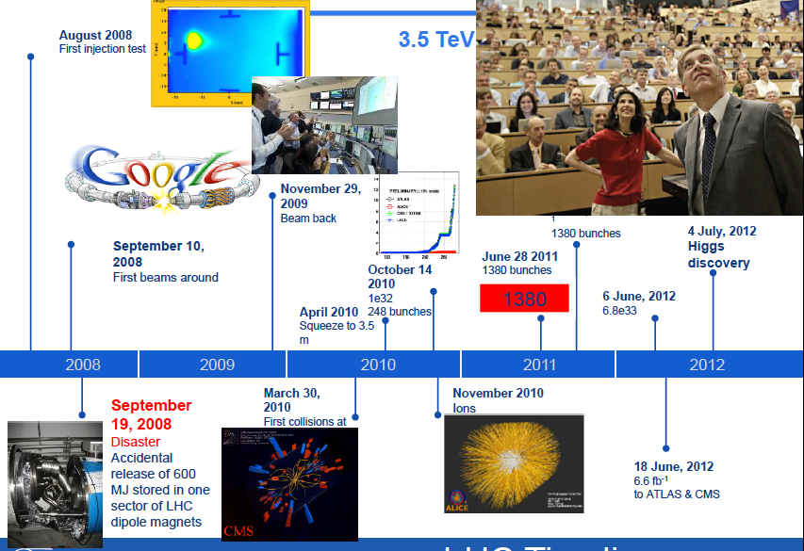
LHC past: In a Nutshell

Slide 50
Higgs: current status
The Higgs Boson has been found
  We don’t understand its mass
  This discovery was a triumph for the entire field (not just the Nobel prize winners ☺ )
The properties of the Higgs match the SM prediction within our measurement capability
  For mass / spin-parity this is pretty good
  For couplings, our present ability allows us to (only) see large deviations from SM predictions
What do we want to do in the future?
  Measure couplings much more precisely
    More stringent tests of SM
  Look for new phenomena
    The (lightish) mass of the Higgs implies there are more things at play
    Fine-tuning? (i.e. SM parameters are what they are just because)
    Additional Higgs / Beyond Standard model particles
  Will we find anything new at the LHC
  If not, what next?
  If we do, what next?

Slide 51

Phase 2 TDAQ / Computing
Trigger / DAQ upgrades for HL-LHC
  L1 track trigger, increased granularity for ECAL / HCAL trigger, more cross detector triggers
  L1 rate 500-750 (100) kHz, latency <12.5 (4)μsec, HLT output rate 5-7.5 (1)KHz, event size 4.5 (1)MB
    () = Run 1 / 2 values
    Implies upgrades in front end electronics, full replacement of trigger / DAQ systems
Computing
  Must reconstruct / analyze 5-7x more (and more complex) data → ~65-200x more CPU, ~20x more storage
  Track market drivers for networking, storage, CPU
    Must adapt our computing model to the market

Slide 52
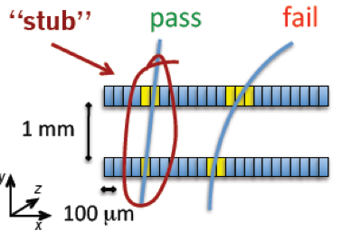
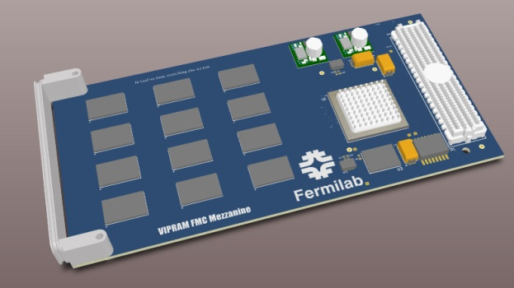
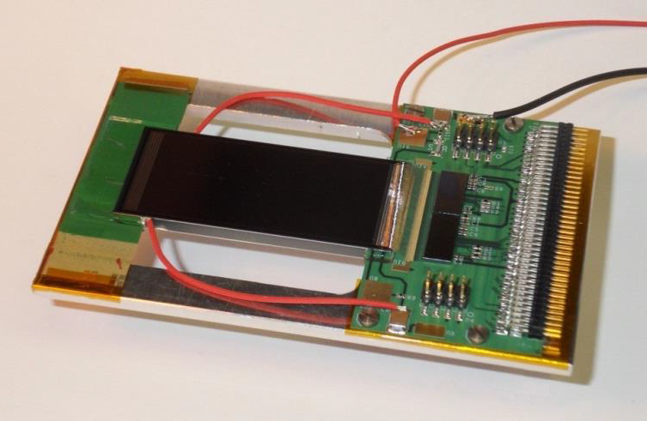
Phase 2 L1 Track Trigger
Tracker modules provide both 40MHz Level-1 data and 100 kHz readout data
Level-1 data allow local rejection of low-pT tracks
  Reduce bandwidth, and simplify track finding @ Level-1
  Threshold of ~ 2 GeV
  ⇒ data reduction of one order of magnitude or more
2 backend approaches based on input stubs
  Associative memory chips (a la CDF)
  Pure FPGA
All Outer Tracker modules are trigger modules

Slide 53
Phase 2 (HL-LHC)
Schedule

Slide 54
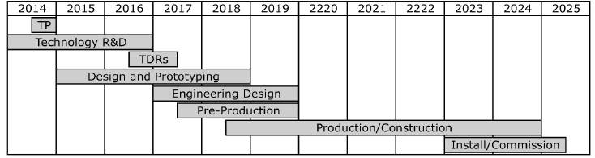
International CMS Schedule

Slide 55
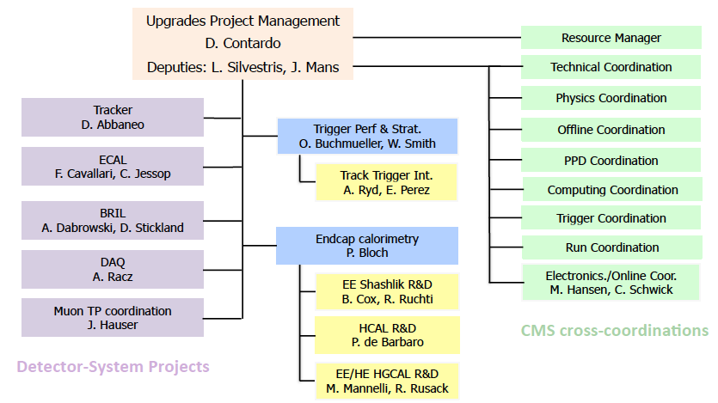
International CMS Phase 2
Technical Proposal Studies
(part of Physics Coordination):
M. Klute, L. Silvestris
  Fast Timing
T. Tomasso, C. Tully

Slide 56
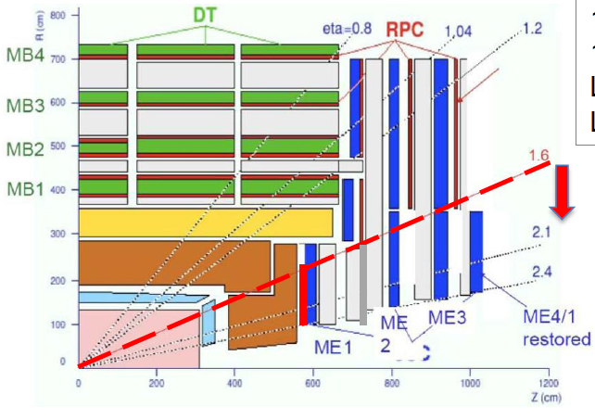
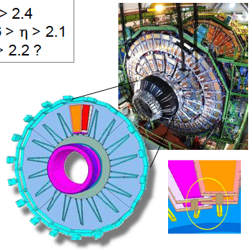
CMS GE1-1 Muon Trigger Upgrade
New GE1-1 GEM Muon Station
Combined with ME1 can
substantially improve p_{T} determination
To reduce trigger rate

Slide 57
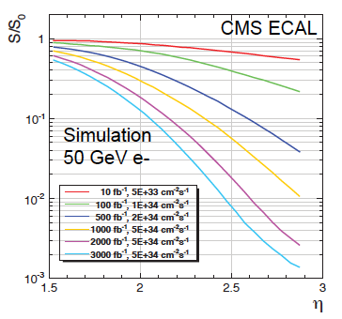
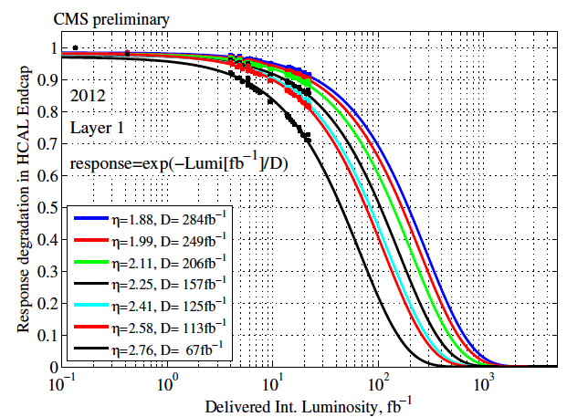

Calorimeters in HL-LHC
Extensive studies of radiation damage
  Both in test exposures and using the ~30fb⁻¹ of CMS data
  Compared with full CMS simulations
Upshot
  Barrel ECAL / HCAL and HF can survive 3000 fb-1
  Must replace ECAL and HCAL endcaps before HL-LHC (300-500fb⁻¹)
Notes:
Remember HF is iron-quartz fiber so is rad hard.

Slide 58
Outline
A few highlights from (USCMS) phase 1 upgrades

Slide 59

Phase 1 Reminder
Hadron Calorimeter (HCAL):
  Higher gain “frontend” photosensors
  and readout for HF, HB/HE
    longitudinal granularity
    timing information
  Higher bandwidth “backend” electronics
Level 1 Muon, Cal Trigger (L1T)
  Modern electronics system (μTCA)
  more sophisticated algorithms
  expanded amount of input data
Forward Pixels (FPIX):
  3 layer endcap pixel detector
    improves tracking and vertexing due to extra layer and less mass
    mitigates data loss due to modern readout chip electronics.
30 institutes, ~ $42M (=Phase 2 ÷ 6)
HCAL
Longitudinal Granularity
Timing info
FPIX
2→3 disks
Less mass
L1 Trigger
(Muon, Calorimeter)
Faster, Smarter Algos

Slide 60


HCAL Progress
HCAL Backend
  HF installed, mostly commissioned
  HE/HB 7 of 9 crates installed
  Perfect agreement in Beam
HF Front End
  In production, on schedule for January installation
HB/HE Front End
  Pre-production slice test in test beam, August
  Preparing production order of Silicon Photomultipliers (big ticket item)
Upgrade
Legacy

Slide 61


FPIX progress
First production batches in hand:
    Sensors
    Readout Chip
    Token Bit Manager
    High Density Interconnect
    Mechanical components
  Good yields, no showstoppers
In 2nd round of Preproduction Module Assembly
  Validating QA procedures on 30 modules at Nebraska, Purdue
April Modules and Mechanics Reviews Successful

Slide 62




L1T Progress
Muons: MTF7 board in Production
  16 new + 2 pilot MTF7 Motherboards assembled
  36 Optical Boards in production
Calorimetry
  Stage 1 (or “2015 trigger”)
    On precipice of supplanting the legacy trigger
  Stage 2 (or “2016 trigger”)
    Production done, full system installed
    Working on interface commissioning between inputs and outputs
Software and emulation work ongoing as well

Slide 63
Phase 2 Track Trigger
FNAL Pulsar 2b FNAL Pulsar 2b
INFN Mezzanine card
for AMchip05/06
FNAL Mezzanine card
for protoVIPRAM02
Data Sourcing
Data
Formatting/Delivery
Pattern Recognition
Track Fitting
Emulate trigger data
from upstream
Deliver stubs to the pattern recognition engine
Fast PR using AM chips
Calculate track parameters in FPGA
Δt1
Δt2
Δt3
Pulsar- 2b/RTM/
IPMC
DS Firmware/
software
Pulsar- 2b/RTM/
IPMC
PRB Firmware
PR Mezzanine Card
Data Organizer firmware
+ AM Chips
Followed by Track Fitting firmware
Notes:
Current TOP: designed to handle 500fb-1 & 50 pileup events
(Pixel detector replaced in PI @ ~150fb-1).
Both detectors will have to be replaced during LS3 (no other convenient time during HL-LHC).
Also restrict DAQ to 100KHz – 4 microsec latency.
Current detector: red is single sided, blue mounted back-to-back
For upgraded tracker: 2S modules: pairs of strip censors, PS = 2 sensors, 1 segmented in 2.5cm strips, 100 micron pitch, the other is “macro-pixel” 100 microns x 1.5mm

