Slide 1
Strategic Planning Process
Erik Gottschalk
Fermilab Physics Advisory Committee Meeting – June 22-25, 2015
22 June 2015

Slide 2
Overview
Motivation
Strategic plan – Handout
Communicating the plan – Annual Lab Plan
Lab goals, objectives, activities…
Planning process
Next steps

Slide 3
Motivation for strategic planning
Wikipedia: Strategic planning is an organization’s process of defining its strategy and deciding on allocation of resources to pursue the strategy.
The P5 plan is the strategy for the U.S. particle physics community “for the next decade and beyond that enables discovery and maintains our position
as a global leader through specific investments”
Fermilab’s strategic planning process has several goals:
  Align the lab’s strategic plan with P5
  Engage more people in strategic planning
  Communicate lab strategy in a consistent manner
  Provide context for budget planning, lab priorities, resource planning...

Slide 4

Fermilab’s plan – Six themes motivated by the P5 plan
Handout – Page 2
Neutrino science
Large Hadron Collider science
Precision science
Cosmic science
Accelerator science
Building for science

Slide 5

Neutrino Science
Handout – Page 3
In 10 years, Fermilab will be to neutrinos what CERN is to the Higgs boson.
Lab Goals (5 years)
N1) Support detector R&D and new initiatives in neutrino science – “neutrino platform”
N2) Build the short-baseline neutrino program
N3) Deliver the world’s highest power beams for neutrino science
N4) Partner internationally to host a world-leading long-baseline neutrino program
Nigel S. Lockyer | Fermilab Annual Laboratory Plan
6/26/2015

Slide 6
Neutrino Science – Lab goals and objectives
Neutrino Science
Handout – Page 4
N1) Support detector R&D and new initiatives in neutrino science – “neutrino platform”
  Exploit existing facilities and add capability
  Consider flexibility in designing new facilities
N2) Build the short-baseline neutrino program
  MicroBooNE taking data in 2015
  SBND built and taking data by 2018
  Refurbished ICARUS detector at Fermilab and taking data by 2018
N3) Deliver the world’s highest power beams for neutrino science
  PIP (700kW), Booster (15 Hz) to fully exploit the science of NOvA and SBN
  PIP-II (1.2 MW), PIP-III (2.4 MW) to fully exploit the science of DUNE
N4) Partner internationally to host a world-leading long-baseline neutrino program
  Cavern construction begins 2017 at the Sanford Underground Research Facility
  Begin installation of 1st 10-kiloton detector module deep underground by 2022
  Additional 30 kilotons of space excavated
  Neutrino beamline completed 2025

Slide 7
Communicating the plan
An important aspect of the strategic planning process is to communicate lab strategy in a consistent manner.
The strategic planning process has been used to structure:
  Annual Lab Plan document – “Each year the Department of Energy (DOE) Office of Science (SC) engages its laboratories in a strategic planning activity that asks the laboratory leadership teams to define an exciting, yet realistic, long-range vision for the future of their respective laboratories. This information provides the starting point for a discussion between the SC leadership and the laboratory about the laboratory’s future directions, strengths and weaknesses, immediate and long-range challenges, and resource needs.”
  Annual Lab Plan presentation – Nigel’s presentation of the lab’s strategic plan to DOE is scheduled to occur on June 26, 2015.
Notes:
Fermilab’s ALP is a 40-page document. The draft ALP was sent to DOE on May 1, 2015. The final version will be sent to DOE in July.

Slide 8

ALP – Slide 3

Slide 9
Fermilab’s science strategy: Diversity + flagship
ALP – Slide 4
We are following the P5 plan
Existing, diverse, and successful discovery science program
  Driving Large Hadron Collider science and future upgrades
  Revealing precision science
  Advancing accelerator science
  Exploring cosmic science
  Focusing on neutrino science
The new flagship program: Long Baseline Neutrino Facility (LBNF) + Deep Underground Neutrino Experiment (DUNE)

Slide 10
Strategic planning system – database architecture
Lab goals, objectives, and activities are entered and managed in a database.
  https://fermipoint.fnal.gov/organization/ocoo/ippm/SitePages/Home.aspx
Strategic Themes
Accelerator
Science
Cosmic
Science
Large Hadron Collider Science
Neutrino Science
Precision Science
Building for Science
Lab Goals
(5 years)
Lab Goal
1
Lab Goal
2
Lab Goal
3
Lab Objectives / Outcomes
Satisfy “SMART” criteria
Lab Objective 1.1
Lab Outcome 1.1.1
Lab Objective 3.1
Lab Objective 3.2
Lab
Activity
X
Lab
Activity
Y
Lab
Activity
Z
U: pacvisitor
P: Planning2015
Lab Activities
(summarized in lab agenda)

Slide 11
Terminology
Terminology for strategic planning process defined in requirements document:
  https://sharepoint.fnal.gov/org/do-ippm/Shared%20Documents/Strategic-Plan-Development-Rev1.0.pdf
Lab agenda: A table that presents lab activities and their status for activities occurring in the current fiscal year.
Lab goal: Long-term, high level aim for the lab established by strategic planning to achieve the lab’s mission as defined by the science community and the DOE. A goal is required to have at least one lab objective or outcome linked to the goal in the strategic planning database, and is not required to have a target date.
Lab objective: A concrete attainment that satisfies SMART criteria. A lab objective is required to have a link to a lab goal to satisfy the fourth criterion (relevance), and a target date to satisfy the fifth criterion (time‑bound).
SMART: An acronym that provides criteria for establishing objectives. We use: Specific, Measurable, Achievable, Relevant, Time‑bound.

Slide 12
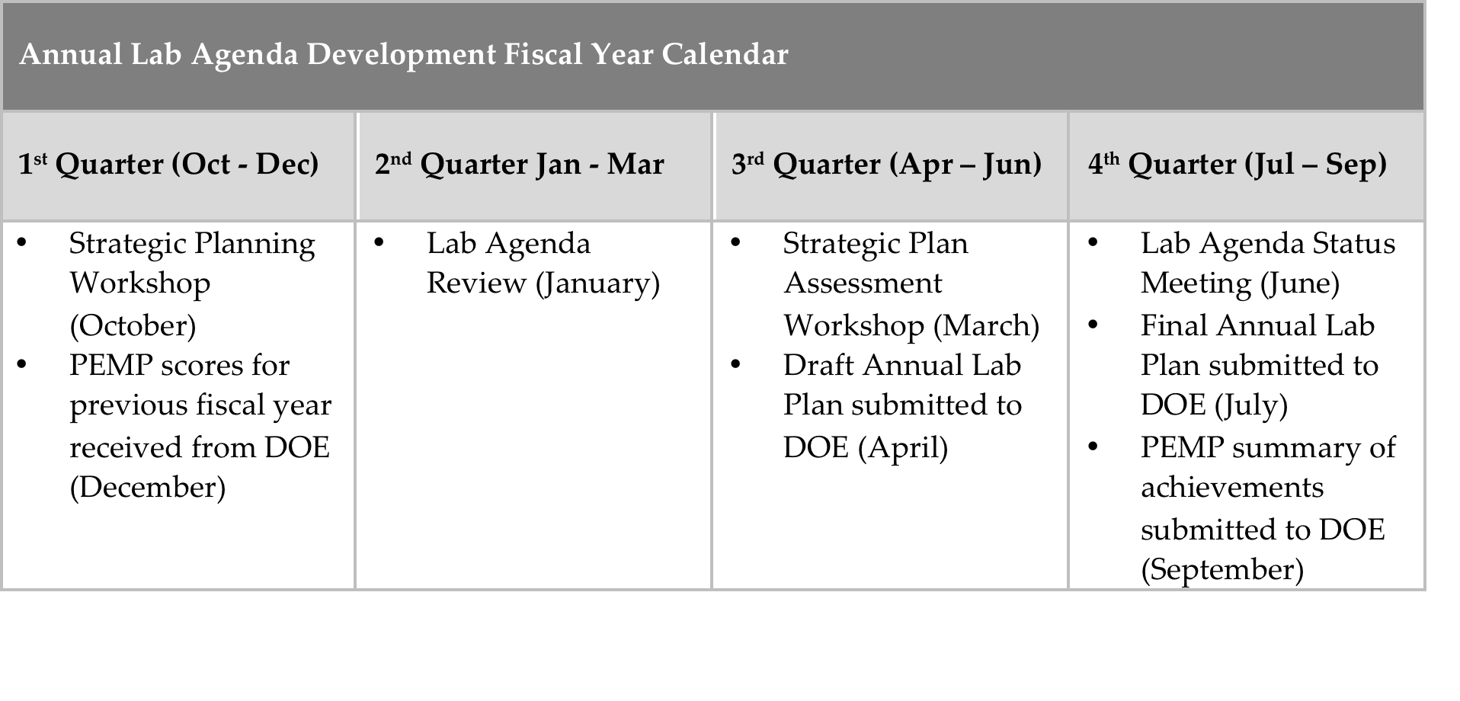
Strategic planning process (1st year)
An annual process:
Establish lab goals ✓
  Goals are established in an annual workshop (1st workshop held Jan. 7-8, 2015)
Establish lab objectives ✓
  Objectives are established by theme teams for each of the 6 strategic themes
Establish lab agenda for current fiscal year
  We will establish the lab agenda at our next strategic planning workshop
Provisional
planning
calendar
Notes:
We are in the 1st year of defining the lab’s strategic planning process.

Slide 13
Theme Teams
Strategic Theme | Team Leader(s)
Accelerator Science | Swapan Chattopadhyay and Alexander Romanenko
Cosmic Science | Hugh Lippincott
LHC Science | Jim Hirschauer
Neutrino Science | Sam Zeller
Precision Science | Brendan Casey
Building for Science | Jolie Macier and Marc Kaducak

Slide 14
Next steps
We are in the first year of defining the lab’s strategic planning process.
The lab’s process has been used to:
  Align the lab’s strategic plan with the P5 plan
  Engage more people (theme teams) in strategic planning
  Communicate lab strategy in a consistent manner (Annual Lab Plan)
The next steps are to:
  Develop the lab agenda to summarize lab activities and their status
  Integrate enterprise risk management with strategic planning
  Complete the development of requirements for the strategic planning process to provide context for budget planning, facilities planning, resource planning…

Slide 15
Backup slides

Slide 16
Strategic planning system
DOE Mission and Science Community
PEMP
Themes
Strategic areas
Accelerator
Science
Cosmic
Science
Large Hadron Collider Science
Neutrino Science
Precision Science
Building for Science
PEMP
Performance Evaluation and Measurement Plan
Goals
Long-term strategic aims
Lab Goal
1
Lab Goal
2
Lab Goal
3
PEMP
Goal 1
PEMP
Goal 2
PEMP
Goal 3
Objectives / Outcomes
Well-defined “SMART” aims / end results
Lab Objective 1.1
Lab Outcome 1.1.1
Lab Objective 3.1
Lab Objective 3.2
PEMP
Objective 2.1
PEMP
Objective 2.2
Notable Outcome 2.2.1
Achievement A
We have implemented:
Strategic Planning Database
The database includes strategic themes, goals, and objectives as well as PEMP goals, objectives, and notable outcomes to track the lab’s progress.
Lab
Activity
X
Lab
Activity
Y
Lab
Activity
Z
Achievement B
Achievements
Attached documents and links describing successes
Lab Activities
Work needed to achieve objectives
– used in Lab Agenda

Slide 17
Strategic planning system
DOE Mission and Science Community
PEMP
Themes
Strategic areas
Accelerator
Science
Cosmic
Science
Large Hadron Collider Science
Neutrino Science
Precision Science
Building for Science
PEMP
Performance Evaluation and Measurement Plan
Goals
Long-term strategic aims
Lab Goal
1
Lab Goal
2
Lab Goal
3
PEMP
Goal 1
PEMP
Goal 2
PEMP
Goal 3
Objectives / Outcomes
Well-defined “SMART” aims / end results
Lab Objective 1.1
Lab Outcome 1.1.1
Lab Objective 3.1
Lab Objective 3.2
PEMP
Objective 2.1
PEMP
Objective 2.2
Notable Outcome 2.2.1
Achievement A
Next to be implemented:
Enterprise Risk
Risks that could jeopardize strategic lab objectives – including high-rank project risks
Lab
Activity
X
Lab
Activity
Y
Lab
Activity
Z
Achievement B
Enterprise Risk A
Enterprise Risk B
High-Rank Project Risk C
Achievements
Attached documents and links describing successes
Lab Activities
Work needed to achieve objectives
– used in Lab Agenda
Notes:
Move up to beginning?

Slide 18
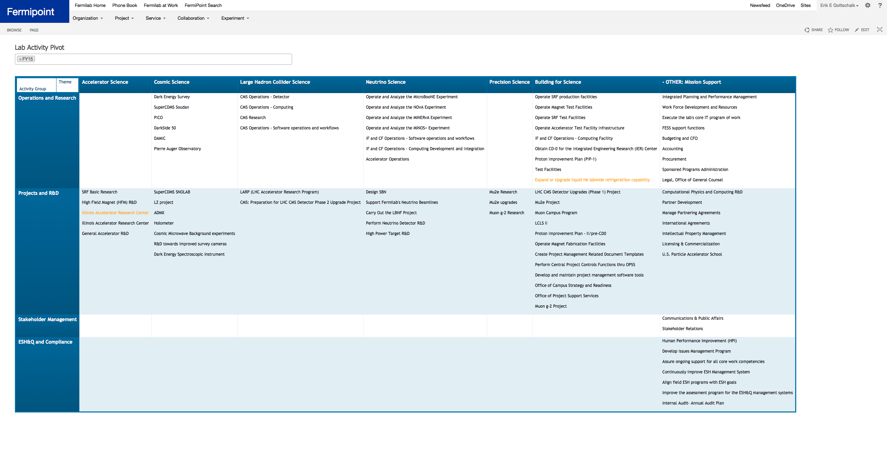
Provisional lab agenda

Slide 19
Strategic planning system diagram
Reference: https://sharepoint.fnal.gov/org/do-ippm/Shared%20Documents/SPS-CONOPS-Rev1.1.pdf

Slide 20
SPS requirements task force
Purpose: Develop requirements for SPS, a Fermilab system to integrate strategic planning with budget planning, resource planning, and risk management. A task force was formed in response to a DOE requirement articulated as a notable outcome in the FY2014 Performance Evaluation and Measurement Plan.
Members:
  Steve Brice (ND)
  Paul Czarapata (AD)
  Ami Dave (PPD)
  Paul Derwent (AD)
  Erik Gottschalk (Integrated Planning and Performance Management)
  Marc Kaducak (Office of Project Support Services)
  Karen Kephart (Office of the CPO)
  Elliott McCrory (AD)
  Scott Nolan (Office of the CIO)
  Randy Ortgiesen (Office of Campus Strategy and Readiness)
  Lucas Taylor (Integrated Planning and Performance Management)
  Tammy Whited (Office of the CIO)

