Slide 1
MICE briefing
8 June 2015
K. Long
Imperial College London/STFC

Slide 2
A briefing on MICE:
November 2014 MICE project was rebaselined:
  NSF briefing 07Jan15:
    Start of study of ionization cooling; summer 2015
    Demonstration of ionization cooling start; summer 2017
International review of MICE 17 & 18 April 2015:
  Resource Loaded Schedule Review
  MICE Project Board
  Funding Agency Committee
NSF has made substantial investments in MICE:
  This briefing an opportunity to present:
    Outcome of recent international review
    Status of the project and the preparations for data taking
Renew invitation to event to mark the start of the MICE study of ionization cooling:
  25th June 2015; STFC Rutherford Appleton Laboratory

Slide 3
Contents
Motivation
April 2015 review
Status
[Emphasis on Step IV]
Papers
Conclusions

Slide 4
Motivation
MICE briefing

Slide 5
Muon beams for particle physics
Muon beams have the potential to:
  Serve neutrino physics by providing intense beams with:
    Precisely known flavour content;
    Precisely known energy spectrum
  Provide multi-TeV lepton-anti-lepton collisions:
    With extremely small energy spread;
    Most cost-effective means to achieve E_{CM} > 1. TeV
Incremental path to Neutrino Factory
and Muon Collider:
  Articulated by:
    US Muon Accelerator Program—“Muon Accelerator Staging Study”
    International Design Study for the Neutrino Factory collaboration (RDR)

Slide 6
Neutrino Factory & Muon Collider concept

Slide 7
Neutrino Factory
Optimise discovery potential for CP and MH:
  Requirements:
    Large ν_{e} (ν_{e}) flux
    Detailed study of
    sub-leading effects
Unique:
  Large, high-energy
  ν_{e} (ν_{e}) flux
  Optimise event rate
  at fixed L/E
    Optimise MH sensitivity
    Optimise CP sensitivity
Flux critical:
  Ionization cooling huge advantage

Slide 8
Muon Collider
Optimum route to multi-TeV lepton-anti-lepton collisions:
  Muon mass; 200 times that of the electron mitigates:
    Synchrotron radiation;
    Beamsstrahlung
  Muon rigidity allows efficient acceleration
    Results in cost-efficient acceleration to very high energy
Luminosity critical:
  6D ionization cooling essential

Slide 9
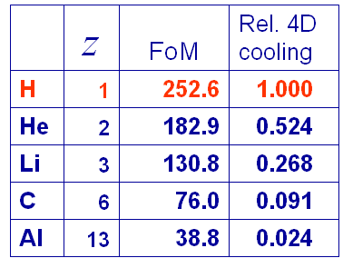
Ionisation cooling formalism
Exponential decrease in normalised emittance:
Competition between:
  dE/dx [cooling] and MCS [heating]
Optimum:
  Low Z, large X₀
  Tight focus
  H₂ gives best
  performance

Slide 10
Muon Ionization Cooling Experiment
MICE approved to:
  Design, build, commission and operate a realistic section of cooling channel
  Measure its performance in a variety of modes of operation and beam conditions
    Results will allow Neutrino Factory [and Muon Collider] complex to be optimised
Requirements:
  Normalised transverse emittance: 0.1%
    Requires selection of 99.9% pure muon sample

Slide 11
MICE rebaselined, November 2014:
International review organised by host organisation, STFC:
    MICE Project Board and [international] Funding Agency Committee:
      Endorsed reconfiguration proposed by collaboration.
Study of the factors that affect ionization cooling (Step IV):
  Construction complete: Spring 2015 [see later]
  Data taking: Summer 2015—June 2016
Demonstration of ionization cooling:
  Construction complete: Early 2017
  Data taking start: Spring 2017

Slide 12
Reviews and recommendations
MICE briefing

Slide 13
MICE Project Board; Apr15

Slide 14
Resource Loaded Schedule Review, Apr15

Slide 15
Status
[Emphasis on Step IV]
MICE briefing

Slide 16
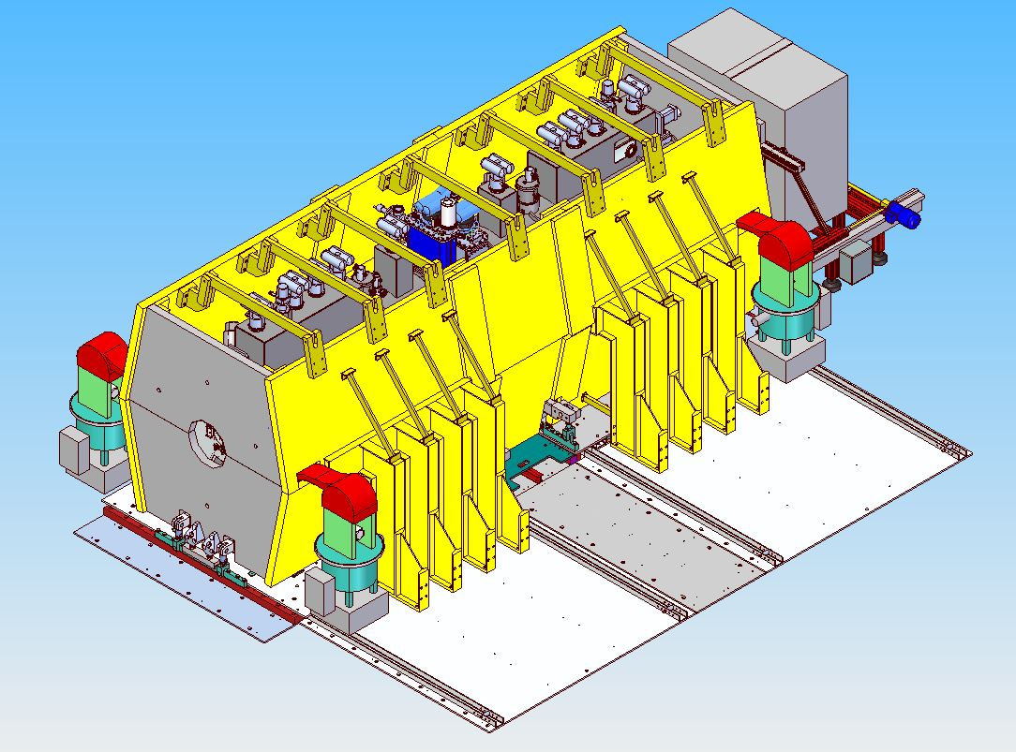
Step IV component status summary
Slide from 07Jan15 briefing
Spectrometer solenoids:
  Upstream:
    Tracker fitted;
    Installed in MICE Hall
  Downstream:
    Tracker fitted;
    Installed in MICE Hall
Focus coil:
  FC1:
    Available at RAL
  FC2:
    Installed in MICE Hall
Partial return yoke:
  Material procurement complete;
  Installation of “below-floor” structures well advanced;
  Above-floor framework complete (at Keller Tools Inc., NY);
  Shielding plates being machined

Slide 17
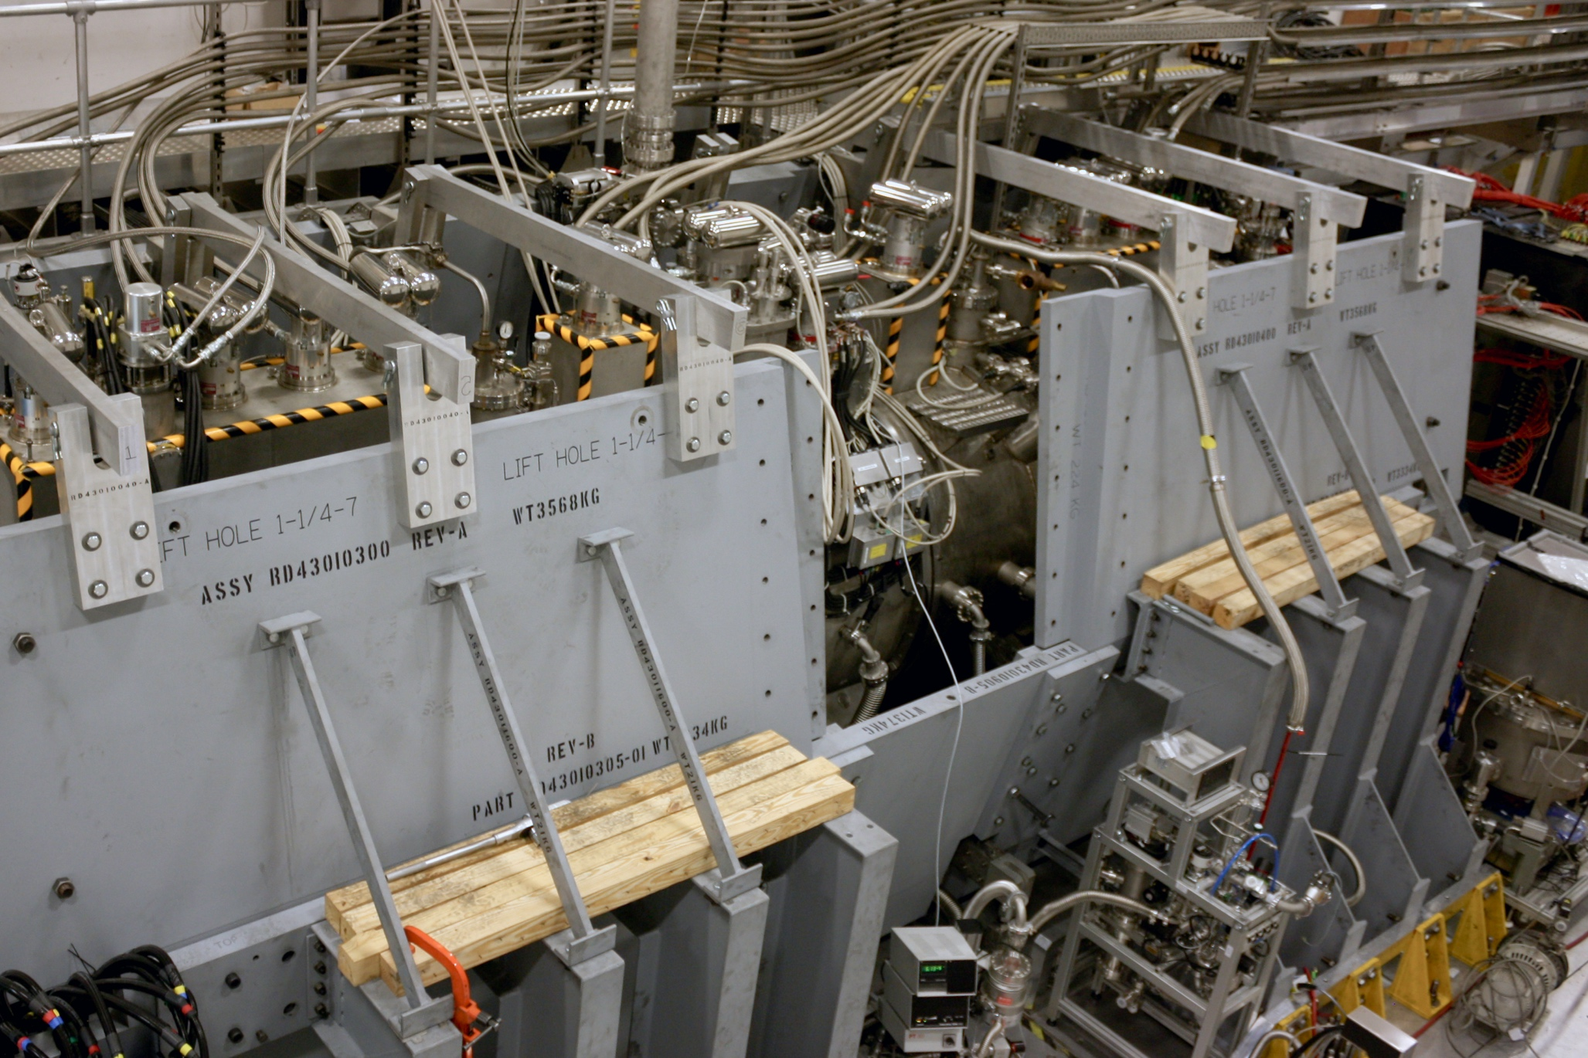
Step IV installation

Slide 18
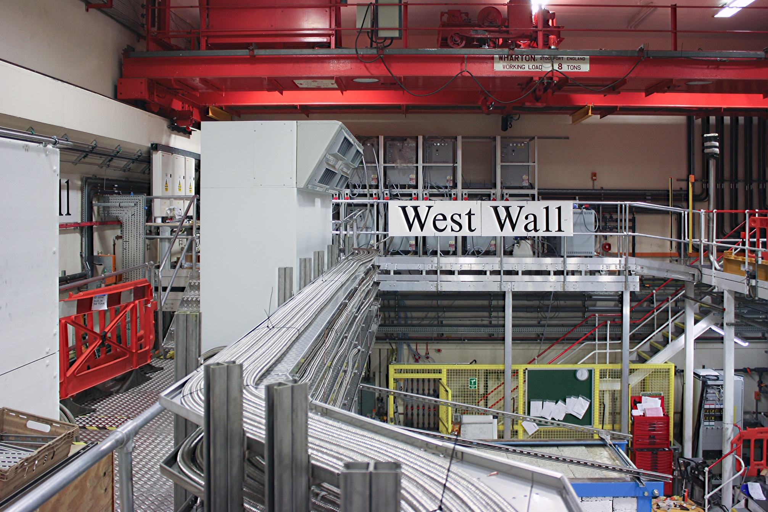
Step IV installation

Slide 19
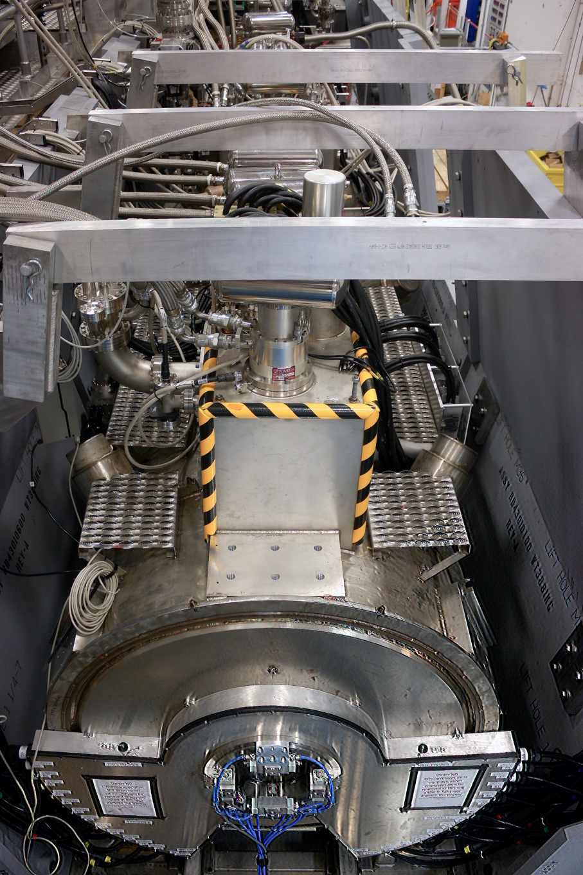
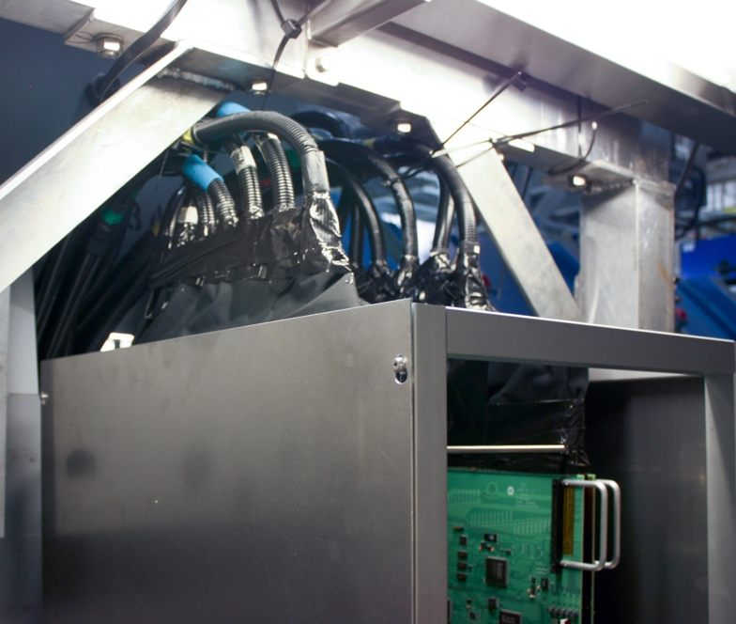
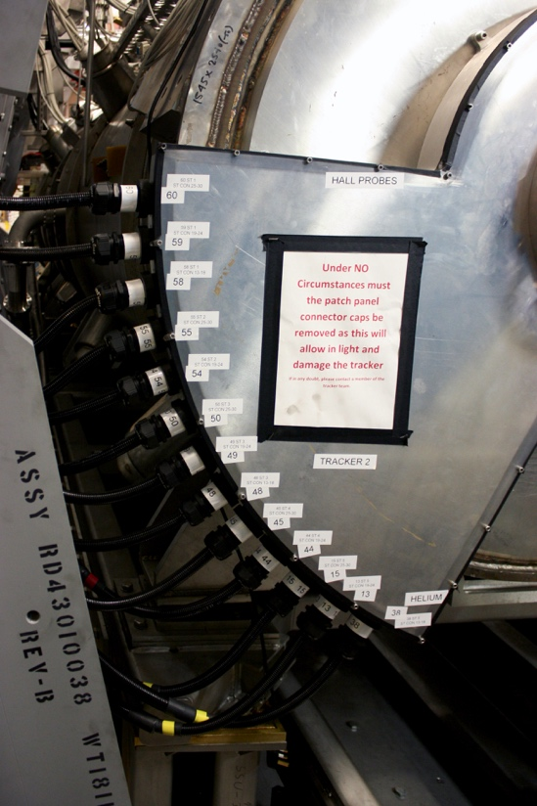
Step IV installation

Slide 20
Step IV installation status
PRY installed
  All plates fitted
    End-plates & “removable” middle plate removed for access
MICE-channel magnets
  “In position”
    Surveyed; verify with tracks
  Services
    High-pressure hoses complete
      Down-stream solenoid termination Monday 08Jun15
    Power: complete
    Sensor cables: complete
Instrumentation
  Commissioned:
    Time-of-flight system
    Cherenkov counters
    Calorimetry
      KL (preshower)
      EMR (totally active calorimeter)
  Scintillating-fibre tracker:
    Upstream:
      Calibrated;
      Commissioning with beam started
    Downstream:
      Calibration underway

Slide 21
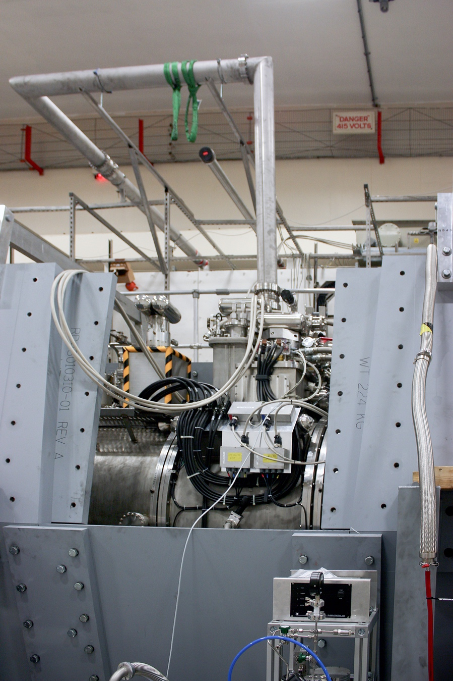
First absorber for Step IV
Safety review of LH2 system Jan15:
  Part of safety “sign-off to operate Step IV” process
  Required:
    Additional safety-window burst tests; and
    Enlarged emergency H2-gas evacuation line
Status of implementation:
  Burst-tests complete; satisfactory
  Enlarged relief line agreed and installed
Next steps:
  Demonstrate satisfactory operation with He gas
  Obtain permission to operate with LH2

Slide 22
Operations Mar/Apr
User Run 2014(03); March/April:
  16 hour operation
    2 shifts, Saturday & Sunday
Goals:
  March 2015 (no decay solenoid):
    Initial calibration of the TOF0,1 and CkovA and CkovB;
    Validate new FPGA-based trigger; and
    Take “pion” data to test muon beam-line optimisation.
  April 2015 (with decay solenoid):
    Initial optimisation of the MICE Muon Beam;
    Initial calibration of TOF2, the KL and the EMR; and

Slide 23
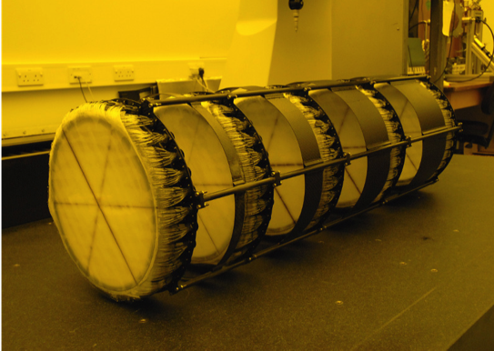
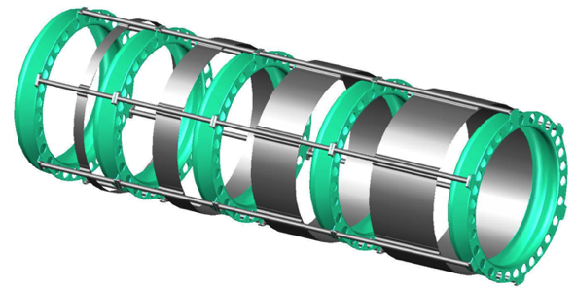
MICE trackers
Calibration of upstream tracker:
Left
Right
Pedestal
Pedestal
Gain
Gain
Pedestal
Pedestal
Gain
Gain

Slide 24
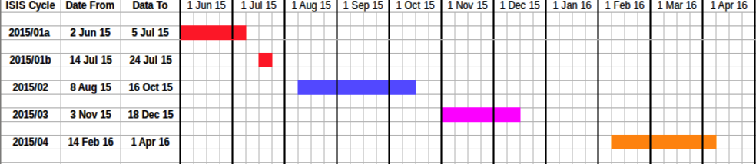
Operations: status
Present ISIS User Cycle “2015/01a”; 02Jun—05Jul
  Goals:
    Commissioning of spectrometer solenoids and focus coil
    Tracker commissioning with beam;
  Status:
    Tracker commissioning with beam started
    Magnet cool-down will start: 19—22 June 2015
      ~2 week delay c.f. plan presented in April 2015
Next ISIS User Cycle “2015/01b”; 14Jul—24Jul
  Goals:
    Data for alignment of channel
Step IV production running from 2015/02; 08A8g—16Oct

Slide 25
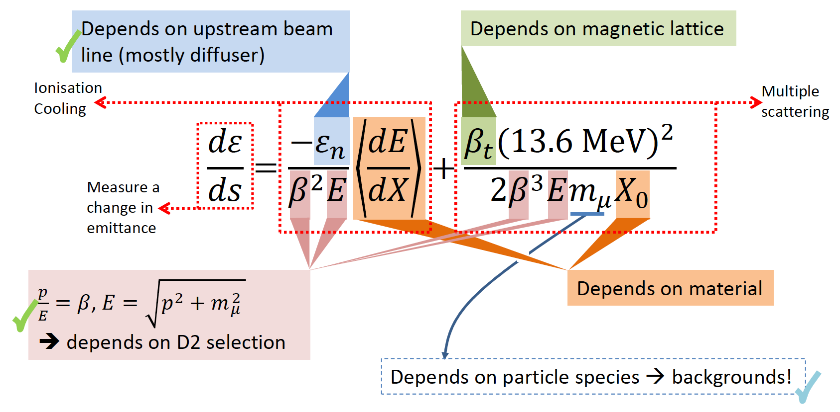
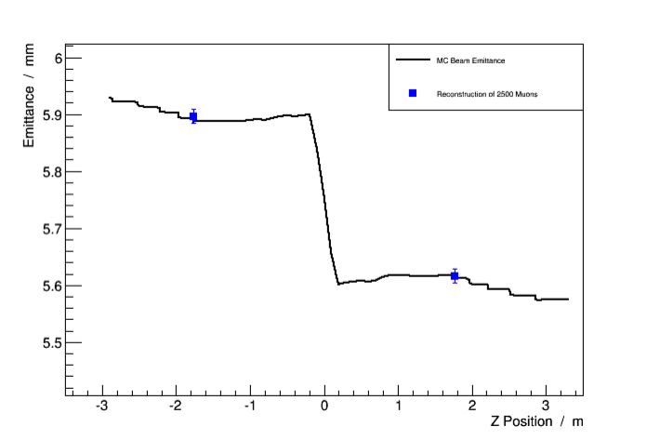
Step IV; scoping the “cooling equation”
Paraxial approximation:
Emittance:
  Varied through MICE Muon Beam optics and diffuser settings
Material:
  Absorber change (LH2; LiH);
p, E and β:
  Vary beam momentum, optics
Study of material, lattice, momentum and emittance (Step IV) will start 2015/02.

Slide 26
Demonstration of ionization cooling
Ionization cooling demonstration:
  Status of preparation of components:
  Cooling demonstration configuration complete: summer 2017
Known procurement
First cavity success in MTA!
First system commissioned
Procurement started (US)
Much already implemented

Slide 27
Single cavity modules
14.5 MV/m achieved
in magnetic field
  MICE requires 10.3 MV/m

Slide 28
Papers
MICE briefing

Slide 29
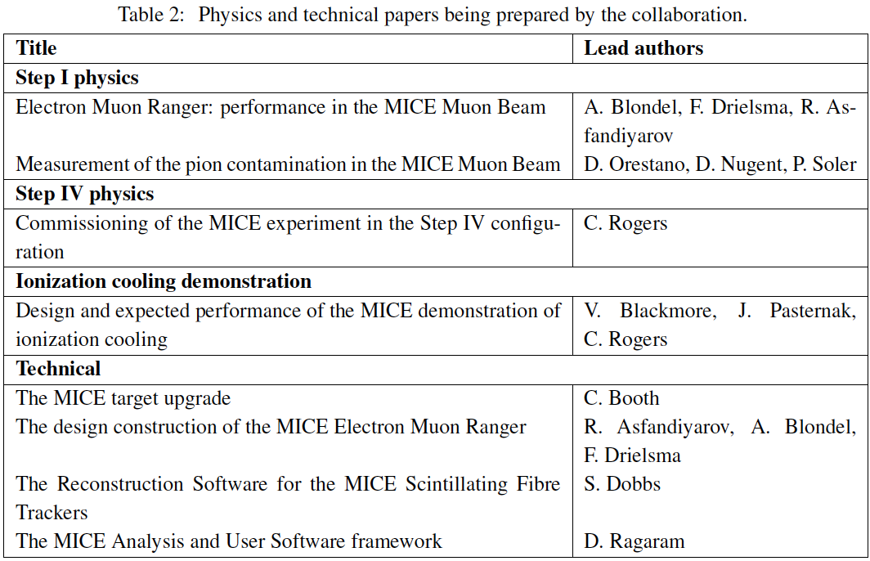
Papers in preparation
EMR: MICE Note ready for circulation to MICE; paper ready for wise-people
Pion contamination: analysis Note/paper being prepared for release
Work organised; KL/CR discussing how to expedite preparation
Analysis note and draft paper circulating
among authors
Draft in preparation
Draft under review in the EMR group
Draft at advanced stage: issue in track-fit being debugged
Draft being
assembled.

Slide 30
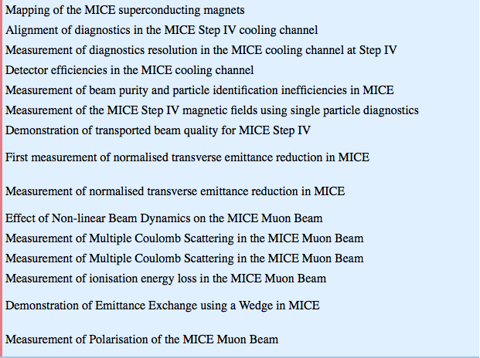
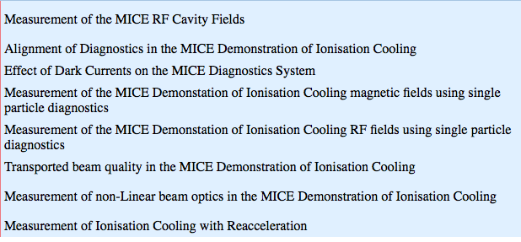
Publication plans
http://micewww.pp.rl.ac.uk/analysis/analysis_dashboard.html
Step IV
Cooling demo

Slide 31
Risk to delivery of full programme
Personnel required to deliver scientific programme:
  Faculty, post-docs and students;
    Excellent training ground
Asia and Europe:
  Reasonable expectation of attracting the necessary resource
US:
  Collaboration will be scientifically impoverished and US will not reap the full benefit from its intellectual, technical and financial input to the project without continued support through the operations and analysis periods of both Step IV and the cooling demonstration

Slide 32
Conclusions
MICE briefing

Slide 33
MICE collaboration [1]
3 regions
10 countries
31 institutes
69 PhD-level
physicists/
engineers *
* Common Fund levy

Slide 34
MICE collaboration [2]
New groups accepted into collaboration; Feb15:
  China:
    IHEP and Sichuan University
  Serbia:
    University of Belgrade
Funding:
  Continuation of funding confirmed in:
    Bulgaria, CERN, Italy, Netherlands, Switzerland
  Bids for continuation of funding required in:
    UK; STFC funding cycle, new award required 01Apr16
    EC; funds to allow Europeans to travel to MICE to be included in EUCARD3
  New bids for funding:
    Bid to NSF (Kaplan et al) under consideration

Slide 35
Recommendations:
  Completed with Nov14 rebaselining
Panel goes on to comment:
  Recognition of breadth of opportunity …

Slide 36
Conclusions
Muon accelerators have the the potential to:
  Revolutionise the study of the neutrino
  Provide a route to multi-TeV lepton-antilepton collisions
MICE:
  Will prove the essential ionization-cooling technique
  Has been rebaselined through the November 2014, international, MPB and FAC reviews
    Study of the factors that affect ionization cooling (Step IV):
      Construction complete: Spring 2015
      Data taking: Summer 2015—June 2016
    Demonstration of ionization cooling:
      Construction complete: Early 2017
      Data taking start: Spring 2017
En route to deliver the demonstration of ionization cooling

Slide 37
25th June 2015; invitation!
The STFC and RAL wishes to mark the start of study of ionization cooling:
  Collaboration RAL Events team organising on “mini conference”;
  Date:
    25Jun15, the day immediately following the next collaboration meeting.
Schedule:
  14:00 — 16:00: Extended seminar
  16:00 — 16:30: Coffee
  16:30 — 17:30: Public Lecture
  17:30 — 18:30: Wine and nibbles
  19:00 — Adjourn for dinner at a local restaurant
Formal invitations have been sent by the Laboratory:
  Be great if NSF can be represented!

