Slide 1
The DOE Supported Effort to Complete the MICE Ionization Cooling Demonstration
Mark Palmer
Fermilab
June 8, 2015

Slide 2
Preface
Would first like to follow up on Ken’s remarks:
The MICE experimental program is now starting to launch
Supported by strong STFC and DOE commitments to complete construction expeditiously
NSF has played a major role in supporting experimenters and deploying hardware for the experiment
Major investment by the agency and by the research groups
There is now unique opportunity to exploit the experiment
Results are absolutely necessary if a neutrino factory successor to the long baseline effort is required
Consistent with the overall P5 consensus that a neutrino factory remains a possibility for the future

Slide 3
Key Updates Since Our Last Meeting
In January…
Presented the re-baselined MICE plan
We were in the midst of…
Completing MICE Step IV Construction Activities
Conducting the remaining critical design and R&D steps towards the Ionization Cooling Demonstration
Now…
MICE Step IV Hardware a DELIVERED!
Cooling Demonstration RF R&D Results a DELIVERED!
Cooling Demonstration Design Work a Ready for procurement process a HARDWARE Deliveries expected Feb-June 2016 a Thus enabling cooling demonstration operations by mid-2017

Slide 4
MICE Step IV PRY Installation

Slide 5
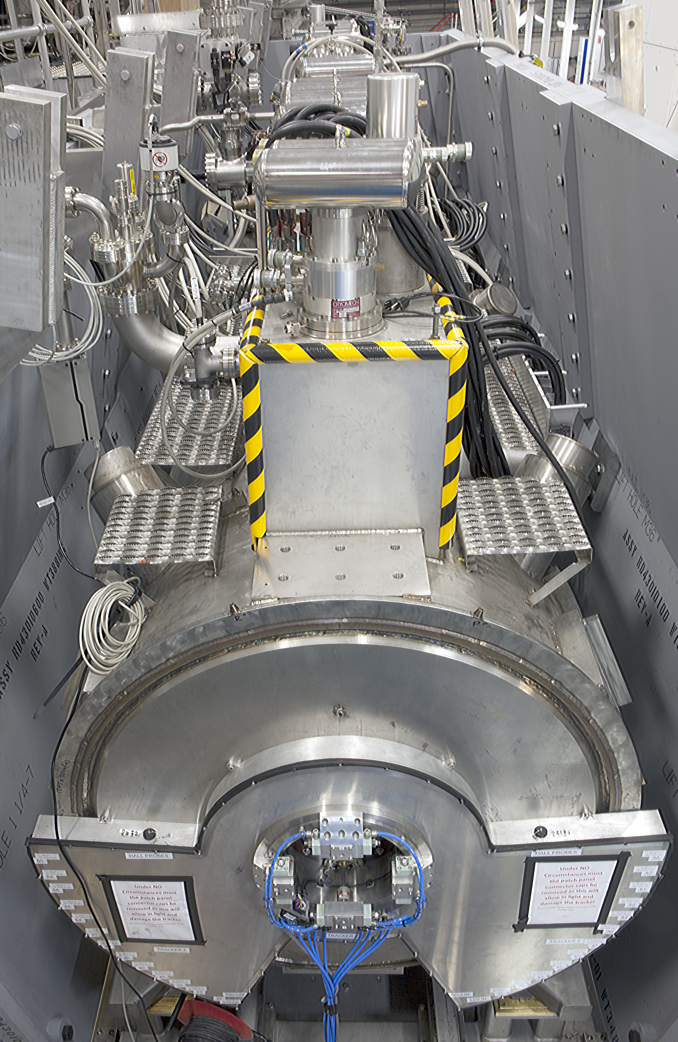
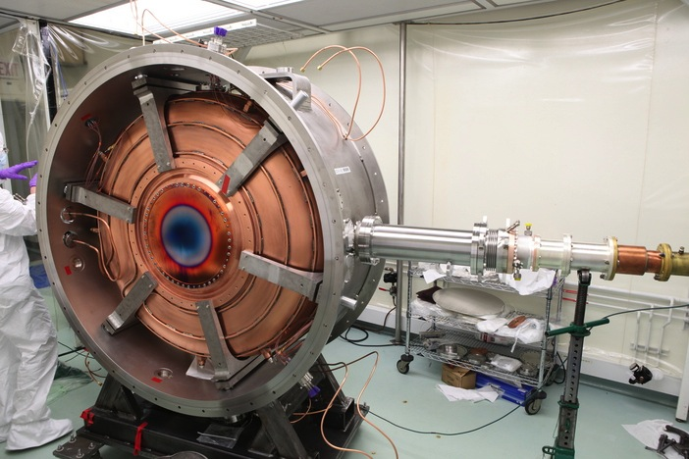
MICE & MuCool Test Area
MICE 201 MHz RF Module – MTA Acceptance Test in B-field Complete 11MV/m in Fringe of 5T Lab-G Solenoid
<4×10⁻⁷ Spark Rate (0 observed)

Slide 6
MICE Cooling Demonstration Design

Slide 7
Fermilab’s MTA RF R&D
R&D Status as of May 31, 2015:
MICE 201 MHz Prototype RF Module
Extended run at 11 MV/m in magnetic field complete
Lab G Solenoid is prototype of focus coil magnet
MICE specification is 10.3 MV/m
Subsequent high power tests up to 14.5 MV/m
These tests all carried out with Be windows in place
High power coupler evaluation completed successfully
Full characterization of tuner system in B-field complete
All acceptance tests are now complete
Critical sign-off for Cooling Demo RF module production
a Construction Project R&D is now complete!

Slide 8
US Effort Summary & Conclusion
Step IV commissioning is underway
Physics data is imminent
Cooling Demonstration construction is moving forward rapidly
We expect all remaining major hardware procurements to be in place on the ~1 month timescale
PRY Extension
Material (JFE Steel) arriving mid-July
Design complete
Drawing package ready for procurement this week
Intend to release sole source package to Step IV vendor this week
RF Modules
Prototype validation complete
Design complete
Drawing package ready for procurement this week
RFP to vendors anticipated next week
Progress is consistent with having all US-supplied hardware to RAL by June 2016 in preparation for 2017 operations
We sincerely hope that NSF will re-connect to the exploitation of this unique experimental capability

