Slide 1
Detector Update
J Stewart
June 12

Slide 2
General Scope and Planning

Slide 3
Internationalization
Roughly half the detector scope is foreseen to come from non-DOE sources.
Will need a joint involvement in most systems.
Collaboration management gives team building highest priority after the review cycle.
Expect rapid progress toward the CERN test detector so many decisions will be made this year.

Slide 4
Cathode Planes

Slide 5
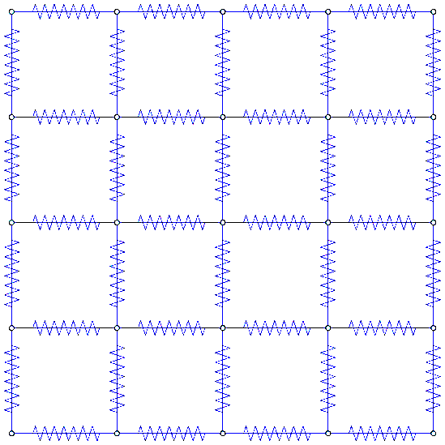
Discharge Model of the Cathode Plane
S. Rescia DOCDB 10865
Divide 12mx2.3m Cathode into 10cmx10cm “cells” i.e. 120x23=2760 (or 2904 nodes) Each cell modeled as resistors to neighbors and capacitor to ground
Resistivity of frame (structural tube) and interior (panels) is different
Capacitance is higher at the frame (fringing field)
SPICE simulation C: 8737 R: 5668 tot: 14419
C
C
C
C
C
C
V
height
width
Large fraction of the total energy is discharged in 20 ns.
May impact cryostat.

Slide 6
Modeling Conclusions
An electrical model of the cathode has been developed
Model explains the time evolution of a discharge and leads to quantitative assessment of mitigation methods
Additional components of the Lar TPC electrical model will be added as design proceeds (drift cage, etc.)
A conductive frame discharges more than 10% of the energy in a very short transient.
Significant risk of preamplifier damage.
Concern about cryostat damage
Best strategy: resistive cathode segments (1-10GΩ/m or more) with a low resistance coaxial “HV bus”. Drift cage fed from the bus, but cathode discharges with long time constant. Transient HV in the gap between bus and cathode “tube”.
Possibly self quenching and intrinsically safe.

Slide 7
Cathode Plane Next Steps
Materials need selected that match electrical requirements.
Antistatic paint, Bulk conducting …
Impact of radiological needs determined.
Is FR4 OK. What impact does U/Th decays have on physice?
HV coupling to the cathode needs designed.
Other alternates may be considered.
Transparency?

Slide 8
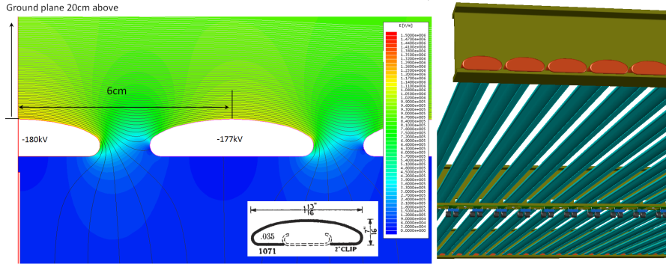
Alternate Field Cage Design
Prompted by suggestions from ICARUS an alternate field cage concept is under study .
Potential advantages
More robust
Lower field
Possibly lower cost
B. Yu docdb 10884
roll-formed metallic profiles

Slide 9
Field Cage
Alternate studies and selection of design need to occur this year. With design and construction in 2016 of the CERN units.
Technical design must promptly progress to a design decision.
Design is in early stages. Simulations are needed. Production process, testing, QA are all needed.

Slide 10
Anode Planes
Full scale frame prototype is under construction now.
Major work is planned for the winding machine. Presently running behind schedule (reviews and CDRs).
Plan to construct a prototype APA this year.
Input into any possible changes is needed this year.
Construction of 1 APA in Fy16 and one in FY17
Need new groups to make additional APAs.

Slide 11
Electronics DAQ
Electronics system integration for the 35t is still ongoing.
35 t will give first experience with the new electronics chain.
Evaluation and real world experience will be very important.
Lot of room for new ideas
Noise, zero suppression, de-convolution, SN triggers, energy scale calibration

Slide 12
Photon system
Plan a technology down select in fall.
Collaboration input needed on that timescale.
Impact of Ar39 needs evaluated
Studies started
Background for SN t0 determination needs understood.
Need to agree on required light yield and impact on both cost and physics.

Slide 13
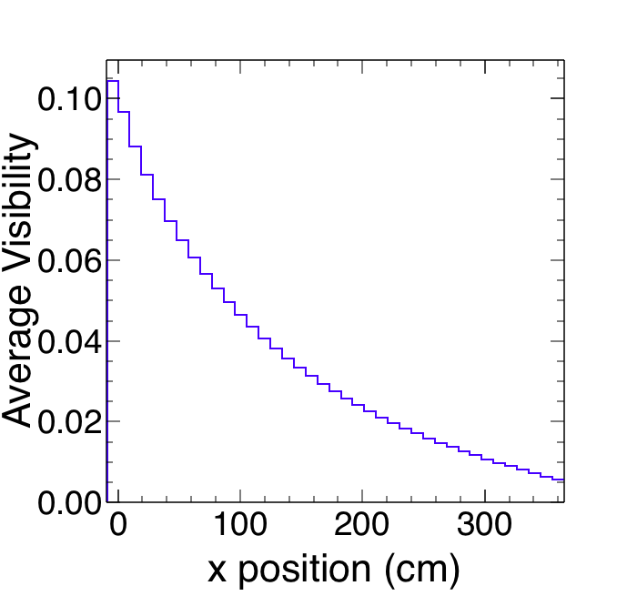
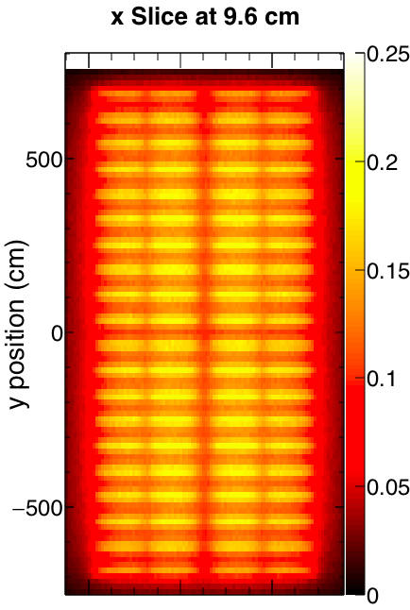
Photons Reaching Optical Detectors
Average yield vs. position in the detector
Central region only to avoid over-emphasizing loss at walls
Average ε_{geo} = 4.7%
Plot also includes 30% wire shadowing
A Himmel Docdb 10896
Visibility
0.5% at
far edge

Slide 14
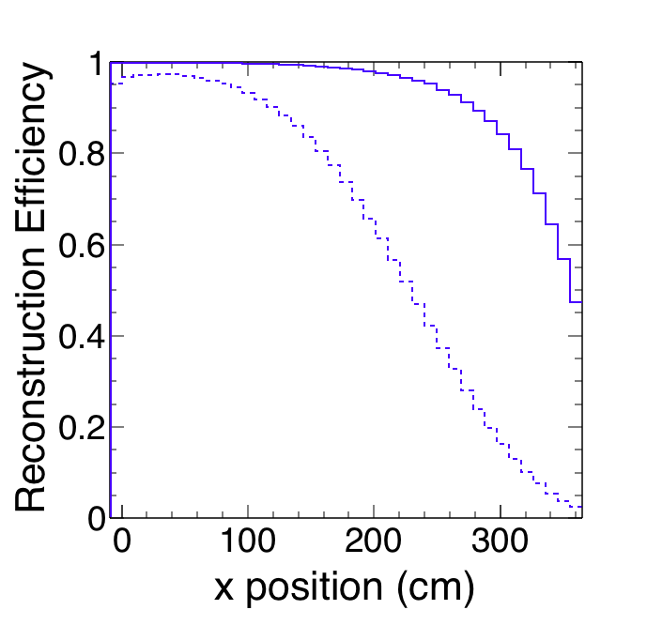
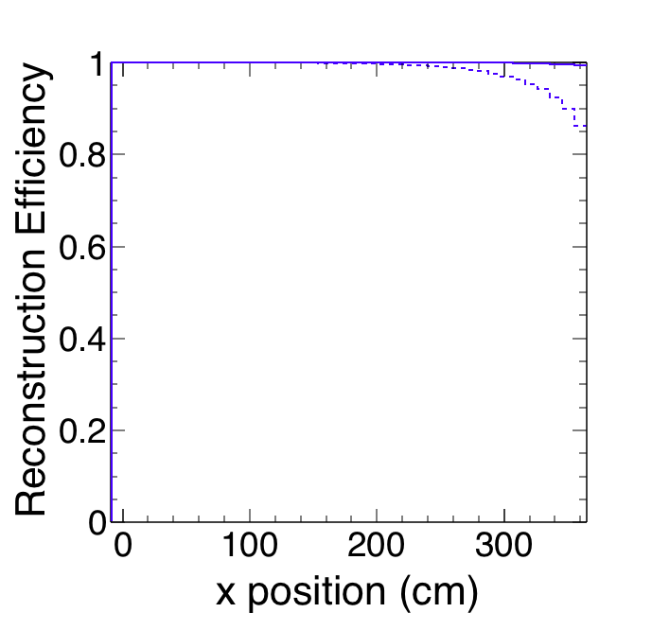
Proton Decay Reconstruction Efficiency
Reference Design
Alternative Design
Early + Late 88% avg.
Early only 57% avg.
Early + Late 99% avg.
Early only 96% avg.
Assuming 200 MeV visible energy (conservative estimate)
Reference design only covers half the volume at 99% efficiency.
Alternative design with late light covers everything at >99% efficiency.

Slide 15
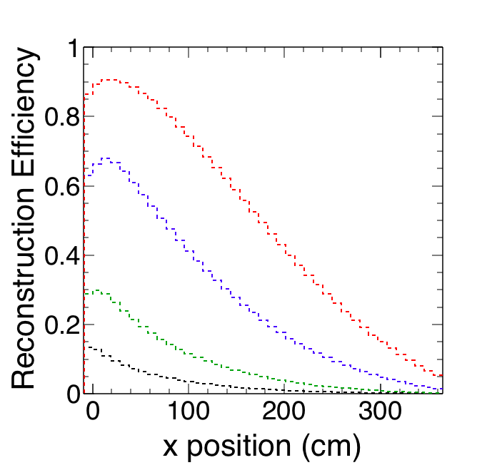
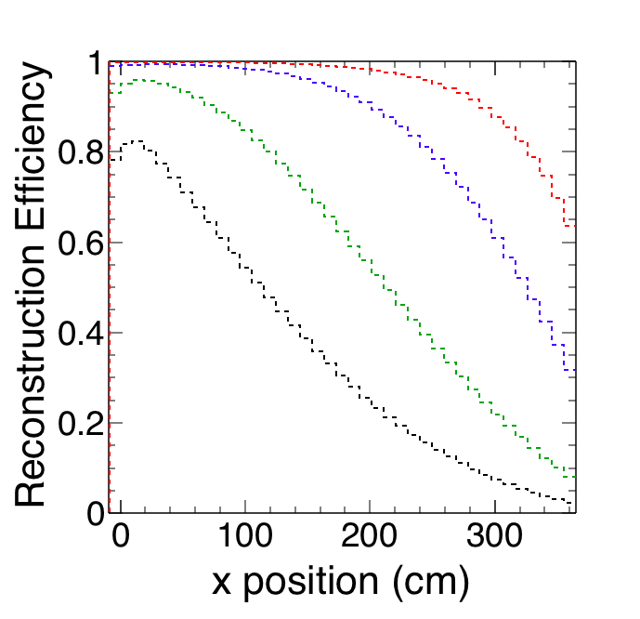
Supernova Reconstruction Efficiency
Reference Design
Alternative Design
50 MeV 46%
20 MeV 25%
10 MeV 8%
5 MeV 3%
50 MeV 91%
20 MeV 79%
10 MeV 54%
5 MeV 33%
Using only early light, requiring 2 coincident photons.
Reference design can only find t₀ for a tiny fraction of 5 MeV events.
Alternative design is better, but still only covers 1/3 of 5 MeV events.

Slide 16
Summary
A lot of progress is happening.
Early involvement will have the most impact.

