Slide 1
Assembly Plan and Tooling for MQXFA1
LARP Internal Review of the MQXFA Mechanical Structure Design and Functional Requirements
7/16/2015
Dan Cheng
Stuart Kincaid, Scott Myers

Slide 2
Outline
Overview of the MQXFA Magnet Structural components
Assembly processes and tooling design
Open Issues
Status and plans
Summary

Slide 3
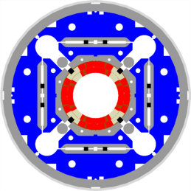
Primary MQXFA Structure Subassemblies
Shell-Yoke Structure
  Half-length subassemblies
  Joined shell-yoke subassembly, full-length
Coilpack
  Coil pack subassembly
    Load pad stacks
  Collar pack subassembly
    Collar stacks
    Instrumented and GPI wrapped coils
Master Key packages
  Load keys, alignment keys, shims
Axial load
  Axial rods, [end plates, wire guides]
Splice Connection box
Magnet support ring
  Instrumentation connector skirt

Slide 4
Shell-Yoke Structure Assembly

Slide 5
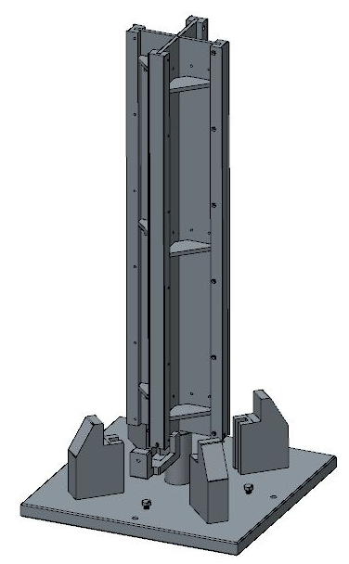
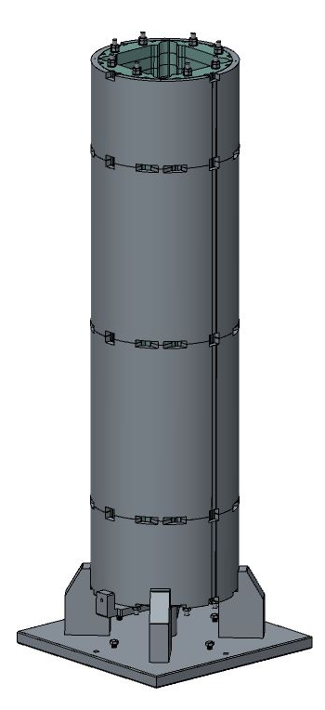
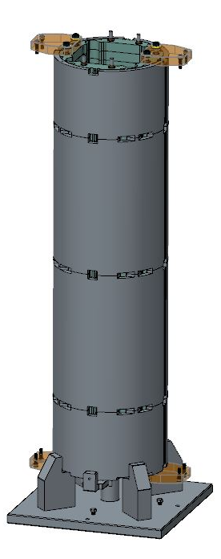
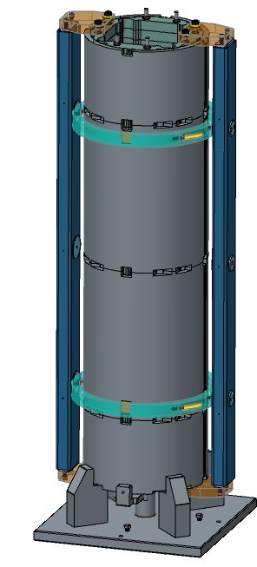
Shell-Yoke Subassemblies
Half-length subassemblies assembled vertically
Preload cross beam serves as integrated seismic support
Lifting support beams with horizontal rotation pivot
Conceptual Tooling
Cross beam support still shown with single bladder per quadrant
Note: Final shell configuration not shown

Slide 6
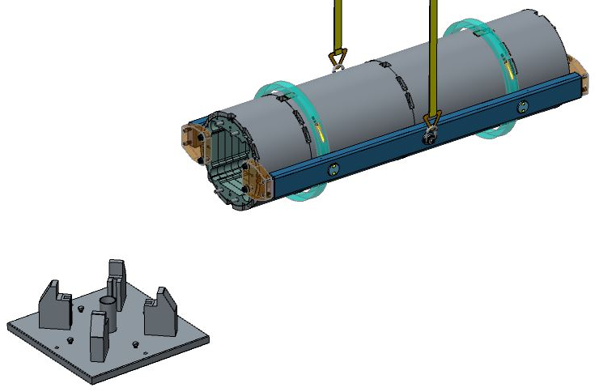
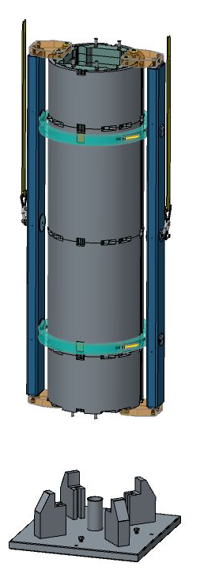
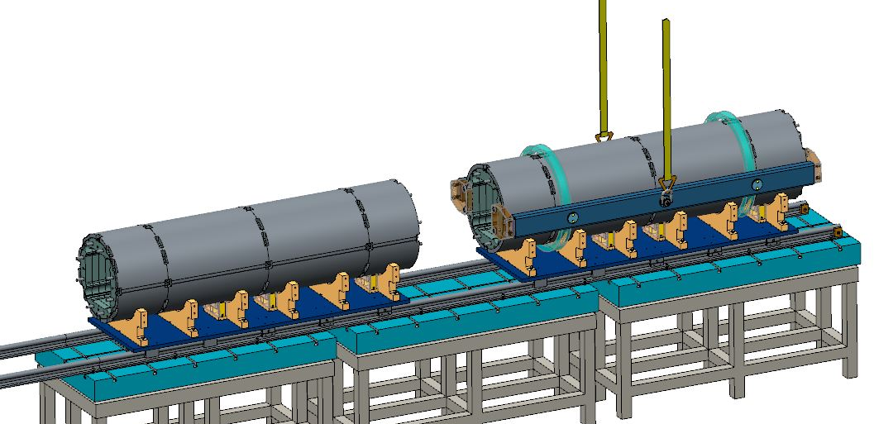
Shell and Yoke Assemblies
Conceptual Scale-up
Half-length lifted &
rotated horizontally
Subassembly placed
on assembly rail table
Note: Final shell configuration not shown

Slide 7
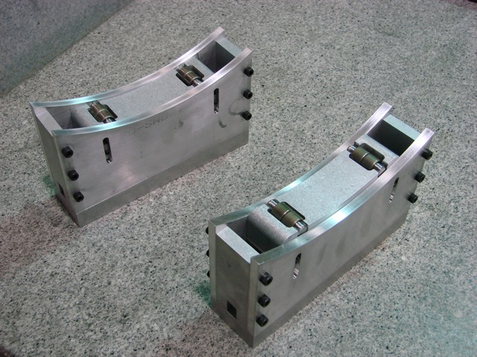
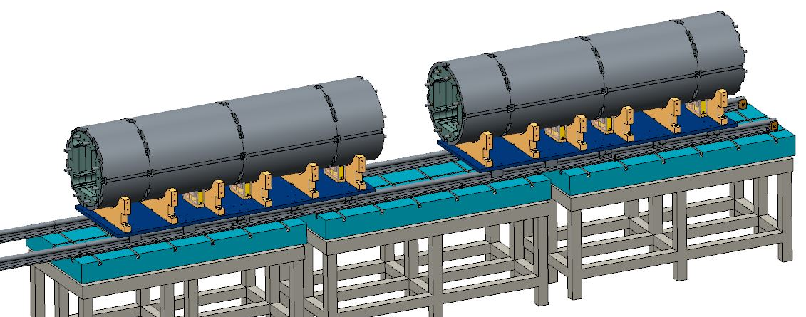
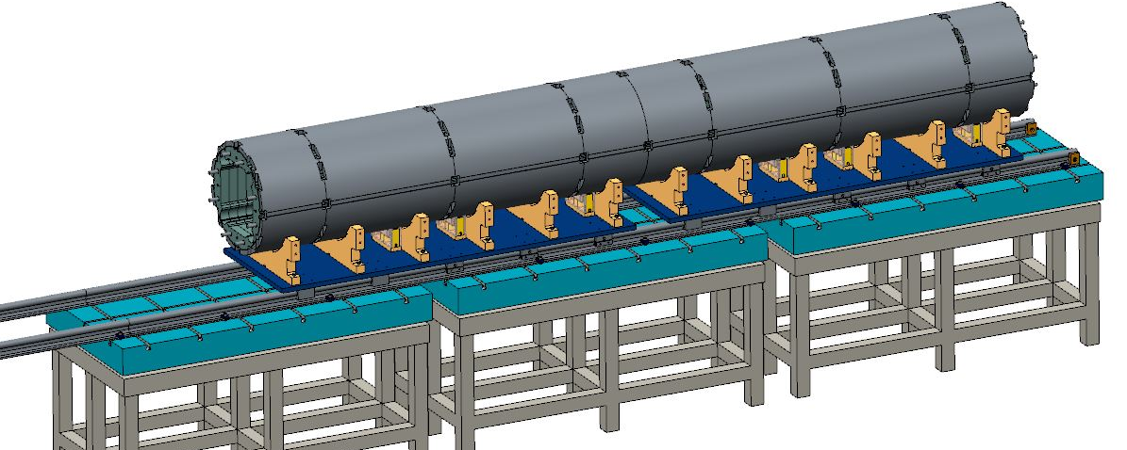
Shell and Yoke Assemblies
Assembly rails allow halves to be joined together
Clocking mechanism will the same as LQ method with lifting rollers
  Resting on shell cutouts for accurate placement
Yoke tie rods will be swapped from half-length to full-length
Conceptual Scale-up
Note: Final shell configuration not shown

Slide 8
Coil Pack Prep & Assembly

Slide 9
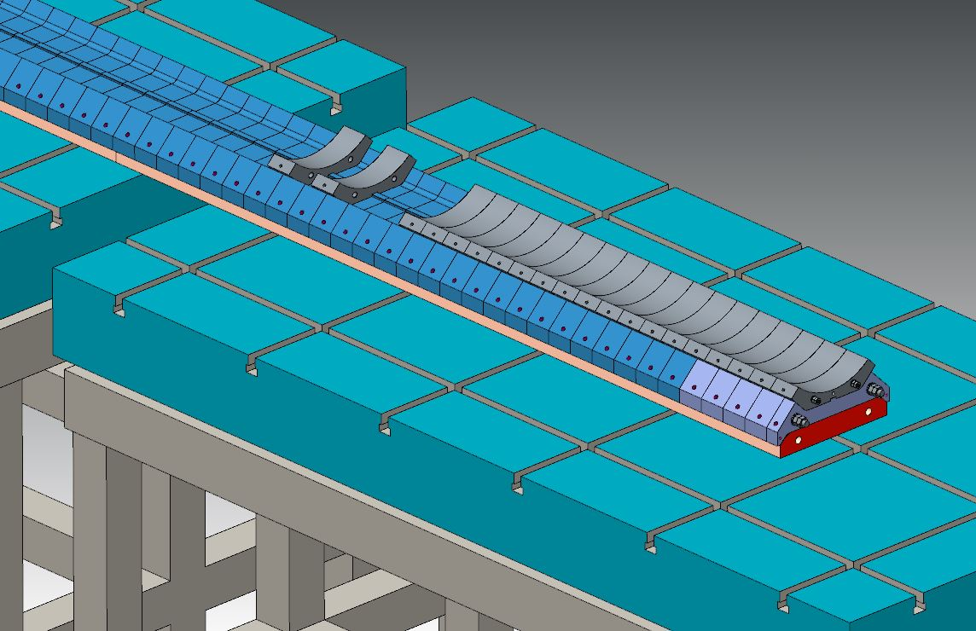
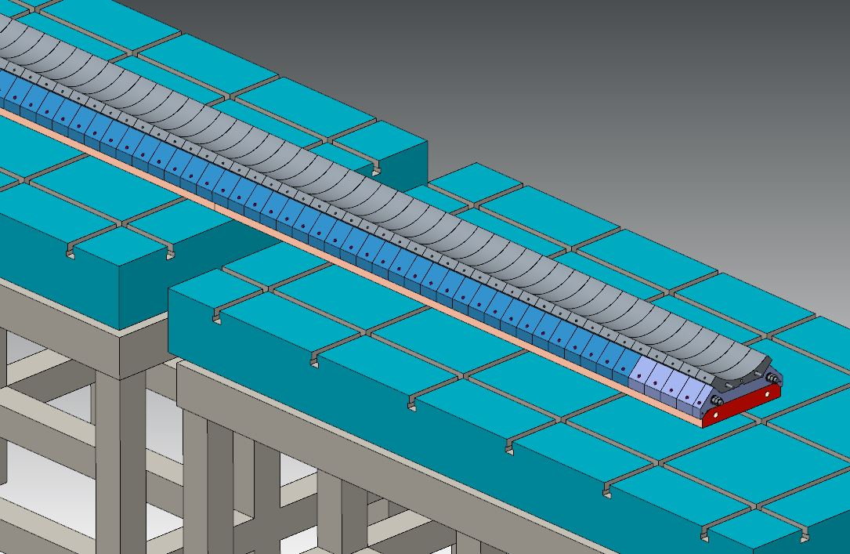
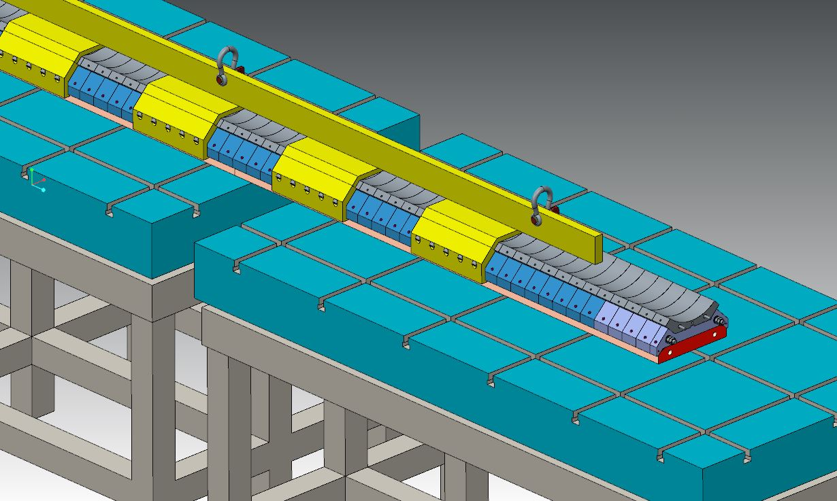
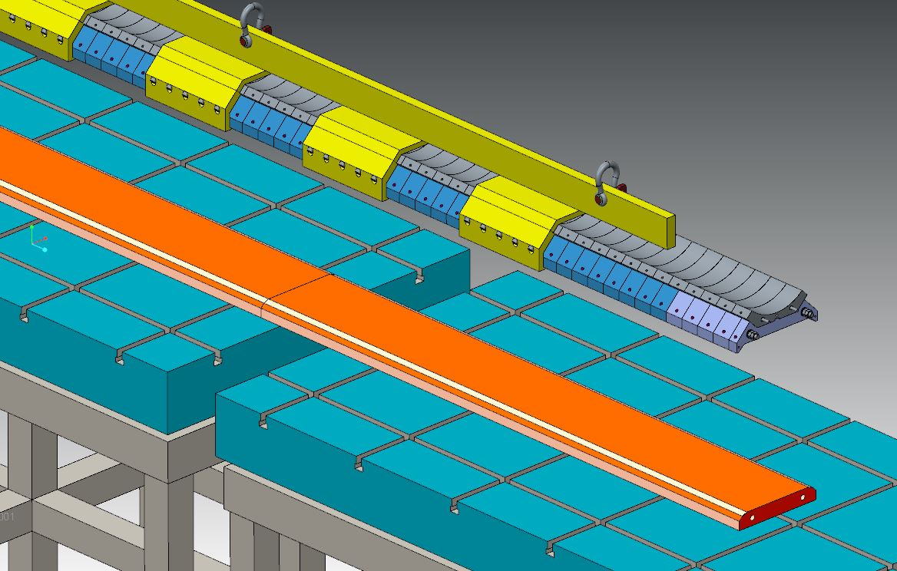
Coil Pack Assembly Prep—Load Pads & Collars
Conceptual Tooling
Load pads assembled on surrogate master
Collars then assembled on load pads
Collars fully assembled on load pads
Lifting beam is mounted to load pad/collar assembly
Lifting beam moves load pad/collar assembly
Second assembly table shown for concept; surrogate master of the coilpack assembly table could be used

Slide 10
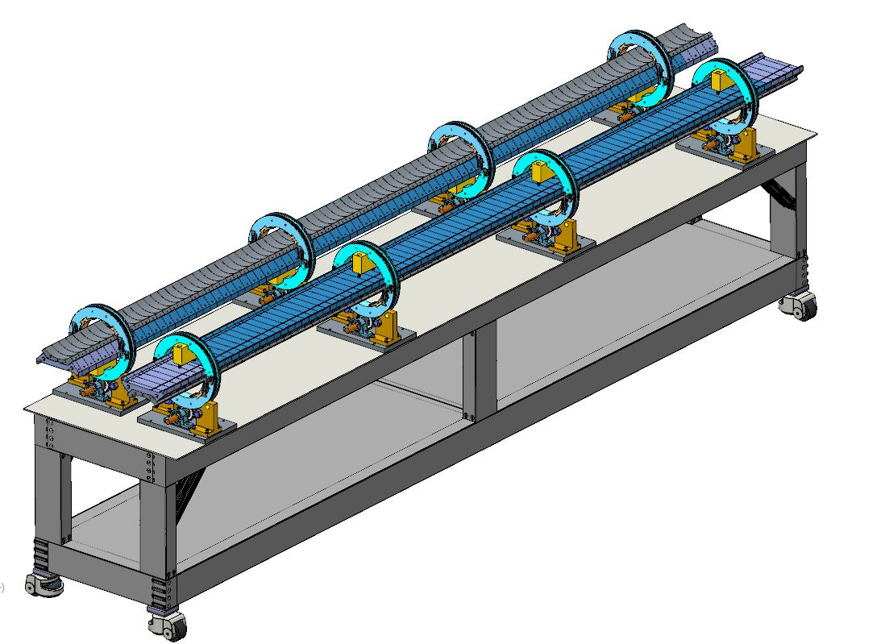
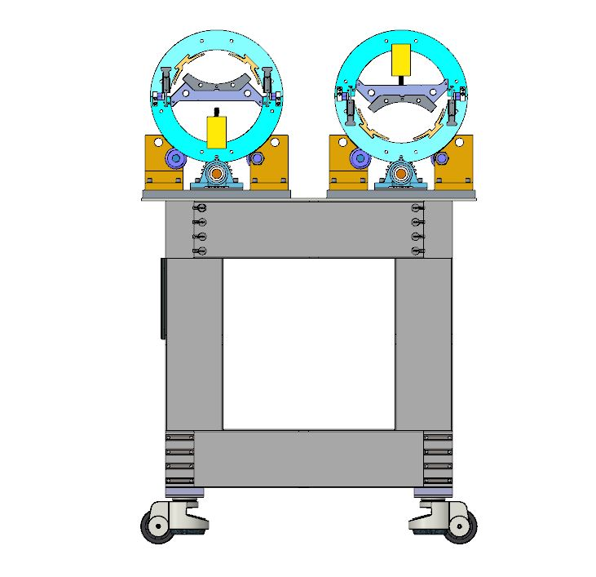
Coil Pack Assembly Prep—Load Pads & Collars
Using existing coil rollover table, swap wheelsets for ones designed to handle loadpad-collar preassemblies
  Load pads and collars will be supported while rotated upside down
  Several sets of screws will attach the load pad to the collar assembly through counterbored holes in the load pad
  Loadpad-collar assemblies can then be handled for coilpack operations
Conceptual Tooling
Special rollers adapted for rotating the load pad/collar assembly for the upper set placement

Slide 11
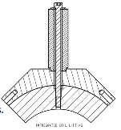
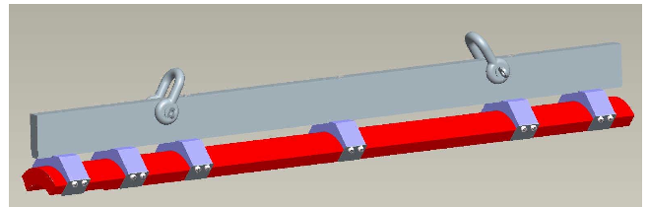
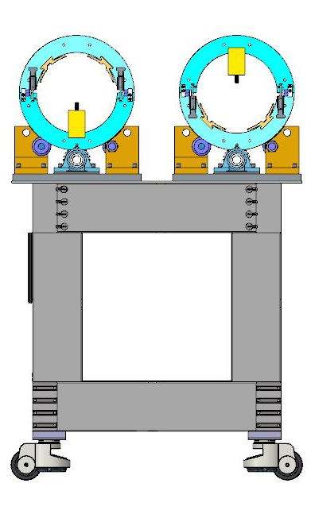
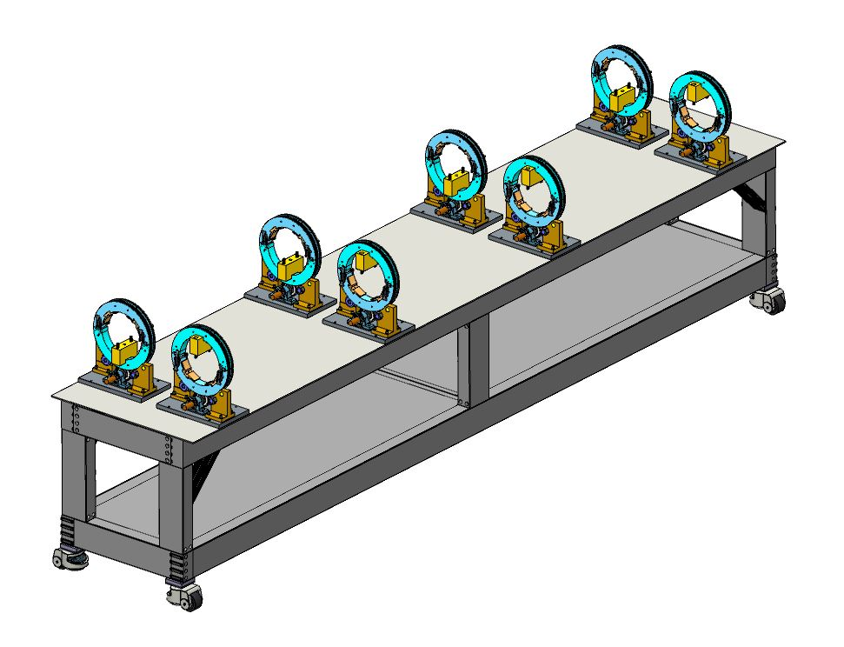
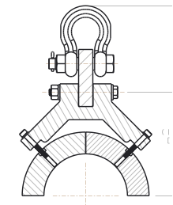
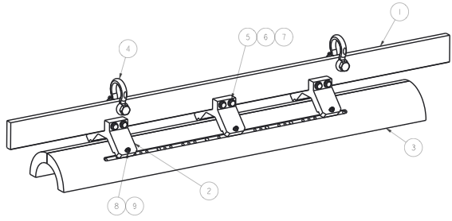
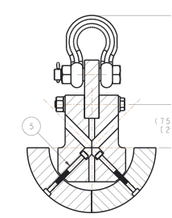
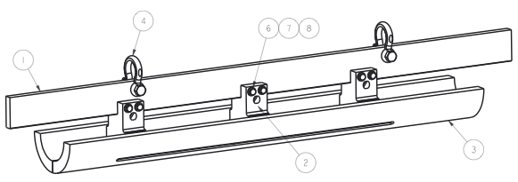
Coil Pack Assembly Prep--Coil Preparations
Coil lifting tooling will be scaled up
  Rollover tooling will be a simple extension of the table being used with the MQXFS
  Lifting tooling will be scaled up from MQXFS fixtures
    Single coil, OD-pick (BNL design)
    Coil pair, OD-pick
    Coil pair, ID-pick
Scaled-up
Tooling

Slide 12
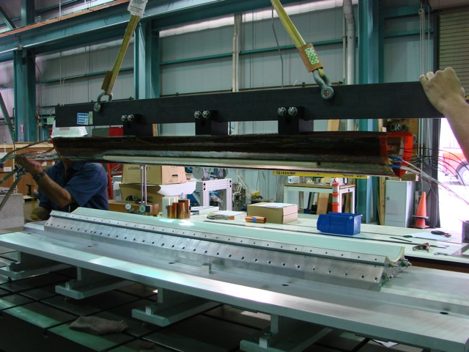
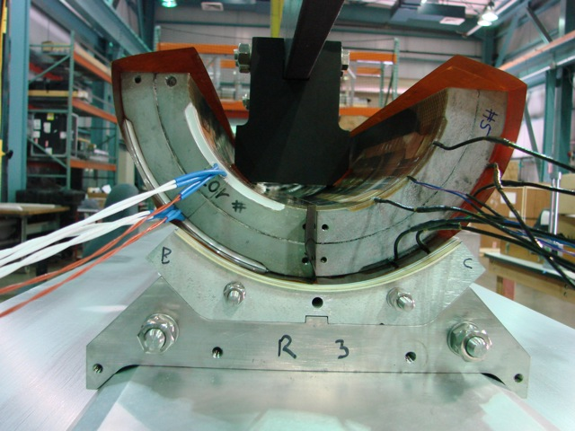
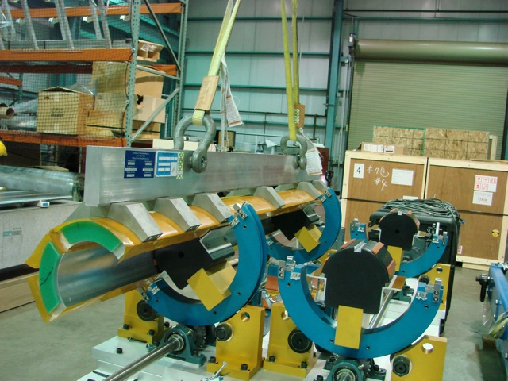
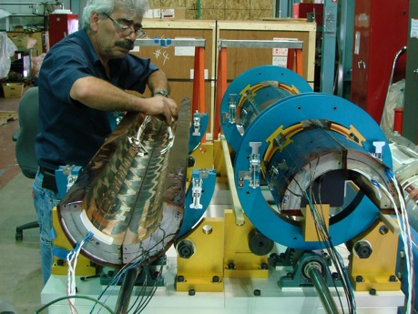
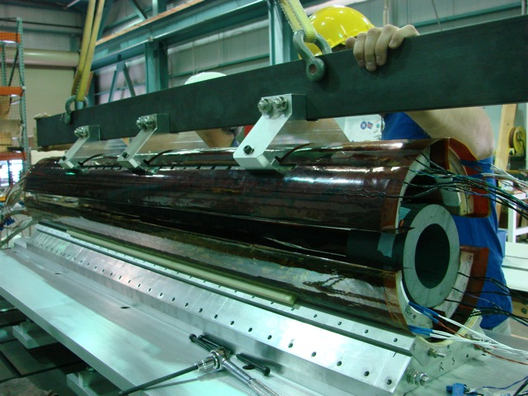
Coil Pack Assembly Prep--Coil Preparations
Coils will be received, CMM’d, instrumented
Rollover tooling is used
  To apply the coil GPI layers
  To pair coils
  To orient coils for handling
Scaled-up
Tooling

Slide 13
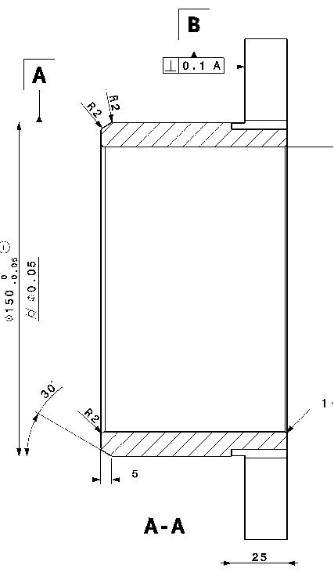
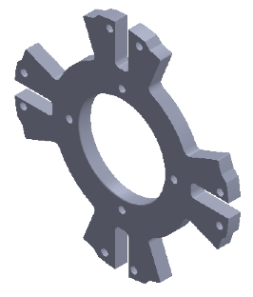
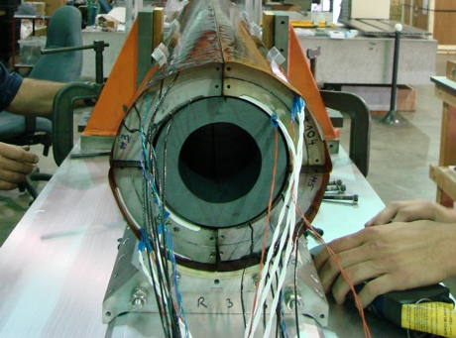
Coil Pack Assembly Prep--Coil Preparations
Install coil assembly support spuds
  Will engage with the holes in the RE end shoe
  A separate bar will engage holes in the LE endshoe (not shown)
  Must clear the Kapton GPI layers, instrumentation wires, and leads (LE only)
Conceptual Tooling

Slide 14
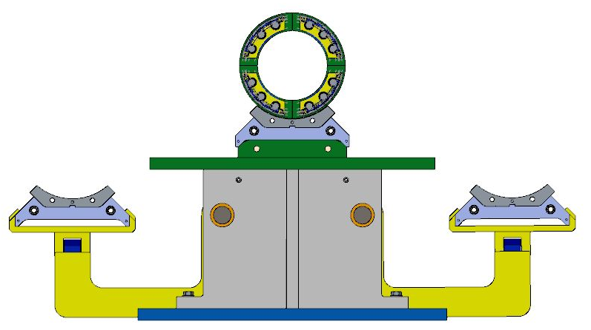
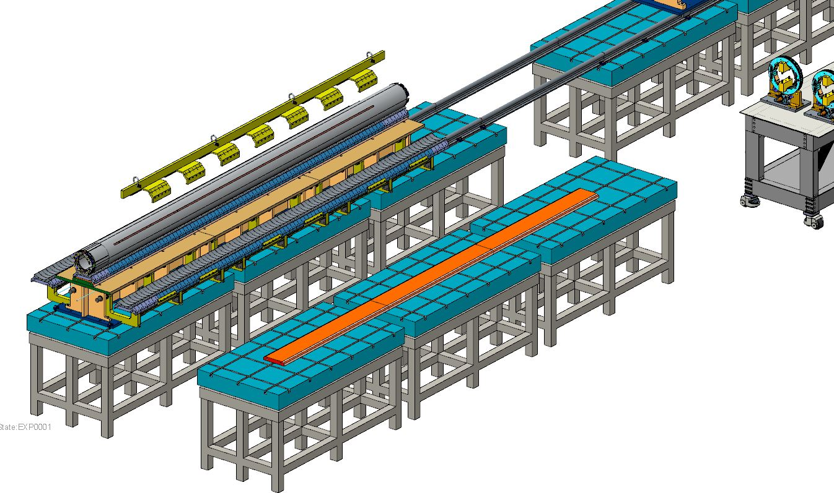
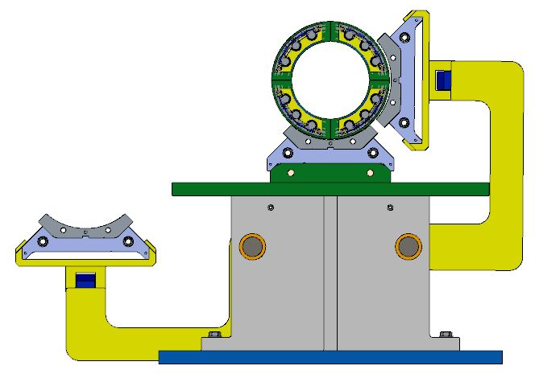
Coil Pack Assembly Prep—Load Pads & Collars
The assembled loadpad-collar subassemblies are moved to articulated arms for positioning and assembly of the coilpack
Only load pads will be bolted
Assembled coil pack is ready for insertion
Conceptual Tooling
Second assembly table shown for concept; surrogate master of the coilpack assembly table could be used

Slide 15
Magnet Integration

Slide 16
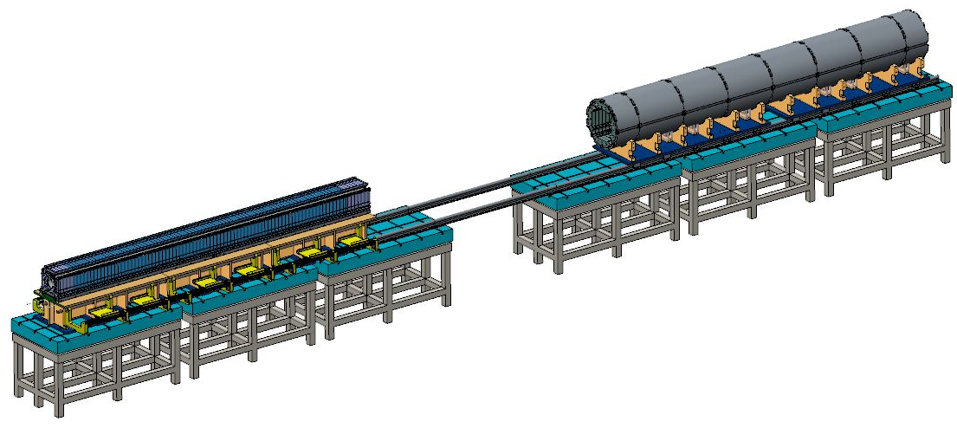
Magnet Integration
Assembled coil pack is ready for insertion
Shell-yoke assembly is shifted over to coil pack assembly table
Rails are attached to coilpack in the lifting operation

Slide 17
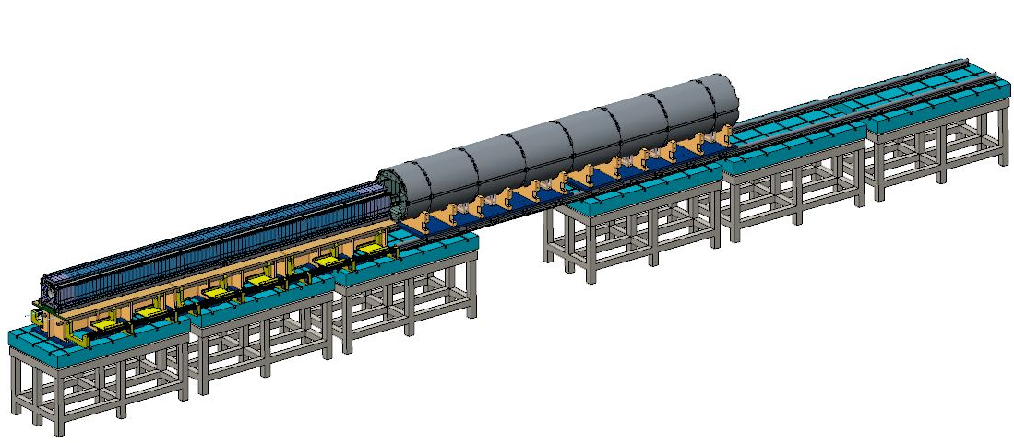
Magnet Integration
Assembled coil pack is ready for insertion
Shell-yoke assembly is shifted over to coil pack assembly table
Rails are attached to coilpack in the lifting operation

Slide 18
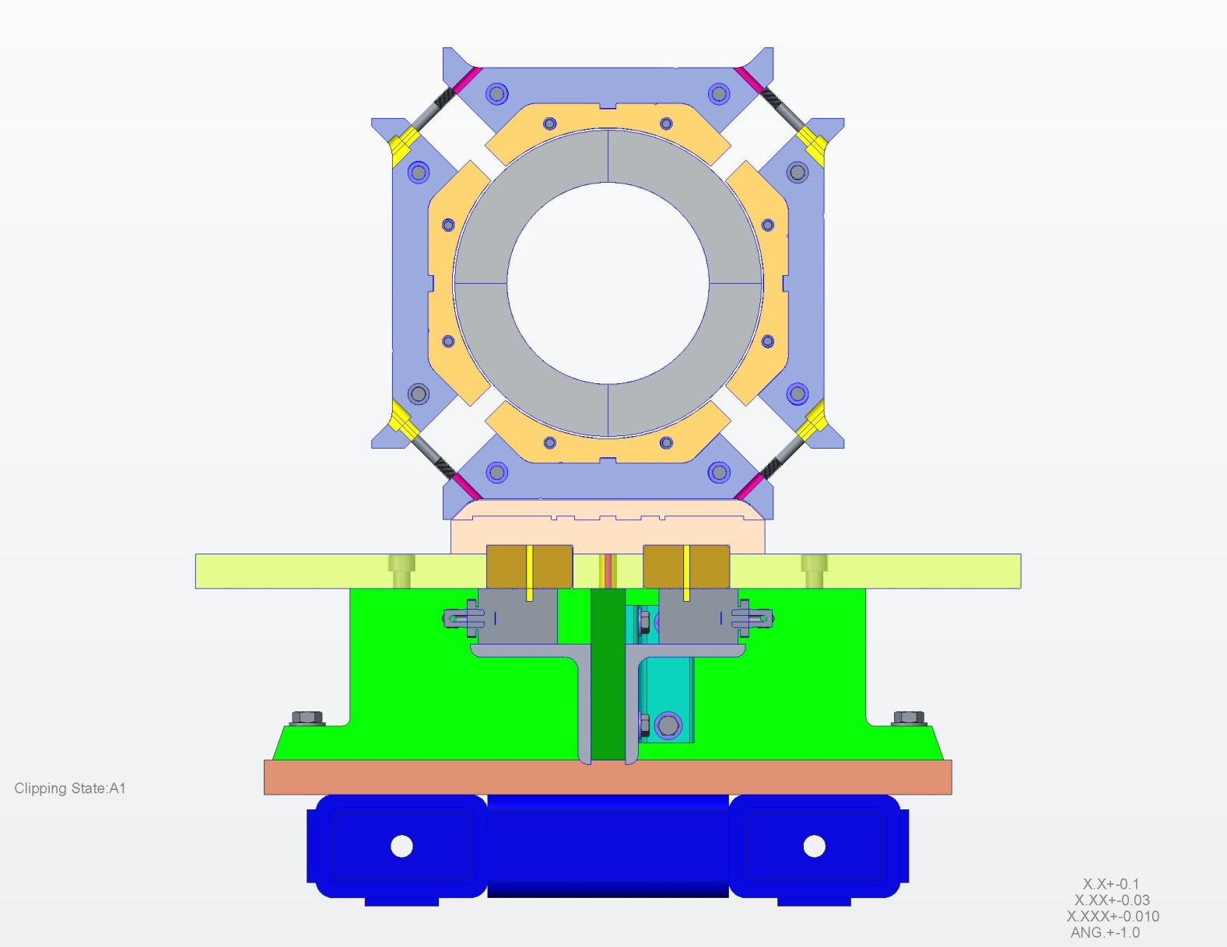
Magnet Integration
Coil pack assembled on assembly master

Slide 19

Magnet Integration
Coil pack assembled on assembly master
Activation of the cylinders

Slide 20
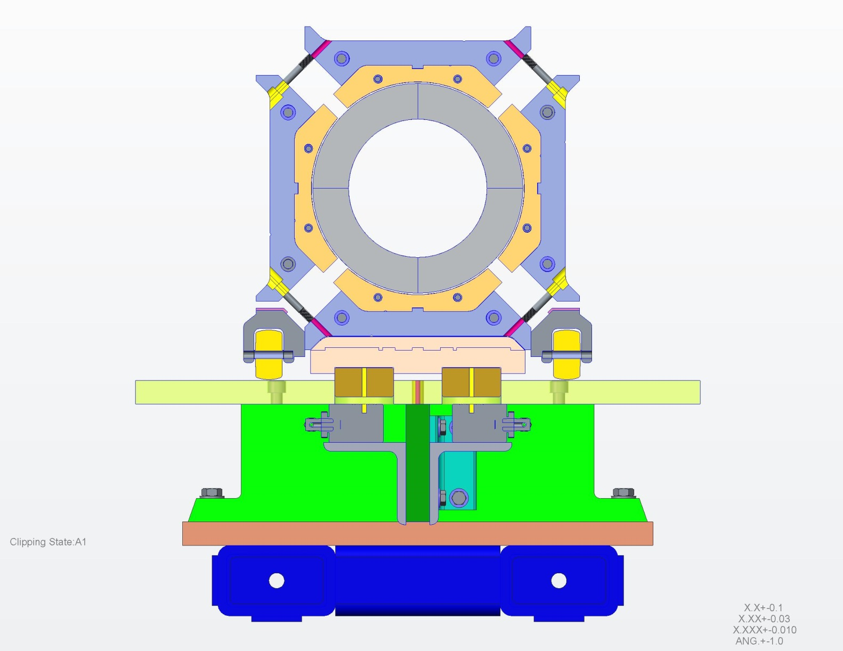
Magnet Integration
Coil pack assembled on assembly master
Activation of the cylinders
Installation of the wheel racks underneath the coil pack

Slide 21
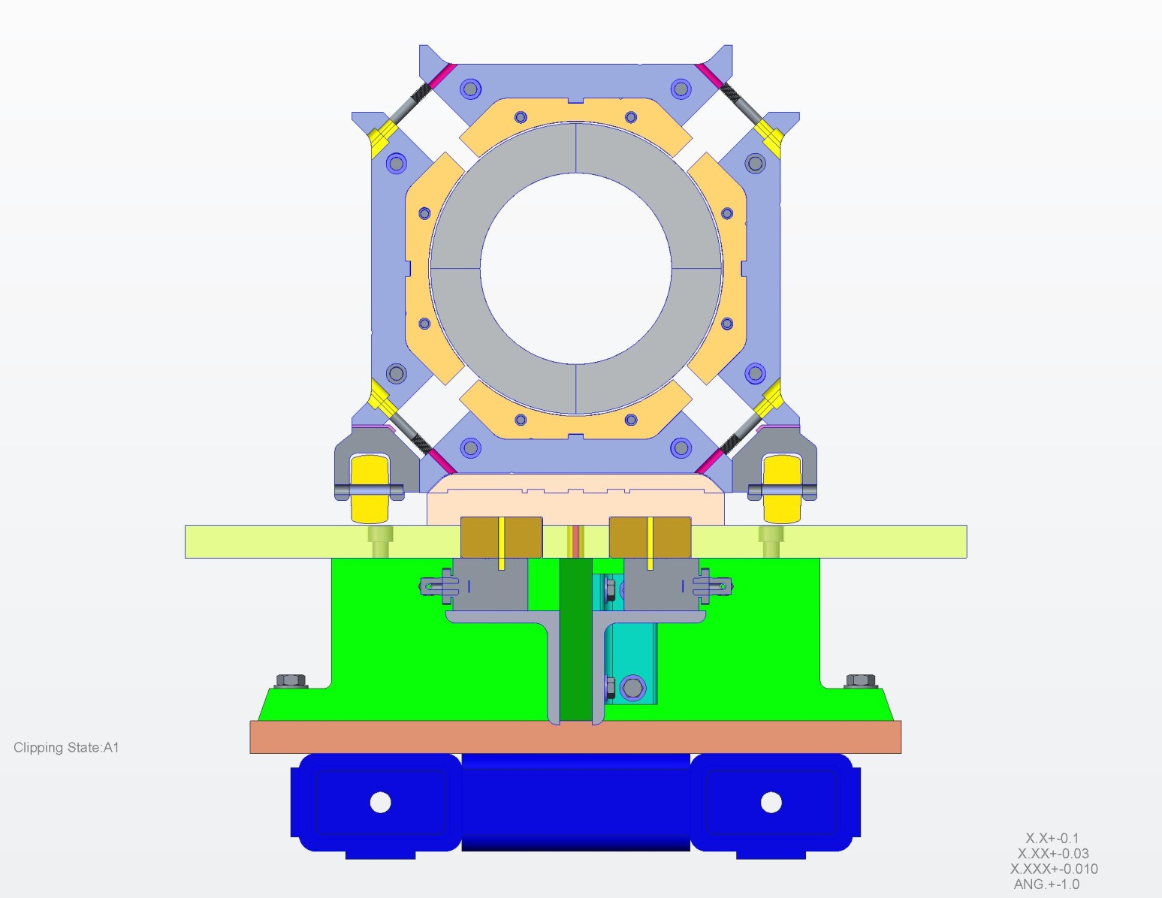
Magnet Integration
Coil pack assembled on assembly master
Activation of the cylinders
Installation of the wheel racks underneath the coil pack
Actuator pressure released
~1 mm gap between assembly master and coil pack

Slide 22
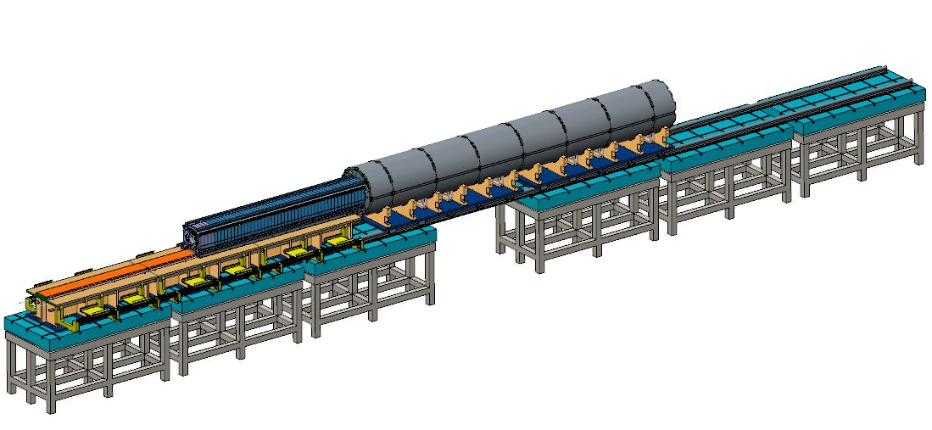
Magnet Integration
Assembled coil pack is ready for insertion
Shell-yoke assembly is shifted over to coil pack assembly table
Rails are attached to coilpack in the lifting operation

Slide 23
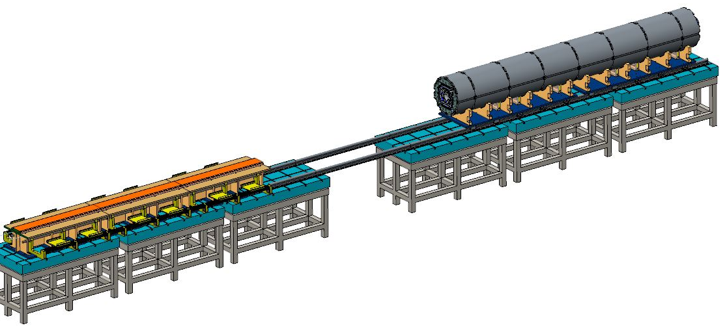
Magnet Integration
Assembled coil pack is ready for insertion
Shell-yoke assembly is shifted over to coil pack assembly table
Rails are attached to coilpack in the lifting operation
Magnet is moved back into position for preload operations

Slide 24
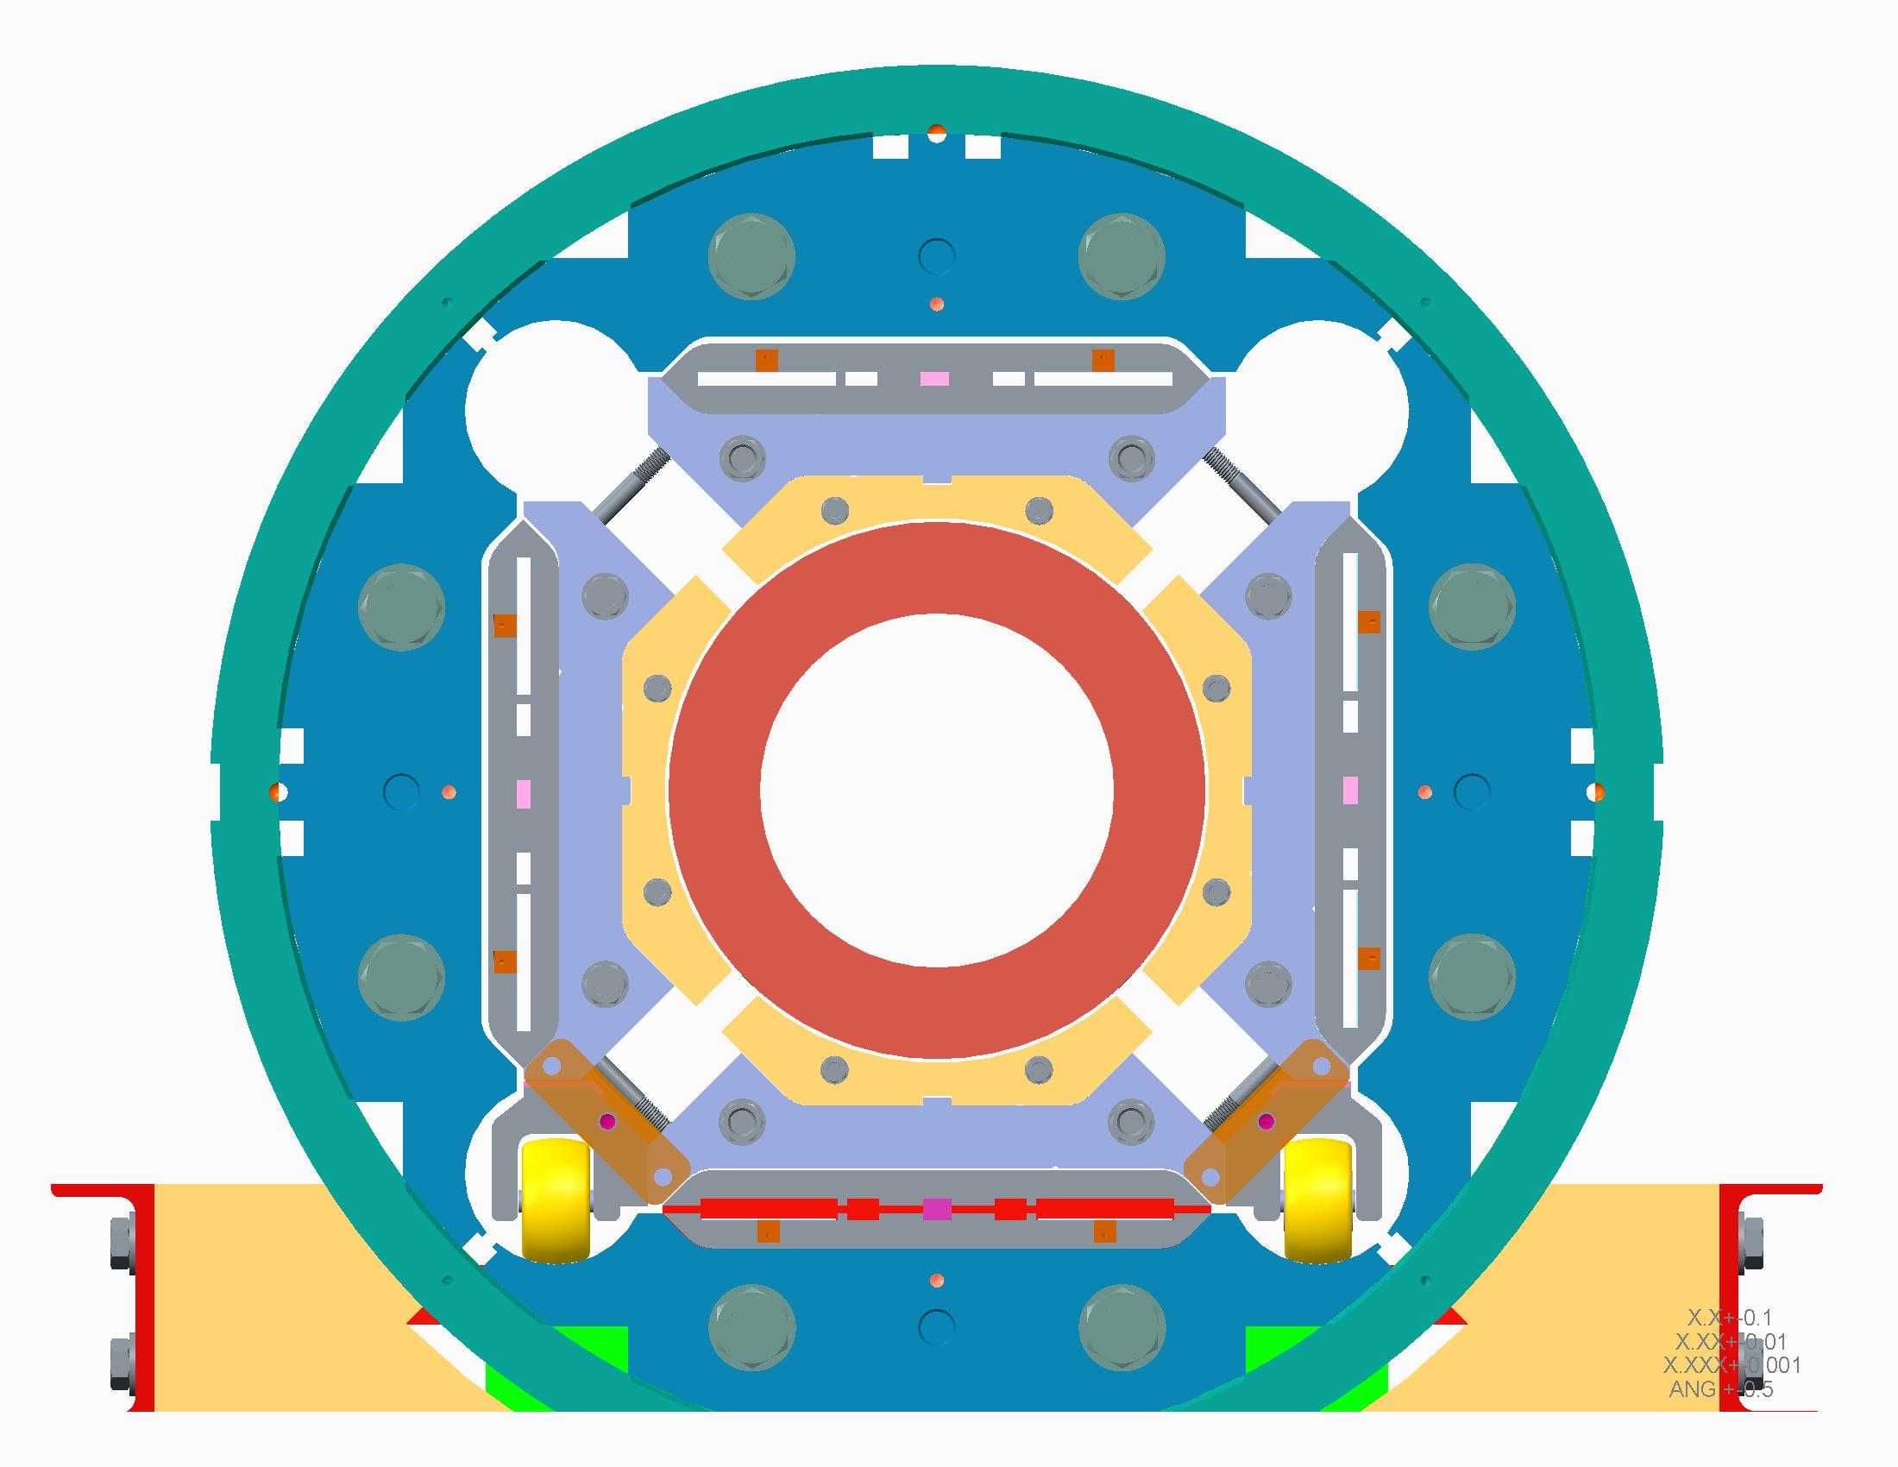
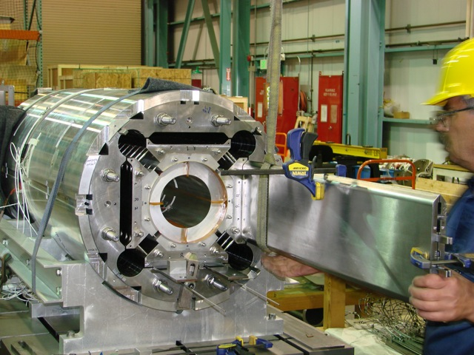
Magnet Integration
Assembled coil pack is ready for insertion
Shell-yoke assembly is shifted over to coil pack assembly table
Rails are attached to coilpack in the lifting operation
Magnet is moved back into position for preload operations
Master keys and bladders are inserted.
Bladder operations are performed

Slide 25
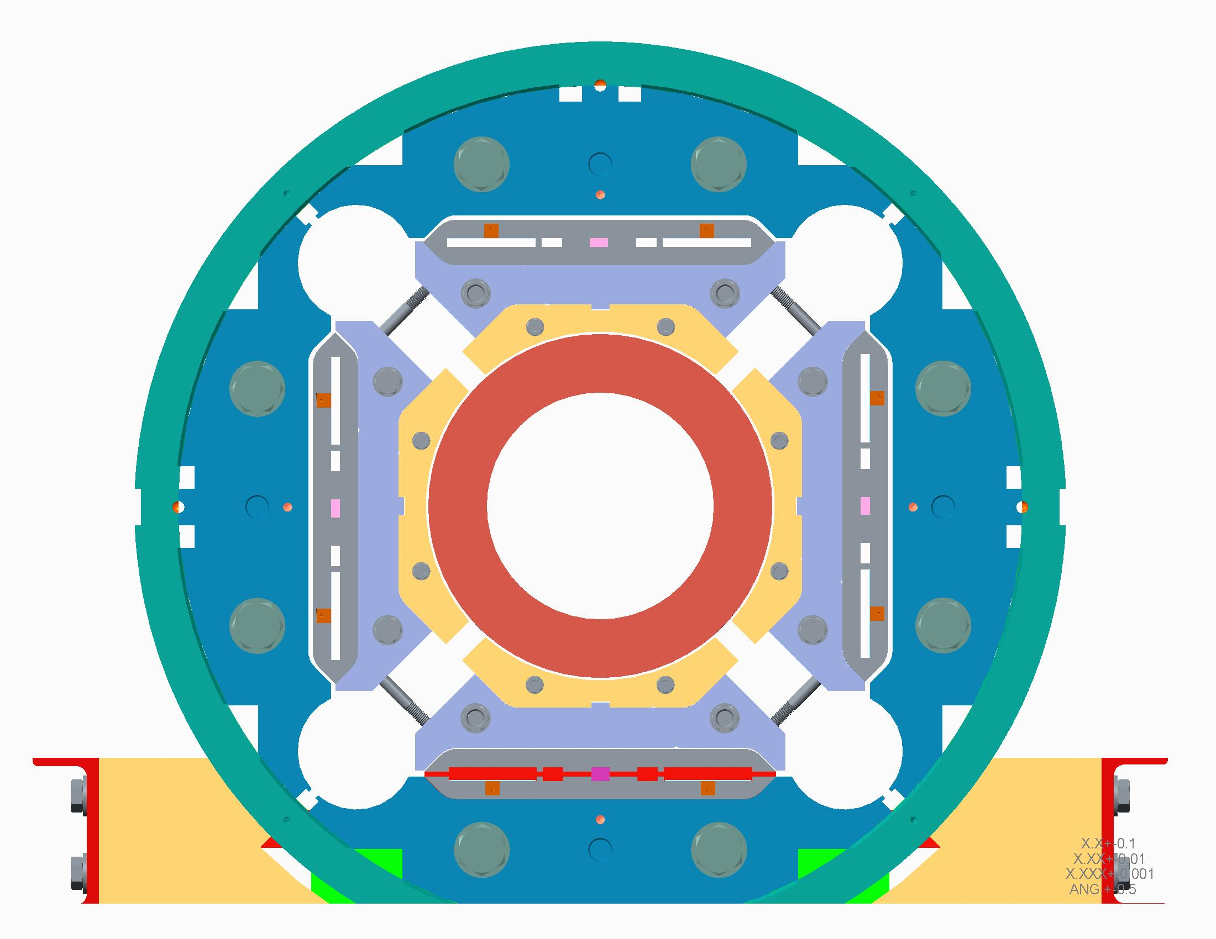
Magnet Integration
Assembled coil pack is ready for insertion
Shell-yoke assembly is shifted over to coil pack assembly table
Rails are attached to coilpack in the lifting operation
Magnet is moved back into position for preload operations
Wheels assembly can be removed after bladder preload operations

Slide 26
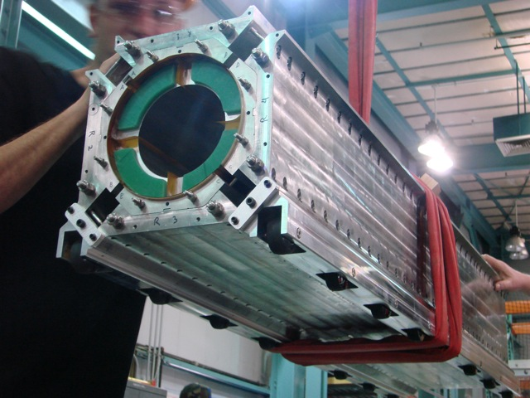
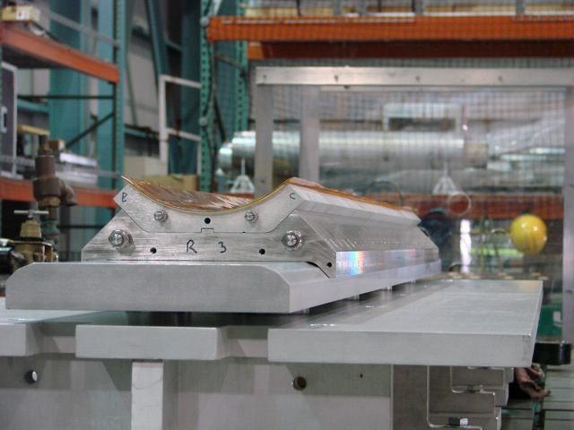
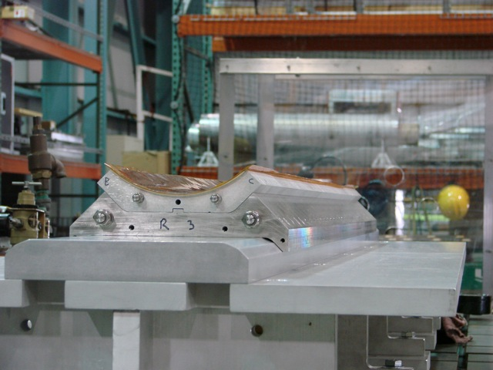
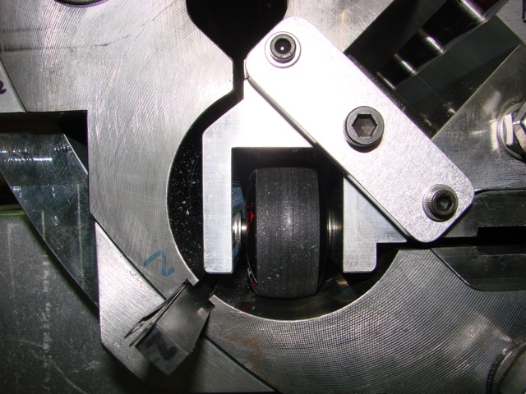
Magnet Integration
Rails and assembly table were not completed in time for MQXFSD assembly.
  But rails were tested after the MQXFSD was disassembled, and they performed well
  Assembly table lift operation was cycled
Scaled-up
Tooling

Slide 27



Magnet Integration - Axial End Loading
IL wiring will be routed through wire guides that will protect them from pinching as a result of the axial end load preparations
In Fabrication

Slide 28



Magnet Integration - Axial End Loading
Endplates are placed
Axial rods are threaded into the endplate
Wiring will be routed (through wire guides) between bullets
Axial loading rig is attached
Axial preload is performed
Scaled-up
Tooling

Slide 29
Open Issues

Slide 30


Magnet Integration – Splice Box
Splices (and CLIQ leads) will be made in two layers
CLIQ leads (max. 3)
Full-size cables shown
In Fabrication
Note: this splice design is based on the style used for prior magnets testing through MQXFS1. Actual splice connectors for long magnets are subject to change based on requirements.
Current leads

Slide 31


Magnet Integration – Fiducialization Discussion
MQXFSD assembly appeared to be mechanically well centered
  All alignment keys were loose after the bladder operations (keys are not being loaded in shear)
Functional Requirement R-03 states:
Straightness: 100 µm/5m
Twist: 1 mrad/5m

Slide 32



Magnet Integration – Fiducialization Discussion
Straightness and Twist requirements mean this long structure must be capable of being measured to these parameters
Fiducial features must be added to structures, and be accessible after magnet has been assembled, as conceptualized here
Measurements will need to be taken before axial endplate install
Collar targets defined to the center (existing single fiducial feature is not sufficient for twist)
Yoke features
remain accessible after axial
endplates are installed
Yoke targets and flats features
defined to collar targets

Slide 33


Magnet Integration – Instrumentation
Instrumentation connectors mount is currently being designed for MQXFS.
  Relies upon the magnet support plates that mate with the FNAL test facility header when MQXFS is tested
Magnet test facility at BNL may have different requirements

Slide 34


Magnet Shipping & Test Preparations
Magnet will be shipped to BNL for testing
Lifting and handling tooling will require discussions with BNL test facility personnel for specific hardware interfaces
If cost is an issue, the shipping frame and container used for the LQ magnet might be usable for this transfer operation
  New support beams and support raft is required, as well as re-analysis

Slide 35
Summary of Assembly Designs & Processes
Shell-yoke assembly stand seismic and bladder support
Half-length shell lifting and handling tooling
Shell assembly rails
Coilpack assembly/insertion table scale-up
  Loadpad-collar pre-assembly and articulated arms
Coil rollover assembly table scale-up
  Rotating wheels for loadpad-collar preassemblies
Coil assembly support spuds
Axial end loading, splice connections, and instrumentation wire protection
Open Issues
  Magnet fiducialization
  Instrumentation connectors interfaces for BNL test facility
  Shipping & handling

Slide 36
Status

Slide 37
Status of Parts & Tooling Design
Most parts’ budgetary quotes have been produced using CERN-supplied drawings
  ISO => ASME 14.5 drawings will need to be created
    Most will be “copies” of features and tolerances
    Some (collars, etc.) will have adjusted dimensions, etc.
Some of the tooling & assembly processes presented here are still conceptual
  Most of these concepts are straightforward in development (based on scale-up, prior experience, etc.), but loadpad-collar preassembly has not been performed before
    CERN is attempting this, and we expect an MQXFS model will be built this way
  We still estimate 2 mos. effort for developing and detailing these concepts, plus additional 2 mos. for detailed design
Resource availability is limited
  We recently lost our primary designer for this work
    Working with management to fill this
    Posting is out for replacement
  Currently sharing resources with other projects
See Kelly’s procurement talk
See Helene’s schedule discussion

Slide 38
Status of Procedures Development
Most procedures developed for the assembly processes of the MQXFS can be reused with slight modification for the MQXFA
Some procedures related to the scale-up will still need to be developed for MQXFA
  Half-shell segment joining
  Lifting and handling
  Shipping preparations
This is an iterative process throughout

Slide 39
Summary
Assembly processes and tooling concepts were presented for the MQXFA magnet
  Most of these concepts are straightforward in development (scale-up, prior experience), but loadpad-collar preassembly has not been performed before
    CERN is attempting this, and we expect an MQXFS model will be built this way
  We still estimate 2 mos. effort for developing and detailing these concepts, plus additional 2 mos. for detailed design
The interface requirements for vertical testing at BNL require some discussions
  This may affect the design of the instrumentation connector layout and even the shipping of the magnet
Designer resource availability is now limited
  More details in the schedule discussion later

Slide 40
Appendix

Slide 41
Assembly steps overview – Shell Structure
Prepare shell segments (CMM, instrumentation, etc.)
Place shell segments on vertical assembly stand
Assemble yoke half stacks
Assemble yokes into shell
Insert bladders into assembly; preload
Remove bladders
Attach lifting beams
Move half shell-yoke assemblies to rails, horizontal
Remove lifting beams
Remove half-length yoke tie rods
Align and join half shell-yoke assemblies
Insert full-length tie rods

Slide 42
Assembly steps overview – Coil Pack
Coil Prep
  Receive coils, CMM
  Instrument coils
  Apply GPI layers to each coil
Collars and load pads prep
  Assemble load pad stacks
  Assemble collar stacks on top of load pads
  Stage for coil pack integration

Slide 43
Assembly steps overview – Coil Pack
Position first collar/load pad pair on assembly table
Pair the first two coils on rollover table
Move these two coils in place, and secure
Pair the second two coils on rollover table
Move these upper coils into place, secure
Move side collar/load pad pairs on assembly wings and rotate into position
Place last, upper collar/load pad assembly onto coil pack
Torque coil pack and measure gaps and sizes, etc.

Slide 44
Assembly steps overview – Magnet Integration
Prepare master key shim and bladder packages, place the bottom ones in structure
Raise coil pack, install insertion rails; secure
Roll coil pack into the structure, secure
Insert the other master key packages
Connect high pressure system and SG system
Perform bladder preload operations
Disconnect systems
Perform magnet splicing operations
Attach connector mounts

Slide 45
Assembly steps overview – Shipping Prep
Prepare shipping container
Secure the leads and instrumentation wires
Attach lifting beams and collars
Transfer magnet to shipping container
Secure magnet structure in place

