Slide 1
MQXFA1 Schedule
Helene Felice
D. Cheng, K. Hanzel, E. Anderssen

Slide 2
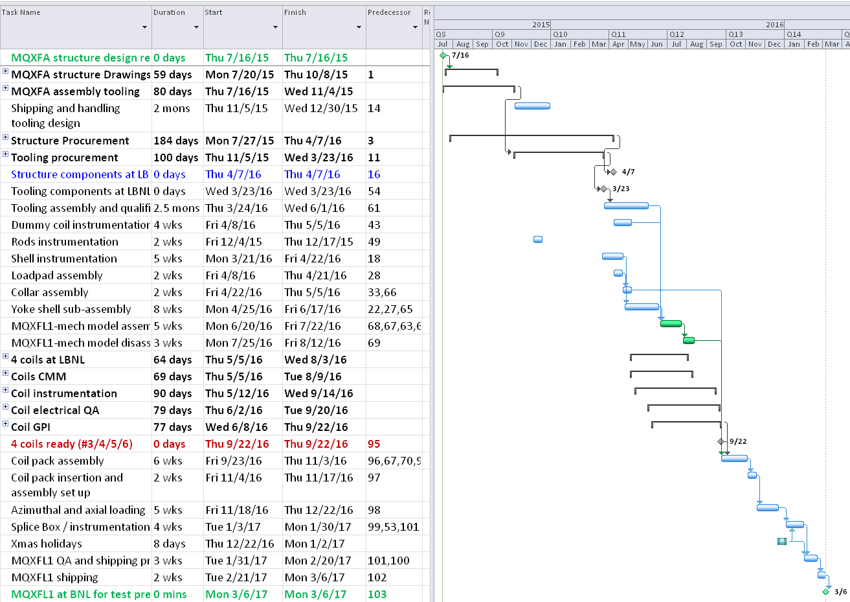
Overview

Slide 3
Drawings and Procurement
Parts Drawings
Sequence based on assembly priorities and concept finalization timeline
Concept finalization
+ Tooling drawings
MQXFA1
Structure Procurement
Tooling procurement
Structure components at LBNL: april 2016

Slide 4
Coil prep and assembly
Instrumentation
Yoke shell subassembly
Mechanical Model
Summer 2016
No cool-down!
June 2016
4 coils at LBNL by early August 2016
Coil preparation
Ready 09/2016
Magnet assembly
Sept 2016-Feb 2017
Magnet at BNL: 03/2017

