Slide 1
LHC Hi-Lumi QXF
Options for Value Engineering
M. Anerella, J. Schmalzle, P. Kovach
July 17, 2015

Slide 2
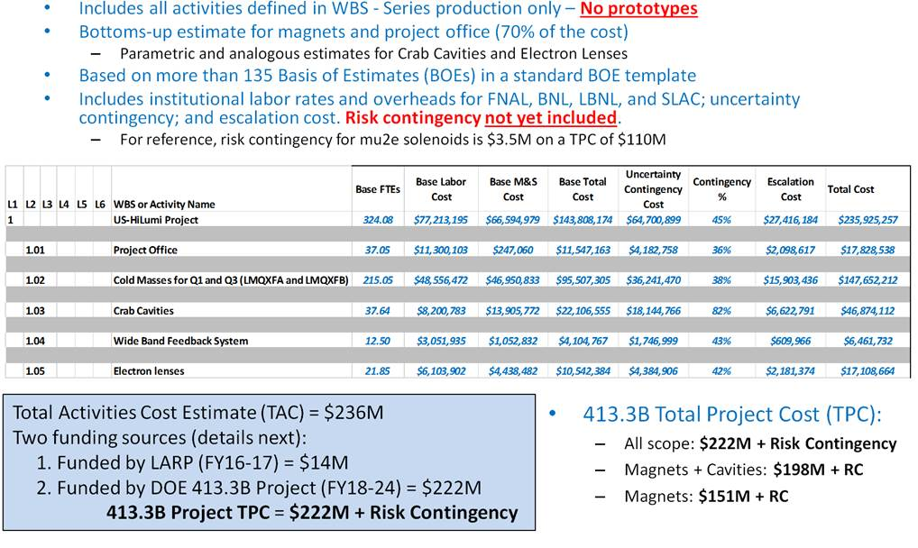
Motivation
From Ruben Carcagno (see below):
Total US-Hi Lumi Project net cost estimate = $222M
Total DOE funding expectation = $181M
$41M shortfall
QXF is $148M total inc. contingency for 20 cold masses
$7.4M per cold mass (most expensive ever?)
Only $28M for Nb₃Sn; $37M for remaining material ($1.8M / CM)
$67M for labor ($3.4M / CM)
Production starts Jan 2018
All Value Engineering must be
evaluated ASAP

Slide 3
Goals
Reduce assembly labor costs / time
Reduce material costs
preserve or improve quality (while achieving goals 1&2)

Slide 4
Candidates previously proposed (see details in back-up slides)
Coils:
Solid formblock
reduces assembly labor (cleaning and installation of many EDM blocks)
likely reduces tooling cost (needs verification)
improves quality via reduced quantity of parts, fewer tolerances to accumulate
Structure:
Eliminate masters
reduces material cost due to elimination of machined parts
reduces assembly labor due to fewer parts to handle at assembly
improves quality via reduced quantity of parts, fewer tolerances to accumulate

Slide 5
Other Candidates
Coils:
Eliminate curing of outer layer; install directly into reaction fixture
Employ silver plated bolts in the reaction fixture to eliminate application and cleaning of anti-seize compound (already implemented?)
Utilize commercial die sets to ensure parallel closing of reaction & impregnation fixtures, eliminating the three-step process of closing to a shim, then opening fixture to remove shim, and then closing again
Eliminate inner trace
Eliminate (resist incorporation of?) secondary operation of potting wires into coil extension; utilize mechanical strain relief instead
Structure:
Replace collar bolts with keys (intermittent spaces permit gap msmts)
Eliminate “Fuji film” inspection assembly
If deemed necessary, develop an optimized plan for magnetic shimming (i.e., avoid/minimize cost growth)

Slide 6
Back-up slides

Slide 7
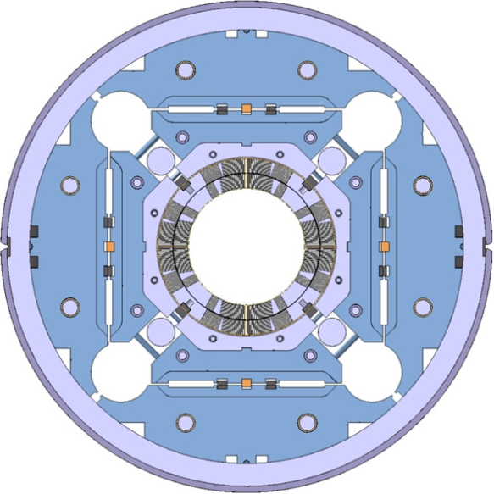
QXF Baseline Design

Slide 8
LHC Hi-Lumi QXF
Proposal for Collar / Yoke Assembly
(updated 7/17/15)
M. Anerella, J. Schmalzle, P. Kovach
July 10, 2015

Slide 9
Proposed QXF magnet cross section
Masters are eliminated.
Bladders / load keys are between yoke and load pads.
Pads locate to collars at angled surfaces
(as masters did 2x)
Pads key directly to yokes

Slide 10
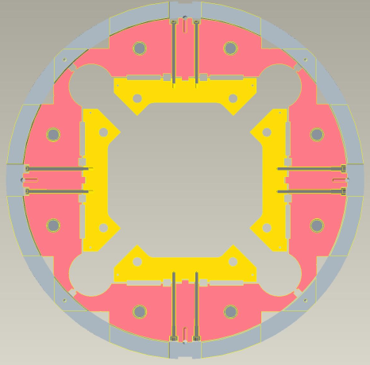
Yoke shell sub-assembly
Load pad are pre-assembled in the yoke shell subassembly
Bolts secure load pads in retracted position. Bolts are installed at existing cutouts in shell.

Slide 11
Collar pack insertion
Collar assembly supported on roller assemblies, roller tracks inserted in yoke holes (more on next slide)
Once collar assembly is in place, screw assemblies used to push pads into position against collars to increase space for bladder installation.
Note: requires holes in table base at bottom screw locations

Slide 12
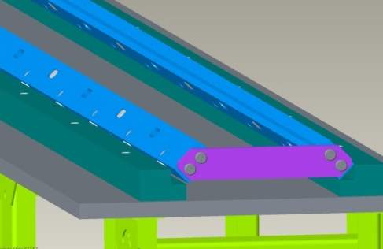
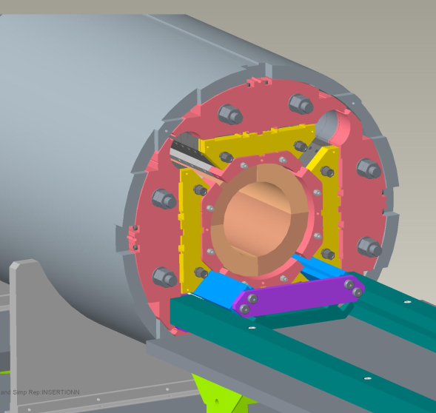
Collar pack insertion
Roller supports ready to accept collar pack
Collar pack on supports, ready for insertion.
Collar assembly installation complete

Slide 13
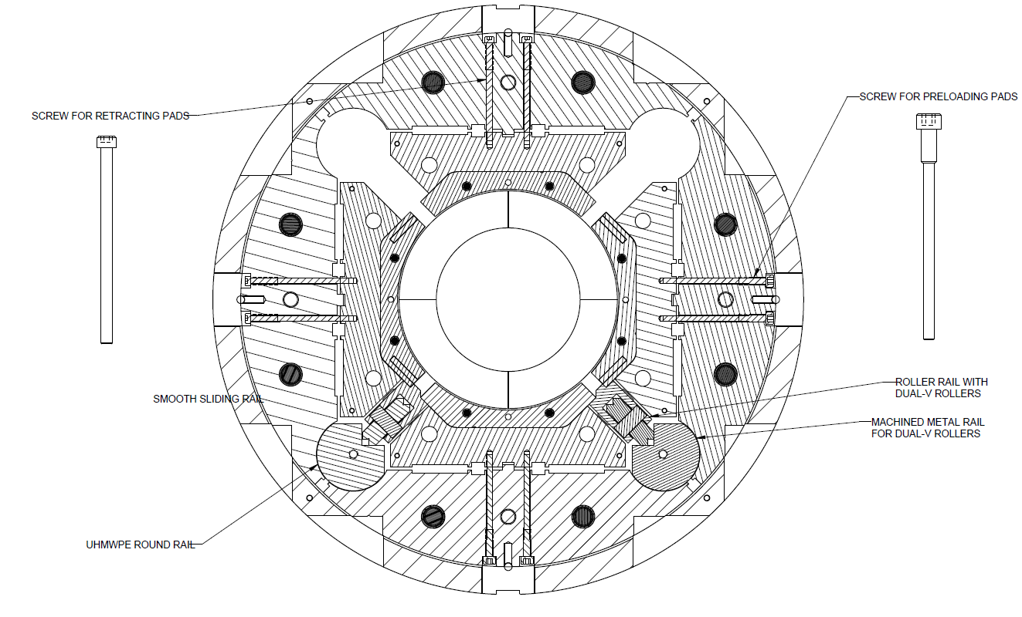
Alternate tooling concept
Alternative (cheaper) insertion rail concept, simpler support bar sliding on low friction UHMW bar.

Slide 14
Summary
Shell - yoke subassembly includes the load pads.
Masters eliminated:
Increases alignment accuracy
Reduces cost
Insertion of only collared coil assembly.
Requires only minor changes to tooling & procedures
New yoke preloading beam
New rollers / slides for collar assembly
Other?

Slide 15
LHC Hi-Lumi QXF
Proposal for Coil Impregnation
(updated 7/17/15)
M. Anerella, J. Schmalzle, P. Kovach
June 11, 2015

Slide 16
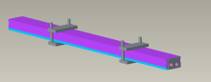
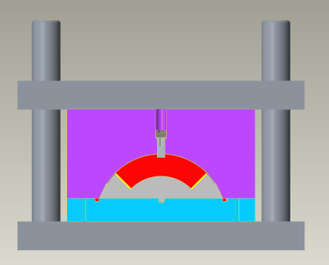
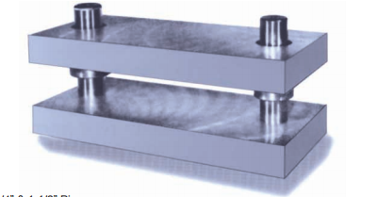
Modified Impregnation Fixture Design
Replace top plate and EDM blocks with solid formblocks, ~2 m long sections, machined & honed
(see appendix for details)
Commercial die sets provide alignment of formblock to mandrel, ensure parallel closing of fixture
0-ring seal to base plate
Mandrel blocks remain unchanged

Slide 17
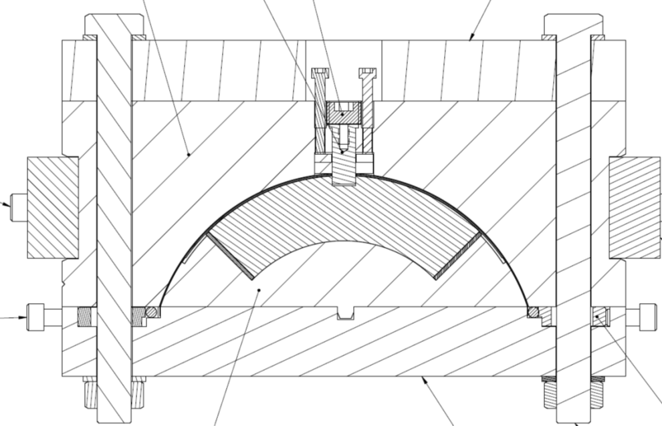
Impact with respect to existing design
Top plate is eliminated
Liner is eliminated
Side bars and screws are eliminated
Mating surface is maintained to retain compatibility with reaction fixture plate
Pusher bars and screws are eliminated
* All changes reduce tolerances and/or reduce cost *

Slide 18
Other (updated 7/17/15)
Vendor quote of 2.3 m parts is $52K each using tool steel, ~ $60K each in 304 sst
Need to compare to existing costs of formblocks + top plate + liner + side bars + pusher bars
4.6 m quotes in both materials are pending
Existing 4 m EDM formblocks can be recycled for 4.2 m reaction fixtures
Time for cleaning of formblocks between coils is significantly reduced

Slide 19
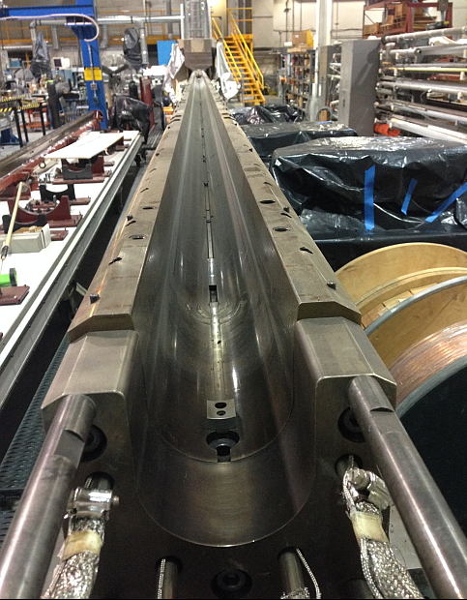
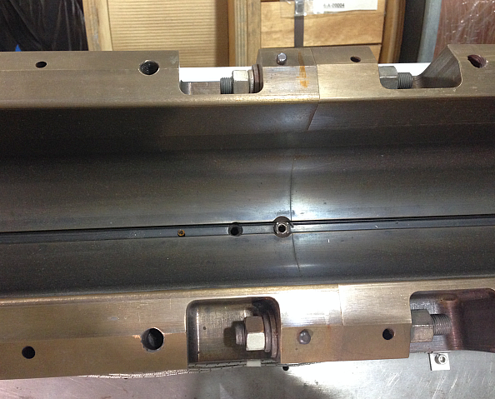
Summary
Solid tooling is a well established, proven method for fabricating formblocks (all production RHIC tooling)
Elimination of parts and tighter tolerance capability (R .01 mm vs. .05 mm) can yield improved coil size & L-R asymmetry results
A seamless implementation is possible due to compatibility with existing tooling
Parts reduction should also yield significant cost savings
Labor savings should result due to reduced surfaces to clean and prepare with each coil

Slide 20
Appendix Tooling Fabrication Steps

Slide 21
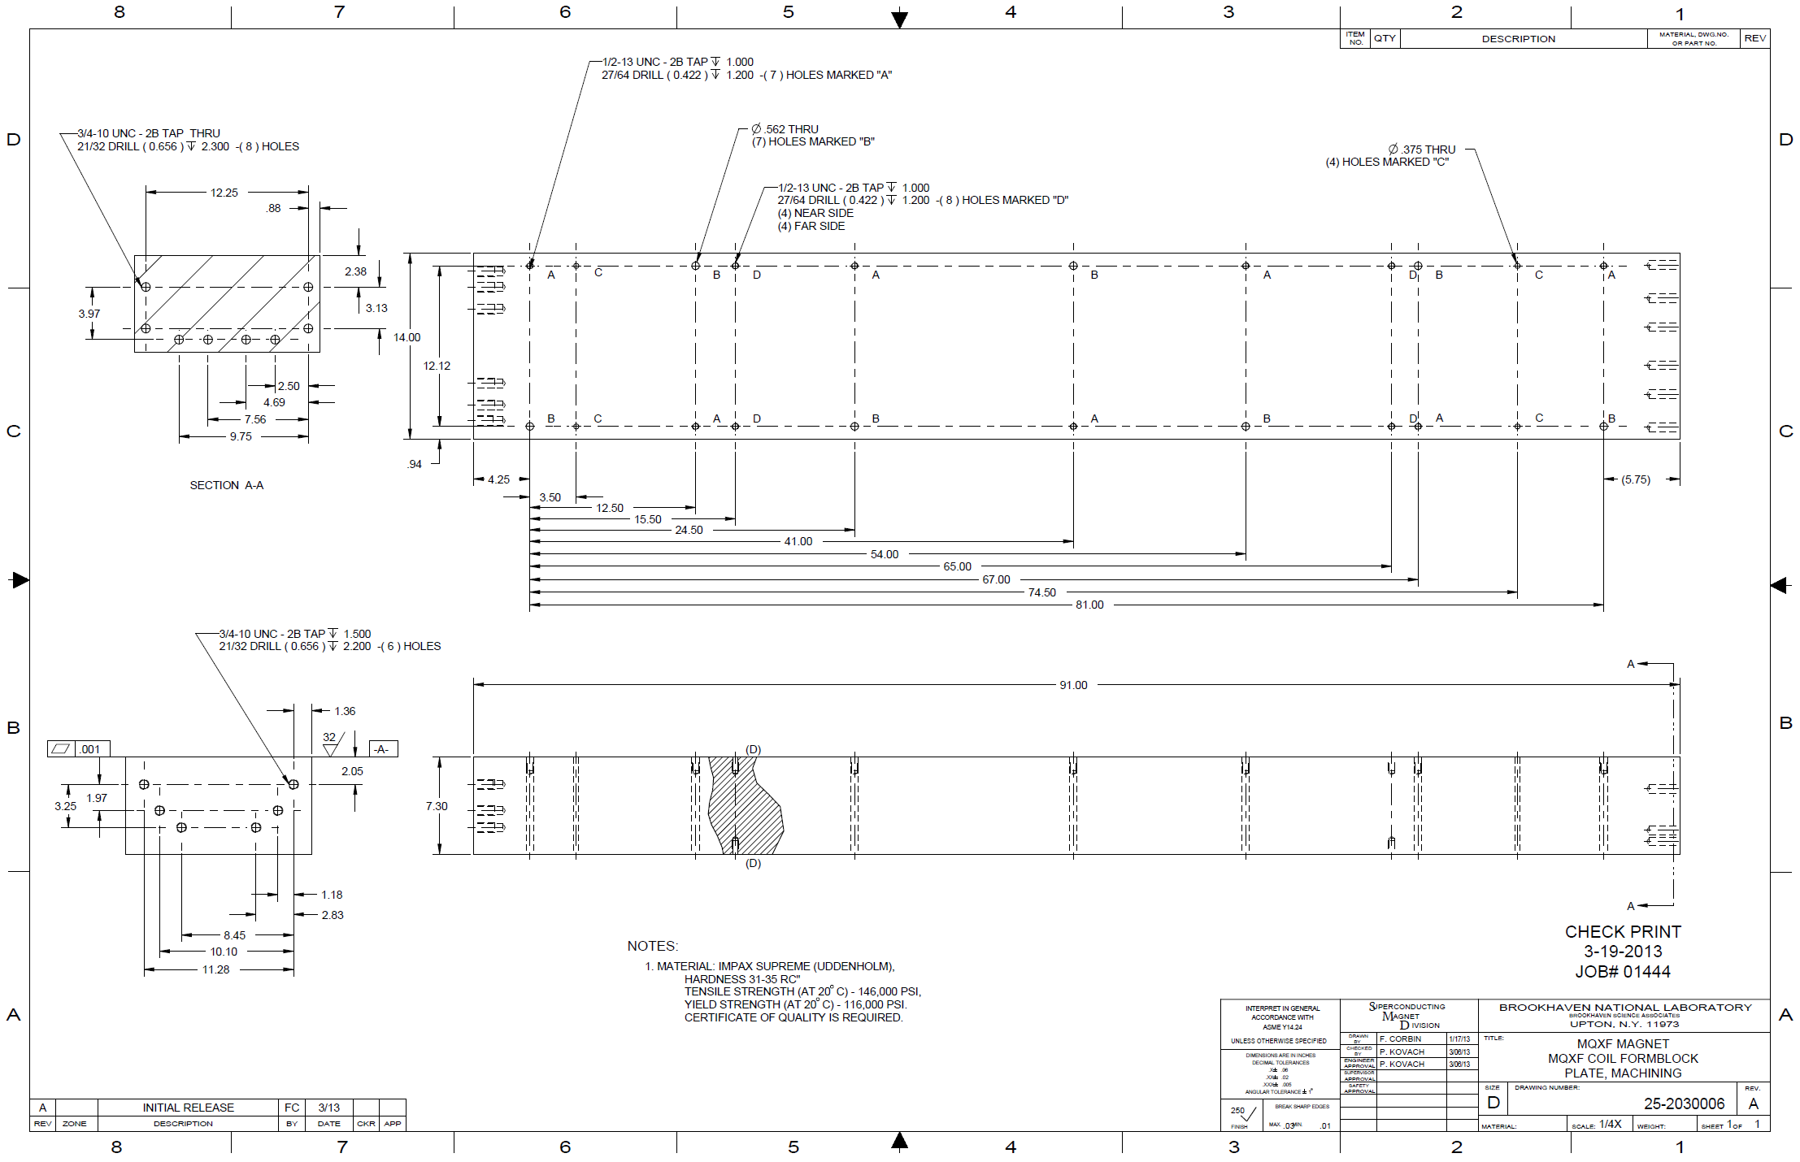
Step 1 – initial milling of tooling halves & drilling holes* * some used for temporary bolting together of halves

Slide 22
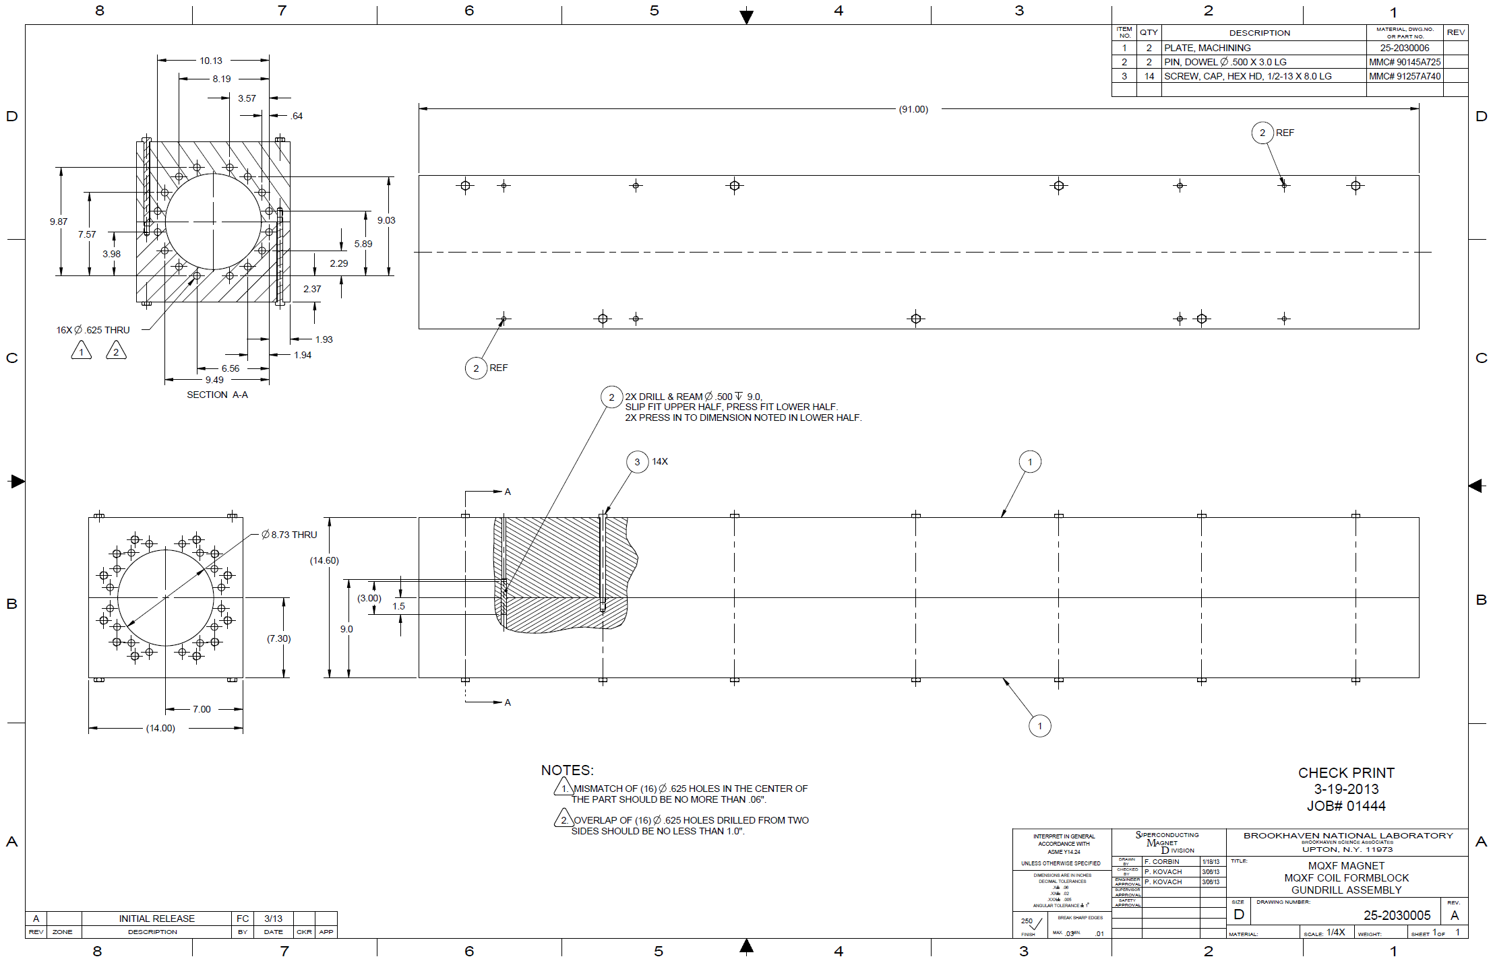
Step 2 – bolt halves together & gun drill to undersized radius

Slide 23
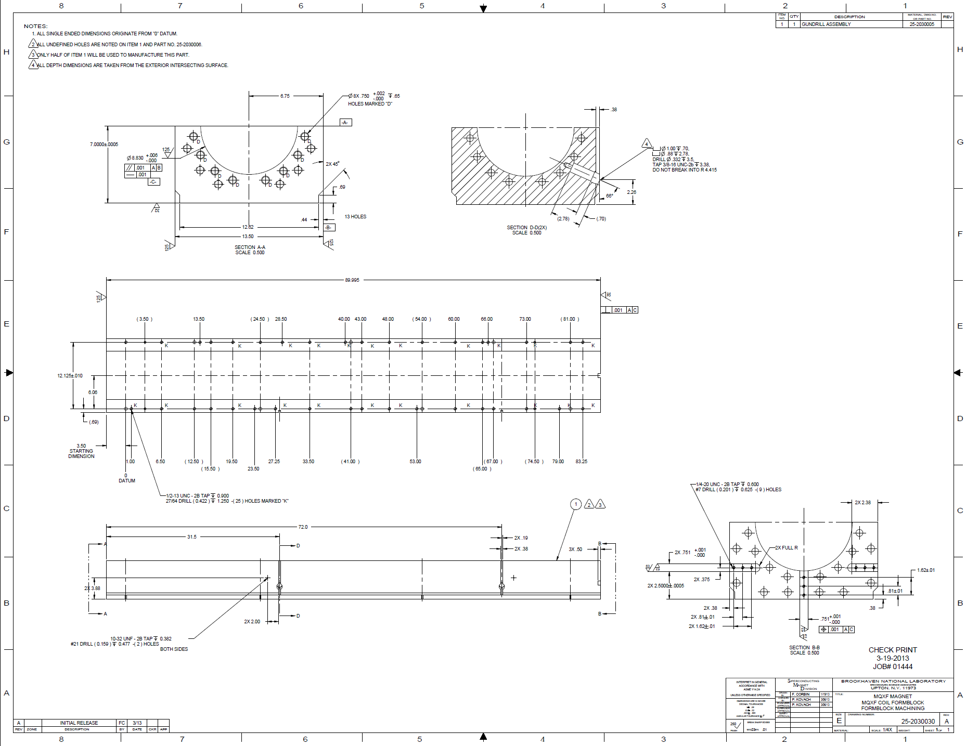
Step 3 – separate and machine each half to larger undersized radius, accurately machine midplane and machine overall height

Slide 24
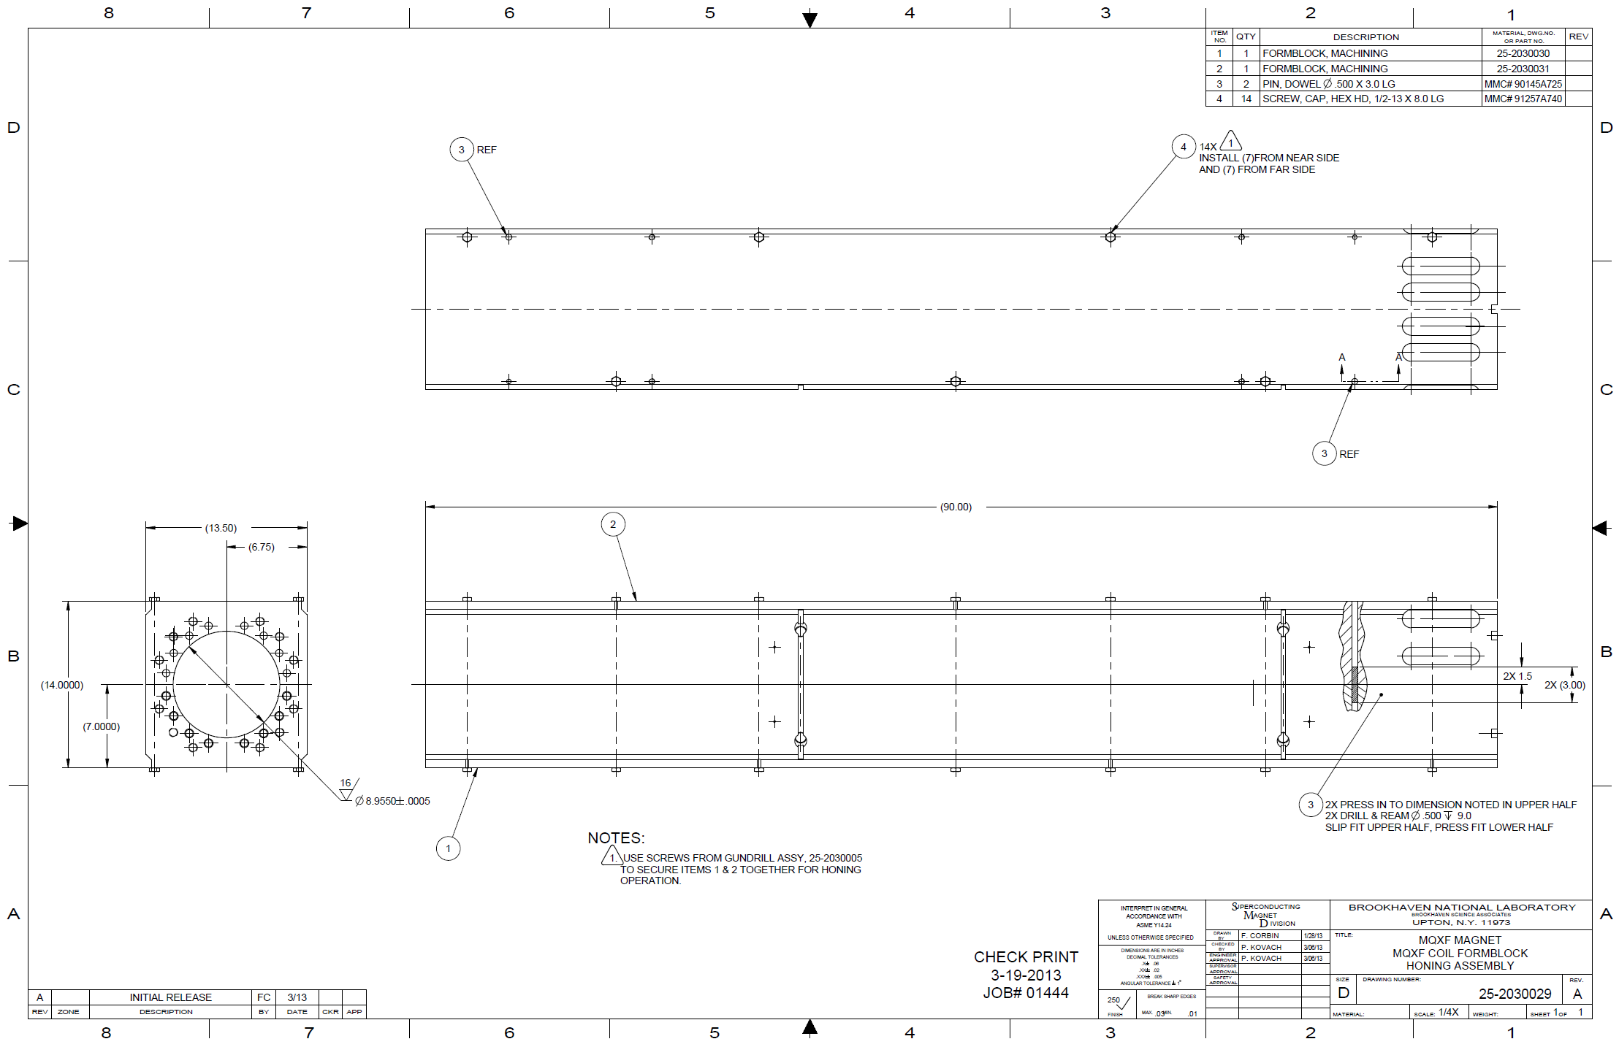
Step 4 – bolt halves together and hone radius to final dimension
Ø ± 0.013 mm

