Slide 1
Cryomodule Interconnect Installation Issues A Comparison of XFEL to LCLSII
Karen Fant
7/29/2015

Slide 2
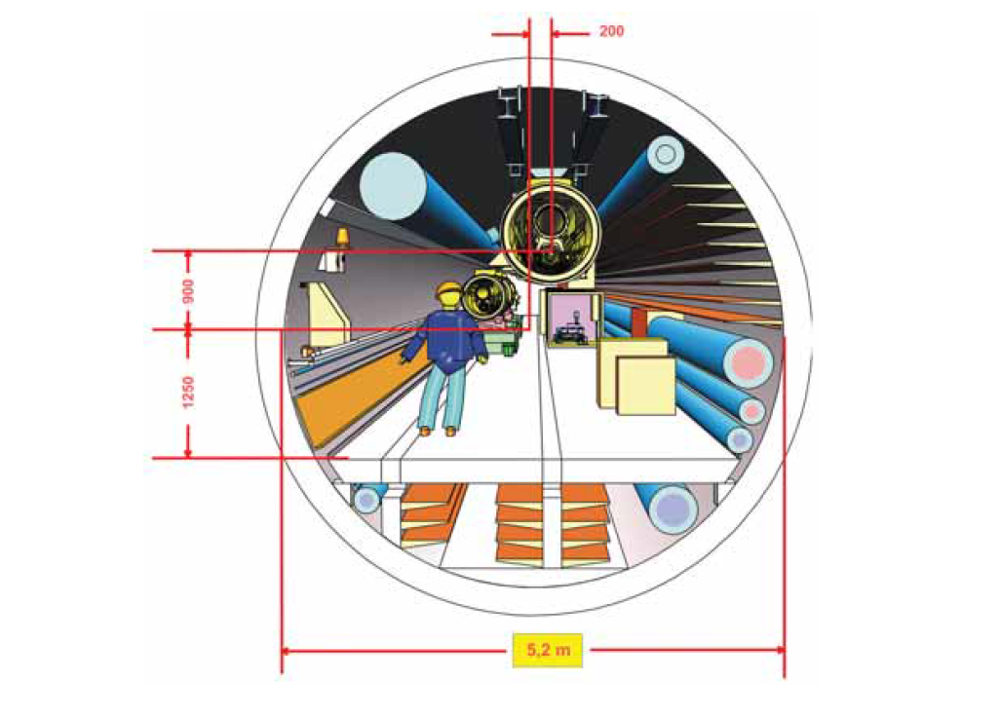
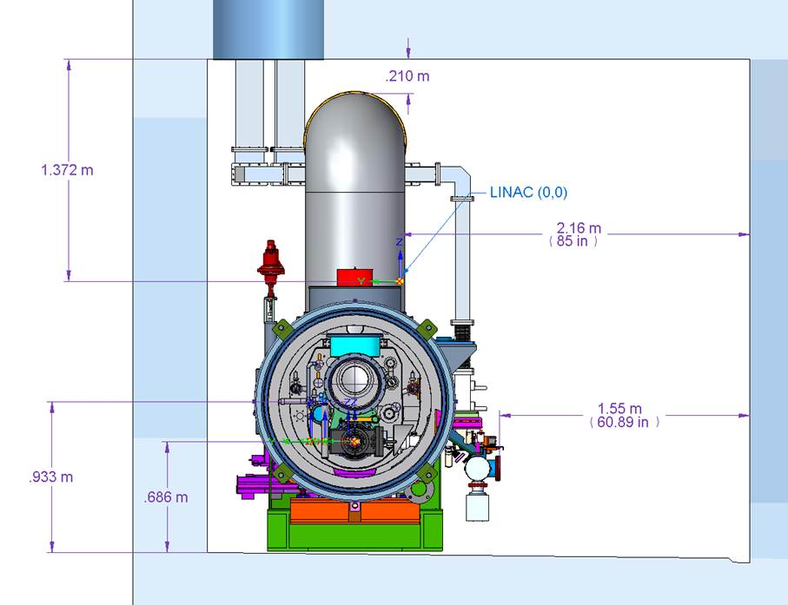
Introduction
Design of LCLS II Interconnection based upon XFEL design
Major Difference in Size of Tunnel & Location CM within Tunnel
Minor Difference in Build to Install Sequence
XFEL: Assembly Transport Accept Test RFI Install
LCLS-II: Assembly Test RFI Transport Accept Install
XFEL
LCLS-II
3.05m (10’)
3.35m (11’)
(Graphics to scale)

Slide 3
SLAC Interconnect Installation Assumptions
FNAL design team has checked that CM interconnections are achievable within SLAC tunnel space and ergonomic constraints
This FDR covers only string interconnect string (CM to CM, not to End/Feed caps)
Prototype and Production CM interconnects are identical
CM delivered to SLAC Ready for Installation
Incoming acceptance inspection confirms no change or damage during long transit
Checks for vacuum, electrical continuity, alignment, shipping
FNAL provides designs for interconnect tooling and fixturing
SLAC procures interconnect tooling and fixturing
FNAL will develop interconnect procedures
SLAC will develop interconnect travelers

Slide 4
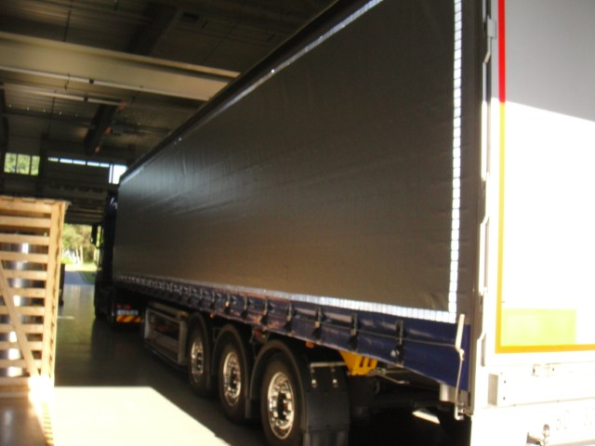
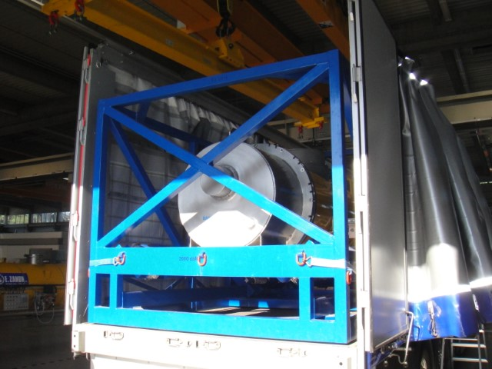
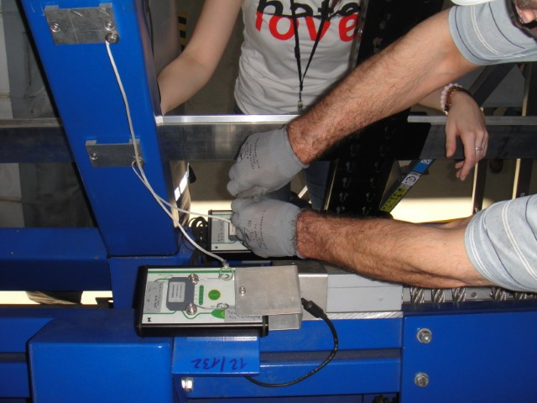
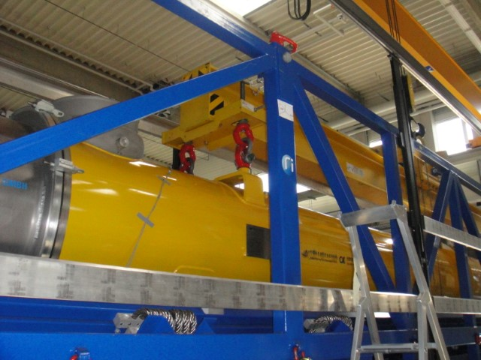
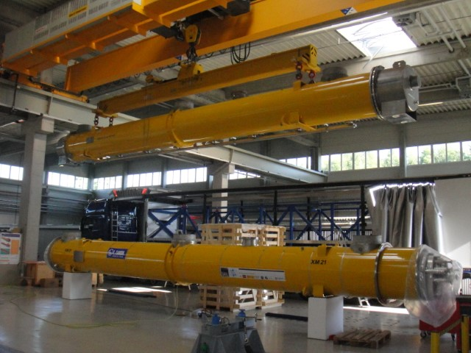
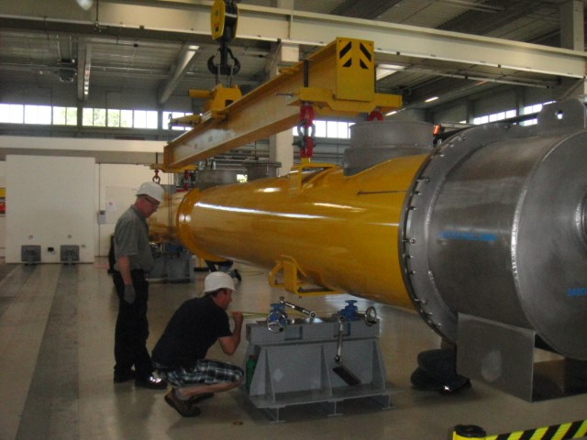
Receiving and Off-Loading
Truck Arrives from SACLAY
Remove Ceiling and Walls
Check Data Shock Logger
Attach Lifting Beam
CM removed from Transport Frame
CM Lowered onto Supports

Slide 5
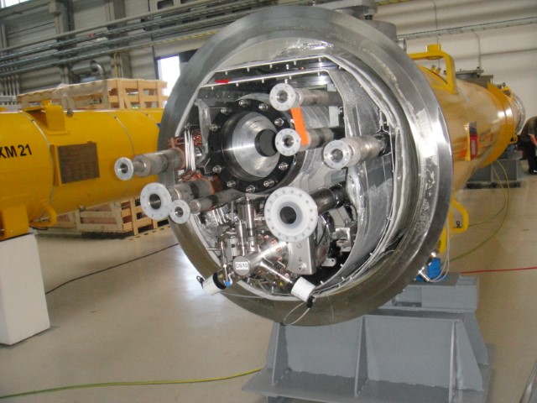
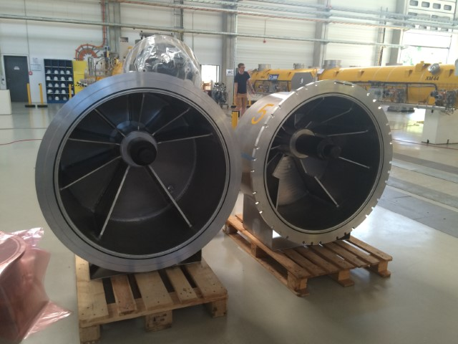
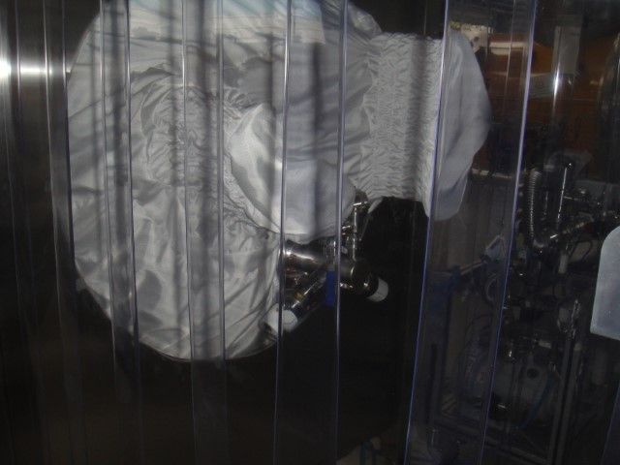
Receiving and Prep for Test
Check Vacuum Gauges and Alignment
Shipping Caps Removed
Accessory Box to Check Pipes and Vacuum
Portable Clean Room to Remove Vacuum Gauges

Slide 6
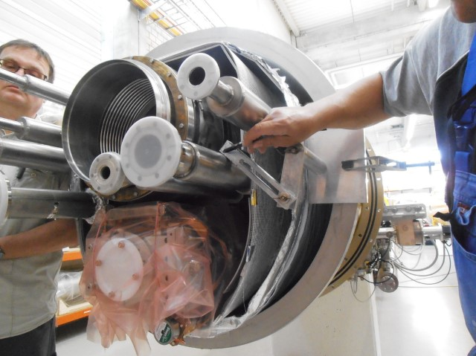
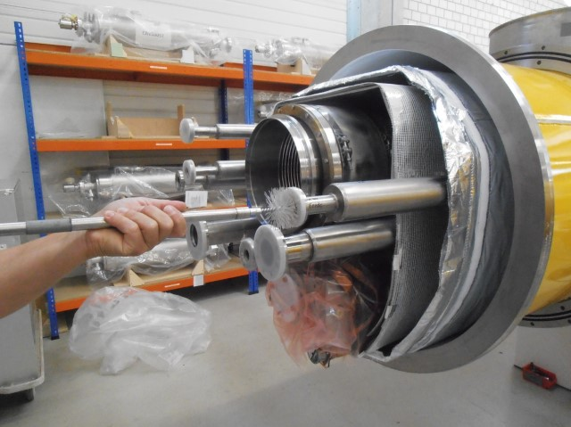
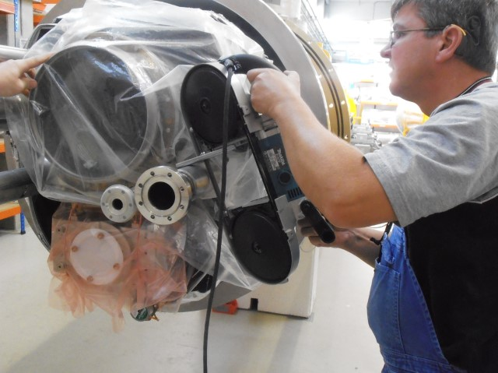
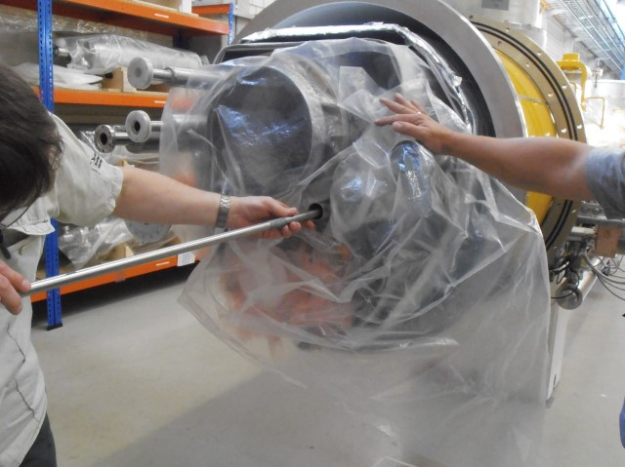
Pipe Preparation-Cut, Face, Clean & Package
Tooling to Measure and Mark Pipe Length
Inserting Wire Brush to Keep Pipe Clean
Cutting Pipe to Length with Band Saw
Removing Brush after Cutting

Slide 7
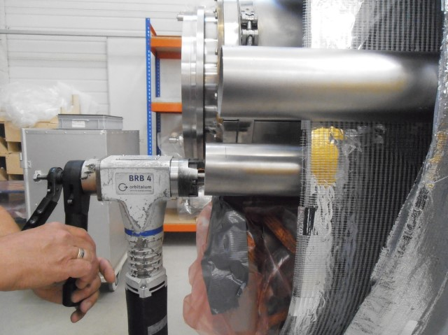
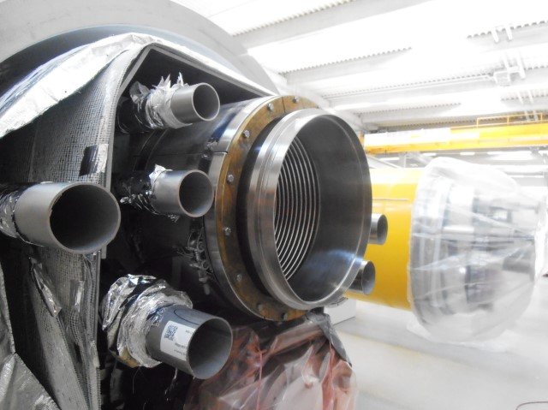
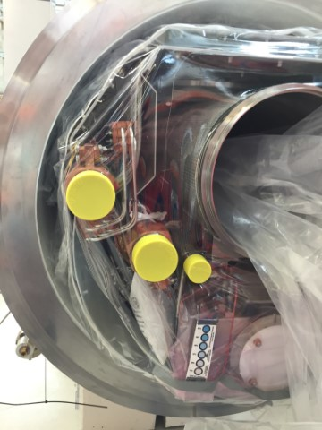
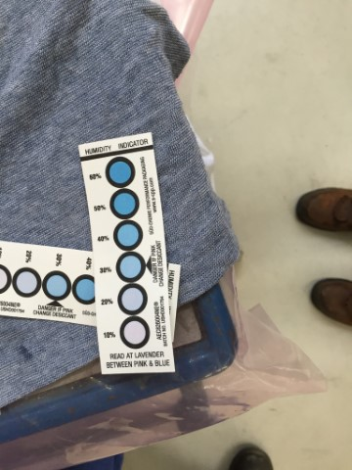
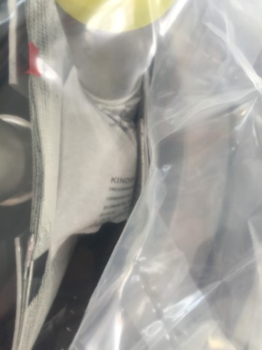
Pipe Preparation-Cut, Face, Clean & Package
Tooling to Face Ends of Pipes
All Pipes are Cut and Faced
Desiccant
Humidity Indicator
Pipes Capped and Ready for Installation

Slide 8
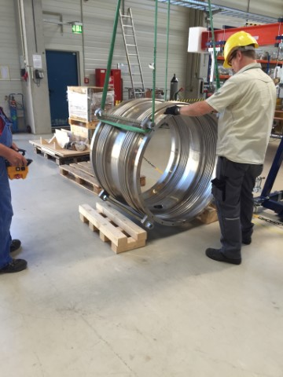
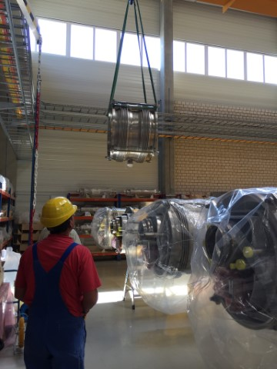
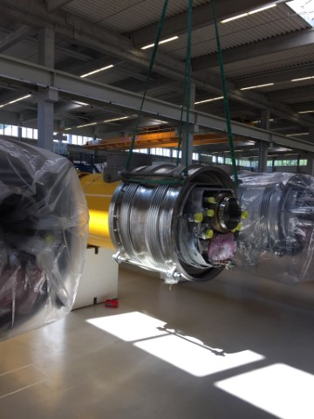
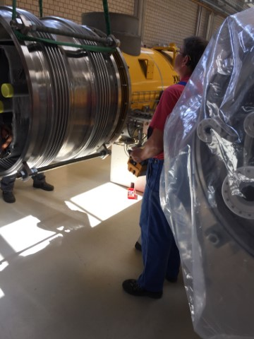
Assembly of Large Bellows on CM
Transport Bellows to CM
Prep to Lift
Prepare to Install on CM
Bellows Install Complete

Slide 9
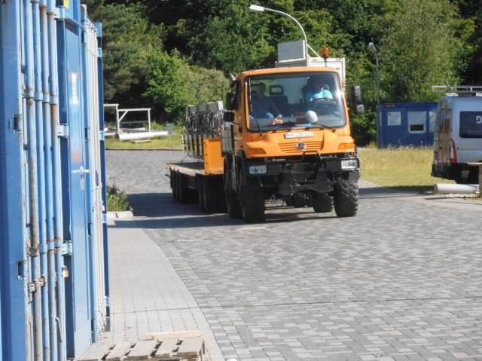
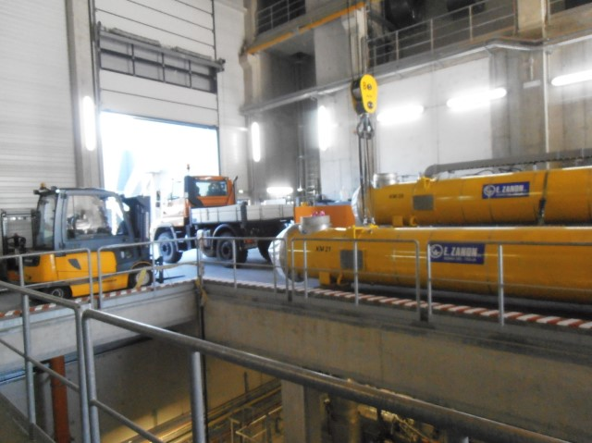
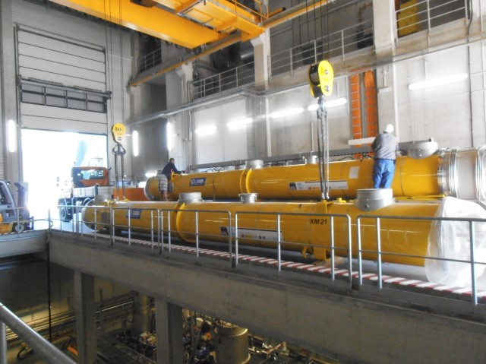
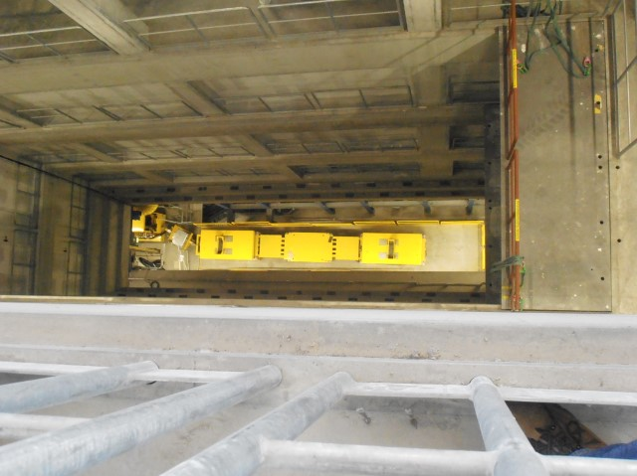
CM Transport Test to Tunnel
CM Transported from Test Facility
CM Arrives at Install Site
Preparing to Lower into Tunnel
CM Transporter Viewed from Above

Slide 10
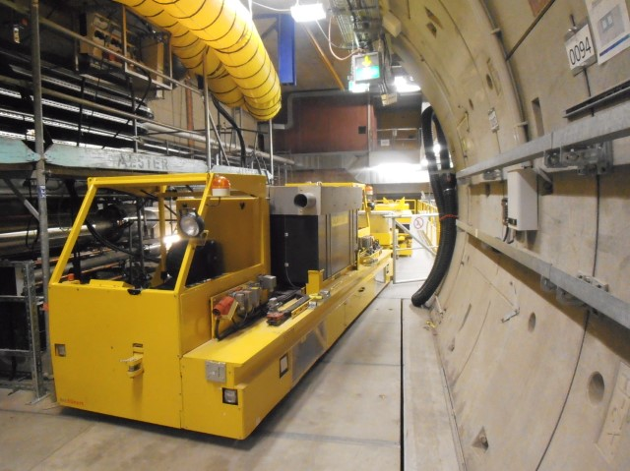
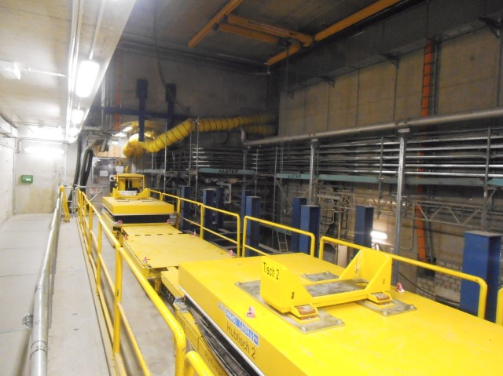
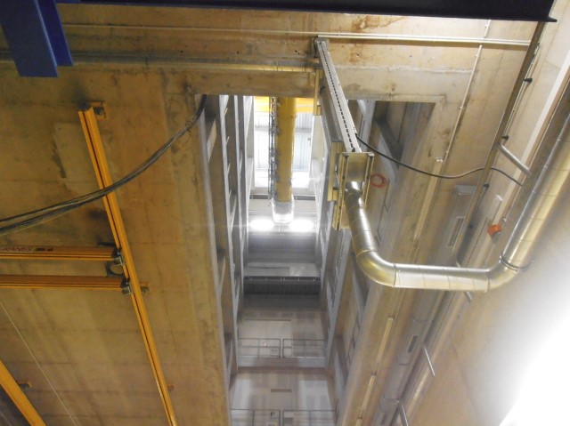
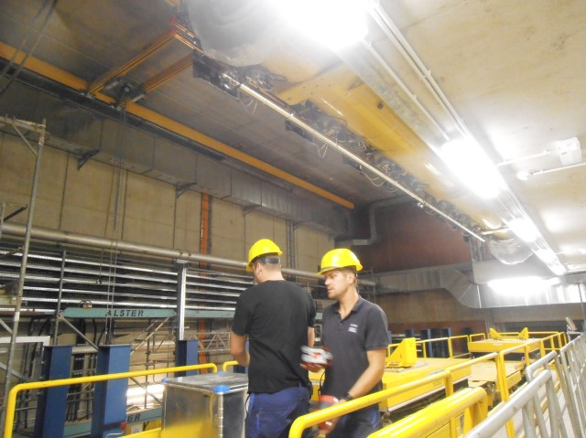
CM into Tunnel
CM Transporter
CM Transporter-Attachment Cradle
Lowering CM to Tunnel
Preparing to Install CM on Transporter

Slide 11
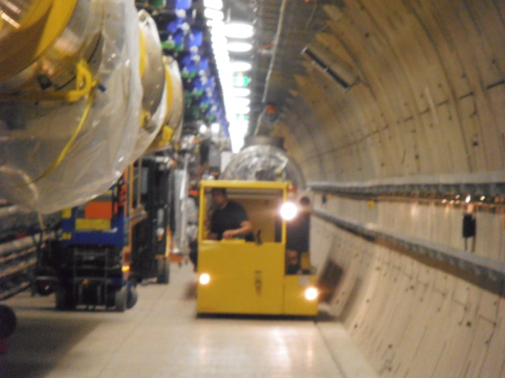
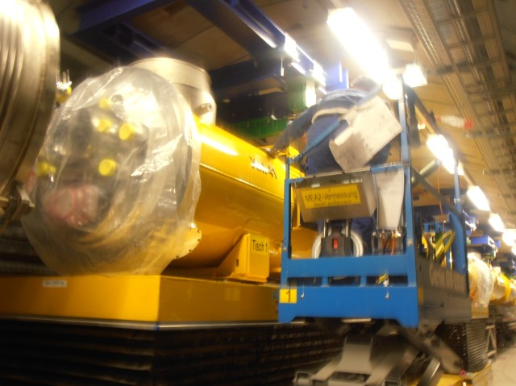
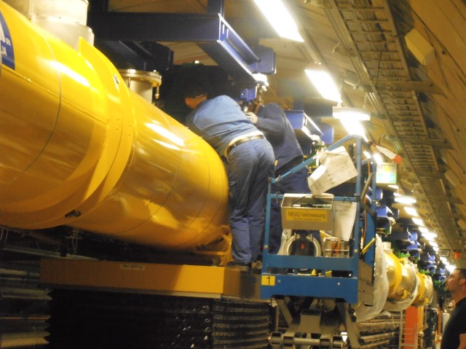
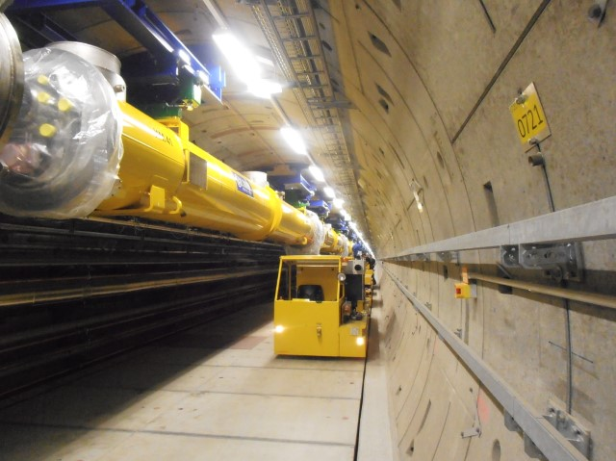
Tunnel Transport and Ceiling Mount
Moving CM through Tunnel
Raising CM to Supports
Attaching CM to Supports
CM Installed

Slide 12
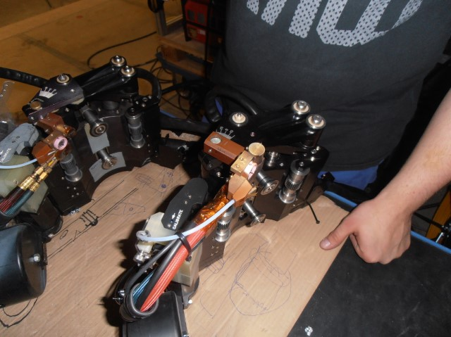
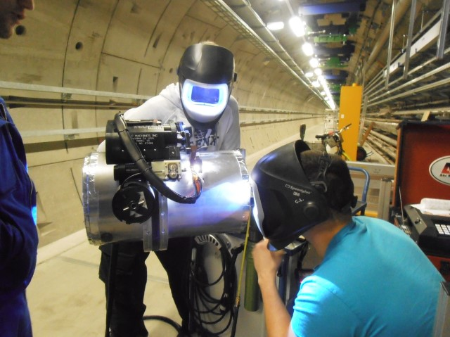
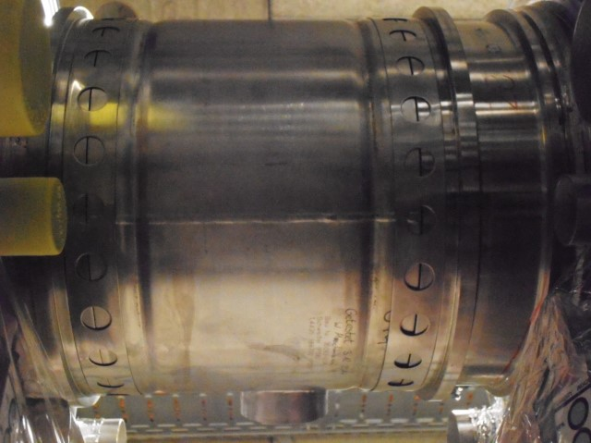
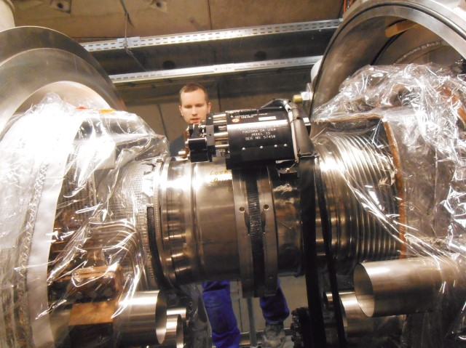
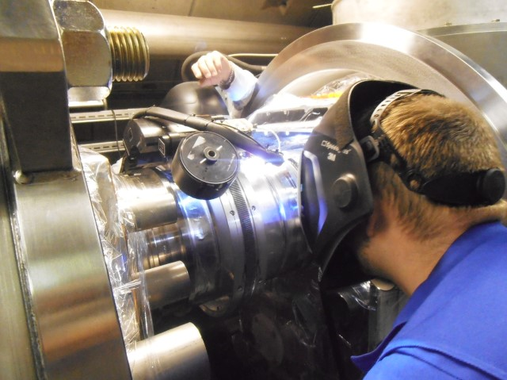
Welding the HGRP
Orbital Track Welder with Custom Head
Qualify the weld
Tack interconnect pipe in place
Checking weld set-up
Performing weld-workers on both sides of CM

Slide 13
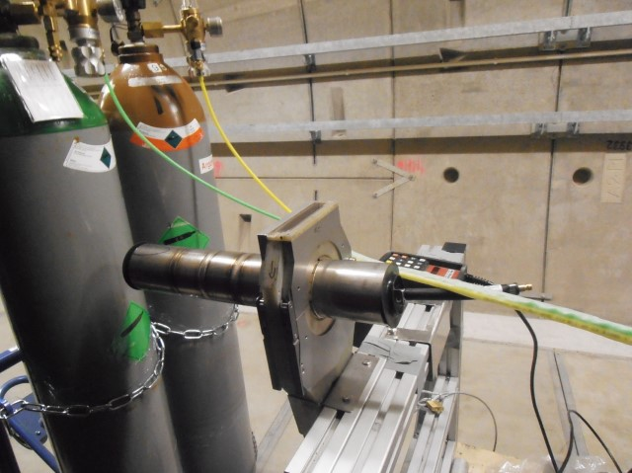
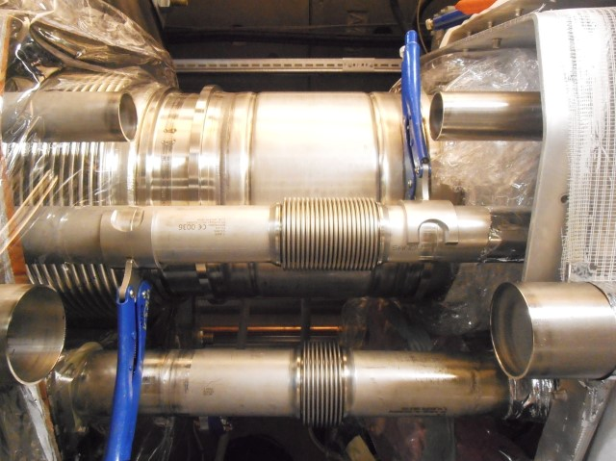
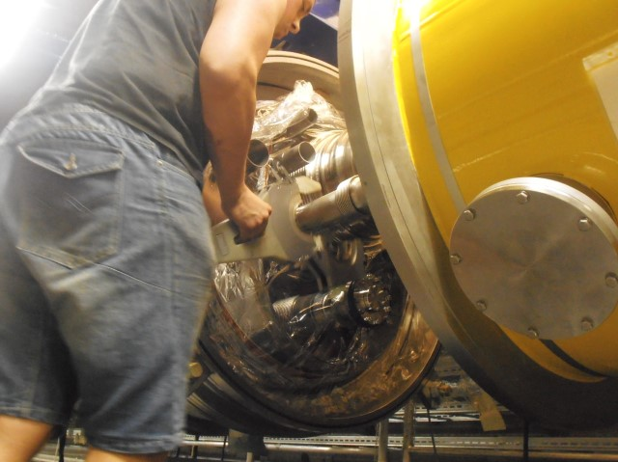
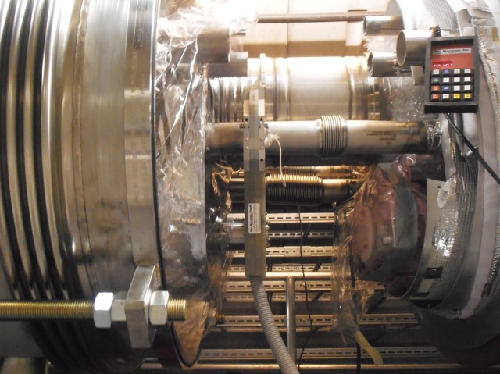
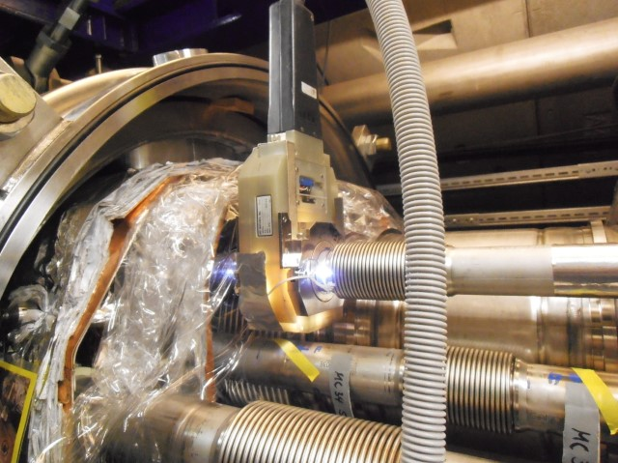
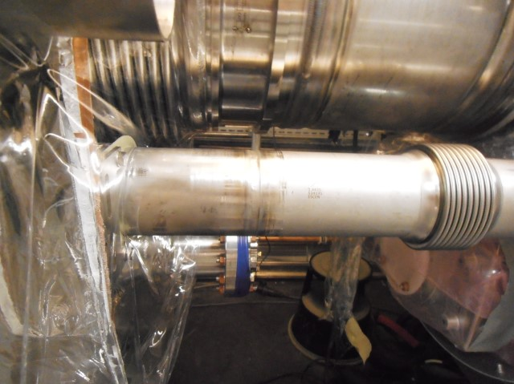
Welding Cryogenic Pipes
Qualify the weld
Tack interconnect pipe in place
Install paddle weld head
Head oriented to fit location
Perform the weld
Completed weld

Slide 14
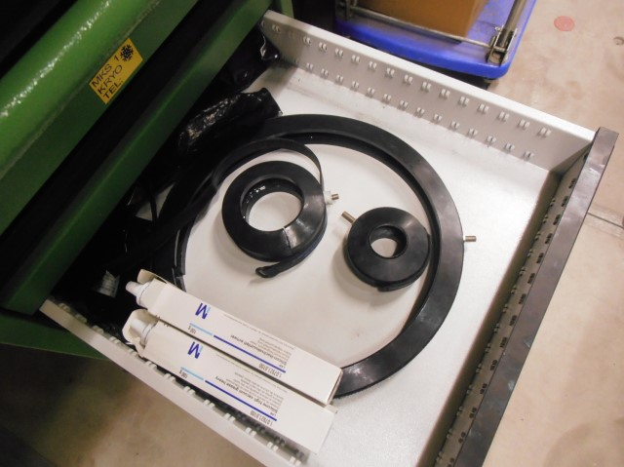
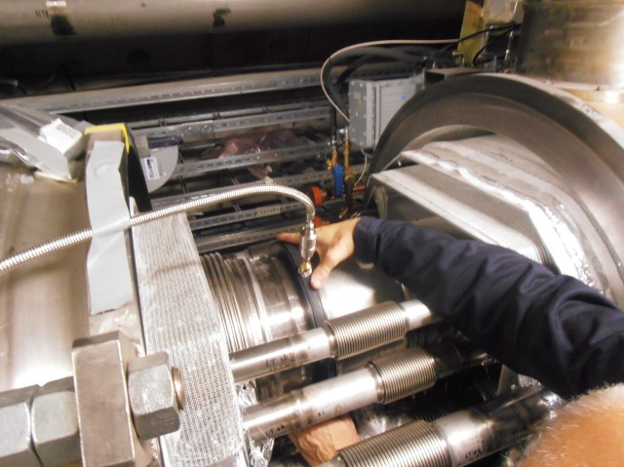
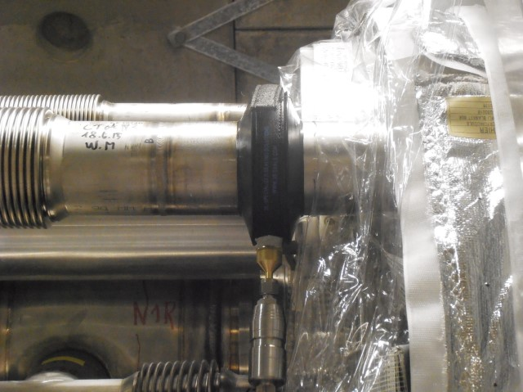
Leak Checking Cryogenic Pipes
Elastomer Leak Check Fixtures
Leak Checking HGRP Welds
Leak Checking Cryogenic Pipes Welds with Elastomer Fixture
Aluminum Leak Check Fixtures
Aluminum Leak Check Fixtures Installed
Leak Checking Cryogenic Pipes Welds with Aluminum Fixture

Slide 15
HOM Installation
Class 10 Portable Cleanroom
HOM Install Fixture
Placing HOM on Fixture in CR
Prep Gate Valves in CR

Slide 16
HOM Installation
Raising HOM into Position
Removing Flange Caps
HOM Ready to Interconnect
HOM Installed
HOM with Clean Room Removed

Slide 17
Thermal Shield Connection
Solid Aluminum Thermal Shield Covers
Shield and Cryo-Pipe Bellows Restraint Installed
Perforated Aluminum Shield Covers
Final Layer of MIL Installed-Ready for Lg Bellows

Slide 18
Large Bellows Installation
Bellows Install Fixture
Bottom Supported (Test Facility)
Bellows Install Fixture
Top Supported (Tunnel)
Bellows Prep’d to Move
Bellows in Position
Sliding Bellows into Position

Slide 19
Large Bellows Installation
Sliding Ring into Position
Bolting Ring to Bellows
Attaching Clamps Aisle Side
Attaching Clamps Wall Side
Bellows Installed and Threaded Rods Removed

Slide 20
Example of Vacuum Pump Station Installed on Large Bellows

Slide 21
Testing the Design
Recommend FNAL and/or JLAB “interconnect” 2 CM for fit up check
In next few months SLAC will build weld test fixture to confirm design
Use pipe X, Y coordinates, materials, dimensions as defined in CM Interconnect Assembly Procedure
Model to confirm clearance work for weld tracker, custom weld head, paddle heads, insulation shield fit
Development of weld sequence and parameters, purge and leak check tooling
Model to check ergonomics, special tooling requirements not already identified
Develop pressure test or X-ray procedures

Slide 22
Some Areas of Concern or Issues to Resolve
Tube cutting prior to ship
Receiving Inspection and Acceptance
Vacuum gages attached during transit in tunnel
Tube welding
Purge, welding gas (space for 12 pack)
Thermal Insulation Shield – XFEL fit problems
Installation of HOM absorber
Pressure test vs X-ray
Big Bellows installation and connection
Continuous dry air purge vs desiccants
Class 10 cleanroom in tight environment
Installation required from wall side? – ergonomics, special tooling

Slide 23
Summary
LCLS II CM Interconnect similar but not identical to XFEL CM interconnect
SLAC personnel observation & participation at XFEL extremely useful for understanding and recording installation process
Photos all courtesy K. Ratcliffe and J. Garcia - Complete set of photos can be found at:
https://slacspace.slac.stanford.edu/sites/ad/work_planning_control/Work_Planning_Control_Documents/Partner_Lab_Info/Partner%20Labs%20Photos%20and%20Videos.aspx
Major differences identified
Working with FNAL design team to identify, address and resolve gap/issues
So far don’t see any show stoppers

Slide 24
End

