Slide 1
650 MHz – FY16 Budget Request
A. Grassellino, Cavity Test Group Leader, SRF dept, TD
PIP-II Budget Retreat
June 30, 2015

Slide 2
Effort request
11.3 FTEs (~1.5 scientists, ~ 7 cryo/mech engineers, ~1 design&draft, ~1.5 technicians )
~$1.5M M&S (HPR, He vessel welding, processing, tuning, prototypes)

Slide 3
PIP-II 650 MHz - FY16 Initial Goals
Cavity design
  Is now expected to be completed in FY15, small effort in FY16
Multi-cell cavity processing and testing
  With the goal of having a 650 CM in FY19, 8 multicell cavities should be processed and tested – need to be dressed and tested dressed in FY17-FY18, CM assembled in FY18
Infrastructure upgrades/design for HPR, tuning and He vessel welding
  Existing infrastructure is insufficient to process cavities for LCLS-2, PIP-2, R&D and other projects; need dedicated processing lab and other tools for PIP-2 cavities only (spoke and 650)
Cryomodule conceptual design
  Cavity string, cryo piping and thermal shield/vacuum vessel design
CM components design including tuner, coupler and shielding
  complete design and prototype
Complete cyromodule design with India

Slide 4
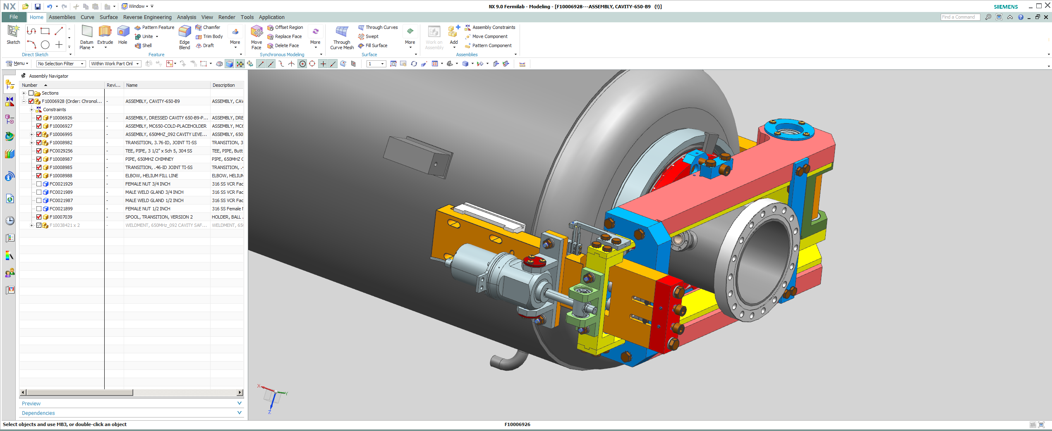
Resonance Control/Tuner development
Proposed plan for 2016
Finish mechanical design/drawings
Complete ANSYS simulation of the structure)
Build first prototype
Installed tuner on the mock-up or real cavity/vessel system
Conduct warm tuner test (range; forces; transfer function; etc.)
3D Model of the slow/fast tuner for 650MHz
(conceptual design; double lever style)
Y. Pischalnikov

Slide 5
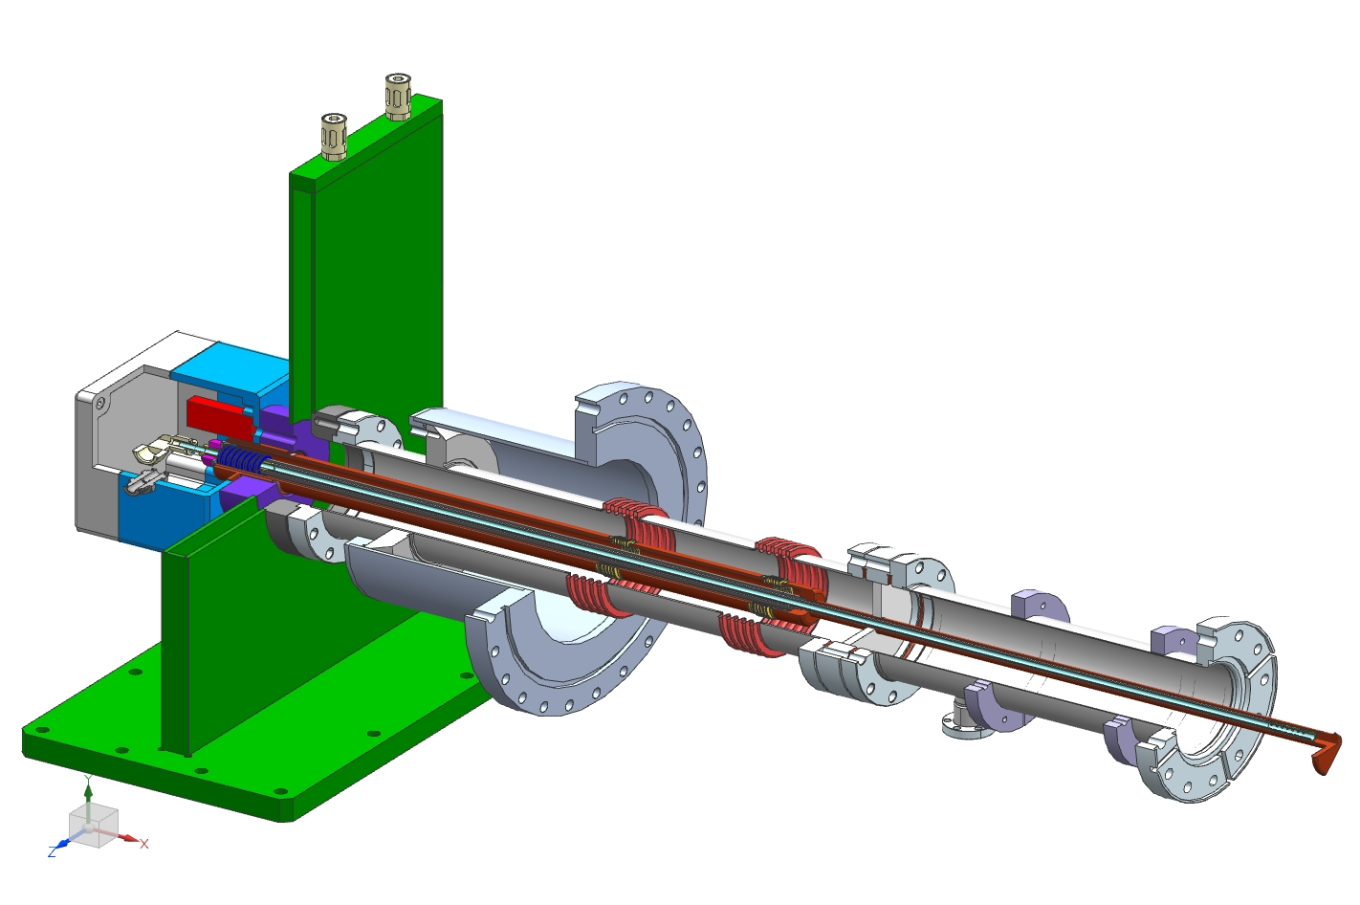
650 MHz coupler
Necessary works:
Refresh design (design was done in 2011).
Or/and new design with new ideas (we have them).
Coupler fabrication.
Design of coupler test stand.
Test stand fabrication and assembling.
Test of prototype coupler at test stand.
Test coupler with cavity in cryomodule (FY17-18).
Kazakov

Slide 6
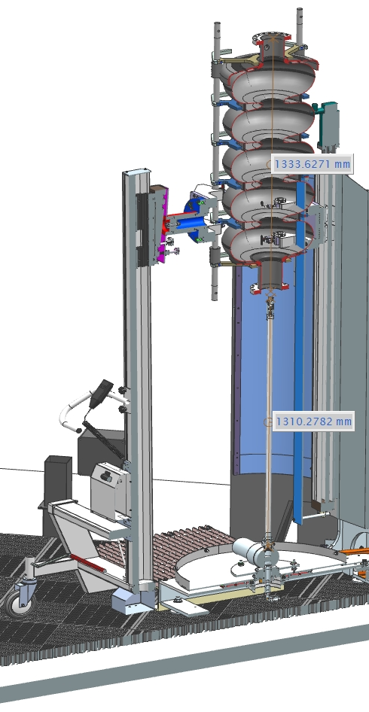
HPR tool for Dressed 650 MHz cavity: the bottleneck
Currently FNAL owns two HPR tools total, one at ANL, one at IB4 -no HPR tool is capable of supporting 650 MHz without modifications
HPR at ANL in FNAL room cannot run simultaneously to HPR in ANL room – several conflicts with other projects
We need to design, purchase and commission a 600 lb capacity HPR tool with support frame suitable for VTS for Dressed 5 cell 650 MHz Cavity with 56” stroke. 2.5 month mechanical engineer, 3 month design and drafting, 1 month control engineer. M&S – 500.000 USD

Slide 7
Multicell 650 MHz Cavity Processing
Lab 2 requirements for HPR:
  Class 10 HPR cleanroom – approx. $100k ($75k for 20’x20’ room + $15k installation + $10k fire protection) [shared with 325 MHz]
  Vertical HPR stands with capacity to hold dressed 650 MHz cavities – $325k (2x$125k M&S + $100k engineering)
  HPR pump – 2x$100k [shared with 325 MHz]
  OCR/commissioning – $85k [shared with 325 MHz]
  Lifting carts – $30k [shared with 325 MHz]
DI water system and other cleanroom items that would be duplicates of existing infrastructure are also required (hopefully covered by director’s reserve)
S. Posen

Slide 8
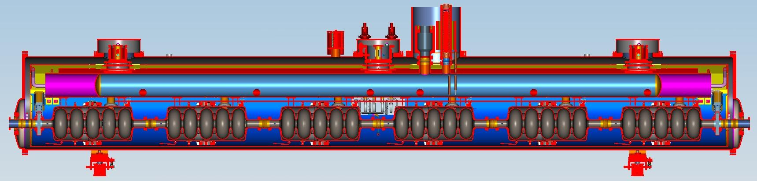
High-Beta Cryomodule Configuration
4 total cryomodules
6 cavities each (650 MHz, 5-cell)
24 total cavities
No magnets internal to the cryomodule
Approximate length = 9.5 m
T. Nicol

Slide 9
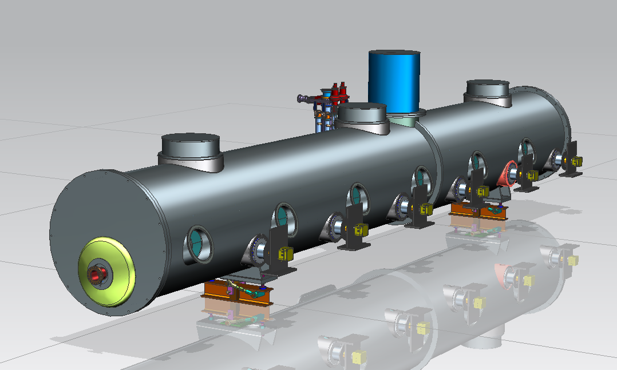
650 MHz High-Beta
Cryomodule General Configuration
T. Nicol
Heat exchanger
Bayonets connections,
cryogenic valves, etc.
Power couplers
Ports to access tuner
motors
Beam pipe

Slide 10
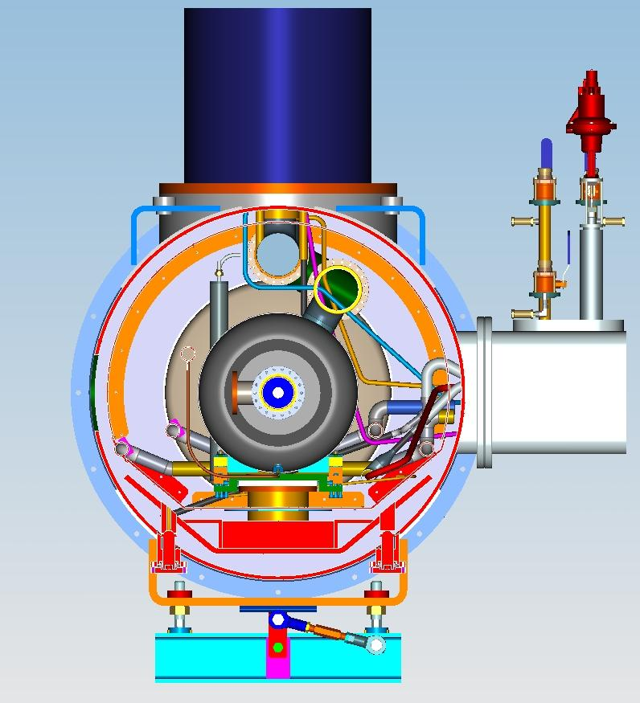
650 MHz High-Beta
Cryomodule General Configuration
T. Nicol
Heat exchanger enclosure
Thermal shield
Vacuum vessel extension for bayonets, cryo valves, etc.
Support post
Strongback

Slide 11
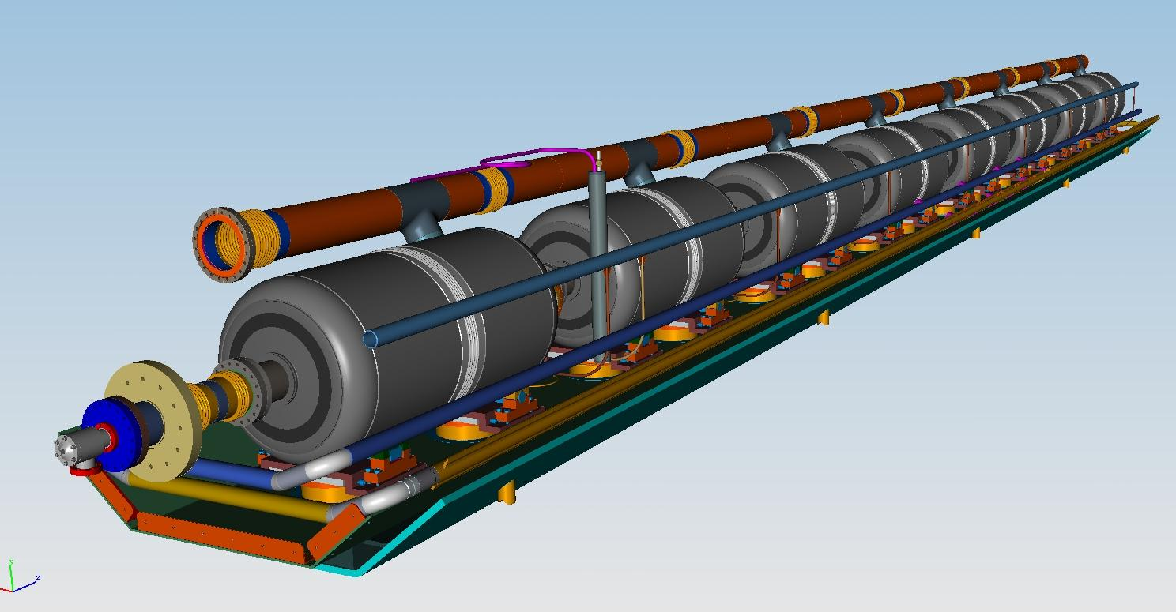
650 MHz High-Beta
Cryomodule General Configuration
He reservoir
with level sensor
T. Nicol
650 Cavity with 2-phase pipe
Warm up cool
down pipe
Strong back with
supports
4K circuit for intercepts
Thermal shield

Slide 12
PIP-II 650 MHz – Resources Required to Meet Initial Goals
Describe FTE resource needs to reach goals
  Engineers for CM conceptual design, for completing design of coupler/tuner, and for infrastructure upgrade, technicians for processing/test/ infrastructure upgrades, scientists for test, mag shielding design
Describe M&S resource needs to reach goals
  HPR, coupler/shielding/tuner prototypes, multicell processing, tuning machine
  He vessel welding machine

Slide 13
PIP-II 650 MHz – FTE – By OHAP Category, Role and Div.
  Mechanical and cryogenic engineers for CM conceptual design
  Mechanical and eletrical engineer for completing design of coupler/tuner, and for infrastructure upgrade design
  Technicians for processing/test/ infrastructure upgrades,
  Scientists for test, mag shielding design

Slide 14
PIP-II 650 MHz – Achievable Goals at Initial Target
Cavity processing sequence will remain a bottleneck until we have enough processing facilities that can support cavity flow
Cavity processing would be slowed down anyway – we need to be independent from LCLS-2
HPR is the most critical – tuning is also critical, He vessel welding machine commissioning could be delayed in FY17 (maximum)
Suggested if limited to initial target:
  HPR and tuning [We could have a contribution to the HPR/lab2 effort from GARD or Doping ECA]
  Some cryo conceptual design (small effort)
  2 multicell cavities processed and tested
This will cut and delay:
  6 cavities processing/testing; coupler, tuner and magnetic shield design/prototype into FY17, as well as part of the CM conceptual design; which would mean > a full year delay for the prototype CM

