Slide 1
325 MHz – FY16 Budget Request
Leonardo Ristori
PIP-II Budget Retreat
June 30, 2015

Slide 2
Standard Presentation Outline
Resources required to meet target goals
Goals that can be met with the initial resources allocation

Slide 3
PIP-II 325 MHz - FY16 Initial Goals
SSR1 CM + Facilities + PIP-II Resonance Control
SSR1 CM cavity string
    8 + 2 cavities: BCP, HPR, Heat treat
    8 + 2 couplers: RF condition
    8 + 2 cavity-coupler qualification in STC
SSR1 cold mass design, tooling, procurement and assembly
    Cold mass drawings, procurement of cold mass components
    Design tooling for lifting cavity string and lowering onto strongback
    Pre-assemble strongback with lower shields, insulation etc.. Perform installation of cavity string on strongback.
Facilities: Lab 2
    Continue to manage renovation operations (crane, cleanroom etc.)
    Rail system + Tooling for string assembly in Lab2 (325MHz & 650MHz)
    Design/Procure horizontal HPR system

Slide 4
PIP-II 325 MHz - FY16 Initial Goals (continued)
SSR1 cryomodules design and initiation of procurement
  Finalize design of cryomodule piping, define assembly procedure.
  Initiate procurement of remaining cryomodule components
PIP-II Resonance Control
  Demonstrate successful compensation of LFD and Microphonics in STC
Support Conceptual Design Report (CDR) development

Slide 5
PIP-II 325 MHz – Resources Required to Meet Initial Goals
Currently (June 2015) the total 325 MHz effort is at 13-14 FTE
    SSR1 ~ 11 FTE
    Lab2 ~ 1 FTE
    Resonance Control ~ 1.5 FTE
Current request of 18.25 FTE + $760K M&S allows to meet the goals with emphasis on string and cold-mass completion.
With a Total Direct of $2.5-2.7M it will be possible to meet the goals, with the following options:
  Ratio of SWF/M&S can be adjusted to favor investments in infrastructures (higher M&S to cover Lab2 HPR) or activities for string assembly (higher SWF).

Slide 6
PIP-II 325 MHz – FTE – By OHAP Category, Role and Div.
Mech Drafter: Drawings for Tooling, Cryomodule and Facilities
Mech Engineer: Design of cryomodule components, tooling, Facilities.
RF engineer: Coupler conditioning, tests/troubleshooting, Cavity RF tuning
RF Scientist: Cavity qualifications + Resonance Control studies
Technician: Cavity chemistry and preparations for tests, vacuum checks, tooling assembly/troubleshooting, cavity string assembly.

Slide 7
PIP-II 325 MHz – Achievable Goals at Initial Target
In the scenario of a budget reduction from the original target, the following measures can be taken:
  $250K Delay String assembly to 2nd half of FY16... Delay processing/qualification of cavities (~$50K direct/ea), budget for only 50% of cavities in FY16
  $500K Delay procurements and assembly of cold-mass to FY17 (+1yr) and Cryomodule to FY18 (+1yr)
    Save ~ 1-2 FTE
    Cold mass tooling shields and piping (save ~$300K)
    Cryomodule tooling and initial procurements (save ~$100K)

Slide 8
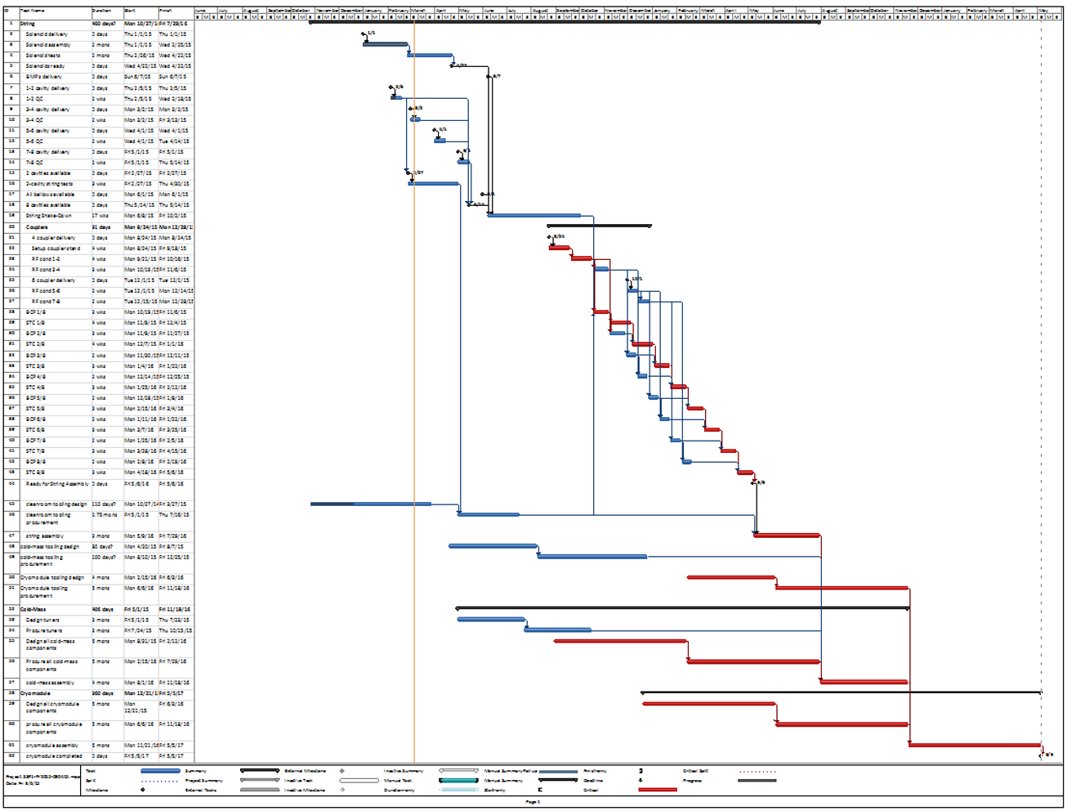
SSR1 Cryomodule Schedule
String assembly rehearsal
  July - Aug 2015
Cav. qualifications
  Nov 2015 - Apr 2016
String assembly
  May - July 2016
Cold mass assembly
  Aug - Nov 2016
Cryomodule assembly
  Oct 2016 - May 2017

Slide 9
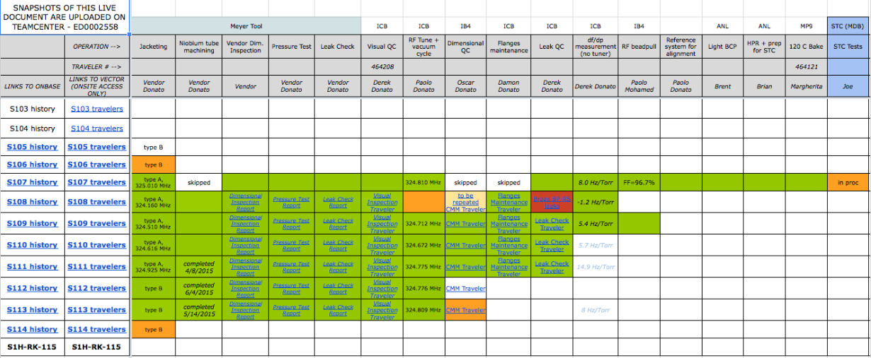
Cavity Status

Slide 10
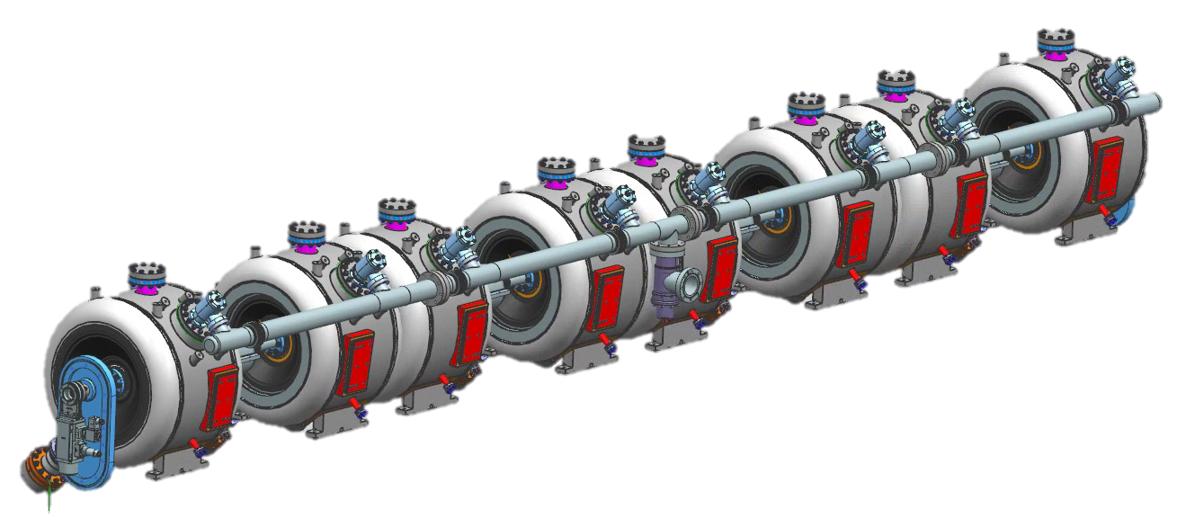
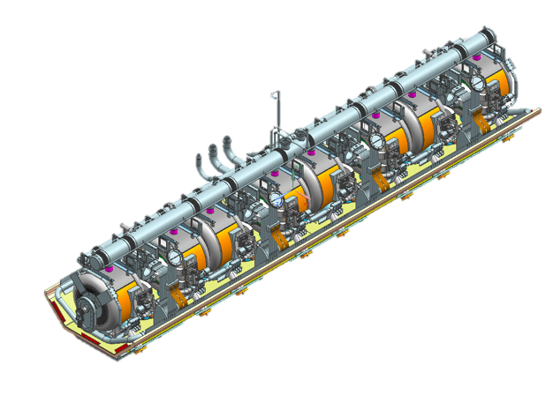
String and Cold-Mass
CAVITY-MAGNET STRING
COLD-MASS

