Slide 1
DUNE/35-ton News and Announcements
Tom Junk, Michelle Stancari, Tingjun Yang, Mark Convery

Slide 2
New LArSoft and lbnecode releases
Last week: v04_13_01 -- regular weekly release
v04_14_00 -- art multiple-file bugfix,
new genie_xsec (v2.8.6a) and
libwda (v2.21.1), ifdhc (v1.8.4)
This week: Another weekly release scheduled

Slide 3
art / LArSoft class August 3 – 7
See https://indico.fnal.gov/conferenceDisplay.py?confId=9928
Last day of the class will be devoted to LArSoft
^{Class is now full!}
If you have registered, but know you cannot attend, please let Erica and Saba know.
Send suggestions, comments to ssehrish@fnal.gov and erica@fnal.gov

Slide 4
LAr Forum – to discuss LArTPC software
^{http://larforum.org/forum}
Resurrection of old LArSoft forum – old posts are still there!
Andrzej Szelc revived it. Tom’s one of the new-user signers/admins
Lots of tools, feature plugins available for phpBB application used
Feature requests welcome!
Please sign up!
Andrzej fixed an issue within a day or two – it couldn’t search for the word
“Genie” as it was too short. Now the search will go down to 3-letter words
(it’ll search for “hit” but not “the” now).

Slide 5
2D Reconstruction by channel vs. time
Requested by DUNE
See Gianluca’s talk at yesterday’s LArSoft Coordination Meeting or ask
Gianluca:
https://indico.fnal.gov/conferenceDisplay.py?confId=10108
Channel Map Discussion
Vagaries of the online channel map should be taken out upstream of the
event display.
Need database access as the channel map could be a function of time (RCE swaps)
Can be put in the lbnecode/lbne/daqinput35t/SplitterInput_source.cxx
-- need to figure out how to hook the database into it.
-- it may force everyone to use the splitter input source if that’s the only
way the channel map can be swizzled.
-- need to have a version accessible online

Slide 6
DUNE FNAL Computing News
We have an experiment number: E-1062
The drop-down menu for “Experiment” affiliation in the Fermilab Service Desk
Web Interface now has DUNE E-1062 listed, under “Approved” experiments.
http://servicedesk.fnal.gov
New
uid 50381
gid 9010
Still to do – new VO. Steve Timm says they were waiting for the listing of DUNE in the
Service Desk to make progress – that should be moving for now. Administrators
for the VO same as the LBNE one.

Slide 7
New Persistent dCache Space at Fermilab
/pnfs/lbne/persistent/users/<makeyourowndirectory>
/pnfs/dune/persistent
These directories share 150 TBytes of persistent space in dCache.
Most people are not yet in the Dune group and cannot yet use the dune directory,
so use the lbne area as a stopgap. Can always mv the files later.
POSIX access (ls, cp, mv, ...) on the interactive lbnegpvm nodes (NFSv4)
use ifdh cp to transfer files back and forth to grid workers.
Recommended local storage on the grid $_CONDOR_SCRATCH_DIR
Best practices, see
https://indico.fnal.gov/getFile.py/access?contribId=30&resId=0&materialId=slides&confId=9737

Slide 8
Need new Redmine projects/
repositories
lbnecode – should get rid of the lbne name
Now have a top-level DUNE Redmine
Some questions – hierarchical structure (ND, FD, Beam, Facility), or flat?
(may prefer flat – otherwise you have lots of projects that do nothing)
Do we take this opportunity to divide lbnecode into pieces? Is it too big yet?
Rename LBNE->DUNE (and lbne->dune and all other combos)
Preserve history? Or just keep the old projects.
lbne-raw-data can probably stay as is.
Shared group – Larsoft Users grants developer permission for all the LArSoft
redmine projects and repositories as well as lbnecode. Probably should just add all the
DUNE ones to the list. Beam sims? ND?

Slide 9
35-ton Computing TSW
“Technical Scope of Work” -- essentially a MOU between Fermilab’s Computing
Sector and the DUNE 35-ton effort
Online systems, database, file transfer, storage, grid
Very rough draft by Eileen Berman, Tom Junk, Stu Fuess, Margaret Votava, others
Sent around to dune-fd-35ton mailing list– if you need a copy, ask Tom
Comments due Friday, July 3

Slide 10
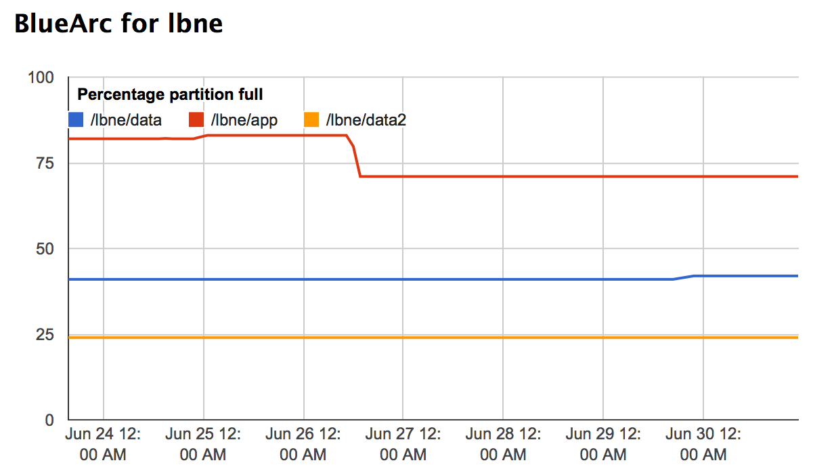
Thanks for cleaning up /lbne/app!
Got a notice that /grid/fermiapp quota for group lbne is critical (nearly full)
/grid/fermiapp/lbne and /grid/fermiapp/products/lbne
Three big usage areas:
old SVN releases of lbnecode
new git/cmake releases of lbnecode
ArgoNeuT flux files – still needed (may not be owned by LBNE so may not count
against lbne’s quota)

Slide 11
Any interest in SL7?
SCD is evaluating the strategic plan for FY16, and wanted to ping
experiments for interest.
Could help performance for multiprocessor applications, and also
improve I/O performance.
May improve compatibility with other Linux distros.
We’ll need to upgrade to it when the grid nodes get upgraded.
Can ask for a test VM. More work, and it’s probably a bit premature to start testing.
ROOT6 however might be coming sooner. art is already testing ROOT6

Slide 12
Schedules
DocDB 8373: Commissioning now begins Sep. 25
We should make a list of some basic plots we want to be able to make
with LArSoft as soon as data become available.

