Slide 1
CHARGE depositions IN THE APA GAPS filtering gap crossing events filtering stopping events using gaps calibration for gap widths
TRISTAN BLACKBURN - SUSSEX

Slide 2
In this presentation
It is currently unknown how charge deposited in the APA gaps will behave in actuality.
I have developed a module to select events that cross single or multiple gaps.
LArSoft presently deals with charge deposited in the cryostat regions between TPCs by drifting the charge to the nearest wires.
The filtering module has been developed to collate data for gap crossing events. It requires reconstructed hits to operate and is thus usable online through RawHitFinder or offline using any HitFinding algorithm.
This presentation comprises three major components: Detailing of the gap filtering module in its present state, what it does and what I hope to do with it in future. Detailing of an online stopping event selector that utilises gap and edge channel information from the gap crossing filter.
Preliminary work on calibrating the gap widths in reality - where the hardware is subject to cooling effects and displacements from ideal simulation geometry.

Slide 3
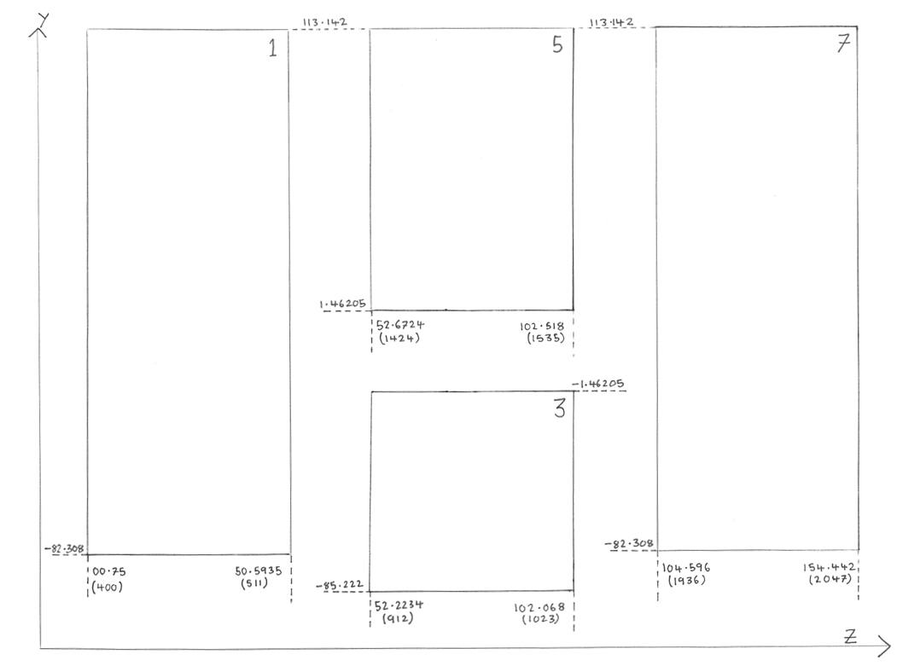
Fig 1 – 35t long drift volume geometry as seen from inside the short drift volume
Gap 1
Gap 2
The LArSoft label for each TPC is given in the top right hand corner.
Gaps 1, 2, 3 & 4 are the only ones for which I have the filter working currently.
The dotted lines indicate the axis on which a coordinate is recorded.
The number in brackets is the channel of the edge collection wire.
Gap 5
Gap 3
Gap 4

Slide 4
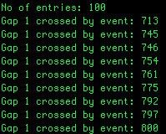
Methodology
The filter loops through events, and in each event through its hits.
The filter identifies whether any events had hits on the edge channel of an APA on the collection wires.
If an event is identified to have such hits on either side of an APA gap it’s pushed to the appropriate sub-category as shown on slide 4.
It outputs a text file containing the event numbers (as given by the input file) for each event that meets the criteria for each gap crossing sub category.
Typical module output. This one is taken from 100 cosmic events using the MC challenge data, courtesy of Tingjun and Karl.

Slide 5
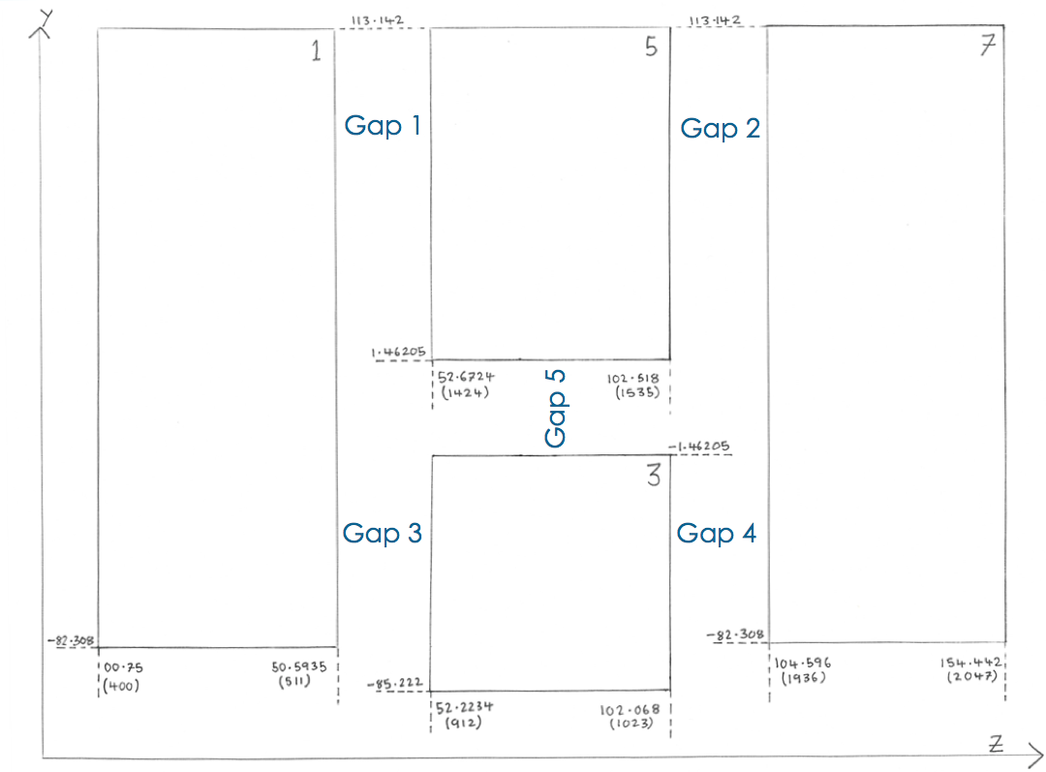
Gap crossing events are filtered by the module
into the below subcategories.
Simple Gap Crossers:
Events that cross Gap 1
Events that cross Gap 2
Events that cross Gap 3
Events that cross Gap 5
Horizontal Multiple Gap Crossers:
Events that cross Gaps 1 and 2
Events that cross Gaps 3 and 4
Diagonal Multiple Gap Crossers:
Events that cross Gaps 1 and 4
Events that cross Gaps 2 and 3
Broad Spectrum Multiple Gap Crossers:
Events that cross Gap 1 and either Gap 2 or Gap 4
Events that cross Gap 2 and either Gap 1 or Gap 3
Events that cross either Gap 1 or Gap 3 and cross either Gap 2 or Gap 4

Slide 6
Results
Ran the filter on 1100 (Of a possible 10,000) cosmic events taken from the Monte Carlo Challenge. Thanks to Karl and Tingjun for providing the data for this.
The results are shown in the corresponding table.
The events are not unique to each group. i.e. the same event can turn up in multiple Gap(s) crossed categories.
As expected gaps 1 through 4 all see a large number of gap crossers.
Only ~280 events of 1100 cross a gap.
A significant number of events cross both gaps. Approximately 1 in 6 gap crossing events cross two gaps.
Approximately 1 in 24 events cross two gaps.
Gap(s) Crossed | No. of Events
1 | 96
2 | 71
3 | 73
4 | 67
1 & 2 | 18
3 & 4 | 11
1 & 4 | 13
2 & 3 | 6
1 & (2 or 4) | 31
2 & (1 or 3) | 23
(1 or 3) & (3 or 4) | 45

Slide 7
Filter Uses
Filter currently creates lists of events that cross gaps, sorting them according to which gaps, and how many gaps, are crossed.
Can filter particles entering through the APA gaps themselves to identify events with tight angular ranges. Doing this allows possible identification of stopping events.
Can utilise the filter to identify stopping events. This can be done as per the previous bullet point. It may be possible to identify such events by making careful cuts within TPC 3 – details on later slides.
When the cryostat is filled with liquid argon, the placement of the TPC elements, and the corresponding gap widths, may differ from the idealised simulation geometry. Can use the filter to identify events which can be used to characterise these geometry variables.

Slide 8
does angle of particle entry, into the cryo, affect the charge appearance (in simulation)?
In order to test the filter, and for specific use cases I had in mind for it, I tried to measure effect of entry angle on the charge collected on edge channels in TPCs 5 & 7.
This was done to determine whether the ratio of charges on either side of a gap could be used to determine trajectories for particles entering the cryostat in the gaps.
The figure illustrates the varied angle. Anti-muons were fired at 5 degree separations from θ= 0 to θ= 80 degrees in the forward z direction.
All muons were fired at a common central point, in line with the top of both the TPCs and at the exact mid point between TPCs 5 and 7 – Y,Z = 113.142, 103.557.
Expected charge to start collecting on the edge of TPC5 (chan1535) as angle became large enough for the active volume of the cryo above the TPC to start experiencing proximal charge to the edge wire.
Observed that no such phenomena happens, within the simulation, between an angular range of θ= -80 to θ= 80 degrees.
Charge only collects on the edge channel, forward in the direction of particle travel, within this range.
θ

Slide 9
Identifying stopping events using edge channels and gaps
Thank to J. Insler for his work regarding stopping muons.
I have written four algorithms for detecting stopping events within the 35t cryostat.
All 4 rely on gap crossing and edge channel hit information.
None of them require reconstruction beyond a hit finding algorithm.
They were developed and tested using cheated hit information.
Require zero disambiguation.
They all share one common cut with respect to the x co-ordinate. This cut excludes all events with hits in the short drift volume or in the region x > 220 cm (30cm from cryo edge).

Slide 10
Stopping Algo 1 – TPC5 stoppers
The first, and simplest, algorithm loops over the hits in an event and discards all events that either fail the x cut (on previous slide) or events that contain hits outside of TPC 5.
This means that no gaps must be crossed and no edge channels, save those on TPC 5, can experience any charge.
Currently the x cut is done by cheating. Can easily be converted to a cut in drift time.
The allowed hit region (TPC5) for Algo 1 has been highlighted above

Slide 11
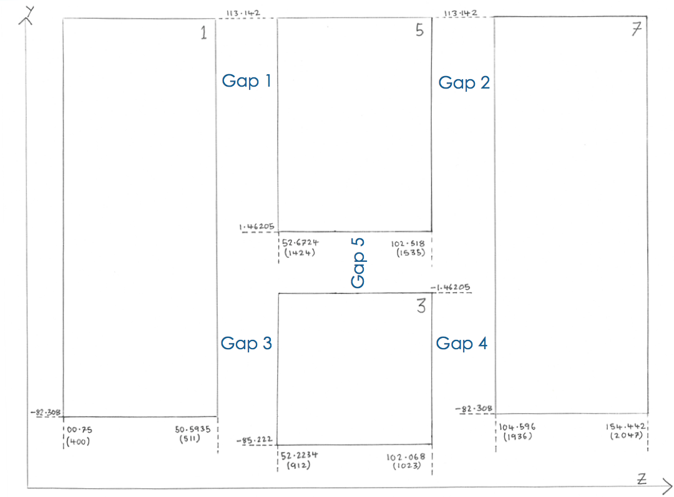
STOPPING ALGO 2 (& 3) – GAP Crossers
The second and third stopping event algorithms rely on the same principle.
Again all events failing the restriction in x are discarded.
Furthermore the events must pass the following criteria: There must be no hit on channels 400 or 2047, the outside edge of TPC1 and TPC7 respectively. Events must either cross Gap 1 (Algo 2) or Gap 2 (Algo 3) There must be no hit in TPC3 (restricting angular range).
Figure showing stopping events that would be picked up by Algo 2 (Blue), Algo 3 (Orange) and by both Algo’s 2 & 3 (Red)

Slide 12
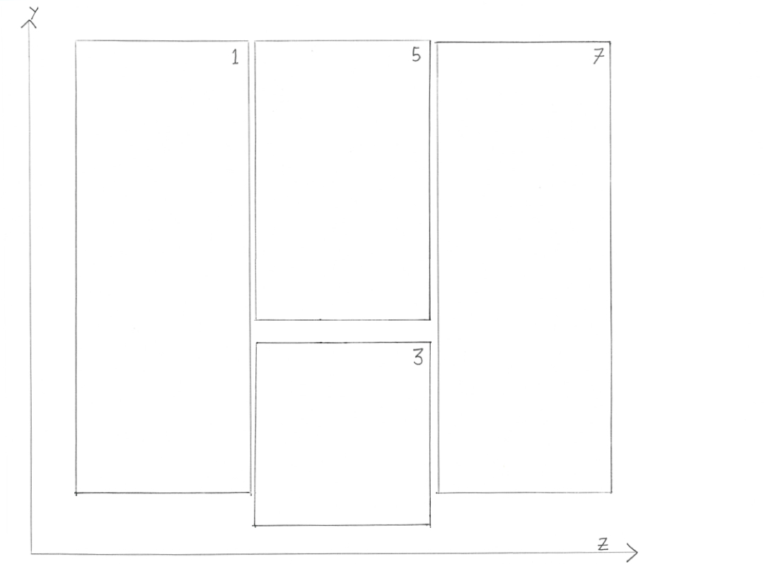
Problem with aLgos 2 & 3
In the cartoon, that has been used throughout this presentation, the width of the gaps is greatly exaggerated.
The actual gap width allows events to cross gap 1 or gap 2 and exit through the bottom of either TPC7 or TPC1. Such an event is shown to the right.
Such an event may pass all the criteria of being a stopper, according to algorithms 2 & 3, whilst actually being a through going event.
Needed a more complicated method to guarantee purity.
Through going event that would fool Algo 2 & 3

Slide 13
Algo 4 – constrained stoppers
Algo 4 requires stoppers to pass the following criteria: There must be no hit on channels 400 or 2047, the outside edge of TPC1 and TPC7 respectively. Events must either cross Gap 1 or Gap 2 There must be no hit in TPC3. Events must cross more than 39 collection channels in their TPC of entry
The last criteria is the only non self-explanatory requirement.
In order to avoid the problem present on slide 12, one can draw a line between the edge channel endpoints of TPC5 (Y,Z = 1.46, 102.52) and TPC7 (Y,Z = -82.3, 154.4) – shown in blue on the cartoon. Then, extrapolating backwards using the gradient (-1.61) one can determine a start point in z for the entry TPC (for TPC1 this is at Z = 33.1cm) – extrapolation shown in orange.
Using the above one can make the angle θ shallower than the max possible angle for the particle to be on a trajectory such that it can exit through the bottom of the TPC.
This is simply done by translating the extrapolated Z value to a channel number. It turns out that a minimum of 38 (The filter uses 39) channels must be crossed for the particle angle to be sufficiently shallow such that it cannot miss channel 2047.
The event must cross channel 2047 to exit the cryostat and so algo 4 guarantees a stopping event (assuming no deflections!)
θ

Slide 14
results
Ran the gap crossing filter with the stopping event filter over 1100 events from the MC challenge.
The number of events roughly corresponds to 2s of cosmic data entering the 35t cryo.
Defined efficiency as the number of stopping events identified by all the algorithms over the number of true stopping events.
Two efficiencies have been provided. One defining all stopping events in the cryostat as the denominator and one defining all stopping events after the x cut in the cryostat. The reason for this is because it is easy to relax the x cut criteria, so the latter measure of efficiency is the ‘better’ metric.
Define purity as the percentage of identified stoppers that are actually stopping events.
Double counted events (one’s passing two algorithms) have been accounted for.
Algorithm | Number of Stoppers
1 (TPC 5 stoppers) | 132
2 (Gap 1 Stoppers) | 15
3 (Gap 2 Stoppers) | 11
4 (Constrained Stoppers) | 20
Results from 1100 MCC events. Events can be double counted.
 | Whole Cryostat | After X-Cuts
Cheated Stoppers | 296 | 265
Algo Stoppers | 144 | 144
Efficiency | 49% | 54%
Purity | 100% | 100%

Slide 15
Stopping filter conclusions
Finding stopping events using the gaps and edge channels appears highly promising.
Can achieve upward of 50% efficiency, in an online fashion, already. Though only in simulation!
Have ideas for further algorithms that may, and should, increase efficiency. These will use gap crossing information in conjunction with TPC 5 entry and similar angular considerations as shown for the ‘constrained stopper’ algorithm on slide 13.
Filtered samples are 100% pure. The algorithms appear to be working well.
Only RawHitFinder is required once one has raw digits.

Slide 16
Preliminary work on determining gap width
Widths of gaps are perfectly even and consistent between TPCs in the LArSoft 35t geometry.
When the cryostat is fully instrumented the hardware will be subject to imperfections in TPC placement and the cooling effect of the argon.
TPCs may be misaligned, out of place and edge channels may not lie parallel to each other (leading to a varying gap width in Y).
Need some metric to determine the exact APA gap width using the available ‘measurables’.
Have created some plots regarding this.

Slide 17
Some Geometry Oddities
Width of Gap 1 = 2.08cm
Width of Gap 2 = 2.08cm
Width of Gap 3 = 1.63cm
Width of Gap 4 = 2.53cm
The widths of the TPC gaps are not identical in z. The sum of the total gap distance is even for A and B where: A = TPC 1-5 (Gap 1) + TPC 5-7 (Gap 2) = 4.16cm B = TPC 1-3 (Gap 3) + TPC 3-7 (Gap 4) = 4.16cm
TPCs 3 & 5 are offset in z. TPC 5 is approximately 0.45cm further along z than TPC 3.
The exact middle of gap 5 marks the zero point of the y axis in the geometry.
TPC 1, 5 & 7 extend the same distance into +Y – Well understood.
TPC 3 extends further into –Y than TPC 1 & 7 – Well understood.

Slide 18
Method of gap width determination
The active volume of the cryostat in the simulation geometry exceeds that of the TPC coverage.
Can use this to study the effect of increasing the length of particle charge deposition within the argon that an extremal edge channel (Channels 400 in TPC1 and 2047 in TPC7) experiences.
Fired five 3GeV anti-muon samples along the positive Z axis at channel 400. No angular variation, no momenta variation.
Started all at X,Y = 100, 56
Varied the distance of the Z starting point between samples, using 0.25cm intervals, such that channel 400 experience more charge as the muon origin point became more distal.
Channel 400 lies at Z = 0.75 cm.
Generated 7 samples, down to -1.00cm.
Firing particles at channel 400 from different origin points changes the overall charge that the wire experiences

Slide 19
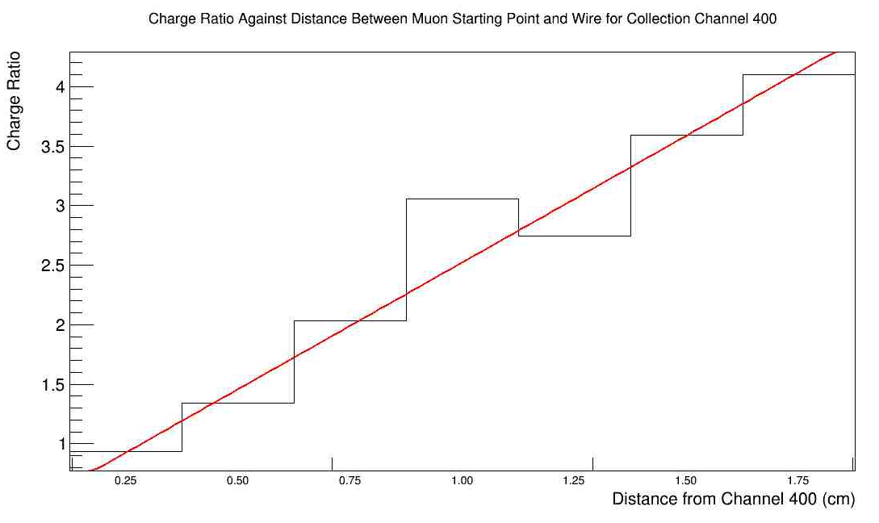
Results
Plots are shown of charge collected on channel 400 against distance of incoming muon from channel 400 (left) and of the charge ratio of channel 400 to the TPC1 collection wire mean against distance of incoming muon from channel 400 (right).
Both plots show the expected linear trend. As the wire experiences more path length, wherein a muon can deposit charge, the wire itself collects more charge and thus the ratio also increases in a similar fashion. Gradients are given on next slides.

Slide 20
Gap WIDTH CONCLUSIONS
The expected trend of increasing muon path length increasing the charge experienced by a wire and thus its charge ratio (as defined on the previous slide) is observed.
Whether the numbers given in the simulated data will reflect the actual phase II run is unknown. For this reason it may be better to use gradients.
The gradient of the charge plot is 2.17e3
The gradient of the charge ratio plot is 2.47
In future I plan to deaden channels in the gaps, adjust the ‘nearest wire’ algorithm to skip dead channels and increase the gap width in this fashion. I will then make the analogous plots for gap crossing events.

