Slide 1
Cryogenic Piezoelectric Drive System for the Axion Dark Matter Experiment
Kelly Backes
August 25 2015
Notes:
Thanks for the introduction

Slide 2
ADMX + ADMX HF collaboration
Lawrence Livermore National Laboratory – ADMX began here in the mid-1990s.
Gianpaolo Carosi, Darrell Carter, Jaime Ruz Armendariz
University of Washington – main experiment moved here in 2010.
Leslie Rosenberg, Gray Rybka, Michael Hotz, Andrew Wagner, Doug Will,
Dmitry Lyapustin, Christian Boutan, Jim Sloan, Cliff Plesha
University of Florida
David Tanner, Pierre Sikivie, Neil Sullivan, Jeff Hoskins, Ian Stern, Nicole Crisosto
National Radio Astronomy Observatory
Richard Bradley
University of California, Berkeley
Karl van Bibber, Tim Shokair, John Clarke, Jaben Root, Ben Clemens,
Austin Lo, Kelly Backes, Bella Urdinaran, Sam Harreschou
Maria Simanovskaia, Sean O’Kelley
Sheffield University
Edward Daw
Yale University (ADMX-HF - NSF sponsored)
Steve Lamoreaux, Yulia Gurevich, Ben Brubaker, Sidney Cahn
University of Colorado (ADMX-HF – NSF sponsored)
Konrad Lenhert, Dan Palkin
Harvey Mudd College
Nicole Crisosto, Max Gonzolez, Oliver Hoidn, David Rolfe, Matt Sreshinsky
Notes:
Add color to for people who are directly involved in this piezo system

Slide 3
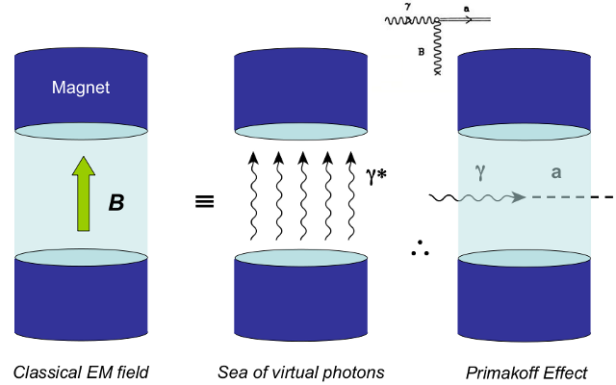
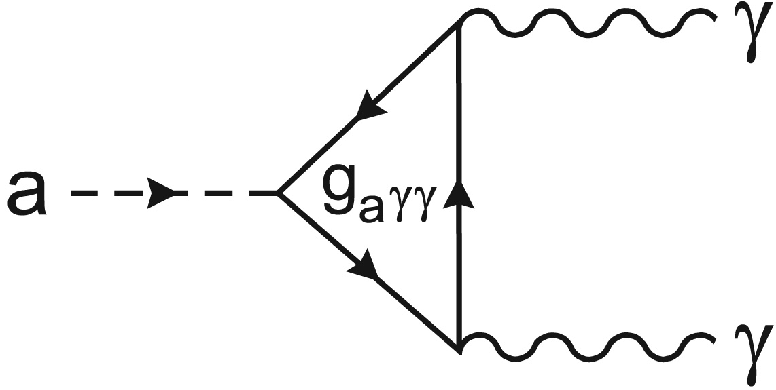
Dark Matter and the Axion
Indirect evidence for dark matter has been present since the 1930s
The axion is a highly motivated candidate for dark matter
The Primakoff Effect allows us to detect the axion
The resonant conversion of the axion to a photon occurs in a tunable RF frequency cavity in the presence of a strong magnetic field
( expected)
Notes:
Here is a brief intro to admx in general. (GP earlier).
Dark matter theorized to make up a quarter of mass. Indirect evidence since the 30s. Such as gravitational lensing and the flattening of the velocity curves of galaxies
Axion postulaed as solution to strong cp problem and is one of two prevalent dark matter theories.
Primakoff effect – couples to virtual photon to produce real photon with frequency equivalent to the mass energy of axion.
Tiny signal – use amplifier and tiny steps to not skip over it.

Slide 4
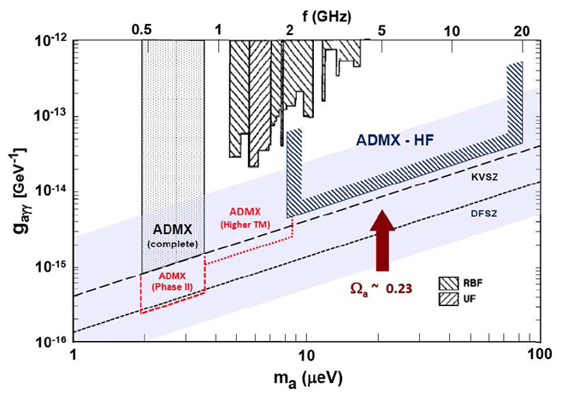
Dark Matter and the Axion (cont.)
The real photon will have an energy equivalent to the mass energy of the axion
photon
axion
Notes:
The real photon will have an energy equivalent to the mass energy of the axion
Here is the plot of the frequencies that ADMX and ADMXHF are planning to cover.
Filled in – scanned
Top is GHz, bottom would be corresponding mass of axion
Left is coupling strength.

Slide 5
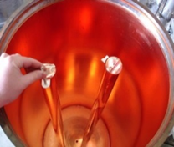
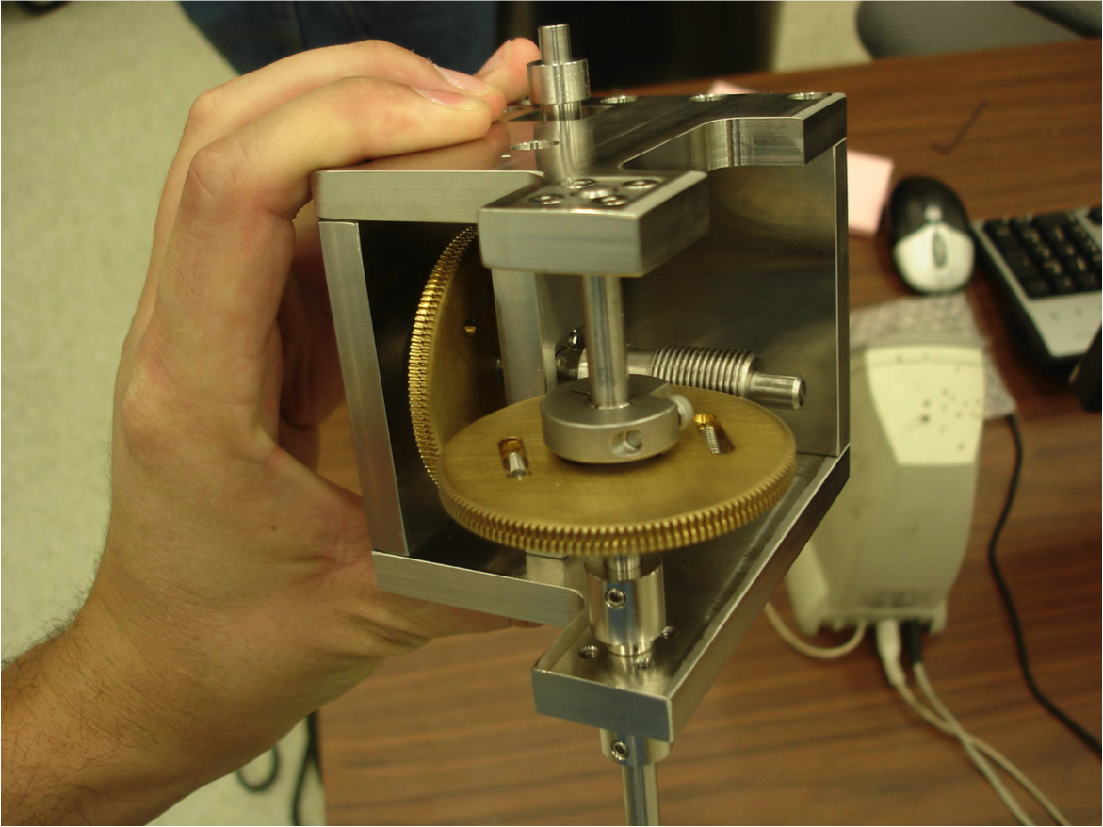
Tuning the Cavity
We rotate tuning rods to change the resonant frequency of the cavity
A system of stepper motors and a gear box is currently in use
Notes:
We do our scanning by mechanically rotating tuning rods inside of the microwave cavity, which change its resonant frequency. This is the main function of our rotary drive which will be introduced soon
Here is the gear box that is currently being used.

Slide 6
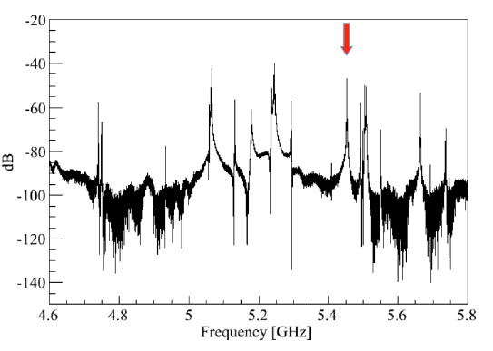
Notes:
Here is a progression of the swept power transmission through the cavity. There are a very large number of resonant modes, several of which are seen in this specific frequency range of 4.6 to 5.8 GHz. The one highlighted by the arrow, which moves, is the TM010 mode that couples most to the axion, and so we track this one as we scan through the frequencies.

Slide 10
Notes:
Here is a progression of the swept power transmission through the cavity. There are a very large number of resonant modes, several of which are seen in this specific frequency range of 4.6 to 5.8 GHz. The one highlighted by the arrow, which moves, is the TM010 mode that couples most to the axion, and so we track this one as we scan through the frequencies.

Slide 11
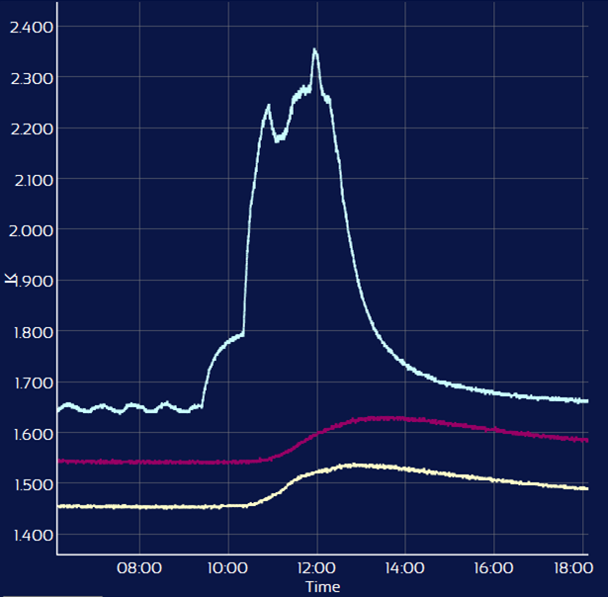
Motivation
The experiment must be conducted at cryogenic temperatures to reduce background noise
Smaller step sizes yield higher accuracy
Temp sensor on gearbox =
+ 0.7 °K
Cavity top = + 0.08 °K
Cavity bottom = + 0.09 °K
Notes:
As seen a few slides ago, the experiment is currently using a gearbox and stepping motor system. Which comes with two problems. Heat and step size. Explain graph. We believe piezoelectrics are the solution to both.

Slide 12
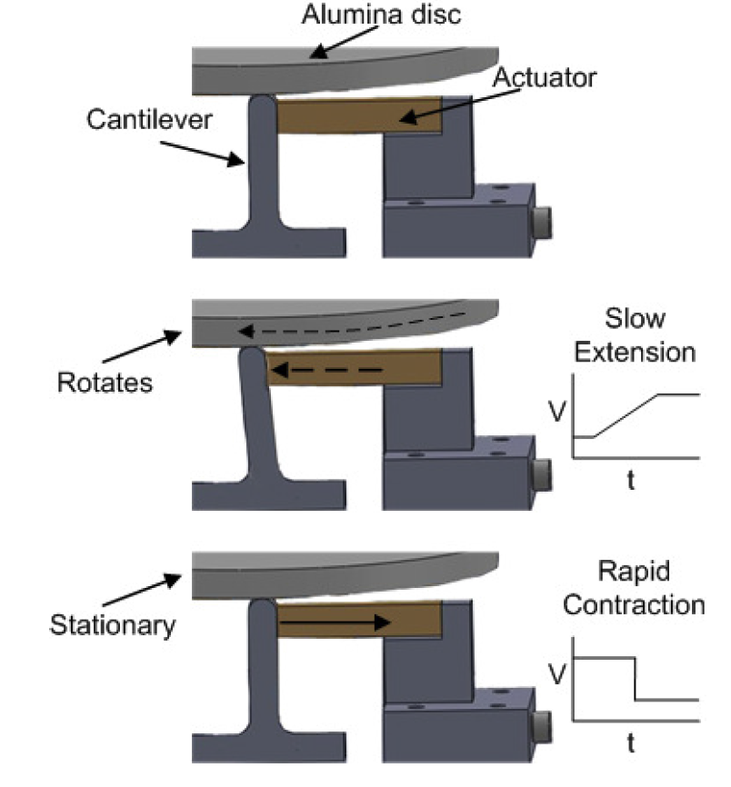
Piezoelectrics
Much lower power dissipation
Run electronically, directly into the cryo chamber
The voltage corresponds directly to the step size
Notes:
Piezoelectrics convert an applied electric field into mechanical strain.
Save space.
Gear box is limited by the size of gears. Piezos are not

Slide 13
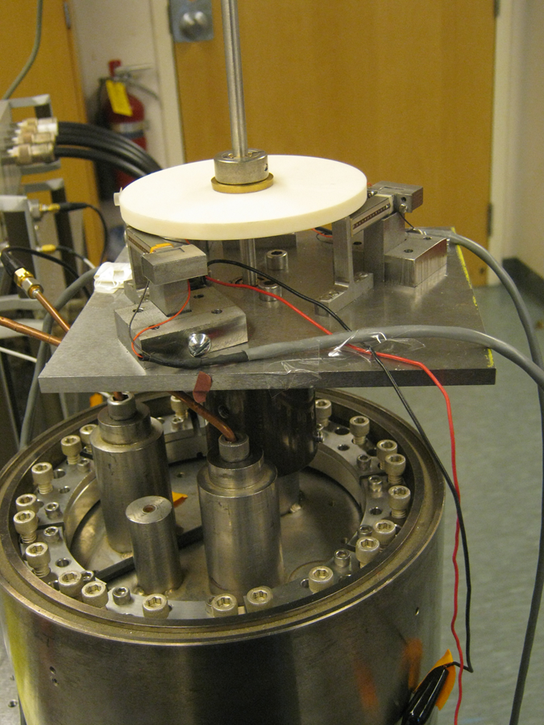
Summary and Goals
In 2011 a Harvey Mudd College clinic team was tasked with designing the piezo drive system.
Our goals for improvement:
Volume less than 5.75” diameter by 3”
See effective motion at cryogenic temperatures
Maintain consistent and reproducible motion
Frequency resolution < 100 Hz (ideally ~ 10 nm steps, or ~ 1 arcsec)
From HMC clinic
Notes:
In 2011 a Harvey Mudd College Clinic team was tasked with designing a drive system based on piezoelectric actuators with a stick slip design in order to minimize heat load. They took measurements of actuation, heat generation, and shifts of resonance on a cavity using a network analyzer at room temperature
Because of the increased need of a piezoelectric system to replace the gear box system, we were given the task of picking up where they left off and improving their and getting it into cryo. Our goals for this were to redesign it to fit in a volume of 5.75 inches in diameter by 3 inches, see motion at cryo, maintain constant and reproducible motion , and a frequency resolution of less than 100Hz

Slide 14
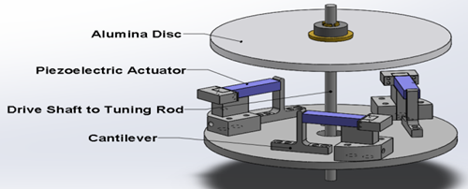
Current Design
5.66” diameter plate as the new base
3 cantilevers with a thinner thickness for higher precision
Smaller designed parts (lower heat capacity) to fit on new plate
Keys added to the ball
Square mounting blocks resized
Notes:
We ended up redesigning it to fit on a 5.66” diameter plate and machining all the holding parts to fit onto this new base. We also made new, thinner cantilevers that can be driven with a reduced voltage for higher precision. (further detail in next slides). Smaller parts.
Changes since this picture: mounting blocks shrunk. Keys added- good cuz no slipping. Bad cuz no self alignment.

Slide 15
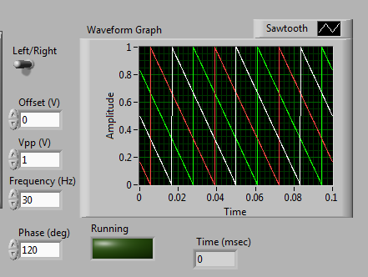
Cantilever Movement
Driven by sawtooth wave functions
Cantilevers are offset
Step size determined by voltage
Notes:
The three piezo stacks are driven by offset wave functions to maximize the stick slip effect. Explain that the stivk slip effect. Lowest voltage we have driven at was 3Vpp. It is possible to drive without offset. Slightly slower.

Slide 16
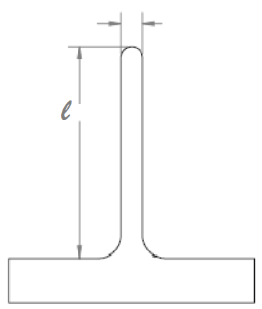
Modeling of Cantilevers
Modeled as a beam with load at tip
Want to drive with small F
Notes:
In order to determine the most efficient way to drive the canilevers we modeled them as a beam with the load at the top.
F is the load (driving)
L is the length
B is young’s modulus
I is moment of inertia

Slide 17
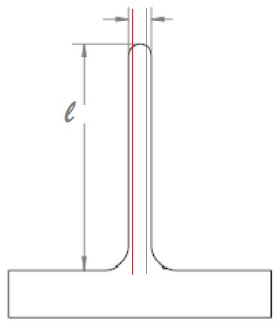
Changes to Cantilevers
Moment of inertia scales with width
Young’s Modulus of stainless steel
303 ~ 193Gpa
304 ~ 205Gpa
Notes:
How to improve them?
Material with lower young’s modulus – 303 as opposed to 304
Thinner because moment of inertia scales with width

Slide 18
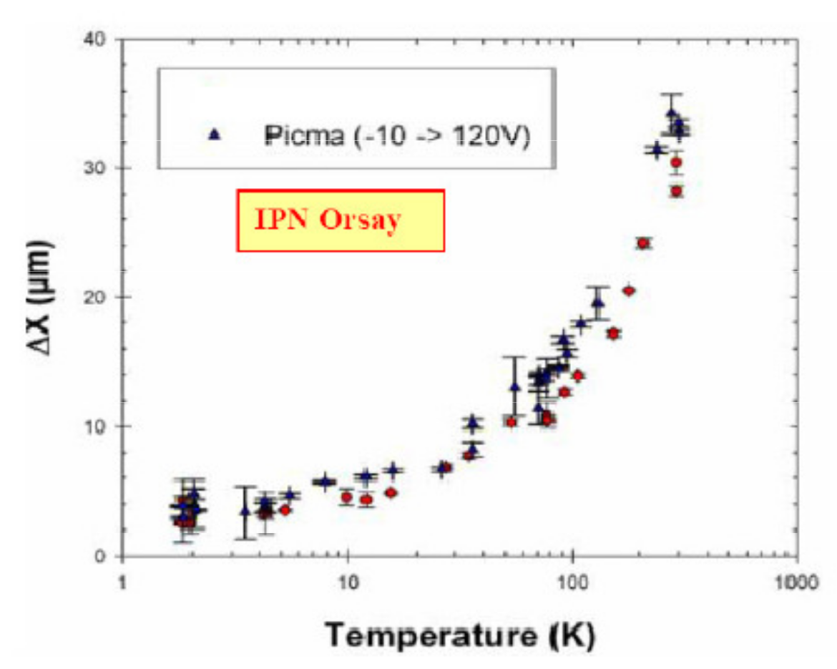
Cryogenics
Using 3 PICMA P-887.91 actuators
Cryogenic testing has been done on similar actuators by Physik Instrumente
At 4.2K 50% increase in Young’s Modulus
Below 10K there is a 90% decrease in displacement
ΔT = .03ºK
t = 10min
P = 100μW
m = 1kg
Notes:
--- rough calc for 2kg
The end goal of our project is to see effective motion at cryogenic temperatures (around 4K and potentially lower). Physik Instrumente has tested PICMA P-888.9 piezoelectric actuators at cryogenic temperatures and got the following results: There was a 50% increase in the Young’s Modulus and a 90% decrease in the actuation of the piezoelectric stacks. The dilution refridgerator on ADMX has a certain amount of cooling power and we have to make sure the heat load from this drive system is under that to ensure the system does not heat up too much. Based on our calculations we expect the temperature rise to be around .03K for 100MicroWatts over ten minutes.

Slide 19
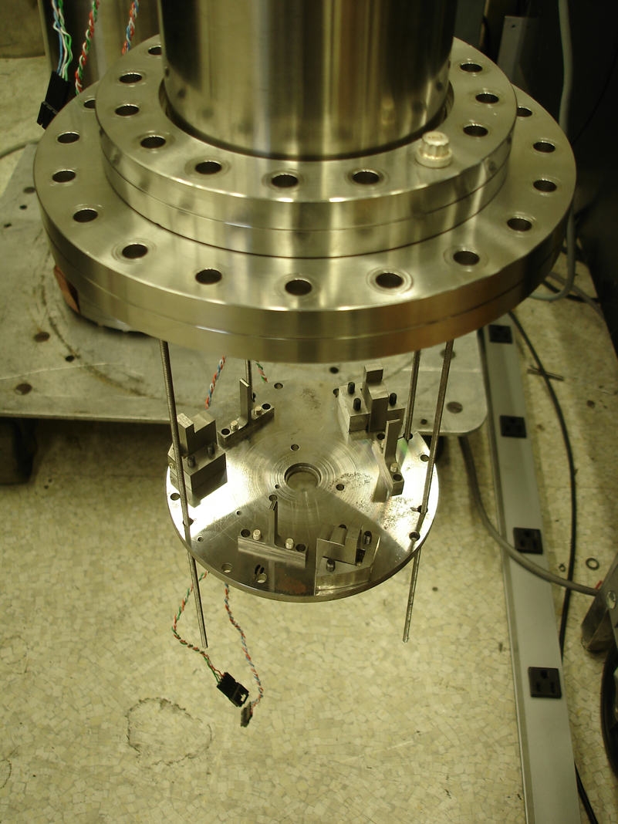
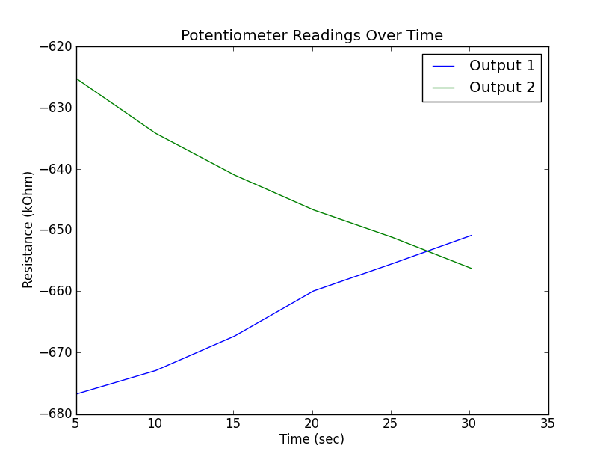
Current Efforts
Mounting system
Working towards reproducibility
Writing LabVIEW scripts for measurement

Slide 20
Next Steps
Determine min. voltage for movement at cryogenic temperatures (< 120 V )
Measure system heat load compared to calibrated loads from resistors.
Look into alternative materials and designs for cantilevers
Look into alternative materials for system
Notes:
How to measure torque at cryo (at room temp we are using a spring scale)
As I mentioned in the last slide, there is a predicted 90% decrease in actuation below 10K. We need to determine if we will be able to get motion in the chamber with less than 120V because that it the maximum amount of voltage we can run into the chamber.
We will be calibrating more temperature sensors so we can measure the heat load.
Issue with cantilevers – constant stress so they deform. Work on modeling the deformation and looking into alternative designs and materials. Need something that will last long because the experiment cant be opened up that often
look into alternative materials for whole system – next slide

Slide 21
Thermal Expansion of Parts
Coefficient of expansion (10⁻⁶ m/(m K))
Brass ~ 18.7
304 Stainless ~ 17.3 (303 is similar)
Allumina ~ 5.4
Notes:
Even though we changed it such that most of it is 303, many of the parts of our system are different materials which works fine at room temperature but will contract at cryo at different rates which will mess with alignment. Through our testing we know its finiky so that’s importnt. Above are coefficients of thermal expansion to show how much they differ. Ball and allumina issue (very different)

Slide 22
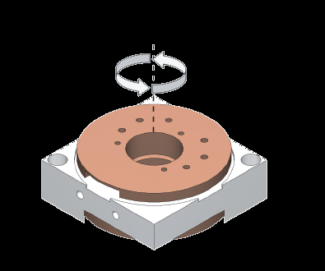
Commercial Rotary Motors
Need to handle torque of about .03Nm
Janssen
Claims .03Nm
Attocube
Premium line - torque of .2Ncm
Industrial line – torque of 4Ncm
Notes:
Another alternative is just using commercial rotary piezoelectric motors.
The next speaker will discuss how they are in use in washington
Pros: more reliable, more easily replicable, more reproducable.
Cons: low torque, not all cryo friendly
Two brands
Janssen : pro they say its good enough
Attocube: one line has good torque one is cryo friendly and they haven’t said they can customize to our specs yet.

Slide 23
Acknowledgements
1. “Cryogenic Piezelectric Rotary Drive System for the Axion Dark Matter Experiment”. Harvey Mudd College Physics/Engineering Clinic Final Report. 2011.
2. Fan, Fu, Huang, Ren, Zhao, et al “Design and Experimental Research of a Novel Inchworm Type Piezo-Driven Rotary Actuator with the Changeable Clamping Radius”. Review of Scientific Instruments. 2013.
This work was supported under the auspices of the National Science Foundation, under grants PHY-1067242, and PHY-1306729, and the auspices of the U.S. Department of Energy by Lawrence Livermore National Security, LLC, Lawrence Livermore National Laboratory under Contract DE-AC52-07NA27344.
Notes:
Thanks for coming woo

