Slide 1
Superconducting Resonator Design work at LLNL
Matthew Horsley, LLNL
Workshop on Microwave Cavity Design for Axion Detection
Tuesday, August 25, 2015

Slide 2
Outline
Introduction
Design Considerations
Simulation

Slide 3
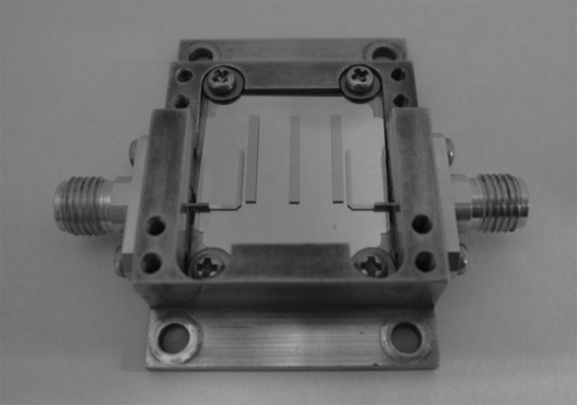
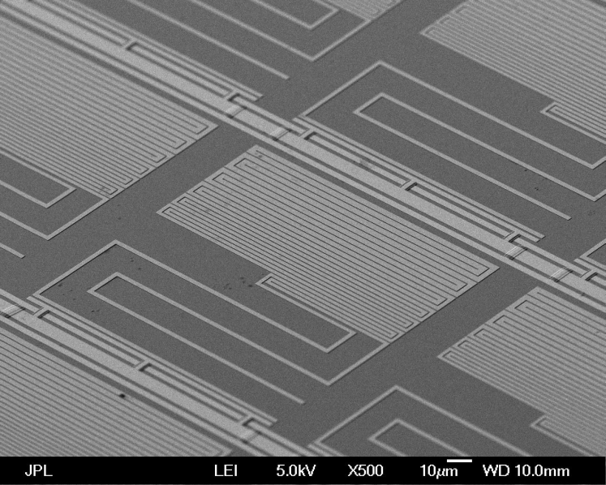
Introduction
Superconducting microwave resonators have many practical uses and are crucial components in many different devices
Filters in telecommunications, Detectors, Qubits, etc…
Photograph of superconducting BPF with top cover removed
Image of a Microwave Kinetic Inductance Detector
Notes:
BPF:
IEEE TRANSACTIONS ON APPLIED SUPERCONDUCTIVITY, VOL. 21, NO. 3, JUNE 2011 559
Improvement in Power-Handling Capability of
Superconducting Filters Using Multi-Layered
Microstrip Line Resonators
Y. Endo, S. Ono, M. Uno, T. Saito, A. Saito, K. Nakajima, and S. Ohshima
Ultra-Broadband Microwave Frequency-Comb Generation in Superconducting
Resonators
R. P. Erickson,1 M. R. Vissers,1 M. Sandberg,1 S. R. Jeerts,1 and D. P. Pappas1,

Slide 4
Understanding Noise
Important to understand noise properties of superconducting resonators
Detectors, quantum information processing
At mK temperatures and very low (single photon) microwave powers, superconducting resonators are noisier than expected
Unexplained loss and frequency jitter
A plot showing the center frequency of a resonator as a function of time¹.
¹ “High Precision readout of superconducting resonators”, J. Burnett Thesis
Notes:
Plot taken from
High Precision readout of superconducting resonators
For analysis of slow noise processes
By
Jonathan Burnett

Slide 5
Conventional Designs
Majority of experimental investigations have been done using conventional methods of fabrication
Thin film superconducting layer deposited on dielectric substrate
Conventional fabrication methods may potentially lead to creation of TLS’s
silicon oxide contains many defects giving rising to possible electron trapping states as well as dipole two-level systems .
Additionally, the dangling bonds in the Si/SiO2 interface have been suggested to lead to flux noise in Josephson flux qubits
An example of a superconducting resonator
Potential sources of noise
¹ “Photon Detecting Superconducting Resonators”, R. Barends
Notes:
Plot taken from
High Precision readout of superconducting resonators
For analysis of slow noise processes
By
Jonathan Burnett

Slide 6
Dielectric-free Superconducting Resonator
Goal is to develop an all-metal, dielectric-free superconducting resonator
Explore potential use of single crystal metal samples, single isotope…
To the greatest extent possible, eliminate material interfaces from resonator
Dielectric-metal, dielectric-vacuum, oxide-metal, oxide-dielectric, etc…
Some Challenges
Resonator needs to be self-supporting
Develop coupler with variable strength
Small size to minimize material costs
Notes:
Plot taken from
High Precision readout of superconducting resonators
For analysis of slow noise processes
By
Jonathan Burnett

Slide 7
Complementary Split Ring Resonator
Split Ring Resonator (SRR)
Double-slit SRR
SRR can be considered as being a small LC circuit
- essentially two wires bent into rings and placed in close proximity
- resonant exchange of energy between inductive current in rings and fields inside capacitive gaps
Complementary versions can be made by using metal plate and cutting slots into metal
- Self supporting, no dielectric
Notes:
Plot taken from
High Precision readout of superconducting resonators
For analysis of slow noise processes
By
Jonathan Burnett

Slide 8
Complementary Double-slit Split Ring Resonator
3D COMSOL Model
Equivalent Circuit*
L_{o}/4
C_{c}
*Baena et al, IEEE TRANSACTIONS ON MICROWAVE THEORY AND TECHNIQUES, VOL. 53, NO. 4, APRIL 2005
Notes:
Plot taken from
High Precision readout of superconducting resonators
For analysis of slow noise processes
By
Jonathan Burnett

Slide 9
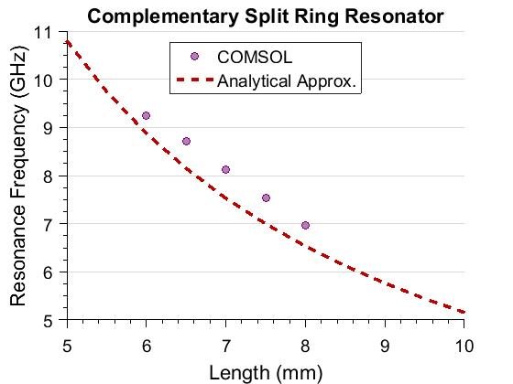
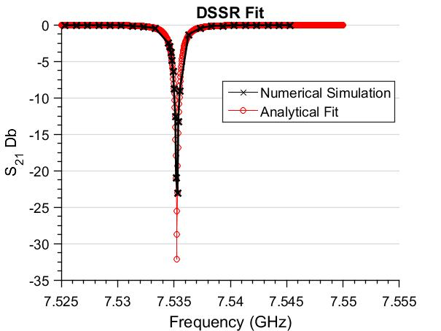
Analytical Approximations Used for Initial Design
Q = 2.5 x 10⁵
Analytical approximations for equivalent capacitance and inductance of resonator used to estimate resonant frequency
Depend on gap size, slot width, side length, separation between rings
Analytical expressions are only approximate, numerical modeling necessary to design resonator
*Bilotti et al, IEEE TRANSACTIONS ON MICROWAVE THEORY AND TECHNIQUES, VOL. 55, NO. 12, DECEMBER 2007
Notes:
Plot taken from
High Precision readout of superconducting resonators
For analysis of slow noise processes
By
Jonathan Burnett

Slide 10
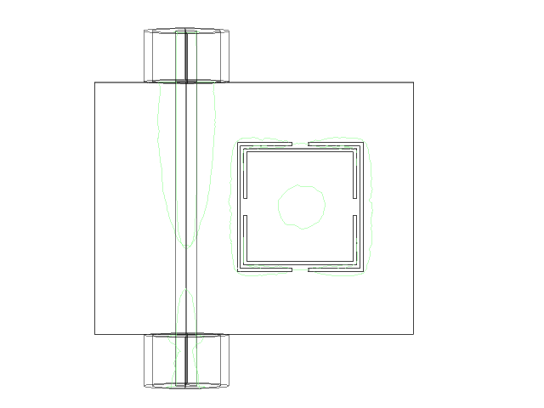
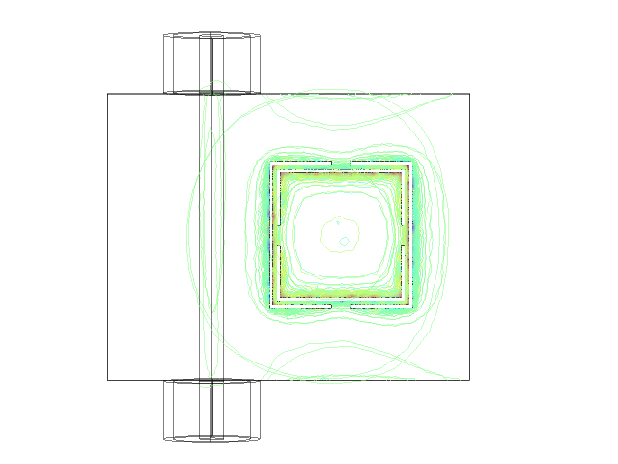
Complementary Split Ring Resonator
7.5 mm size
Frequency sweep across resonance
Phase sweep at resonance
Notes:
Plot taken from
High Precision readout of superconducting resonators
For analysis of slow noise processes
By
Jonathan Burnett

Slide 11
Summary
Two-level System noise still not well understood
Affects many different quantum devices
Can be studied using simple to build superconducting resonators
Initial design based on Complementary Double-slit Split Ring Resonator
Can be made self supporting
All metal construction
Easy to build
Next Steps
Build it!

