Slide 1
Resonator strategies for axion detection
Aaron S. Chou
Fermilab
8/27/15

Slide 2
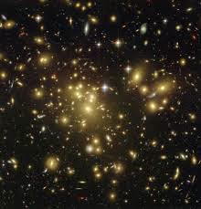
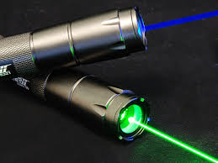
The local axion dark matter can be regarded as a classical wave with properties similar to those of a modern solid-state laser
Huge number density,
Linewidth ≈ kHz,
Coherence time ≈ ms
Except, we don’t know the color of this mystery laser pointer, and it doesn’t interact much with our detectors…..

Slide 3
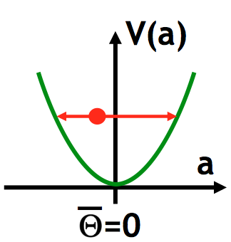
Axion DM behaves as a coherent oscillation of the QCD θ angle
The interaction
then rotates magnetic fields into electric fields (and vice-versa),
and magnetic dipoles into electric dipoles, etc.

Slide 4
Placing conductors at the appropriate spacing to absorb momentum then allows the induced E field oscillations to be converted to real photons
Usable
magnetic energy
EM
coupling
Input signal
Signal freq.
Important observations:
The signal power is suppressed only by the QCD scale Λ⁴, not by f_{a}
2) The signal power grows with mass m_{a}
The “form factor” C now contains all geometric factors including
the cavity mode overlap integral, the magnet bore filling factor, maybe even the geometric factor in Q from volume/area ratio.

Slide 5
Assuming copper cavities:
Anomalous skin depth:
Spherical cow cavity:
Signal power now grows only weakly with frequency:

Slide 6
Thermal noise
We will narrow-band the detection all the way down to the axion linewidth. This improves signal/noise linearly with tuning time, up to the coherence time of the axion. (At this point the axion line is resolved and the signal power becomes split into neighboring bins each with longer coherence time).
The in-band noise is then kT per resolved mode
The signal/noise ratio is then:
Not bad! But gets worse with increasing frequency.

Slide 7
Integration time at each tuning
Need to tune antenna to scan for the axion transmission frequency.
If P_{signal} < P_{noise}, need to average over many measurements to detect the small signal power excess. Integration time required at each tuning is given by the Dicke radiometer equation which parametrizes the sqrt(N) improvement:
# samples
needed
Sample time
e.g. if noise = 10x signal, need 100 samples to average down noise by factor of 10.

Slide 8
Total integration time to cover an octave in mass
Viewing the cavity as a bandpass filter, each tuning simultaneously measures Q_{a}/Q_{cav} bins. (i.e. by long integration times, we are resolving the Lorentzian bandpass of the cavity)
Each tuning then covers a frequency range
To cover an octave requires repeating the tuning
times.
Multiply by 9 for 3-sigma, multiply by 3⁴=81 for DFSZ to get 12 days scan time.

Slide 9
At 100 mK, the noise becomes quantum-limited above 2.5 GHz
Noise = 1 photon per resolved mode
Noise power now scales as f² rather than linearly with f (!)
The signal power still grows as f^{1/3}, but is 7 times smaller with SNR now scaling very poorly as f^{-5/3} …

Slide 10
Compared to thermal-noise-limited searches, the quantum-limited search has much poorer frequency scaling
Quantum-limited
Thermal-limited

Slide 11
Tuning times now scale so quickly with frequency that they must be explicitly integrated
KSVZ coupling at 1-sigma

Slide 12
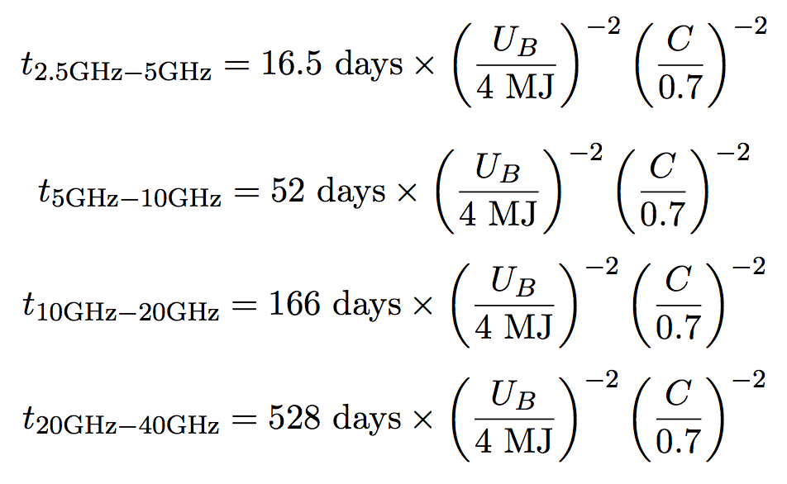
Total integration times per octave for 3-sigma DFSZ sensitivity
DFSZ has 3x weaker coupling than KSVZ, so multiply integration times by 81
3-sigma needs 9 times integration time per tuning

Slide 13
Realistic expectations
A likely factor of 3 in the total geometric efficiency will cost a factor of 10 in increased integration time
490 days
10 GHz is barely do-able in the context of ADMX G2

Slide 14
Realistic expectations
A likely factor of 3 in the total geometric efficiency will cost a factor of 10 in increased integration time
1540 days
4900 days
Above 10 GHz will *definitely* need a new magnet with a factor of 10 in energy stored in the bore. This is a $100M scale magnet!
Even if we get such a magnet, to achieve C≈0.25 will need innovative and efficient packing of resonator elements to fully utilize the magnetic energy.

Slide 15
Even ADMX-HF fat tuning rod is not good enough with big UW ADMX magnet
Geometric utilization C=0.12 gives:
1666 days to reach 10 GHz,
5240 days to reach 20 GHz.
λ/2 = 1.5 cm
DFSZ @ 3 sigma
R = 25 cm

Slide 16
Rectilinear is better than cylindrical, but would still need an array to efficiently pack the bore
l_{m} = 1 m
Not obvious how to tune frequencies.
Multiple elements need complicated power combining.
w_{m} = 50 cm
w_{m} = 50 cm
λ/2= 1.5 cm

Slide 17
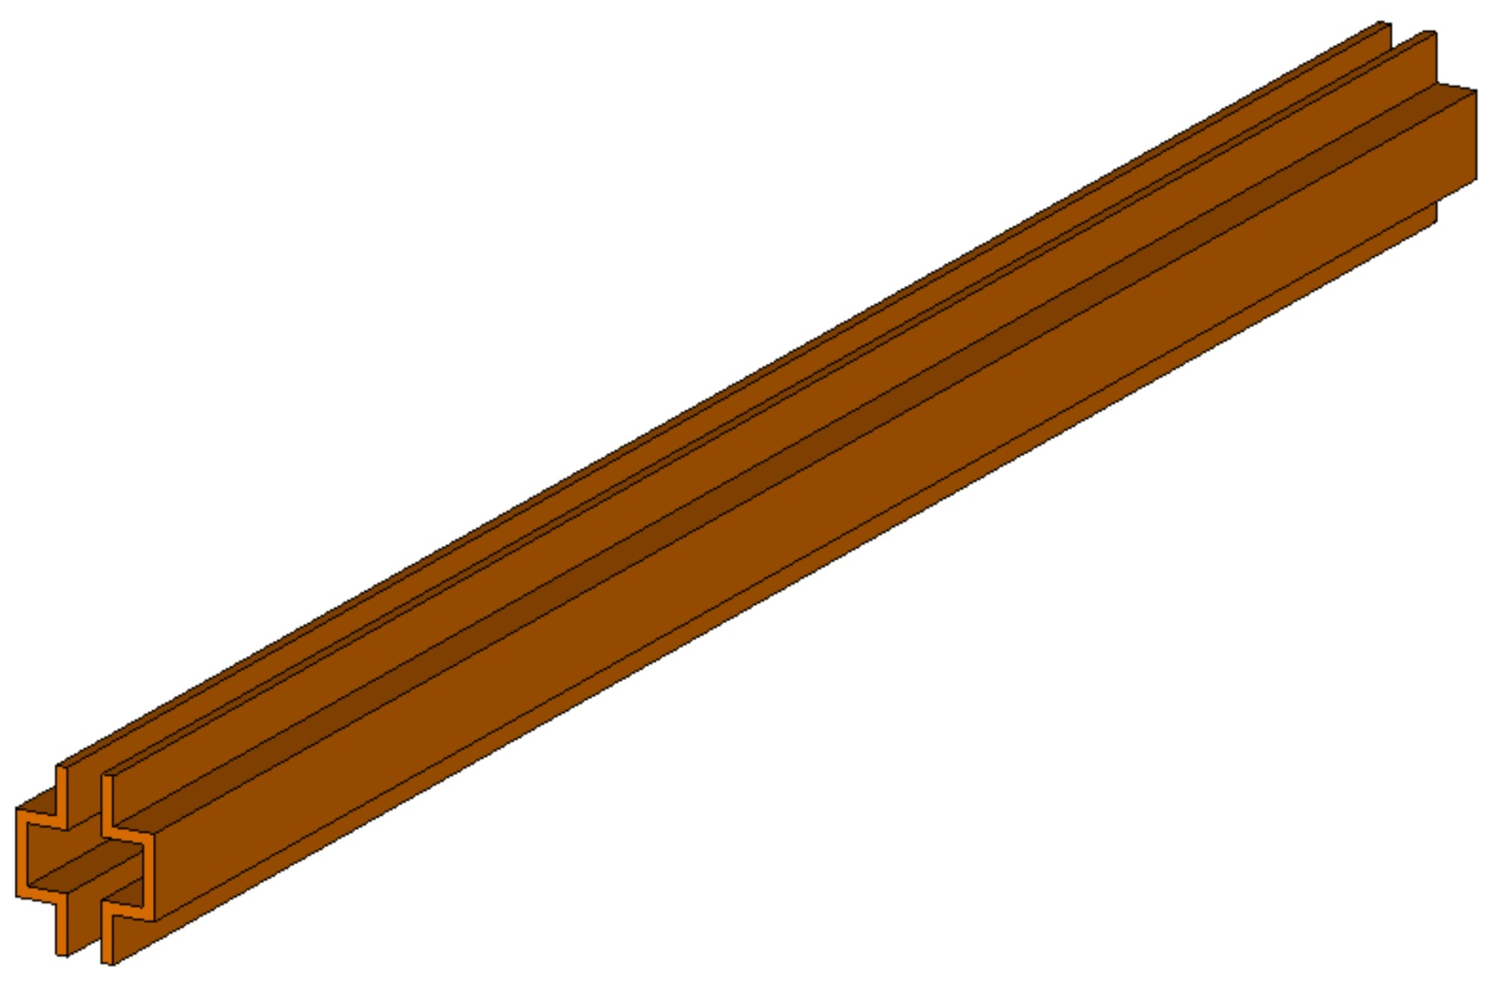
Idea for tunable waveguide cavity
S. Kazakov (FNAL)
Straight waveguide has very poor mode matching and hence does not efficiently use the magnet volume
Exotic current J aligned with external B field.
J

Slide 18
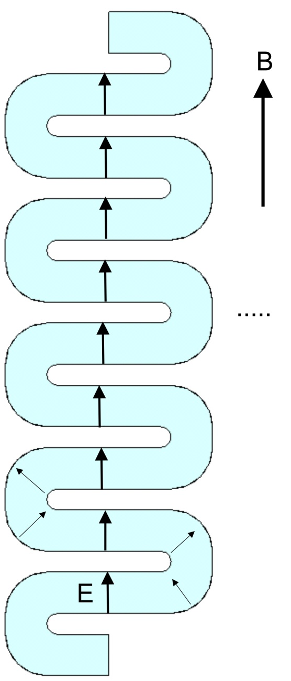
S. Kazakov (TD)
For efficient coupling, the resonant mode must be aligned with the exotic current source.
For example, bend the waveguide resonator whenever the electric field starts changing direction
Exotic current J aligned with external B field.
J

Slide 19
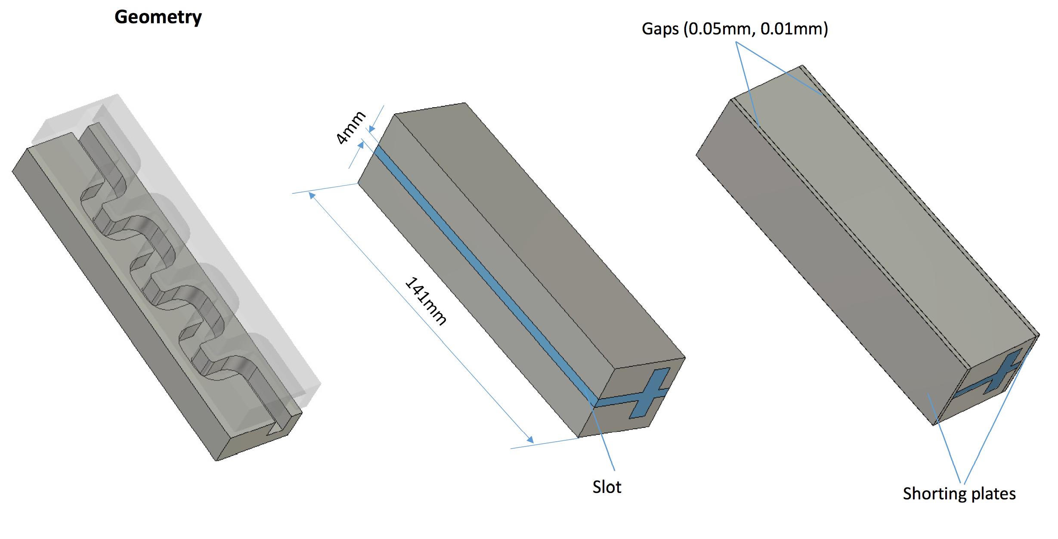
Tune frequency by moving opposite sides away from each other to change transverse boundary conditions
Maintain high Q by covering gaps with high capacitance shorting plates.

Slide 20
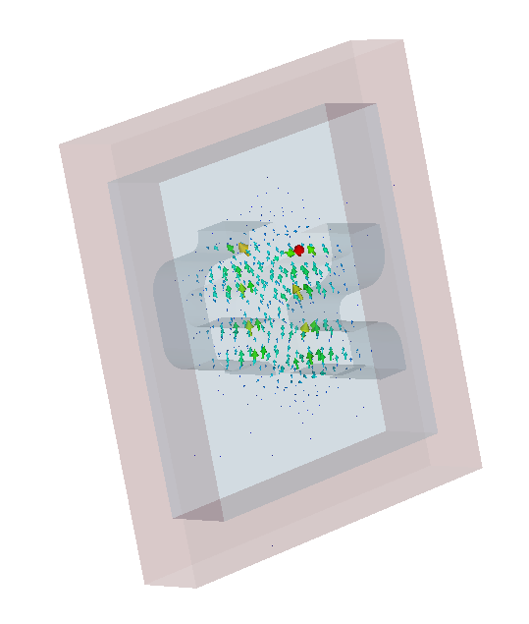
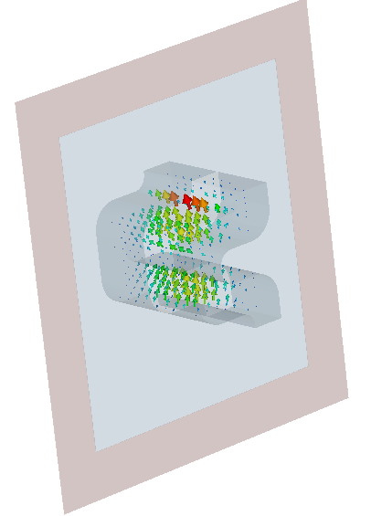
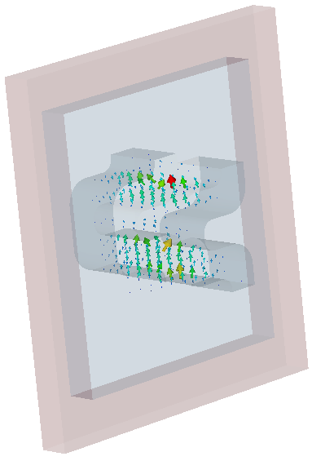
S. Kazakov (TD)
Quality factor and form factor vs slot size
Slt = 0.1mm
F = 11.603 GHz, Q = 6414,
C = 0.327
Slt = 5 mm
F = 10.814 GHz, Q = 6977,
C = 0.364
Slt = 10mm
F = 10.087 GHz, Q = 1317,
C = 0.416
Tunablity ~ 10% before leakage through slot significantly impacts Q. Shorting plates across slot improves Q by a factor of around 5. (cf. spherical cow Q = 3x10⁴@ 10 GHz)
Geometric form factor C is fairly good, at least for the cavity mode coupling.

Slide 21
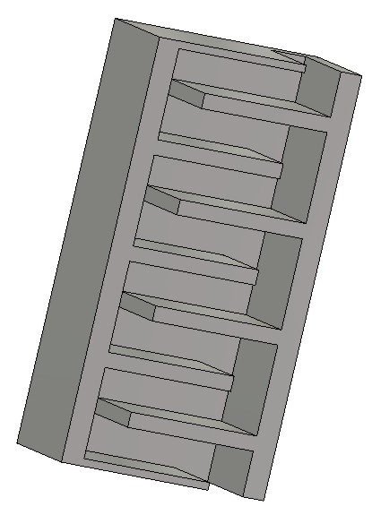
Efficient packing may be possible for a single, long snaking waveguide, filling the entire magnet bore.
IKEA rug cavity
or

Slide 22
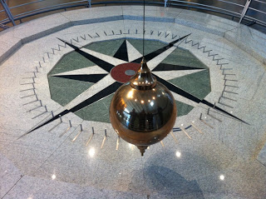
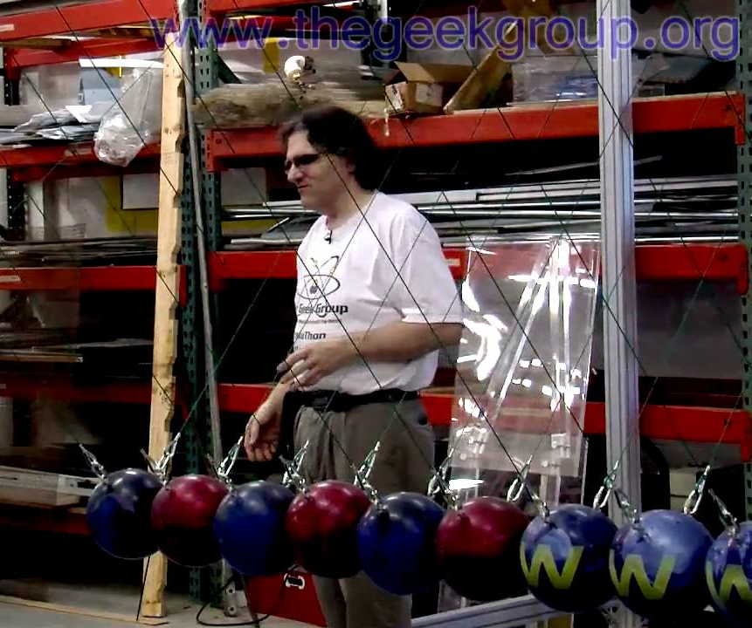
Big advantages of waveguide-based cavity:
Only need to tune 1 continuous resonator, not N independent resonators.
Strong coupling from 1 region to its neighbors → good adiabatic tolerance for small geometrical fabrication errors. (A coax cable still works even if you accidentally step on it.)
Power combining is not necessary since Poynting vector snakes around before arriving at ends of the waveguide.
Geometry is scalable to higher frequencies

Slide 23
Conclusions
Thermal-limited ADMX G2 search up to 2.5 GHz is in good shape
Reaching 10 GHz already requires innovative packing of resonators to fully utilize the full 4 MJ of energy in the ADMX magnet bore
Going beyond 10 GHz will almost certainly require buying or borrowing a $100M scale magnet
Even with a new magnet, scalable designs for efficient packing of resonators will be needed for higher frequency axion searches.

